Slide 1
Stock Market Data Analysis Using SQL

Slide 2
Project Description
This project focuses on analyzing stock market data using SQL. The dataset contains information about various companies, including their sector, stock prices over time, and dividend records. By leveraging SQL queries, multiple business questions were answered to uncover meaningful insights.
Key objectives of this project include:
Retrieving company information by sector and date ranges.
Calculating average, moving average, and standard deviation of stock prices.
Identifying companies with specific trading behavior, such as:
Continuous decline in closing prices.
High difference between open and close prices.
Ranking companies within sectors based on their performance.
Finding companies that have issued the highest or no dividends.
Creating views for efficient query operations.
The project also demonstrates the use of:
SQL functions like AVG(), STDDEV(), LAG(), and RANK().
Window functions and subqueries.
Views for simplified access to combined data.
Some of the advanced queries were created with the assistance of AI tools (ChatGPT), and were thoroughly studied and understood before implementation.

Slide 3
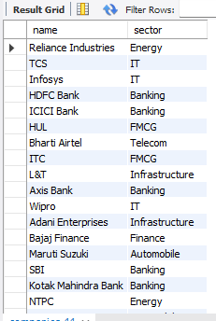
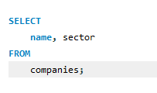
Company List
List all companies along with their sectors.
Input
Output

Slide 4
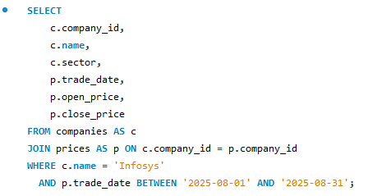
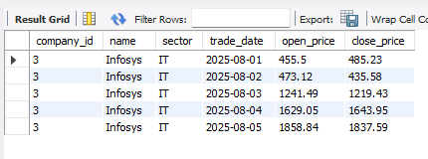
Infosys August 2025 Prices
Stock prices of Infosys for August 2025.
Input
Output

Slide 5
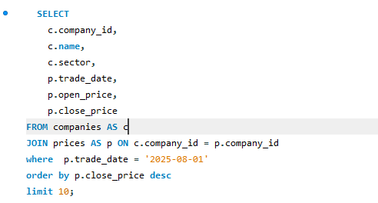
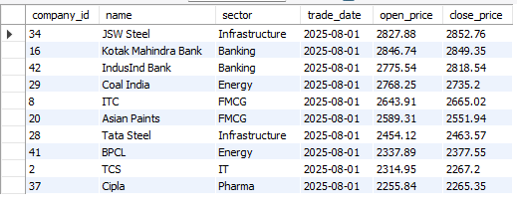
Top 10 Companies by Closing Price
Companies with highest closing price on 2025-08-01.
Input
Output

Slide 6

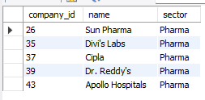
Pharmaceutical Sector
Companies in the Pharmaceuticals sector.
Input
Output

Slide 7
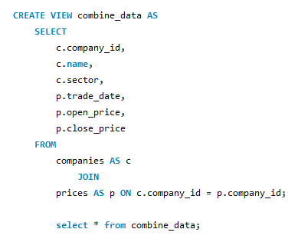
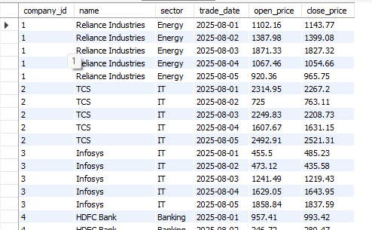
Create View
View created to combine company and price data.
Input
Output

Slide 8
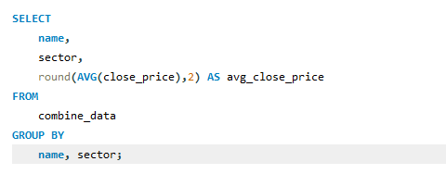
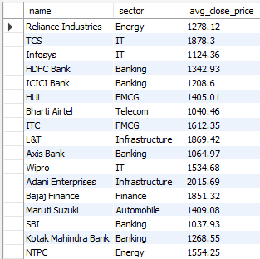
Average Closing Price
Average closing price of each company.
Input
Output

Slide 9
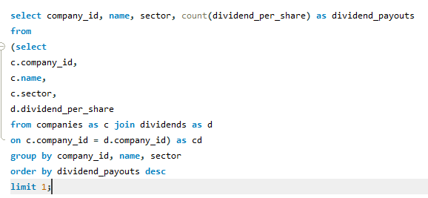
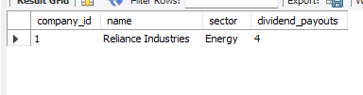
Most Dividend Payouts
Company with highest number of dividend payouts.
Input
Output

Slide 10
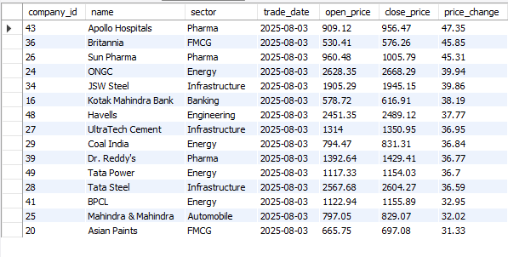
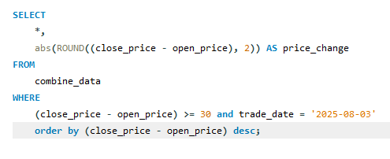
Price Difference > ₹30
Companies with > ₹30 difference in open and close prices.
Input
Output

Slide 11
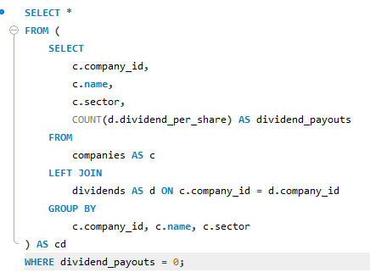
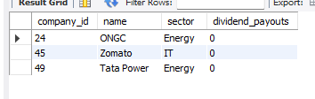
Never Issued Dividend
Companies that never issued a dividend.
Input
Output

Slide 12
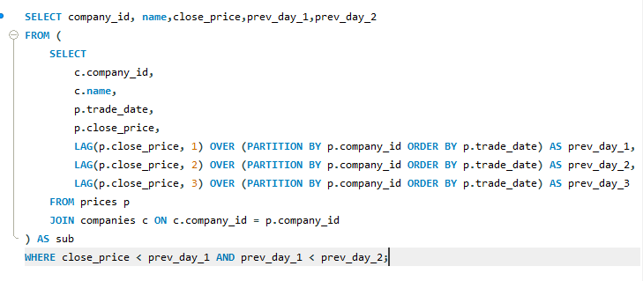
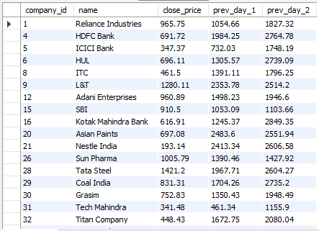
3-day Price Decline
Companies whose stock declined 3 days consecutively.
Input
Output
Some advanced SQL queries in this project were created with the help of AI tools and used for learning purposes

Slide 13
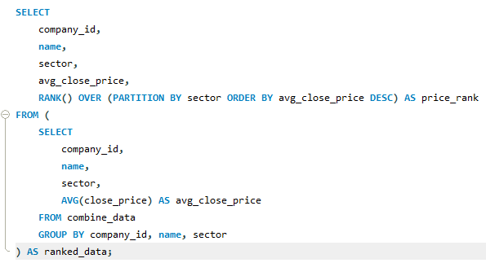
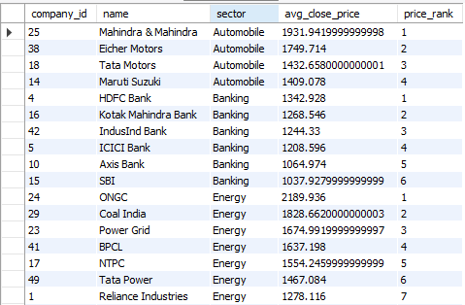
Rank by Avg Close Price
Rank companies in each sector by avg close price.
Input
Output
Some advanced SQL queries in this project were created with the help of AI tools and used for learning purposes

Slide 14
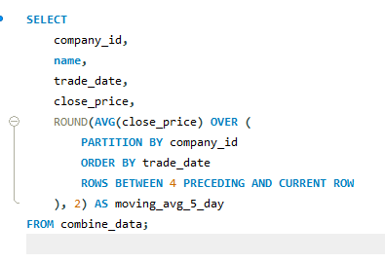
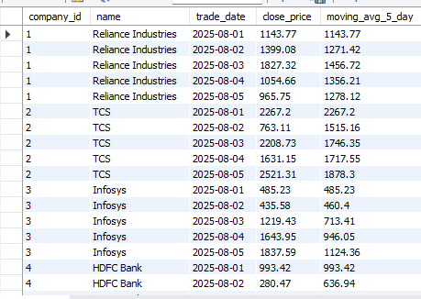
5-day Moving Average
5-day moving average of closing prices.
Input
Output
Some advanced SQL queries in this project were created with the help of AI tools and used for learning purposes

Slide 15
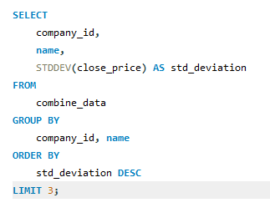
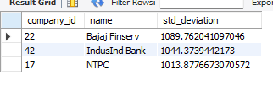
Most Volatile Stocks
Top 3 most volatile stocks by std deviation.
Input
Output
Some advanced SQL queries in this project were created with the help of AI tools and used for learning purposes

