Slide 1


APPLIED IMAGE AND VIDEO PROCESSING PROJECT 2
FALL 2019
Aditya Dutt - Sanghee Han - Daniele Pinton

Slide 2
Experiments (1)
APPLIED IMAGE AND VIDEO PROCESSING – FALL 2019
PROJECT 2 – GROUP 6
Image segmentation → is the process of partitioning a digital image into multiple segments.
Segmentation Goal → is to simplify and/or change the representation of an image into something
that is more meaningful and easier to analyze
Image enhancement Algorithms applied:
Gaussian Filter (GF)
Gamma Correction (GC)
Histogram Equalization (HE)
GC + HE
(Canny Edges Detector)
Segmentation/Object recognition Algorithms applied:
Canny Edges Detector
Skimage Snake on Active Contour Algorithm
K Means Algorithm
Fuzzy K Means Algorithm
Connected Component Analysis
Range of parameters investigated for every algorithm used in this Project

Slide 3
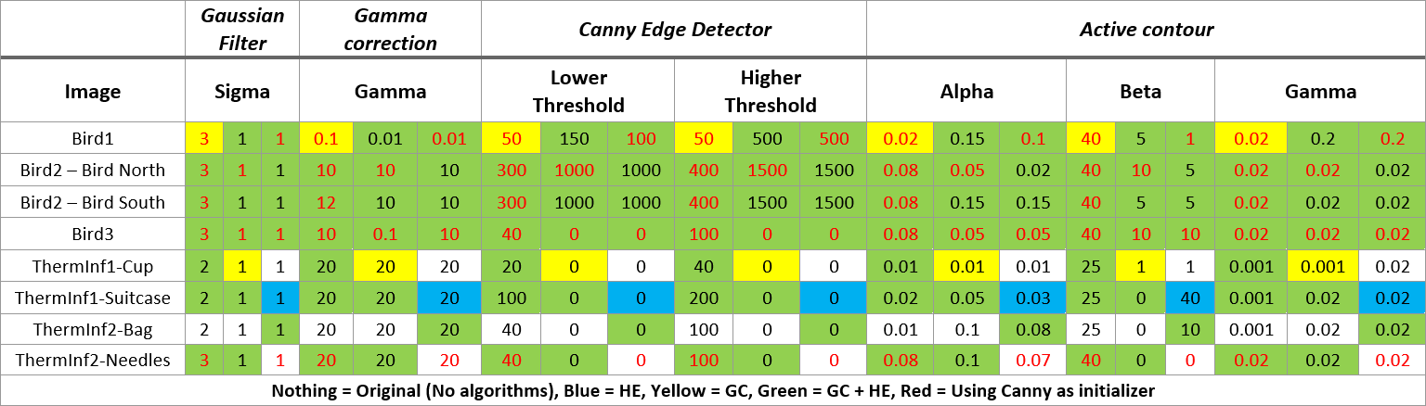
Experiments (2)
APPLIED IMAGE AND VIDEO PROCESSING – FALL 2019
PROJECT 2 – GROUP 6
By merging several ways, we tried to find the best way to do the image segmentation.
Gamma correction → Histogram equalization → Canny Edge Detector → Active Contour (snake)
For Squall images, it is hard to obtain the result with Canny Edge Detector and Active contour method
Fuzzy k mean and connected component analysis were tried to get better result for image segmentation
The results for other images with fuzzy k mean and connected component analysis were also applied and combined with Canny Edge Detector and Active Contour
Suggested values for every investigated image sets, used to obtain good results in the segmentation procedure. For each parameter, the first column is related to the original images, without clustering, the second column is for images clustered using K-Means algorithm, and the third column is for images clustered using Fuzzy K-Means algorithm.

Slide 4
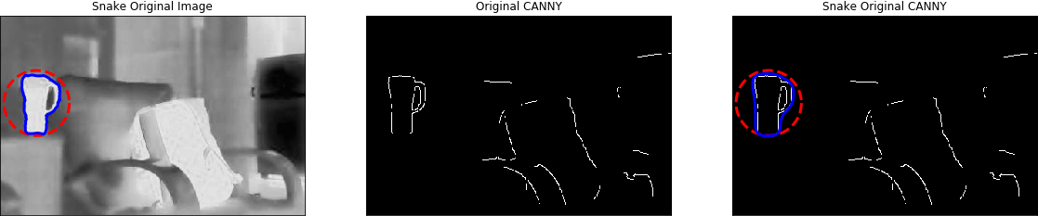
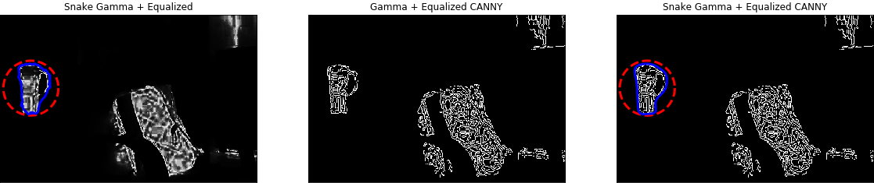
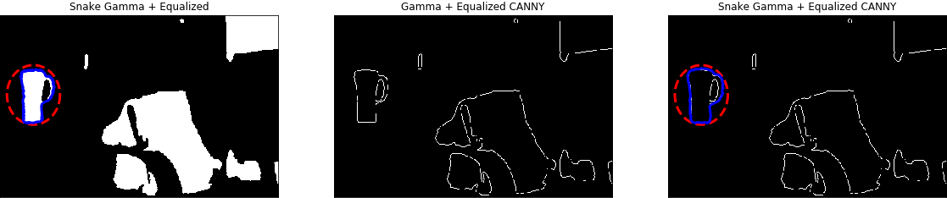
Gamma = 20 ,20,20
APPLIED IMAGE AND VIDEO PROCESSING – FALL 2019 - PROJECT 2 – GROUP 6
No k-means
α=0.01 ,β=25 ,γ=0.001
LT = 200, ht = 300
α=0.08 ,β=40 ,γ=0.02
RESULTS AND OBSERVATIONS (1)
Thermal Image 1 - cup
No k-means
α=0.01 ,β=25 ,γ=0.001
LT = 20, ht = 40
α=0.01 ,β=40 ,γ=0.02
k-means
α=0.2 ,β=1 ,γ=0.02
LT = 0, ht = 0
α=0.05 ,β=40 ,γ=0.02

Slide 5
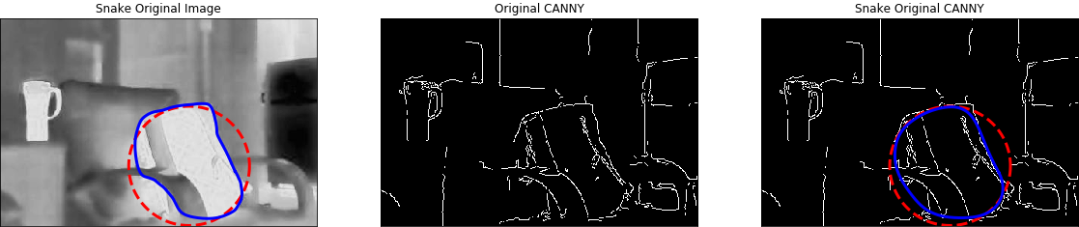
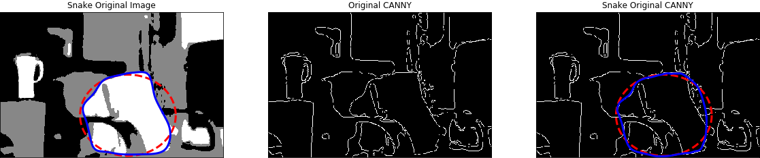
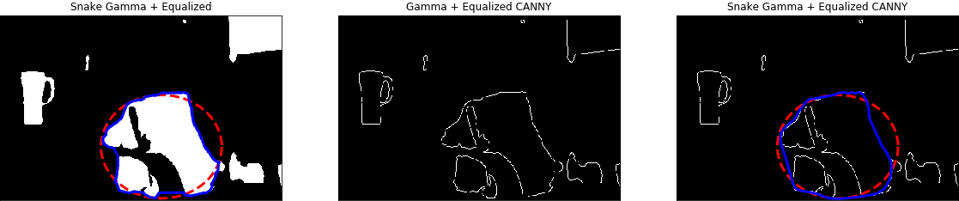
Gamma = 20 ,20,20
APPLIED IMAGE AND VIDEO PROCESSING – FALL 2019 - PROJECT 2 – GROUP 6
No k-means
α=0.01 ,β=25 ,γ=0.001
LT = 40, ht = 100
α=0.07 ,β=40 ,γ=0.02
RESULTS AND OBSERVATIONS (2)
α=0.03 ,β=40 ,γ=0.02
k-means
α=0.02 ,β=5 ,γ=0.002
LT = 0, ht = 0
Thermal Image 1 - Suitcase
Fuzzy k-means
α=0.05 ,β=0 ,γ=0.02
LT = 0, ht = 0
α=0.03 ,β=40 ,γ=0.02

Slide 6
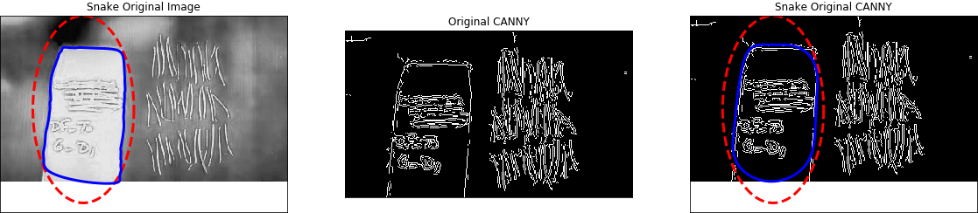
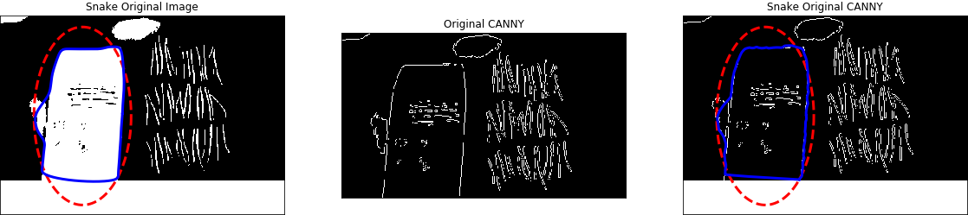
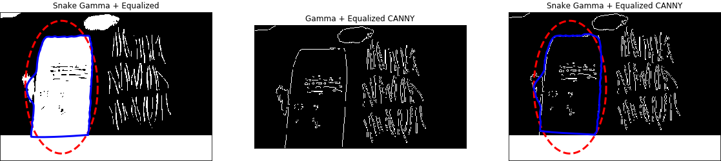
Gamma = 20 ,20,20
APPLIED IMAGE AND VIDEO PROCESSING – FALL 2019 - PROJECT 2 – GROUP 6
No k-means
α=0.01 ,β=25 ,γ=0.001
LT = 40, ht = 100
α=0.07 ,β= 40, γ=0.02
RESULTS AND OBSERVATIONS (3)
k-means
α=0.05 ,β=10 ,γ=0.02
LT = 0, ht = 0
α=0.07 ,β=5 ,γ=0.02
Thermal Image 2 - bag
Fuzzy k-means
α=0.05 ,β=10 ,γ=0.02
LT = 0, ht = 0
α=0.08 ,β=5 ,γ=0.02

Slide 7
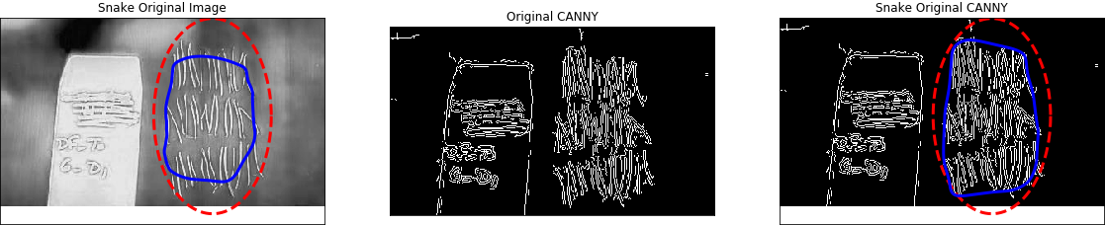
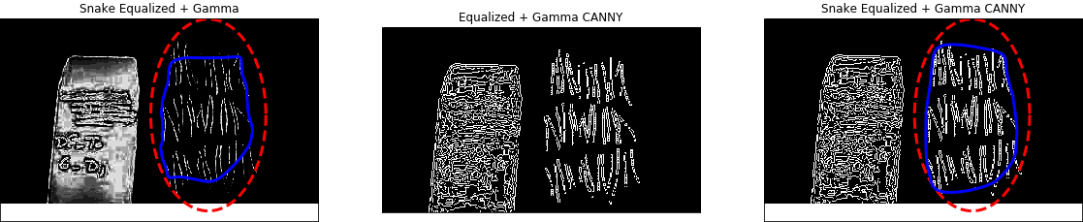
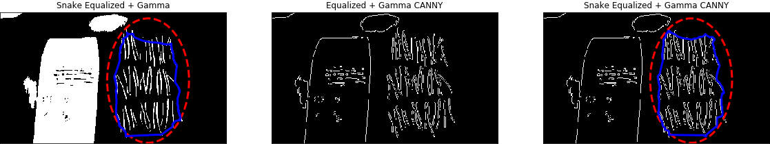
Gamma = 20 ,20,20
APPLIED IMAGE AND VIDEO PROCESSING – FALL 2019 - PROJECT 2 – GROUP 6
No k-means
α=0.07 ,β=25 ,γ=0.001
LT = 40, ht = 100
α=0.07 , β=40 , γ=0.02
RESULTS AND OBSERVATIONS (4)
No k-means
α=0.06 ,β=25, γ=0.001
LT = 40, ht = 100
α=0.08 , β=40 , γ=0.02
Thermal Image 2 - needles
k-means
α=0.1 ,β=0 ,γ=0.02
LT = 0, ht = 0
α=0.08 ,β=0 ,γ=0.02

Slide 8
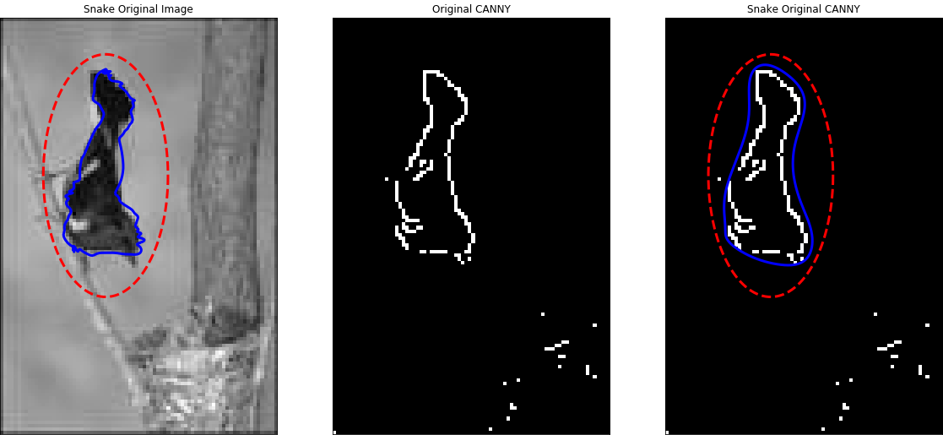
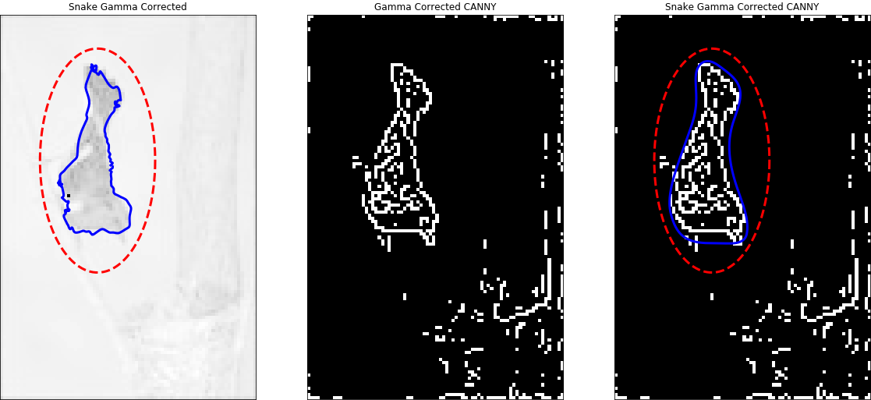
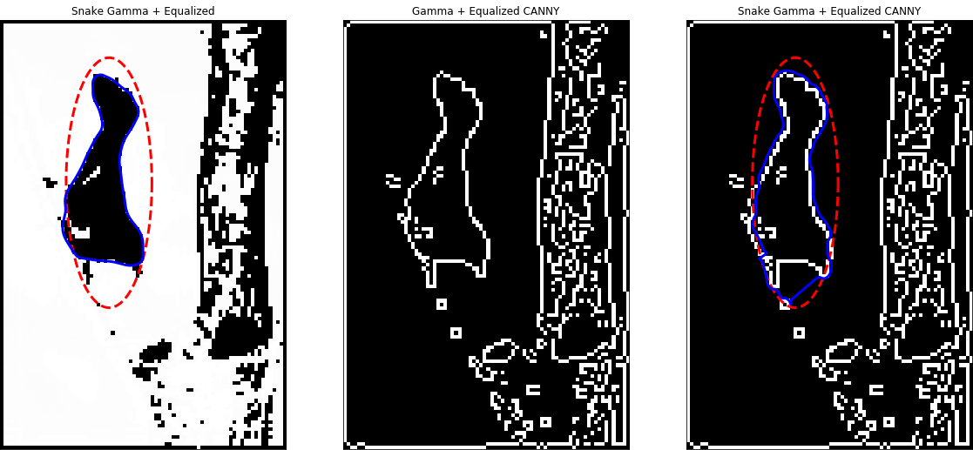
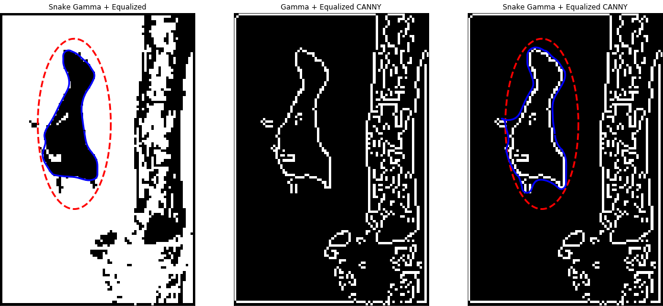
Gamma = 0.1, 0.01, 0.1
Gamma = 0.1, 0.01, 0.1
APPLIED IMAGE AND VIDEO PROCESSING – FALL 2019 - PROJECT 2 – GROUP 6
α=0.01 ,β=25, γ=0.001
α=0.07 ,β=40, γ=0.02
α= 0.02,β=25, γ=0.001
α=0.05 ,β=40, γ=0.02
LT = 400, ht = 410
gamma
LT = 50, ht = 55
RESULTS AND OBSERVATIONS (5)
α=0.15 ,β=5 ,γ=0.2
α= ,β= 0,γ=0.2
α=0.1 ,β=5 ,γ=0.02
Bird 1
Original and gamma or gamma + eq
α=0.55 ,β= 0,γ=0.05
LT = 0, ht = 0
G + eq
LT = 100, ht = 500
α=0.55 ,β=0 ,γ=0.05
LT = 0, ht = 0
α=0.1 ,β=1 ,γ=0.1
α=0.15 ,β=5 ,γ=0.2
LT = 100, ht = 500
α=0.1 ,β=1 ,γ=0.2
G + eq

Slide 9
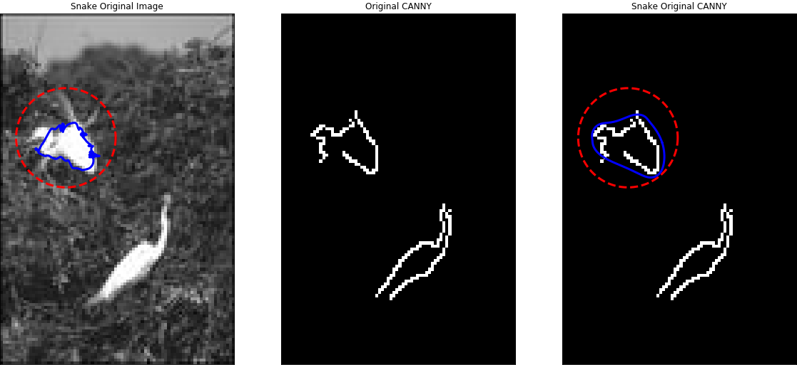
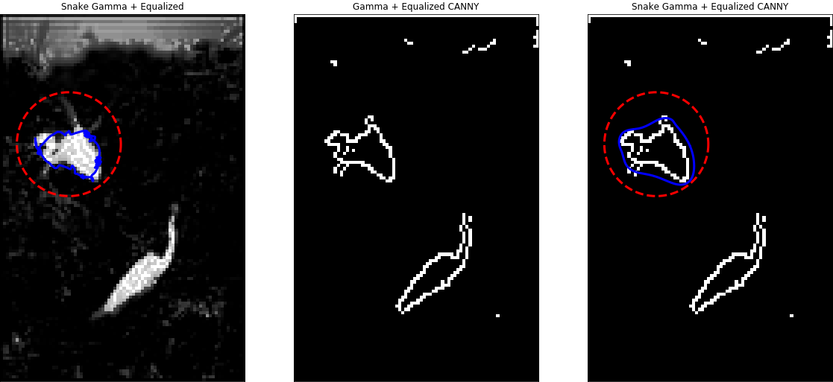
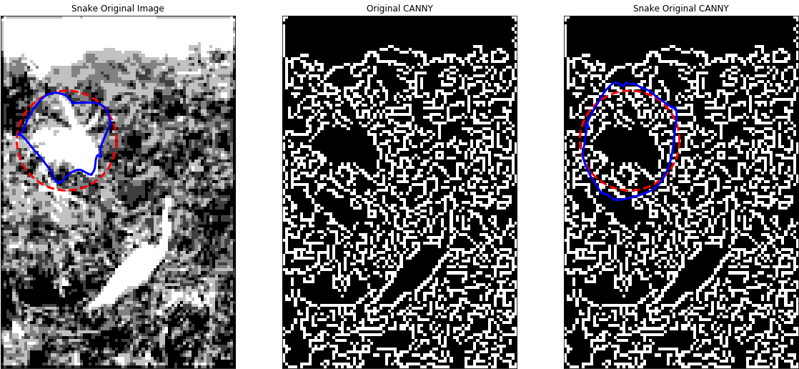
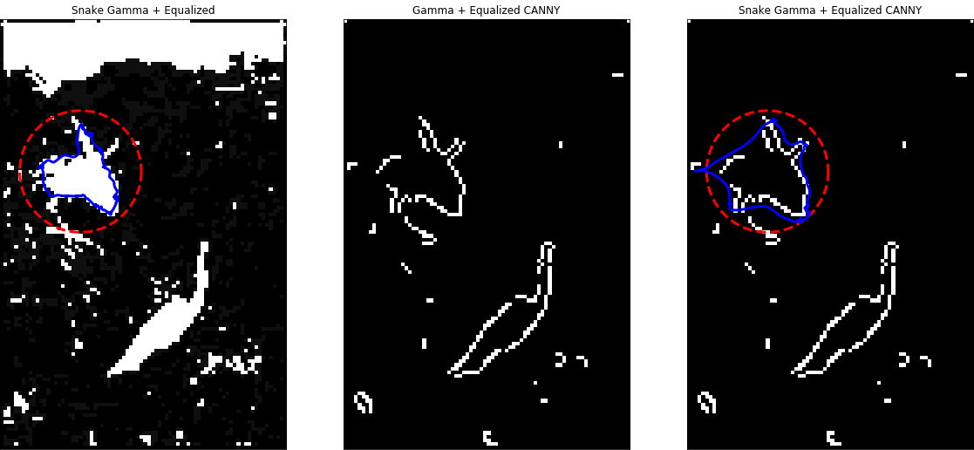
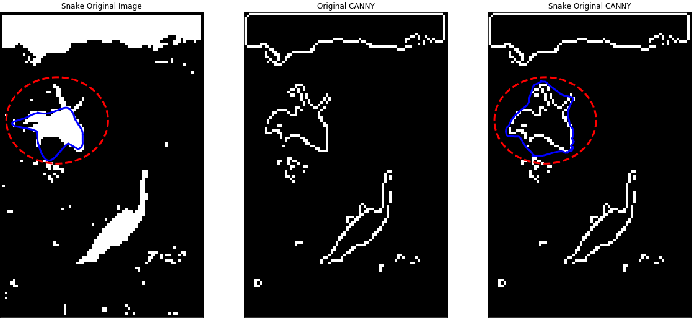
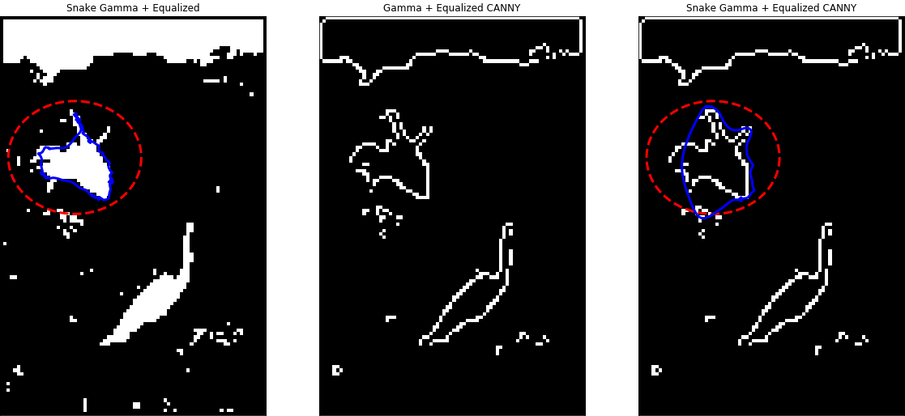
Gamma = 10, 10, 10
Gamma = 10, 10, 10
APPLIED IMAGE AND VIDEO PROCESSING – FALL 2019 - PROJECT 2 – GROUP 6
α=0.07 ,β=40, γ=0.02
α=0.05 ,β=40, γ=0.02
α=0.01 ,β=25, γ=0.001
LT = 500, ht = 800
G + eq
α=0.02 ,β=25, γ=0.001
LT = 400, ht = 500
RESULTS AND OBSERVATIONS (6)
G + eq
Bird 2
Original and gamma + eq
α=0.1 ,β=5 ,γ=0.02
LT = 100, ht = 500
α=0.07 ,β=40 ,γ=0.02
α=0.02 ,β=5 ,γ=0.02
LT = 1000, ht = 1500
α=0.05 ,β=10 ,γ=0.02
LT = 100, ht = 500
G + eq
α=0.05 ,β=10 ,γ=0.02
α=0.1 ,β= 5,γ=0.02
α=0.07 ,β=40 ,γ=0.02
α=0.02 ,β=5 ,γ=0.02
LT = 1000, ht = 1500

Slide 10
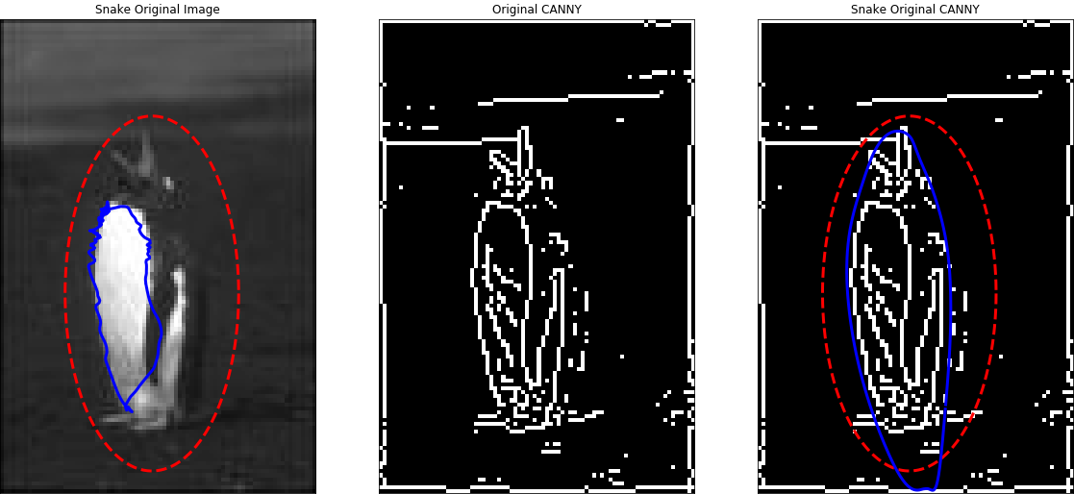
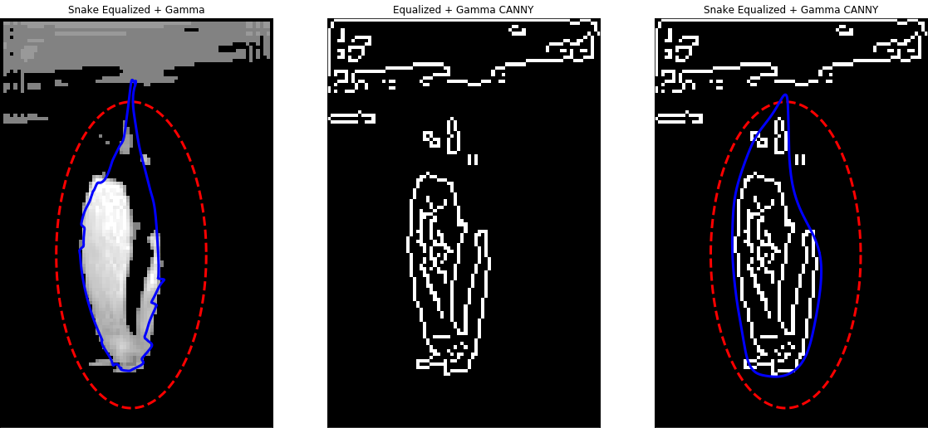
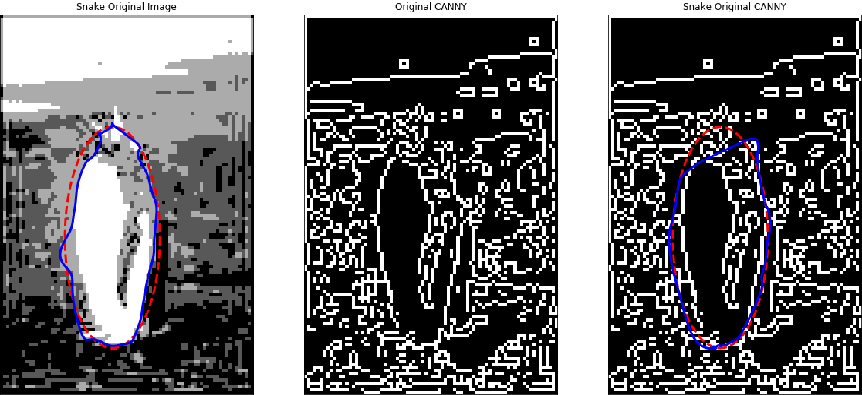
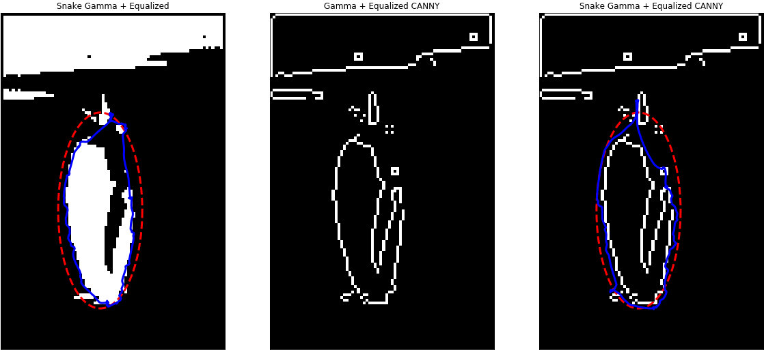
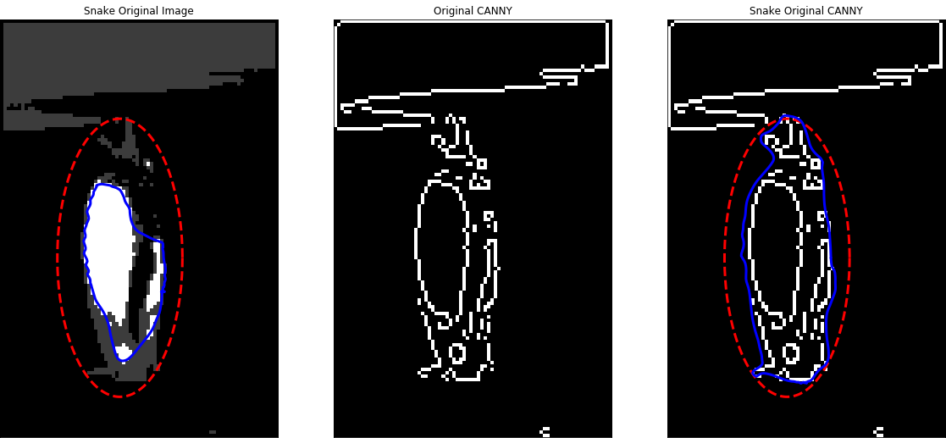
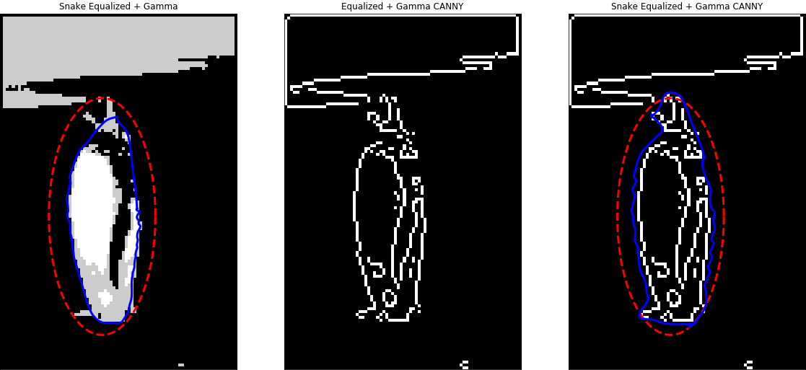
Gamma = 5, 5, 0.1
Gamma = 20, 20, 5
APPLIED IMAGE AND VIDEO PROCESSING – FALL 2019 - PROJECT 2 – GROUP 6
α= 0.01,β=25, γ=0.001
α=0.08 ,β=40, γ=0.02
α=0.05 ,β=25, γ=0.001
α= 0.05 ,β=40, γ=0.02
LT = 60, ht = 65
G + eq
LT = 40, ht = 100
RESULTS AND OBSERVATIONS (7)
Bird 3
Original and gamma or gamma + eq
LT = 0, ht = 0
α=0.08 ,β=40 ,γ=0.02
LT = 0, ht = 500
α=0.02 ,β=40 ,γ=0.02
α=0.2 ,β=5 ,γ=0.2
gamma
α=0.02 ,β=25 ,γ=0.001
LT = 0, ht = 0
α=0.15 ,β=10 ,γ=0.04
α=0.05 ,β=10 ,γ=0.02
α=0.1 ,β=5 ,γ=0.02
G + eq
α=0.01 ,β=10 ,γ=0.02
LT = 0, ht = 0

Slide 11
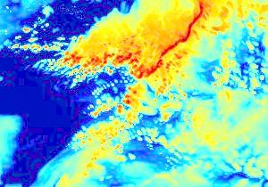
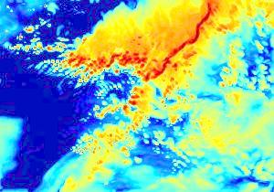

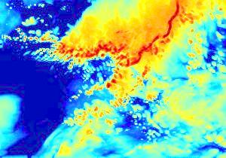
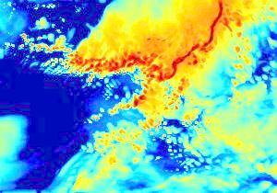
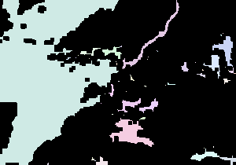
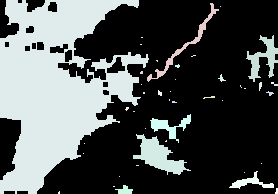
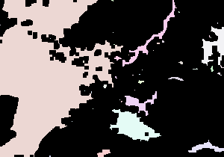
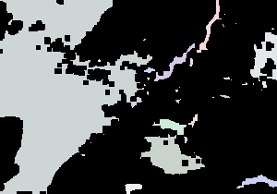
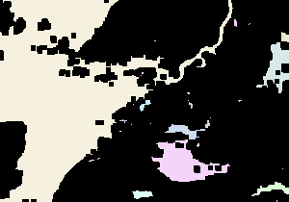
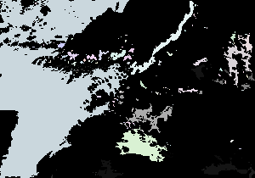
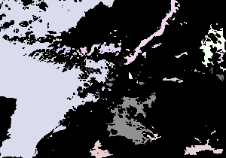
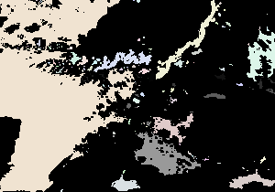
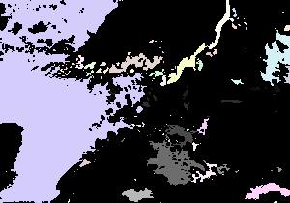
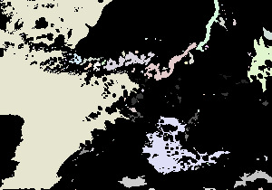
Squall images
APPLIED IMAGE AND VIDEO PROCESSING – FALL 2019 - PROJECT 2 – GROUP 6
Original images
Connected component analysis with morphology (dilation → erosion → connected component analysis)
RESULTS AND OBSERVATIONS (8)
Connected component analysis without Image morphology

Slide 12




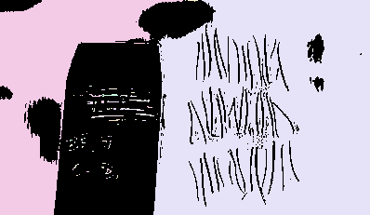


APPLIED IMAGE AND VIDEO PROCESSING – FALL 2019 - PROJECT 2 – GROUP 6
The result of connected component analysis with morphology of bird images can be used to determine the initial coordinate of the active contour
Connected component analysis with morphology
Connected component analysis without morphology
RESULTS AND OBSERVATIONS (9)

Slide 13

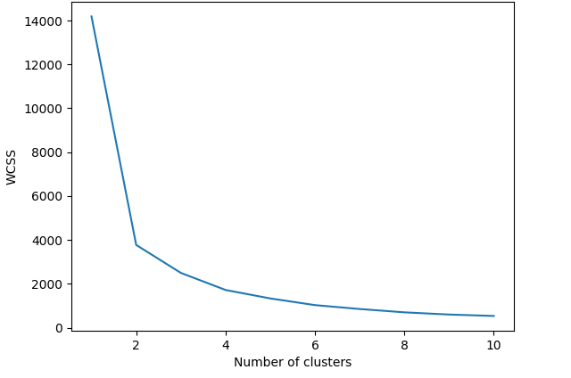


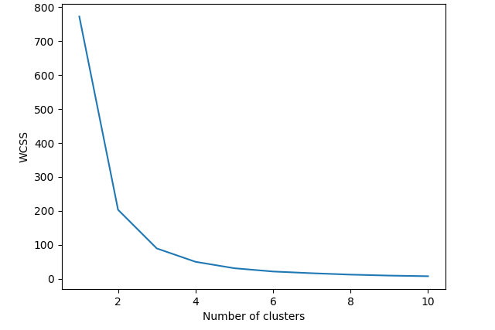

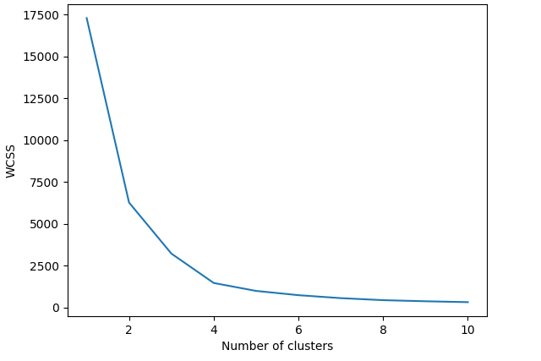
K – Means clustering
Ran K means with different number of clusters
Used WCSS(Within-cluster sum of squares) to find optimal number of clusters
Input Image Output Image WCSS graph
RESULTS AND OBSERVATIONS (10)

Slide 14

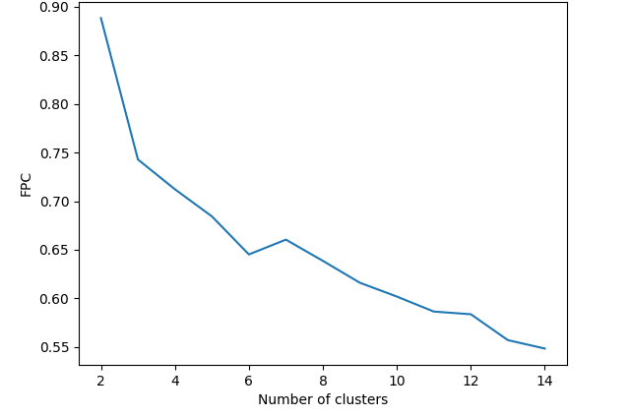

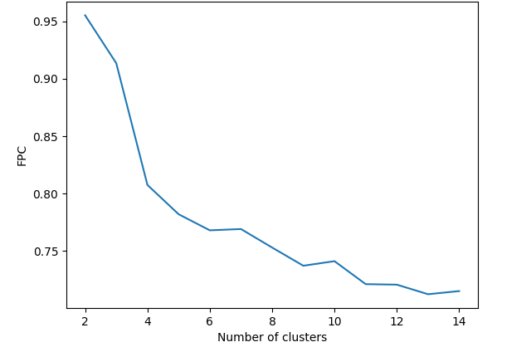

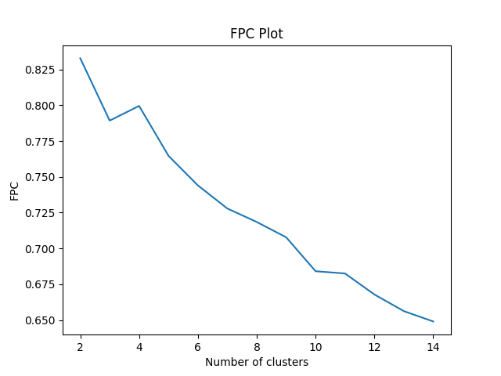
Fuzzy K – Means clustering
Ran fuzzy K means with different number of clusters. Assigned fuzzy membership to each pixel.
Used WCSS(Within-cluster sum of squares) to find optimal number of clusters.
Results in case of fuzzy k-means for gray scale were better than k means.
Input Image Output Image WCSS graph
RESULTS AND OBSERVATIONS (11)

Slide 15
Conclusions
Fuzzy K-means gave the best performance because it assigns fuzzy membership to each sample. The optimal number of clusters can be easily selected from the WCSS graph. K-means and fuzzy k-means gave similar performances except in gray scale images.
Canny edge detector gave all the important edges and performed well. But, when the contrast between background and foreground is less, it gave bad results.
The Snake method provides smooth and closed contours, but we have to know the desired contour shape beforehand.
Connected component analysis gave good results when the objects have different contrast from background. But the results are not as good as other algorithms.
By opening the image and then using connected component analysis can help us find initial region for snake algorithm because it gives a blob like region.

