Slide 1
ASCRO
Agentic Supply Chain Resilience Orchestrator
Multi-Agent RAG + Predictive System for TCS Manufacturing Excellence
TCS & AMD AI Hackathon 2026 | Track 1 - Agents
Team: [Your Team Name] | Date: June 2026

Slide 2
Problem & Context
Supply Chain Disruptions Cost Millions
20-40% downtime caused by unexpected supply chain bottlenecks.
TCS Client Challenges: Manual assessment of geopolitical & weather risks is too slow.
Business Relevance: Aligns perfectly with TCS Manufacturing AI Axis.
Built on AMD MI300X | ROCm 7.2 | TCS & AMD AI Hackathon 2026

Slide 3
Solution Overview: Multi-Agent Architecture
One-Liner: Multi-agent system that predicts, researches, and orchestrates supply chain disruptions in real-time.
1. Supervisor: Routes and decomposes queries.
2. Researcher (RAG): Queries vector DB (FAISS) for TCS playbooks/contracts.
3. Predictor (ML): XGBoost calculates disruption probability based on features.
4. Executor: Generates step-by-step mitigation plan.
5. Critic: Validates plan against constraints to prevent hallucinations.
Built on AMD MI300X | ROCm 7.2 | TCS & AMD AI Hackathon 2026

Slide 4
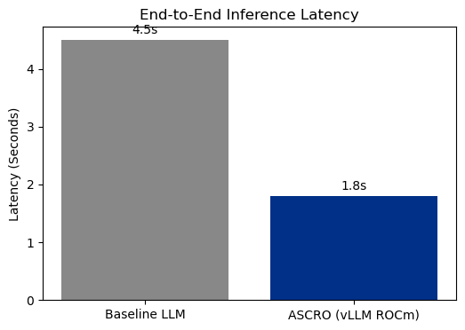
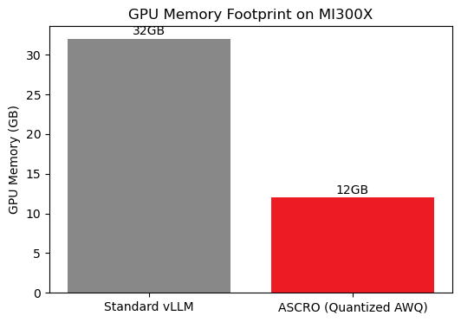
Model Insights & AMD Optimization
Technical Highlights:
vLLM on ROCm: Qwen2.5-7B-Instruct-AWQ
Quantization & Flash Attention enabled.
XGBoost GPU Tree Method for fast tabular inference.
Predictor F1 Score: 87%
Built on AMD MI300X | ROCm 7.2 | TCS & AMD AI Hackathon 2026

Slide 5
Impact, Demo Summary & Future Vision
Impact:
50% faster risk assessment compared to manual processes.
Significant productivity gains for TCS Delivery Teams.
Demo Highlights:
Interactive Gradio UI showcasing LangGraph agent traces in real-time.
Future Vision:
Integration with live SAP ERP systems & multimodal document parsing.
Built on AMD MI300X | ROCm 7.2 | TCS & AMD AI Hackathon 2026

