Slide 1
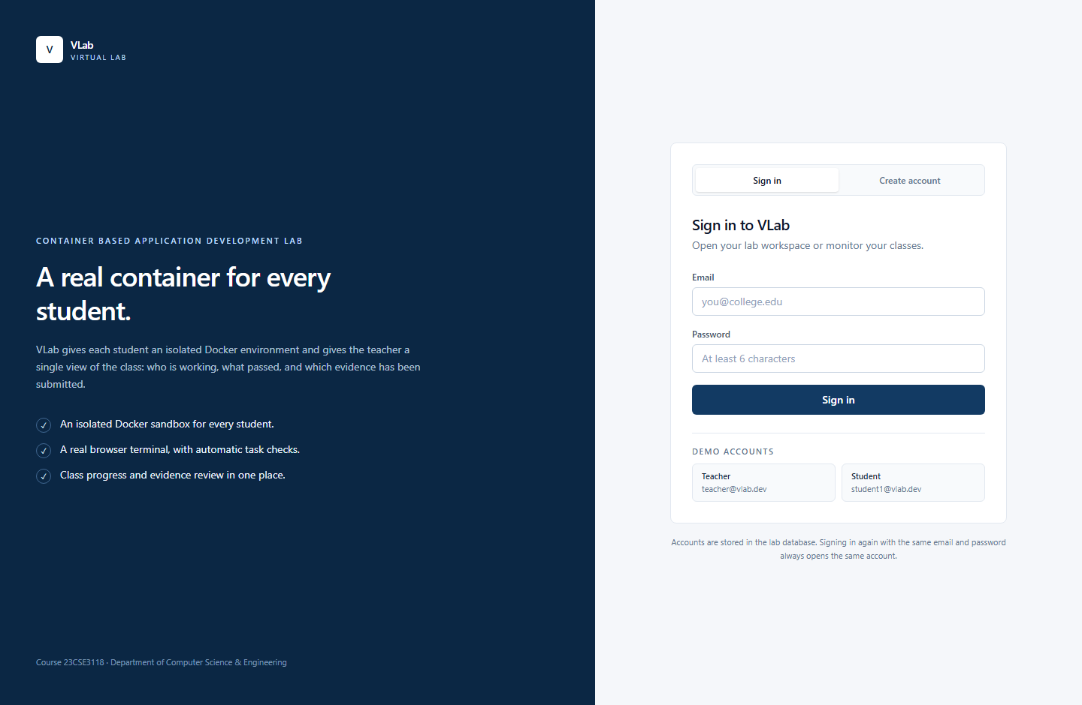
CBAD MINI PROJECT · PROJECT REVIEW
VLab
A container-based virtual lab
with live teacher visibility
One disposable Docker sandbox per student.
One live view of the whole class.
Node 22 + Express
React + Vite
Docker-in-Docker
http://localhost:5173
Sign in as a teacher or student
Project review · 2026
Notes:
VLab is a classroom-first Docker lab. The key idea is one disposable container per student plus a teacher view that shows real state, not screenshots.

Slide 2
V
WHY THIS EXISTS
PROJECT REVIEW · 2026
Docker labs break before the learning starts
01
02
03
Setup drift
No live visibility
Manual evidence
Docker Desktop, ports, images, and permissions differ on every laptop. One broken install stalls the practical.
The teacher cannot see who is running commands, who is stuck, or which task is failing right now.
End-of-lab screenshots are easy to fake, slow to collect, and hard to review consistently.
VLab gives every student a disposable container
and gives the teacher one live view of the class.
VLab · Container-based virtual lab
02 / 10
Notes:
Frame the problem around classroom friction, not just Docker. The teacher needs visibility and trustworthy evidence.

Slide 3
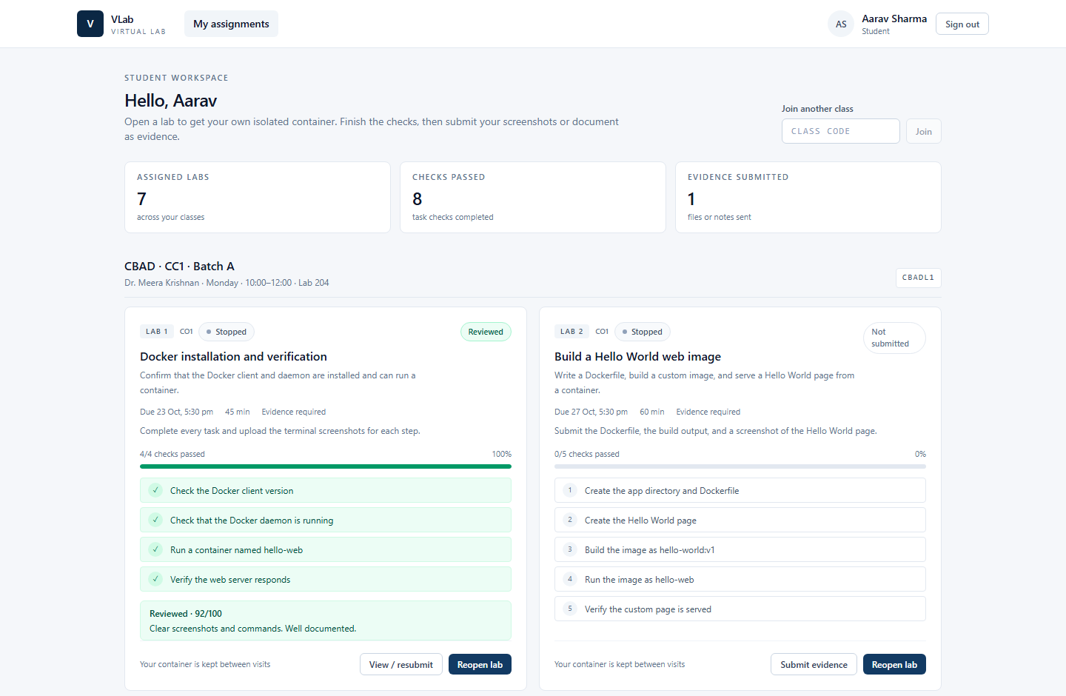
V
THE IDEA
PROJECT REVIEW · 2026
A class workflow around a disposable sandbox
1
Isolated by default
Each student gets a private Docker-in-Docker container. Their work never touches the host.
2
Everything in the browser
Terminal, file editor, and read-only Docker inventory in one lab workspace.
3
Checks inspect state
Tasks verify files and containers, not keystrokes, so completion is honest and repeatable.
4
Teacher in the loop
Live roster, task progress, last command, evidence review, and read-only inspection.
Student workspace: assignments, task progress, and evidence
VLab · Container-based virtual lab
03 / 10
Notes:
The differentiator is the class workflow: join by code, start a lab, get checked, submit evidence, and let the teacher see it live.

Slide 4
V
ARCHITECTURE
PROJECT REVIEW · 2026
Three boundaries: browser, backend, runtime
Browser
Frontend + API
Docker engine
Student sandbox
React 19
xterm.js
CodeMirror
nginx
Express 5
REST + WebSocket
dockerode
Host daemon
Resource limits
DinD container
Inner daemon
Private /root
No Docker socket
Auth and ownership
Only the backend
One per student
Control plane
Data plane
JWT auth · class membership · session lifecycle
checker · file read/write · Docker inventory
WebSocket terminal · docker exec · fixed commands
per-session checks · read-only teacher attach
The terminal is a docker exec into the student's own container. The browser never receives /var/run/docker.sock.
VLab · Container-based virtual lab
04 / 10
Notes:
Explain the three boundaries. The most important security sentence is that students never receive the Docker socket; the backend owns it.

Slide 5
V
INSIDE THE PLATFORM
PROJECT REVIEW · 2026
Small modules with clear jobs
Labs & assignments
Checker
Terminal
Handout labs, a short demo tour, and practice labs. Exact task steps and due dates.
15 s timeout, serialized per session, 30 s background loop plus a manual check button.
xterm.js over WebSocket, shared exec, scrollback, and read-only teacher attach.
Workspace
Docker inventory
Evidence & grades
/root file listing, UTF-8 reads/writes, 256 KiB cap, teacher read-only.
Fixed ps / images / networks / volumes commands, capped at 200 rows.
Uploads, feedback, protected downloads, and a student-visible grade.
No arbitrary Docker API proxy. No host shell. No student access to the host daemon.
VLab · Container-based virtual lab
05 / 10
Notes:
This slide is the feature map. Keep each module to one sentence; the next slides show the two main user journeys.

Slide 6
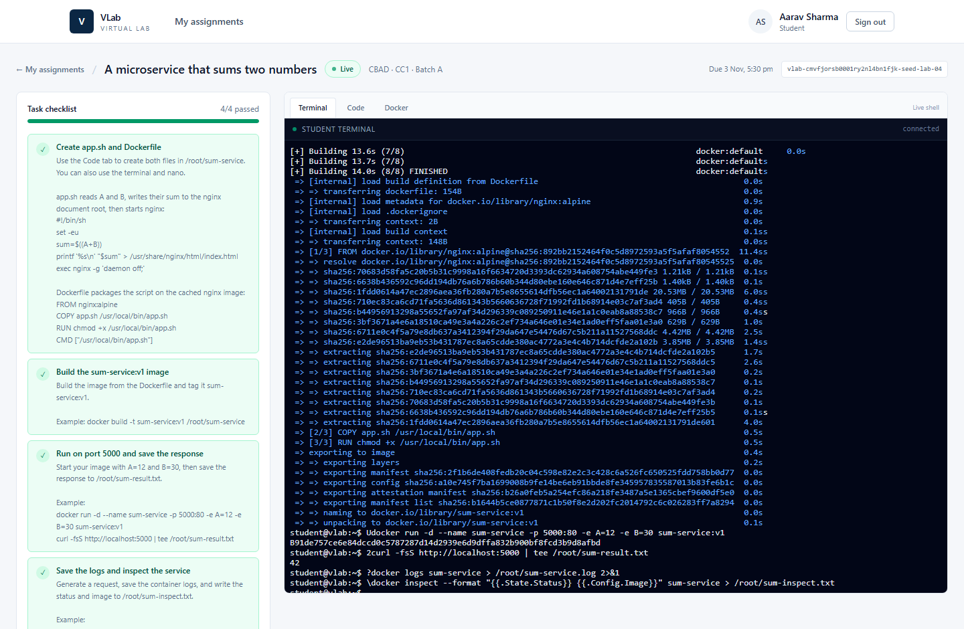
V
STUDENT EXPERIENCE
PROJECT REVIEW · 2026
From join code to checked work in one screen
1
Join the class
Use the class code, or sign in with a seeded student account.
2
Start a lab
VLab provisions a private DinD container and waits for the inner daemon.
3
Run the commands
Use the live terminal, or edit files in the Code tab.
4
Check my work
State-based checks turn green when the files and containers exist.
5
Submit evidence
Attach a screenshot or PDF; the teacher can review and grade it.
docker run -d --name basic-web \
-p 8080:80 nginx:alpine
curl -fsS http://localhost:8080 \
> /root/demo/page.html
A real shell in the browser, connected to the student's container
VLab · Container-based virtual lab
06 / 10
Notes:
Walk through the student journey. The terminal screenshot is a real build inside the sandbox; the code strip is the simple demo path.

Slide 7
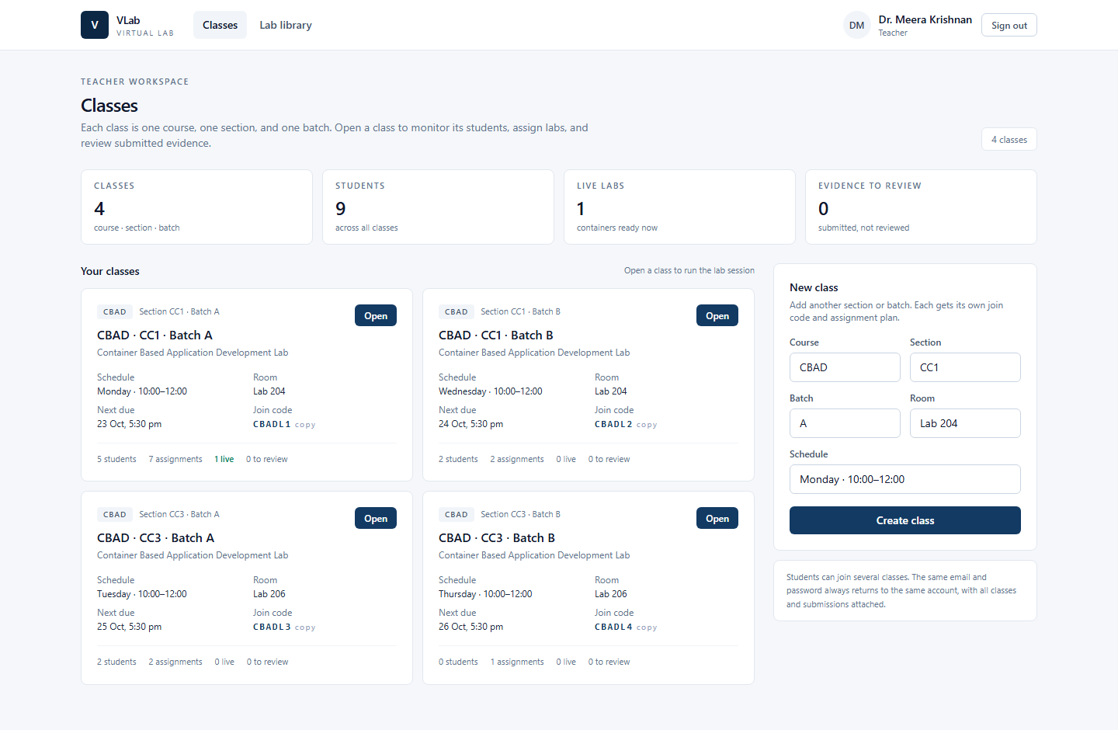
V
TEACHER EXPERIENCE
PROJECT REVIEW · 2026
See the class, not just the final screenshot
4
• Roster grid with per-task ticks and progress %
• Last command and last activity for each student
• Read-only terminal, files, and Docker inventory
• Evidence queue with feedback and grades
classes
9
seeded students
1
live lab
0
to review
Four classes, live labs, and evidence waiting for review
VLab · Container-based virtual lab
07 / 10
Notes:
The teacher view is the strongest differentiator. Point out progress, last command, evidence, and read-only inspection.

Slide 8
V
TRUST BOUNDARIES
PROJECT REVIEW · 2026
Isolation that fits a classroom
Browser
Backend
Runtime
JWT + role checks
No Docker socket
Teacher input dropped
Owns docker.sock
Ownership checks
Fixed inventory
1 GB / 1 CPU / 512 PIDs
Per-student DinD
Private /root
• Path-normalised /root files, UTF-8 only, 256 KiB maximum
• Teacher file writes return 403; teacher terminal input is dropped
• Docker inventory is a fixed allowlist, not a proxy
• Command logging is advisory; checks never read the log
Deliberate boundary
DinD is privileged by design. Isolation is namespace-level, not a hostile multi-tenant boundary.
For production: microVM per student or dedicated lab hosts.
VLab · Container-based virtual lab
08 / 10
Notes:
Be explicit about the trade-off: this is safe for a classroom demo, not for arbitrary hostile users. Production would use microVMs or dedicated hosts.

Slide 9
V
VERIFICATION
PROJECT REVIEW · 2026
Verified with real containers, not mocks
47
43
4/4
100%
backend unit tests
smoke checks
checks in the demo lab
frontend build
• Login, class join, assignment visibility, and teacher dashboard
• Real DinD provisioning, WebSocket terminal, and command logging
• Checker verdicts, editor save/read, and teacher read-only access
• Docker inventory, evidence flow, and cleanup
• A negative check: version tasks stay red until files exist
SMOKE OK
One command exercises the full stack:
provision → terminal → check → dashboard
→ files → Docker → evidence → cleanup.
cd backend · npm run smoke
VLab · Container-based virtual lab
09 / 10
Notes:
Lead with evidence. The smoke test is the strongest proof because it uses the real API, real WebSocket, real container, and real checker.

Slide 10
LIMITS · NEXT · QUESTIONS
What we would build next
Project at a glance
VLab
• Replace DinD with a microVM runtime for stronger isolation
• Move from SQLite to PostgreSQL for multi-instance hosting
• Add LTI / LMS integration and CSV gradebook export
• Add per-task hints, richer editor, and scheduled lab templates
Container Based Application Development Lab
Runtime
Docker Compose
Backend
Node 22 · Express 5 · Prisma
Frontend
React 19 · Vite · Tailwind
Isolation
One DinD sandbox per student
Demo
Basic Linux & Docker tour
VLab is a working MVP: one student, one sandbox, one live class view.
Thank you · Questions?
Notes:
Close with the trade-off and the roadmap. Emphasise that the MVP is real: the demo runs a container, checks state, and shows the teacher the same workspace.

