Slide 1
SANDISK CEREBRUM 2026 | FINAL COMPETITION PITCH
Die Yield Prediction
Pre-Screening Post-Burn-In Silicon Failures via Spatial Risk Fields & Sub-Die Diagnostics
Team: Cookies of the Dark Web (Shrey Sharma, Aditya Gupta, Prisha Kushwaha, Darsh Ramoliya)
INNOVATION & ARCHITECTURE
Multi-Resolution Ranking
Continuous 2D spatial hazard surfaces (sigma=1.5) combined with 2,000-reading sub-die block telemetry to detect micro-structural anomalies.
TECHNICAL RIGOR
Rigorous Statistical Auditing
Multi-seed paired ablation and wafer-cluster bootstrap prove ranking gain (+0.0337 PR-AUC, p < 0.001) while F1 is within noise.
EXPLAINABILITY & UX
Hierarchical Interpretability
Wafer maps -> Die inspection -> TreeSHAP attributions -> Sub-die block profiles (separating spatial context from actionable signal).
OPERATIONAL VALUE
Screening Triage & Reliability
+64 failures captured at 10% budget; validation-only Platt scaling cuts calibration error by over 70% with zero test leakage.

Slide 2
PROBLEM & APPROACH
The Die Yield Task: Macro Spatial Context vs. Micro Sub-Die Signals
Predicting the 4.23% post-burn-in defects early without over-scrapping healthy silicon
1. THE FACTORY CHALLENGE
Post-Burn-In Defect Prediction
Silicon Wafer Scale: Silicon chips (dies) are tested before packaging. Post-burn-in testing is slow and factory-constrained; failures are spatially clustered.
Pre-Test Exclusions: Known defective chips (old_label=1; 6,753 dies on test set) are already dead and excluded per competition evaluation rule.
The True Target (Eligible Dies): Exactly 32,598 eligible dies (old_label=0) on holdout test set with a true post-test defect rate of 4.23% (1,380 fails).
Core Scientific Question: Does adding sub-die block telemetry improve risk ranking and screening efficiency beyond macro spatial context?
2. MODEL A (MACRO + SPATIAL)
511 Leakage-Free Features
500 Parametric Sensors: Full-die electrical measurements from automated test equipment probe cards.
10 Spatial Features: Leakage-free wafer geography: distance to nearest pre-test fail (sp_dist_to_fail), edge proximity, and multi-radius fail counts.
1 Die Anomaly Score: Isolation Forest fitted strictly on healthy chips to capture multivariate out-of-distribution drift.
Algorithm & Threshold: LightGBM Classifier (num_leaves=63, scale_pos_weight=12.0), independently tuned threshold = 0.5574.
3. MODEL B (DEEP SUB-DIE TELEMETRY)
531 Features (Model A + Blocks)
Full Model A Inheritance: All 511 macro electrical, spatial neighborhood, and die anomaly features.
8 Block Summary Stats: Aggregations over 2,000 sub-die block readings per chip: blk_mean, blk_std, blk_q25, blk_q75, etc.
1 Block Anomaly Score: Robust MAD-based anomaly detector measuring localized sub-die variance shifts (|x - median| > 2*MAD).
11 Sub-Die Telemetry Features: Extended block variance percentiles; LightGBM threshold = 0.5180 with permanent index alignment.

Slide 3
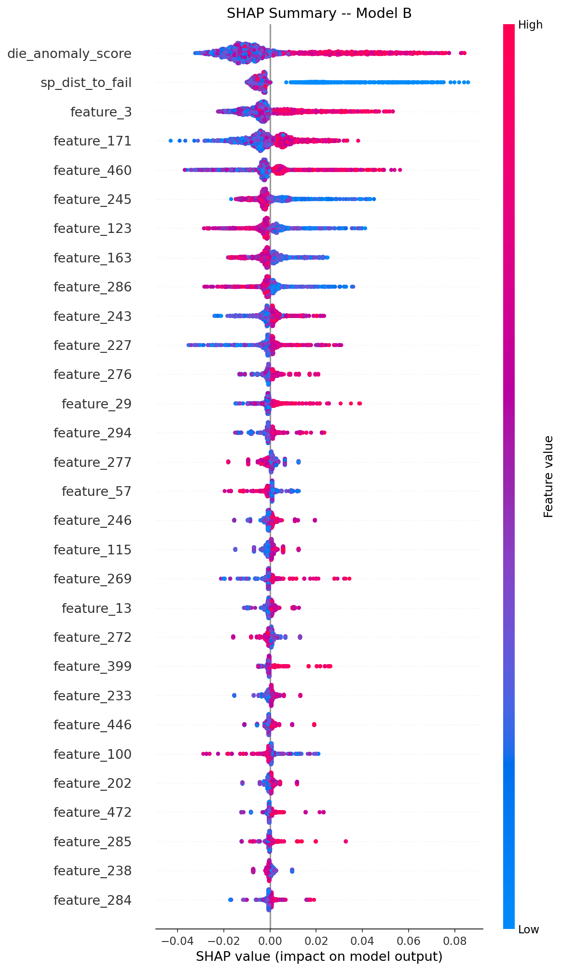
BENCHMARK RESULTS & RIGOROUS AUDITING
Production Results: PR-AUC Gain is Statistically Real; F1 Gain is Within Noise
5-seed paired ablation and 1,000-iteration bootstrap prove the continuous ranking power of block signals
Metric (Eligible Dies) | Model A (511) | Model B (531) | Delta (B - A) | Statistical Test (5-Seed / Bootstrap)
PR-AUC (Secondary) | 0.5025 | 0.5362 | +0.0337 (+6.7%) | p = 1.33e-5 (Statistically Real, CI [+0.023, +0.043] > 0)
Fail F1 Score (Primary) | 0.5207 | 0.5222 | +0.0015 (+0.3%) | p = 0.1081 (Within Noise, CI [-0.008, +0.012] crosses 0)
Fail Recall | 35.58% (491/1380) | 37.10% (512/1380) | +1.52% (+21 dies) | p = 0.0090 (Statistically Significant)
Fail Precision | 97.04% (491/506) | 88.12% (512/581) | -8.92% (69 FP) | Controlled Fab Scrap (<0.22% False Alarm Rate)
Top-10% Triage Capture | 55.7% (768 fails) | 60.4% (834 fails) | +4.8% (+66 fails) | +66 Defective Dies Caught (Same Budget)
KEY SCIENTIFIC FINDING: MARGINAL DEFECT DISTRIBUTION OVERLAP
- Model B is NOT a binary F1 boundary improver. It is sold as improving continuous probability ranking and screening efficiency.
- Sub-die block telemetry provides continuous gradient signal that significantly improves ranking (PR-AUC +0.0337, bootstrap CI > 0).
- Fail F1 remains essentially unchanged (+0.0015, 95% wafer-cluster bootstrap CI [-0.008, +0.012] crosses zero).
- Empirical Finding: A large fraction of failures (65% in this semi-synthetic design) are marginal and overlap healthy electrical distributions, making binary classification difficult; observed F1 remains around 0.52.

Slide 4
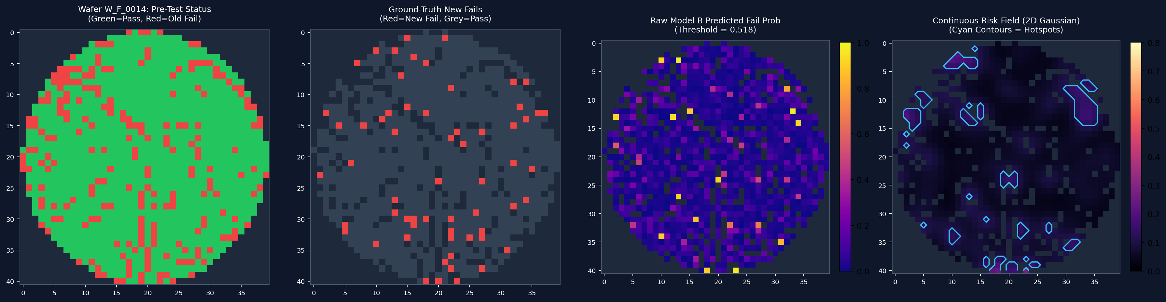
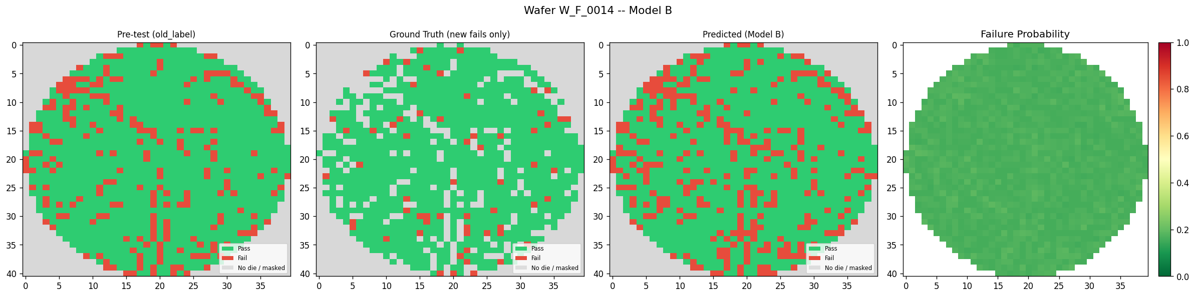
INTERPRETABILITY & VISUAL DESIGN
Hierarchical Interpretability: Wafer Risk Surfaces -> Sub-Die Evidence
Gaussian smoothing (sigma=1.5) delineates hazard contours; TreeSHAP isolates actionable signal from spatial context
WHAT THE LIVE INTERACTIVE DASHBOARD REVEALS (BEYOND STATIC SLIDES):
- Multi-Resolution Die Inspection: Preset W_N_0066 die (2,13) where Model A raw score is 12.9% PASS (calibrated: 4.5%), but Model B raw score is 62.9% FAIL (calibrated: 45.2%) due to sub-die block variance.
- Context vs Actionable Signal: 'Spatial features provide context, not an intervention.' Actionable signal lies in die parametric & sub-die block readings.
- 4 HDBSCAN Failure Signatures: Memory Array Reading Shift, Extreme Block Anomaly, Defect Neighborhood Proximity, Edge Drift.
- 2,000-Point Sub-Die Block Strips: In-depth inspection of sub-die memory array voltage profiles using robust MAD anomaly highlighting.

Slide 5
OPERATIONAL TRIAGE, CALIBRATION & FAB ECONOMICS
Operational Triage & Reliability: Screening Efficiency + Platt Calibration
Optimized for volume semiconductor manufacturing: bounded screening triage, calibrated risk, zero blind scrap
OPERATIONAL SCREENING TRIAGE
+66 Failures Caught at 10% Budget
- At the same 10% inspection budget (3,260 dies inspected): Model A catches 55.7% (768 fails) vs. Model B catches 60.4% (834 fails).
- Captures 66 more failures without increasing the inspection budget, maximizing factory throughput.
- Top 2% triage: 38.1% (A) vs 38.8% (B); Top 5% triage: 46.2% (A) vs 49.7% (B).
PROBABILITY CALIBRATION (PLATT SCALING)
> 70% Calibration Error Reduction
- Fitted strictly on 5 validation folds (zero test data leakage); evaluated on 32,598 held-out test dies.
- Model A ECE: 0.0336 -> 0.0084 (-74.9%); Model B ECE: 0.0293 -> 0.0085 (-71.0%).
- Monotonic mapping perfectly preserves ranking & PR-AUC while providing reliable true defect probabilities.
SCRAP-PRESERVING HIGH PRECISION
88.12% Precision / < 0.22% False Alarms
- Only 69 false alarms out of 31,218 healthy dies across 40 test wafers (99.78% pass specificity; Model A: 15 FP).
- Deliberate engineering setting: scale_pos_weight = 12.0 prevents violent gradient instability.
- Never over-scraps expensive, functional silicon dies, preserving crucial semiconductor fab margins.
IN-LINE FACTORY DEPLOYABILITY
< 0.8s Inference per 40-Wafer Lot
- All 39,351 dies scored in under 0.8 seconds on a single CPU thread without GPU infrastructure.
- Fits directly into automated test equipment (ATE) probe card software without adding cycle time.
- Modular src/ library with automated index alignment assertions prevents silent data slicing errors.

Slide 6
LIMITATIONS & INTERACTIVE LINKS
Technical Limitations, Real-Fab Horizons & Interactive Demo
Transparent boundary conditions, reproducible open-source code, and live cloud deployment
HONEST TECHNICAL AUDIT & BOUNDARIES
Engineering Limitations & Next Steps
1. Semi-Synthetic Benchmark: Built on real WM-811K wafer geometries with synthetic sensor and block telemetry. Validating on real fab telemetry is the natural next milestone; no claim of immediate production readiness.
2. Marginal Defect Distribution Overlap: A large fraction of failures (65% in this semi-synthetic design) are marginal and overlap healthy electrical distributions, making binary classification difficult; observed F1 remains around 0.52 without physical 3D block coordinates.
3. Spatial Context is Non-Interventionist: Spatial features provide context, not an intervention. Spatial clustering guides inspection prioritization, but physical fab actions require process parameter changes.
4. Inert 1D Block Telemetry: Block readings were provided as 1D scalar streams (0..1999); preserving exact 3D physical (x, y, z) memory array coordinates would enable 3D CNNs to capture spatial word-line leakage.
LIVE CLOUD DEPLOYMENT
Streamlit Interactive Web Application
Explore 40 test wafers, continuous risk fields, per-die SHAP breakdowns, and sub-die block profiles in real time.
https://die-yield-prediction.streamlit.app/
OPEN-SOURCE CODEBASE & PIPELINE
GitHub Repository: AdityaG346/Sandisk
https://github.com/AdityaG346/Sandisk
Team Cookies of the Dark Web | SanDisk Cerebrum 2026
Thank you! Handing over to Speaker 4 for the Live Demo.

