Slide 1
Semi-Supervised Topic Discovery
and Sentiment Extraction on
Textual Feedback Systems
Aditya Gadepalli (19BM6JP08)
Srijan Gupta (19BM6JP19)
Anudeep Immidisetty (19BM6JP54)

Slide 2

Introduction
Any consumer facing organization needs to constantly keep track of any feedback/grievances from the stakeholders.
Any relevant feedback must be classified, and the incumbent issues need to be clustered into appropriate categories.
In fact, any new categories need to be tracked in an unsupervised manner preferably.
This clustering needs to be assessed over several KPIs that convey effect over business performance

Slide 3

Problem
Statement
We intend to prepare an end-to-end on-shot solution for GST fraud tracking, which scraps text from online sources, and categorize the given article into their fraudulent domain.
Since there is no prepared dataset for it, we prepared our own dataset for the same using a self-developed semi supervised feedback classification system.
We further develop the reason for the GST Fraud using Topic Modelling, Classification and Clustering approaches.

Slide 4

What is GST?
GST (Goods and Services Tax) is a comprehensive value added tax on goods and services introduced on 1st July 2017 in India.
It is collected on value added at each stage of sale/purchase in the supply chain and is hence a seamless input tax credit system.
The Taxation is ultimately borne by the final consumer.
The total number of GST frauds stand at 637, till Feb 20th 2020 [ref].
It is categorized under four tax slabs of 5%, 12%, 18% and 28%.
Types include Centre GST (CGST), State GST (SGST), Integrated GST (IGST).

Slide 5
Project Outline
Data Preparation
Data Filtering
Data Exploration
Categorization
Evaluation
1. Web Scrapping
from URLs of several news providers to get articles.
2. Preliminary EDA
is done over the data.
3. The Standard Corpus is prepared by extensive manual labelling to help build a classifier to filter GST fraud articles from rest of the news in next step.
1. Data Cleaning
using NLTK library for stemming, lemmatization, regex based filtering and custom stop words removal and data contraction mapping (done first actually).
2. BERT Embedding
is used to embed each article into a finite size vector to capture semantic meaning.
3. Classification Model
is built using cosine similarity over the standard corpus to filter any incoming articles being published on news websites as GST fraud articles or not.
4. Hyperparameter Tuning
is performed on the above classifier and the precision and recall are greatly improved in this step. Also a Latent Semantic Analysis (using PCA) is performed to understand semantic relations between articles in a better way.
1. Secondary EDA
is performed post the filtering. A word web is also generated to visualize the fraud categories.
2. Sentiment Analysis
is performed on the articles to understand the degree of severity each article poses in terms of the attention it can draw and the magnitude of the fraud. This helps us understand the priority of assignment of these topics to the respective departments for timely resolution/review of the issue.
3. Complex Network
is built to understand the relation between various aspects of GST fraud.
1. Topic Modelling
is performed using LDA (Latent Dirichlet Allocation)
and iDF (inverse Document Frequency) to identify the categories of GST fraud in a completely unsupervised manner.
2. Cluster Analysis
is performed on the articles using Hierarchical clustering determine any sub-categories or hierarchies.
3. Classification
is done over extracted RoBERTa features to allocate articles to respective fraud categories (concerned departments) and the results are manually reviewed, and the feedback is updated once model is in deployment.
1. Standard Metrics
such as Top-3 accuracy are used for model evaluation.
2. Indicators and Benchmarking
are thoroughly assessed. We propose custom indicators based on growth rate in number of misc. article allocations, identification of new fraud categories, weighted misclassifications (by fraud amount) etc. and also benchmark our model performance against human performance both in terms of accuracy and scale.
3. Going Further
is also presented wherein once the model is under deployment, continuous feedback is collected about what solutions have been used on which particular issue. This will help is developing a fully scalable dashboard that can propose solutions as soon as the fraud is classified.

Slide 6
Database Preparation
Web Scraping
Goal: Fetch GST fraud articles using the keyword “GST” / ”GST Fraud” as the primary search phrase.
Libraries: BeautifulSoup4, newspaper3k
We perform web-scraping to collect news articles from several sources* using python libraries.
The URLs typically include GST articles, advertisements, social media links, and redirects to the same page.
The links in the page were extracted using regular expression after loading the whole page’s script using Beautiful Soup.
*Sources: Economic Times, Financial Express, Livemint, Times of India, Hindustan Times, Business Standard, The Hindu, The Hindu-Business Line, Deccan Herald, Zee News, India Today, Indian Express, NDTV, Money Control, Business Today, Bloomberg, The Print, Google News, The Tribune, and GST Compendium.

Slide 7
Database Preparation
Preliminary EDA and the Standard Corpus
Preliminary EDA
A preliminary EDA reveals that there is a need for extensive cleaning.
We perform secondary EDA with extensive visualizations later.
We note that the headlines are not complete indicative of the content or the sentiment of the articles.
The writing style largely varies between authors and websites.
The sentiment largely remain same within a website. This will be explained later.
The IPC Sections applicable for certain kinds of GST frauds are also mentioned (eg. Section 67-A).
Standard and Reference corpus
A Standard Corpus was prepared with total 50 articles, 25 for the favorable class (i.e. GST Fraud Case) and 25 non favorable articles (a mix of GST non fraud, and a few advertisement and social media links).
A Reference Corpus is also prepared consisting of 75 articles on the desired topic

Slide 8
Data Filtering
Data Cleaning
Library: NLTK
Stemming and Lemmatization are performed to obtain the root words of the textual data.
Regex based filtering and custom stop words removal are performed to remove any unnecessary whitespaces, special characters, spam words etc.
Data contraction mapping is performed to map spoken short word forms, mis-spelt words and abbreviations into regular textual English, singular spellings and full-forms respectively.
Example:
Contractions like he'd, she'll’ve, and they'll’ve upon punctuation removal becomes hed, shellve, and theyllve, which is neither a logical word nor is specifying the context it serves.
So using contraction mapping, they were developed into he would, she will have and they will have resp.
Abbreviations like GST, rs, cr, etc were also converted to their respective full forms using the same mechanism.
Inconsistent spelled words like adhar, aadhar and aadhaar were unified into a single entity, aadhaar.
Tax officials detected Rs 37,946 cr worth of tax fraud in 2019\n\nand Rs
tax officials detected rs 37946 cr worth of tax fraud in 2019 and rs
tax officials detected rupee 37946 crore worth of tax fraud in 2019 and rupee
tax officials detected rupee 37946 crore worth tax fraud 2019 rupee
Cleaning special characters and brackets using regular expression
Mapping for the corpus
Stop words and words of character lengths less than 3 were removed

Slide 9
Data Filtering
Embeddings, Classification and Hyperparameter Tuning
Embedding Generation
Considered TF.iDF, Word2Vec and RoBERTa to obtain the best performing embedding.
Used RoBERTa because it generated the best evaluation metric value on the standard corpus.
Reason for best performance: attention ability of RoBERTa best captures the necessary context and semantic content of the articles, which was essential for our similarity comparison.
Evaluation Parameter Selection
Precision: selected articles should be relevant to the target class.
Recall : essential to capture as many relevant articles from the corpus possible.
Latent Schematic Analysis
Reduced feature space, using PCA, to better capture schematics of articles.
Not used, since it did not improve evaluation scores further and would only act as a redundant process.
Similarity
Developed using cosine similarity and the Maximum similarity pairs are taken to compare results.
Similarity threshold set for classification. Threshold value selected for value which gave the maximum f1 score .
Model Results (on test corpus)
Precision : 0.96
Recall: 0.926
Able to even detect 2 articles which were incorrectly labelled (intentionally labelled incorrectly to replicate human performance), thereby surpassing the human benchmark.

Slide 10
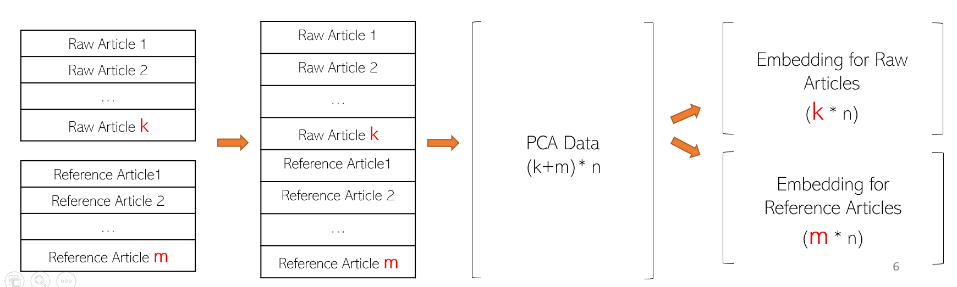
Data Filtering
Embeddings, Classification and Hyperparameter Tuning

Slide 11
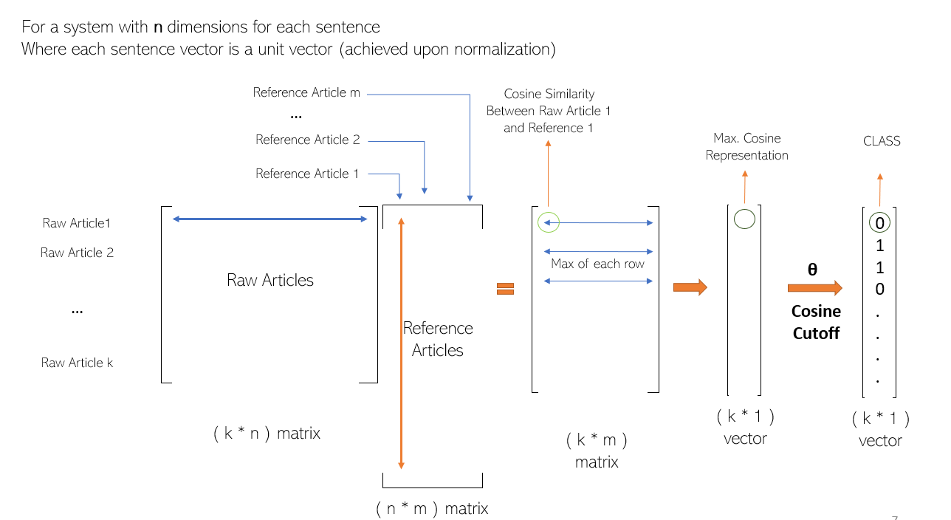
Data Filtering
Embeddings, Classification and Hyperparameter Tuning

Slide 12
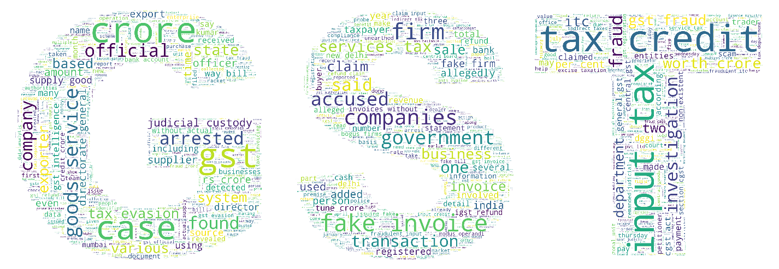
Data Exploration
Secondary EDA
Word Cloud: Provides a visualization of keywords across the corpus.
A few are listed below:
Tax credit
Input tax
Investigation
Goods services
Companies
Fake invoice
Accused
GST
Firm
Fraud

Slide 13
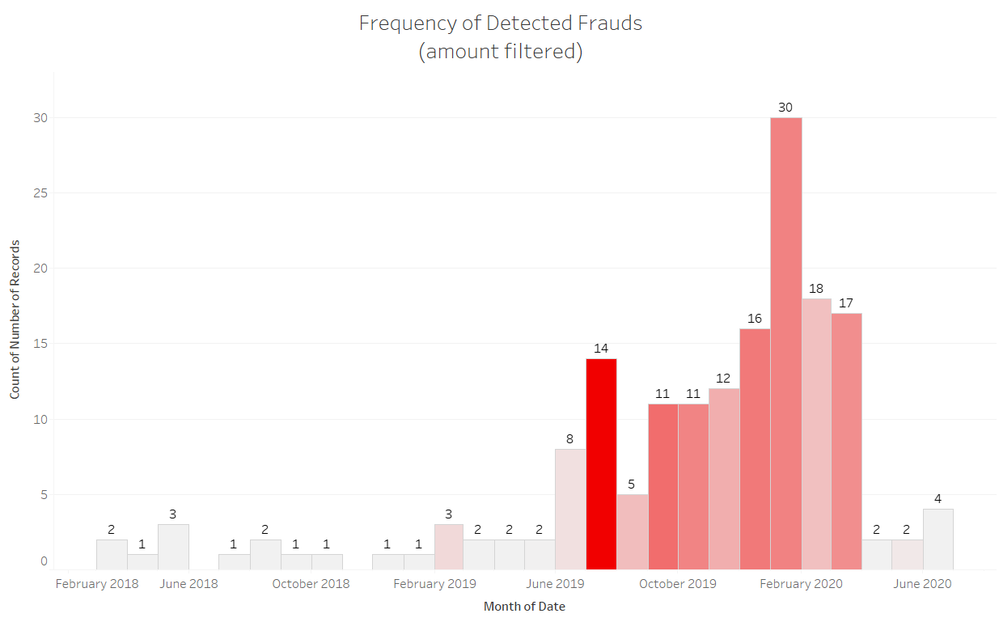
Data Exploration
Secondary EDA
The biggest fraud (in terms of monetary value) were reported in the period for July 2019
Maximum frequency of cases was recorded for the period Jan 2020 to Feb 2020
Subsequent decline in the number of cases for the following period due to introduction of lockdowns in India, due to the COVID-19 pandemic.
Upon lockdown relaxation, we may begin seeing a rise in the number of GST fraud cases.

Slide 14
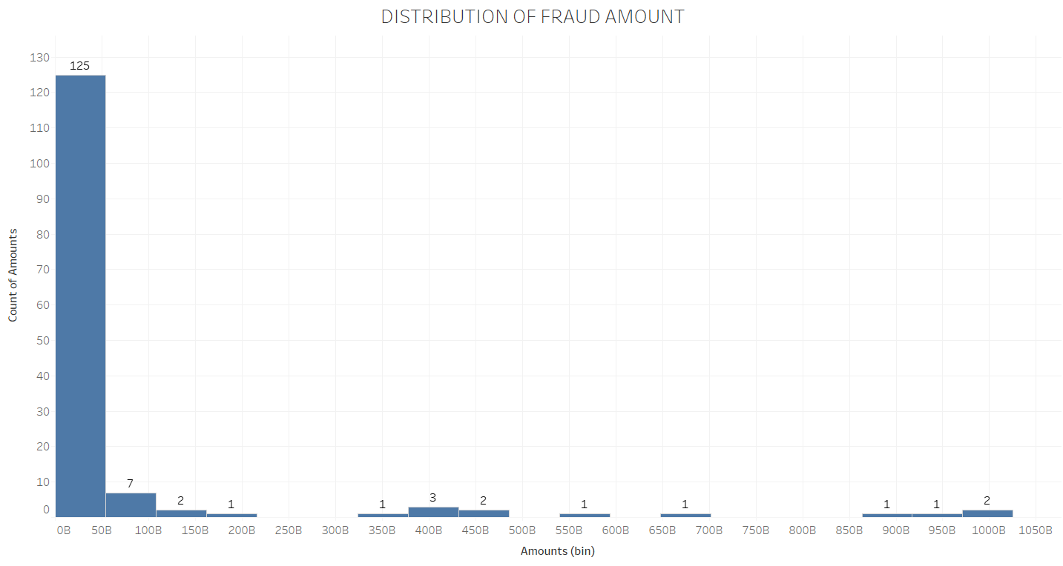
Data Exploration
Secondary EDA
Looking at the distribution, we see majority of the fraudulent transactions are relatively on the lower end of the amount involved (in the bin 0-50 Bn INR)
Maximum fraud recorded for a single fraud event was recorded at 97.1 thousand crore, from the developed corpus.

Slide 15
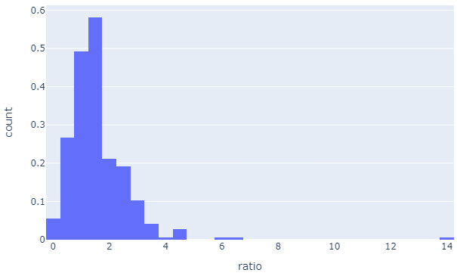
Data Exploration
Sentiment Analysis
We used NLTK’s SID Polarity in this for sentiment analysis
70% articles have a predominantly more negative sentiment than a positive sentiment.
This bias in sentiment scores highlights media sentiment on the GST frauds.
Turning point for us
It showed that the semantic part of the articles is quite important to capture and predominantly categorize whether a given article is of favorable class or not (which is not always guaranteed in a supervised classifier)
But this alone is not sufficient to categorize an article a raw article as fraudulent or not.

Slide 16
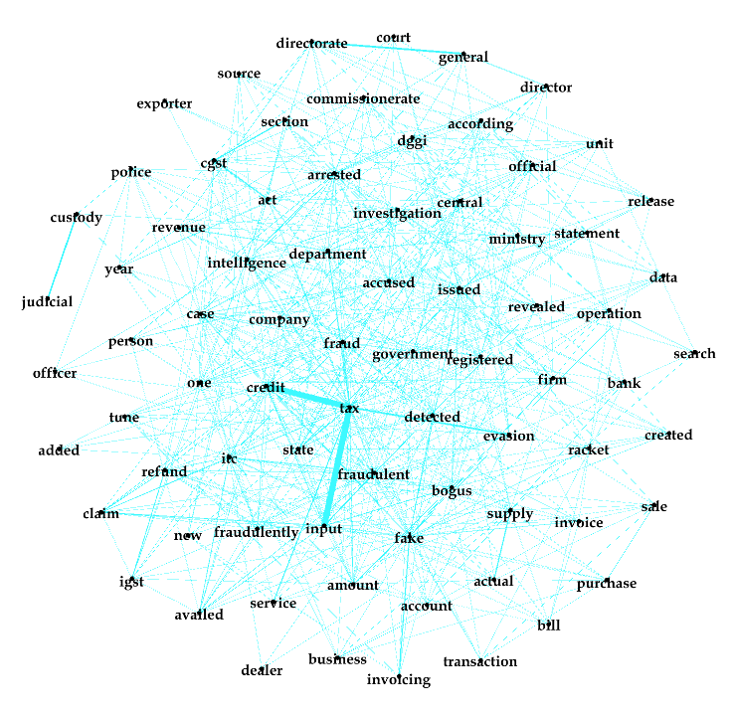
Data Exploration
Complex Network
Network analysis used to depict relations among factors and to analyze the social structures that emerge from the recurrence of these relations
Gephi v0.9.2 is used to chart the co-occurence matrix of bigrams.
A “Fruchterman-Reingold” rearrangement is used to depict nodes with higher node-centrality at the geometric centre of the graph using a gravity factor of 10.
This graph helps assess most common bigrams in data
Shows “input tax” and “tax credit” are most common word pairs
Gave us an idea on potential fraudulent areas
Judicial custody
Tax evasion
Bogus claims
Fake amount
Fake invoicing
Fake transaction etc.

Slide 17
Categorization
Topic Modelling using Latent Dirichlet Allocation
To perform Topic Discovery over the refined corpus of articles, we now proceed with topic modelling using Latent Dirichlet Allocation (LDA).
LDA is a text mining method based on “Bayes Hierarchy Model” first proposed in 2003.
The generative process of LDA:
Take a topic from a document；
Take a word from the chosen topic from 1；
Repeat 1 and 2 until every single word was matched with a topic in the document.
The data is first filtered to retain only nouns and adjectives as they usually comprise the topics-words of our interest.
The major topic of a document is inferred from the distributions of “document-topic” and “topic-word”.
From the above distributions, we obtain a set of topics (comprised of relevant topic-words) in this unsupervised way.
The number of topics needed is also obtained in an unsupervised manner using “Hierarchical Dirichlet Process” (HDP).
Libraries: Gensim, NLTK

Slide 18
Categorization
Topic Modelling using Latent Dirichlet Allocation
The obtained output is presented below, from which we intuitively assign topic labels as depicted through two examples below.
(1, '0.033*"tax" + 0.032*"gst" + 0.013*"credit" + 0.009*"input" + 0.008*"invoices" + 0.008*"crore" + 0.008*"gstr" + 0.006*"evasion" + 0.006*"companies" + 0.006*“bill"'),
Tax Evasion
(4, '0.027*"tax" + 0.026*"gst" + 0.024*“trading" + 0.023*"fake" + 0.019*"firms" + 0.019*"goods" + 0.017*"crore" + 0.016*"credit" + 0.013*"input" + 0.011*"companies"')]
Fake Firms
List of obtained topics
Tax Evasion
Fake Invoices
Fake Firms
Claims Without Receipts
Info
Others

Slide 19
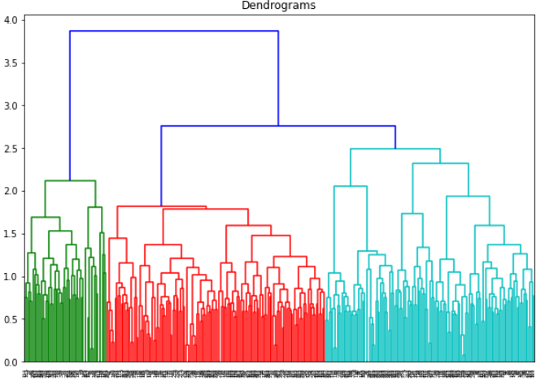
Cluster Analysis
Hierarchical clustering
A clustering Analysis is performed to understand the relation between the obtained topic classes and their prevalence.
This represents “Tax Evasion” class and we observe that it’s the third most prominent type of fraud
This represents “Fake Invoices” class and we observe that it’s the second most prominent type of fraud
This represents “Fake Firms” class and we observe that it’s the most prominent type of fraud

Slide 20
Classification
Topic Allocation
We perform a multi-class classification over RoBERTa (A Robustly Optimized BERT Pretraining Approach) features.
The class imbalance is considered several classifiers are experimented with to obtain best classification results.
The features were developed using Latent Semantic Analysis to yield 25 features and was able to account for 68.34% variance in the data.
The number of features were decided to optimize the evaluation metric accuracy for the developed classifier.

Slide 21
Evaluation
Metrics
The classification results, for different models, are as follows:
Model | Train_Accuracy | Validation_Accuracy | f1
Random Forest | 1.000 | 0.704918 | 0.686565
bagged LR | 0.684 | 0.655738 | 0.650781
Naive-Bayes | 0.656 | 0.639344 | 0.629129
XGB Classifier | 1.000 | 0.622951 | 0.620330
LightGBM | 1.000 | 0.622951 | 0.618613
Ada boost | 0.760 | 0.606557 | 0.616051
Logistic Regression | 0.688 | 0.590164 | 0.582434
Bagging | 0.980 | 0.557377 | 0.561949
KNN | 0.664 | 0.557377 | 0.534754
Decision Tree | 1.000 | 0.442623 | 0.454486
A 73.77% accuracy upon hyperparameter tuning of Random Forest Classifier is noted as the best performing classifier.

Slide 22
Evaluation
Indicators and Benchmarking
nltk_compound | nltk_neg | nltk_pos | nltk_neuteral | ratio | amount | labels
-0.9565 | 0.134 | 0.049 | 0.817 | 2.271186 | 400000000 | fake invoices
-0.9524 | 0.126 | 0.079 | 0.795 | 1.41573 | 1E+09 | fake firms
-0.693 | 0.056 | 0.056 | 0.889 | 0.848485 | 1.125E+11 | INFO
-0.9918 | 0.128 | 0.071 | 0.801 | 1.580247 | 8E+09 | fake invoices
0.9686 | 0.017 | 0.071 | 0.912 | 0.209877 | 3.5E+10 | others
-0.9805 | 0.168 | 0.06 | 0.772 | 2.4 | 280000000 | fake invoices
-0.9337 | 0.109 | 0.067 | 0.824 | 1.415584 | 1.2E+10 | fake firms
-0.9027 | 0.109 | 0.065 | 0.826 | 1.453333 | 4.5E+09 | fake invoices
0.872 | 0.04 | 0.06 | 0.9 | 0.571429 | 2E+10 | others
-0.8591 | 0.075 | 0.053 | 0.872 | 1.190476 | 560000000 | fake firms
-0.9819 | 0.132 | 0.047 | 0.821 | 2.315789 | 690000000 | fake invoices
-0.9918 | 0.131 | 0.034 | 0.836 | 2.977273 | 1.2E+11 | fake firms
We see that the “nltk_compound” and the “amount” column are very useful indicators of the severity of the GST fraud case that has been reported.
We propose custom indicators based on growth rate in number of misc. article allocations, identification of new fraud categories, weighted misclassifications (by fraud amount) etc. and also benchmark our model performance against human performance both in terms of accuracy and scale.
The Topic modelling can be now applied within the classified label categories to discover newly evolving sub-categories.
Under the “others” label we discover new GST frauds such as those seeking illegal benefits from foreign tourists’ GST benefits.

Slide 23
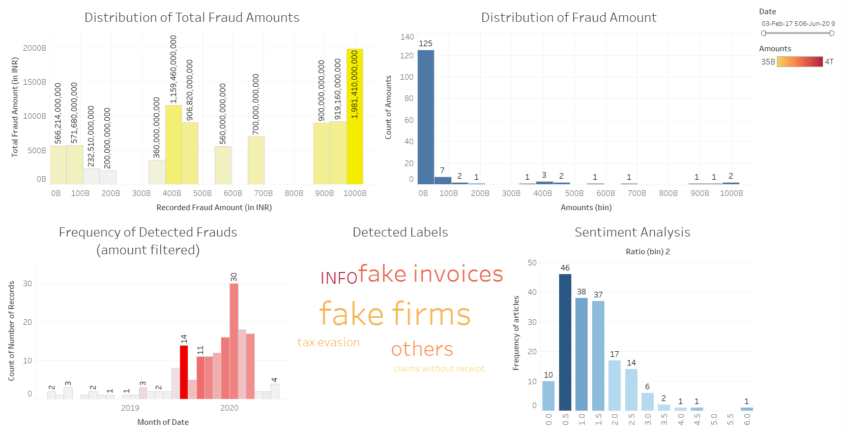
Evaluation
Going Further
Once the model is under deployment, continuous feedback is collected about what solutions have been used on which particular issue.
This will help is developing a fully scalable dashboard that can propose solutions as soon as the fraud is classified.
Dashboard Preview and Features
Allows selective features on the following category (single or in combination of one another)
Over a time period (on discrete and continuous scales)
Over a fraud label category
Over the class of fraud (based on amount of frauds)
Over the sentiment of articles

Slide 24
Other Applications
Analyzing Reviews
The current work discussed about the GST application in detail.
We further provide an overview of how the same mechanism can prove useful for other use-cases like an e-commerce website like Amazon.com or a hotel booking website like OYO or even a mobile application platform like Apple’s AppStore.
The reviews are analogous to articles. One may include tweets and blog posts too; the cleaning process would be much simpler for these.
The sentiment extraction can be done in the exact same manner.
Additionally, the star ratings can also be accounted for and correlation can be established between top keywords and the average ratings.
The topic discovery model would now give us a wide classification of user reviews say on the grounds of duplicate products, broken items, delayed delivery, improper refunds etc.
This mechanism would speed up the process of grievance addressal on platforms of such huge scale such as Amazon.com

Slide 25
Questions?
Thank You!

