Slide 1
TradeWise: Stock Strategy Analysis
Moving average crossover (20/50) backtest on the top 20 Nifty 50 stocks
EDA Project | Adi | October 2026

Slide 2
Agenda
What this presentation covers
1
Problem and objectives
2
Data and cleaning
Why test a moving average crossover
47 series, what was fixed, top 20 selection
3
Method and metrics
4
Objective findings
20/50 signals, backtest rules, six metrics
Returns, drawdown, volume, trades, extremes
5
Subjective insights
6
Recommendation
Annualized returns, volume, correlation, risk
Which stocks fit the strategy, and caveats
2

Slide 3
Introduction and Objectives
Does a simple trend-following rule beat the market on large Indian stocks?
18 of 20
6 of 20
-17% vs -43%
stocks made a positive annualized return with the strategy
stocks where the strategy beat buy and hold
max drawdown: strategy portfolio vs buy and hold
Backtest a long-only 20/50 day SMA/LMA crossover on 5 years of data (Jun 2018 to Jun 2023)
Measure total and annualized return, max drawdown, Sharpe, win/loss ratio and trade count
Answer 12 objective and 5 subjective questions, then recommend stocks
3

Slide 4
Data Overview
238,885 rows, 10 columns, 47 series, daily prices to 23 June 2023
47 to 20
5 years
56,788
0
series narrowed to the 20 most liquid stocks
24 Jun 2018 to 23 Jun 2023
rows in the 5-year window (all 46 eligible stocks)
daily moves above 50% (no split distortion)
Cleaning steps
Top 20 selection
Dropped the blank row and the NIFTY_50_STOCKS index series
Converted dd-mm-yyyy text dates to datetime
VWAP text converted to numeric (#VALUE! error became NaN)
Dropped Price column (99% empty)
Ranked by average daily traded value (Close x Volume)
Only stocks with a full 5-year history are eligible
Liquid names are realistic to trade with a crossover rule
"First stocks after sorting" = alphabetical order of the 20
4

Slide 5
Methodology
From raw prices to performance metrics
1
2
3
4
Signals
Positions
Trades
Metrics
SMA 20 vs LMA 50. Buy on cross up, sell on cross down
Long-only, enter next day (no look-ahead). Rs 1,00,000 per stock
Entry and exit log; open trade closed at last price
Total and annualized return, max drawdown, Sharpe, win/loss, trades, yearly
Metric definitions
Annualized = (1 + total)^(252/days) - 1 | Max drawdown = worst peak-to-trough fall of equity
Sharpe = mean daily return / std dev x sqrt(252), risk-free rate 0 | Win/loss = winning trades / losing trades
5

Slide 6
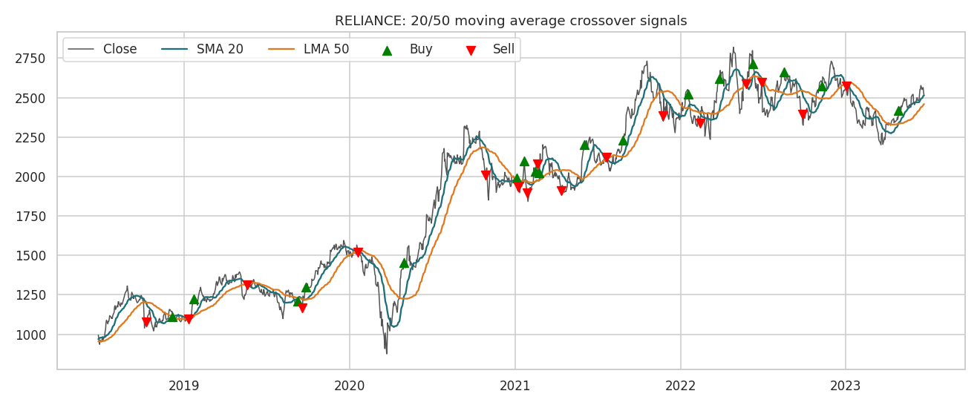
The Strategy in Action: Reliance
Triangles mark the buy and sell crossovers
Crossovers lag price: they catch long trends but get whipsawed in sideways markets (Reliance: 17 trades, 7 wins).
6

Slide 7
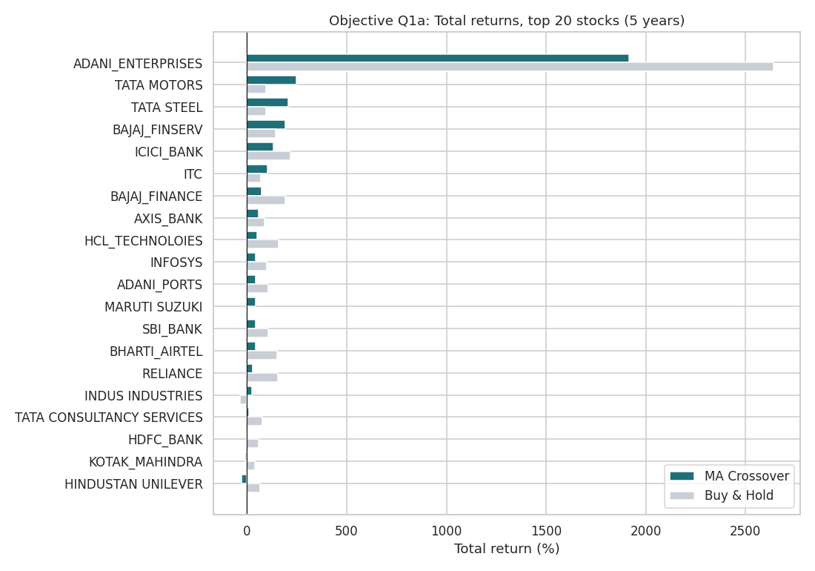
Total Returns: A Few Big Winners
Strategy return vs buy and hold, top 20 stocks
Adani Enterprises +1,917%, Tata Motors +247%, Tata Steel +208%, Bajaj Finserv +191%
Losers: Hindustan Unilever -27.6%, Kotak -7.6%
Strategy trails buy and hold in 14 of 20 stocks: the window was a strong bull market
Gains arrive after the March 2020 crash; 2018-19 curves are flat
7

Slide 8
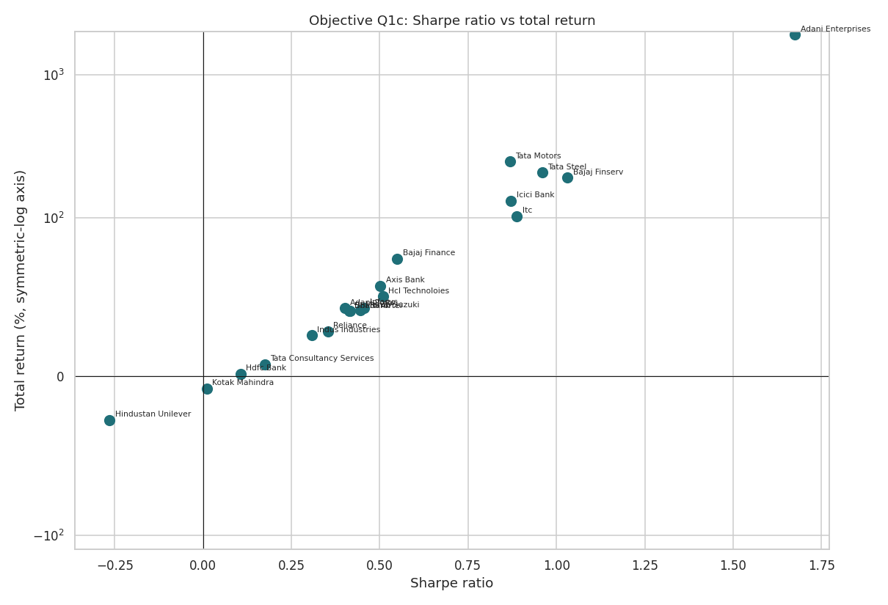
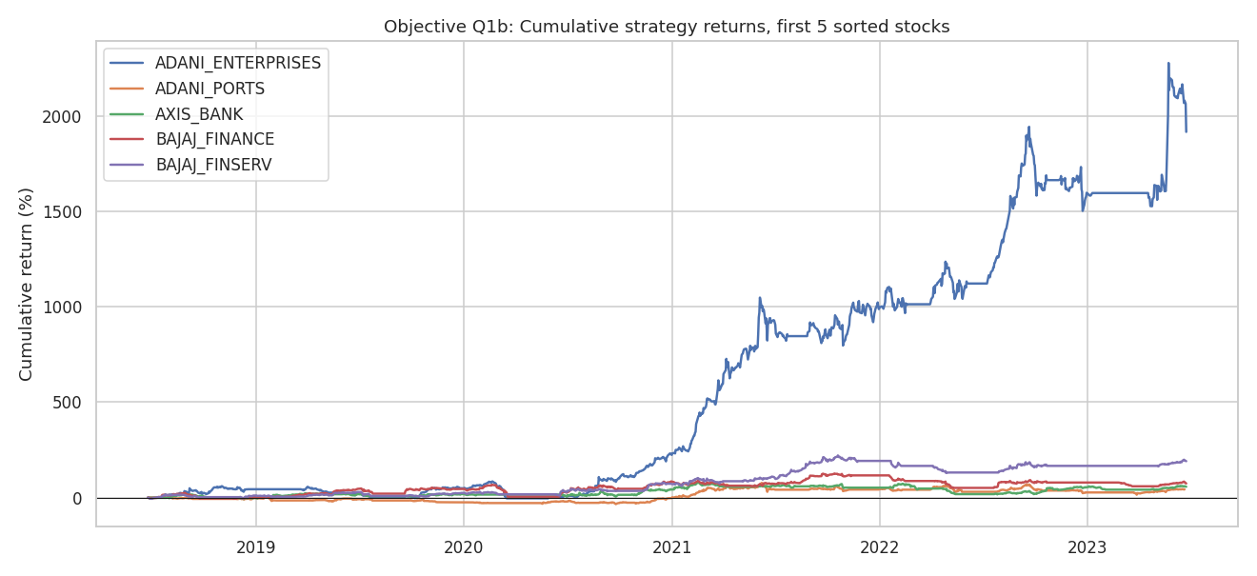
Cumulative Returns and Risk-Adjusted Return
Left: first 5 stocks (A-Z). Right: Sharpe ratio vs total return
Adani Enterprises dwarfs Adani Ports, Axis, Bajaj Finance and Bajaj Finserv
Sharpe and total return correlate at 0.74: higher earners tend to be more efficient
8

Slide 9
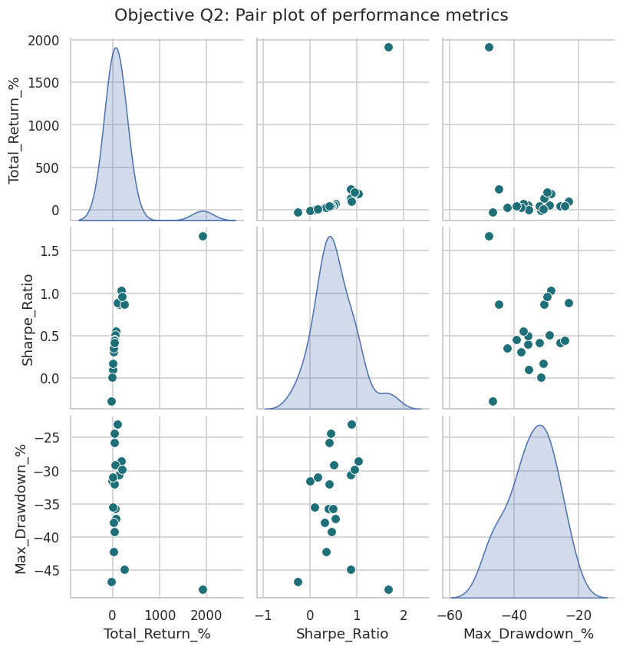
Return, Sharpe and Drawdown Together
Pair plot of the three key metrics
Return vs Sharpe: +0.74. Efficient earners lead
Return vs max drawdown: -0.42. Higher return came with deeper drawdowns (Adani, Tata Motors)
Sharpe vs drawdown: about 0. A high Sharpe does not guarantee a shallow drawdown
Takeaway: rank on Sharpe and drawdown, not return alone
9

Slide 10
Objective Questions: Key Facts
What stands out across the 20 stocks
Adani Enterprises
ITC
Tata Steel
Reliance, HDFC Bank, HUL
Highest total return: +1,917%
Lowest max drawdown: -23.0%
Highest avg volume: 113.9m shares/day
Most trades: 17 each (269 total)
Adani Enterprises
Indus Industries
Tata Steel
March 2020
Worst day: -28.2% on 1 Feb 2023
Best day: +44.7% on 26 Mar 2020
Lowest avg close: about Rs 77
Worst month for 14 of 20 stocks
10

Slide 11
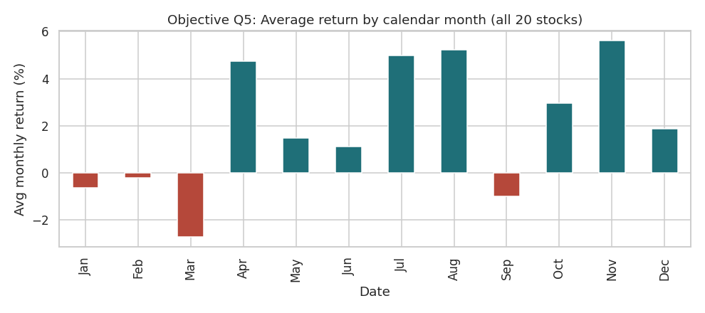
Best and Worst Months
Returns are dominated by the 2020 crash and rebound
March 2020 was the worst month for 14 of 20 stocks (Indus Industries -68%, Bajaj Finance -50%)
November 2020 was the best month for 8 of 20 stocks (vaccine-news rally)
No stable calendar-month pattern: averages are driven by 2020
11

Slide 12
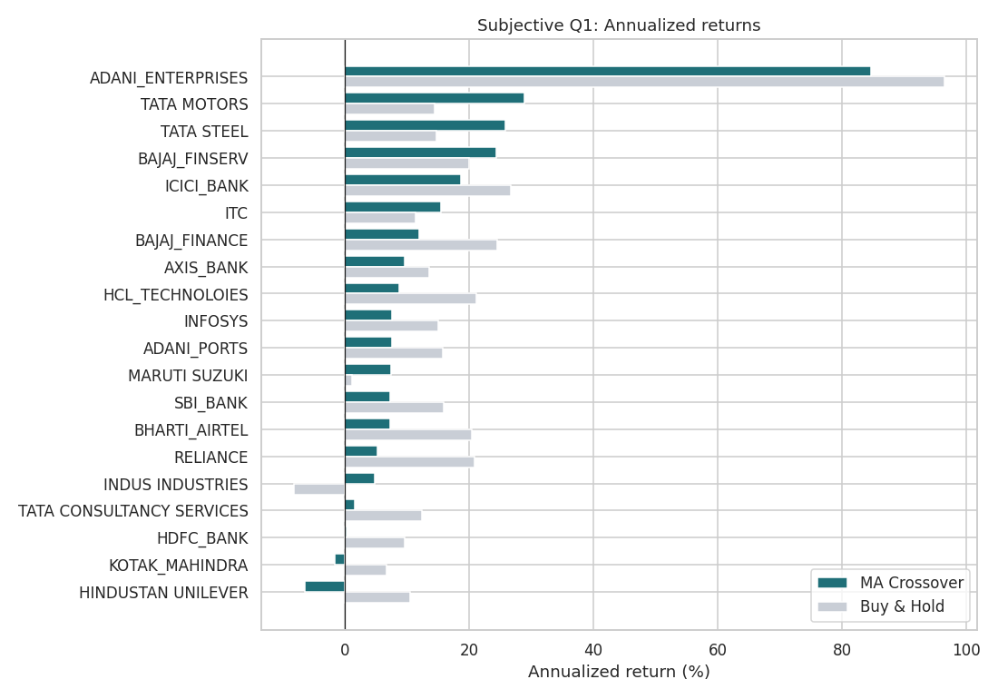
Annualized Returns Across the 20 Stocks
Mean 13.5%, median 7.6%: skewed by one outlier
Leaders: Adani 84.6%, Tata Motors 28.9%, Tata Steel 25.8%, Bajaj Finserv 24.4%
Laggards: HUL -6.4%, Kotak -1.6%, HDFC Bank 0.3%
Without Adani the mean of the other 19 is about 10%
Trending cyclicals suit crossovers; range-bound defensives do not
12

Slide 13
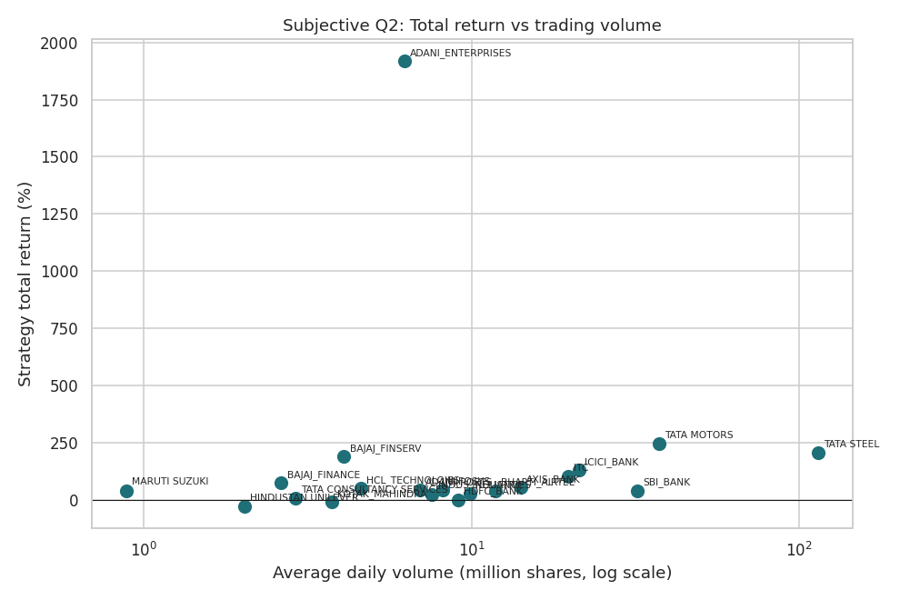
Total Return vs Trading Volume
A weak relationship: volume is a liquidity filter, not a predictor
Pearson 0.02; Spearman 0.40 (strategy) and 0.17 (buy and hold) on only 20 points
Lowest-volume Maruti still returned +42%; high-volume SBI and Reliance returned +41% and +28%
Share volume is distorted by share price (Tata Steel is cheap per share)
13

Slide 14
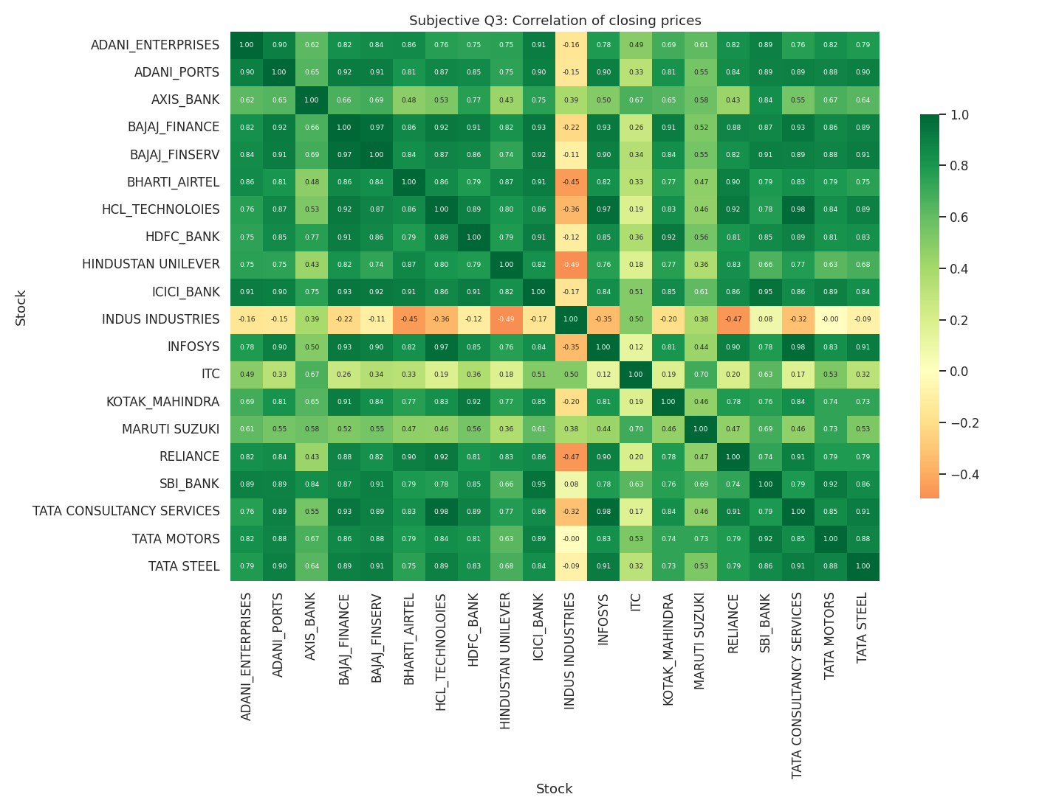
Which Stocks Move Together?
Correlation of closing prices
HCL Tech and TCS 0.98; Infosys and TCS 0.98; Bajaj Finance and Finserv 0.97; ICICI and SBI 0.95
Daily-return correlation is lower: Bajaj pair 0.83, Axis and ICICI 0.74
Diversifiers: Indus Industries (avg -0.12), ITC (0.37)
14

Slide 15
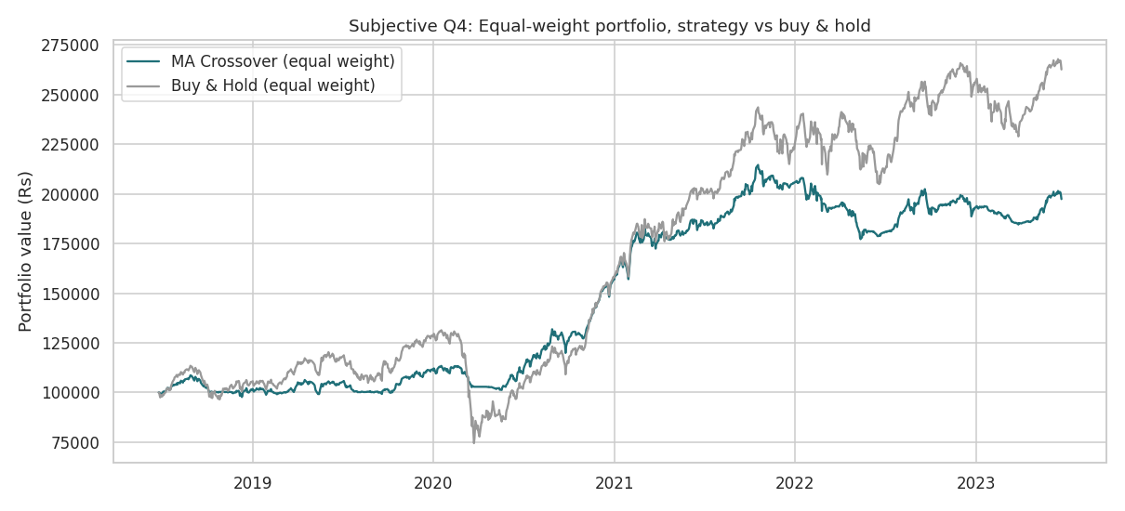
Strategy as a Risk Overlay
Equal-weight portfolio of the 20 stocks
14.9%
21.8%
Strategy annual return
Buy and hold annual return
-17.4%
-43.3%
Strategy max drawdown
Buy and hold max drawdown
Sharpe 1.22 vs 0.99. Only 46% of trades won (win/loss 0.84): winners are larger than losers.
15

Slide 16
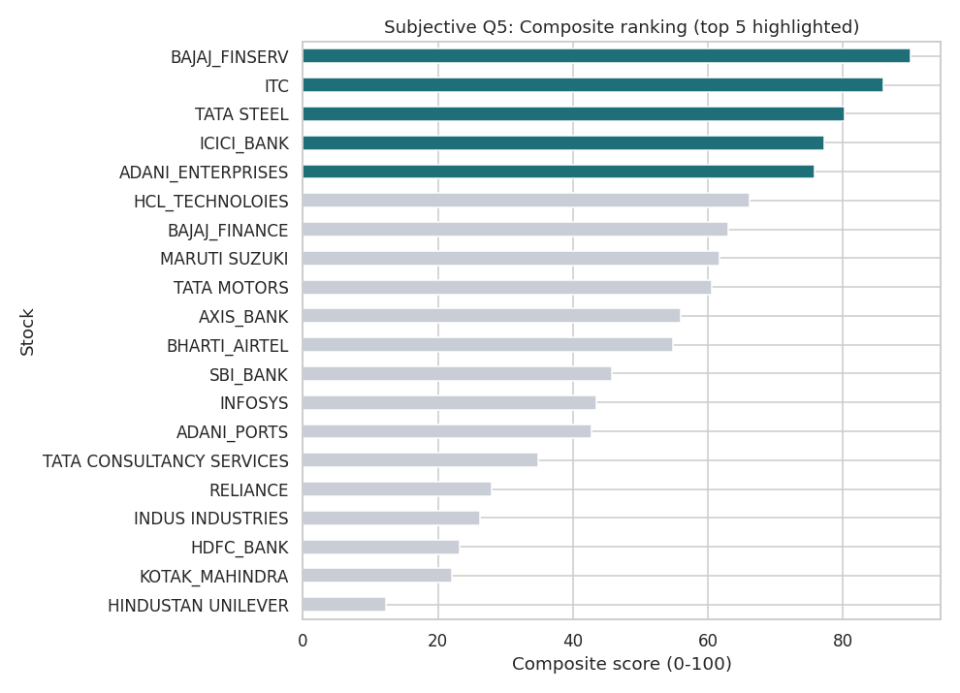
Recommended Stocks
Composite score: Sharpe 35%, annualized return 30%, drawdown 25%, win rate 10%
1. Bajaj Finserv (90)
24.4% annual, Sharpe 1.03, win rate 80%
2. ITC (86)
Shallowest drawdown -23.0%, low correlation
3. Tata Steel (80)
25.8% annual, Sharpe 0.96, very liquid
4. ICICI Bank (77)
18.7% annual, Sharpe 0.87, consistent
5. Adani Enterprises (76)
Highest return, but -48% drawdown and event risk: small position only
Weakest fit for this strategy: HUL, Kotak, HDFC Bank, Indus Industries, Reliance
16

Slide 17
Conclusion
The 20/50 crossover is a risk-control tool, not a way to beat a bull market.
It was profitable on 18 of 20 stocks and cut portfolio drawdown from -43% to -17%, giving up about 7 points of annual return.
Stock choice matters more than the signal: Bajaj Finserv, ITC, Tata Steel and ICICI Bank fit best.
Caveats: no costs or taxes, a single 20/50 setting, and a short window shaped by the 2020 crash. Academic analysis, not financial advice.

Slide 18
Acknowledgements and References
Dataset: combined_nifty_50_data.csv (Nifty 50 daily prices, supplied with the project)
Tools: Python (pandas, NumPy, Matplotlib, Seaborn), Jupyter
Project brief, task list and submission guidelines supplied with the assignment
Deliverables: TradeWise_Stock_Strategy_Analysis.ipynb, TradeWise_Report.docx, this presentation
18

