Slide 1
Pricing A/B Test
Finding the right delivery fee set-up: same revenue, more orders
EDA 2 Project | Newton School, Data Analytics Program
Presented by: Aditya Anil Gaikwad

Slide 2
Agenda
1
Problem statement and objective
2
Dataset and approach
3
KPIs and overall result
4
EDA: 3 questions
5
A/B testing: 5 questions
6
Additional analysis: 7 questions
7
Recommendation, limitations and conclusion
Aditya Anil Gaikwad | Newton School, Data Analytics | EDA 2: Pricing A/B Test
2

Slide 3
Problem statement and objective
Problem
Objective
Delivery fee is a pricing lever: it affects how many customers order and how much the company earns.
Control group pays a flat fee of 2.29 on every order.
Test group has a tiered fee set-up.
Run a pricing A/B test to find the delivery fee set-up that gives the same revenue with more orders.
Revenue = order value × 20% commission + delivery fee.
KPIs measured
Orders
Average order value (total order value / total orders)
Delivery fee
Revenue
Aditya Anil Gaikwad | Newton School, Data Analytics | EDA 2: Pricing A/B Test
3

Slide 4
Dataset overview
Column | Meaning | Note
date | Transaction date | 1 to 31 July 2021
code | Unique order id | 18,006 unique rows
variant_transaction | Control or Test | 8,232 Control, 9,774 Test
order_value | Basket value (currency) | Not an item count: revenue formula only fits this way
hour | Hour of order (24h) | Hours 8 to 21
delivery_fee | Fee charged | Control 2.29; Test 0 to 3.29
revenue | Revenue per order | Checked: equals value × 0.2 + fee on every row
Data quality: no missing values and no duplicate order codes.
Aditya Anil Gaikwad | Newton School, Data Analytics | EDA 2: Pricing A/B Test
4

Slide 5
Approach
1
2
3
4
5
Clean and check
EDA
A/B tests
Segment view
Decide
Nulls, duplicates, revenue formula
Hour, time of day, fee vs revenue
Welch t-test, Mann-Whitney, bootstrap, Levene
Orders below and above 33, hour by hour
Recommendation with caveats
Significance level 5%. For the 14 hour-by-hour tests a Bonferroni correction is applied (0.05 / 14 = 0.0036).
Aditya Anil Gaikwad | Newton School, Data Analytics | EDA 2: Pricing A/B Test
5

Slide 6
KPI scorecard: Control vs Test
Overall result
KPI | Control | Test | Change
Orders | 8,232 | 9,774 | +18.7%
Average order value | 29.32 | 31.90 | +8.8%
Average delivery fee | 2.29 | 1.95 | -14.9%
Total revenue | 67,131 | 81,415 | +21.3%
Revenue per order | 8.15 | 8.33 | +2.1%
Orders per day | 266 | 315 | +18.7%
The Test fee set-up gets more orders and does not lose revenue.
Aditya Anil Gaikwad | Newton School, Data Analytics | EDA 2: Pricing A/B Test
6

Slide 7
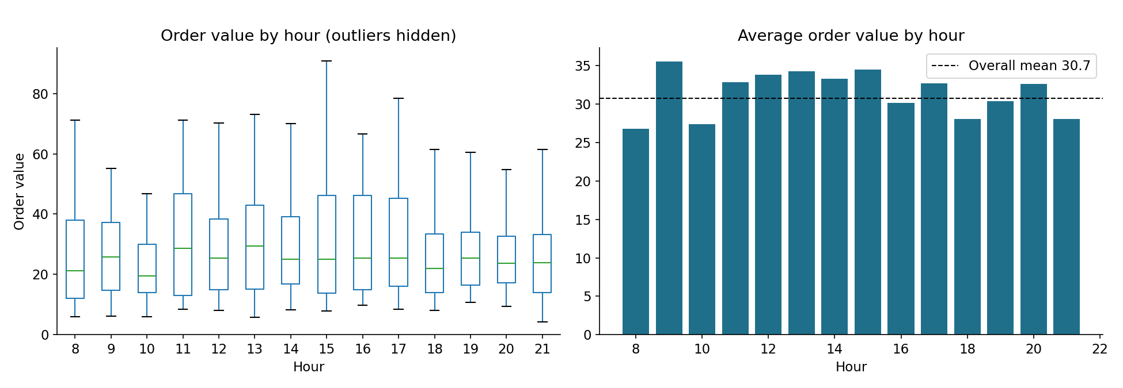
EDA Q1: Order value by hour of day
What is the distribution of order value across hours? Which hours are significantly higher or lower?
EDA
Highest average basket at 9:00 (35.55), then 15:00, 13:00, 12:00.
Lowest at 8:00 (26.82) and 10:00 (27.38).
Differences by hour are significant (Kruskal-Wallis p < 0.001), but spread inside each hour is wide.
Aditya Anil Gaikwad | Newton School, Data Analytics | EDA 2: Pricing A/B Test
7

Slide 8
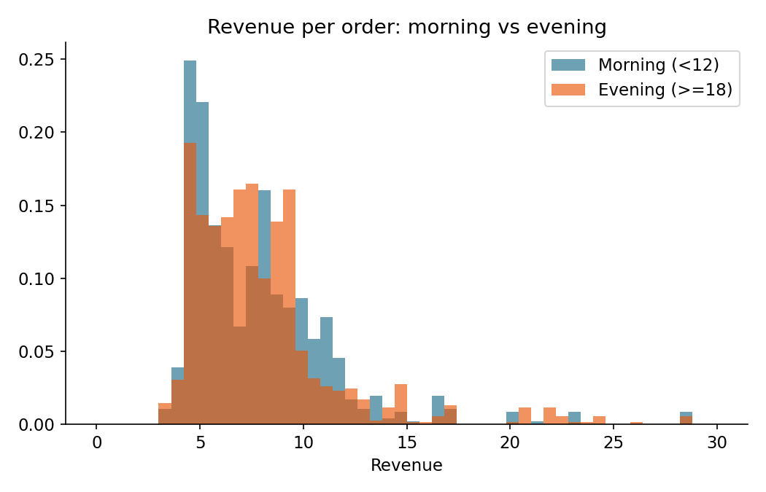
EDA Q2: Revenue in the morning vs evening
How does revenue differ between morning (before noon) and evening (after 6 PM)?
EDA
Morning average revenue 7.90 (4,644 orders).
Evening average 8.05 (6,942 orders), only +1.8%.
Welch p = 0.069: not clearly different.
Evening brings more orders, not higher revenue per order.
Aditya Anil Gaikwad | Newton School, Data Analytics | EDA 2: Pricing A/B Test
8

Slide 9
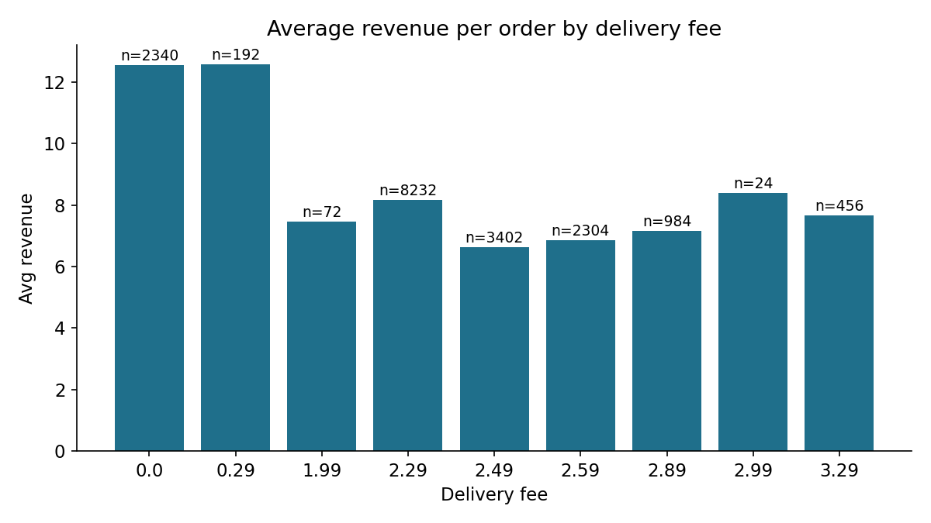
EDA Q3: Delivery fee and revenue
How does the delivery fee impact revenue? Do higher or lower fees correlate with revenue changes?
EDA
Fee and revenue correlation is -0.40, but this is not cause and effect.
Free-delivery orders are the biggest baskets (avg 62.74), so they earn the most commission (12.55).
Fees are 28% of Control revenue and 23% of Test revenue; commission matters more.
Aditya Anil Gaikwad | Newton School, Data Analytics | EDA 2: Pricing A/B Test
9

Slide 10
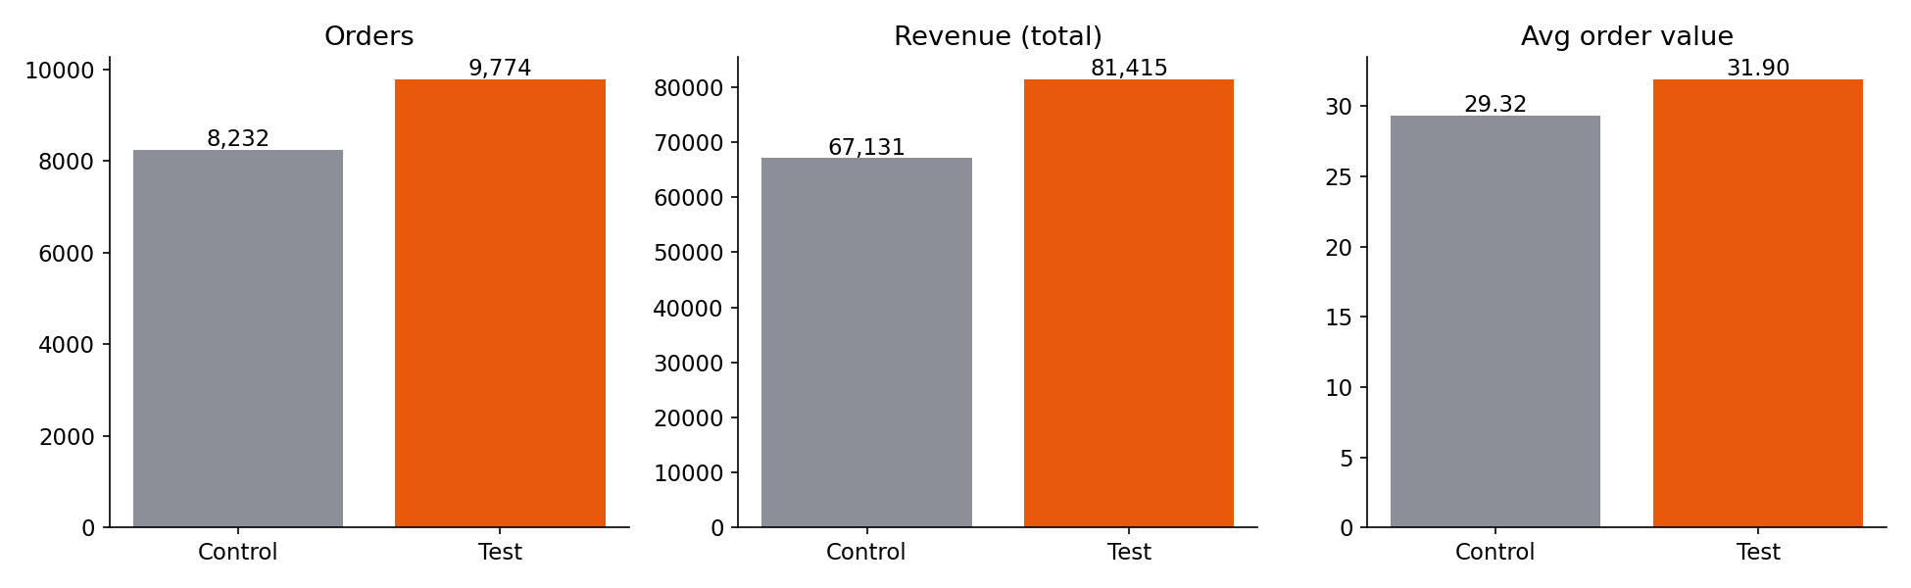
A/B Q1: Is revenue different between Control and Test?
Is there a statistically significant difference in revenue between the groups?
A/B test
Result: YES, significant
Revenue per order 8.15 to 8.33 (+2.1%)
95% CI of difference: 0.05 to 0.30
Welch t = 2.64, p = 0.008
Total revenue +21.3%; Test ahead on 26 of 31 days
Bootstrap interval agrees (0.05 to 0.30). Mann-Whitney is also significant, but it compares whole distributions, so the t-test is used for the mean.
Aditya Anil Gaikwad | Newton School, Data Analytics | EDA 2: Pricing A/B Test
10

Slide 11
A/B Q2: Effect of variant on order value
Does one variant lead to higher order values?
A/B test
 | Control | Test
Average order value | 29.32 | 31.90 (+8.8%)
Orders of 33 or more | 27.6% | 34.1%
AOV, orders 33 or more | 57.4 | 56.6
AOV, orders below 33 | 18.65 | 19.08
Test is higher: +2.58, CI 1.88 to 3.28, p < 0.001.
But the basket is the same inside each size group.
The rise is a mix effect: more orders reach 33 and above.
Aditya Anil Gaikwad | Newton School, Data Analytics | EDA 2: Pricing A/B Test
11

Slide 12
A/B Q3: Effect of variant on delivery fee
Does the variant influence the delivery fee charged? Is the difference significant?
A/B test
 | Control | Test
Average fee | 2.29 | 1.95 (-14.9%)
Orders with free delivery | 0% | 24%
Average fee, orders below 33 | 2.29 | 2.63 (+15%)
Total fee collected | 18,851 | 19,053 (+1.1%)
Yes, strongly different (p < 0.001).
Test charges small baskets more, big baskets nothing.
Total fee income still rises slightly because there are more orders.
Aditya Anil Gaikwad | Newton School, Data Analytics | EDA 2: Pricing A/B Test
12

Slide 13
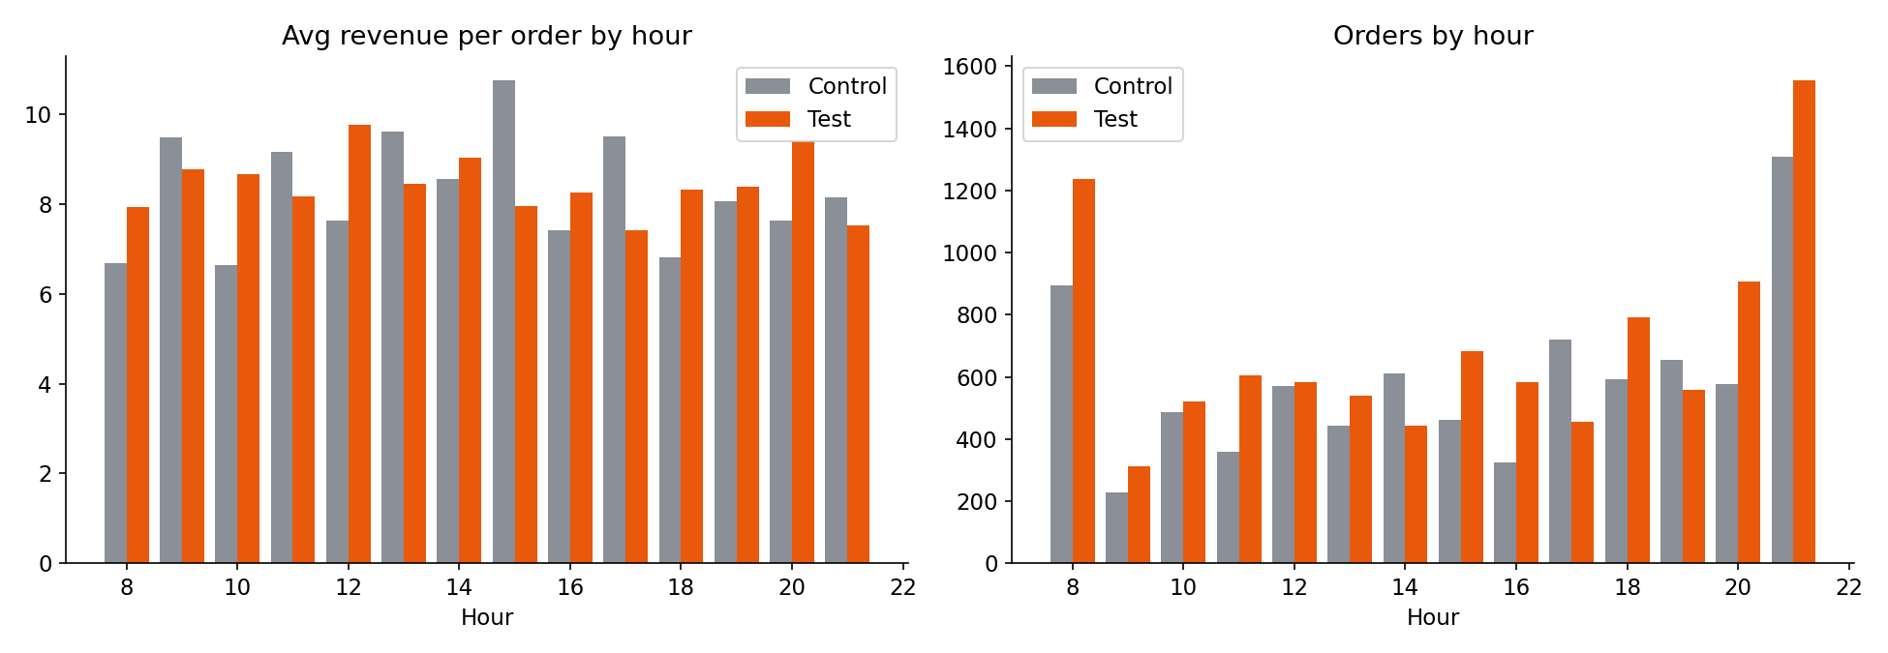
A/B Q4: Does time of day change the effect?
Are there times where Test outperforms Control in revenue?
A/B test
Test earns more total revenue in 11 of 14 hours; Control leads at 14:00, 17:00 and 19:00.
Biggest gains: 16:00 (+100%), 20:00 (+93%), 8:00 (+64%), 18:00 (+63%).
Revenue per order is better in Test at 8, 10, 12, 16, 18, 20 and worse at 11, 13, 15, 17, 21.
The hour pattern zig-zags, so treat it as directional.
Aditya Anil Gaikwad | Newton School, Data Analytics | EDA 2: Pricing A/B Test
13

Slide 14
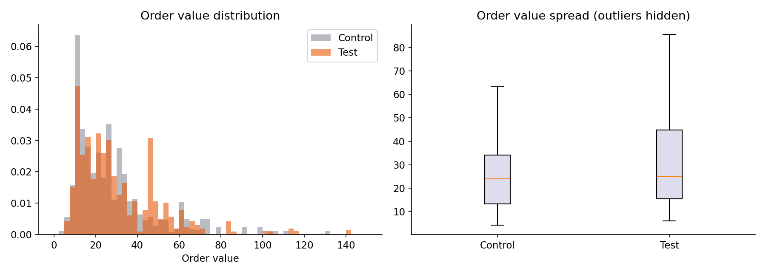
A/B Q5: Variance of order value
Is there greater variance in order value in Control or Test? What does it mean?
A/B test
Test has more variance: SD 24.67 vs 23.11 (Levene p = 0.002).
Relative spread is the same: CV 0.77 vs 0.79.
95th percentile is lower in Test (68 vs 73): the tail is not longer.
Test is not riskier; more orders sit in the 33 to 80 range.
Aditya Anil Gaikwad | Newton School, Data Analytics | EDA 2: Pricing A/B Test
14

Slide 15
Add Q1: Order value by hour, Control vs Test
How does order value vary by hour across the two groups?
Additional
Hour | Control AOV | Test AOV
8:00 | 22.0 | 30.3
9:00 | 36.0 | 35.2
10:00 | 21.8 | 32.6
11:00 | 34.4 | 31.9
12:00 | 26.7 | 40.8
13:00 | 36.7 | 32.3
14:00 | 31.4 | 36.0
15:00 | 42.3 | 29.2
16:00 | 25.7 | 32.7
17:00 | 36.1 | 27.3
18:00 | 22.6 | 32.1
19:00 | 28.9 | 32.1
20:00 | 26.8 | 36.4
21:00 | 29.3 | 27.1
Control swings widely: 21.8 (10:00) to 42.3 (15:00).
Test is flatter: 27.1 (21:00) to 40.8 (12:00).
Test is higher in 8 of 14 hours; biggest gaps at 12:00, 10:00, 20:00.
Bold = higher group in that hour.
Aditya Anil Gaikwad | Newton School, Data Analytics | EDA 2: Pricing A/B Test
15

Slide 16
Add Q2: Presence of a delivery fee and revenue
Does having or not having a delivery fee significantly affect revenue?
Additional
Segment | Orders Ctl / Test | Rev per order Ctl / Test | Total revenue Ctl / Test
33 or more (Test: free) | 2,268 / 3,336 (+47%) | 13.77 / 11.96 (-13%) | 31,227 / 39,913 (+28%)
Below 33 (Test: ~2.63) | 5,964 / 6,438 (+8%) | 6.02 / 6.45 (+7%) | 35,904 / 41,502 (+16%)
Only Test has free-delivery orders (24%); they bring 36% of Test revenue through commission.
Waiving the fee costs about 1.80 per large order, but 47% more large orders arrive.
Charging small baskets about 0.34 more lifts their revenue per order by 7% without losing orders.
Aditya Anil Gaikwad | Newton School, Data Analytics | EDA 2: Pricing A/B Test
16

Slide 17
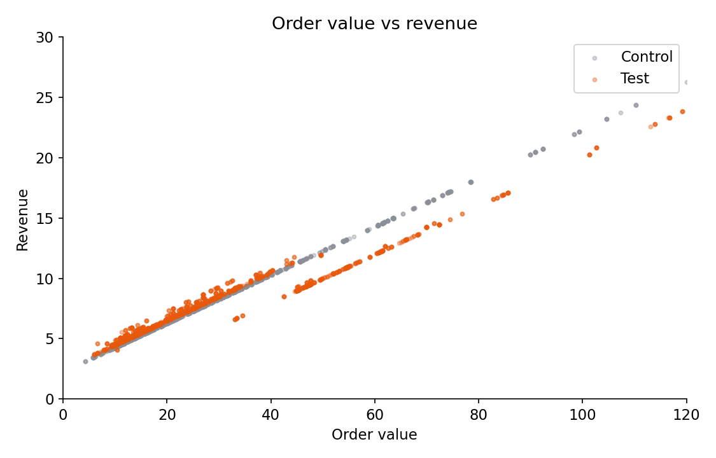
Add Q3: Order value and revenue correlation
How strong is the link between order value and revenue in each group?
Additional
Control: r = 1.00, because revenue = 0.20 × order value + 2.29 exactly.
Test: r = 0.982 (R² = 0.96), slightly weaker as the fee varies.
Test slope is 0.166 vs 0.200: as baskets grow the fee shrinks, so each extra unit earns less than the 20% commission.
Aditya Anil Gaikwad | Newton School, Data Analytics | EDA 2: Pricing A/B Test
17

Slide 18
Add Q4: Time of day and revenue
Are there hours where one group outperforms the other in revenue?
Additional
Test leads in 11 of 14 hours. Control leads at 14:00, 17:00 and 19:00.
Test is more even through the day: revenue per order stays between 7.43 and 9.77 vs 6.64 to 10.75 in Control.
Aditya Anil Gaikwad | Newton School, Data Analytics | EDA 2: Pricing A/B Test
18

Slide 19
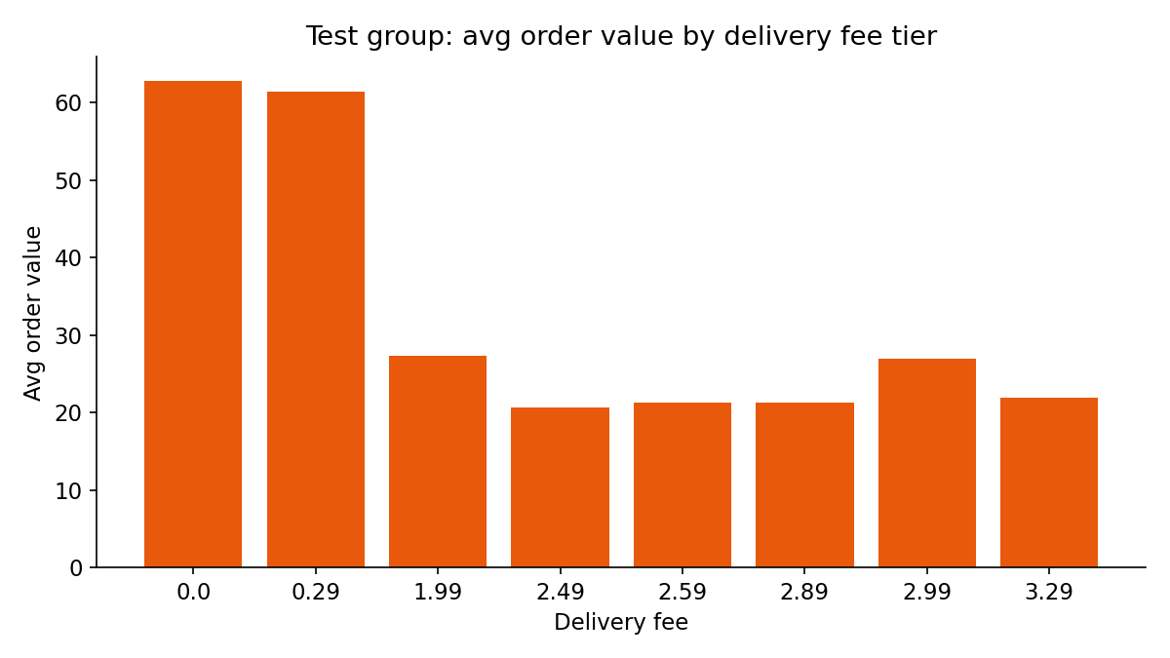
Add Q5 and Q6: Order value, and fee vs order value
Is the AOV difference significant? Does the fee influence order value?
Additional
AOV difference +2.58 (+8.8%) is significant: p < 0.001, CI 1.88 to 3.28.
In Test, fee and order value are strongly negatively related (Spearman -0.57): free orders average 62.7 vs 22.2 for paid.
Part of this is the rule itself (free from 33). The behaviour part shows in the mix: orders of 33+ went from 27.6% to 34.1%.
Control fee never changes, so its effect cannot be measured.
Aditya Anil Gaikwad | Newton School, Data Analytics | EDA 2: Pricing A/B Test
19

Slide 20
Add Q7: Variance of order value, Control vs Test
Is variance greater in Control or Test, and what does it say about consistency?
Additional
Measure | Control | Test
Standard deviation | 23.11 | 24.67
Variance | 534 | 609
Coefficient of variation | 0.79 | 0.77
Middle 50% range (IQR) | 20.70 | 29.33
95th percentile | 72.99 | 68.47
Levene test p-value | 0.002
Test has the larger variance and a wider middle.
Relative spread and tail are about the same, so consistency is similar.
Forecasting revenue is slightly harder in Test, not materially.
Aditya Anil Gaikwad | Newton School, Data Analytics | EDA 2: Pricing A/B Test
20

Slide 21
Why Test works: the free-delivery threshold at 33
Insight
Large baskets: 47% more orders, 13% less revenue per order, 28% more total revenue.
Small baskets: 8% more orders, 7% more revenue per order, 16% more total revenue.
Both halves of the design help.
Aditya Anil Gaikwad | Newton School, Data Analytics | EDA 2: Pricing A/B Test
21

Slide 22
Recommendation
Conclusion
1
Adopt the tiered fee
Free delivery from about 33; roughly 2.49 to 2.89 below it.
2
Do not push 3.29 broadly yet
That tier appears mainly at 20:00 and 21:00, and no tier-level demand test was run.
3
Fix the weak hours
Test lost revenue at 14:00, 17:00 and 19:00. Review fee or promotion there.
4
Run a follow-up multi-arm test
Thresholds 25, 33, 40 and small-basket fees 2.29, 2.49, 2.89, randomised by customer.
Aditya Anil Gaikwad | Newton School, Data Analytics | EDA 2: Pricing A/B Test
22

Slide 23
Limitations and checks before roll-out
Conclusion
Traffic split
Short, tidy data
Test has 19% more orders and the file has no visitor counts.
Confirm both groups got similar traffic; otherwise compare conversion per visitor.
One month only.
Daily order counts repeat weekly from 7 July, so daily p-values are optimistic.
Revenue is not profit
No randomisation inside Test
No courier cost in the data.
More orders with free delivery may raise cost per order.
Fee tier depends on basket size and hour.
No causal elasticity for a single tier. Watch for novelty effect over 4 to 8 weeks.
Aditya Anil Gaikwad | Newton School, Data Analytics | EDA 2: Pricing A/B Test
23

Slide 24
Conclusion
Conclusion
Test fee set-up: +18.7% orders, +21.3% total revenue, +2.1% revenue per order (p = 0.008).
Free delivery above 33 pulls in large baskets; a slightly higher fee on small baskets protects revenue.
Average order value rose 8.8%, but through basket mix, not bigger baskets.
Effect differs by hour: strong at 8, 16, 18, 20; weak at 14, 17, 19.
Recommendation: roll out the tiered fee after confirming the traffic split, then fine-tune with a multi-arm test.
Aditya Anil Gaikwad | Newton School, Data Analytics | EDA 2: Pricing A/B Test
24

Slide 25
Thank you
Aditya Anil Gaikwad
Newton School, Data Analytics | EDA 2: Pricing A/B Test

