Slide 1



Excel and VBA for Chemical Engineers
Presented by: Aditya ganesh
Joint ph.d. student
Iitb–monash research academy
EMAIL: 22D2017@iitb.ac.in
WEBSITE: sites.google.com/view/aditya-ganesh

Slide 2
About myself
B.E. (ChE) from TSEC (2016–2020)
M.Tech. (ChE) from IIT Jodhpur (2020–2022)
Joint Ph.D. (ChE/Mech & Aero) from IITB-Monash Research Academy (2022-present)

Slide 3
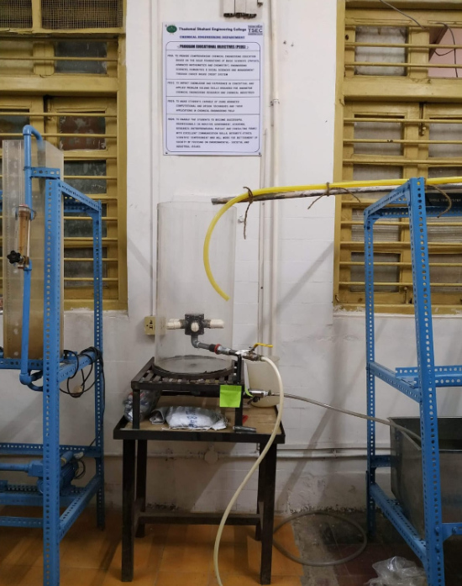
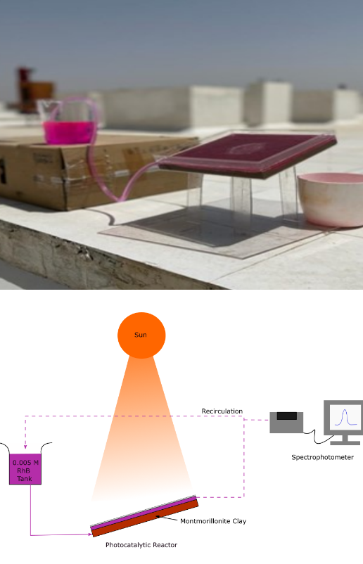

My projects
Slurry Bubble Column Reactor
Photocatalytic Reactor
Heat Exchanger Network Simulator

Slide 4
Basic Requirements for this course
Any version of MS Excel (I will be using version 2405)
Operating system: Windows 10 and above, MacOS, not available for Linux
Google spreadsheets are of no use in this course. Several features are not available (Solver, iterators, VBA, etc.)

Slide 5
Basic Requirements for this course
Any version of MS Excel (I will be using version 2405)
Operating system: Windows 10 and above, MacOS, not available for Linux
Google spreadsheets are of no use in this course. Several features are not available (Solver, iterators, VBA, etc.)
Your attention!!!

Slide 6
About the course
Meant for: Undergraduate students
Every Sat-Sun till the first week of July (11 a.m.-3 p.m.)
Attendance is compulsory for receiving the certificate
A final individual project will be given
For any doubts, you can email me or write in teams.

Slide 7
MS Excel setup
Lets open MS Excel!

Slide 8
Problem 1: Conversion formulae
You have taken admission in the US for doing your masters. Here, you find that all the temperature units used in this country are in Fahrenheit (F). You are supposed to solve a problem in SI units (convert F to Kelvin), and you don’t remember the formula properly. You are not able to Google the answer as you don’t have an internet connection with you. Use MS Excel to your advantage.
Check: C vs F
Then C vs K
And finally F vs K

Slide 9


Problem 2: Find the roots of an equation
The ideal gas law can represent the pressure-volume-temperature (PVT) relationship of gases only at low (near atmospheric) pressures. For higher pressures more complex equations of state should be used. The calculation of the molar volume and the compressibility factor using complex equations of state typically requires a numerical solution when the pressure and temperature are specified. The van der Waals equation of state is given by:

Slide 10

Problem 2: Find the roots of an equation
The variables are defined by
P = pressure in atm
V = molar volume in liters/g-mol
T = temperature in K
R = gas constant (R = 0.08206 atm.liter/g-mol.K)
T_{c} = critical temperature (405.5 K for ammonia)
P_{c} = critical pressure (111.3 atm for ammonia)

Slide 11
Problem 2: Find the roots of an equation
(a) Calculate the molar volume and compressibility factor for gaseous ammonia at a pressure
P = 56 atm and a temperature T = 450 K using the van der Waals equation of state.
(b) Repeat the calculations for the following reduced pressures: P_{r} = 1, 2, 4, 10, and 20.
(c) How does the compressibility factor vary as a function of P_{r}.?

