Slide 1


Slide 2


ONLINE MOVIE BOOKING
Group 8:
Group members:
S AdityaGanesh 1215316252
D Pavan Kalyan 1215316209
Dheeraz Kishore 1215316260
B Sasi Pavan 1215316204

Slide 3
Abstract
This project is aimed at developing an online ticket reservation system for a Cinema Hall. The Ticket Reservation System is an Internet based application that can be accessed throughout the Net and can be accessed by anyone who has a net connection. This application is used to book tickets through internet. The System provides complete information regarding currently running movies on all the screens with details of show timings, available seats and fare charges of different classes. Seats can be reserved for different classes as well for same show and screen also. Our online tickets reservation system is one of the best opportunities for those who cannot afford enough time to get their tickets reserved standing in long queues. People can book tickets online at any time of day or night.

Slide 4
GOALS
To provide a anytime anyplace service for the customer
To minimize the number of staff at the ticket box
To promote the film the film on the internet
To increase the profit.
Reduce waiting time for booking tickets.

Slide 5
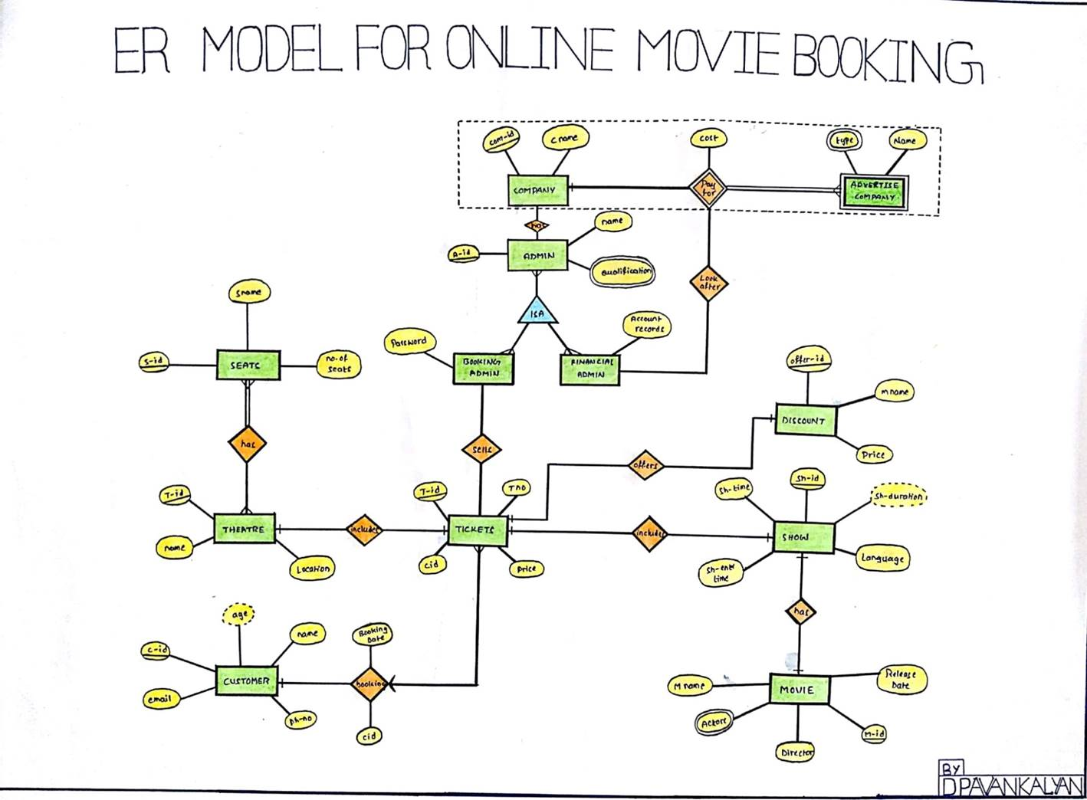

Slide 6
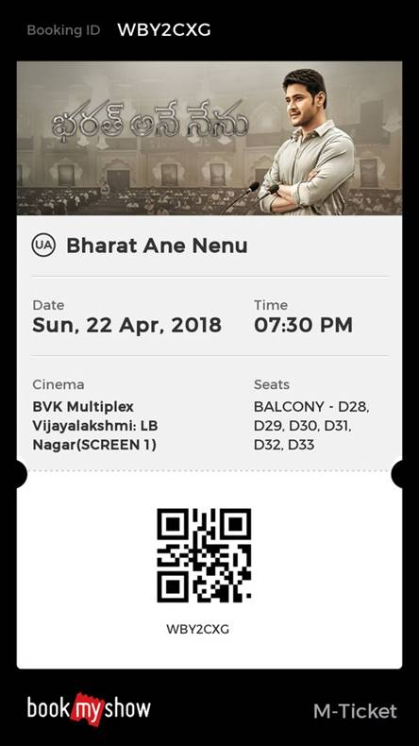

Ticket Consists of:
1.Movie Name
2.Theatre Name
3.Date and Time
4.Booking Id
5.Seat Names

Slide 7
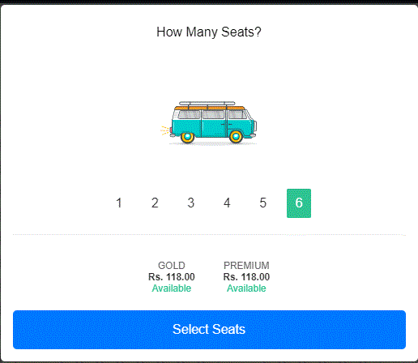

Slide 8
Requirements
Location based selection Choice based selection

Slide 9
Ratings of the movie should be given
Users should be notified about the availability of tickets.

Slide 10
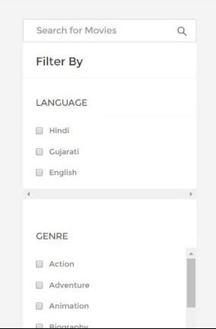
 filter the selection according to
their choices.
Users should be notified about the age restriction.

Slide 11
Features of our project
User-friendly Design.
Location Based Movie Search.
Top trending Movies List.
Now showing and upcoming movies list.

Slide 12
Users can view the trailers of the currently running movies.
Filter for better movie search.
Secured and integrated Payment gateway.
Provision for selecting your favourite seat.

Slide 13
Conclusion
Online movie ticket booking system enables a customer to check availability of seats in the theatre
and enable customer to book tickets online .It makes a customer easy to get movie tickets online instead of queue up to buy the movie tickets

