Slide 1
ACEI-HACKATHON5.0

Slide 2
Problem Statement
Planning postings for doctors and sisters in the outpatient department is a recurrent challenge due to uneven distribution of patients during different days of week and even different hours of the day especially on high volume days. This leads to long waiting time for the patients.

Slide 3
Our Aim
  Our team is trying to use ML to solve this problem by coming up with a system that updates waiting time for patients and displays it on the website real-time, based on the arrival of patients in the hospital. This will help the patient make an informed decision regarding his hospital visit.

Slide 4
Data used
5 year data of total number of patients.
1 year data with monthly,weekly and day to day total patient load in new and review opd.
Predicted and actual patients data for 1.5 years.
Day wise analysis of 1-month data.
Arrival pattern for patients for a week.
1 week data analysing duration between different stations like Registration, clinic in-time, refraction, investigation and doctor examination.

Slide 5
Variation on different days in a week
 | Percentage of OP for each day in a week in Unit 3
Monday | 17
Tuesday | 15
Wednesday | 14
Thursday | 14
Friday | 17
Saturday | 24

Slide 6
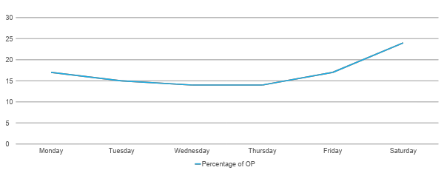
Variation on different days in a week

Slide 7
Variation during different hours in a day
 | Percentage of OP for each hour of a day
7 AM – 8 AM | 8
8 AM – 9 AM | 10
9 AM – 10 AM | 11
10 AM – 11 AM | 15
11 AM – 12 PM | 17
12 PM – 1 PM | 13
1 PM – 2 PM | 8
2 PM – 3 PM | 6
3 PM – 4 PM | 7
4 PM – 5 PM | 3
5 PM – 6 PM | 1

Slide 8
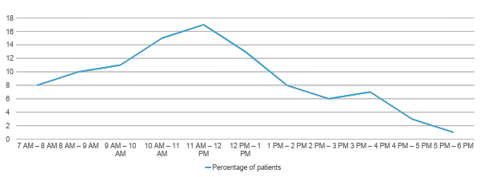
Variation during different hours in a day in Unit 3

Slide 9
Team of doctors available
Senior MO
Junior MO,
Fellow
POSTGRADUATE

Slide 10
Our proposed solution
Creating an ML model to predict average waiting time which can be displayed at the reception display which can also be integrated with the existing systems in order to recommend less hectic time to the patients.
Allocating less work loaded doctors to a crowded section of the hospital based on the skills he/she has which could ease the flow of work.

Slide 11
Predicting the Average wait time
🡪Telling the average waiting time to the patients helps them plan their next visit during the less hectic period of the day or less hectic day of the month
🡪helps to organize and distribute the cases uniformly over all the days,reducing the chaos during the peak hours

Slide 12
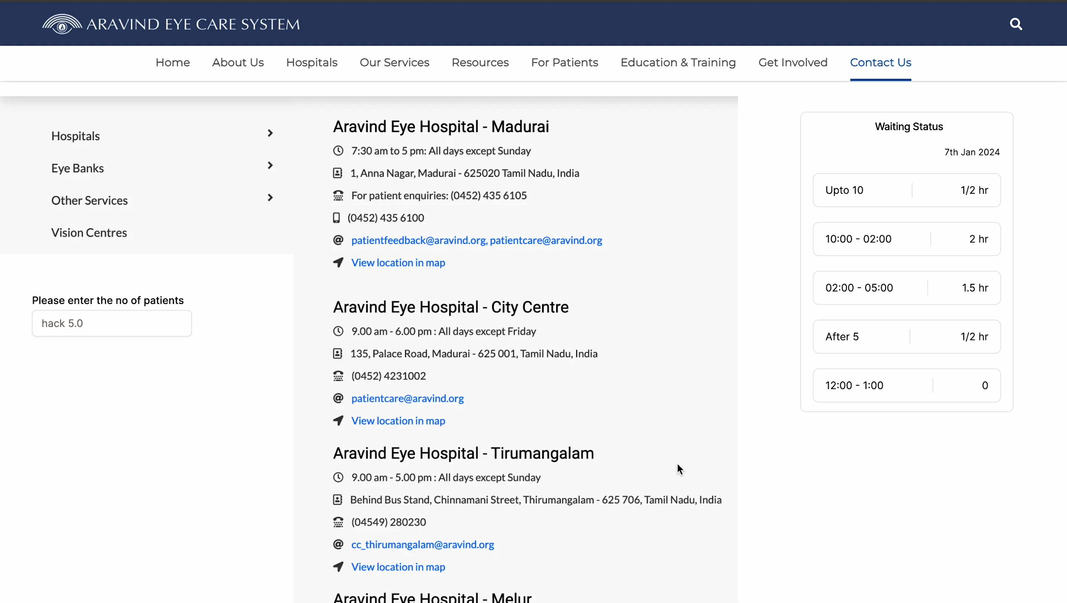
Demo video

Slide 13
About the arima model

Slide 14
Recommending allocation of doctors to the overloaded sections of the hospital based on their matching skill
Data used to create the model
🡪Doctors speciality : skills & speciality,experience level & seniority
🡪Emergency or routine cases : allocate senior or junior doctors respectively

Slide 15
Model creation snippet

Slide 16
Breaking down the model
🡪using tensorflow/keras models
🡪training and testing the model based on the parameters
🡪testing and tuning the weights and parameters
🡪displaying the recommended section of the hospital

Slide 17
Basic frontend snippet

Slide 18
Future Enhancements
INTEGER PROGRAMMING
There are many ML algorithms like Supervised Learning Algorithms (Decision Trees and Random Forests), Unsupervised Learning Algorithms (Clustering Algorithms (like K-Means)), Reinforcement Learning, Optimization Algorithms.
Integer Programming: Although not strictly machine learning algorithms, they can be highly effective in allocating resources under constraints.
Weighted Sum Model: It’s a method used to handle problems with multiple objectives. In this model, each objective is given a weight to signify its importance, and these weighted objectives are summed to form a single composite objective. This method is used to simplify a multi-objective problem into a single-objective problem by combining the various objectives into one.

