Slide 1



Slide 2

Cross border Platform made easy

Slide 3
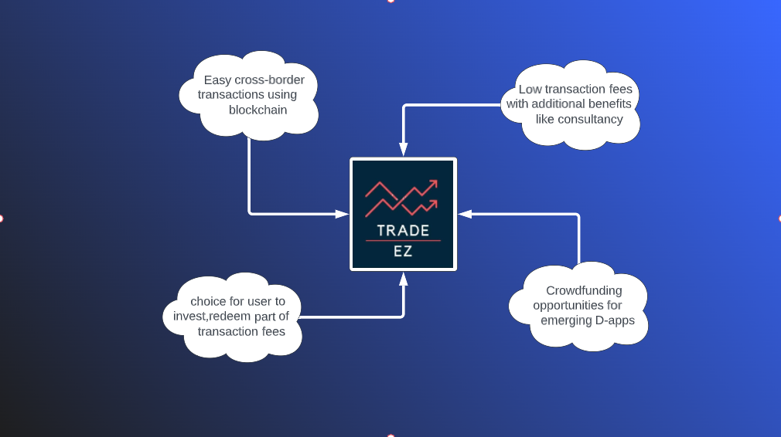

Slide 4
What does TradeEZ do?
Deploy own ERC20 Token.
Easy Cross Border Payments.
Provides very low gas fees.
Peer to Peer transactions.
Crowdfunding for emerging projects and Decentralized Applications.
Provides Consultancy for cryptocurrency trading with additional features.

Slide 5

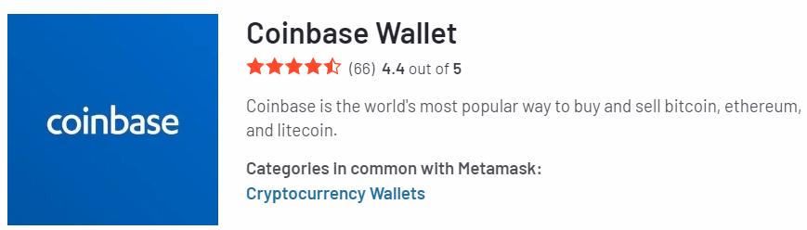

Metamask and alternatives

