Slide 1



N E T F L I X A N A L Y T I C S
Netflix Subscriber
Churn Analysis
Behind every cancel button — what does the data really say?
EXPLORATORY DATA ANALYSIS PROJECT
Presented by: Aditya Gavali
LinkedIn
GitHub
Netflix_Churn_Prediction.csv • pandas · numpy · matplotlib · seaborn

Slide 2
Problem Statement & Objective
PROBLEM
OBJECTIVE
Subscriber churn is one of the biggest revenue risks for a streaming platform. Without a clear, structured view of how usage and engagement relate to cancellations, retention efforts stay reactive instead of data-driven.
Clean and explore the subscriber dataset to uncover patterns in age, tenure, watch hours, login frequency, plan type, device, and satisfaction — and identify which behaviors are most closely linked to churn, to support smarter retention decisions.
02

Slide 3
Dataset Snapshot
Netflix_Churn_Prediction.csv — raw, uncleaned export
1,200
9
24
1,176
Raw Rows
Columns
Duplicate Rows
Rows After De-dup
Columns in the raw file
• Customer_ID
• Age
• Tenure_Months
• Watch_Hours
• Login_Frequency
• Plan
• Device
• Satisfaction_Score
• Churn
Every column arrived as messy text — mixed units, stray labels, and out-of-range codes had to be parsed before analysis could begin.
03

Slide 4
Data Quality Check
Missing values by column, before cleaning
Column | Missing | % Missing
Watch_Hours | 66 | 5.50%
Satisfaction_Score | 58 | 4.83%
Login_Frequency | 55 | 4.58%
Tenure_Months | 51 | 4.25%
Device | 47 | 3.92%
Age | 46 | 3.83%
Plan | 41 | 3.42%
Churn | 25 | 2.08%
Customer_ID | 0 | 0.00%
Every column had gaps — this is normal for a scraped / self-reported dataset, but each needed a deliberate imputation strategy.
24
exact duplicate rows
found and dropped
Rows: 1,200 → 1,176 after removing duplicates
04

Slide 5
Data Cleaning Approach
Column-by-column, before any analysis
1
Age / Tenure / Watch Hours / Login Frequency
2
Invalid values → NaN → Median
Extracted numbers out of text (e.g. "56 years" → 56) with regex, then cast to float.
Ages like 0 or 150, tenure > 60 months, and logins > 50/day were flagged as invalid and replaced with the column median.
3
Outlier capping (IQR)
4
Plan / Device text standardization
Watch_Hours values above the upper whisker (105.9) were capped instead of dropped, preserving row count.
Trimmed spaces, lower-cased, removed the word "plan", mapped synonyms (e.g. "tab"/"tablet" → Tablet), then title-cased.
5
Churn label normalization
6
Categorical nulls → Mode
Collapsed "yes/1/y/churned" → Yes and "no/n/active/0" → No into one consistent Yes/No field.
Plan, Device, and Churn missing values were filled with the most frequent category.
05

Slide 6
Before vs. After Cleaning
The same five rows, raw export vs. cleaned dataset
RAW · BEFORE CLEANING
Customer_ID | Age | Tenure | Watch_Hrs | Logins | Plan | Device | Score | Churn
NF100001 | 56 | 23 | 6.4 | 2 | Premium | MOBILE | 4 | no
NF100002 | 69 | 15 | 46.0 | 26 | Premium | Mobile | 4 | No
NF100003 | 46 | 33 | 49.9 | 25 | Standard | Laptop | 3 | 1
NF100006 | 25 | 33 | 25.0 | 8 | Basic | Mobile | 2 | N
NF100008 | 56 years | 55 | 33.7 | 12 | PREMIUM | Tablet | 3 | No
CLEANED · AFTER PROCESSING
Customer_ID | Age | Tenure | Watch_Hrs | Logins | Plan | Device | Score | Churn
NF100001 | 56.0 | 23.0 | 6.4 | 2.0 | Premium | Mobile | 4.0 | No
NF100002 | 69.0 | 15.0 | 46.0 | 26.0 | Premium | Mobile | 4.0 | No
NF100003 | 46.0 | 33.0 | 49.9 | 25.0 | Standard | Laptop | 3.0 | Yes
NF100006 | 25.0 | 33.0 | 25.0 | 8.0 | Basic | Mobile | 2.0 | No
NF100008 | 56.0 | 55.0 | 33.7 | 12.0 | Premium | Tablet | 3.0 | No
Text units, casing, and stray labels are gone — every value is now a clean, analysis-ready type.
06

Slide 7
Duplicate Records
Exact duplicate rows found in the raw export and removed during cleaning
SAMPLE DUPLICATE PAIRS · IDENTICAL ACROSS ALL COLUMNS
Customer_ID | Age | Tenure | Watch_Hours | Login | Plan | Row
NF100065 | 64 | 47 | 35.5 | NaN | Basic | Original (row 64)
NF100065 | 64 | 47 | 35.5 | NaN | Basic | Duplicate (row 1170)
NF100085 | 48 | 6 | 61.2 | 16 | Basic | Original (row 84)
NF100085 | 48 | 6 | 61.2 | 16 | Basic | Duplicate (row 1162)
NF100331 | 42 | 52 | 38.9 | 20 | Standard | Original (row 330)
NF100331 | 42 | 52 | 38.9 | 20 | Standard | Duplicate (row 1163)
NF100360 | 55 | 4 | 47.1 | 17 | Standard | Original (row 359)
NF100360 | 55 | 4 | 47.1 | 17 | Standard | Duplicate (row 1159)
24
exact duplicate rows found
1,200 → 1,176
rows after dropping duplicates
Left in, these copies would double-count subscribers and skew every churn rate and average, so each was dropped and the first occurrence kept.
Separately, 20 Customer_IDs appear twice with different details. They are not exact copies, so they were kept as distinct records.
07

Slide 8
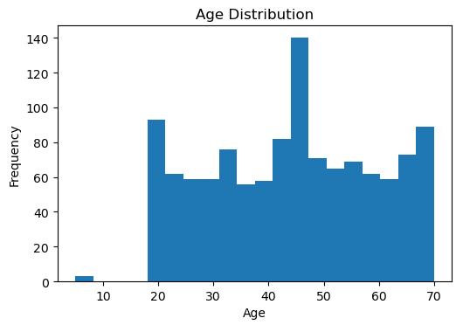
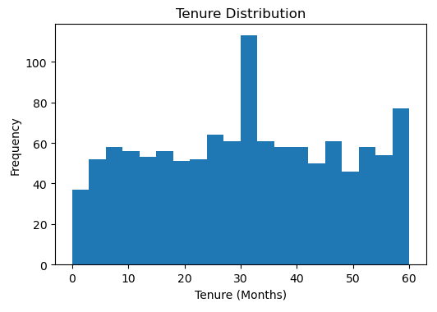
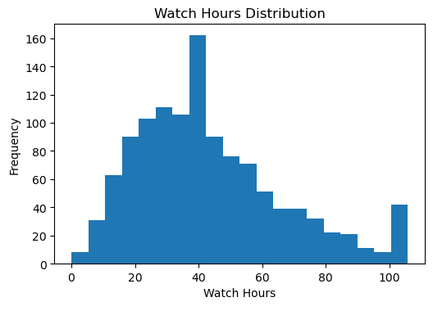
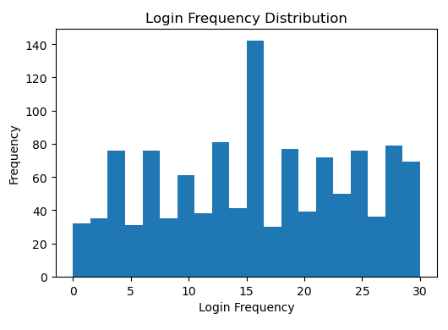
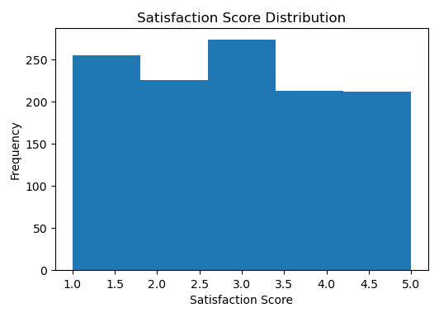
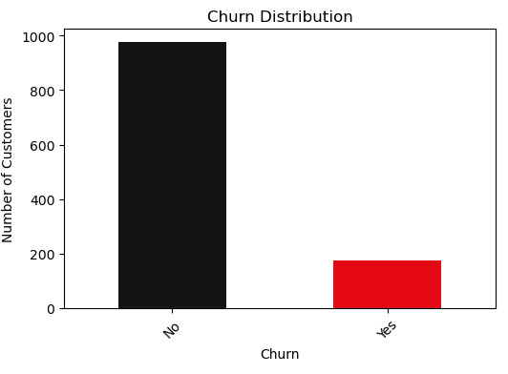
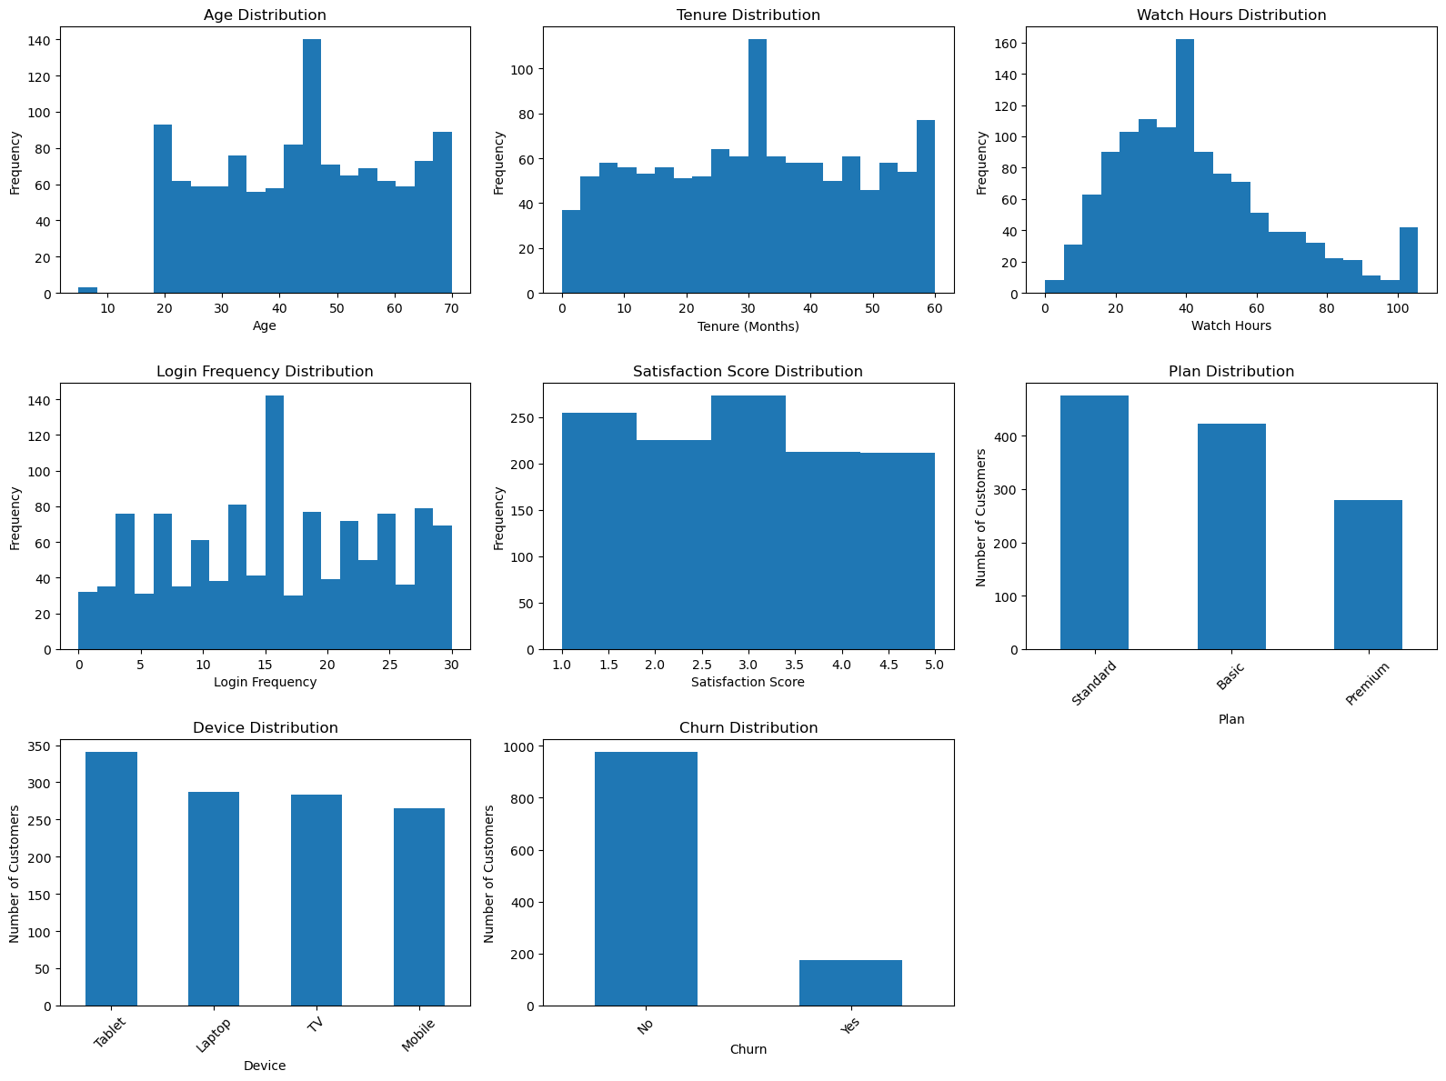
Univariate Analysis — Numerical
Distribution of the numerical features, plus the target variable (Churn)
Key insights
Age and tenure are spread evenly across subscribers; watch hours are right-skewed and satisfaction is spread evenly from 1 to 5.
Churn, the target column, is imbalanced: 977 subscribers stayed vs 175 who left (15.2%).
08

Slide 9
Univariate Analysis — Categorical
Subscription plan and device mix
Standard is the largest plan (475 subscribers, ~40%), followed by Basic (422); Premium is the smallest tier at 279 (~24%).
Devices are evenly split: Tablet leads (341) and Mobile trails (265), so no single screen dominates.
09

Slide 10
Churn Overview
1,152 subscribers with a known churn status
15.2%
overall churn rate
175 of 1,152 subscribers left
977
subscribers retained
("No" churn label)
Only 15.2% churned (175 of 1,152), so retention is strong overall.
About 5.6 subscribers stay for every one who leaves.
24 rows had no valid churn label after cleaning and were excluded from churn-rate calculations.
10

Slide 11
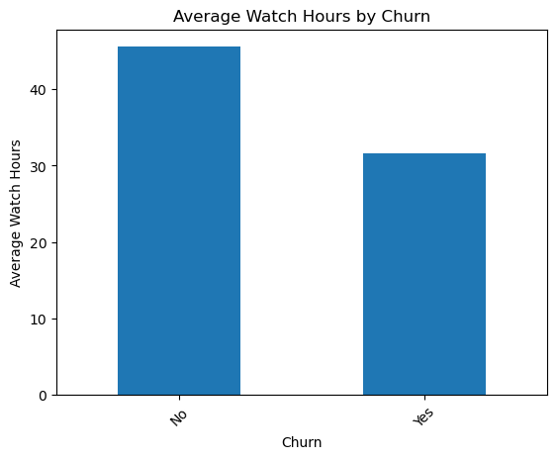
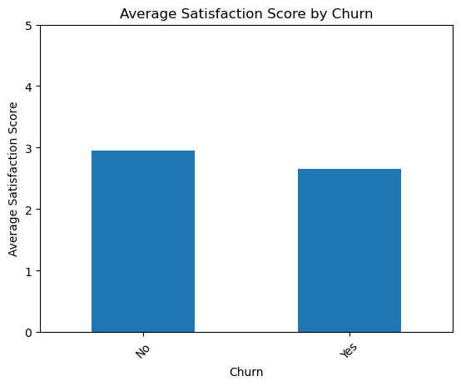
Bivariate Analysis — Key Churn Drivers
Average watch hours and satisfaction score, stayed vs. churned
Churned subscribers watch about 32 hours on average versus ~46 for retained ones, roughly 30% less viewing.
Satisfaction is also lower for churners (~2.7 vs ~3.0), though the gap is smaller than the watch-hours gap.
11

Slide 12
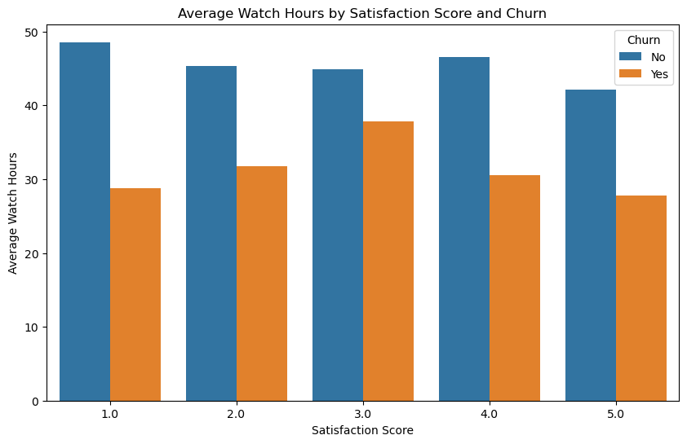
Multivariate Analysis
Average watch hours by satisfaction score and churn status
Key insights
At every satisfaction level, churned subscribers watch fewer hours (about 28–38 vs 42–49 for those who stay).
Even churners who rate the service 5 watch only ~28 hrs vs ~42, so low viewing signals risk whatever the rating.
12

Slide 13
Conclusion
Key takeaways from the exploratory analysis
Satisfaction score is the strongest behavioral signal — low ratings track closely with churn.
1
Engagement matters: churned subscribers watch far fewer hours and log in less often than those who stay.
2
Only 15.2% of subscribers with a known status churned — retention is strong, but concentrated risk pockets exist.
3
Data quality was a real challenge: every column needed text-parsing, outlier handling, or standardization before analysis.
4
13

Slide 14
Thank You
Questions & Discussion
LinkedIn
GitHub
Presented by: Aditya Gavali
14

