Slide 1
Capstone Project Machine Listening
Name: Aditya Gavankar
Bachelors of Technology in Data Science
Roll Number: J072

Slide 2
Overview
Evaluation of self-supervised representation learning in the time-frequency domain of machine listening for musical instrument recognition.

Slide 3
Motivation
Music does not have a lot of labelled data.
Annotating music demands a high level of domain specific expertise.
We want to investigate the effect of self-supervision in alleviating the need for human intervention in the design of convnets for machine listening.

Slide 4
Related Work
It uses Audio-Visual correspondence as cross-modal self-supervision to generate audio and visual embeddings. [1]
It introduces a pretext task to identify the ordering of scrambled pieces of an image, much like solving a jigsaw puzzle. [2]
It trains a classifier on videos to predict whether the video is playing forwards or backwards. [3]

Slide 5
Problem Definition
Define two pretext tasks that try to predict the spatial structure of audio clip spectrograms. Model learns useful representations by solving these tasks.
Downstream task: build a classifier that detects the presence of each instrument class in an audio clip.
Establish baseline performance by training a randomly initialized classifier and compare it with classifiers that utilize the learned representations.

Slide 6
Data
Pretext tasks use the Free Music Archive (FMA)[4] dataset. It includes 106,574 tracks of 30 seconds each by some 16,341 artists. FMA is an unlabelled dataset.
Downstream task is evaluated on OpenMIC-2018[5]. This dataset contains 20,000 tracks of 10s each. The samples are partially labeled for the presence or absence of 20 instrument classes.
MP3 files from the datasets are converted into dB-scaled spectrograms using Constant-Q Transform and amplitude-to-dB conversion.

Slide 7
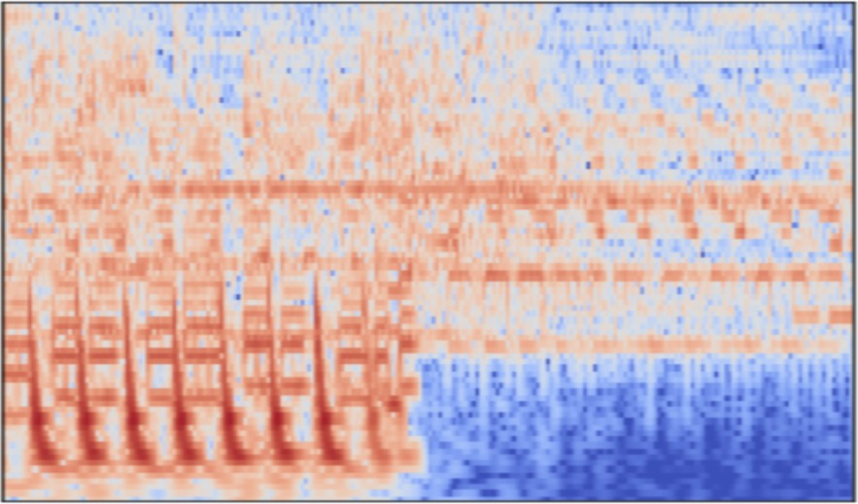
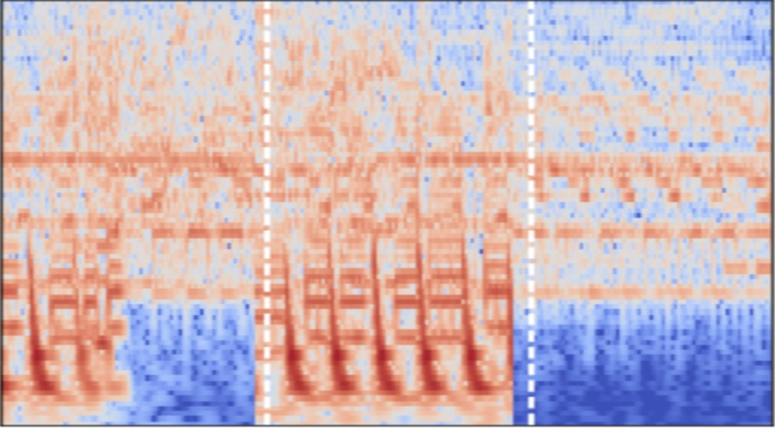
Pretext Tasks
Jigsaw: In this task, we split the spectrogram of an audio clip into three equal parts along the time axis. We shuffle these pieces randomly and train a classifier to predict whether the spectrogram is shuffled or not.

Slide 8
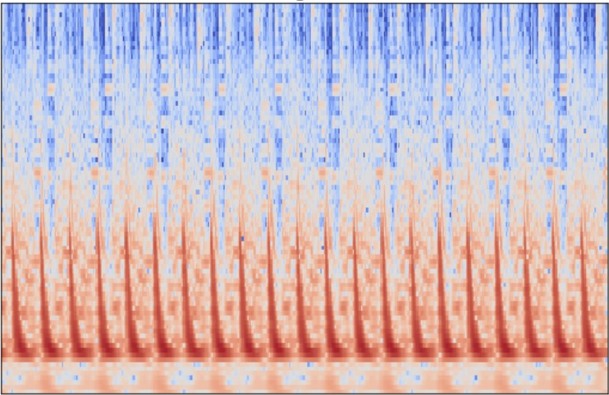
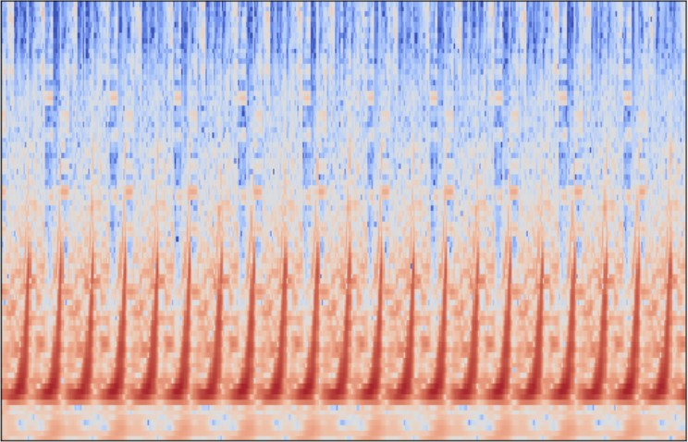
Time Reversal: In this task, we flip the spectrogram of an audio clip along the time axis. We then train a classifier to predict whether the spectrogram is flipped or not.

Slide 9
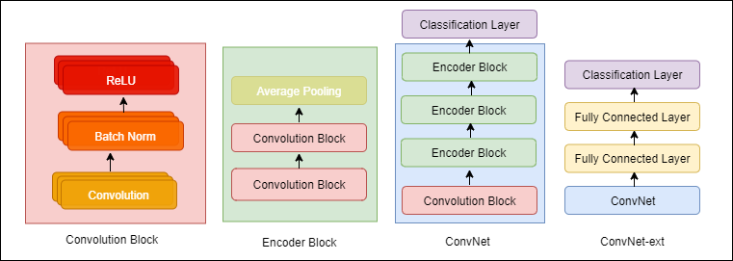
Model Architecture

Slide 10
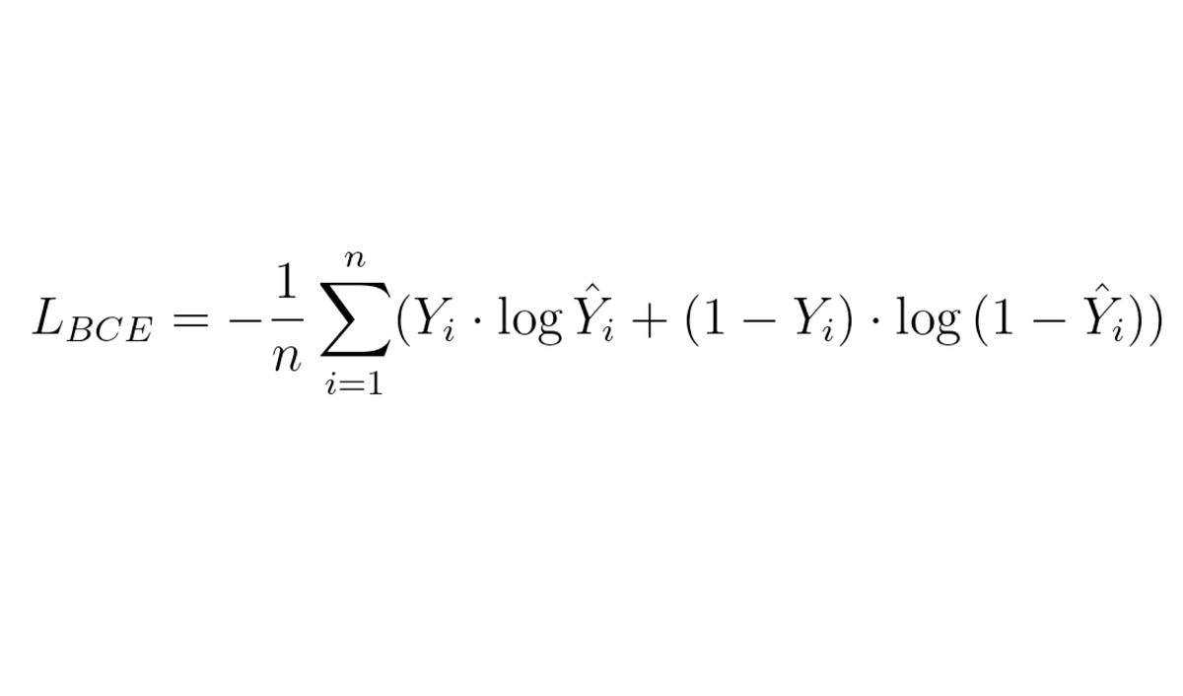
Evaluation and Loss Function

Slide 11
Experiments
Varying the amount data used for training pretext tasks
Varying audio clip length in pretext tasks
Varying Architectures Used
Varying initialization and training methods for the downstream task
Varying amount of labelled data used for training downstream

Slide 12
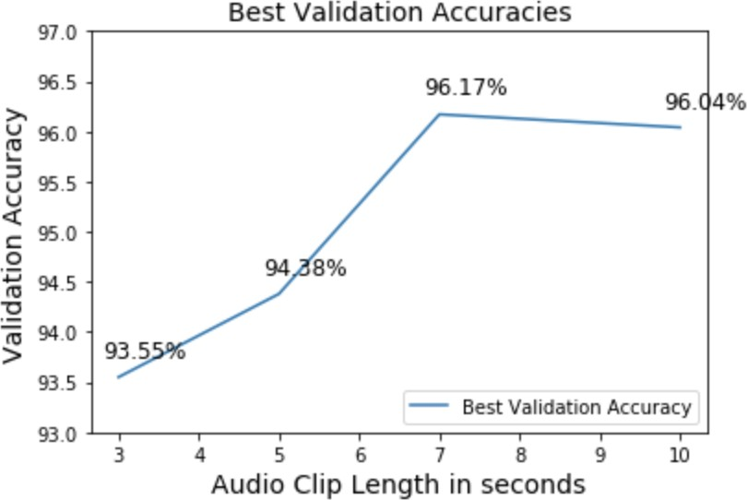
Pretext Experiment
Varying audio clip length in pretext tasks — Time Reversal

Slide 13
Varying audio clip length in pretext tasks — Jigsaw
We experimented with total clip lengths of 10s and 3s for the jigsaw task. Task always performed better in terms of accuracy for total clip length of 10s. This is also inline with our intuition about human performance. If we are given three clips of just one second each, it is hard for us to arrange them in order.

Slide 14
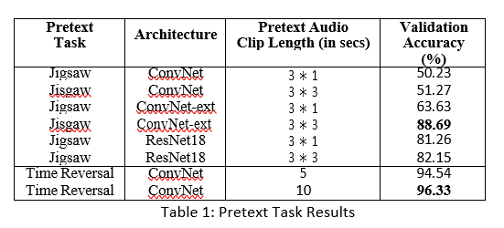
Pretext Results
We tried ConvNet-ext and ResNet only for the Jigsaw task because ConvNet achieved low accuracy.

Slide 15
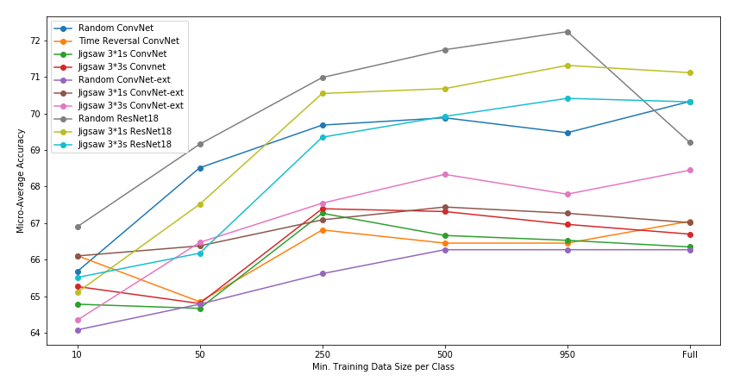
Downstream Experiments
Varying amount of labelled data used for training downstream
Performance after freezing weights from pretext models

Slide 16
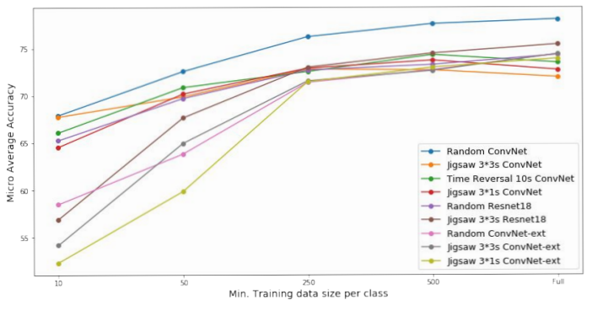
Performance after fine-tuning

Slide 17
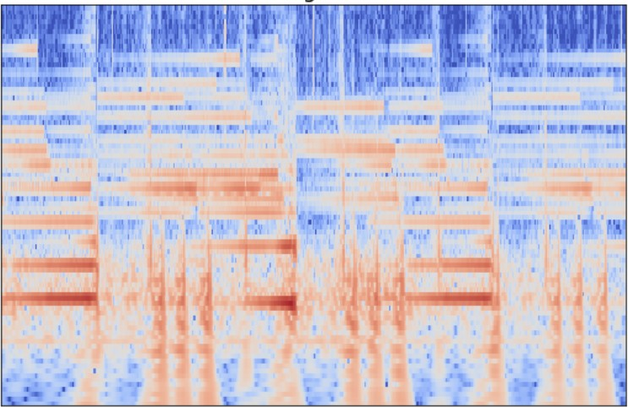
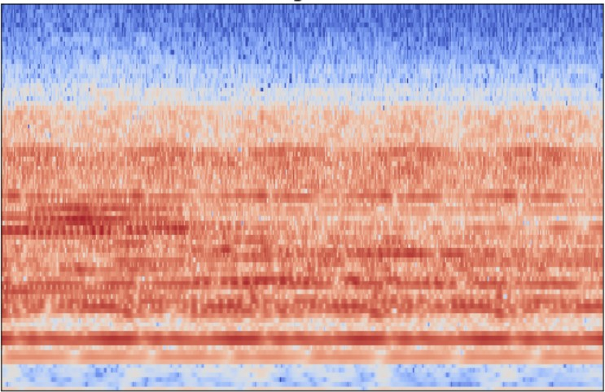
Error Analysis
Time Reversal: On analyzing the mistakes of our model, we found two interesting cases:
Model got confused by drone music
b) Model’s false negative was a track already in reversed state

Slide 18
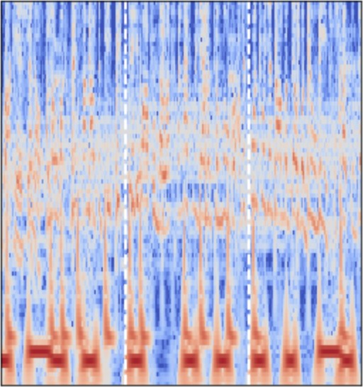
Jigsaw: We found that the musical pieces (c), where model was confused (prediction probability ~0.5) on whether the piece was jigsawed, were confusing even to a human listener.

Slide 19
Conclusion
Our pretext training does not reduce the need for labelled data.
It improves model performance (better than random) for ConvNet-ext and ResNet architectures after crossing the 250 labelled examples per class.
Prompts further research investigating different pretext tasks and alternative datasets to reduce necessity of labelled data.
Our pretext model is good at reasoning about sequence in a music clip. This is a new feature in music information retrieval.

Slide 20
Future Work
Pretext invariant representation learning
Contrastive Predictive Coding as a pretext task
Alternate direction would be to test our models and strategies on a bioacoustics dataset like BirdVox

Slide 21
Reference
[1] R. Arandjelovi and A. Zisserman. Objects that sound. ECCV 2018.
[2] Mehdi Noroozi and Paolo Favaro. Unsupervised Learning of Visual Representations by Solving Jigsaw Puzzles. ECCV 2016.
[3] Donglai Wei et al. Learning and Using the Arrow of Time. CVPR 2018.
[4] Free Music Archive: https://www.freemusicarchive.org
[5] Humphrey, Durand and McFee. OpenMIC-2018. ISMIR 2018

Slide 22
Thank You

