Slide 1

Machine Learning Project Finding Donors for Charity
By: Aditya Gavankar (J072)

Slide 2
Introduction
In this project, we will test out several supervised algorithms to accurately model individuals' income using data collected from the 1994 U.S. Census. The dataset for this project originates from the UCI Machine Learning Repository.
We will then choose the best candidate algorithm from preliminary results and further optimize this algorithm to best model the data.
Our goal with this implementation is to construct a model that accurately predicts whether an individual makes more than $50,000.
This sort of task can arise in a non-profit setting, where organizations survive on donations.
Understanding an individual's income can help a non-profit better understand how large of a donation to request, or whether or not they should reach out to begin with.
While it can be difficult to determine an individual's general income bracket directly from public sources, we can infer this value from other publicly available features.

Slide 3
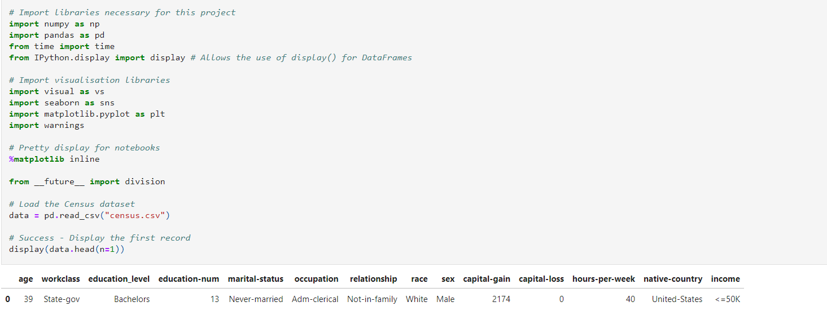
Exploring the data
Let's start with importing the necessary libraries, reading in the data, and checking out the dataset.
The last column from this dataset, 'income', will be our target label (whether an individual makes more than, or at most, $50,000 annually). All other columns are features about each individual in the census database.

Slide 4
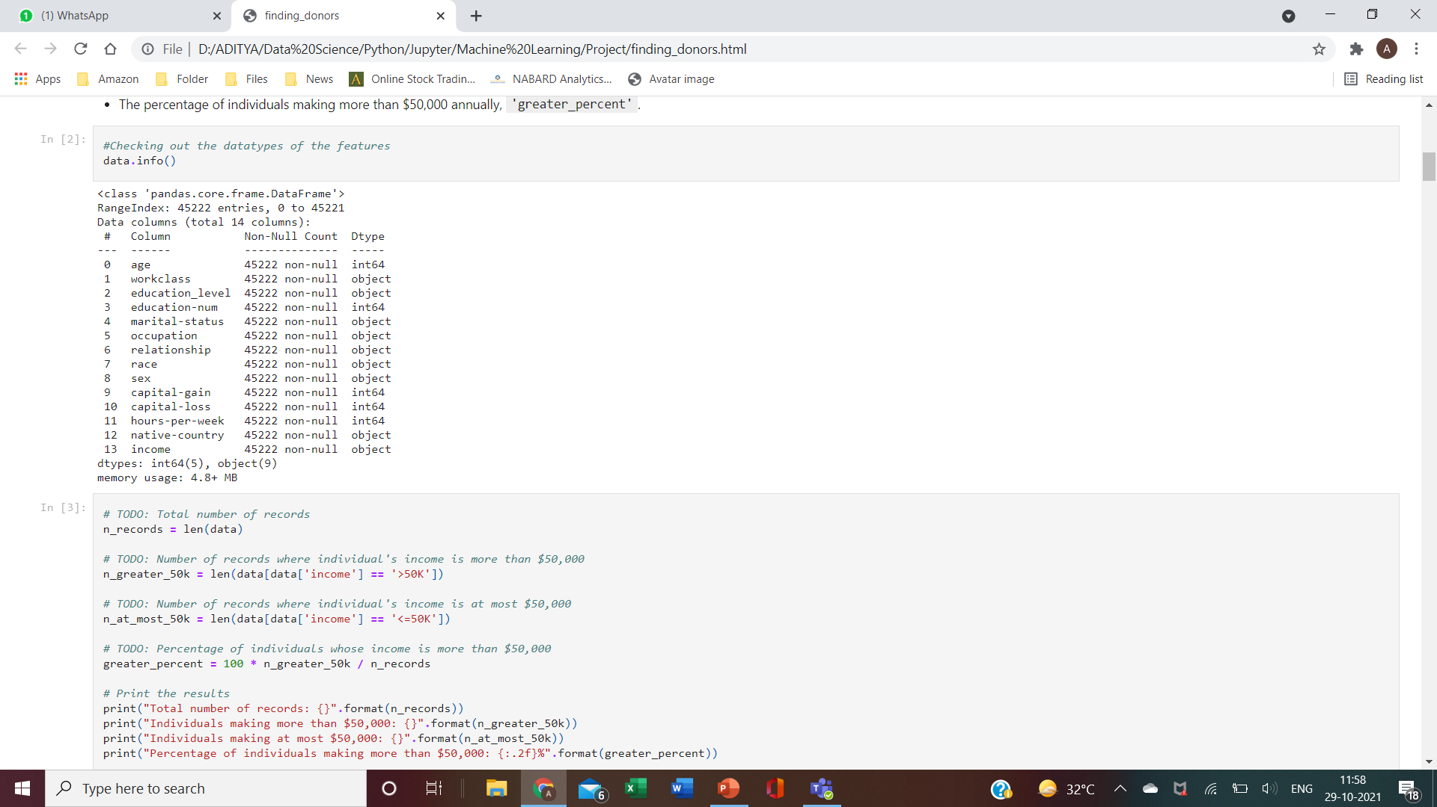
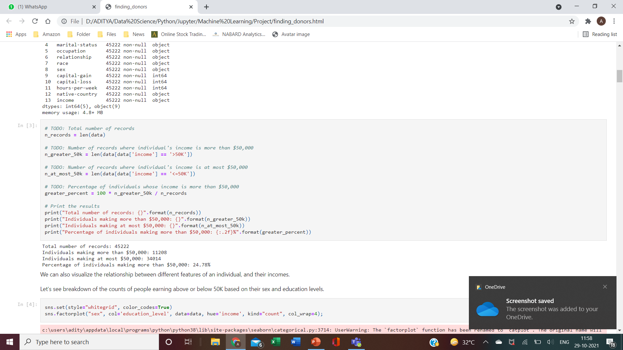
A simple investigation of the dataset can determine how many individuals fit into either group, and tell us about the percentage of these individuals making more than $50,000.
Let's take a look at the following:
- The total number of records, 'n_records’
- The number of individuals making more than $50,000 annually, 'n_greater_50k’.
- The number of individuals making at most $50,000 annually, 'n_at_most_50k’.
- The percentage of individuals making more than $50,000 annually, 'greater_percent'.

Slide 5
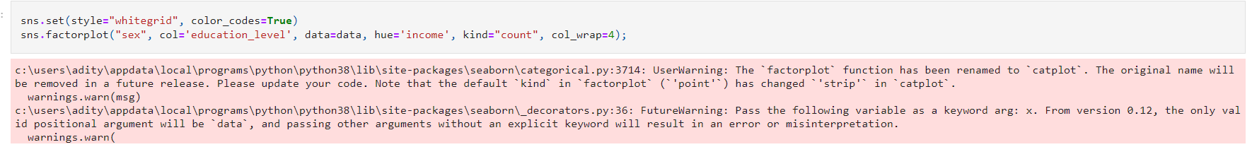
Data visualization
We can also visualize the relationship between different features of an individual, and their incomes.
Let's see breakdown of the counts of people earning above or below 50K based on their sex and education levels.

Slide 6
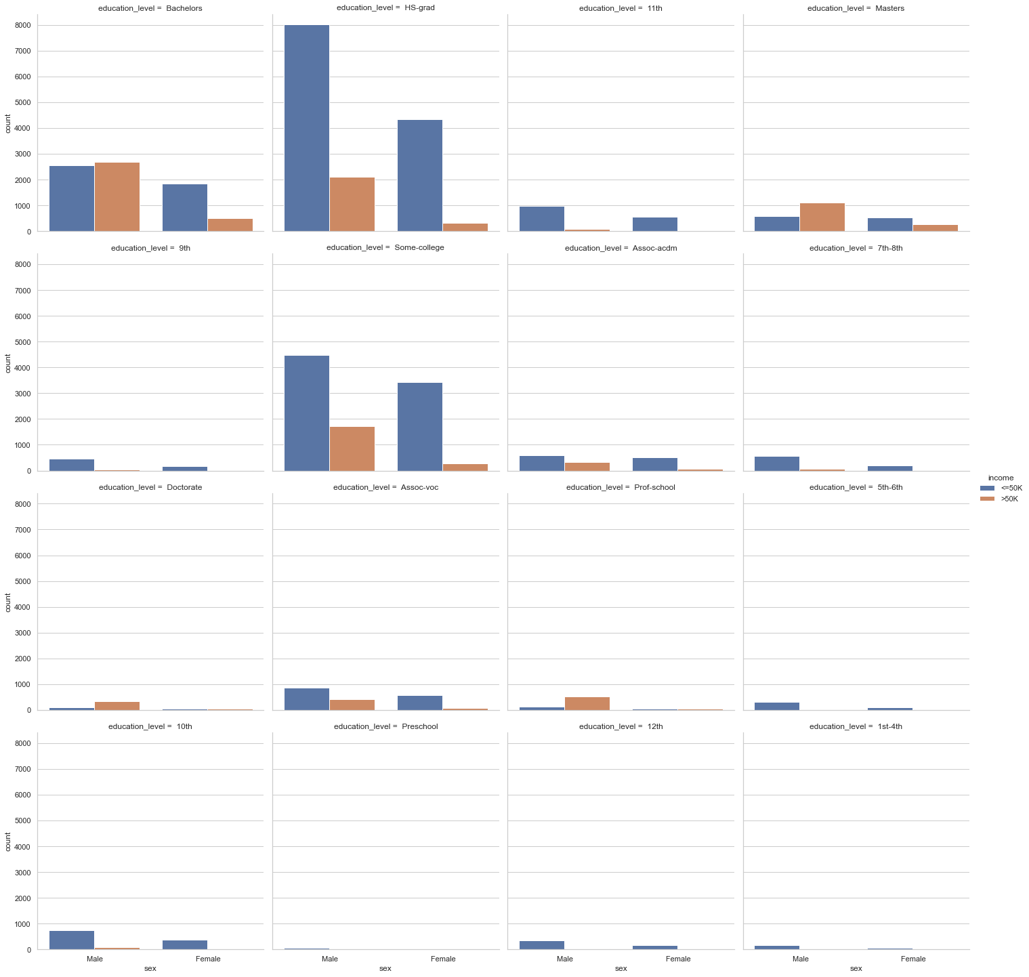

Slide 7
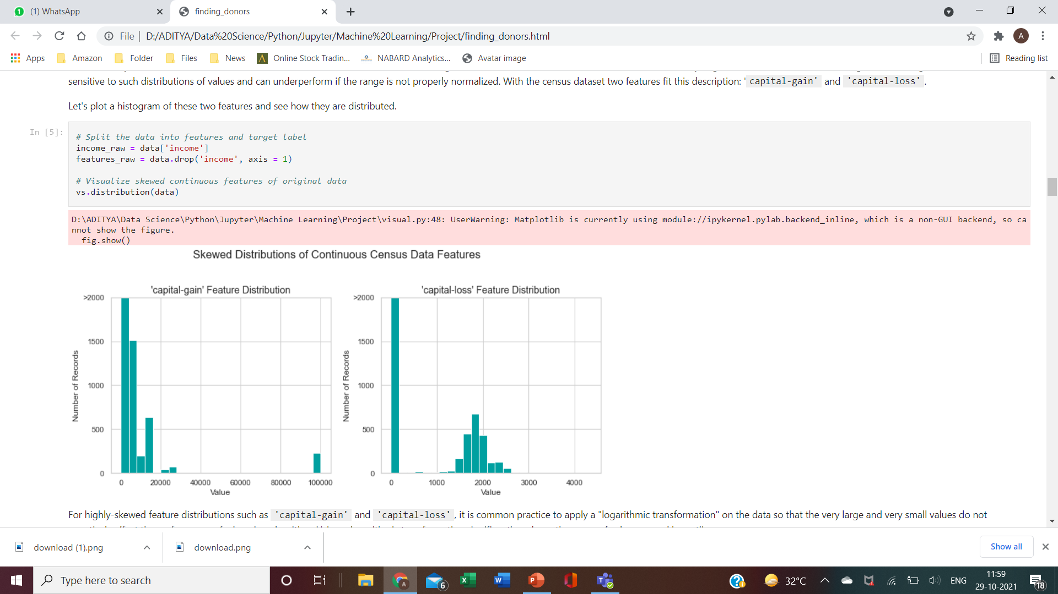
Preparation of the data
For this dataset, there are no invalid or missing entries we must deal with, however, there are some qualities about certain features that must be adjusted.
Transforming Skewed Continuous Features: With the census dataset two features fit this description: 'capital-gain' and 'capital-loss'. Let's plot a histogram of these two features and see how they are distributed.

Slide 8
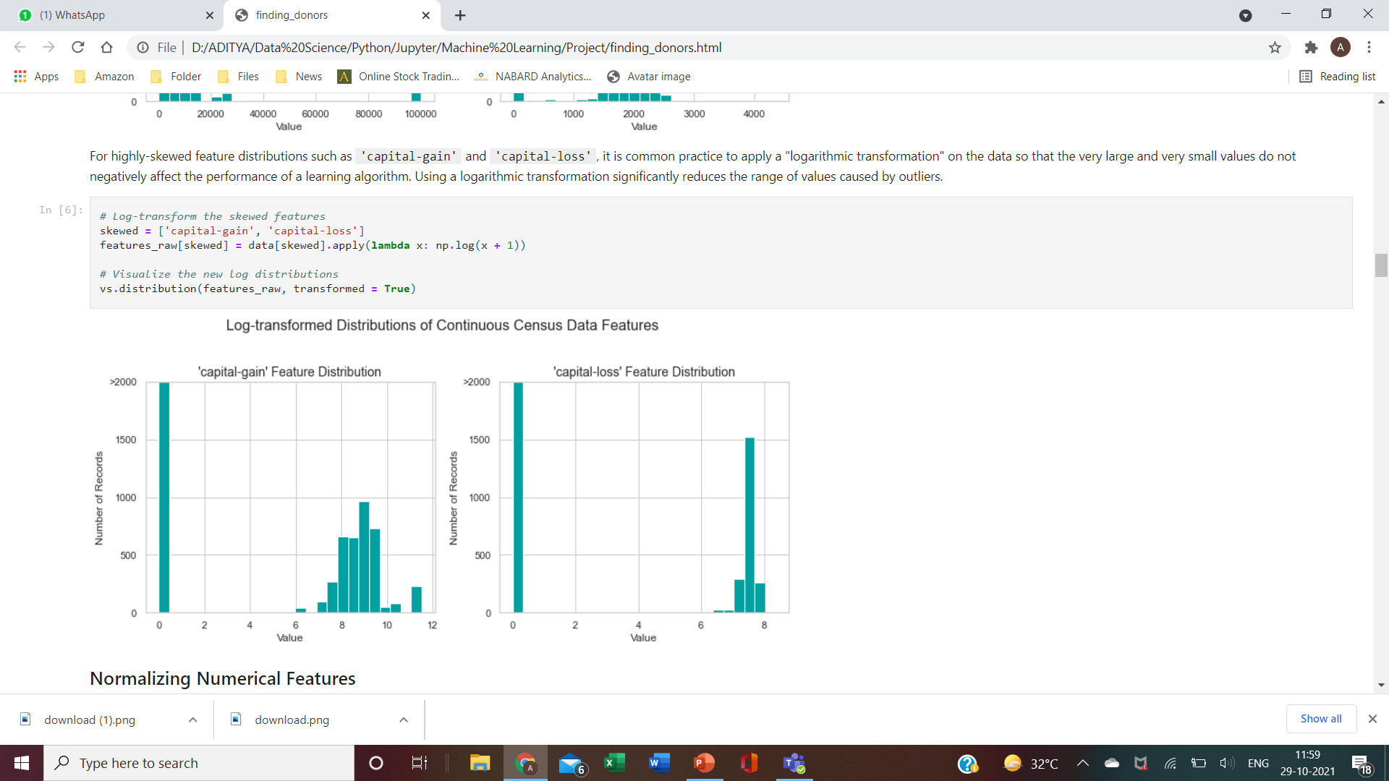
For highly-skewed feature distributions such as 'capital-gain' and 'capital-loss', it is common practice to apply a logarithmic transformation on the data so that the very large and very small values do not negatively affect the performance of a learning algorithm. Using a logarithmic transformation significantly reduces the range of values caused by outliers.

Slide 9
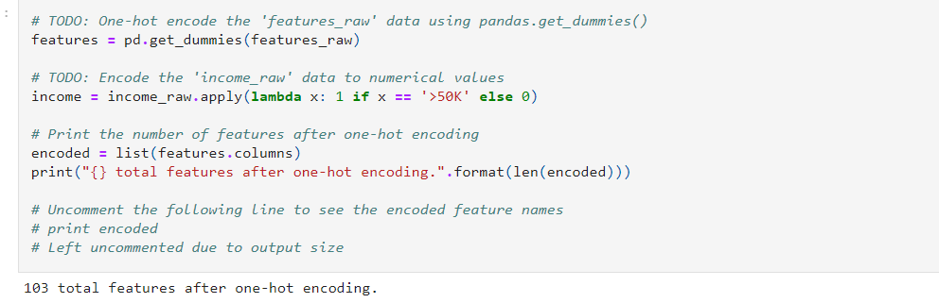
Data Preprocessing
From the given table, we can see there are several features for each record that are non-numeric. Typically, learning algorithms expect input to be numeric, which requires that non-numeric features (called categorical variables) be converted. One popular way to convert categorical variables is by using the one-hot encoding scheme. One-hot encoding creates a "dummy" variable for each possible category of each non-numeric feature.
Additionally, as with the non-numeric features, we need to convert the non-numeric target label, 'income' to numerical values for the learning algorithm to work. Since there are only two possible categories for this label ("<=50K" and ">50K"), we can avoid using one-hot encoding and simply encode these two categories as 0 and 1, respectively.

Slide 10

Shuffle and Split Data
Now all categorical variables have been converted into numerical features, and all numerical features have been normalized. As always, we will now split the data (both features and their labels) into training and test sets. 80% of the data will be used for training and 20% for testing.

Slide 11
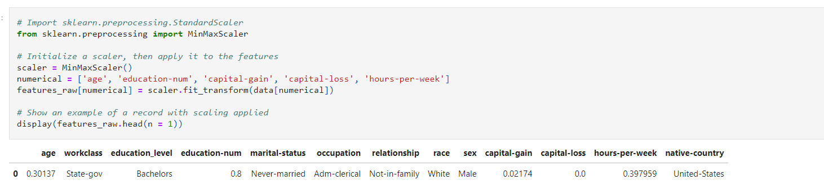
Normalizing Numerical Features
In addition to performing transformations on features that are highly skewed, it is often good practice to perform some type of scaling on numerical features. Applying a scaling to the data does not change the shape of each feature's distribution (such as 'capital-gain' or 'capital-loss'); however, normalization ensures that each feature is treated equally when applying supervised learners. Once scaling is applied, observing the data in its raw form will no longer have the same original meaning.

Slide 12
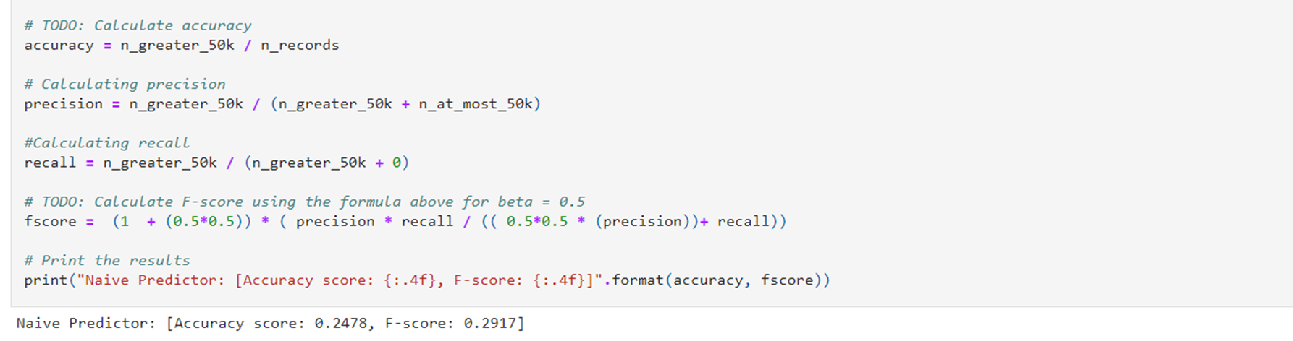
Metrics
It would seem that using accuracy as a metric for evaluating a particular model's performace would be appropriate. Additionally, identifying someone that does not make more than $50,000 as someone who does would be detrimental to Charity, since they are looking to find individuals willing to donate. Therefore, a model's ability to precisely predict those that make more than $50,000 is more important than the model's ability to recall those individuals. We can use F-beta score as a metric that considers both precision and recall:
Fβ = (1+β^2) ⋅ precision ⋅ recall
-----------------------------
(β^2⋅precision)+recall
Naïve Predictor Performance:

Slide 13

Creating a Training and Predicting Pipeline
To properly evaluate the performance of each model we've chosen, it's important that we create a training and predicting pipeline that allows to quickly and effectively train models using various sizes of training data and perform predictions on the testing data.

Slide 14
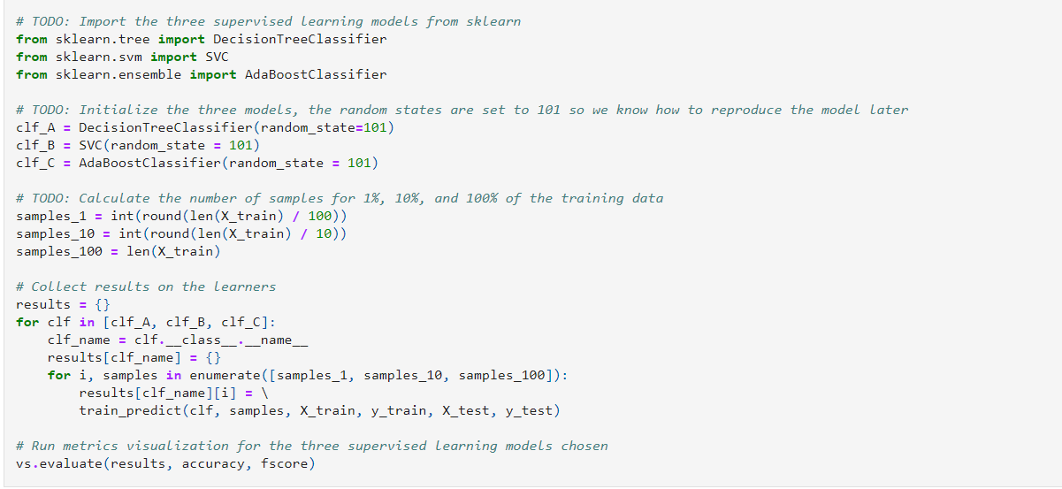
Model Evaluation
Let's train and test the models on training sets of different sizes to see how it affects their runtime and predictive performance (both on the test, and training sets).

Slide 15
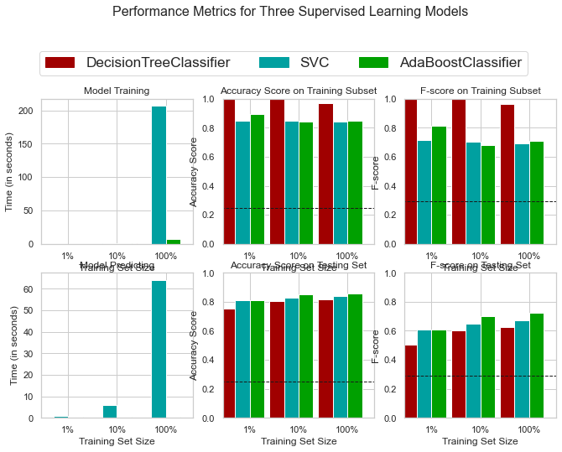
DecisionTreeClassifier trained on 362 samples
DecisionTreeClassifier trained on 3618 samples
DecisionTreeClassifier trained on 36177 samples
SVC trained on 362 samples
SVC trained on 3618 samples
SVC trained on 36177 samples
AdaBoostClassifier trained on 362 samples
AdaBoostClassifier trained on 3618 samples
AdaBoostClassifier trained on 36177 samples

Slide 16
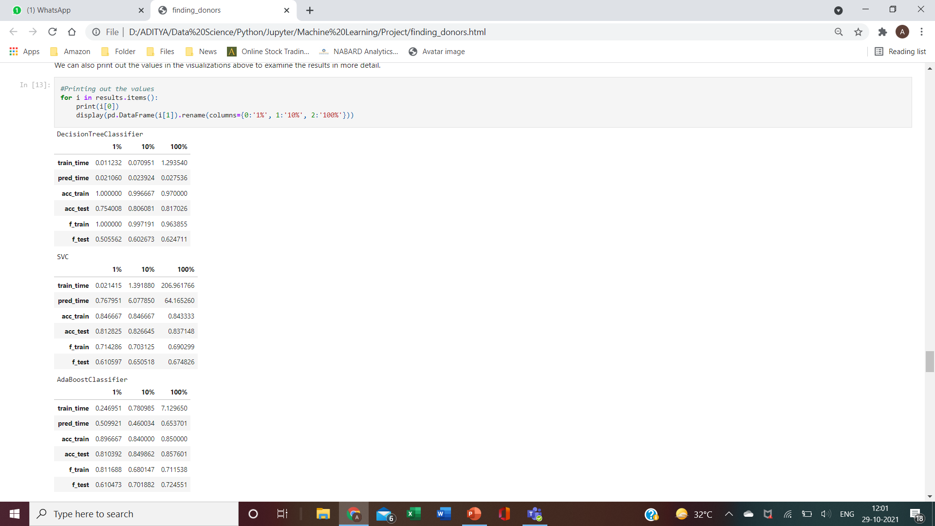
We can also print out the values in the visualizations above to examine the results in more detail

Slide 17
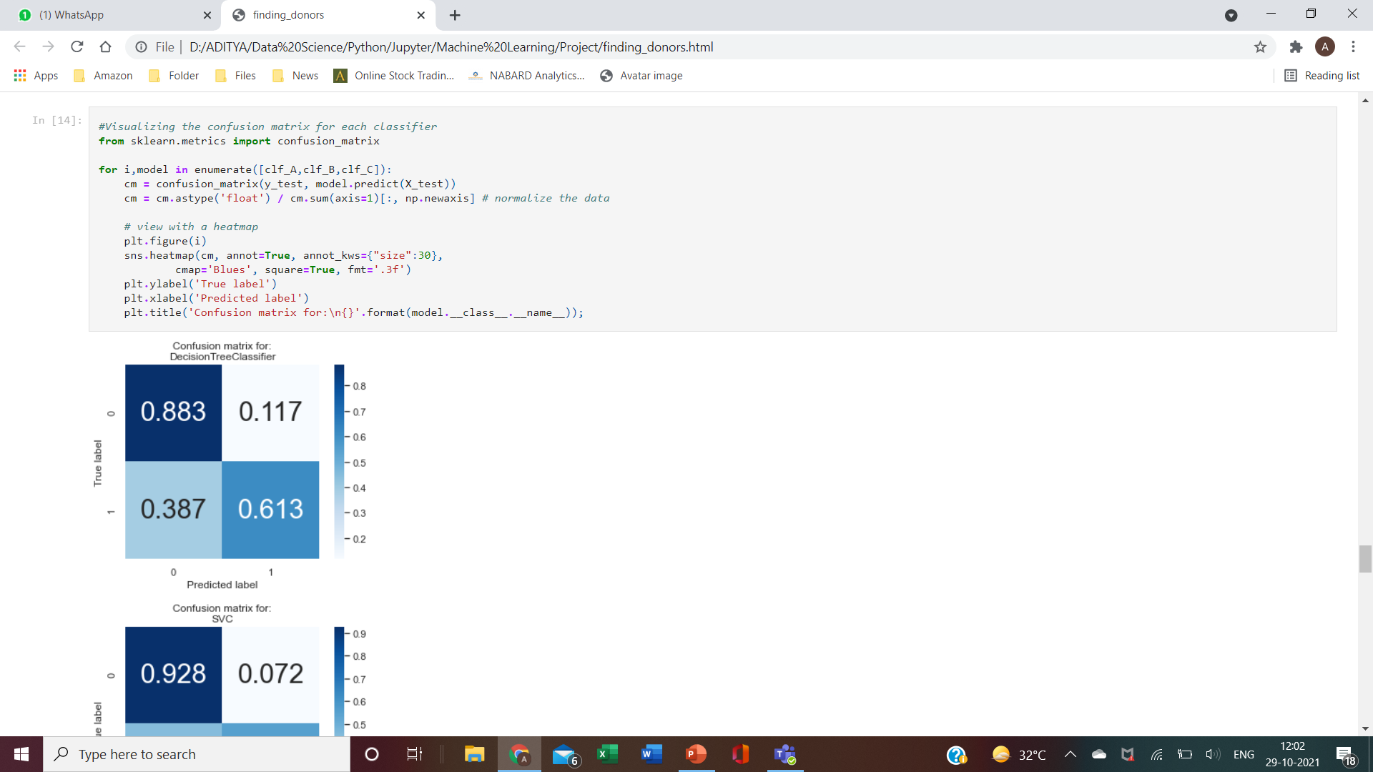
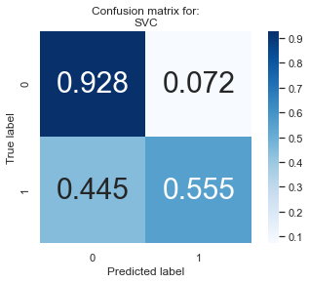
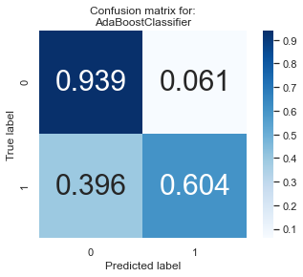
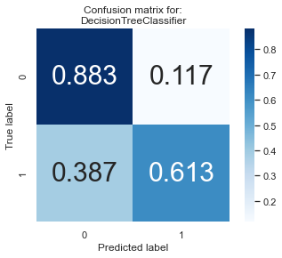
And visualize the confusion matrix for the results.

Slide 18
The Best Model
Looking at the results above, out of the three models, AdaBoost is the most appropriate for our task.
First and foremost, it is the classifier that performs the best on the testing data, in terms of both the accuracy and f-score. It also takes reasonably low time to train on the full dataset, which is just a fraction of the 120 seconds taken by SVM, the next best classifier to train on the full training set. So it should scale well even if we have more data.
By default, Ada-boost uses a decision stump i.e. a decision tree of depth 1 as its base classifier, which can handle categorical and numerical data.

Slide 19
But how does AdaBoost work?
AdaBoost works by combining several simple learners (for ex: decision trees), to create an ensemble of learners that can predict whether an individual earns above 50k or not.
Each of the learners, in our case decision trees, are created using "features" we have about individuals (eg. age, occupation, education, etc) create a set of rules that can predict a person's income.
During the training process, which lasts for several rounds, the AdaBoost algorithm looks at instances where it has predicted badly, and prioritizes the correct prediction of those instances in the next round of training.
With each round, the model finds the best learner (or decision tree) to incorporate into the ensemble, repeating the process for the specified number of rounds, or till we can't improve the predictions further.
All the learners are then combined to make a final ensembled model, where they each vote to predict if a person earns more than 50k or not. Usually we take the majority of the votes to make a final prediction.
Using this model with the census information of individuals, we can predict the same information for a potential new donor and predict if they earn more than 50K or not, and thus make a decision on the likeliness of them donating to charity.

Slide 20
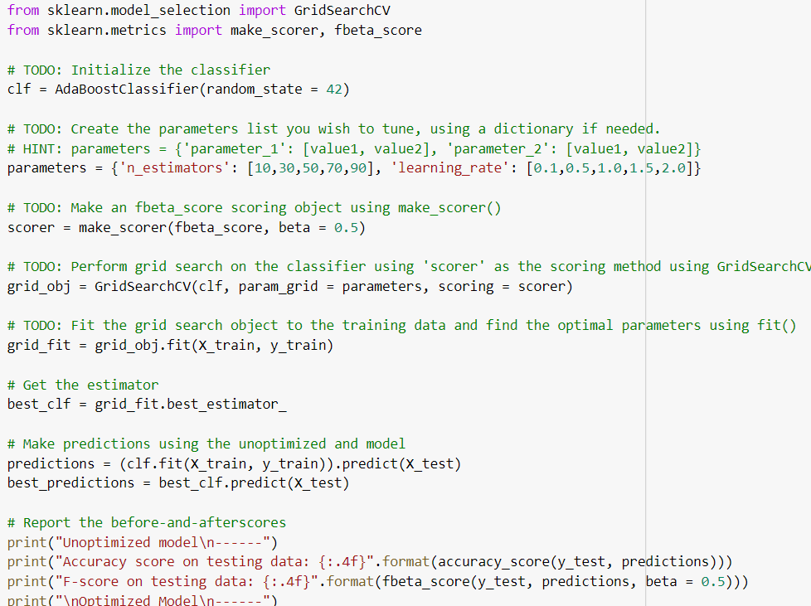
Improving our Model: Model Tuning
Using grid search (GridSearchCV) with different parameter/value combinations, we can tune our model for even better results.
For AdaBoost, we'll tune the n_estimators and learning rate parameters, and also the base classifier paramters (remember our base classifier for the AdaBoost ensemble is a Decision tree!).

Slide 21
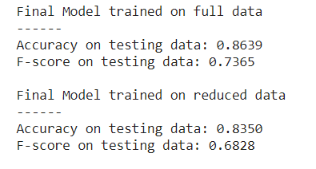
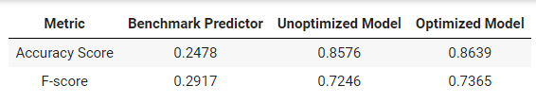
Comparing models

Slide 22
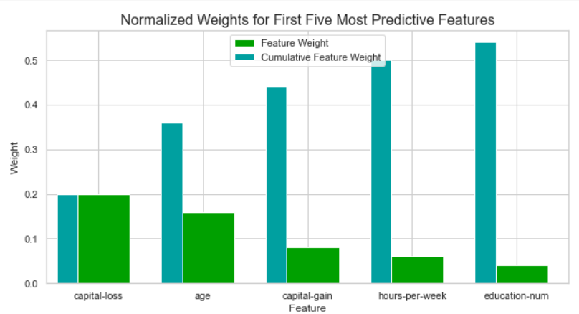
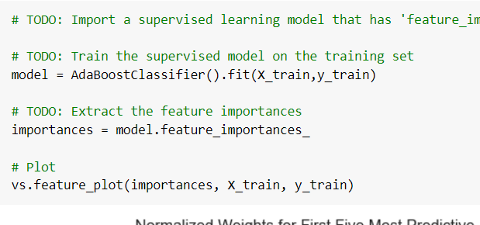
Extracting Feature Importance

Slide 23
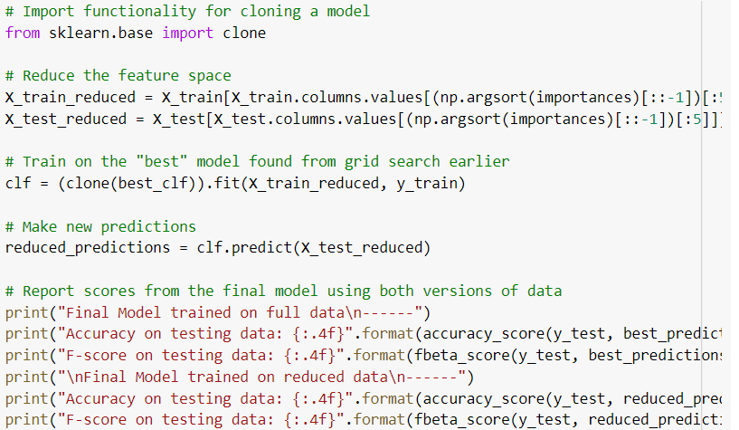
Feature selection

Slide 24
Effects of Feature Selection
On a reduced dataset, the final model's accuracy and f-score are still very comparable to the results on the full dataset.
The accuracy is ~2.7% lower, while the f-score is ~5% lower. Even though Adaboost is relatively faster than one of the other classifiers that we tried out, I'd still consider training on the reduced data (acc. to features) if training time was a factor, and we have more training points to process. This decision will also depend on how important accuracy and f-scores are (or if f-score is more important than the accuracy, as the dip for that is larger than the dip in accuracy), to make a final decision regarding this.

