Slide 1
FINAL PROJECT FORECASTING FOREIGN TOURIST ARRIVALS IN INDIA
Name: Aditya Gavankar
Bachelors of Technology in Data Science
Roll Number: J072

Slide 2
TABLE OF CONTENT
Introduction
Objective
Data
Exploratory Data Analysis
Time Series Decomposition
Stationarity
Augmented Dickey-Fuller Test
Smoothing Technique
ARIMA Model
Results
Conclusion
Future Improvement

Slide 3
INTRODUCTION
India is a popular tourist destination due to its unique climatic conditions and cultural heritage.
The government has implemented visa regulations to encourage tourists to apply for an electronic visa online, and has made it the "ultimate tourist spot" to boost tourism-related earnings.
However, due to pandemics and infectious diseases, the tourism industry has become very unstable, with travel restrictions, social distancing, and lockdowns causing a recession.
This has caused foreign tourists to cancel their tours and reduce the tourist graph.

Slide 4
OBJECTIVE
The major objective of this project is to:
Gain some quick insights,
Understand the general trends in the data,
Predict and forecast the foreign tourist arrivals in India.
Moreover, this project also attempts to understand the impact of COVID-19 on Indian tourism sector.

Slide 5
DATA
For this project, I have created and used the monthly time series data that contains the total number of international tourists that arrived in India from the year 1981 to 2022, along with the total number of passengers based on their continents, ages, gender, and travel accommodation.
This time series data is taken from the annual reports of the “Indian Tourism statistics” for the duration till 2022 which are available at the Indian Ministry of Tourism.
Here is the list of variables in this dataset:
Date
FTA
North America
C&S America
Western Europe
Eastern Europe
Africa
West Asia
South Asia
South East Asia
East Asia
Australasia
Male passenger
Female passenger
Air Transport
Land Transport
Sea Transport
0-14 age passenger
15-24 age passenger
25-34 age passenger
35-44 age passenger
45-54 age passenger
55-64 age passenger
65 and above age passenger

Slide 6
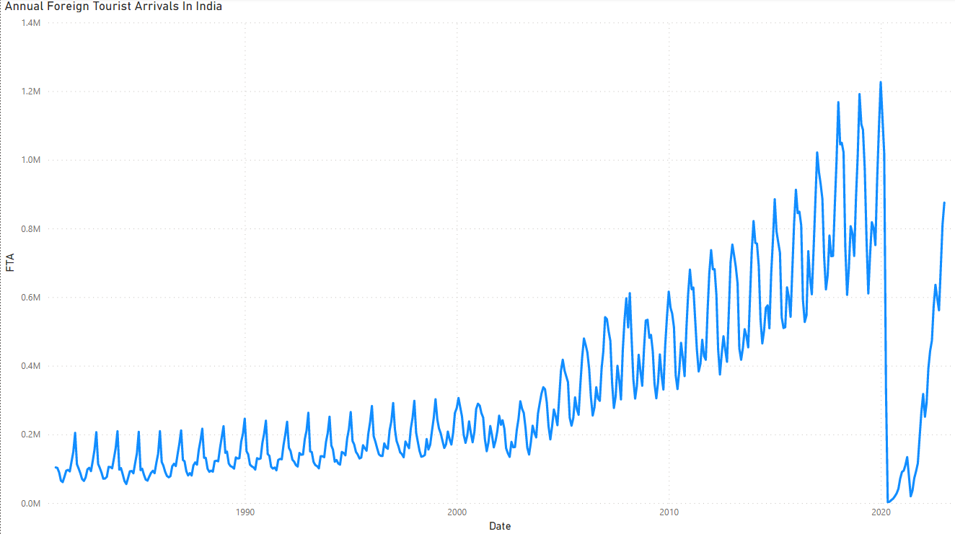
EXPLORATORY DATA ANALYSIS

Slide 7
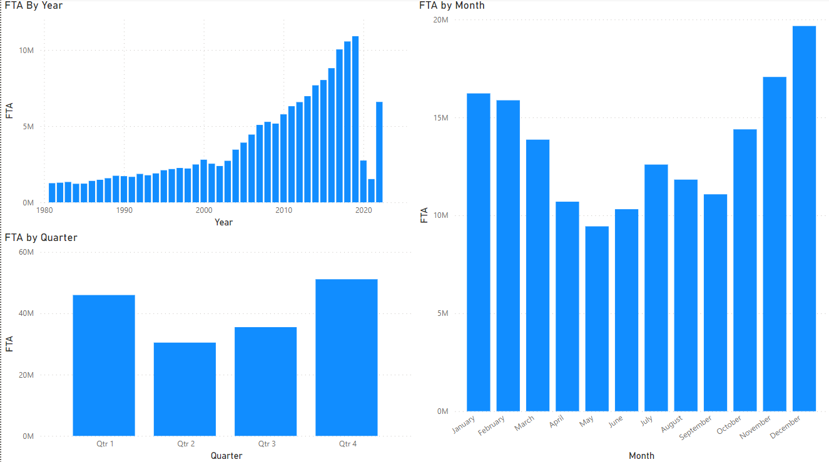

Slide 8
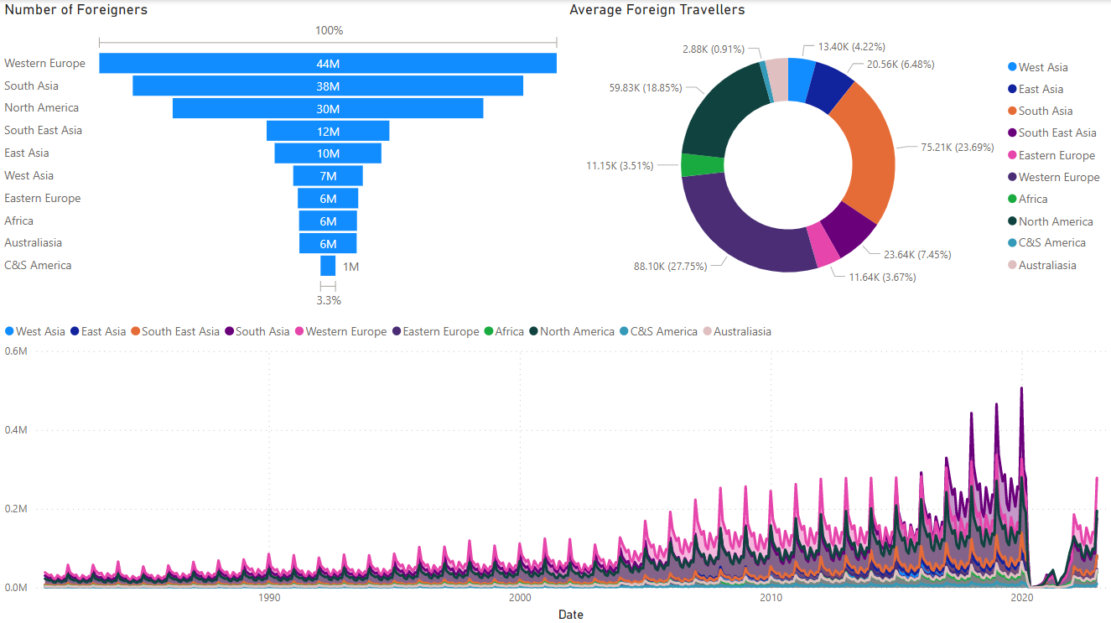

Slide 9
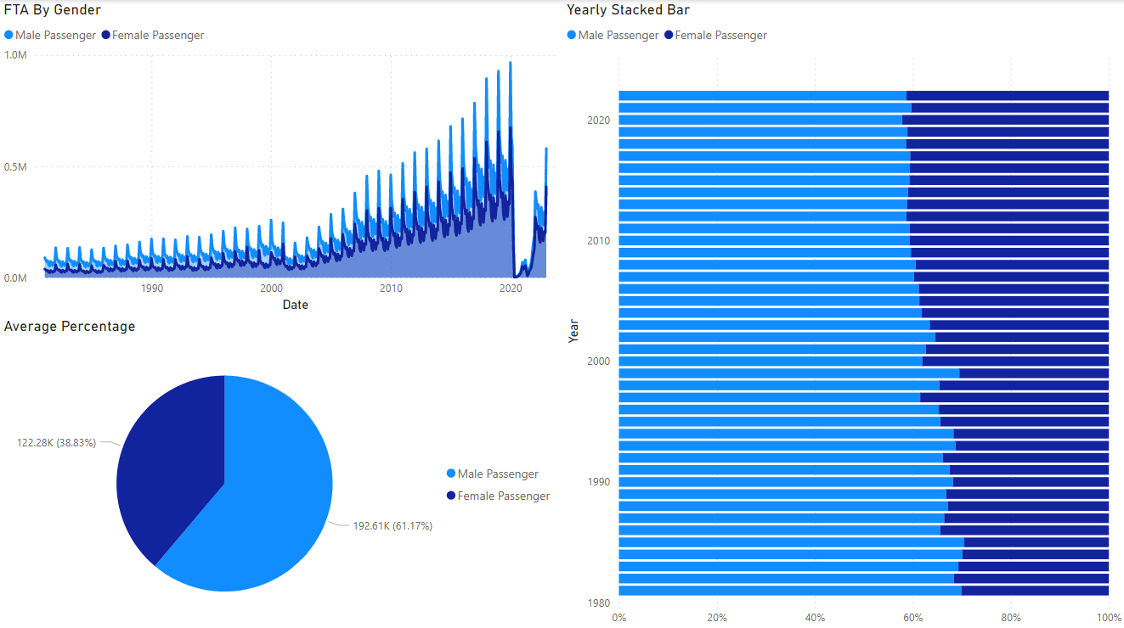

Slide 10
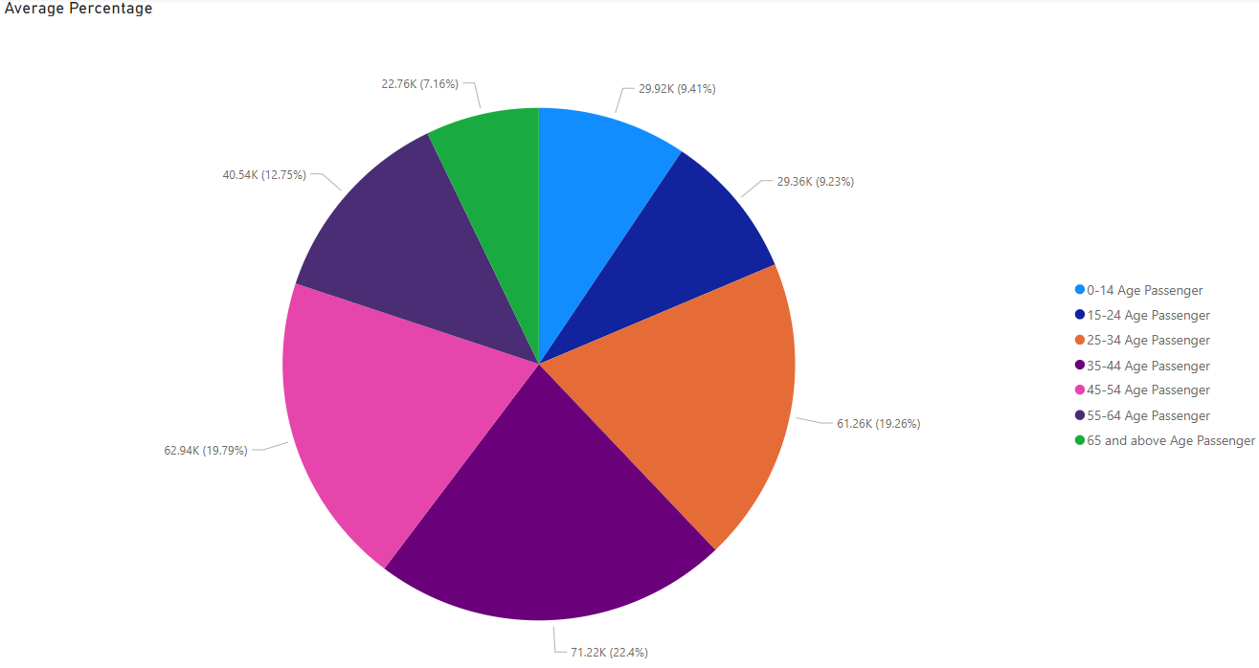

Slide 11
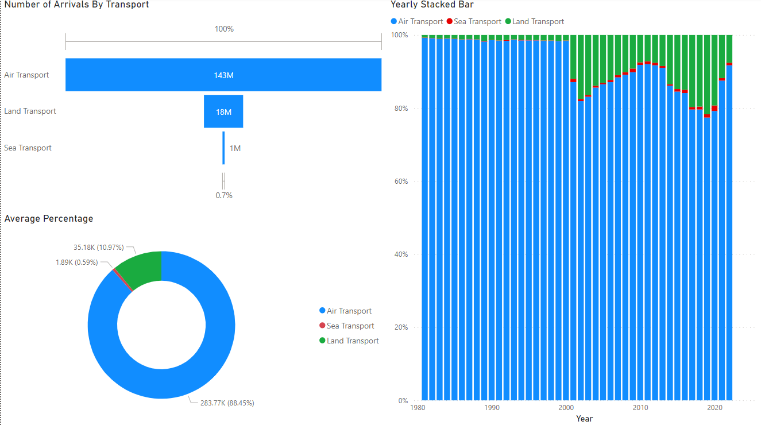

Slide 12
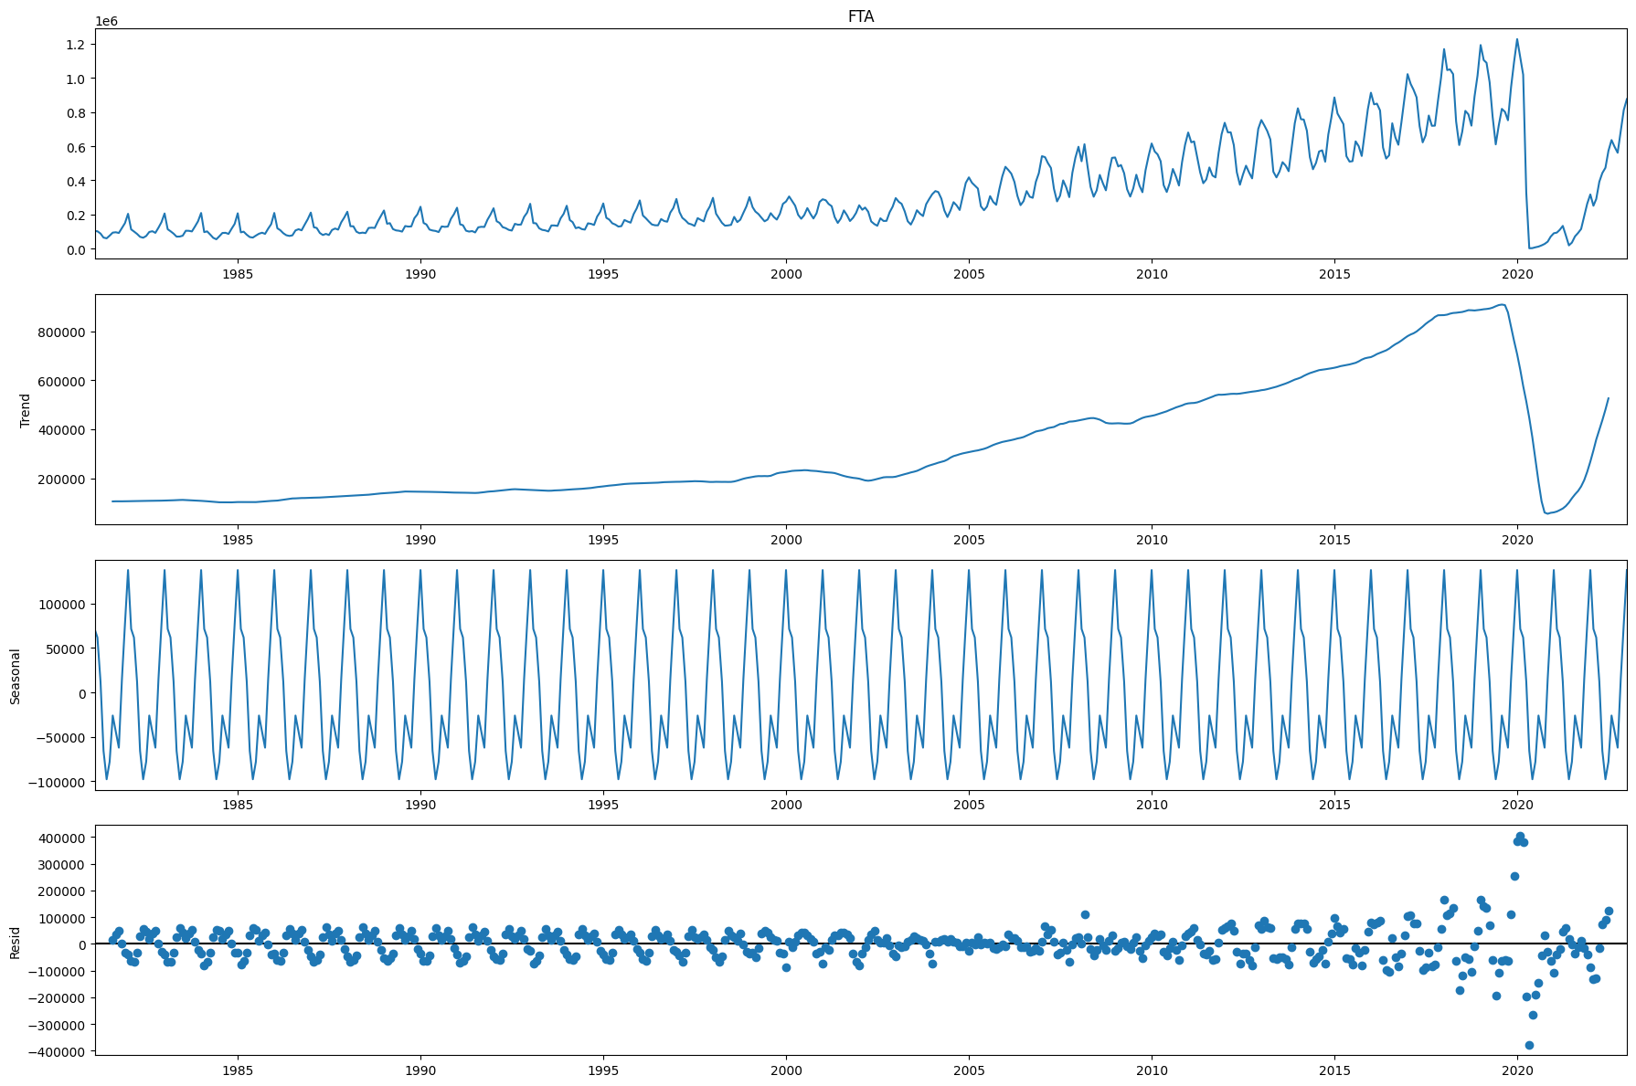
TIME SERIES DECOMPOSITION
Trend: The increasing or decreasing value in the series.
Seasonality: The repeating short-term cycle in the series.
Noise: The random variation in the series.

Slide 13
STATIONARITY
‘Stationarity’ is one of the most important concepts while working time series data.
A time series is said to be stationary if its statistical properties such as mean, variance remain constant over time.
Though stationarity assumption is taken in many time series models, almost none of practical time series are stationary.
Most of the time series models work on the assumption that the time series is stationary.
Intuitively, we can say that if a time series has a particular behaviour over time, there is a very high probability that it will follow the same in the future

Slide 14

AUGMENTED DICKEY-FULLER TEST
Null Hypothesis (H0): Unit root is present in a time series (alpha = 1).
p-value is greater than significance level.
Time series is non-stationary.
Alternate Hypothesis (HA): p-value is less than significance level.
Time series is stationary.

Slide 15
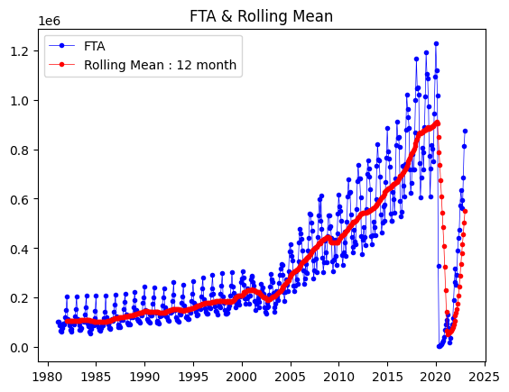
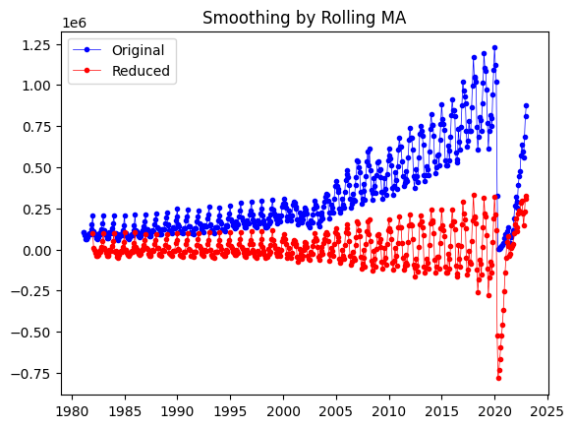
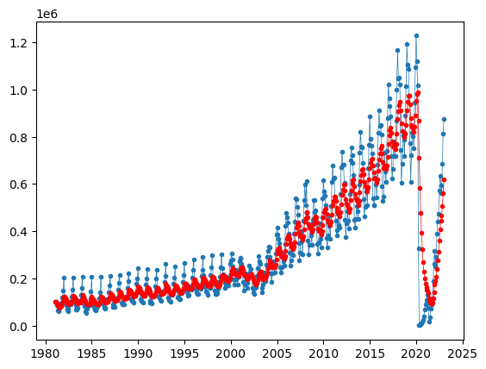
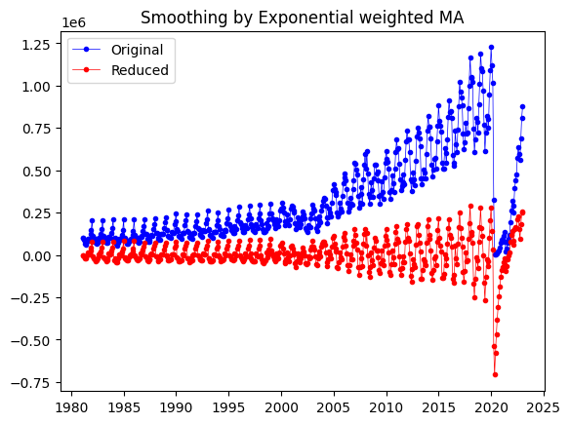
SMOOTHING TECHNIQUE
Moving Average Smoothing
Exponential Smoothing

Slide 16
ARIMA MODEL
An Autoregressive Integrated Moving Average (ARIMA) model is a statistical analysis model that uses historical time series data to predict future trends.
Autoregression (AR): refers to a model that shows a changing variable that regresses on its own lagged, or previous, values.
Integrated (I): represents the differencing of raw observations to allow the time series to become stationary.
Moving Average (MA): incorporates the dependency between an observation and a residual error from a moving average model applied to lagged observations.
Prediction = Constant + Linear combination lags + Linear combination of of Y lagged forecast errors

Slide 17
ARIMA PARAMETERS
For ARIMA models, a standard notation would be ARIMA with p, d, and q.
p: the number of lag observations in the model, also known as the lag order.
d: the number of times the raw observations are differenced.
q: the size of the moving average window, also known as the order of the moving average.
If a time series has seasonal patterns, then we need to add seasonal terms and it becomes SARIMA (Seasonal ARIMA). SARIMA notation is quite a bit more complex than ARIMA, as each of the components receives a seasonal parameter on top of the regular parameter. They denoted with notation SARIMA (p, d, q, m).

Slide 18
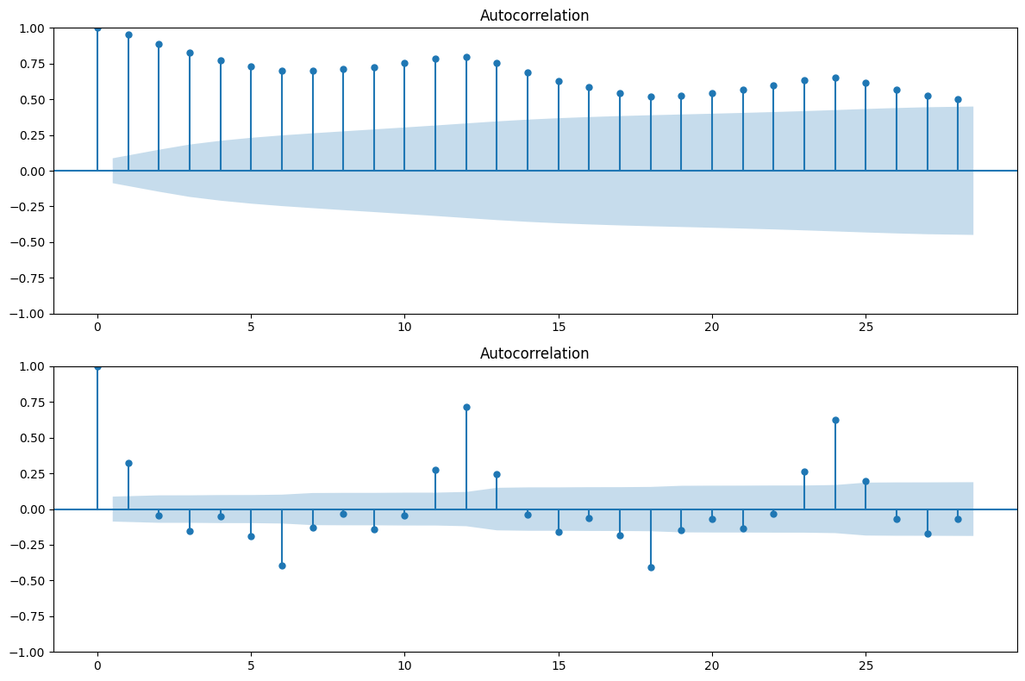
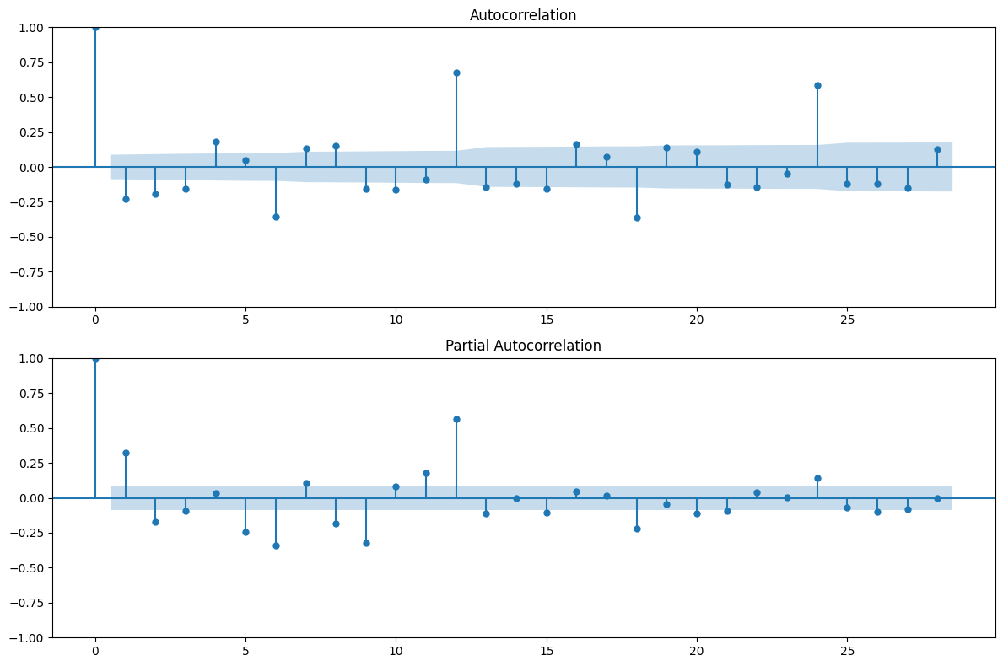
ACF plot of the original Time series ACF plot of 1st order differencing
ACF plot of 2nd order differencing PACF plot of 1st order differencing

Slide 19
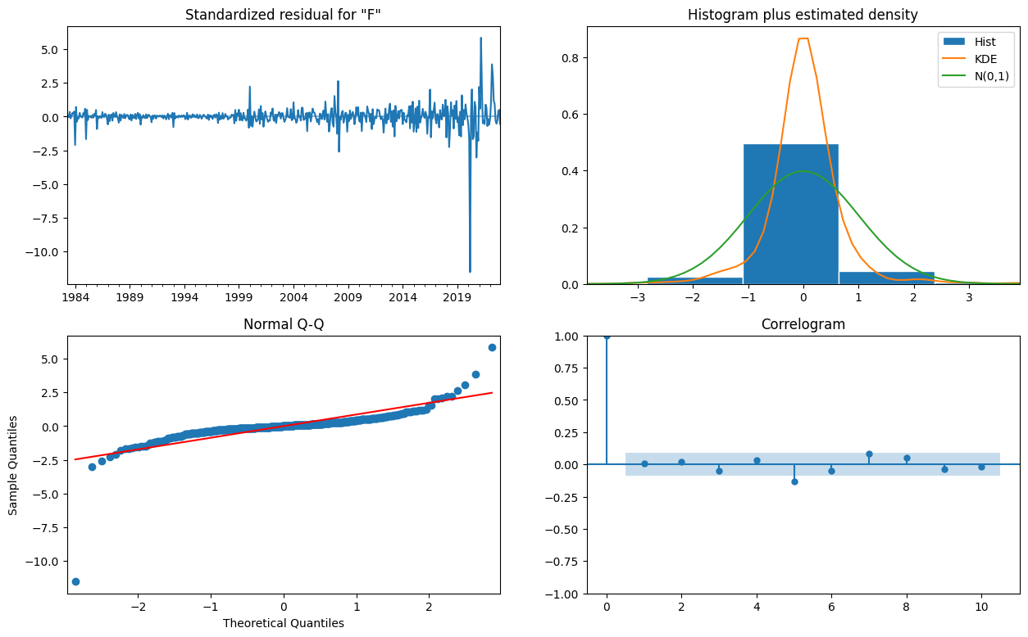
In the top right plot, we see that the red KDE line really does not follow closely with the N(0,1) line.
The QQ-plot shows that the moderately ordered distribution of residuals follows the linear trend of the samples taken from a standard normal distribution with N(0, 1).
Hence the residual plots are perfectly normally distributed.
Our model produces a satisfactory fit that could help us understand our time series data and forecast future values.

Slide 20
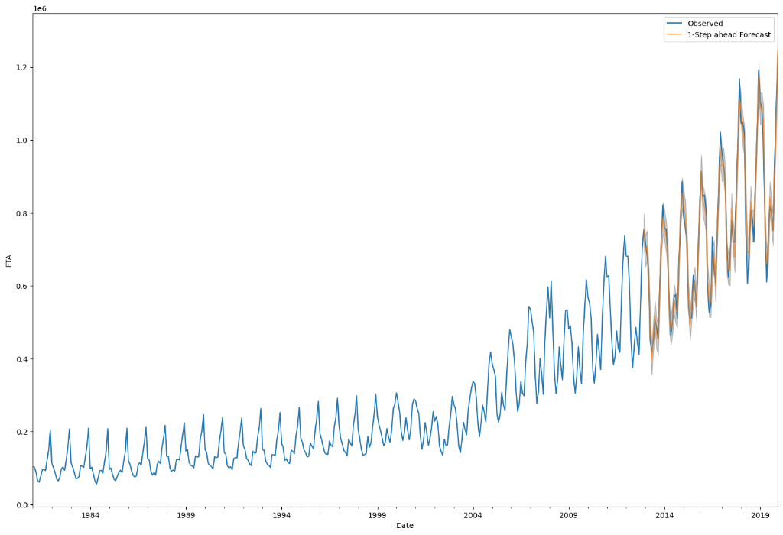
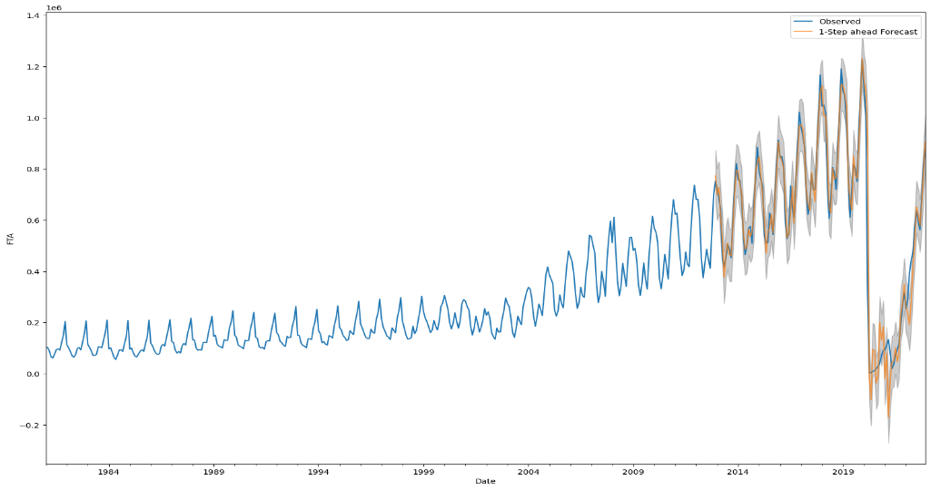
RESULTS
I start by comparing predicted values to real values of the time series, which will help us understand the accuracy of our forecasts.
Overall, our forecasts slightly differ with the true values, but shows an upward trend starts from the beginning of the year and captured the seasonality toward the end of the year.

Slide 21
Variables | Root Mean Squared Error
 | Before COVID-19 | After COVID-19
FTA North America C&S America Western Europe Eastern Europe Africa West Asia South Asia South East Asia East Asia Australasia Male passenger Female passenger Air Transport Land Transport Sea Transport 0-14 age passenger 15-24 age passenger 25-34 age passenger 35-44 age passenger 45-54 age passenger 55-64 age passenger 65 and above age passenger | 29447.28 1239.65 352.45 3915.82 2765.18 592.84 1386.44 12131.47 1668.77 1880.77 463.84 11270.17 6435.40 14618.71 11597.70 703.10 2867.22 2598.84 5001.82 3370.17 4490.73 2427.46 4059.80 | 79882.34 22660.64 1306.45 30201.40 7366.54 4475.28 5612.68 38267.01 11985.95 10319.26 5496.37 77428.50 54650.07 106809.37 27546.85 1432.71 12137.38 10722.28 24406.50 27594.35 25897.22 19097.19 12761.46

Slide 22
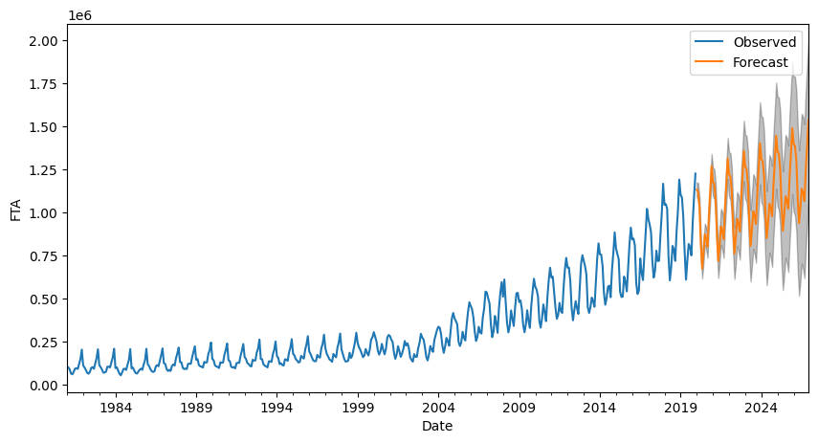
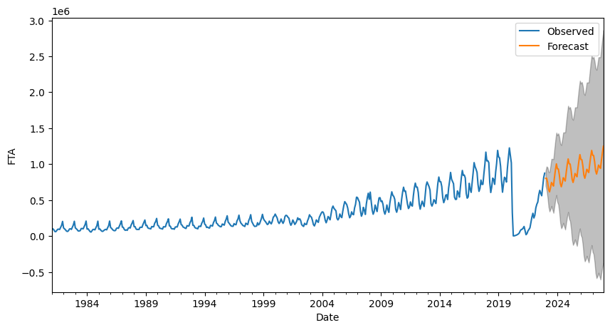
Both the forecasts and associated confidence interval that we have generated can now be used to further understand the time series and foresee what to expect.
Our forecasts show that the time series is expected to increase linearly.
As we forecast further out into the future, it is natural for us to become less confident in our values.
This is reflected by the confidence intervals generated by our model, which grow larger as we move further out into the future.

Slide 23
CONCLUSION
Overall, the results demonstrate that ARIMA model is one of the quality algorithms for forecasting time series data.
This project also helps us to understand how COVID-19 had really impacted the tourism sector in India. It has enabled the tourism industry to face the huge thread as well as the slowdown of economy and tourist arrivals are seen.

Slide 24
FUTURE IMPROVEMENTS
We could change the start date of the prediction to see how this affects the overall quality of our forecasts.
We could try more combinations of parameters to see if we can improve the goodness-of-fit of the model.
We could select a different metric to select the best model. We used the ACF and PACF plot to find the best model, but we could seek to optimize the out-of-sample mean square error instead. We also could have used the AIC measure to find the best model.

Slide 25
THANK YOU

