Slide 1

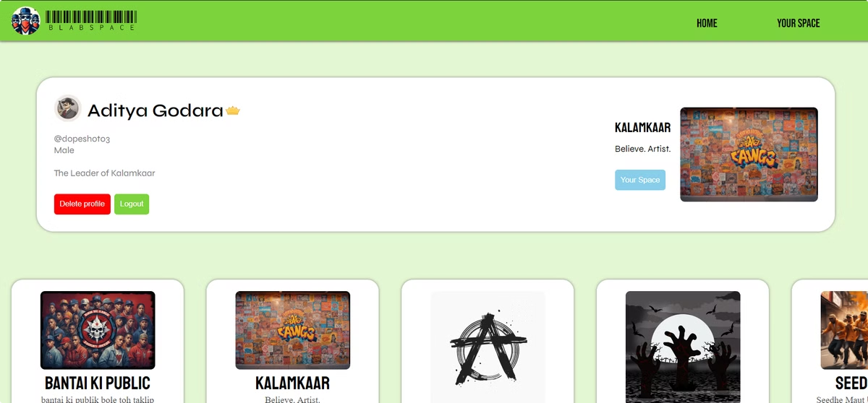
Blab Space: A Platform for Open Discourse
Blab Space, created by Aditya Godara, is a digital platform designed to foster dynamic, topic-centric communities. This virtual environment enables users to engage in text-based interactions within specialized digital spaces, promoting meaningful connections and facilitating collaborative dialogue among diverse participants.
by Aditya Godara

Slide 2
Skills Used
Frontend
Backend
Database
React JS is used to create a visually appealing and user-friendly interface. Bootstrap provides additional styling and components.
Express JS serves as the backend programming language, connecting the database to the website. Node JS concepts and program structures are used to access Express JS functionalities.
MongoDB is used as the database to store various components of Blab Space, including posts, user data, and spaces.

Slide 3
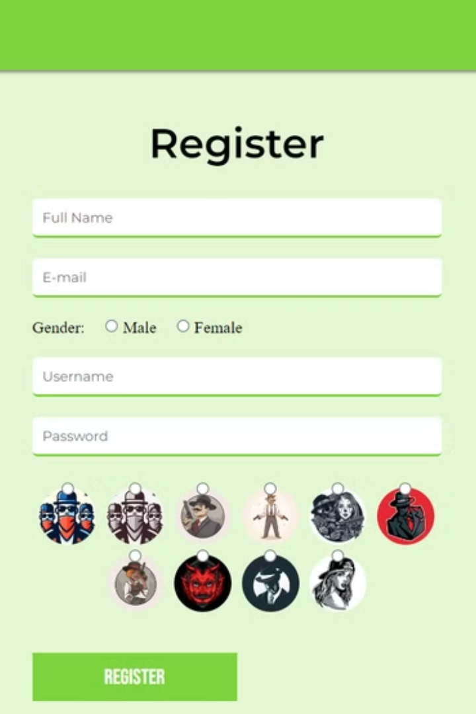
User Functionality
1
Registration
2
Login
Users can register for a new account to access Blab Space features.
Existing users can log in to their accounts to access their spaces and participate in discussions.
3
Logout
4
Profile Management
Users can log out of their accounts when they are finished using Blab Space.
Users can manage their profiles, including deleting their accounts.

Slide 4

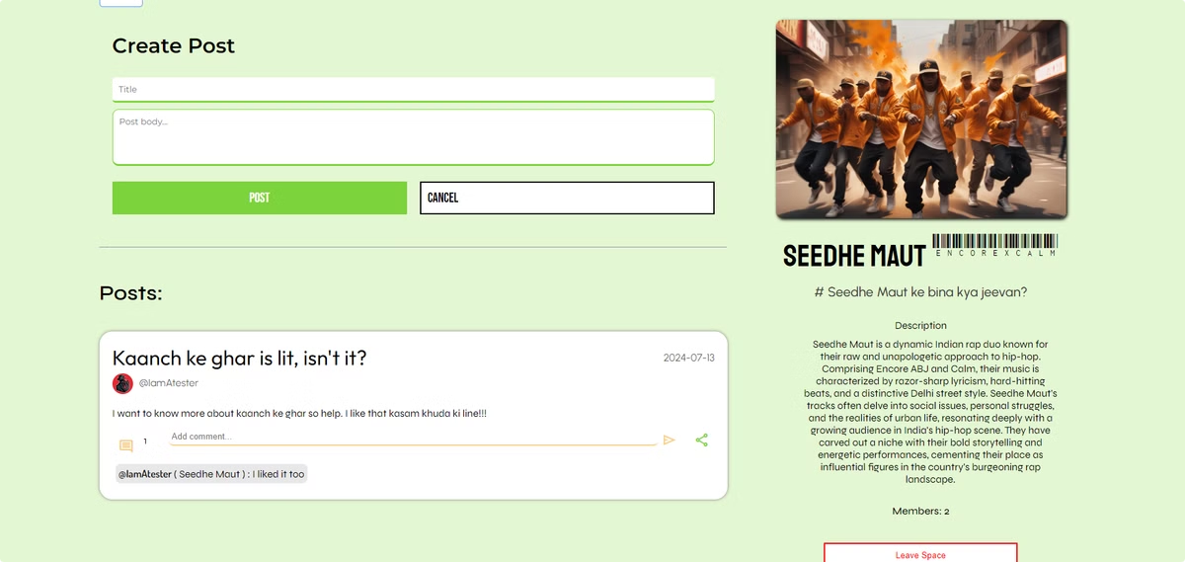
Space Management
1
Join Spaces
Users can join existing spaces to participate in discussions and connect with other members.
2
Create Spaces
Users can create their own spaces to focus on specific topics and build communities around shared interests.
3
Leave Spaces
Users can leave spaces they are no longer interested in or are no longer active in.

Slide 5


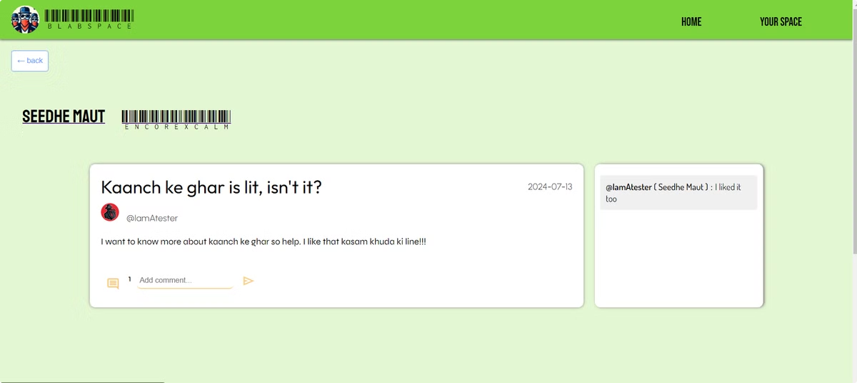

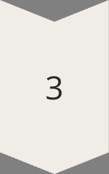
Content Interaction
Post Creation
Users can post freely within their joined spaces, sharing their thoughts and ideas.
Commenting
Users can comment on posts within their spaces, engaging in discussions and responding to others.
Post Sharing
Users can share posts from their spaces with others, even if they are not members of the same space.

Slide 6
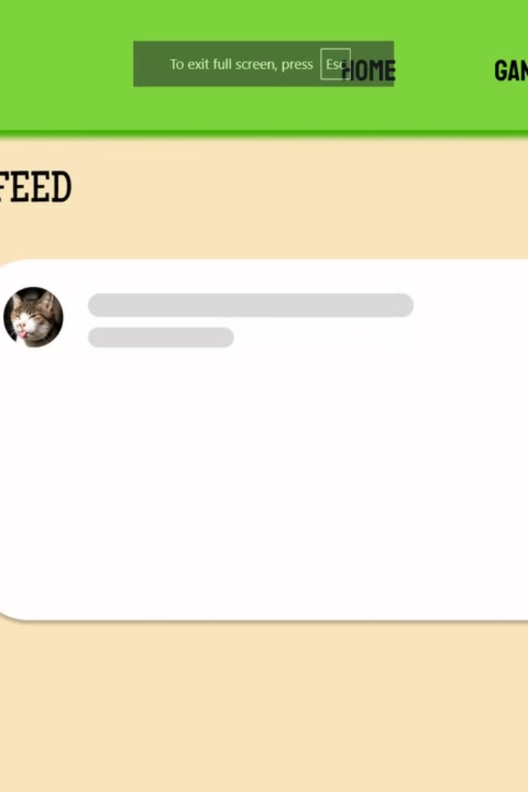
Space Leader Restrictions
Space Deletion
Leaving Spaces
Space leaders cannot delete their spaces, ensuring the continuity of the community.
Space leaders cannot leave their spaces, ensuring that there is always a leader to manage the space.

Slide 7
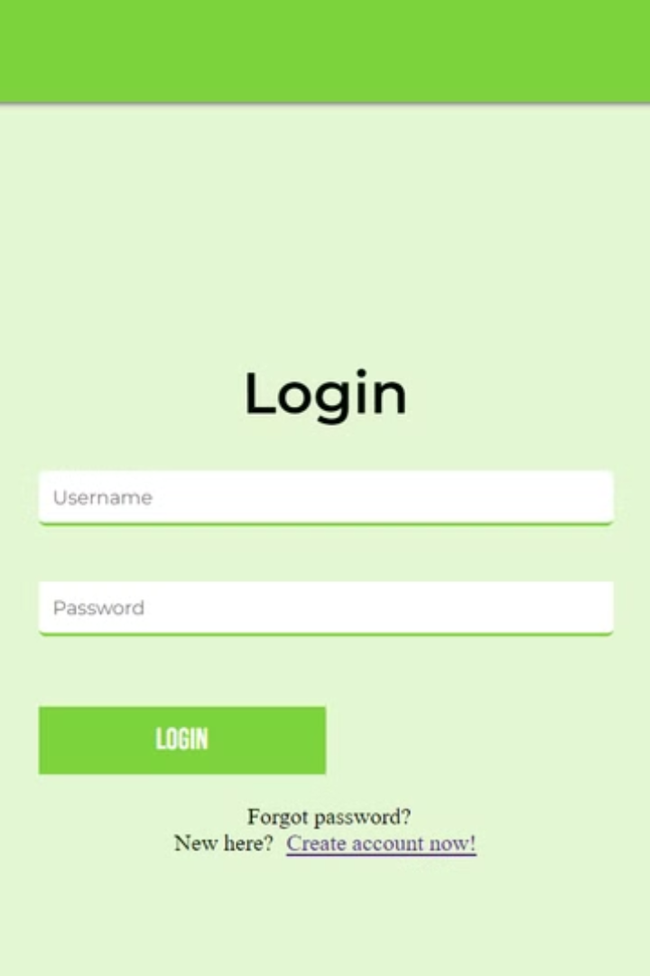
Access Restrictions
Function
Requirement
Join a new space
Must be logged in
Leave a space
Must be logged in
Post in a space
Must be logged in
Comment on a post
Must be logged in

Slide 8
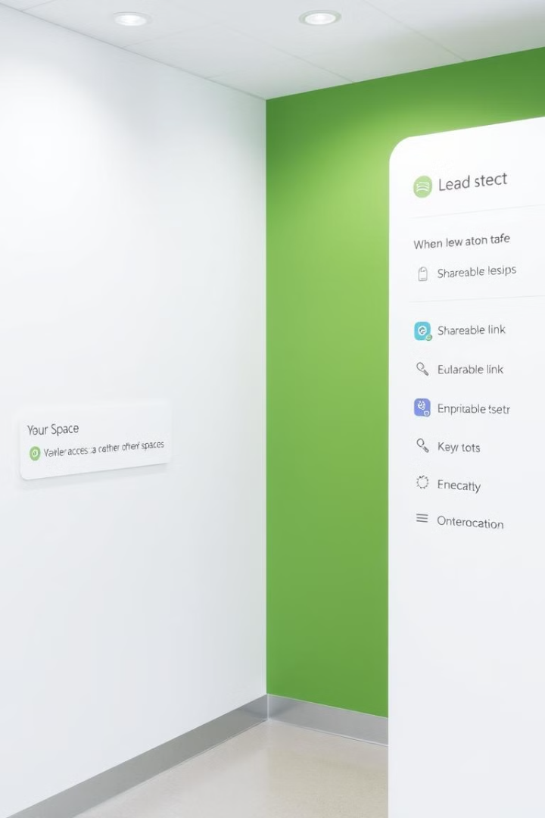


Space Access Limitations
Private Spaces
Space Membership
Users cannot access posts from other spaces without a shareable link.
Users cannot join a new space if they are already a member of another space.

Slide 9
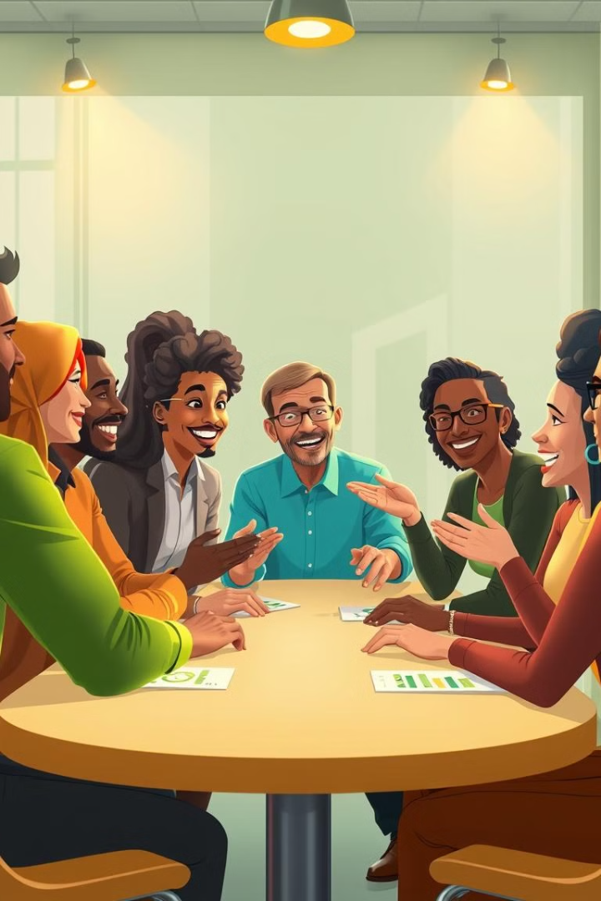
Conclusion
Blab Space provides a unique platform for fostering open discourse and intellectual exchange. By enabling users to create and participate in topic-centric communities, Blab Space promotes meaningful connections and facilitates collaborative dialogue among diverse participants.

