Slide 1
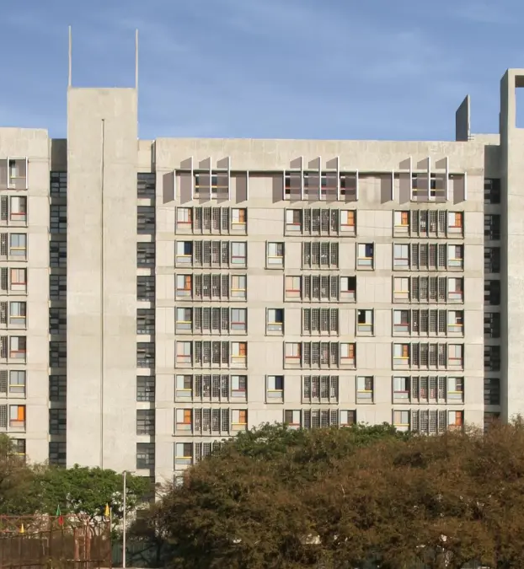
HOSTEL MANAGEMET
Unraveling Accommodation Administration

Slide 2
System Workflow Overview :
Hostel Management System
Room Allocation & Management
Administrative Control Actions
Students Records
Effective Roommate and Room Matching Based on Preferences
Room Availability Viewing
Student Check-In/Check-Out Monitoring
Seamless Maintenance Inquiries and Requests Processing
Reservation Requests and Stay History Tracking
Administration of Student Records and Occupancy Reports

Slide 3

ADMIN ROLE:
One Superadmin[Rector] can create other Admins [warden,security guard]
Security guards will monitor students check-in and check-out times
01
04
02
Admin will decide hostel allotment Timeline
05
Admins will manage guest room requests and allocate guest rooms
03
Admins will handle students inquires and maintenance requests
06
Admins can track guest room records ,stary history, generate monthly reports

Slide 4

OUR TEAM :
QUANTAMQUARKS:
Sumit Girnar [B.TECH,COMP,612203055]
Aditya Gund [S.Y,COMP,612203061]
Avadhoot Ghewade [S.Y,COMP,612203057]
Pradnyesh Mate [S.Y,COMP,612203113]
Om Kendre [T.Y,COMP,112103069]
Suyog Arlimar [S.Y,COMP,612203010 ]
Thanks!
gundau22.comp@coeptech.ac.in
+919322208635
-QUANTUMQUARKS

