Slide 1

SOCIOTHON

Slide 2
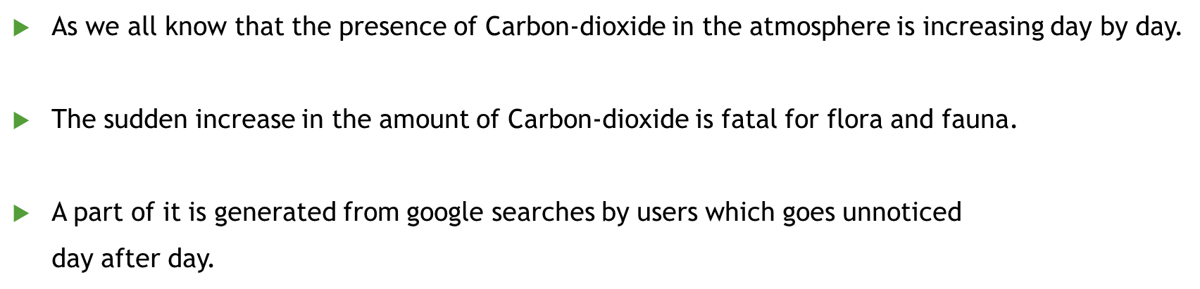

INTRODUCTION

Slide 3
HOW DOES IT HAPPEN ?

Slide 4
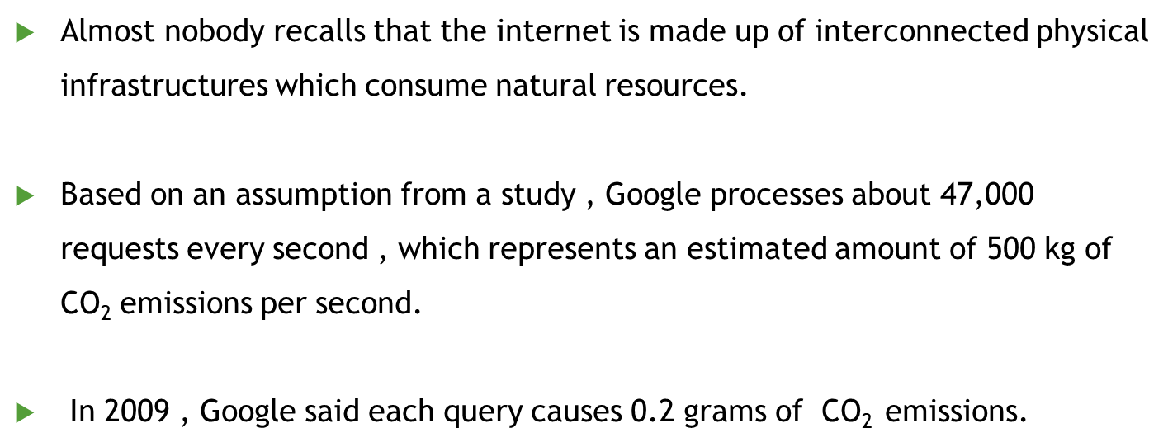

Slide 5
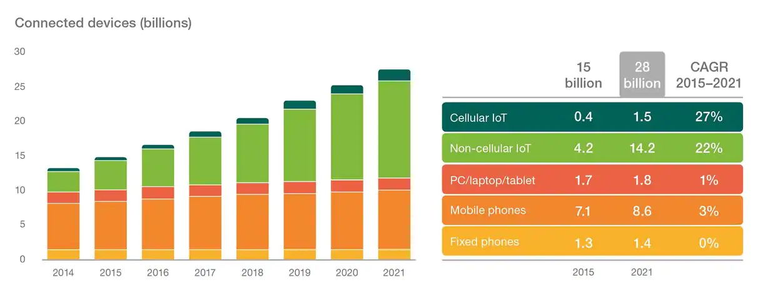
THE UPSURGE OF ELECTRONIC MEDIA -
The last few years have been dominated by the electronic media and there has been a rapid growth in the industries those who manufacture electronic devices. Here are some of the facts –

Slide 6
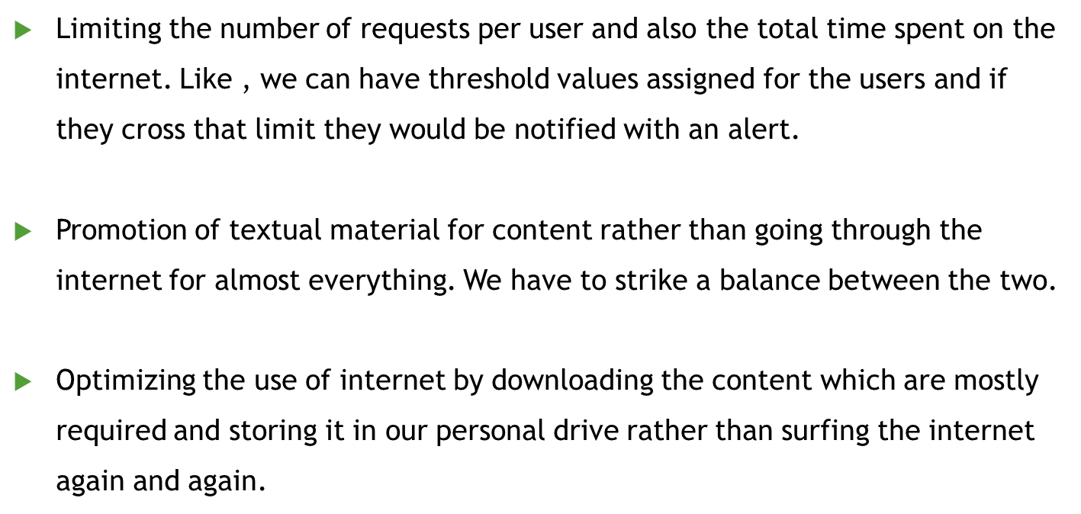
WHAT ARE THE SOLUTIONS

Slide 7
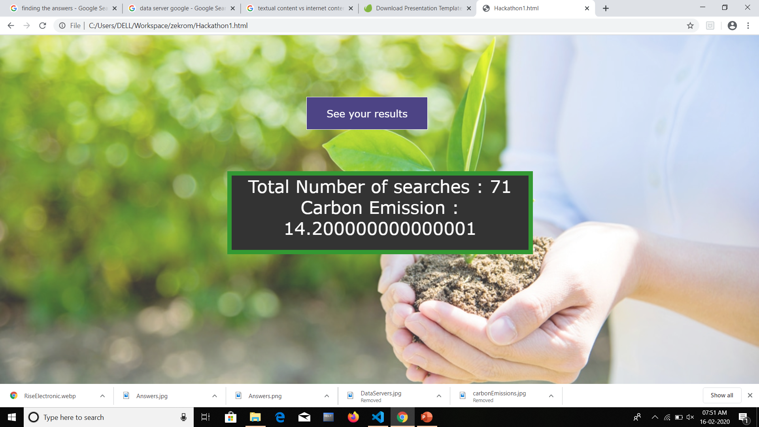
The CO2 generated by this system
Our System generated –

Slide 8
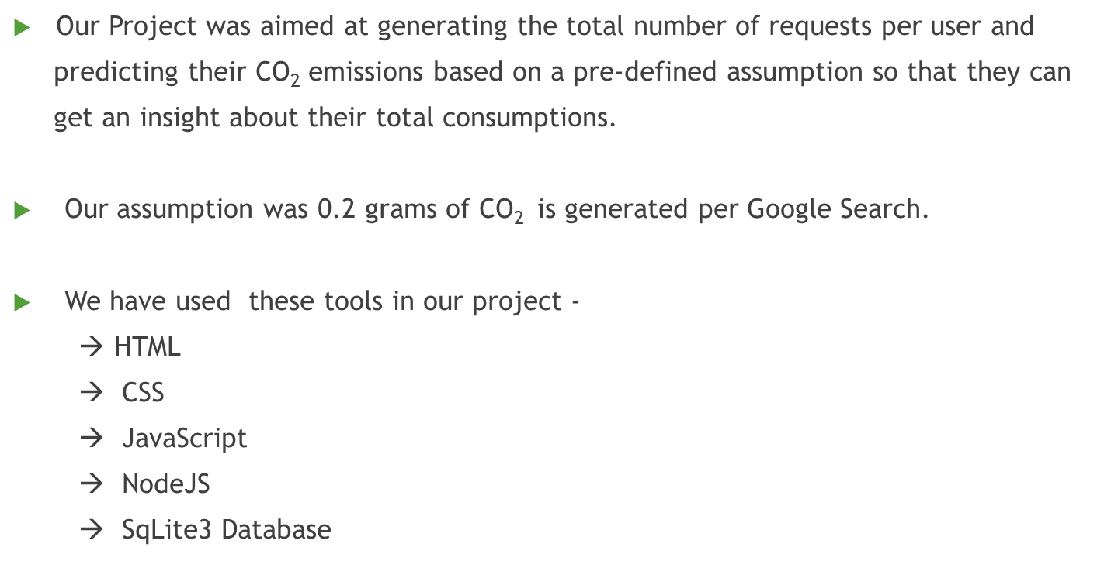
ABOUT OUR PROJECT

Slide 9
SCOPE OF IMPROVEMENT
We can further extend the capabilities of our project by incorporating a method to devise an alert system whenever a person goes beyond a threshold value of optimum consumption.

Slide 10

Thanks!

