Slide 1
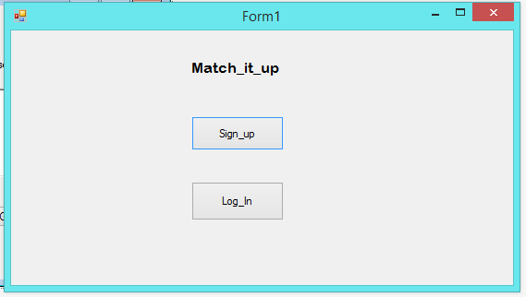
Basics:

Slide 2
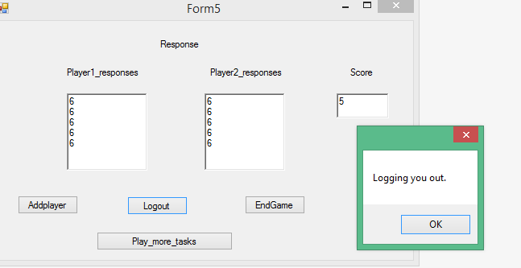
Using Addplayer button multiplayer can log in:

Slide 3
System is able to keep track of answers submitted by players: Both the player responses can be easily seen as Player_1 responses and Player_2 responses.

Slide 4
Features included:
App is persistent and stays unless user ends the game.
Answers stay there even when app is not running in answers.txt file.
UX has been provided.

Slide 5
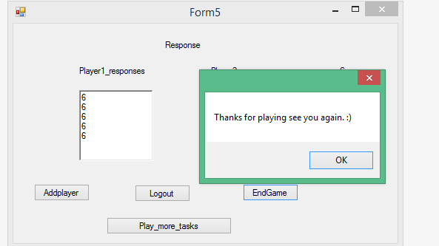
Player is able to end the game:

Slide 6
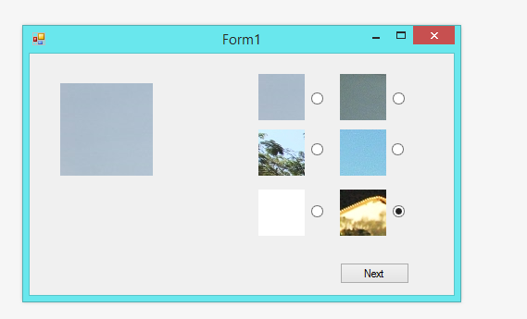
Features included:
App is functioning correctly.
Each task contains at least 5 questions.

Slide 7
Each question has a primary image and >1 secondary image.

Slide 8
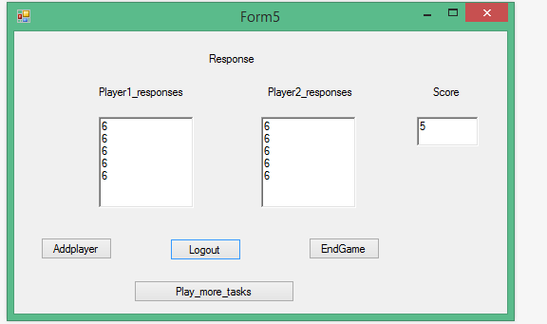
Player can play multiple tasks using the Play_more_tasks button.

Slide 9
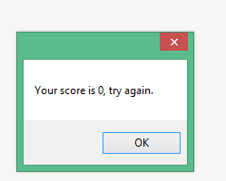
Player’s response are discarded if it gets 0 score:

Slide 10
If same image is selected then points are awarded to both the players: See the score panel

Slide 11
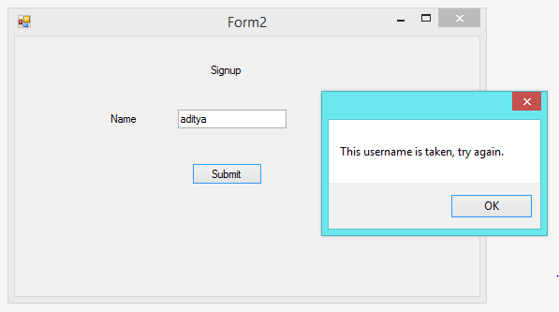
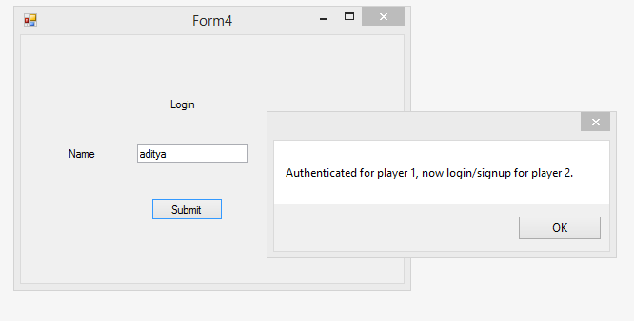
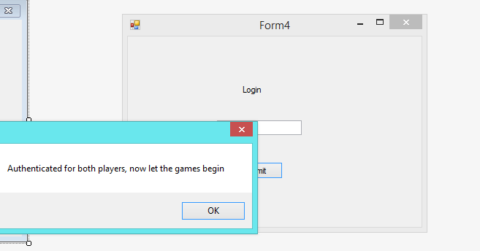
Demoability: All features are demoable.

Slide 12
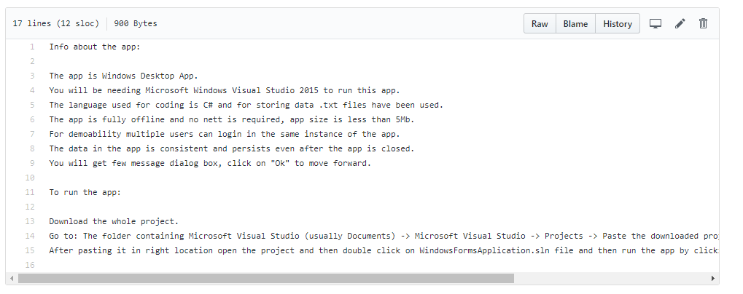
Instructions to run the app:

