Slide 1

ADVISOR
Dr. Debadreeta Das
EnduroSense: Uncertainty-Aware Mission Feasibility Prediction for UAVs
Aditya Harikrishnan
B.Tech Presentation
MINOR PROJECT - III
Notes:
Good morning. Our project is EnduroSense. The brief asked us to predict how much flight time a drone battery has left, using machine learning, and to compare five algorithms. We did that. We then added one step: deciding whether a battery can safely fly a specific mission, and how sure we are about that answer.

Slide 2
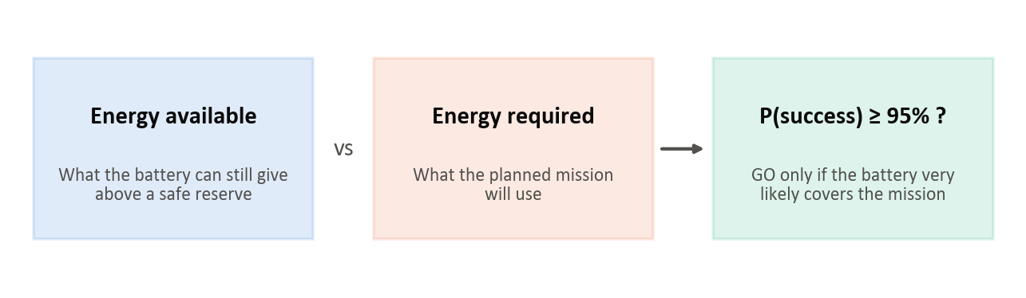
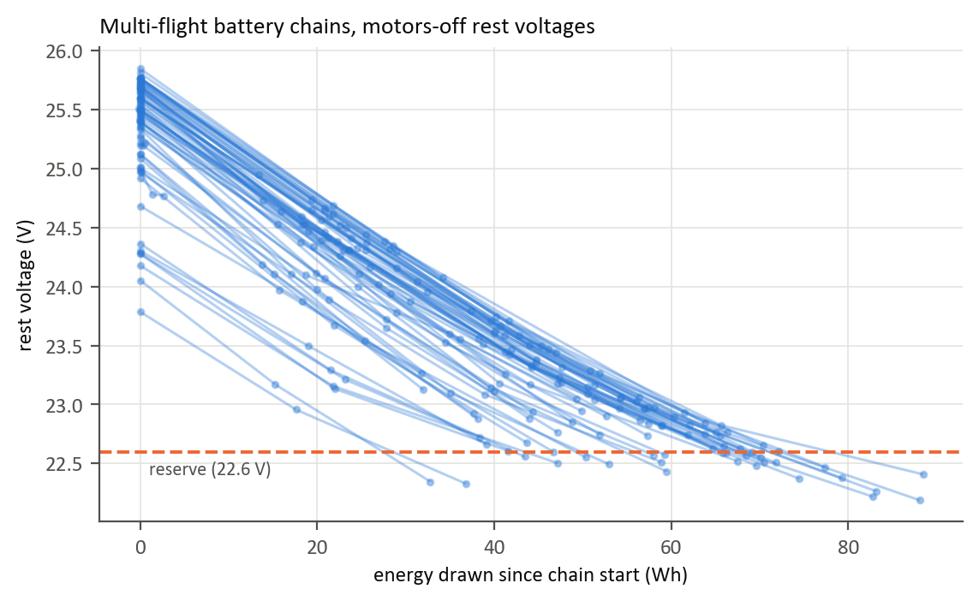
  INTRODUCTION:
UAV Battery and Remaining Flight Time
  Small electric UAVs (delivery, inspection, mapping) are limited by battery energy, and every mission must end with a safe reserve.
  The brief: predict a UAV battery's remaining flight time with machine learning, comparing Linear Regression, Random Forest, XGBoost, LSTM and GRU.
  A dispatcher's real question is mission-specific:
    Can this battery fly this mission and still keep a safe reserve?
Evolution of Battery Estimation
  Classical methods [5]
    Coulomb (energy) counting, open-circuit voltage lookup, equivalent-circuit models
    Limitations: drift over time, need rest periods or a per-cell model
  Machine learning [6]–[9]
    Tree ensembles and recurrent networks learn from voltage and current
    Usually one number (minutes or charge), with no measure of confidence
  This project: EnduroSense
    Predicts energy available and energy required, each with a calibrated range
    Combines them into P(success); a mission is approved only at 95% or more
Fig 1.1 EnduroSense: energy available against energy required
Fig 1.2 Rest voltage of every battery against energy drawn [17]
Notes:
Every drone mission has to end with a safe reserve left in the battery. The brief gives a number of minutes, but an operator really needs a yes or no for a specific mission. Classical methods such as counting energy or reading the voltage, and machine-learning models, usually give one number with no confidence attached. EnduroSense predicts two energies instead: what the battery can still give, and what the mission needs. Each comes with a range, and together they give a probability of success. A mission is approved only at 95 percent or more.

Slide 3
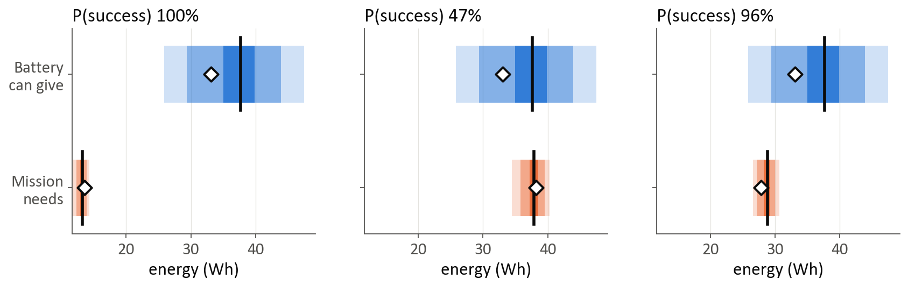
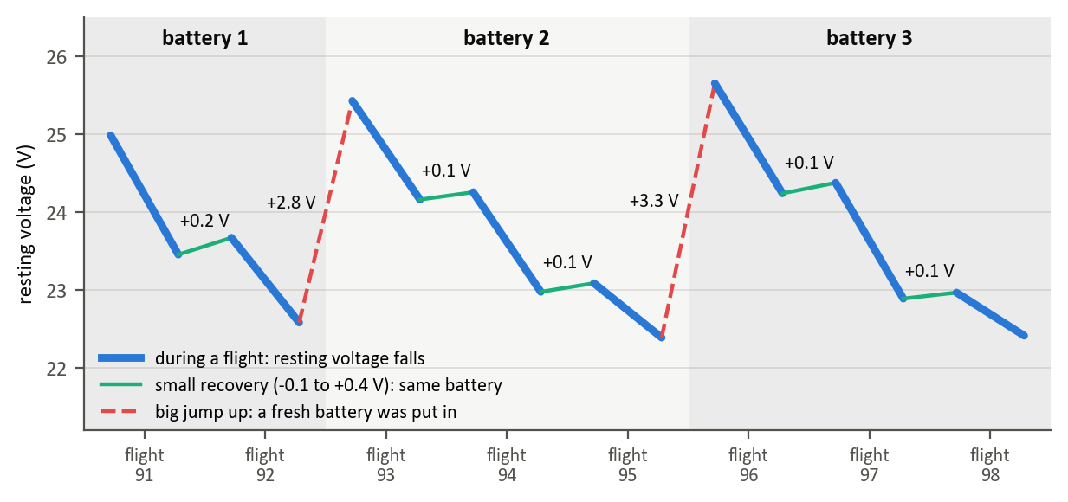
  PROBLEM STATEMENT
Background
  Minutes of flight left = energy left ÷ power being drawn now.
  It depends on what the drone does next, and a single number hides how sure the estimate is.
Key Limitations
  Better battery models barely improve minutes: energy errors of 2.6–4.5 Wh all gave about 0.9 min error.
  Batteries differ: full packs give 47 to 77 Wh above the reserve.
  Two batteries can show the same estimate with very different certainty.
  The public dataset does not record which battery flew each flight, so naive train/test splits leak.
  On unseen data, a minutes-left rule approved 12.4% of missions that would cut into the reserve.
Core Problem
Design a decision system for UAV missions that:
  Predicts energy available above a 22.6 V reserve from battery telemetry (Model A)
  Predicts the energy a planned mission needs from its plan (Model B)
  Attaches calibrated uncertainty ranges to both
  Decides GO / NO-GO from P(success), safer than the minutes-left rule
Fig 2.1 One battery, three real missions: minutes-left approves all three
Fig 2.2 Rebuilding battery identity from resting voltage
Notes:
Minutes left is energy divided by the power being drawn right now, so it changes with what the drone is doing at that moment. In our data, better battery models barely improved the minutes. Batteries also differ a lot: a full pack gives anywhere from 47 to 77 watt-hours above the reserve. On the left of figure 2.1, the minutes rule approves all three missions, and one of them would actually cut into the reserve. The dataset also does not say which battery was used, which we had to rebuild. So the problem is to predict both energies, with honest ranges, and make a safer decision.

Slide 4
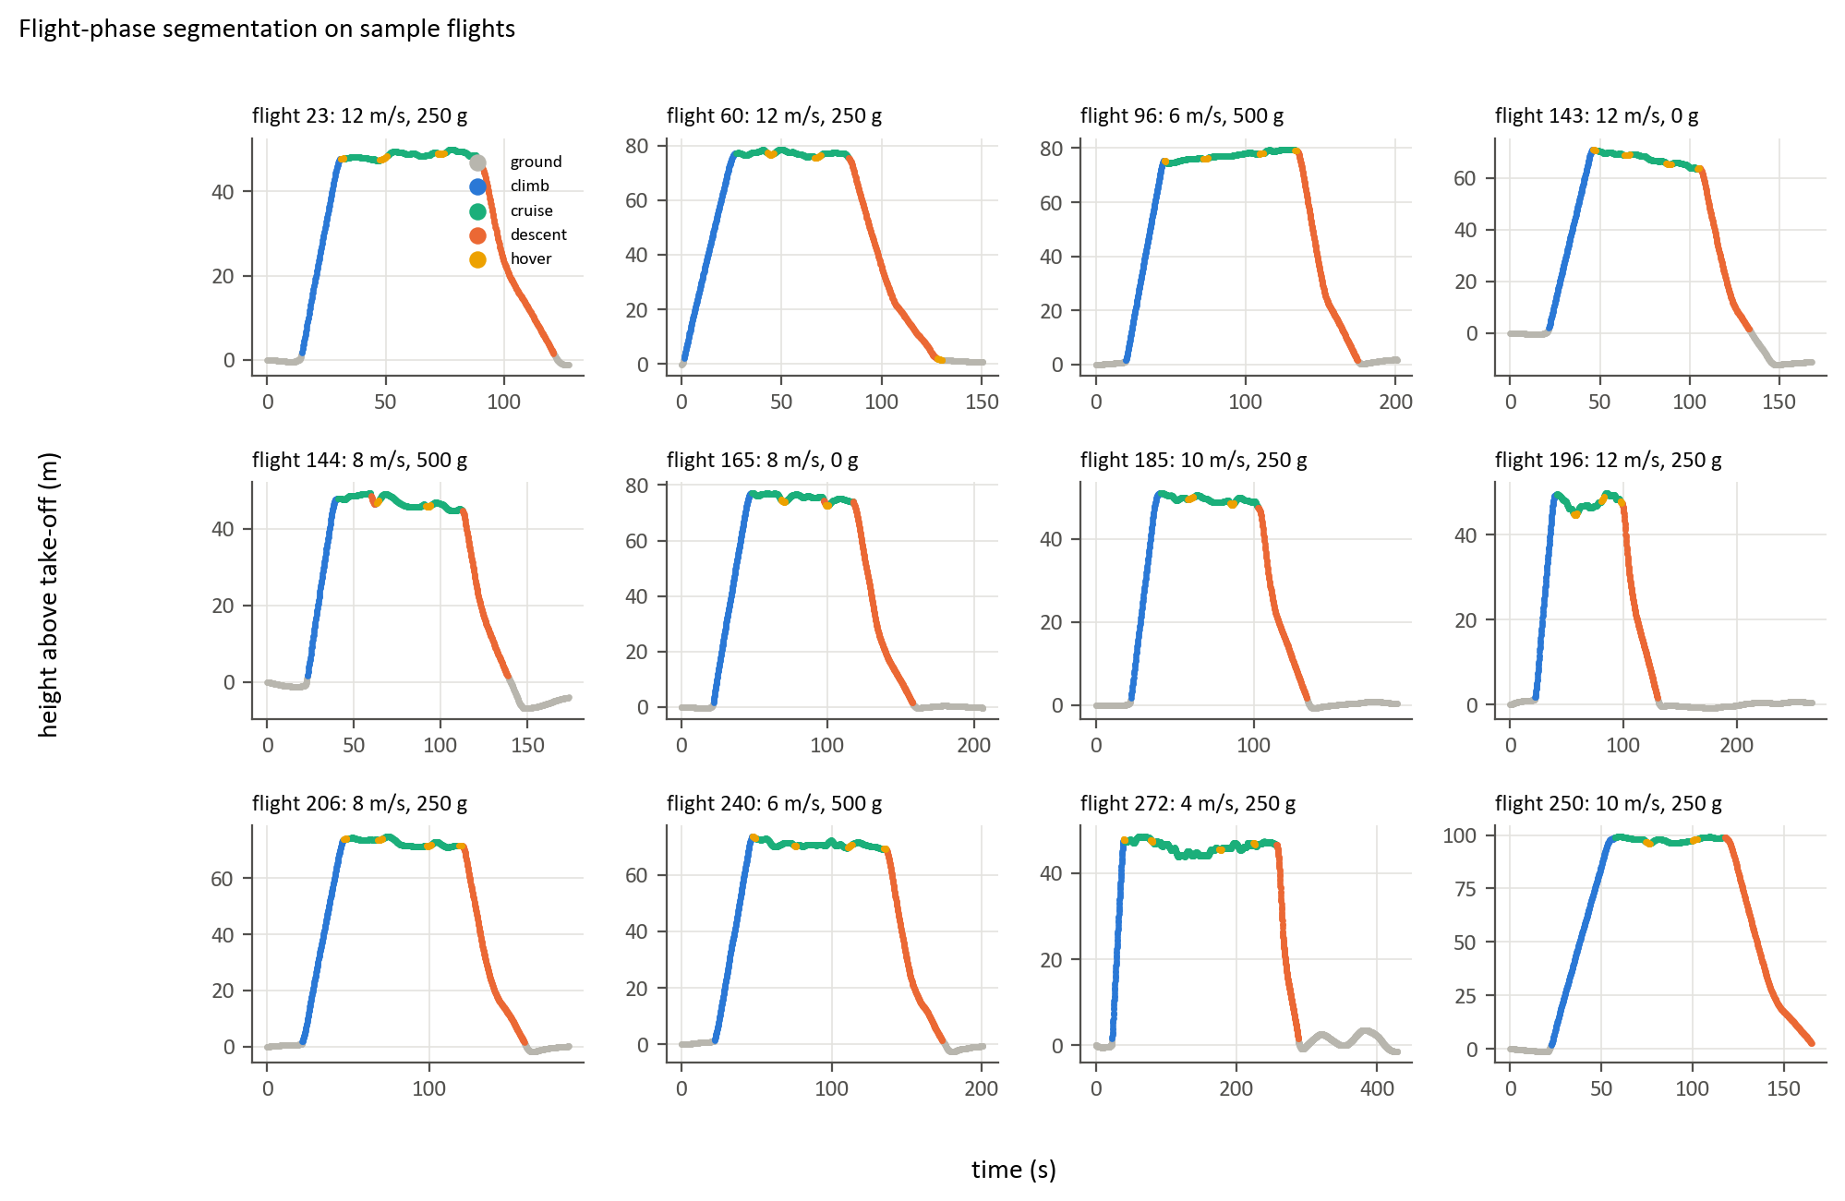
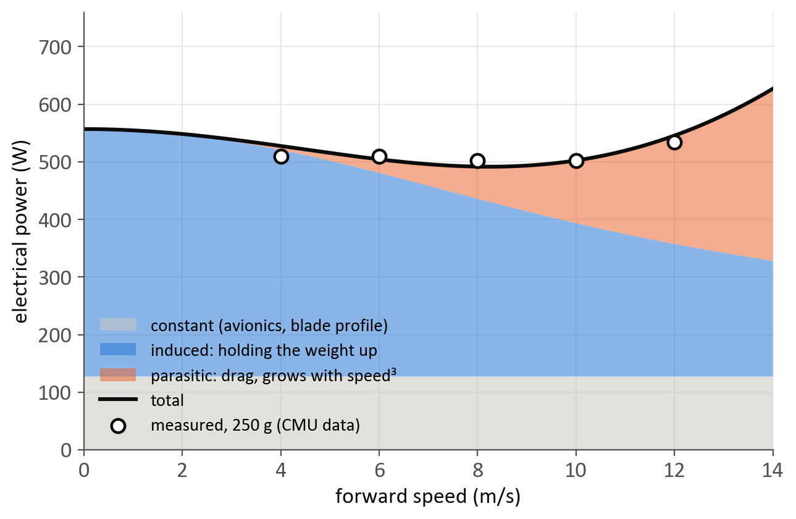
  LITERATURE REVIEW
Finding 1: Classical Battery State Estimation
  Battery management systems estimate charge using [5]:
    Coulomb counting: integrating current over time
    Open-circuit voltage lookup at rest
    Equivalent-circuit and Kalman-filter models
  Limitations: counting drifts, voltage lookup needs the battery at rest, and the output is state of charge, not whether a mission fits
Finding 2: Machine Learning Models
  Ridge regression [15], Random Forest [6] and XGBoost [7] on engineered features
  LSTM [8] and GRU [9] read the telemetry as a time series
  Limitations:
    Point estimates without a measure of confidence
    Random train/test splits can leak readings of the same battery
Finding 3: UAV Energy Consumption Models
  Rotor momentum theory: induced power falls with speed, drag grows with speed³ [4]
  Published drone energy models disagree widely [3]
  The CMU delivery-drone dataset [1], [17] and its energy study [2] allow validation on measured flights
Fig 3.1 Flight phases in the CMU delivery-drone data [1]
Fig 3.2 Rotor momentum theory: power components against speed [4]
Notes:
We reviewed three areas. Battery management systems estimate charge by counting energy or reading the voltage at rest, but they do not tell you whether a mission fits. Machine-learning models such as Random Forest, XGBoost, LSTM and GRU learn from telemetry, but usually give a single number, and random data splits can leak information. For mission energy, rotor physics explains why power first falls and then rises with speed, shown in figure 3.2, and published energy models disagree widely, so we checked ours against real measured flights.

Slide 5
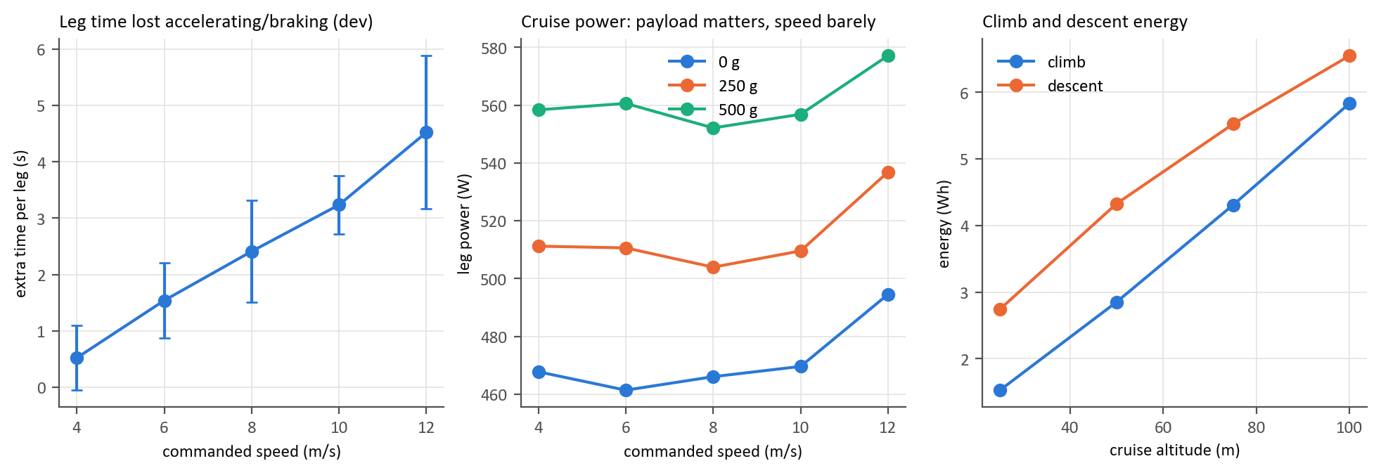
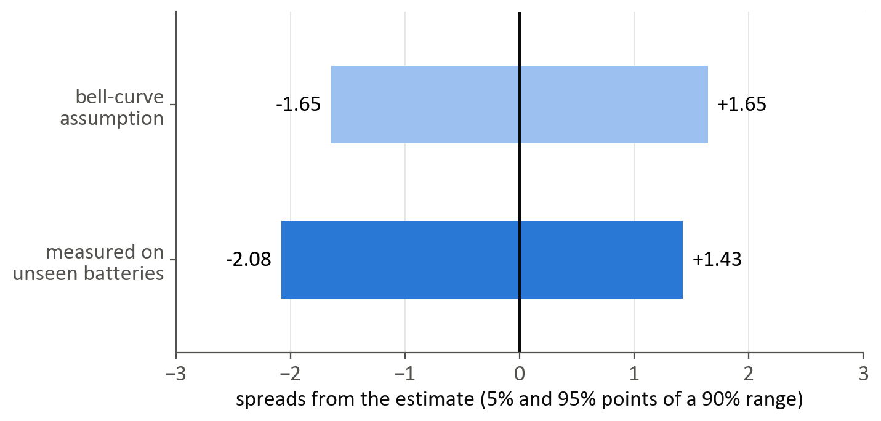
  LITERATURE REVIEW
Finding 4: Uncertainty Quantification
  Deep ensembles: several networks whose disagreement measures uncertainty [10]
  Quantile regression and conformal prediction give ranges with valid coverage on unseen data [11], [12]
  Grouped (correlated) data needs group-aware calibration [11]
Finding 5: Fleet Scheduling and Edge Computing
  Assigning tasks to vehicles is a matching problem (Hungarian method) [13]
  Mobile edge computing trades computation against communication energy and delay [16]
  Link capacity grows with bandwidth × log₂(1 + SNR) [14]
Research Gap
  In the work reviewed, battery energy and mission energy are predicted separately, mostly as single numbers
  We did not find a method that combines both, with calibrated ranges, into a probability of mission success
Our Motivation
  Mission-specific, uncertainty-aware GO / NO-GO decisions
  Honest evaluation on batteries never seen in training
  Physics-based models that extend to unseen conditions
Fig 3.3 Measured effects of speed, payload and altitude [1]
Fig 3.4 Bell-curve assumption against measured error multipliers [11]
Notes:
For uncertainty, deep ensembles and conformal prediction give ranges that can be checked on unseen data. For the extensions our guide asked for, task assignment is a matching problem, and edge computing trades computing energy against communication. The gap we found: in the work we reviewed, battery energy and mission energy are predicted separately, mostly as single numbers. We did not find a method that combines both, with calibrated ranges, into a probability of success. That is our motivation.

Slide 6
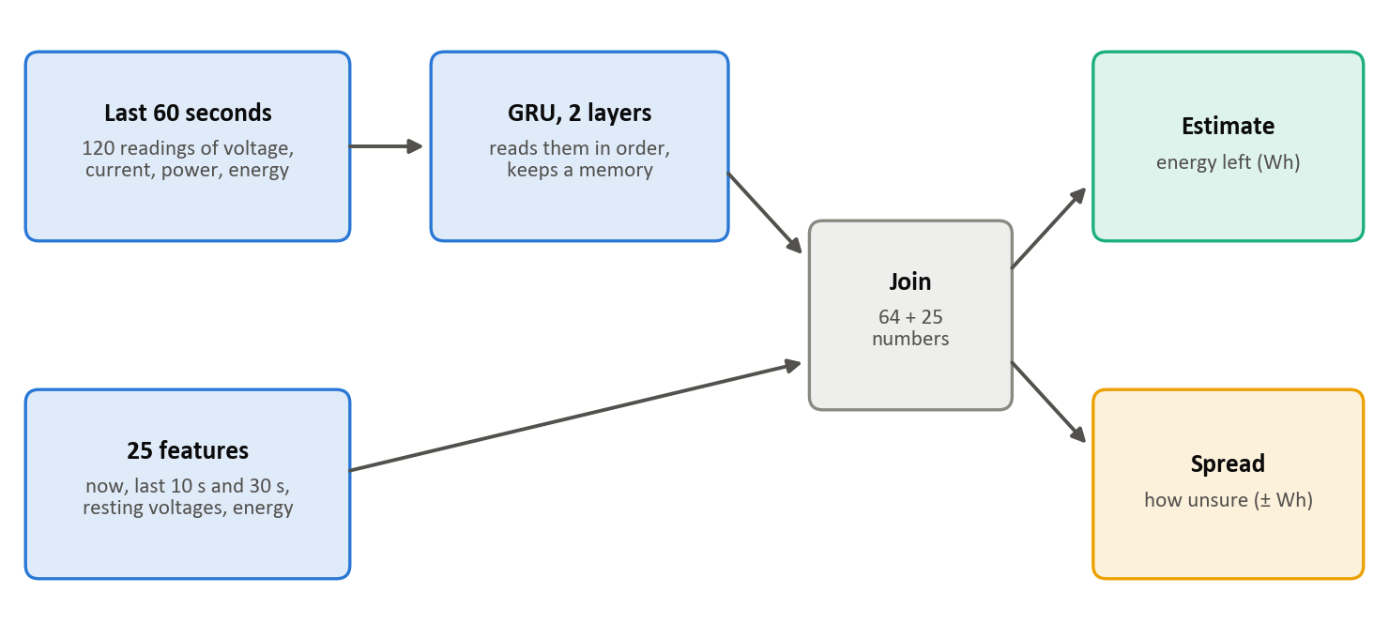
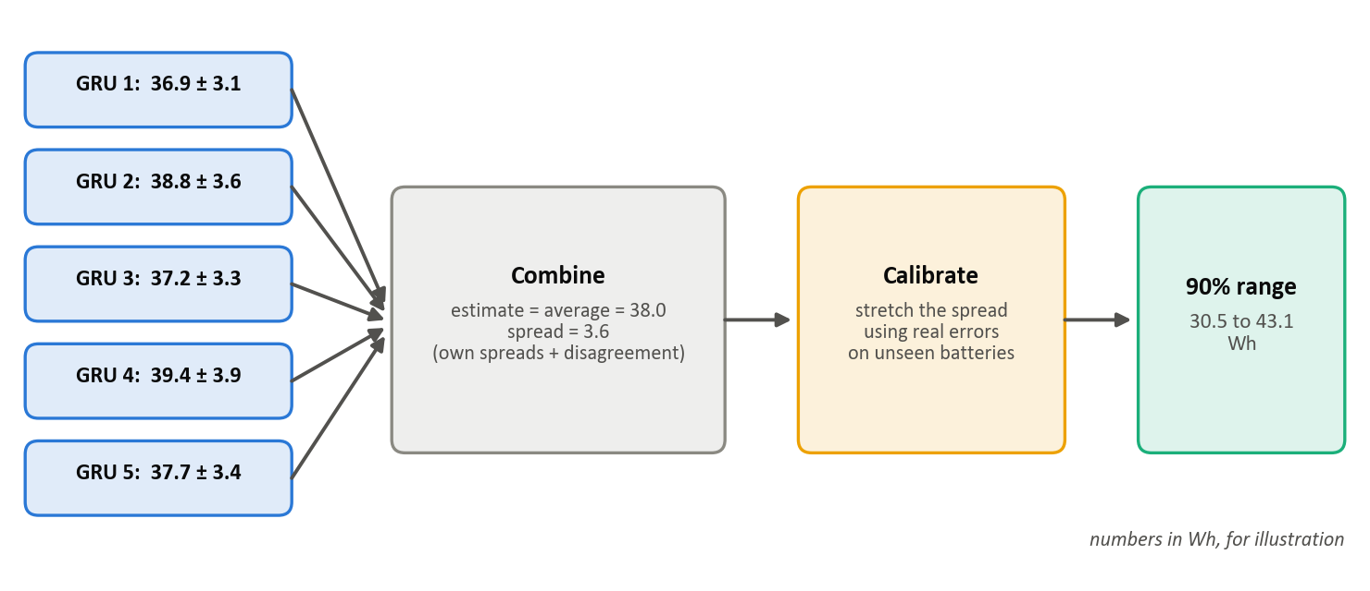
  KEY CONCEPTS
GRU Ensemble for Energy Available [9], [10]
  GRU: reads the last 60 s of battery readings in order and keeps a memory; joined with 25 battery features
  Ensemble: five GRUs averaged; their disagreement measures how unsure the estimate is
  Effect: one GRU 2.81 Wh on the test set; five averaged 2.19 Wh
  Why GRU: lowest error of the five algorithms compared (the brief)
Honest Evaluation
  Split by battery: 90 battery chains; 16 locked away for the test, none used in training
  Conformal calibration [11], [12]: range widths set from real errors on unseen batteries, so a 90% range holds the truth about 90% of the time
Fig 4.1 Inside one GRU network
Fig 4.2 From five networks to one calibrated range
Notes:
Model A predicts the energy left in the battery. A GRU reads the last minute of voltage and current in order, together with 25 summary features. We average five GRUs; where they disagree, the model is less sure. One GRU scored 2.81 watt-hours on the test, five averaged scored 2.19. To keep this honest, we split the data by battery, so no test battery was ever seen in training, and we set the range widths from real errors on unseen batteries.

Slide 7
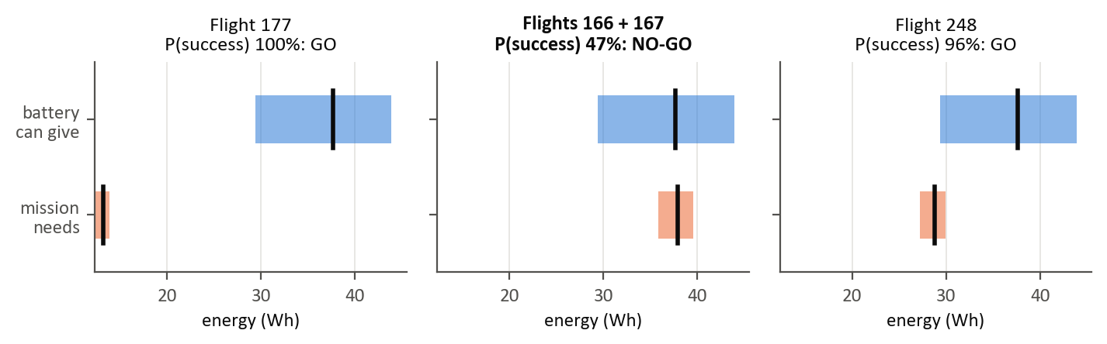
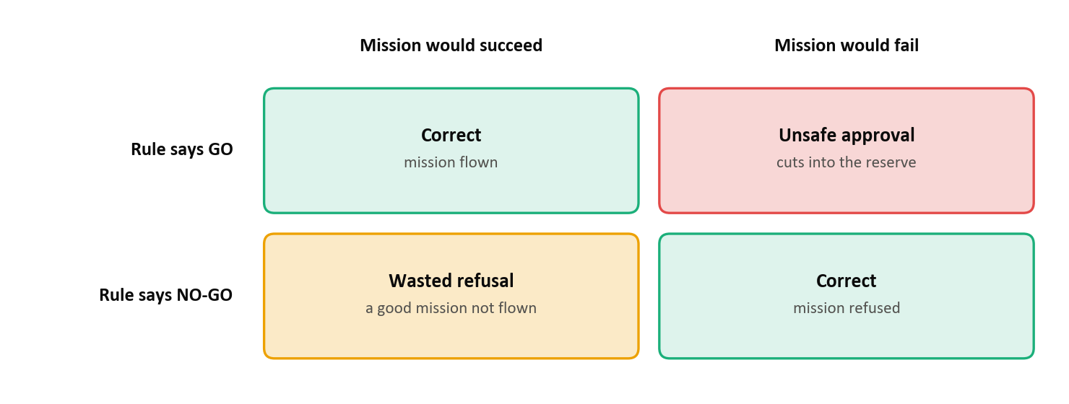
  KEY CONCEPTS
Physics + XGBoost for Energy Required [4], [7]
  Physics: leg power = lift + drag (grows with speed³); leg time = distance ÷ speed
  XGBoost: corrects only what the physics gets wrong
  Why: on unseen altitudes or payloads, physics-first erred 2.5–3.1%; pure tree models 9–14%
Probability of Success
  P(success) = P(energy available ≥ energy required), from the two ranges
  Decision: GO only if P(success) ≥ 0.95
  Two mistakes: unsafe approval (cuts into the reserve) and wasted refusal (a feasible mission refused)
Fig 4.3 One battery, three missions: overlapping ranges lower P(success)
Fig 4.4 The two kinds of decision mistake
Notes:
Model B predicts the energy a mission needs. Physics gives the power and time of each leg, and XGBoost corrects only what the physics gets wrong. Physics-first stays accurate on altitudes and payloads it has not seen. The two ranges are combined into P of success, the chance the battery has enough energy, and a mission is approved only at 95 percent or more. We count two mistakes: approving a mission that would cut into the reserve, and refusing one that would have been fine.

Slide 8
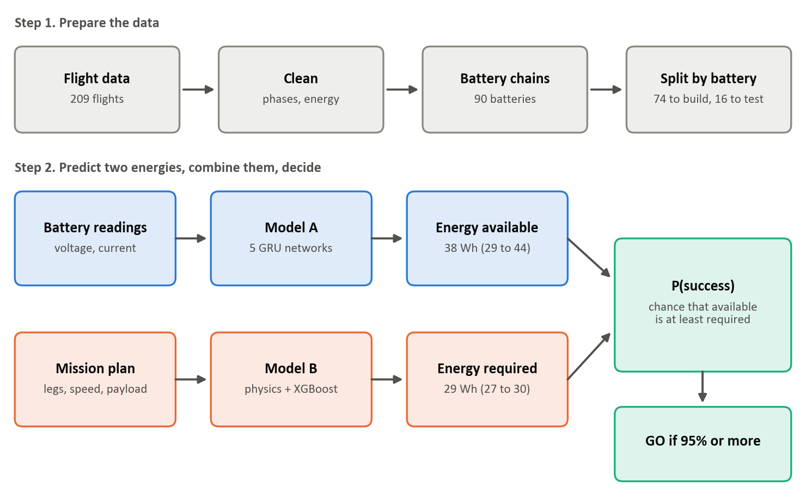
  PROPOSED SOLUTION
EnduroSense: Uncertainty-Aware Mission Feasibility
Two models, each with a calibrated range, combined into one probability of success.
Key Components
  Model A (energy available): five-GRU ensemble on battery telemetry, calibrated by battery
  Model B (energy required): physics + XGBoost for each mission part; error replay for the range
  Decision layer: GO if P(success) ≥ 0.95; abstains without a pre-flight reading; warns outside tested ranges
  Fleet layer: which drone takes which task, and when to swap batteries
Dataset
  CMU package-delivery quadcopter data [1], [17]: 209 flights, 257,896 readings, DJI Matrice 100
  5 speeds × 3 payloads × 4 altitudes; mostly one 3-leg route
Key Advantages
  Mission-specific decisions instead of a generic minutes estimate
  Ranges checked on batteries never seen in training
  Physics-based extrapolation to unseen conditions
Fig 5.1 EnduroSense system architecture
Notes:
This is the whole system. The battery model gives energy available with a range. The mission model gives energy required with a range. The decision layer combines them into a probability and approves at 95 percent. It refuses to answer if there is no battery reading before take-off, and warns when a mission is outside what it was tested on. We used the public Carnegie Mellon dataset: 209 real flights of a DJI Matrice 100.

Slide 9
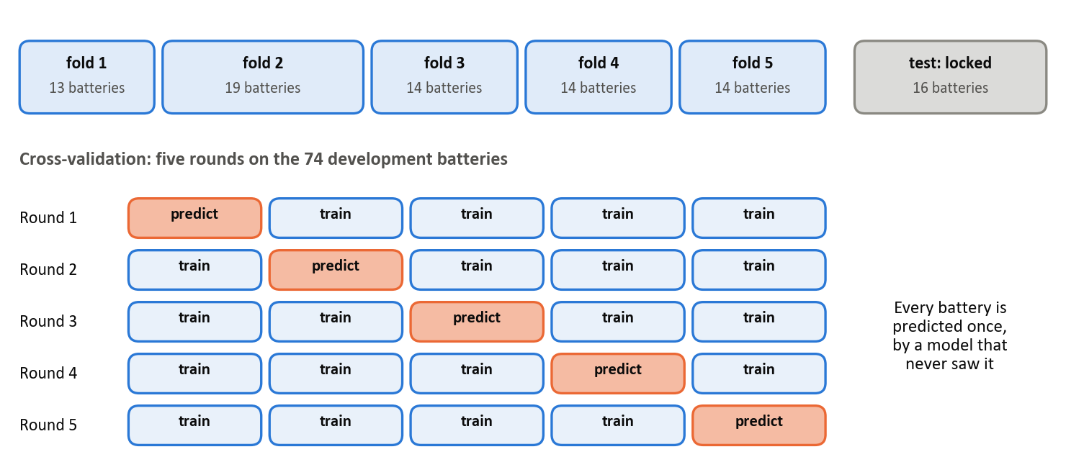
  IMPLEMENTATION
Overall Workflow
  Data preparation:
    Fixed text-sorted start times (7 days out of order), 4 mis-recorded times, a vertical-speed sign error, altitude drift after landing and 76 sensor glitches
    Energy = voltage × current × time; every reading labelled ground, climb, cruise, hover or descent
    Raw data never edited: every fix is applied in code
  Battery chains and locked split: 90 chains; 16 for the test, 74 for development in 5 folds
  Labels: energy left above the 22.6 V reserve, located along a fitted discharge curve
  Model A: 25 causal features + 60 s sequences; 3 baselines and 5 algorithms compared
  Model B: 587 legs from 193 flights; physics, ML and hybrid models for each part
  Ranges and decisions: calibration, P(success), what-if evaluation, fleet simulation
  Pipeline: ten numbered scripts; one command rebuilds everything in about 30 minutes
Fig 6.1 Locked test set and battery-grouped cross-validation
Notes:
We first cleaned the data and fixed several problems, for example flights sorted by text time and sensor glitches, without ever editing the raw files. We rebuilt 90 battery chains, locked 16 for testing and used the other 74 in five rounds of cross-validation, so every battery is predicted by a model that never saw it. The whole pipeline is ten numbered steps, and one command rebuilds everything in about 30 minutes.

Slide 10
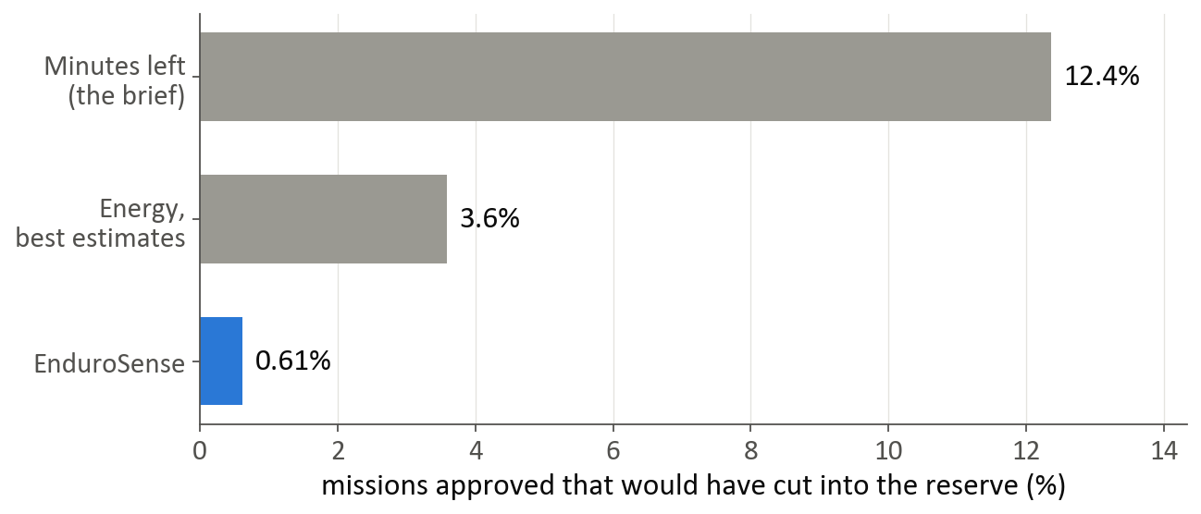
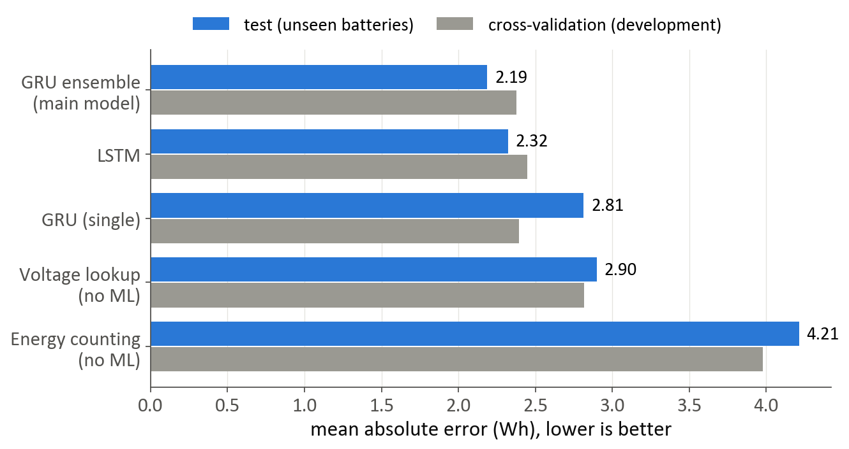
  RESULTS
Results on the Locked Test Set (16 batteries, 40 flights)
  Model A: 2.19 Wh error, against 2.90 Wh for the best non-ML method (voltage lookup)
  Model B: 3.1% error (2.6% on the trained route; 5.7% on unseen routes, over-predicted)
  90% ranges held the truth: Model A 93.8%, Model B 80.0%
  Unsafe approvals: 12.4% (minutes left), 3.6% (best estimates), 0.61% (EnduroSense); 0.00% at take-off
  Price: 24% of feasible missions refused, mostly close calls (median margin 3.8 Wh)
  Fleet simulation: 12.0 against 0.73 unsafe missions per 100, for about 10% more battery swaps
Success Criteria (fixed before the test)
  Met: Model A beats both non-ML baselines; decisions safer than minutes-left and best estimates
  Not met: Model B within 5% on unseen routes; ranges within 88–92% (within sampling noise)
Fig 6.2 Unsafe approvals on unseen batteries and flights
Fig 6.3 Model A error: cross-validation against test
Notes:
These are the results on the 16 batteries and 40 flights kept aside from the start. The battery model is 2.19 watt-hours off on average, better than the best method without machine learning at 2.90. The mission model is 3.1 percent off. Most importantly, the brief's minutes rule approved 12.4 percent of missions that would cut into the reserve. EnduroSense approved 0.61 percent, and none at take-off. The price is caution: it refuses about a quarter of good missions, mostly close calls. We set four criteria beforehand. Two were met. The mission model was 5.7 percent off on routes it had never seen, against a 5 percent target, and its ranges were too narrow. We reported these as they are.

Slide 11
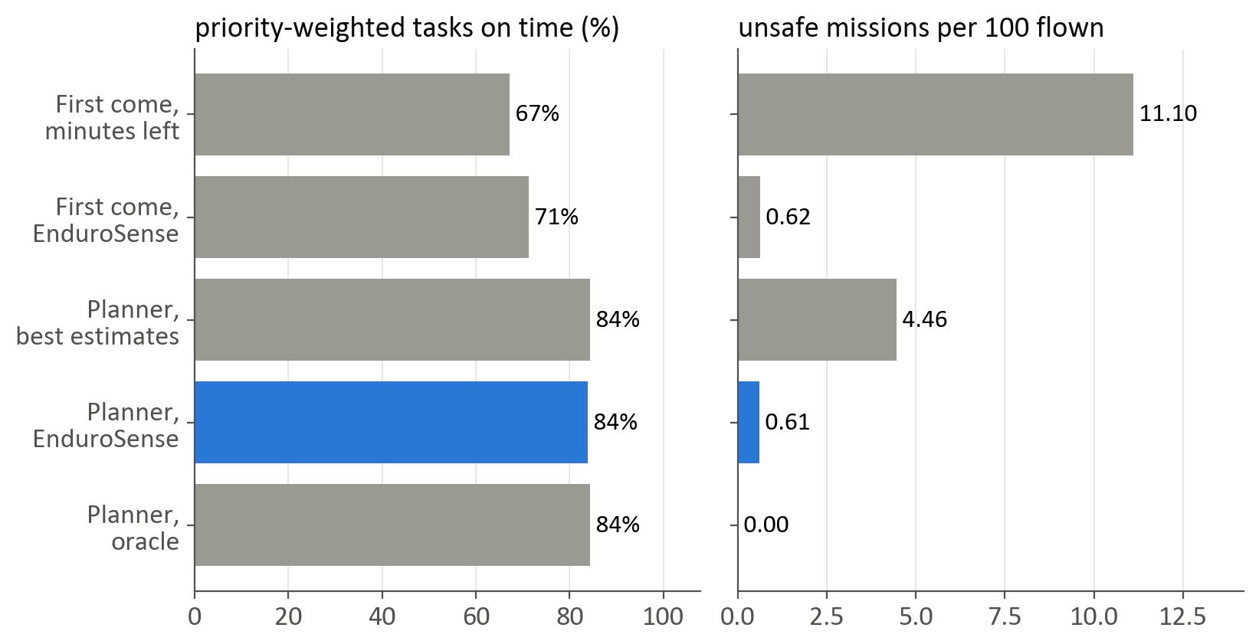
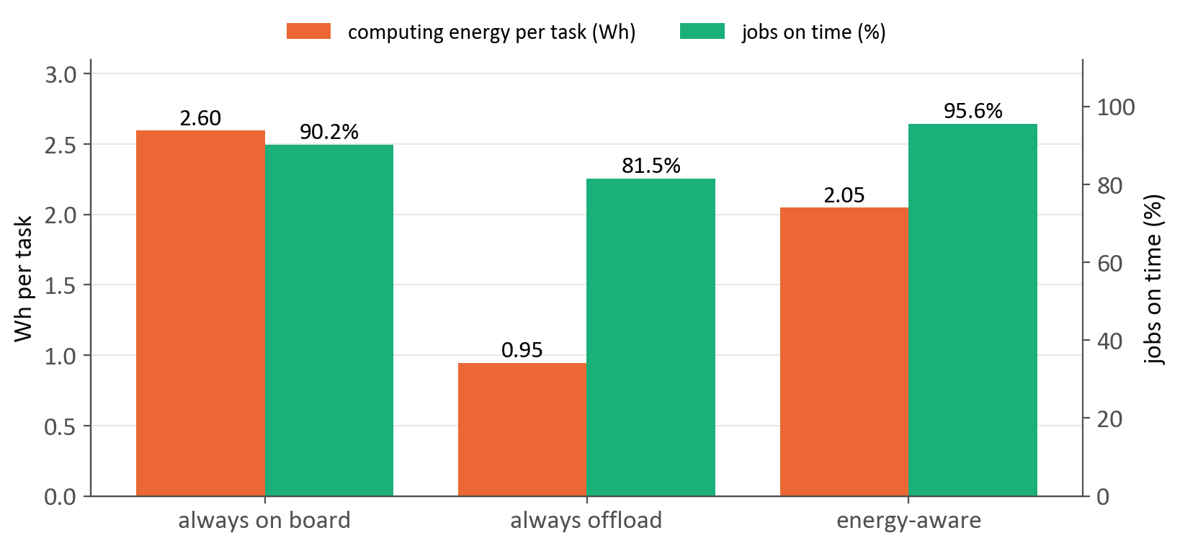
  EXTENSIONS
Extension 1: Energy-Aware Fleet Planner
  4 drones (payload limits 750, 500, 500, 250 g), 100 tasks a day with priorities and deadlines, 2 chargers
  Hungarian matching [13] of waiting tasks to free drones, only if the payload fits, the deadline is met and P(success) ≥ 0.95
  84% of priority-weighted work on time, against 71% first-come; 95% against 62% for urgent tasks
  0.61 unsafe missions per 100, against 4.46 with best estimates and 11.1 with minutes left
Extension 2: Where to Process Task Data
  On board, on an edge server, or on another drone; link rate from SNR [14], server availability [16]
  Hovering while waiting (539 W, measured) dominates the energy cost
  Energy-aware choice: 95.6% of jobs on time at 2.05 Wh per task, against 90.2% at 2.60 Wh on board
  Batteries and missions are real; schedules and radio settings are simulated. Criteria fixed beforehand: all three met
Fig 6.4 Fleet planner on unseen batteries (simulated schedules)
Fig 6.5 Where to process task data: energy and deadlines met
Notes:
Our guide asked for two extensions, which we built as simulations on the real batteries and missions. The first is a fleet planner that weighs priority, deadline, payload, charging and the probability of success. It got 95 percent of urgent tasks done on time, against 62 percent for a simple queue, while staying safe. The second decides where to process a task's data. The surprise was that hovering while waiting costs far more energy than the radio, so choosing by energy and deadline met more deadlines for less energy. The schedules and radio settings are simulated, and we say so.

Slide 12
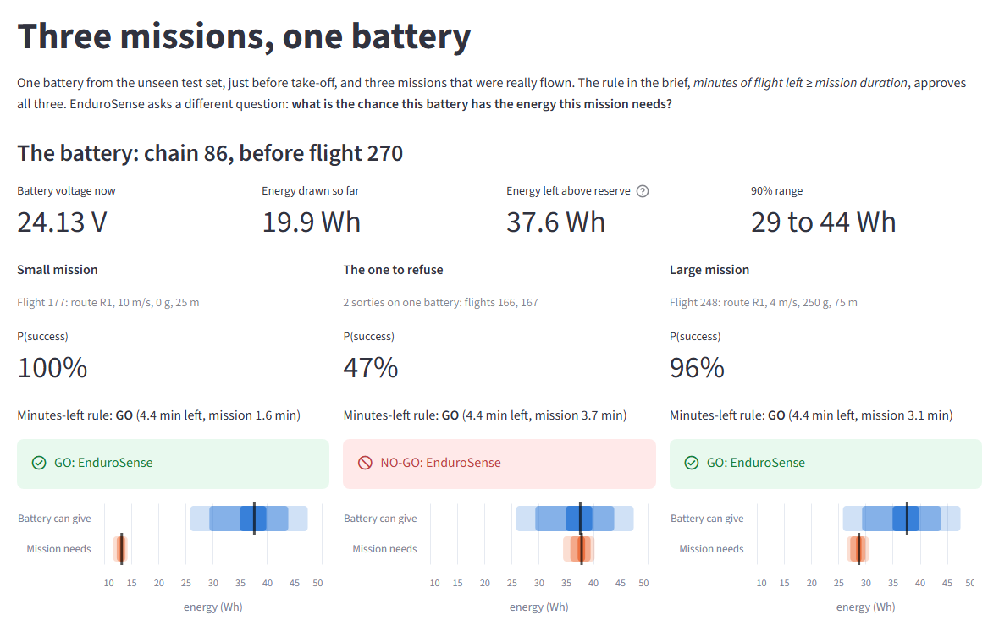
  TECH STACK
Programming Language
  Python 3.11
Machine Learning
  PyTorch: LSTM and GRU ensembles, trained on GPU
  scikit-learn (Ridge, Random Forest) and XGBoost
  SciPy: physics model fitting and Hungarian assignment
Data and Visualisation
  pandas, NumPy, PyArrow; Matplotlib and Altair
Application and Reporting
  Streamlit dashboard with six pages
  Report and slides generated from the result files
Dataset
  CMU Package Delivery Quadcopter Drone dataset [17]
Quality and Reproducibility
  pytest: 166 automated tests, including leakage and causality checks
  Fixed seeds, one-command rebuild, logged test-set access
Development Environment
  Local workstation with an NVIDIA RTX 4050 GPU (6 GB)
Fig 7.1 Streamlit dashboard: three missions, one battery
Notes:
We used Python throughout: PyTorch for the neural networks, scikit-learn and XGBoost for the other models, and SciPy for the physics fitting. The dashboard, shown in figure 7.1, is built with Streamlit and shows the decisions live. 166 automated tests check the calculations, and every result can be rebuilt with one command.

Slide 13
  CONCLUSION
  Designed and implemented EnduroSense, an uncertainty-aware mission feasibility system for UAVs that extends remaining-flight-time prediction
  Compared the five required algorithms; a five-GRU ensemble predicted energy available to 2.19 Wh on unseen batteries, beating the best non-ML method (2.90 Wh)
  A physics + XGBoost model predicted mission energy to 3.1%
  Calibrated ranges combined into P(success):
    Unsafe approvals fell from 12.4% (minutes left) to 0.61%, and to 0.00% at take-off
    Extensions: an energy-aware fleet planner and an edge-computing choice kept the same safety
Key Observations
  Risk is per battery: all unsafe approvals came from two batteries the model over-estimated
  The mission model extrapolates less well to longer unseen routes (5.7%), and its ranges were too narrow (80%)
  A well-tuned fixed margin performs about as well overall; the probability needs no tuning
Future Work
  Learn each battery's capacity in flight; more batteries and longer routes; timing on on-board hardware
Final Takeaway
Predicting energy with honest uncertainty, rather than minutes, turns a battery estimate into a safe, mission-specific decision.
Notes:
To conclude: EnduroSense turns a battery estimate into a mission decision with an honest measure of confidence. On unseen data it cut unsafe approvals from 12.4 percent to 0.61 percent. Its main limits are that the risk is per battery, the mission model extrapolates less well to longer routes, and it was tested on one drone type. The next steps are learning each battery's capacity as it flies and adding more batteries and routes.

Slide 14
  References
  [1] T. A. Rodrigues et al., “In-flight positional and energy use data set of a DJI Matrice 100 quadcopter for small package delivery,” Scientific Data, vol. 8, 2021.
  [2] T. A. Rodrigues et al., “Drone flight data reveal energy and greenhouse gas emissions savings for very small package delivery,” Patterns, vol. 3, 2022.
  [3] J. Zhang, J. F. Campbell, D. C. Sweeney, and A. C. Hupman, “Energy consumption models for delivery drones: A comparison and assessment,” Transportation Research Part D, vol. 90, 2021.
  [4] J. G. Leishman, Principles of Helicopter Aerodynamics, 2nd ed. Cambridge University Press, 2006.
  [5] G. L. Plett, Battery Management Systems, Volume I: Battery Modeling. Artech House, 2015.
  [6] L. Breiman, “Random forests,” Machine Learning, vol. 45, no. 1, pp. 5–32, 2001.
  [7] T. Chen and C. Guestrin, “XGBoost: A scalable tree boosting system,” in Proc. ACM SIGKDD Int. Conf. Knowledge Discovery and Data Mining, 2016, pp. 785–794.
  [8] S. Hochreiter and J. Schmidhuber, “Long short-term memory,” Neural Computation, vol. 9, no. 8, pp. 1735–1780, 1997.
  [9] K. Cho et al., “Learning phrase representations using RNN encoder–decoder for statistical machine translation,” in Proc. EMNLP, 2014, pp. 1724–1734.
  [10] B. Lakshminarayanan, A. Pritzel, and C. Blundell, “Simple and scalable predictive uncertainty estimation using deep ensembles,” in Proc. NeurIPS, 2017.
  [11] A. N. Angelopoulos and S. Bates, “A gentle introduction to conformal prediction and distribution-free uncertainty quantification,” 2021, arXiv:2107.07511.
  [12] Y. Romano, E. Patterson, and E. Candès, “Conformalized quantile regression,” in Proc. NeurIPS, 2019.
  [13] H. W. Kuhn, “The Hungarian method for the assignment problem,” Naval Research Logistics Quarterly, vol. 2, no. 1–2, pp. 83–97, 1955.
  [14] C. E. Shannon, “A mathematical theory of communication,” Bell System Technical Journal, vol. 27, pp. 379–423, 1948.
  [15] A. E. Hoerl and R. W. Kennard, “Ridge regression: Biased estimation for nonorthogonal problems,” Technometrics, vol. 12, no. 1, pp. 55–67, 1970.
  [16] Y. Mao, C. You, J. Zhang, K. Huang, and K. B. Letaief, “A survey on mobile edge computing: The communication perspective,” IEEE Communications Surveys & Tutorials, vol. 19, no. 4, pp. 2322–2358, 2017.
  [17] T. A. Rodrigues et al., “Data collected with package delivery quadcopter drone,” Carnegie Mellon University, dataset, 2021, doi: 10.1184/R1/12683453.
Notes:
These are the papers, books and the dataset we built on. The dataset is public, so all of our results can be checked.

Slide 15
THANK YOU
Notes:
Thank you. We are happy to take questions, and we can show the dashboard live.

