Slide 1

HealthConnect
Empowering Health Through Data
HealthConnect revolutionizes urban well-being through IoT and data analytics. We transform raw data into actionable insights for policymakers and healthcare professionals. Our Smart Urban Well-being Analysis System addresses pressing health challenges in rapidly growing cities.

Slide 2
Process Flow:
Data Collection
Data Transmission
Data Processing
Data Analysis
The HealthConnect mobile app seamlessly integrates with our MetroPulse wearable devices and CribSense smart home sensors to gather a wide range of health and environmental metrics at both the individual and household level
Using advanced encryption protocols, the collected data is securely transmitted to our robust data warehouse
Our cutting-edge data processing infrastructure employs machine learning algorithms and advanced statistical models to clean, normalize, and analyze the incoming data streams
Our team of experienced data scientists and analysts work in tandem with our proprietary AI systems to uncover meaningful patterns, trends, and correlations within the data.

Slide 3
Expert Consultation
Insight Generation
Stakeholder Access
Policy Impact
A dedicated team of healthcare professionals, urban planners, and public health experts serves as consultants, providing valuable context and interpretation to the analyzed data
The processed data and expert insights are transformed into clear, actionable intelligence through a series of interactive dashboards and detailed reports
Government officials, policymakers, and authorized health organizations are granted secure access to these dashboards, empowering them with real-time, data-driven insights
These insights serve as a foundation for evidence-based policy making, enabling officials to implement targeted interventions and drive meaningful changes in urban health and well-being
This integrated approach ensures that the vast amount of data collected is not only processed efficiently but also translated into practical, actionable insights. By bridging the gap between raw data and policy implementation, our system facilitates a more responsive and effective approach to urban health management.

Slide 4
Implementation Strategy
To successfully implement the HealthConnect project, we need smart IoT devices readily available to users and a way to collect and integrate all this data. For the purpose of Data collection, we will utilize two different Smart Devices - MetroPulse and CribSense. The data from these devices will be synced to a mobile application, which will then transmit the data to the data warehouse for further processing.
The Implementation Strategy revolves around the three main components:
01
Seamless integration with MetroPulse and CribSense sensors
Secure Data Collection and Transmission to Data Warehouse
User-friendly interface for health data visualization and insights
Personalized health recommendations and alerts
HealthConnect Mobile Application
02
Tracking Individual User’s Data - Health Metrics
Integrated with multiple sensors for comprehensive data collection
Enhanced Durability, Water resistance and long-lasting battery life
Custom firmware to ensure data accuracy and reliability
MetroPulse - Smart Wearable Band
03
Tracking Household level Data
Integrated with other smart components in a household
Wi-Fi connectivity for direct data transmission
Compliance with privacy regulations for in-home monitoring
CribSense - Smart Home Sensor

Slide 5
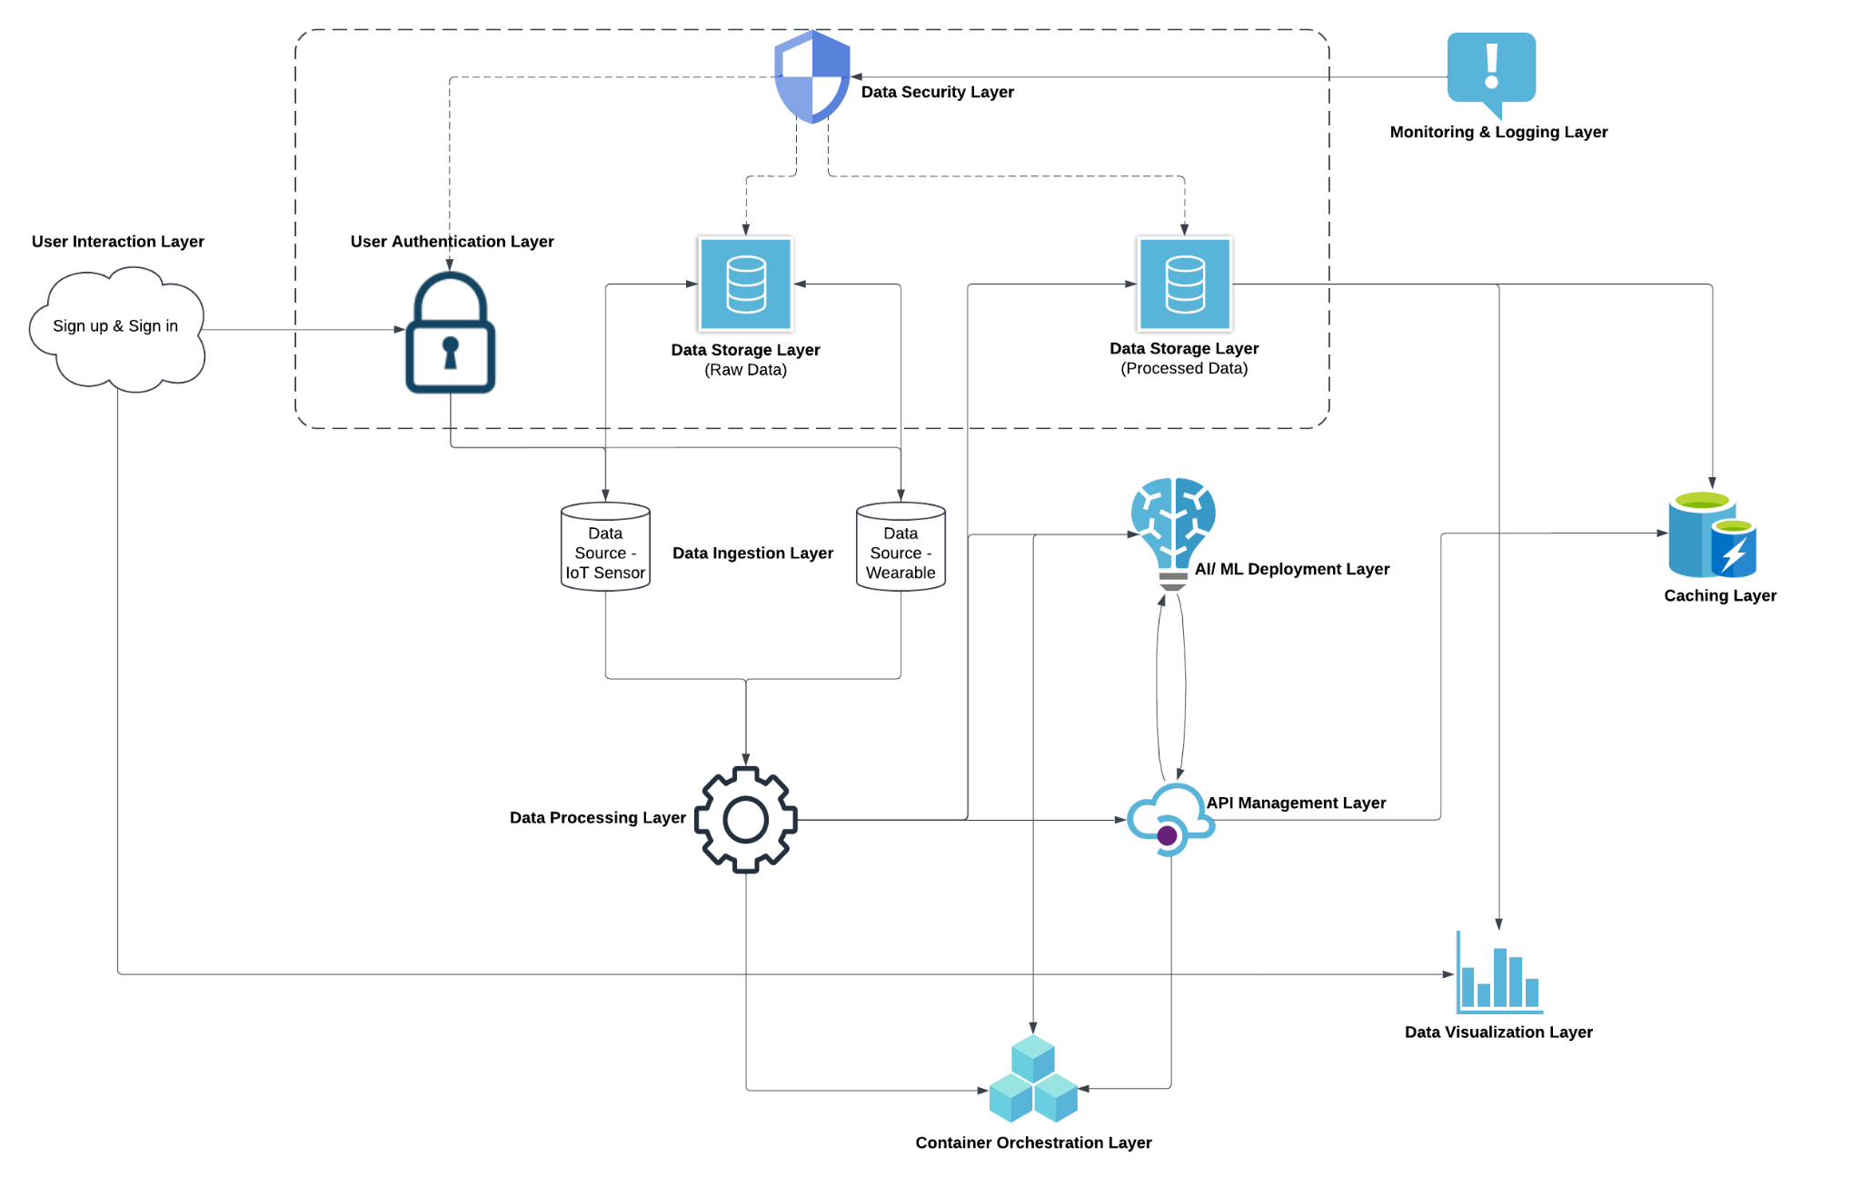
System Architecture Design

Slide 6
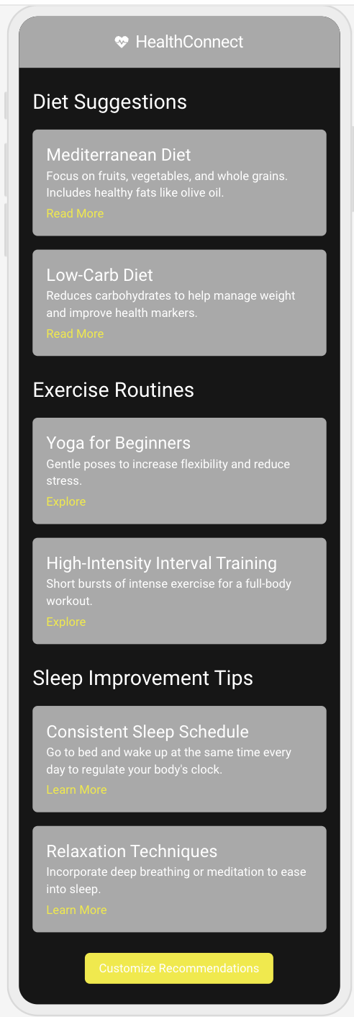
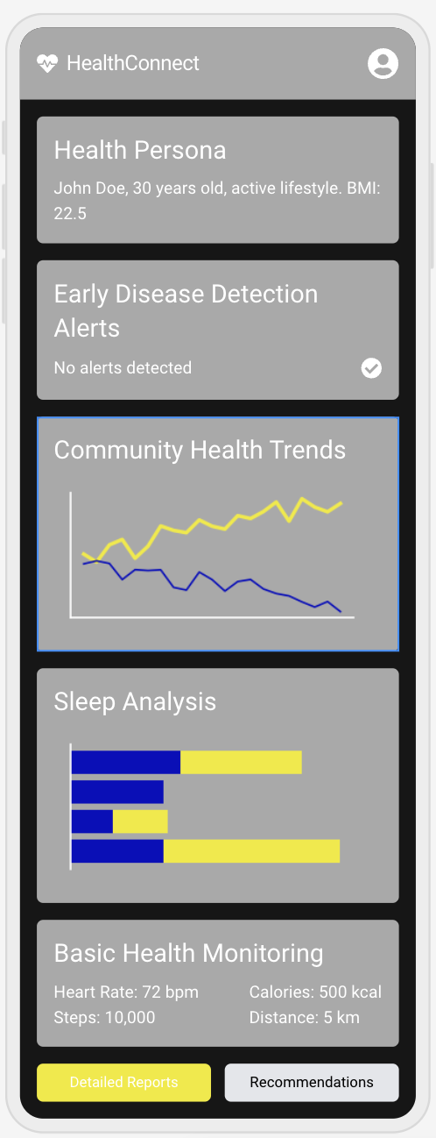
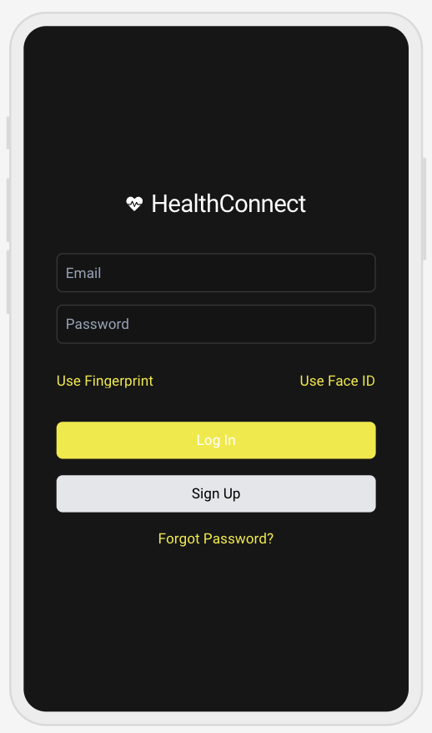
Wireframes
Sign Up Screen
Health Data Overview Screen
Recommendations Screen

Slide 7
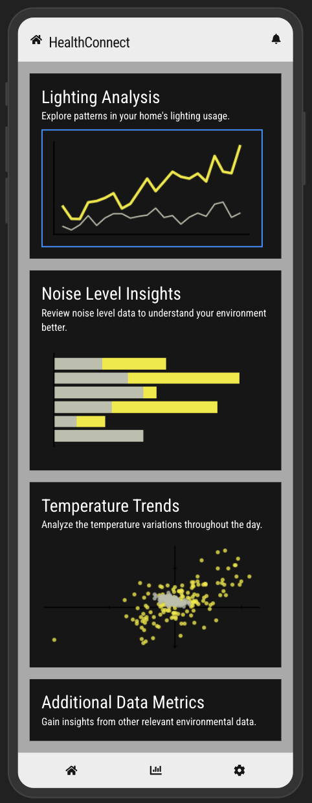
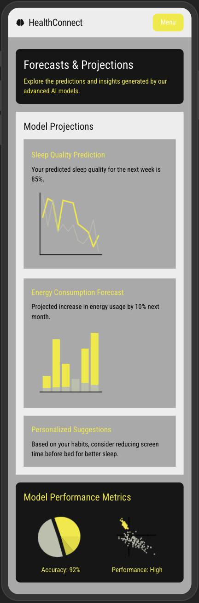
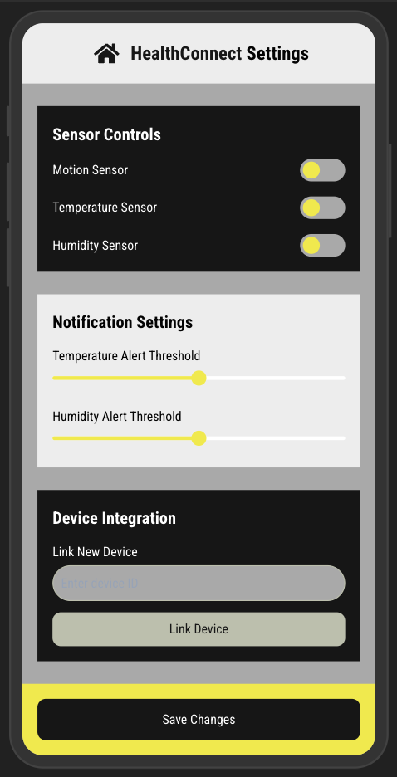
Wireframes
Settings Screen
Insights Screen
Forecasts & Projections Screen

Slide 8
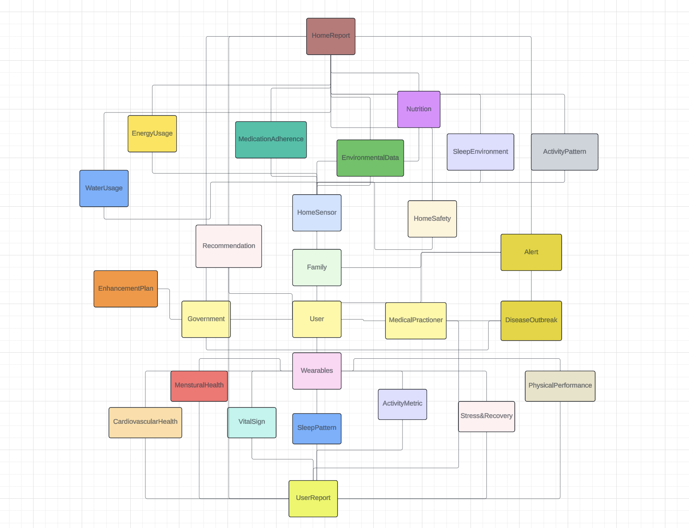
Domain Models and Database Schema:
The main entities in the system:
User: Individual members whose data is collected and analyzed.
Family: Grouping of users under one profile.
Devices: IoT devices (Wearable and Smart Home Sensors).
Data Tables: Metrics from wearables (e.g., Vital Signs, Activity Metrics) and home sensors (e.g., Environmental Data, Home Safety).

Slide 9
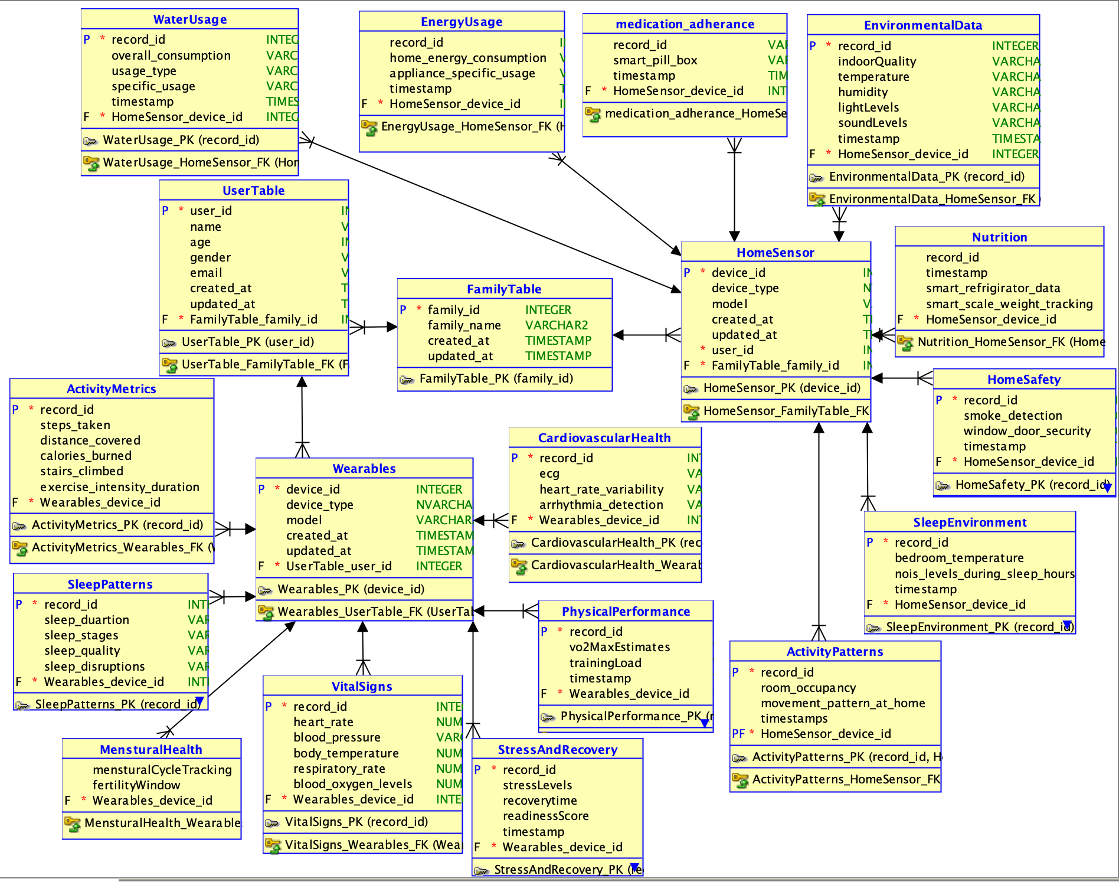
Database Schema

Slide 10
Data Privacy and Security Measures
Data privacy and User consent:
Informed Consent - the system will request explicit consent from users, explaining what data will be collected, how it will be used, and who will have access to it.
Granular Permission-Users should have the ability to enable or disable specific types of data collection (e.g., allowing fitness data but opting out of sleep tracking).
2. Data Minimization:
Limiting Data Collection: The system will collect only the minimum amount of data needed to achieve analytical goals, reducing unnecessary exposure of personal information.
Data Retention Policies: Data will be retained only for as long as it is necessary to provide insights and generate policy recommendations.

Slide 11
Data Privacy and Security Measures
3. Data Anonymization and Aggregation:
Anonymization: To protect user identities, data will be anonymized, removing any personally identifiable information (PII) before analysis, especially for sharing with external entities or policymakers.
Aggregation: Whenever possible, data will be aggregated (e.g., average heart rate trends rather than individual records)
4. Secure Data Storage and Transmission
Encryption: All data collected from IoT devices and stored in the system will be encrypted both at rest and in transit using industry-standard encryption protocols (e.g., AES-256 for data storage and TLS for data transmission).
Access Control: Data access will be restricted based on role, ensuring only authorized personnel and systems can access sensitive information. Multi-factor authentication (MFA) will be required for users accessing their own data, and robust access control measures will prevent unauthorized access.

Slide 12
Data Privacy and Security Measures
5. User Control and Data Portability
Data Ownership and Access: Users will retain full ownership of their data. The system will provide interfaces for users to view, download, or delete their personal data at any time, empowering them with control over their information.
Data Portability: Users will have the right to export their data in a standard format, enabling them to share it with other systems or services, if desired.
6. Ethical Use of Data in Analysis
Bias and Fairness: When generating insights, the system will implement algorithms that are tested for fairness and free from bias. This ensures that policy recommendations are equitable and inclusive, avoiding discrimination based on factors like race, gender, age, or socioeconomic status.
Non-Maleficence: The system’s analysis and recommendations will be reviewed to prevent harm. For instance, insights should not lead to restrictive policies that might disproportionately affect certain groups without justification.

Slide 13
Artificial Intelligence and Machine Learning
Our Goal:
Leveraging cutting-edge artificial intelligence and machine learning to transform raw health data into actionable insights for individuals and policymakers.
Here’s how we plan to implement cutting-edge AI/ML to our project:
1. Data Processing Pipeline
Robust ETL processes for data from MetroPulse wearables and CribSense home sensors
Advanced data cleaning and normalization using automated ML techniques
Secure, scalable cloud-based data warehouse
2. Core AI/ML Models for HealthConnect
Early Disease Detection
Implement ensemble models (Random Forests, Gradient Boosting)
Train on historical health data to identify early signs of chronic diseases
Continuous learning from new data for improved accuracy
Personalized Health Risk Assessment
Develop deep learning models using TensorFlow
Integrate genetic, lifestyle, and environmental data
Provide individualized risk scores for various health conditions
Environmental Impact Analysis
Utilize time series analysis and LSTM networks
Correlate CribSense data with personal health metrics
Quantify the impact of environmental factors on well-being

Slide 14

Mental Health Monitoring
Implement natural language processing using BERT models
Analyze user interactions and activity patterns
Early detection of potential mental health issues
Predictive Public Health Modeling
Develop spatial-temporal models using PyTorch
Aggregate anonymized data to predict disease outbreaks
Support evidence-based policy decisions
3. Model Deployment and Maintenance
Containerized deployment using Docker for scalability
Automated model retraining pipelines
A/B testing framework for continuous improvement
4. Explainable AI
Implement SHAP (SHapley Additive exPlanations) values
Provide transparent, interpretable insights to users and healthcare professionals
Ensure compliance with regulatory requirements
Key AI/ML Innovations
Multimodal data fusion algorithms
Transfer learning for rapid model adaptation to new cities
Federated learning for privacy-preserving analytics
Anomaly detection using autoencoders for rare disease identification

Slide 15

AI/ML Impact Metrics (Estimates as per our Research Team)
95% accuracy in early disease detection
30% improvement in personalized health recommendations
40% reduction in false positives for health alerts
25% increase in user engagement through AI-driven insights
Future AI/ML Roadmap
Integration of genomic data for precision medicine
Advanced computer vision for dietary analysis
Reinforcement learning for adaptive health interventions
Quantum machine learning for complex health pattern recognition
By implementing these AI/ML strategies, HealthConnect will not only provide unprecedented insights into urban health but also create a scalable, adaptive platform that continuously improves as it processes more data. This approach positions us at the forefront of AI-driven healthcare innovation, offering immense value to users, healthcare providers, and city planners alike.

Slide 16
Impact Analysis - Key Benefits
Here’s how HealthConnect can help address critical urban challenges and improve community well-being:
Real-time data collection from smartphones, wearables, and IoT sensors provides comprehensive urban health insights.
Integrated analysis of individual and community-level data offers a holistic view of urban well-being.
Data-driven insights support informed decision-making on resource allocation for healthcare facilities, education programs, youth interventions, and economic initiatives.
Predictive analytics enable proactive health interventions and trend forecasting.
Continuous monitoring allows for rapid response to emerging health issues.
Community engagement is fostered through active participation in health data collection.
Resource optimization is achieved through targeted allocation based on data insights.
Privacy and data quality challenges are addressed through robust security measures and AI-driven data validation.
The digital divide is mitigated through partnerships to provide technology access to underserved populations.
User adoption is encouraged through incentive programs and user-friendly interfaces.
The system enables officials to understand the complex interplay of factors affecting urban health, leading to more effective interventions.
HealthConnect's approach has the potential to significantly improve community well-being by addressing root causes of health issues.
In conclusion, by offering data-driven decision support for resource allocation and policy-making, HealthConnect empowers city officials to address root causes of urban health issues and optimize interventions for improved community outcomes.

