Slide 1
Evolution Of Course Recommendation System
Group-14 Guided By
Buddha Teja (201IT115)
Yash Nirmal (201IT168) Dr. Shrutilipi Ma’am
L.Koushik (201IT131)
Aditya Hegde (201IT105)
Balaji (201IT267)

Slide 2
Introduction
We discuss the challenges of filtering through the thousands of courses available on online learning platforms like LinkedIn.
The paper focuses on the evolution of course recommendation algorithms and the challenges of building a more effective course recommender system. Some the challenges we will face in this are cold start problem, creating an efficient system to model and analysing member interaction data and creating time efficient model.

Slide 3
Literature Survey
Base Paper : https://dl.acm.org/doi/pdf/10.1145/3357384.3357817
Published Year :- CIKM’19
Shivani Rao, Konstantin Salomatin, Gungor Polatkan, Mahesh Joshi, Sneha Chaudhari, Vladislav Tcheprasov, Jeffrey Gee, Deepak Kumar. 2019. Evolution of a course recommendation system. In Proceedings of the 28th ACM International Conference on Information and Knowledge Management .

Slide 4
Problem Statement
Our objective is to design and develop an effective course recommendation system that can provide personalized and relevant course recommendations to learners on an online learning platform.

Slide 5
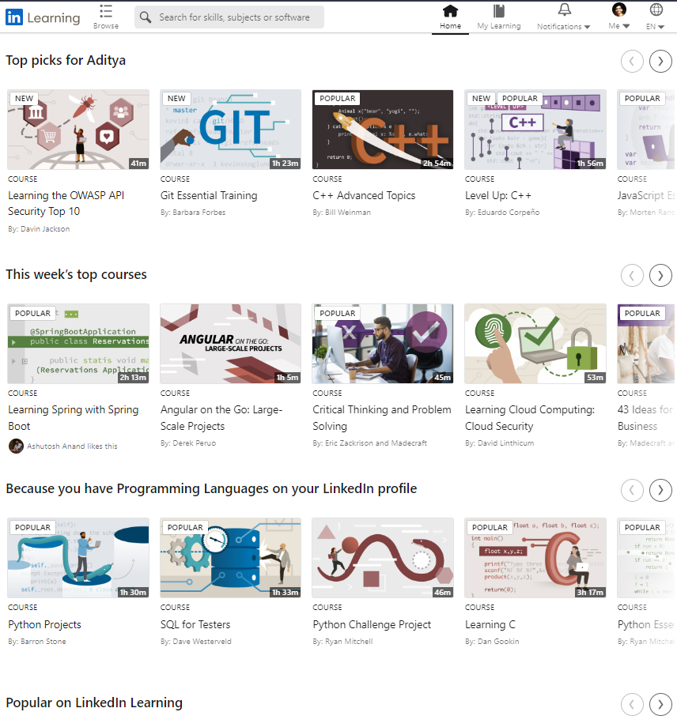
LinkedIn Learning Recommendations

Slide 6
Improvements
Pre-requisites for a course are also recommended.
Suggesting the top picks based on user profile.
Based on the top rated and viewed courses.
Suggesting based on the user history.
Recommended top courses based on the organization.
Suggesting based on the Difficulty levels.

Slide 7
Conclusions
Base paper discusses the evolution of a course recommender system for LinkedIn Learning, an online learning platform.
System was able to mine activity data and develop a scalable supervised learning platform that supported multi-channel models
Improvements using techniques like GLMix to consider per-member and per-course patterns and enhance the user experience.

Slide 8
Thank You

