Slide 1
Blockchain Based Auction Platform
Blockchain (IT465) Mid-Semester Evaluation
Presented by
Aditya Hegde (201IT105)
Rakshith Jain (201IT147)
Satyam Vats (201IT156)
Guided By
Dr. Bhawana Rudra
Assistant Professor
Department of Information Technology
National Institute of Technology Karnataka, Surathkal-575025

Slide 2
CONTENTS
Introduction
Literature Survey
Outcomes of Literature Survey
Problem statement and Objectives
Methodology
Results
Conclusions and Future Work
References

Slide 3
Introduction
Blockchain technology ensures transparency in traditional auctions by recording all transaction data in an immutable ledger. This builds trust among participants, as they can verify the auction history and authenticity of items.
Blockchain's security features help reduce fraud and disputes in traditional auctions. Smart contracts can automate and enforce the auction rules, ensuring fair and tamper-proof transactions. This, in turn, minimizes the need for intermediaries and associated costs.
Blind Auctions enhance user privacy and fairness by concealing bid information, reducing strategic influence. Participants are encouraged to bid honestly, resulting in more accurate price discovery and fair outcomes.
Blind Auctions seamlessly integrate into our blockchain-based auction platform, driven by smart contracts.This unique feature sets us apart, ensuring user trust and adding transparency and fairness to the auction process.

Slide 4
Literature Survey (Paper 1)
Research on Blockchain-Based E-Bidding System : Dan Wang, Jindong Zhao * and Chunxiao
Year: 2021
Algorithm Used
To develop the bidding process they have used "Permissioned blockchain" such as hyperledger. MSP(Membership Service Provider) and chaincode are used as hyperledger fabric that can control the access of users at same time and can also set time limits. Hyperledger fabric is an open source blockchain framework
Limitations
Hyperledger fabric (HLF) is a new technology which is changing rapidly. Adapting such technology is a huge challenge
Maintaining and operating a block chain system needs skilled technical personnel which is also an obstacle.

Slide 5
Literature Survey (Paper 2)
Secure E-Auction System Using Blockchain: UAE Case Study : Hani Qusa, Jumana Tarazi, Vishwesh Akre
Algorithm Used
They presented blockchain e-auction system that can be applied to improve the existing e-auction systems implemented in the UAE.
Hyperledger/fabric has been used to solve the security issues in traditional systems. It is an architecture that allows different functions to be combined. That can be used for production of smart contracts that can host any mainstream language
Limitations
Scalability is real problem in this system due complex nature of blockchain

Slide 6
Literature Survey (Paper 3)
In paper “ Distributed E-Voting and E-Bidding Systems Based on Smart Contract” , they:
Algorithm Used
The authors introduce the first decentralized electronic voting and bidding systems based on a blockchain and smart contract.
they also use cryptographic techniques such as oblivious transfer and homomorphic encryptions to improve privacy protection.
The proposed systems allow voters and bidders to participate in the opening phase and improve participant anonymity, the privacy of data transmission, and data reliability and verifiability.
Limitations
This process is a bit more complex than the existing process.

Slide 7
Literature Survey (Paper 4)
In paper “ Blockchain based Smart Contract for Bidding System” :
Algorithm Used
The smart contract is composed of the address of Auctioneer, the start auction time, deadline, the address of current winner, the current highest price.
In the experiments, the accounts are created through Ethereum wallet.
In miner stage, the MinerGate is used in miner stage for obtaining money to pay the transaction fee.
At recorder stage, the nodes of blockchain are synchronized to generate smart contract.
Technologies used : Solidity, Serpent, LLL, and EtherScript
Limitations
This process is longest as well as complex
Due to the complexity of this program, bidders may call the wrong contract function.

Slide 8
Literature Survey (Paper 5)
In paper ”Integration of Blockchain and Auction Models: A Survey, Some Applications, and Challenges “:
Algorithm Used
This paper discussed about various representative auction model types which are very important for the blockchain integration to auctions.
We got different auction mechanisms ,scenarios and solutions through which we can handle the auction.
Technologies used : Solidity, Ethereum.
Limitations
auction privacy protection, transaction ordering & fairness, decentralization of auction front-end

Slide 9
Literature Survey (Paper 6)
In paper ”An anonymous and fair auction system based on blockchain“, September , 2022:
Algorithm Used
This paper used IPFS(interplanetary file system) a distributed file system in order to address the issue of excessive file redundancy.
It showcases the signature scheme to generate and verify the key for the auction messages in order to maintain the privacy effectively.
Technologies used : Solidity, Ethereum,IPFS.
Limitations
This process is a lot more complex than the existing as using IPFS for storing auction details and implementing the generation of keys.

Slide 10
Literature Survey (Paper 7)
In paper ”Secure Online E-Auction System using Blockchain Technology” :-
designs an online system using blockchain technology and smart contracts. They
developed a user-friendly, reliable, trustworthy, and secure web application for the
auction of electronic goods and items.
They have used css, html, react js, AI, machine learning, chatbots, Ui path for automation on the frontend, and MySQL, MongoDB on the backend to fetch data from the database.
There are different modules for seller, bidder and admin with the provision of report generation as well.

Slide 11
Literature Survey (Paper 8)
In paper ”Blockchain Based M+1st-Price Auction With Exponential Bid Upper Bound“, 2023:
Algorithm Used
This paper describes the famous m+1st auction that sells identical goods to b bidders.
The top m winners can buy the goods at the m+1st price.
The bidders send their bids secretly to the manager as a bidding vector.
In their proposal, the role of manager was done by a smart contract.
By utilizing Smart Contracts, binary format bidding vector, and the ZkAnd zero-knowledge proof, they built the first secure M+1 st-price auction protocol that can reach an exponential bid upper bound without a manager and SHE or FHE.
Technologies used : Solidity, Ethereum.

Slide 12
Outcomes of Literature Survey
Smart Contracts:- Smart contracts are a fundamental aspect of blockchain technology. Literature survey discusses how smart contracts can automate and streamline various auction-related processes, such as bid validation, payment, and asset transfer.
Blockchain Platform :- Ethereum, Known for its smart contract capabilities, Ethereum is often chosen for building decentralized applications, including auction platforms. Hyperledger Fabric, A permissioned blockchain platform that offers high customization and privacy features, making it suitable for enterprise-level auction applications.
Cryptographic hash functions like SHA256 are used to create fixed-size, irreversible representations of data. These hashes are used in blockchain transactions and blocks to ensure data integrity.
Cryptocurrency Integration:- Since many blockchain-based auctions involve digital assets, integrating cryptocurrencies is common. Some papers incorporate wallets and payment gateways to facilitate transactions in cryptocurrencies like Ethereum (ETH) or other tokens.

Slide 13
Problem Statement
In traditional blockchain-based auction platforms, transparency and privacy concerns persist as participants can view each other's bids, leading to strategic and insincere bidding practices. This lack of privacy hampers genuine price discovery and fairness, undermining the auction process. The challenge is to enhance user privacy and promote honest bidding while maintaining the benefits of blockchain technology in our auction platform.

Slide 14
Objectives
Implement blockchain technology to ensure transparency by recording all auction transactions and bid histories on an immutable ledger. This transparency will provide participants with equal access to information, fostering trust in the auction system.
Enhance security by leveraging blockchain's robust cryptographic techniques to safeguard valuable assets and transactions, reducing the risk of fraud and unauthorized access.
Improve efficiency by automating various auction processes, such as bid verification and payment processing, thereby reducing the time and labor required and minimizing the need for intermediaries in the traditional auction model.

Slide 15
Methodology
The system uses ethereum server and solidity as the software for development , the system comprises interaction of blockchain technology , smart contracts and miners for transactions .
The proposed system takes details of the product from the seller and is been passed to the auctioneer , the auctioneer verifies and post it on the system with initial bid price , it allows the bidders (users) to bid on the product and if user 1 placed a bid which is lower than the user 2 then the user1 gets notified so that if he wants to bid more he can , in this the bidding continues to take place until the final day of placing the bids takes place.
The auctioneer announces the highest bid in the system without mentioning the bidders details , so that the transparence should be maintained.

Slide 16
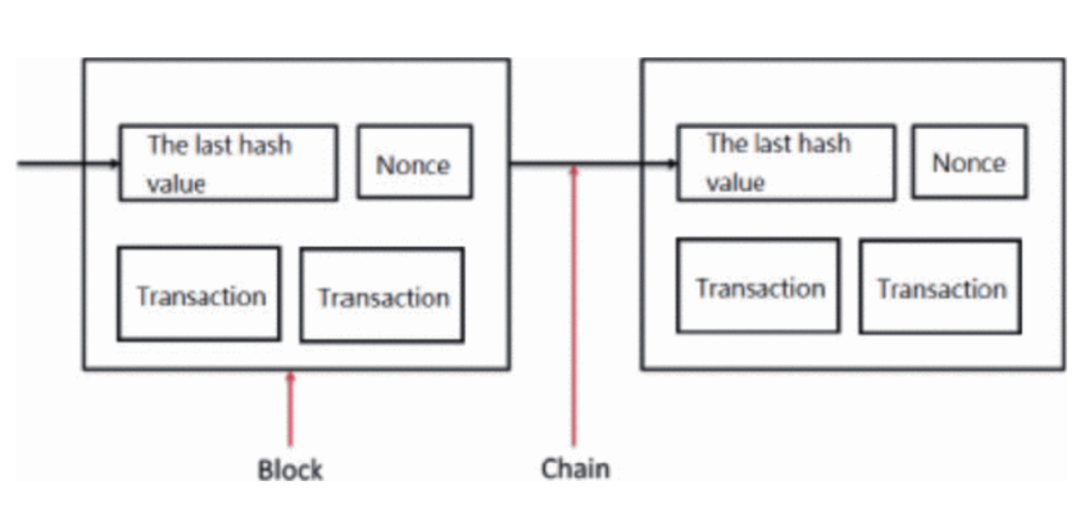
Methodology
The highest bidder gets notified and a smart contract is been made between the bidder and the auctioneer , and a time is given to the bidders to contact with the miners for transaction of the value , the system used for transaction is ethereum wallet when the auctioneer verifies that he has received the transaction the product transfer takes place . Then the funds are transferred to the seller .

Slide 17
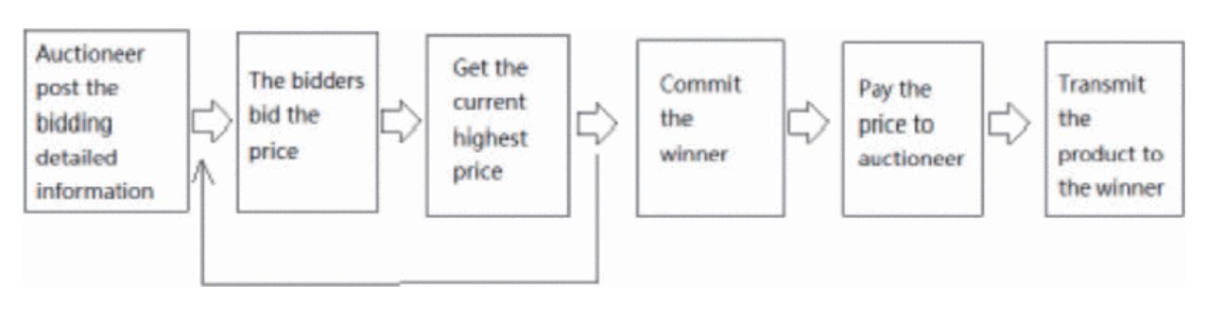
Methodology (Contd.)
In the initialization data, we will announce the following information in advance.
Auctioneer: The tenderer address used to record the originating contract.
startblock: Used to denote the time of the contract.
Endblock : Used to denote the ending time of the contract.
highestBidder: The address of the bidder who currently bids the product with the highest price.
highestBid: Used to record the current highest price.

Slide 18
Methodology (Contd.)
we define the following functions :-
Auction(): The auctioneer announces the item or service to be auctioned and sets the rules, including the starting bid, minimum bid increment, and the deadline for submitting bids.
Bid(): This function can be called by any person to perform the bidding action. Before the function is executed, AuctionStart and biddingTime are used to judge whether the contract is expired. The contract system will use highestBid and highestBidder to record the current highest price and the corresponding bidder's address.
reveal(): Opens the bid by calling this function, and compares the prices of all the tickets to get the final winner.
AuctionEnd(): In this function, AuctionStart and biddingTime are automatically used to determine the contract validity time. If the effective time ends, the successful bidder's Address and the current highest price will be automatically sent to the tenderer. This function will be disabled to avoid repeated execution.
withdraw(): Returns the amount of bids tendered by bidders other than the successful bidder.

Slide 19
Methodology (Blind Auction)
A blind auction is a type of auction in which bidders submit their bids without knowing the bids of other participants. The highest bidder wins the auction, and the amount they bid is the price they pay for the item or service being auctioned.
1) Everything Implementations are same as the normal auction. But some rules and procedures are there in the blind auction.
2) In order to make the bids sealed and confidential, the bid is represented by a hash produced by the keccak 256 hash function, an implementation of the SHA-3 hash algorithm. Bid hash hides the bid value. It is not possible to know the bid value until a later time when the bid is revealed. So far, only the deposit is known and required to make the bidder commit by depositing an amount with the bid.
3) The bidder’s deposit may differ from the enclosed bid value, which might confuse the competition by making them estimate the bid value based on the deposit. The bid value cannot exceed the deposit, but it can go as low as 0.

Slide 20
Blind Auction Advantages
Reduced Strategic Bidding: In a traditional open auctions, bidders often engage in strategic bidding by trying to gauge the competition and bidding accordingly. This can result in inflated or inefficient prices. In a blind auction, bidders are not aware of the other participants' bids, reducing the incentive for strategic bidding. Bidders are more likely to bid their true valuation, leading to potentially fairer prices.
Enhanced Privacy: Blind auctions provide more privacy for bidders. Participants do not need to reveal their intentions or valuation publicly, which can be especially important in sensitive or high-value auctions.
Increased Participation: Blind auctions can attract more participants, as bidders may be more willing to engage in an auction where their bids are confidential. This increased participation can lead to more competitive pricing.
Fairness and Equal Opportunity: Blind auctions promote fairness by ensuring that all bidders have an equal opportunity to participate and win without being influenced by the actions or knowledge of other bidders.

Slide 21
Novelty
Blind Auction :- Auction type in which bidders simultaneously submit bids to the auctioneer without knowledge of the amount bid by other participants.
Partial Ownerships :- We will allow partial ownership of certain products such as real states, bonds, NFTs.
Recommendations :- Recommending the auctions based on their interests or previous history.

Slide 22
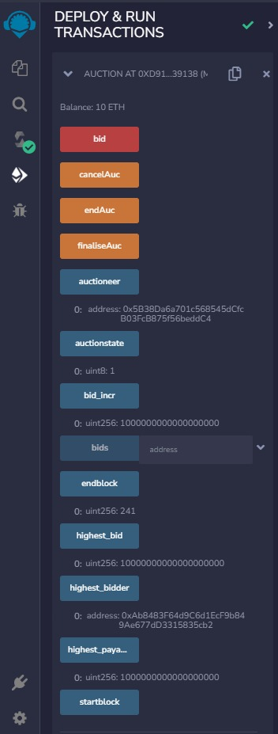
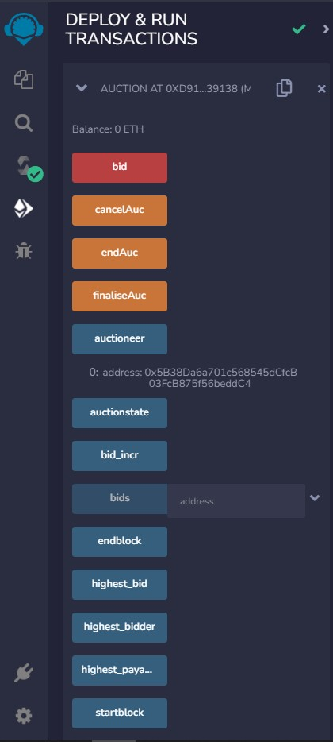
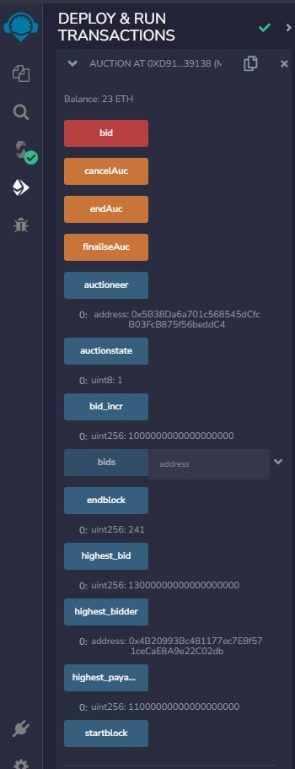
Results

Slide 23
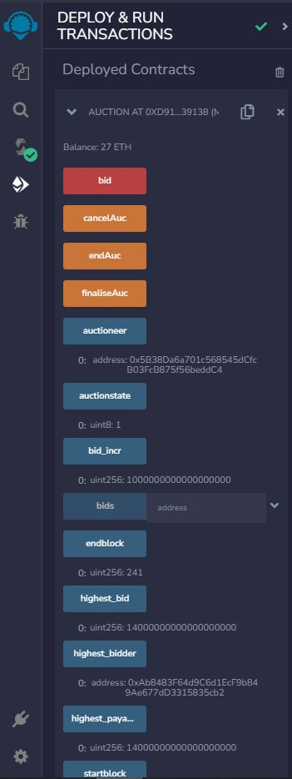
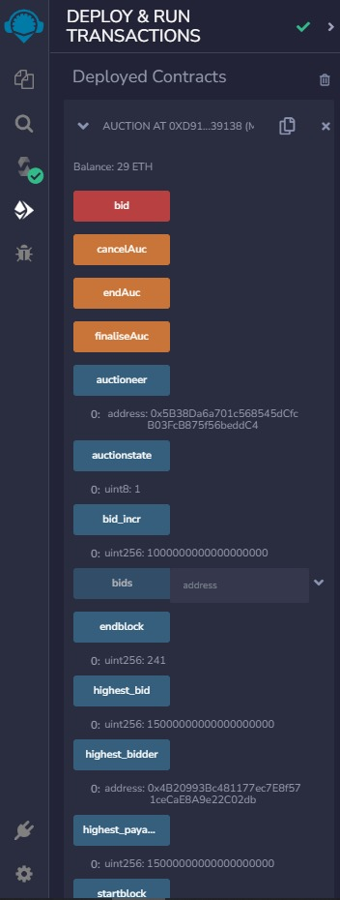
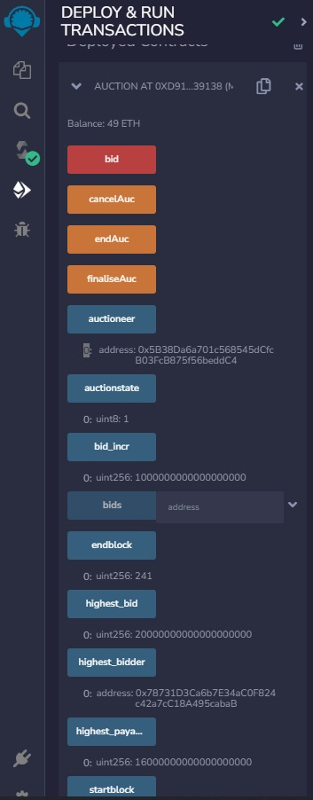
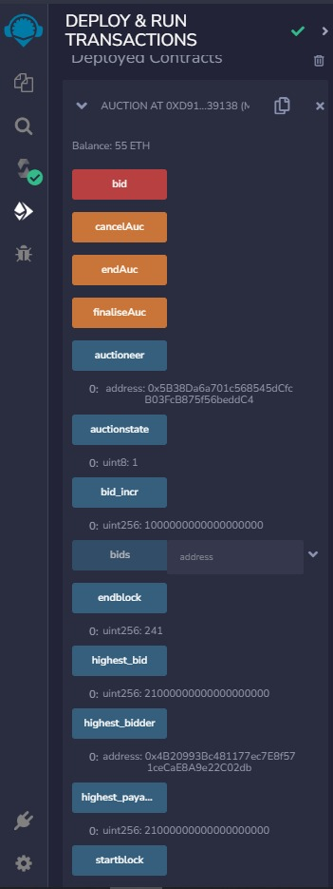
Results

Slide 24
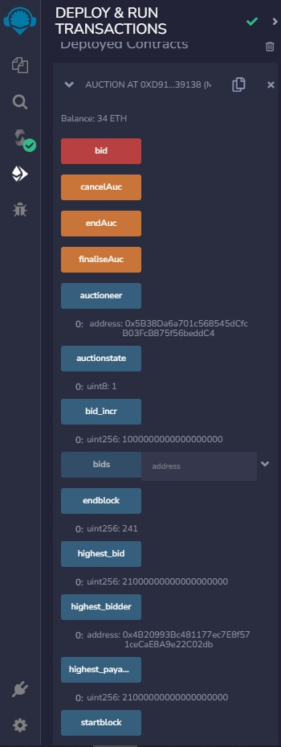
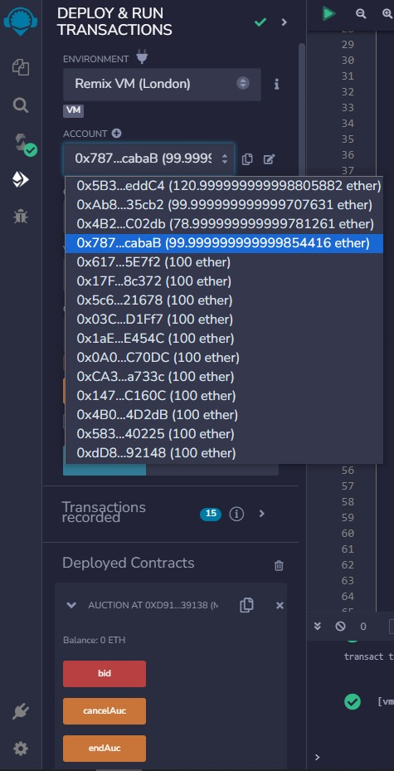
Results

Slide 25
Conclusions and Future Work
The use of blockchain technology in auctions can offer several advantages and improvements to the traditional auction process. We Implemented a auction system in which users can bid and buy the required products in a very transparent and secure system. We built smart contracts for the bidding, finalising and withdrawing processes, which automates various aspects of the auction process, such as bid verification, countdown timers and payment release upon successful bids. We also implemented a special novel blind auction in which users will not be knowing the highest bid and will bid without the competition prices. They will also profit the auctioneer with the more highest bid-prices.
Here are some of the Future Works :-
Implementing Partial Ownership Feature
Recommendation of Auctions based on his previous auction history
Converting it to Auction Website

Slide 26
References
Blockchain based smart contract for bidding system (June 2018)
https://ieeexplore.ieee.org/document/8394569
Secure E-Auction System Using Blockchain: UAE Case Study (June 2020)
https://ieeexplore.ieee.org/document/9118213
Research on Blockchain-Based E-Bidding System (April 2021)
https://www.researchgate.net/publication/351177519_Research_on_Blockchain-Based_E-Bidding_System
Distributed E-Voting and E-Bidding Systems Based on Smart Contract (April 2019)
https://www.mdpi.com/2079-9292/8/4/422
Integration of Blockchain and Auction Models: A Survey, Some Applications, and Challenges(2021)
https://arxiv.org/abs/2110.12534

Slide 27
References
6) An anonymous and fair auction system based on blockchain
Anonymous Fair Auction on Blockchain | IEEE Conference Publication | IEEE Xplore
7) Secure Online E-Auction System using Blockchain Technology
Secure Online E-Auction System using Blockchain Technology | IEEE Conference Publication | IEEE Xplore
8) Blockchain Based M+1st-Price Auction With Exponential Bid Upper Bound
https://ieeexplore.ieee.org/document/10225494/

Slide 28
Thank You

