Slide 1
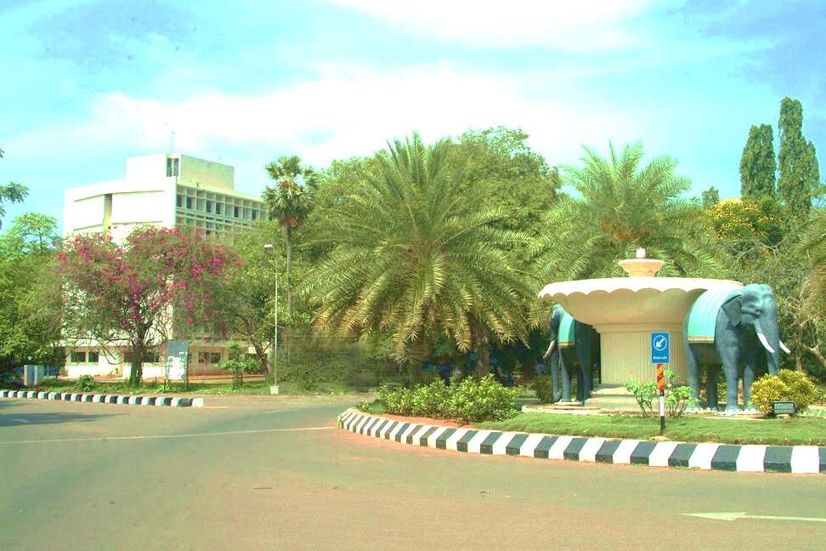
One Day National Workshop on
Design and Construction of Stainless-Steel Structures
On June 06 2024
Home
Organizers
Speakers
Workshop Schedule
Committee
Registration
Contact Us
Registration last date extended to June 04 2024
**Ticker

Slide 2



Home
Organizers
Speakers
Workshop Schedule
Committee
Registration
Contact Us
Joint Initiative by
Indian Institute of Technology, Madras
National Institute of Technology Karnataka, Surathkal
&
Jindal Stainless Limited

Slide 3
Home
Organizers
Speakers
Workshop Schedule
Committee
Registration
Contact Us
Objective of the Workshop
This one-day workshop is designed to empower engineers, builders, construction professionals, researchers and students with the knowledge and confidence to leverage the full potential of stainless steel in their projects.
Through a series of interactive sessions, you will gain a comprehensive understanding of:
The compelling advantages of stainless steel in construction: Discover its exceptional durability, corrosion resistance, aesthetic appeal, sustainability benefits, and lifecycle cost advantages.
Diverse applications across construction projects: Explore how stainless steel can be effectively utilized in architectural facades, roofing systems, structural elements, railings, cladding, rebars and more.
Essential design standards and specifications: Navigate the key considerations for selecting the right grade, finish, and fabrication techniques for your specific needs.
Expert insights from industry leaders: Gain valuable perspectives from renowned engineers who have successfully integrated stainless steel into their projects.
Hands-on learning and case studies: Delve into real-world examples to understand the practical implementation of stainless steel in various construction contexts.
By the end of this workshop, you will be equipped with:
The knowledge and confidence to confidently specify and integrate stainless steel into your projects.
A comprehensive understanding of design considerations, best practices, and potential challenges.
Valuable resources, including design material and reference guides, to support your future projects.

Slide 4
Home
Organizers
Speakers
Workshop Schedule
Committee
Registration
Contact Us
Workshop Brochure
Please find attached workshop brochure here
Who can attend
Engineers (Civil, Structural, etc.), Builders and Contractors, Project Managers and Procurement Specialists, Engineering Students, Anyone interested in sustainable building practices.
This workshop is open to all levels, from those with no prior knowledge of stainless steel to those who want to enhance their existing expertise.

Slide 5
Home
Organizers
Speakers
Workshop Schedule
Committee
Registration
Contact Us
Workshop Brochure
Please find attached workshop brochure here
Who can attend
Engineers (Civil, Structural, etc.), Builders and Contractors, Project Managers and Procurement Specialists, Engineering Students, Anyone interested in sustainable building practices.
This workshop is open to all levels, from those with no prior knowledge of stainless steel to those who want to enhance their existing expertise.

Slide 6
Home
Organizers
Speakers
Workshop Schedule
Committee
Registration
Contact Us
Venue for the Workshop
Google Maps Link:
CSIR Auditorium, IIT Madras
How to Reach the Venue
https://web.iitm.ac.in/ibse/symposium/images/How-to-reach-IIT-Madras.pdf

Slide 7
Home
Organizers
Speakers
Workshop Schedule
Committee
Registration
Contact Us
Indian Institute of Technology, Madras
Standing tall as a premier institute of national importance, the Indian Institute of Technology Madras (IIT Madras) has carved a remarkable niche in the landscape of Indian engineering education and research. Established in 1956 with collaboration from the German government, IIT Madras has blossomed into a powerhouse of technical excellence.
Its impact on the nation's engineering field is undeniable. IIT Madras fosters a vibrant environment for learning and innovation, producing generations of highly skilled engineers who have gone on to shape various sectors. From contributing to India's space program and advancements in nuclear energy to spearheading developments in infrastructure, communication technologies, and sustainable solutions, IIT Madras alumni have been instrumental in propelling the nation's engineering prowess.
Beyond academics, IIT Madras actively engages in research collaborations with industries and institutions, tackling real-world challenges and developing solutions that benefit society. This institute fosters an entrepreneurial spirit, nurturing startups that offer innovative products and services.
In conclusion, IIT Madras stands as a beacon of engineering excellence in India. Its commitment to education, research, and innovation has not only produced top-notch engineers but also significantly contributed to the nation's technological advancement and progress.

Slide 8
Home
Organizers
Speakers
Workshop Schedule
Committee
Registration
Contact Us
National Institute of Technology, Karnataka
Nestled on the scenic coast of Karnataka, the National Institute of Technology Karnataka (NITK), formerly known as Karnataka Regional Engineering College (KREC), has established itself as a prominent institution in India's technical education landscape. Founded in 1960, NITK boasts a rich legacy of nurturing exceptional engineers who have left their mark on various industries.
NITK's contribution to the nation's engineering excellence is multifaceted. The institute provides a rigorous academic curriculum across various engineering disciplines, preparing students to become well-rounded professionals. Its strong focus on research fosters innovation and problem-solving skills, leading to advancements in crucial areas. NITK alumni have played a vital role in shaping India's infrastructure development, contributing to the construction of bridges, dams, and power plants. They have also been instrumental in the growth of core sectors like manufacturing and aerospace, propelling India's technological capabilities.
Furthermore, NITK actively collaborates with industries, fostering knowledge transfer and ensuring its curriculum remains relevant to contemporary needs. The institute's emphasis on entrepreneurship empowers students to translate their ideas into viable solutions, further contributing to the nation's technological ecosystem.
In essence, NITK, Suratkal serves as a vital engine for engineering excellence in India. Through its commitment to quality education, cutting-edge research, and industry engagement, the institute has empowered generations of engineers who are driving the nation's technological progress and shaping its future.

Slide 9
Home
Organizers
Speakers
Workshop Schedule
Committee
Registration
Contact Us
JINDAL STAINLESS
India’s leading stainless steel manufacturer, Jindal Stainless, has an annual turnover of INR 35,700 crore (USD 4.30 billion) in FY23, and has 3 million tonnes of annual melt capacity. It has seven stainless steel manufacturing and processing facilities in India and abroad, including in Spain and Indonesia, and a worldwide network in 15 countries. In India, there are ten sales offices and six service centres. The company’s product range includes stainless steel slabs, blooms, coils, plates, sheets, precision strips, wire rods, rebars, blade steel and coin blanks.
Integrated operations have given Jindal Stainless the edge in cost competitiveness and operational efficiency, making it one of the world’s top stainless steel players. Founded in 1970, Jindal Stainless continues to be inspired by a vision for innovation and enriching lives and is committed to social responsibility. The company boasts an excellent workforce, value-driven business operations, customer centricity and the best safety practices in the industry. Jindal Stainless remains committed to a greener, sustainable future, fuelled by environmental responsibility. The company manufactures stainless steel using scrap in an electric arc furnace, the least greenhouse gas emission route since it enables 100% recyclability with no reduction in quality, thereby achieving a circular economy. The company aims to reduce carbon emission intensity by 50% well before FY 2035 and achieve Net Zero by 2050.

Slide 10
Home
Organizers
Speakers
Workshop Schedule
Committee
Registration
Contact Us
Chief Guest
Keynote Speakers

Slide 11
Home
Organizers
Speakers
Workshop Schedule
Committee
Registration
Contact Us
The workshop is Scheduled to be conducted on
June 06 2024
Entire workshop is divided into four sections as described below:
Time | Programe
9:00 AM to 9:30 AM | Inauguration
9:30 AM to 10:30 AM | Lecture 1: By _____________
10:30 AM to 10:45 AM | Tea Break
10:45 AM to 12:15 PM | Lecture 2: By______________
12:15 PM to 1:30 PM | Lunch Break
1:30PM to 3:15 PM | Lecture 3: By______________
3:15 PM to 3:30 PM | High Tea
3:30 PM to 5:00 PM | Lecture 4: By______________
5:00 PM to 5:30 PM | Closing Session and Certificate distribution

Slide 12
Home
Organizers
Speakers
Workshop Schedule
Committee
Registration
Contact Us
Coordinator:
Dr. S Arul Jayachandran,
Professor,
Department of Civil Engineering,
Indian Institute of Technology Madras,
Chennai - 600 036
Team Members:
IIT Madras:
NITK Surathkal:
Rosemary Francis (PhD – Research Scholar)
Amoke Shabhari (PhD – Research Scholar)
Fathimath Thasreefa (PhD – Research Scholar)
Co-coordinator:
Dr. J Vijaya Vengadesh Kumar,
Assistant Professor,
Department of Civil Engineering,
National Institute of Technology Karnataka,
Surathkal, Mangalore - 575025
Industrial Partner:
Jindal Stainless Limited, New Delhi

Slide 13
Home
Organizers
Speakers
Workshop Schedule
Committee
Registration
Contact Us
Registration deadline: June 01 2024
Fees:
Students - Rs 500/-
Industry professionals – Rs 1000/-
(includes food and workshop materials)
Email: stainless.randd@gmail.com
Address: Department of Civil Engineering, Indian Institute of Technology Madras, Chennai - 600 036
Registration Link
Registration Fee Includes:
Comprehensive workshop materials and handouts
Lunch and refreshments
Certificate of Completion
Access to exclusive online resources, including design guides and reference materials

Slide 14
Home
Organizers
Speakers
Workshop Schedule
Committee
Registration
Contact Us
One day National Workshop on
The Use of Stainless Steel in Construction
June 06 2024
Contact
Department of Civil Engineering
Indian Institute of Technology
Madras
Email: stainless.randd@gmail.com

