Slide 1



P. R. Pote (Patil) College of Engineering & Management, Amravati
(An Autonomous Institute)
Department of Artificial Intelligence and Data Science
Presentation on
AI-Powered Fitness Website (FitVerse)
Presented By
Aditya Hire (L)
Aman Kokate Kasturi Bhogal
Dnyaneshwari Bhagat Nikhil Ingale
Guided By
Prof. S. D. Garle
Year 2025-26

Slide 2

AIM
To build an AI-powered, scalable fitness coaching platform that provides personalized workout routines, nutritional support, and real-time feedback through ML and AI technologies.
To create a community-driven ecosystem where certified fitness coaches can manage clients, offer programs, and users can track progress with interactive tools.

Slide 3
Objectives
Deliver personalized training recommendations using user data and machine learning.
Integrate a food tracker with calorie analysis for diet planning.
Implement AI-powered pose estimation to guide and evaluate exercise form in real-time.
Build a coach-client ecosystem with subscription management and performance dashboards.

Slide 4
Abstract
Brief overview of the project:
  FitVerse is a full-stack AI-powered fitness coaching platform offering personalized training, nutritional tracking, and form correction through intelligent technology. Developed using Django (backend) and Tailwind CSS + JavaScript (frontend), it integrates machine learning for workout recommendations, food logging with calorie data, and AI pose estimation for exercise form feedback.
  The platform enables certified coaches to join and manage clients, while users benefit from interactive dashboards to track their fitness journey. FitVerse uses Stripe/Razorpay for secure subscriptions and is deployed via Railway with CI/CD automation through GitHub Actions. With less emphasis on chatbot support, the system focuses on visual tools, real-time corrections, and data analytics for an engaging and effective user experience.

Slide 5
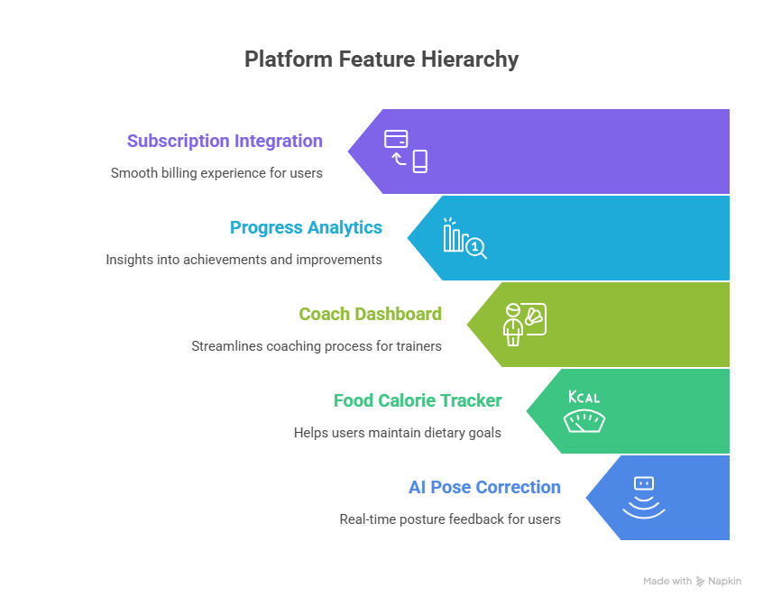
Idea / Methodology

Slide 6
References / Research Papers
AI-Powered Fitness and Diet Recommendation System: A Personalized Approach to Health and Wellness
Authors: Samita Bhandari, Surabhi G. Bansal, et al.
Published: IRJAEM, March 2025
Link: https://www.researchgate.net/publication/390046095
Use in FitVerse: Inspired the development of the personalized recommendation engine and AI coaching modules.
2. A Framework for AI-based Fitness Tracking and
Coaching Systems
Source: National Library of Medicine / PMC
Link: https://pmc.ncbi.nlm.nih.gov/articles/PMC10955739/
Use in FitVerse: Helped guide the integration of pose estimation and AI-based feedback loops for user exercise monitoring.

