Slide 1
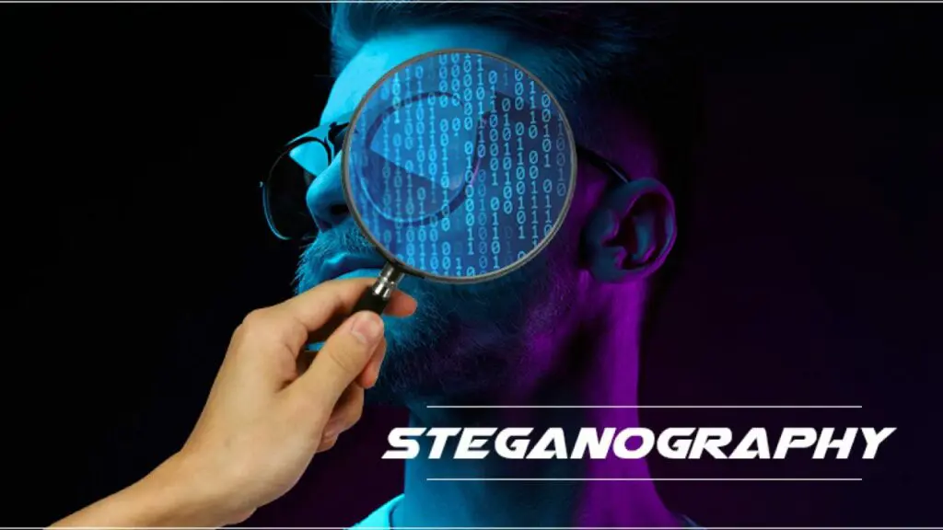


Hide Text in Image
Gui App
Tkinter
using PYTHON

Slide 2
Contents
INTRODUCTION
LITERATURE SURVEY
OPERATING ENVIRONMENT
SOFTWARE AND HARDWARE REQUIREMENTS
MODULES / LIBRARY
FUTURE SCOPE
CONCLUSION
REFERENCES

Slide 3
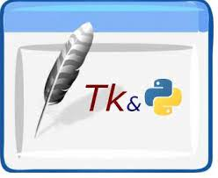
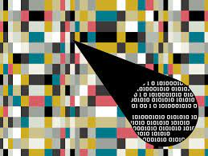
INTRODUCTION
GUI ( Graphical User Interface ) is the common user Interface that includes Graphical representation like buttons and icons, and communication can be performed by interacting with these icons rather than the usual text-based or command-based communication.
Steganography :
Steganography is the use of various methods to hide information from unwanted eyes.
Steganography by definition is the hiding of one file within another.
It is the art and science of embedding secret messages in a cover message in such a way that no one, apart from the sender and intended recipient, suspects the existence of the message.

Slide 4
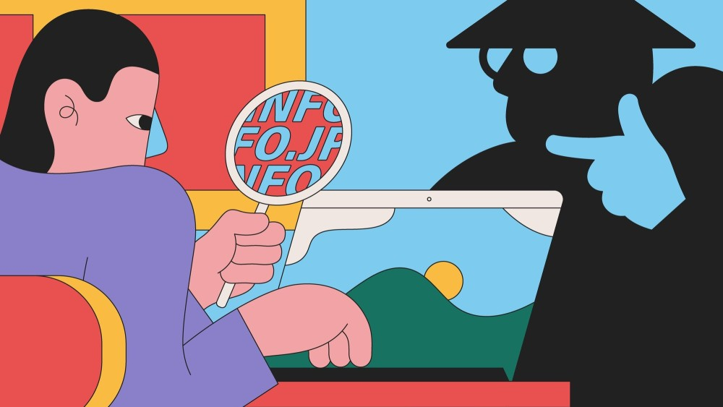
Literature SURVEY
Malicious hackers use steganography for a variety of tasks such as hiding malicious payloads and script files. Malware developers often use LSB steganography to hide the code for their malware in images of celebrities or in simple WhatsApp Good-Morning Wishes and execute them with another program after the file is downloaded on the victim’s computer.
The term ‘Trojan Horse’ is used to describe a dangerous file hidden within a harmless file. Macro attacks are a form of steganography as well
In several cases, the attackers used steganography to hide their malware in images uploaded on social media networks and then used a local tool to download them onto the victims’ computers.

Slide 5
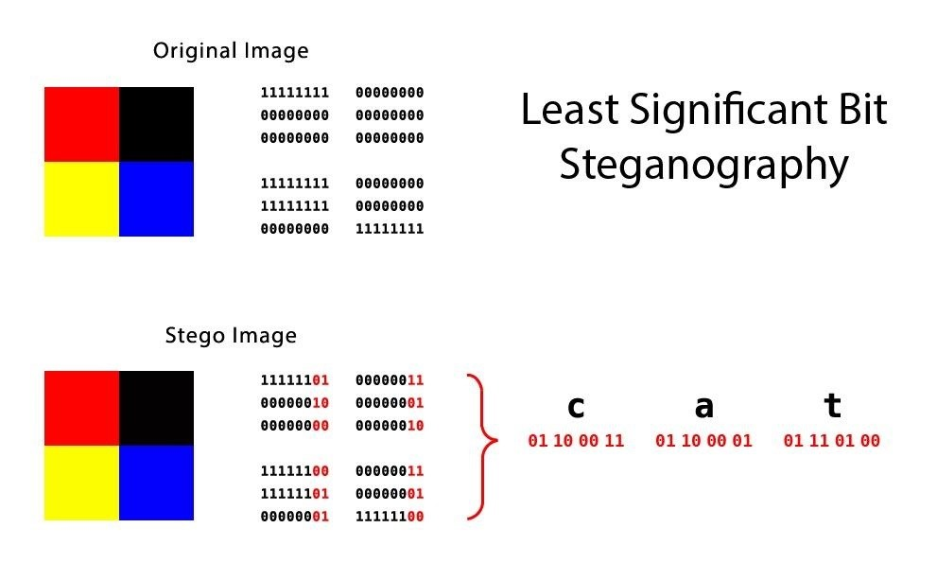
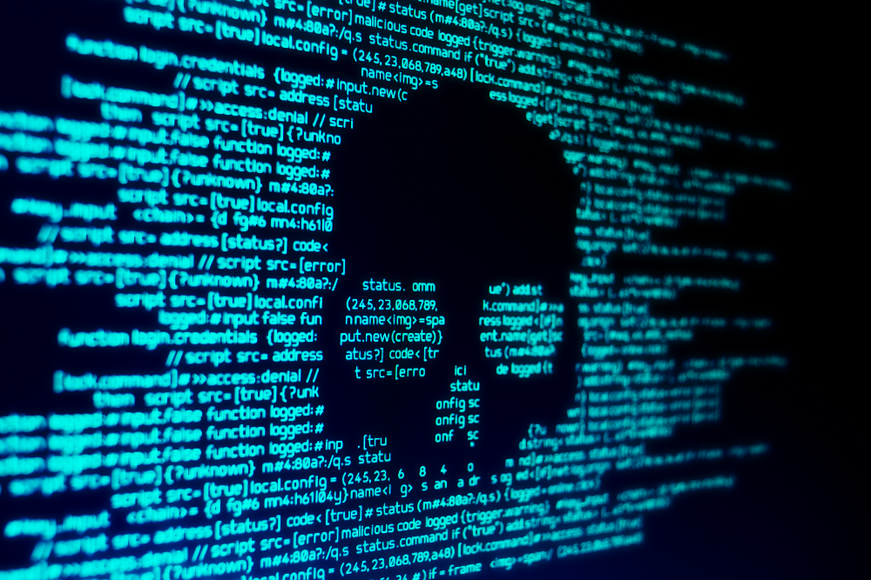
LSB IMAGE STEGANOGRAPHY
Images are essentially two dimensional lists of pixels, which in turn consist of three integer numbers in the range 0-255 that represent values for red, green and blue.
The difference between a pixel with value rgb(230, 129, 200) and rgb(229, 129, 201) are virtually imperceptible. So we can leverage this and hide information in that least significant bits of each pixel.
To hide a message in an image a function is needed that converts a string to a binary representation and one that embeds that data in the least significant bits of an image.
To reveal the message we need to be able to reverse this, so first a function will extract the least significant bits and the final step is to convert them back into a string.

Slide 6
OPERATING ENVIRONMENT
CPU cores : Minimum 2 cores
Recommended
memory : 2GB for Windows
Disk Space : 50MB
Additional : Requires PyCharm IDE,
Python interpreter
on Windows

Slide 7


SOFTWARE AND HARDWARE
REQUIREMENTS
Technical details:
Language : Python
Software requirements:
PyCharm Integrated Development Environment (IDE)
Python Interpreter
Hardware requirements:
Minimum 1GB of RAM
50MB of free hard diskspace
Monitor
Keyboard
Mouse

Slide 8
MODULES/LIBRARY
The following are the main modules of the project :
Tkinter :
Tkinter is the standard GUI (Graphical User Interface) library for Python. Python when combined with Tkinter provides a fast and easy way to create GUI applications.
PIL :
PIL library is used to load the image, which is than turned into a one-dimensional list of all Red, Green and Blue values of the pixel in the image.
NumPy :
NumPy is a general-purpose array-processing package. It provides a high-performance multidimensional array object, and tools for working with these arrays.

Slide 9
Source Code
import cv2
import pickle
import numpy as np
import tkinter as tk
import tkinter.ttk as ttk
from os import path, remove
from PIL import Image, ImageTk
from tkinter import filedialog, messagebox
AUTHENTICATED = False
IMAGE = None
IMAGE_LOADED = False
FILETYPE = (('PNG File', '*.png'), )
LABEL_FONT = ('Comic sans MS', 13, 'bold')
BUTTON_FONT = ('Arial black', 10, 'bold’)
image_frame = None
img_button = None
encode = None
decode = None
x = None
y = None
pass_var = None
.
..
…
…..
……..
…………
key = data['key']
l = len(key)
for b in img_bytes:
message += chr(int(b, 2))
if message[-l:] == key:
break
message = message[: -l]
decode.config(state=tk.NORMAL)
decode.delete('1.0', tk.END)
decode.insert(tk.END, message)
decode.config(state=tk.DISABLED)
messagebox.showinfo(title='Operation Successful', message='Data decrypted successfully')
if __name__ == '__main__’:
if not path.exists('config.pickle'):
data = {'initialized_user': False, 'password': '', 'question': '', 'answer': '', 'key': ‘’}
else:
with open('config.pickle', 'rb') as f:
data = pickle.load(f)
if not data['initialized_user']:
get_data()
if data['initialized_user']:
init_gui()
else:
open_screen(None)
if AUTHENTICATED:
init_gui()

Slide 10
FUTURE SCOPE
This project Hide Text in Image GUI App has been developed in such a manner, that the future requirements of the user are met.
The project is flexible to adapt the changes efficiently without affecting the present system. In future, there can be a provision to add/adjust the INPUTS and new student names and for this dedicated graphical buttons, dialogue boxes,etc. can be provided.
It is also planned to implement the app on various other mobile platforms like Windows and IOS.

Slide 11
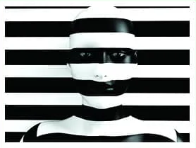
CONCLUSION
Steganography main feature is that it
protects information privacy but to make
matters worse, attackers are tampering with
the hidden data using steganalysis techniques.
It’s concerning that cyber thieves are
increasingly employing steganography to steal
genuine data from businesses.
To encode and decode, our Hide Text in Image GUI App can be very useful.

Slide 12
REFERENCES
Python and Tkinter Programming : Design innovative interfaces and introducing Python and OOP to traditional development methods, Author : John Grayson, Publisher : Manning Publications (1 March 1999)
Python GUI Programming with Tkinter : Develop responsive and powerful GUI application with Tkinter, Author : Alan D. Moore, Publisher : Packt Publishing Limited (15 May 2018)
https://realpython.com/python-gui-tkinter
https://threatpost.com/steganography-pinpoint-attacks-industrial-targets/156151/
https://www.edureka.co/blog/steganography-tutorial
https://www.coursera.org/courses?query=tkinter
https://www.comparitech.com/blog/information-security/what-is-steganography/

Slide 13
Thank You

