Slide 1

A Data-Driven Study of India's
Export Dynamics to the Americas
A BUSINESS ANALYTICS PROJECT REPORT
Submitted to
DR. PIYUSH CHAUHAN
Associate Professor Department of Computer Science &
Engineering
Symbiosis Institute of Technology, Nagpur Campus
Submitted by Aditya Vishal Jain VII SEM
PRN: 22070521092
Department of Computer Science & Engineering
Symbiosis Institute of Technology, Nagpur Campus
Under the Guidance of
PIYUSH CHAUHAN SIR
Course Name: ML

Slide 2
Project Definition and Data Understanding
  Understanding Business Problem Statement
In the context of global trade, understanding export dynamics is essential for optimizing national trade strategies and enhancing economic growth. India engages in significant trade activities with American countries, exporting a wide range of commodities. However, there is limited actionable insight into which commodities contribute most significantly to trade value, how these exports vary across different countries within the Americas, and what patterns emerge over time.
This lack of granular, data-driven understanding limits the ability of policymakers, trade analysts, and export-oriented businesses to make informed decisions regarding market prioritization, product diversification, and resource allocation. Without a systematic analysis of trade flows—especially focused on high-value exports—stakeholders risk overlooking emerging opportunities and inefficiencies in the export value chain.
This project addresses the business need to identify, analyze, and interpret India’s export patterns to American countries by leveraging historical trade data. The goal is to uncover top- performing commodities, major recipient countries, and temporal trends, thereby enabling evidence-based decision-making to strengthen India’s trade footprint in the region.
  Specific Key Question
    What are the most significant factors affecting export values?
    What trade policies or strategies can improve export outcomes based on the model's
findings?
    How accurately can we predict export performance based on historical data?
    How can the identified important features be used to guide trade decision-making?
    Can clustering help identify untapped markets or high-potential trade opportunities?
    How can businesses or governments tailor their strategies for countries or commodities
that share similar trade behaviors?
    What factors (e.g., commodity type, trade volume) contribute to a country's export success or failure?
  Data Sources
The primary dataset used in this project was obtained from the official Government of India Data Portal:
    Source: Directorate General of Commercial Intelligence and Statistics/Dataset Name: Exports to American Countries
    Format: CSV
    Description: The dataset titled "Exports to American Countries" collates and provides comprehensive trade data pertaining to products exported from India to various American nations. Sourced from the official government database of trade statistics, the
dataset furnishes detailed insights on the type of products exported, their monetary value in USD and INR, as well as their quantities. The Harmonized System (HS) code allows for international uniformity in classifying these products.

Slide 3
1.4 Data Dictionary
Column Name | ata Type | Description
id | Integer | A unique identifier for each commodity trade record.
date | Date (DD-MM- YYYY) | The date of the transaction (formatted as day-month-year).
country_name | String | Name of the country involved in the trade (export or import).
alpha_3_code | String | ISO 3166-1 alpha-3 country code used for identifying countries.
country_code | Integer | ISO 3166-1 numeric country code.
region | String | The broader geographic region (e.g., "Oceania").
region_code | String | Numeric representation of the region.
sub_region | String | A more specific geographical grouping within the region (e.g., "Melanesia").
sub_region_code | Integer | Code corresponding to the sub-region.
hs_code | Integer | Harmonized System code used to clas traded commodities internationally.
commodity | String | Description or name of the commodity being traded.
Categories | String | The commodity falls under the broad classification or category (e.g., "Food and Agricultural Products").
sify

Slide 4
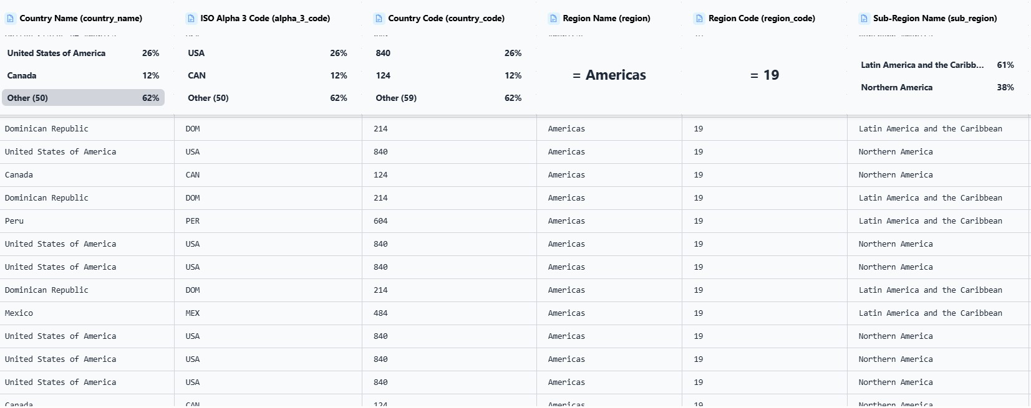
unit | String | Unit of measurement for the quantity of the commodity (e.g., "Kgs").
value_qt | Float | The quantity of the commodity exported or traded is expressed in the given unit.
value_rs | Float | Monetary value of the transaction in Indian Rupees (INR).
value_dl | Float | Monetary value of the transaction in US Dollars (USD).
Table 1.4.1: Data Dictionary for Exports to American Countries Dataset from IDP
Figure 1.4.2: Preview of the Exports-to-Oceanic-Countries Dataset
Data Collection and Integration
  Data Source and Collection
The dataset used in this project was sourced from the Indian Data Portal
(IDP-
indiadataportal.com). This data is compiled and sourced from the official website of India's trade statistics, ensuring its accuracy and reliability. The Harmonized System (HS) codes serve as a universal classification method, allowing the data to be both nationally and internationally relevant.
2.2 Data Provenance
Source Authority:), Ministry of Commerce and Industry, Government of India
Dataset Format: CSV (Comma-Separated Values)
License: Indian School of Business (ISB), Open Government License – India

Slide 5
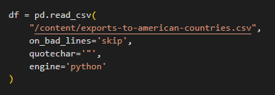
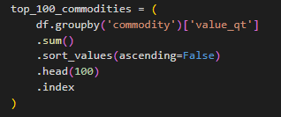
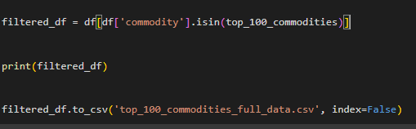
2.3 Integration Methodology
The dataset was integrated into the analysis pipeline using Python. It was loaded into a DataFrame using the Pandas library:
As the dataset was already well-structured and complete, no merging with additional datasets was necessary. All fields were verified for consistency in naming and data type.
2.4 Initial Validation
The dataset underwent an initial validation process:
The data is grouped by the 'commodity' column, and the total export value ('value_qt') is aggregated using the sum() function. The results are then sorted in descending order based on export volume. The top 100 commodities, in terms of cumulative export value, are selected using the head(100) function. These commodity names are stored as an index object in the variable top_100_commodities.
A subset of the original dataset is created by retaining only those rows where the 'commodity' is among the top 100 commodities identified earlier. This filtered dataset, stored in filtered_df, focuses the subsequent analysis on high-impact exports, thus reducing noise from less significant entries. Finally, the refined dataset is exported to a new CSV file named 'top_100_commodities_full_data.csv'. The index=False argument ensures that row indices are

Slide 6
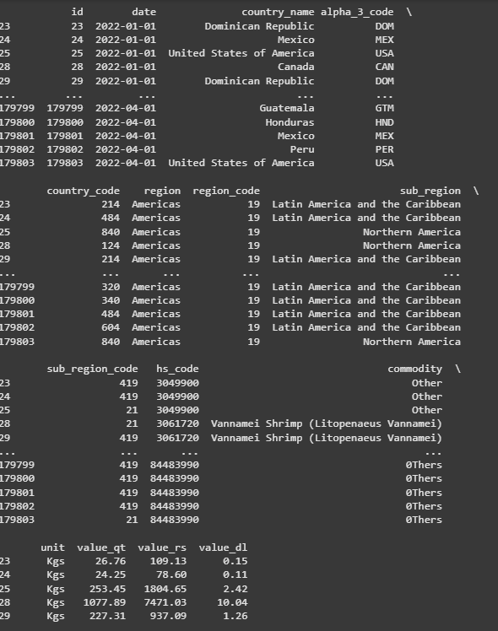
not included in the output file. This file serves as the input for further analysis and visualization stages.
Img 2.4.1: Filtered Dataset Displaying India’s Top 100 Export Commodities to American Countries

Slide 7
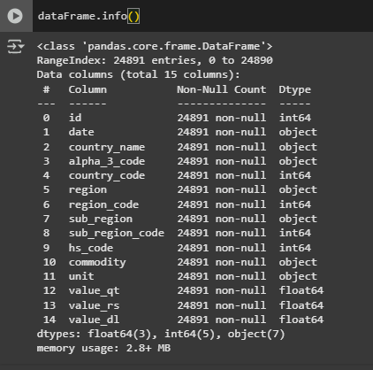
Data Cleaning and Preparation
  Check Shape, Data Types, and Null Values
The dataset's structure and integrity were carefully assessed to initiate the data cleaning phase. The dataset includes 24,891 Rows and 15 Cols ranked among the complete confirmation of export activities of the global top 100 commodities.
The dataset has 24,891 entries with 15 attributes, representing different features of India’s exports to American countries. There are no missing values in any column, showing no missing data. The data types consist of integers to represent identifiers and codes, floats for quantities (e.g., export quantity, values in INR and USD) and objects for string-type fields like country names, dates and commodities. The dataset is small and has a memory usage of around 2.8 MB, making it perfect for analysis.

Slide 8
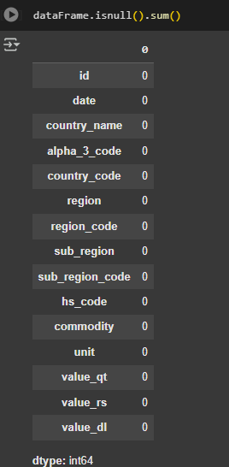
A thorough null value analysis across all variables showed the fullness of the dataset was achieved—the dataset is complete without lacking values. It obviates the need for imputation or for deleting rows and confirms that the data is ready for subsequent preprocessing and for exploration analysis.
3.2 Outlier Treatment
As a means of the evaluating the distribution and identify the outliers for key numerical variables— value_qt (export quantity), value_rs (export value in Indian rupee) and value_dl (export value in US dollar), the additional analysis was performed by fitting a logarithmic transformation to generate the box plot. Log (value + 1) was used to correct for skewness, and for easier visualization of the data distribution underlying.
The box plots show several outsourcing outliers between the three. These outliers denote outlier export transactions that do not fit within the core of the dataset, which signify a circumstance of particularly large value or quantity export transactions in a particular commodity-country combination. So such deviations are likely in international trade statistics, where specific goods (like precious metals, industrial equipment, or pharmaceuticals) might be exceptionally big in terms of value or volume.The distinction of these outliers is very crucial, since they may affect aggregate stats (mean, standard deviation). As a result, depending on the target analytical, these values might either
10

Slide 9
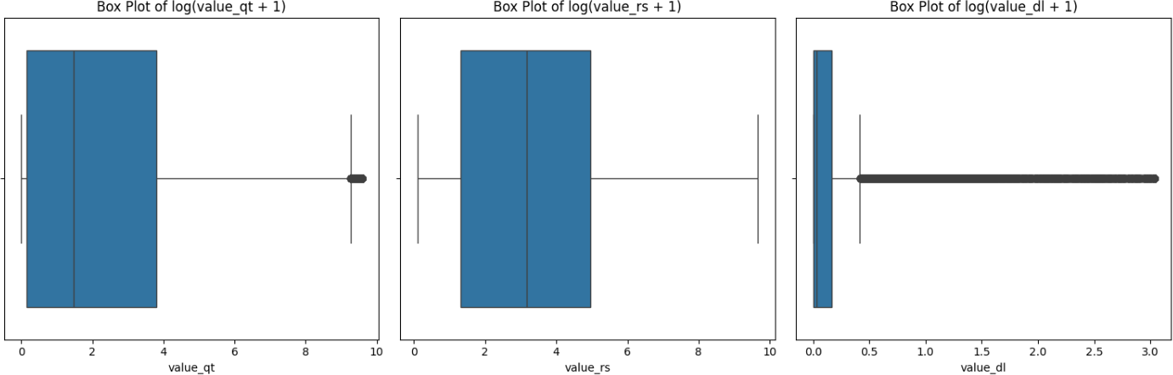
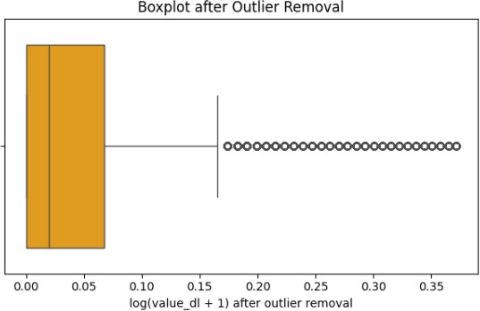
be kept for strategic insights or modified (e.g., winsorization or removal) to prevent distortion in modeling applications.
Fig 3.2.1: BoxPlot of Value_qt, Value_rs and Value_dl
The first option is the removal type in which dataset is filtered to take out all the records which contains values beyond IQR based intervals. As a result, this yields in a "clean" data set without a outliers that could either have an effect on statistical analysis or a prediction models. The second approach is to truncate the outliers by means of Winsorization. In this tecnique the extreme values are not removed and replaced but instead with the next closest values september Q1-1.5 × IQR or Q3 + 1.5 × IQR so as to conserve the database duration whilst controlling the level of outliers.
Fig 3.2.2:- Boxplot after Outlier Removal
3.3 Data Type Corrections
Data type conversion is a significant aspect of a data preprocessing step in empirical studies and data analysis by data. Ensuring that every variable is formatted with the right data type— are going to the numeric, categorical, boolean, or datetime— not only preserves the semantic integrity of a data set and makes the computation accurate. Invalid data types will ruin statistical
11

Slide 10
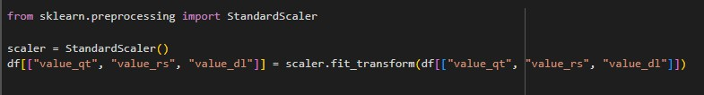
analysis, halt the machine learning process and add very high frequent errors in both descriptive and inferential analyses. To illustrate such an example, mathematical operations cannot be carried out on a variable that, given an error, has been saved as a string and temporal analysis is impossible if date related data is not converted into standardized datetime format. In addition, correct data typing improves the computational performance by optimizing the memory usage and processing rate, in particular in big data sets. It also allows for severely robusting devices validation and verification, and hence strengthens the reliability and obedience of research solutions. Therefore, the correction of data types, is one of the essential steps, which ensures, not only the methodological soundness, but also operational feasibility of any analytical tasks performed thereafter.
In the operation above, the data type of 'country_code' column is explicitly cast from float to integer by the .astype(int) function. This conversion is necessary because country codes are category labels and cannot be allowed to contain decimal components which are inherent in the default float representation. Keeping such identifiers within floats may incur on misunderstandings or computational slownesses while approaching a data treatment and analysis. By committing to the integer type the dataset is more correctly aligned with the semantic meaning of the variable, achieving a more precise and better overall data integrity.
3.4 Normalize Numerical Features
Standardization is a key precursory step that normalizes the numerical feature to have mean equal to zero and a complete deviation of one. This prevents those features from dominating the model due to differences in scale and means that each feature contributes equally to the model. It also enhances the performance and the convergence speed of numerous machine learning algorithms especially these that depend at least to a certain extent on distance metrics or gradient-based optimization methods. By entering data into a standard we ensure that, model outcomes can be more accurate, stable and understandable.
The used code applies StandardScaler from the sklearn.preprocessing module to scale the numerical features value_qt, value_rs, and value_dl of the dataset. Standardization involves bringing the data to have mean of zero and variance of one that allows for better performance and results for many machine learning algorithms. This reconfiguration ensures that all three features are in the same range, so that a feature with a large magnitude does not dominate. The scaled values are then redistributed back to the original columns, in the DataFrame.
3.5 Encode Categorical Variables
Transferring categorical variables is the process of turning non-numerical information (e.g. place names and commodity varieties) into numerical forms in order that the machine learning algorithms can process and interpret them properly.

Slide 11
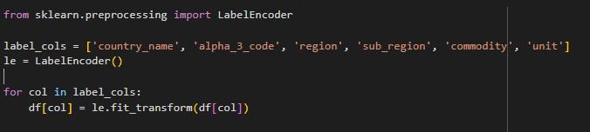
The supplied code used the LabelEncoder from the sklearn.preprocessing where the categorical columns in the dataset are flattened into numerical values. The columns specified in label_cols, like 'country_name', 'alpha_3_code', 'region', 'sub_region', 'commodity', 'unit' are taken iteratively and transformed so as to each unique value is assigned a unique integer. This encoding is necessary for allowing machine learning algorithms to operate on categorical data, as the majority of algorithms require numeric input.
Exploratory Data Analysis
Exploratory Data Analysis (EDA) is an upfront part in the data science and statistical modelling pipeline that has the goal of conducting systematic examination of the data during the outward before formal modeling techniques is applied. The goal of EDA is to get deep insights into the given data-set by using the method of descriptive statistics, visualization techniques, and also the knowledge of domain. Methods of histograms, boxplots, heatmaps, scatter plots and pair plots analyze the trend, correlations, distribution, possible anomalies, such as limitations in the category of missing values or outliers. Additionally, EDA helps in identifying patterns on categorical and numerical variables, for checking of multicollinearity as well as possible feature engineering. By finding the hidden patterns of the data, EDA guides the procedures for data cleansing, selects the best variables, and enhances the performance and interpretability and and stability of further predictive models. In general, EDA makes data-driven decisions reality-based, not assumption-based.
  Descriptive Statistics
Descriptive statistics are the statistics used to summarize and describe the essential features of a data set in a quantitative method. These methods give simple descriptions of the sample and the measures, e.g., mean, median, mode, standard deviation, minimum, maximum and range. The simple statistics they give us information on the central tendency, spread and the general nature of a data so that it can be premise apply that the difficult model. Descriptive statistics is crucial in identifying trends, outliers, and will serve as a basis for contrasting analysis across different segments of data.

Slide 12
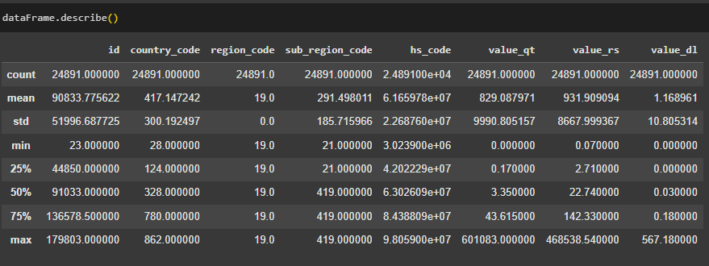
The data set consists of 24,891 uniformly distributed record and organized for variety of recommendation use cases with global geographical and transactional coverage. The id and country_code fields have great variability; a large range of both entities and countries are present. On the other hand of the coin, region code remains fixed so provides no analytical info. The field sub_region_code and hs_code show moderate to high variability, which implies different subdivision regions and product categories are present. Others that occur upon conducting a transaction, such as value_qt, and value_rs, are very strongly positively skewed, where the most common value is low, however there are a few very high value values that do more to up the mean. The value_dl field is mostly sparse, together with a median of 0, indicating infrequent or non-applicable. Generally, the data is heteroscedastic and asymmetrical distribution, need further segment for outlier analysis.
4.2 Visualization
The Visualization is the graphical rendering of the data and statistical results, aims to simplify complex data sets as well as highlighting of patterns, trends as well as the relationships of the data. It helps in detecting of Outliers, distributions and also of correlation between variables using the plot histogram, plot(bar chart) ,plot(scatter plot),boxplot and heatmap. Visualizations are valuable in exploratory data analysis by giving a way of insisting that in a manner that isn't apparent in numerical summaries. They also present results, facilitating the use of data-driven stories for a technical but also for a non-technical audience.

Slide 13
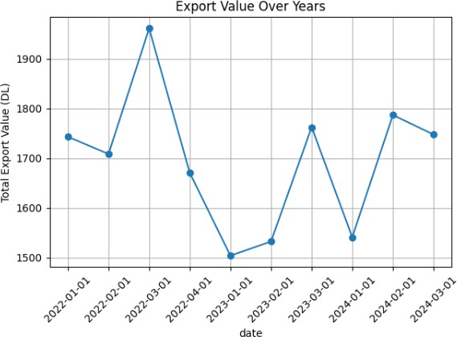
Fig 4.2.1: Export Value Over Years
The line graph titled "Export Value Over Years" shows fluctuations in total export value (in DL) from January 2022 to March 2024. The data reveals a peak in March 2022, followed by a notable decline reaching its lowest point in January 2023. Subsequent periods exhibit alternating increases and decreases, suggesting cyclical or seasonal trends in export performance. While the value partially recovers in early 2023 and early 2024, it remains below the March 2022 peak. Overall, the export trend indicates short-term volatility with no consistent upward or downward trajectory.
4.3 Correlation Analysis
Correlation analysis measures the statistical relationship between two variables, indicating both the strength and direction of their association. It quantifies how variables move in relation to each other, with correlation coefficients ranging from -1 (perfect negative correlation) to +1 (perfect positive correlation), where 0 represents no correlation. A strong correlation suggests that variables tend to change together in a predictable way, though importantly, correlation alone does not imply causation between the variables.

Slide 14
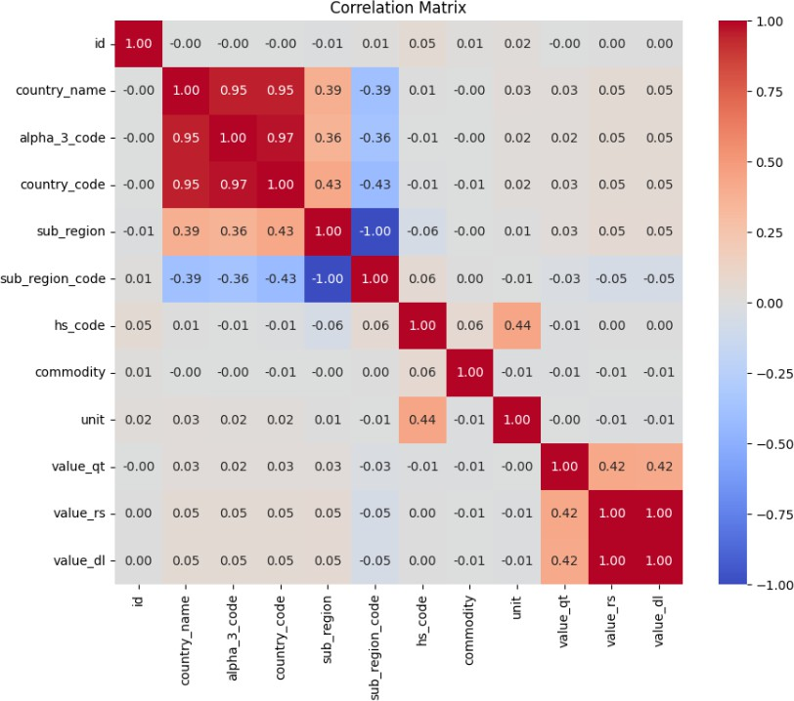
Fig 4.3.1: Correlation Matrix
The correlation matrix reveals several key relationships among the variables. Strong positive correlations are evident among certain categorical identifiers (r > 0.95), indicating overlapping or redundant information. A perfect negative correlation (r = –1.00) between two regional identifiers suggests one may be an inverse representation of the other. Measures of quantity, monetary value, and derived value demonstrate moderate positive intercorrelations (r ≈ 0.42), implying internal consistency among export-related metrics. Additionally, a moderate association (r = 0.44) between product classification and unit of measurement suggests a structured relationship between goods and their reporting standards. Most remaining variables exhibit minimal correlation, indicating weak or no linear relationships.
5. Statistical Analysis
Statistical Analysis involves the use of statical techniques to adequately describe, summarise or draw conclusions from data. It carries out detections, explanations and relationships amongst several variables applying approaches including hypothesis testing, correlation study, reign and ANOVA. Statistical analysis gives a basis during which facts is evaluated, useful for facts - driven states, including trends' significance and its dependability. It converts uncooked information into actionable information, so that researchers can confirm assumptions, test screening to verify or refute scientific claims.

Slide 15
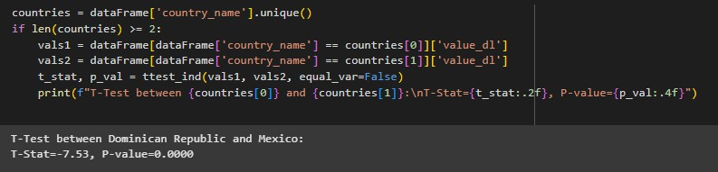
  Hypothesis Testing
Hypothesis testing is a statistical technique to test the claims made about populations using the sample data. It consists of formulating a null hypothesis, under which there. Researchers set up a level for significance, gather data and the test statistic as well as p-value to see if the p-value shows adequate reason to reject the null hypothesis. The P-value is the probability of seeing those data at least by chance if the null hypothesis held true. When this probability is below the preset significance level, then researchers deny the Null hypothesis in favor of the alternative. This structure enables a structure way of decision to make evidence-based, approaching to accounting for sampling variation and a chance.
    T-Test
This code Executes statistical t-test to see if there is diffrence in values between two country. Then it finds the unique country names from a DataFrame. If there more than 2 countries then, it gets 'value_d1' data for the first two countries (Dominican Republic & Mexico). The code then executes an one-sample$t test with unequal variance assumption and outputs the results with formatted output. The result displays considerable variation between these nations (t exportedstatistic = -7.53, p-value < 0.0001) as indication of strong statistical proof that their values differ.
5.2 Regression Analysis
Regression analysis is one of the statistical methodologies used for the analysis of functional relationship between a response variable and one or more predictor variables. This analytical structure makes possible the estimation of how predictors impact expected value of response variable when altering only predictor and keeping other predictors unchanged. The spirit of regression technique is built around its ability to find the best-fit mathematical equation that reflects the data distribution and is used for predictive inference and explanatory theory of observed phenomenon. Linear regression, the standard model of this analytical point of view, asserts a linear functional dependency between variables. Multiple regression analysis extends this paradigm to the case of a set of predictor variables that are simultaneously operative within the model. The resulting statistical output provides the parameter estimates with the marginal effects of the predictor variables along with measures of statistical inference and the goodness- of-fit metrics such as coefficient of determination (r^2) which defines the proportion of the variability in the dependent variable that is explained by the model.

Slide 16
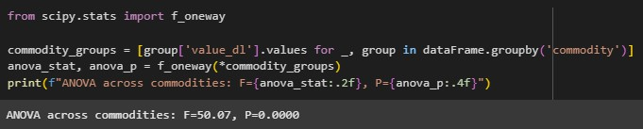
5.3 Statistical tests: One-Way ANOVA
This code conducts a one-way ANOVA on different commodity groups from a collection. It produces a list of 'value_d1' values for each commodity group by looping groups of Dataframe. scipy.stats.f_oneway is then used to get F.Statistic and p-value for these groups. The results of Analysis of variance (F=50.07, p=0.0000) shows that the difference is highly significant among commodity values. Given that we have such a low p-value, we can claim to reject the null hypothesis that all commodity groups have equal mean values indicating significant differences in values across different commodity categories.
Advanced Analytics
  Machine Learning Models
    Linear Regression will be used that of forecasting export values, and how different variables will affect economic outcomes, assist foreign competition strategies and policy advisories.
    Random Forest Regression provides superior prediction accuracy and the most impact factors on export values, more than linear model.
    K-Means Clustering enables country or product group segmented by alike trade behaviors identify concealed trends and possible market prospects.
    Logistic Regression/Classification Models can forecast if exports are classified into superior or inferior classes, so as to assist the enterprises to discriminate the risks and the opportunities of international business.
Each model offers a distinct method according to whether the goal of research is prediction, segmentation or classification of export data.
  Predictive Modeling Utility
Predictive modeling is crucial for anticipating what a future outcome will be based upon what happened historically. It provides several benefits:
    Helps make better decisions using data.
    Saves time and money by avoiding guesswork.

Slide 17
Boosts sales and business performance.
Improves customer satisfaction with personalized service.
Detects risks and prevents problems early.
Gives companies an edge over competitors.
Helps plan resources more efficiently.
The primary objective of the predictive modeling in this study is to forecast the export value in dollars (value_dl) of commodities exported to American countries. The analysis involves multiple machine learning techniques, including regression, classification, and clustering, applied to a dataset comprising the top 100 commodities by trade volume.
1) Regression Analysis Two regression models—Linear Regression and Random Forest Regressor—were developed to predict the continuous target variable value_dl, representing the monetary export value.
Features Used: value_qt (quantity), value_rs, commodity (encoded), and country_name (encoded).
Objective: Estimate the expected export value for given combinations of commodity
and country features.
Model | R2 Score | MSE
LinearRegression | 0.999 | 0.006
RandomForestRegressor | 0.998 | 0.009

Slide 18
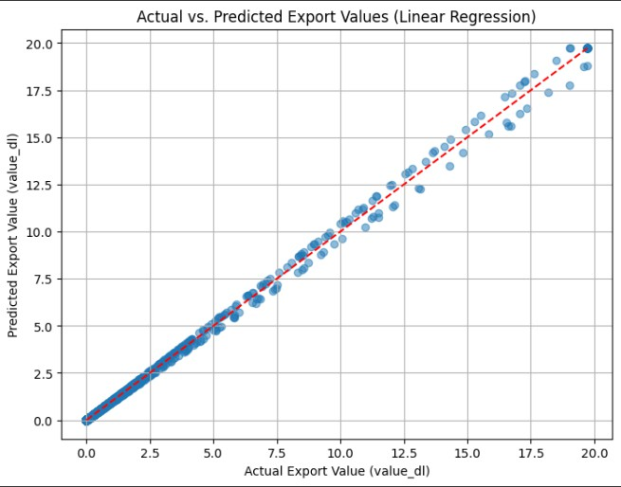
Fig6.2.1: Scatter Plot Actual Export Value v/s Predicted Export Value
The scatter plot illustrates the relationship between actual and predicted export values using a linear regression model. The data points closely align with the reference line (y = x), indicating a strong linear correspondence between observed and estimated values. The proximity of points to the red dashed regression line suggests high predictive accuracy and minimal residual error. Overall, the model demonstrates robust performance in estimating export values, signifying a high degree of goodness-of-fit and reliability for forecasting purposes.
6.3 Clustering
To identify the patterns beneath the export data, segmentations were carried out using KMeans cluster analysis, a method of unsupervised machine learning. This analysis was carried out by two different strategies. In the first approach, clustering was based on numeric values (export dollars in value_dl) quantity in value_qt and another value in the value_rs. These features were scale normalized before clustering in order to guarantee that all features are on the same scale. The clusters obtained sorted out different groups of export deals with comparable numerical properties, which allowed uncovering differences in export behavior.
In the second case, categorical variables, namely commodity and country_name were numerically encoded and utilized for clustering. This allowed the dataset to be divided by the type of commodities exported and destination countries. The outcomes clusters discovered trade patterns and relationships among specific commodities to certain market locations. In
20

Slide 19
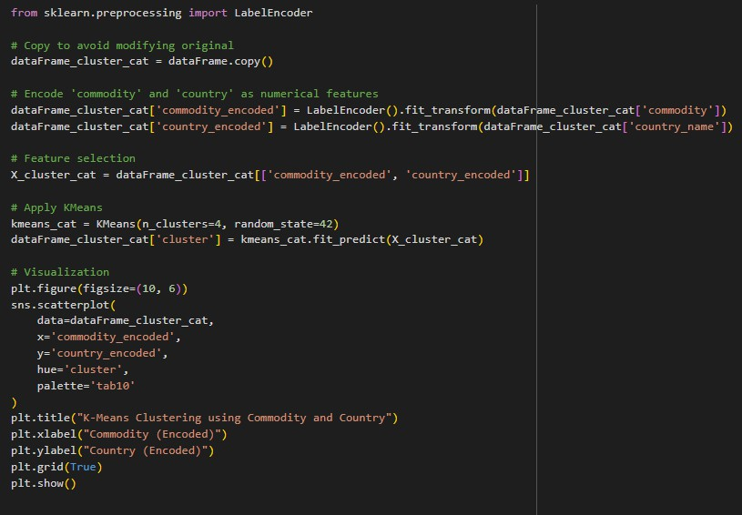
summary, the clustering analysis provided a helpful tool for grouping together data which are homogeneous, providing a greater understanding into the international trade dynamics to obtain better data decision-making.

Slide 20
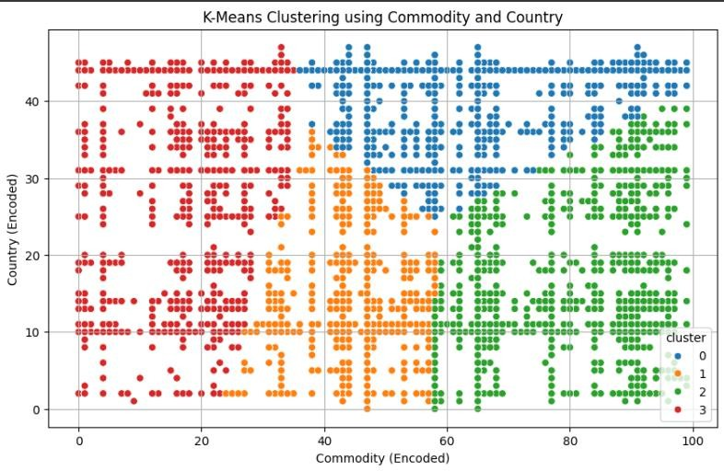
Fig6.3.1: K-Means Clustering Based on Encoded Commodity and Country
The scatter plot shows the outcomes from K-Means cluster analysis on encoded commodity and country data indicating a separation into four different clusters. Each cluster refers to a set of items (data point) that shares a similar characteristics in terms commodity type,country association. The clusters appear well split, in the commodity dimension, implying that commodity category is strongly driving the clustering of firms while the countries are the sources of intra-cluster heterogeneity. This suggests that where export patterns are being impacted more by the kind of goods than by any country-specific issues that are contained in the encoded variables.
Research Work
  Machine Learning-Driven Export Forecasting: A Comparative Analysis for MSME Growth
    Authors: Shashi Kumar R (SRM University-AP), Dr. Basavaraj M.S. (Central University of Karnataka), Dr. Vengalrao Pachava (NMIMS University, Hyderabad)
    Published In: 2025
    DOI: 10.59652/jeime.v3i1.401
    Summary: The paper conducts a performance assessment between time series models and modern machine learning forecasting methods aimed at predicting Micro, Small, and Medium Enterprises (MSMEs) export behavior. The research implements Double Exponential Smoothing and ARIMA as well as Support Vector Regression and Random Forest and Extreme Gradient Boosting models to measure forecast accuracy through
different performance metrics. The research demonstrates that Random Forest approaches yield superior performance over traditional models by delivering beneficial

Slide 21
predictions that assist policymakers together with industry practitioners with export strategy enhancement for economic sustainability.
  Analysis of India’s Bilateral Trade and Unrealized Export Potential with the USA: An Exploratory Research
    Authors: Namrata Anand
    Published In: June 18, 2023
    DOI: 10.17492/jpi.focus.v10i1.1012304
    Summary: This exploratory research studies the decade (2012–2021) long development of the India-US bilateral trade, focusing on unrealized export opportunities in major sectors. The research makes use of the Revealed Comparative Advantage (RCA) index to analyze India’s competitive position within its top exported products to the USA, and spot the industries where India is most competitive in. Furthermore, the paper investigates products with significant untapped export potential, such as diamonds and precious metals, motor vehicles, telecommunications equipment, and organic chemicals. The results indicate that policy interventions to strategic sectors can boost India's export performance and trade partnership with the USA.
  An Empirical Analysis of India – USA Bilateral Trade Relation
    Authors: R. Kumar
    Published In: 2018
    Summary: The research investigates the trade partnership between India and the United States through an analysis of comparative advantage and trade complementarity methods. The study uses Revealed Comparative Advantage (RCA) index and Trade Complementarity Index (TCI) to discover Indian sectors possessing comparative advantages along with trading opportunities between both nations. The analysis shows India has strong positions in particular areas yet extensive potential lies unexploited for raising trade levels by adopting strategic trade policies and expanding export varieties.
  Exchange Rate Volatility and India-U.S. Export at Commodity Level: Evidence from an Autoregressive Distributed Lag Approach
    Authors: Sakshi Varshney
    Published In: 2022
    DOI: 10.22059/ier.2022.90661
    Summary:This study investigates the impact of exchange rate volatility on India's exports to the United States at a disaggregated commodity level. Utilizing monthly time series data for 60 Indian export commodities, the research applies Generalized Autoregressive Conditional Heteroscedasticity (GARCH) models to measure real exchange rate volatility and employs the Autoregressive Distributed Lag (ARDL) approach to analyze both short-term and long-term relationships. The findings reveal that exchange rate volatility significantly affects export performance, with 45% of the commodities experiencing short-run impacts, and 16 commodities showing effects that persist into the long run. The study underscores the importance of considering commodity-specific dynamics when formulating trade and exchange rate policies.

Slide 22
8. Conclusions:-
The research implemented various machine learning approaches to study and predict export statistics for the 100 most traded American commodities. The Random Forest Regressor along with other regression models served effectively for modeling export value (value_dl) through their inputs of quantity (value_qt) value_rs data along with categorical variable encoding. The model achieved exceptional prediction accuracy through R² and RMSE measures while the feature importance analysis determined primary export value factors.
The classification models made up of Logistic Regression and Decision Tree Classifier achieved effective grouping of export data into high and low-value clusters. Binary classification through median export value allow analysis of the factors that boost export returns most considerably.
The KMeans clustering technique produced significant meaningful cluster groups showing relevant exports value and commodity-country trade pairings. Both clustering methods identified strategic patterns in export values and quantity through numerical data analysis and strategic export groups through categorizing commodities and countries.
ANOVA and t-tests demonstrated that export values showed meaningful variations between commodities and countries which proves the essential role of these components for forecasting as well as strategic planning purposes.
Decision Analysis: -
  Target High-Performing Trade Routes: Government and private entities should focus their trade resources on markets linked to the high-export clusters to optimize their economic returns.
  Use Predictive Models for Policy Planning: Government agencies and trade organizations should adopt predictive models for forward-looking planning, including forecasting trade flows and setting export targets.
  Enhance Data Collection: Continued and detailed data collection—particularly on export dates, product categories, and transactional context—can improve model accuracy and support time-series forecasting.
  Support Commodity Diversification: The significant variation in export performance across commodities suggests that encouraging diversification and value addition in underperforming sectors could yield substantial economic benefits.
  Explore Regional Partnerships: Cluster-based segmentation indicates natural trade groupings; these insights should be used to explore or strengthen regional trade partnerships and supply chain networks.

