Slide 1
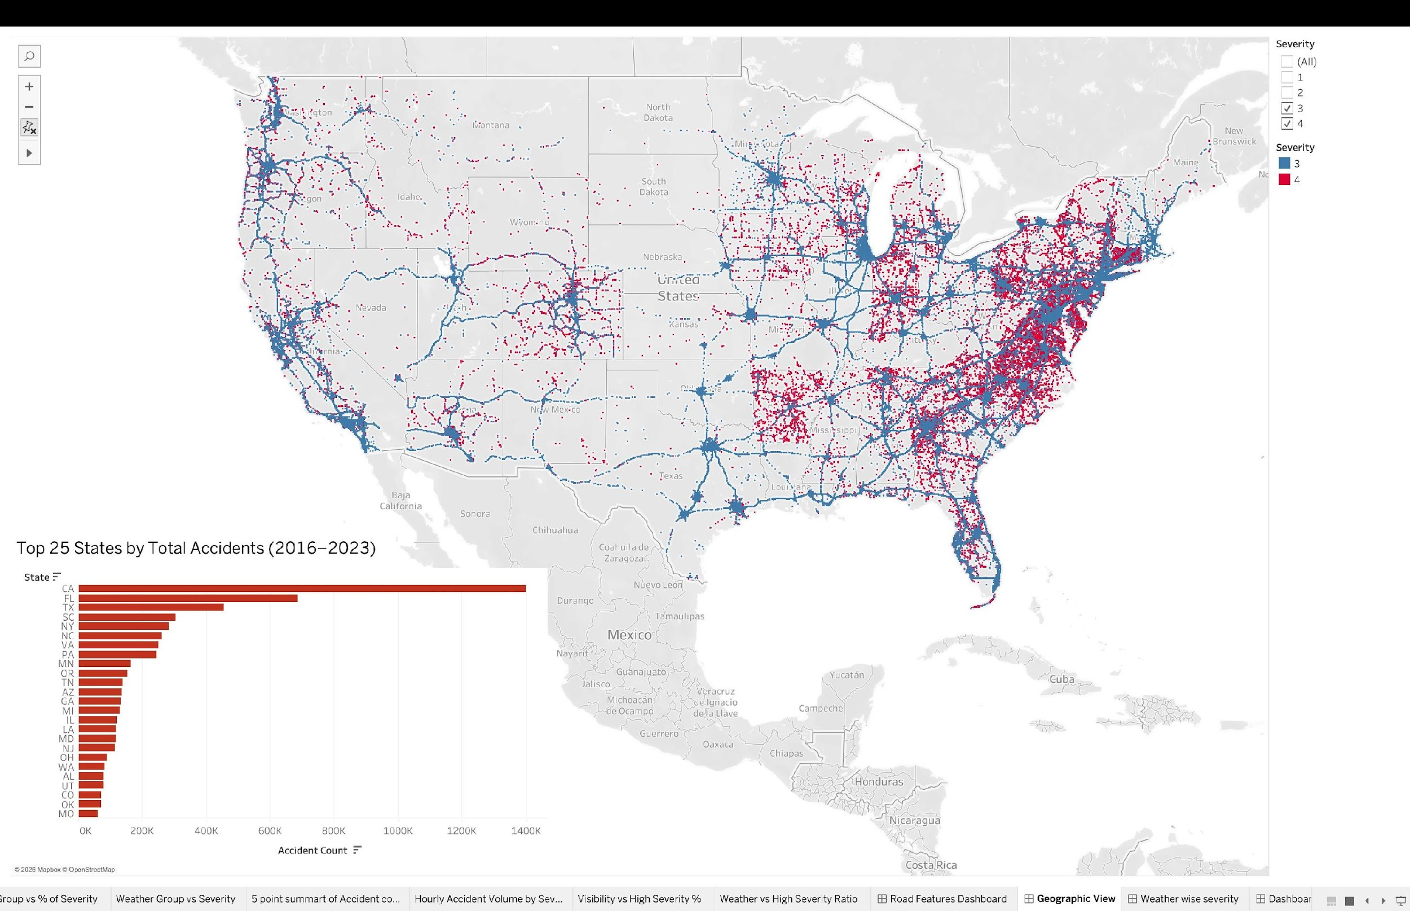
US Road Accidents
2016 – 2022
A Data-Driven Story of Severity
7.73M records · 49 states · 7 years
DS612 – Interactive Data Visualisation | Group 7

Slide 2
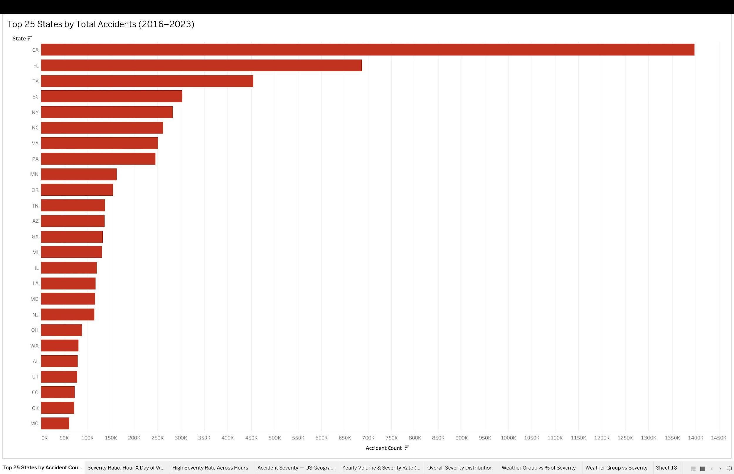
The Dataset: Scale, Scope & Geographic Distribution
7.73M
49
Accident Records
US States Covered
46
7 yrs
Original Features
2016 – 2022
⚠ Geographic Bias (Fault 2)
CA alone = ~1.4M records — nearly 2× Florida. This reflects sensor density, not accident rates. All state-level comparisons are partially reflections of data collection coverage.
DS612 · IDV · Group 7 · US Accidents 2016-2022
2 / 10

Slide 3
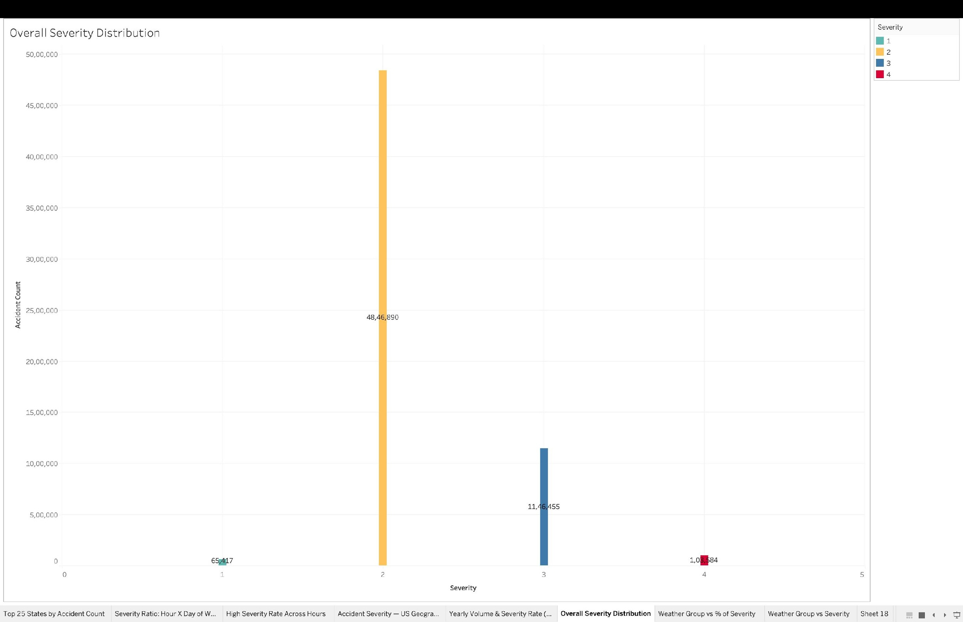
The Most Important Slide: Redefining Severity
This dataset does NOT measure physical injury. It measures traffic disruption duration.
Severity 1
Severity 2
Severity 3
Severity 4
Short Delay
Moderate
Significant
Major Disruption
Clears quickly
Minimal impact
~80% of all data
Some disruption
Extended closure
Complex incident
Prolonged blockage
Long response
⚡
Volume ≠ Risk — 80% of accidents are Severity 2. High-severity rate is a proportion, not a count — they need separate charts.
🛑
Clearance Time = Severity — Long duration → high severity. Infrastructure that speeds response directly reduces severity score.
🚗
Rush Hours: Two Stories — High volume at rush hour means many Severity-2 accidents. High-rate hours are actually late-night.
DS612 · IDV · Group 7 · US Accidents 2016-2022
3 / 10

Slide 4
Data Quality: 12 Structural Faults — Every Chart Must Be Read With These In Mind
All visualizations correctly represent the data. The faults are in the dataset itself.
Severity Label Imbalance
Geographic Sampling Bias
Missing Exposure Data
Sev 2 = 80%+. All severity rates must be read as proportions, not absolute risk.
CA over-represented. State comparisons reflect sensor coverage, not true accident rates.
No traffic volume. All rates are accident-conditional, not trip-conditional.
Confounding Variables
Exposure Bias (Time)
Temporal Data Drift
Weather not isolated from road type, speed, or time of day simultaneously.
Rush hours have more accidents because more cars are on road — not higher risk per trip.
Severity rate fell 36%→7.6% due to API expansion adding Sev 2 records, not safety improvement.
Road Network Bias
Mixed Metrics
Over-Aggregation
Rural areas under-recorded. Highways over-represented in all spatial views.
Volume and rate have different denominators. Never compare them directly.
Heatmaps average 7 years across 49 states — masks regional and extreme-event variation.
Weather Simplification
Selection Bias
Lack of Context
7 broad categories hide within-group variation (Thunderstorm ≠ Light Drizzle).
Urban areas with sensors are over-represented. Minor rural accidents missed.
No speed limits, road type, or traffic density — limits causal analysis.
DS612 · IDV · Group 7 · US Accidents 2016-2022
4 / 10

Slide 5
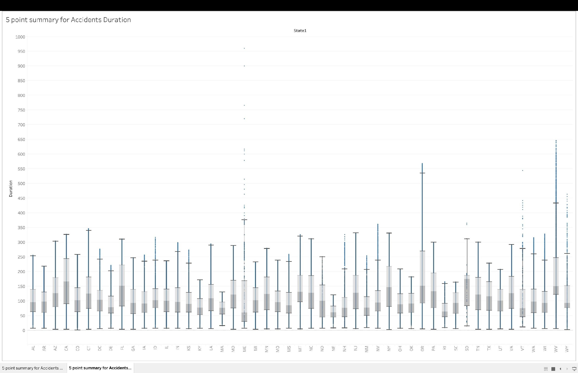
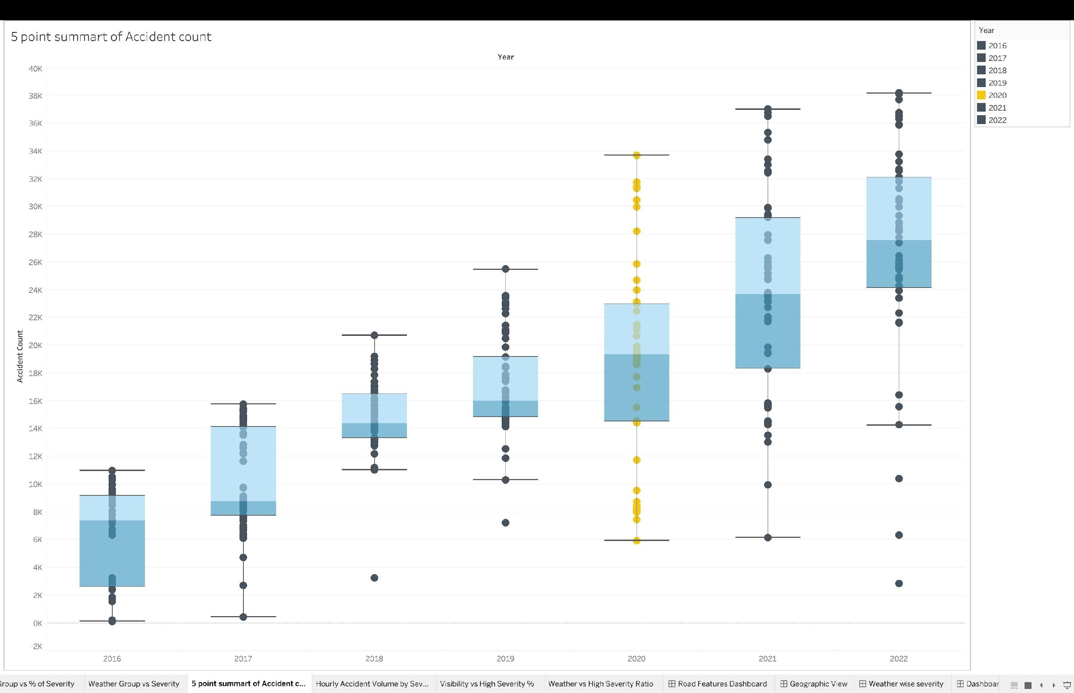
Cleaning the Data: What the Box Plots Revealed (2×IQR Method)
Duration by State — 5-Point Summary
Accident Count by Year — 5-Point Summary
Maine: 950 min → removed
2023 excluded entirely
Dataset growth, not more accidents
~16 hours pre-clean. Almost certainly a timestamp error. 2×IQR cap brings it to ~375 min.
Only 3 months of data. Comparing a partial year box to full annual distributions is meaningless.
Median per-state count: 8K (2016) → 26K (2022). API expansion explains the rise, not worsening roads.
DS612 · IDV · Group 7 · US Accidents 2016-2022
5 / 10

Slide 6
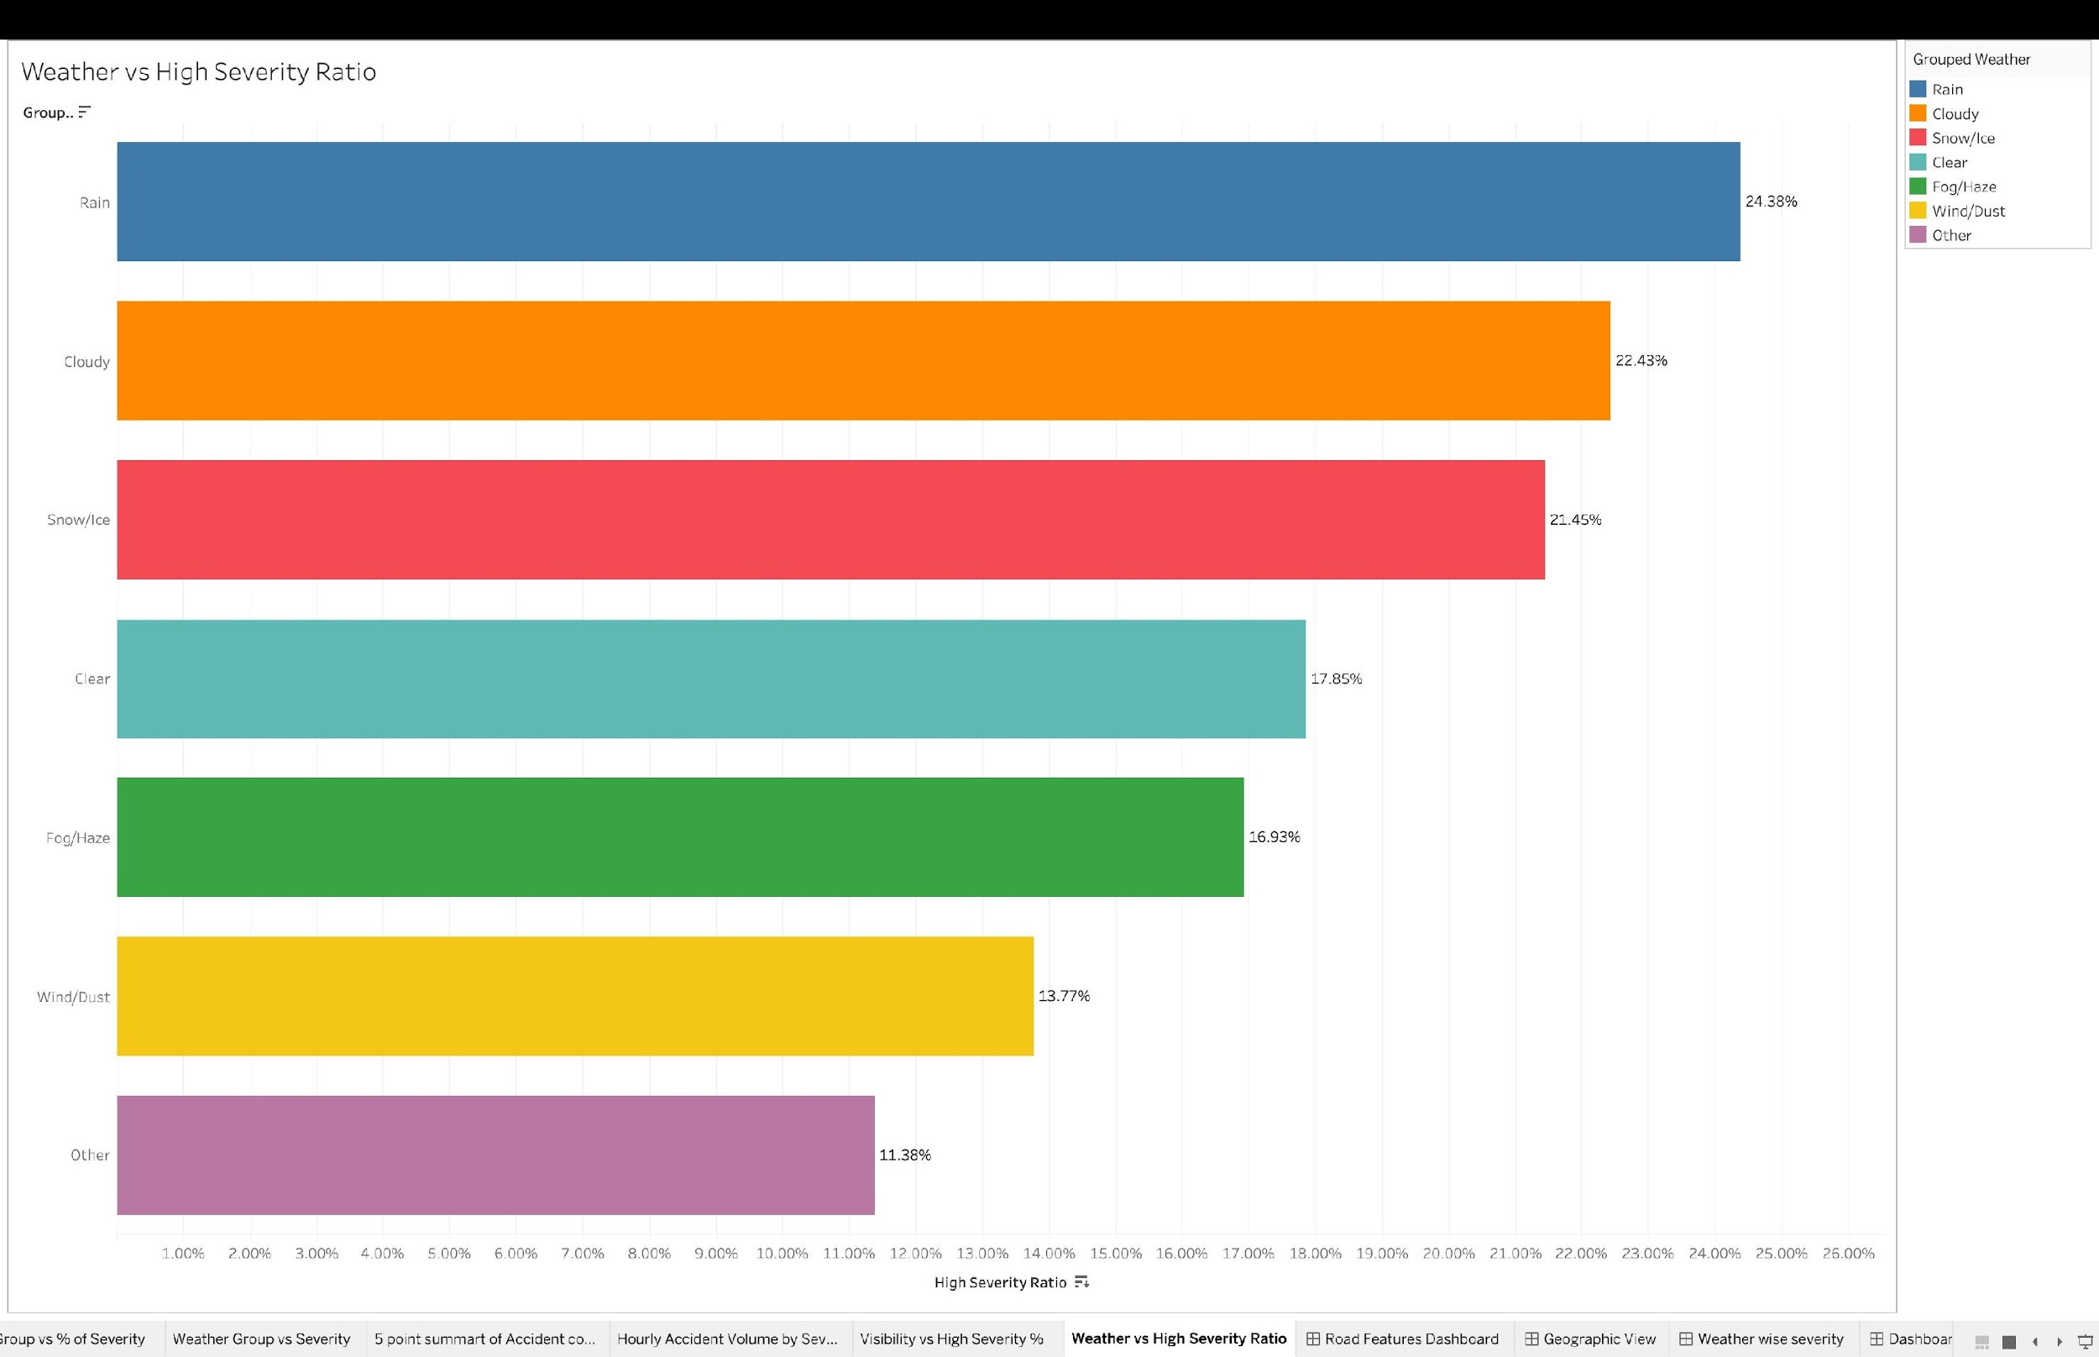
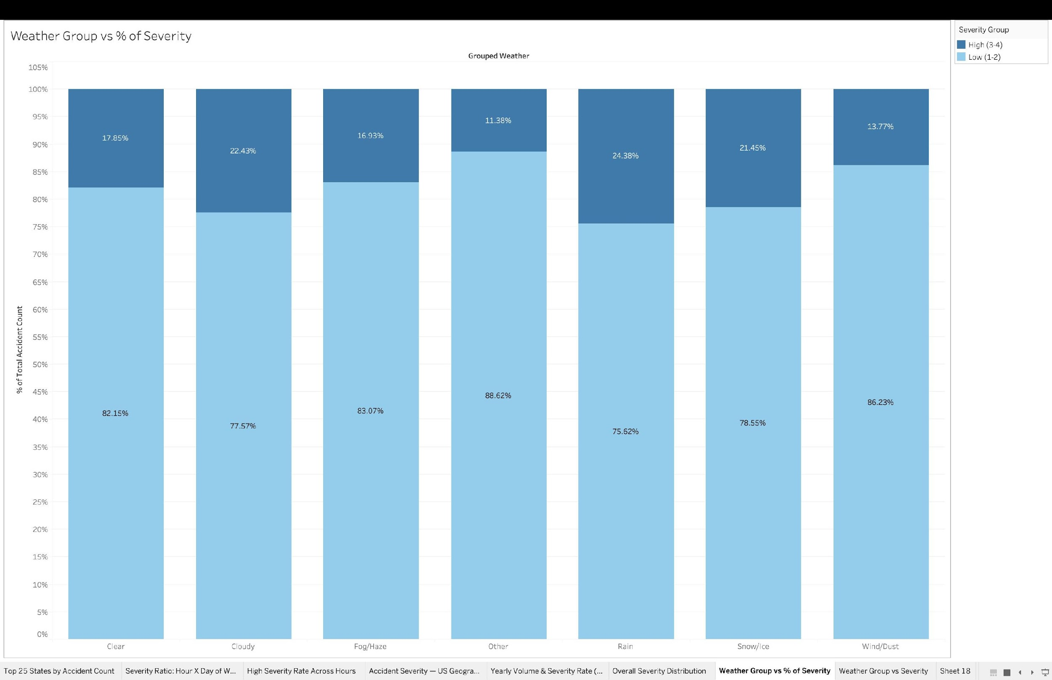
H1: Does Adverse Weather Increase Accident Severity?
Partially Supported
Ranked by High Severity Ratio
% High Severity Within Each Group (Normalized)
24.38%
22.43%
21.45%
17.85%
+6.53pp
2.1×
Rain — highest
Cloudy
Snow/Ice
Clear (baseline)
Rain lift over Clear
Infra vs weather effect
DS612 · IDV · Group 7 · US Accidents 2016-2022
6 / 10

Slide 7
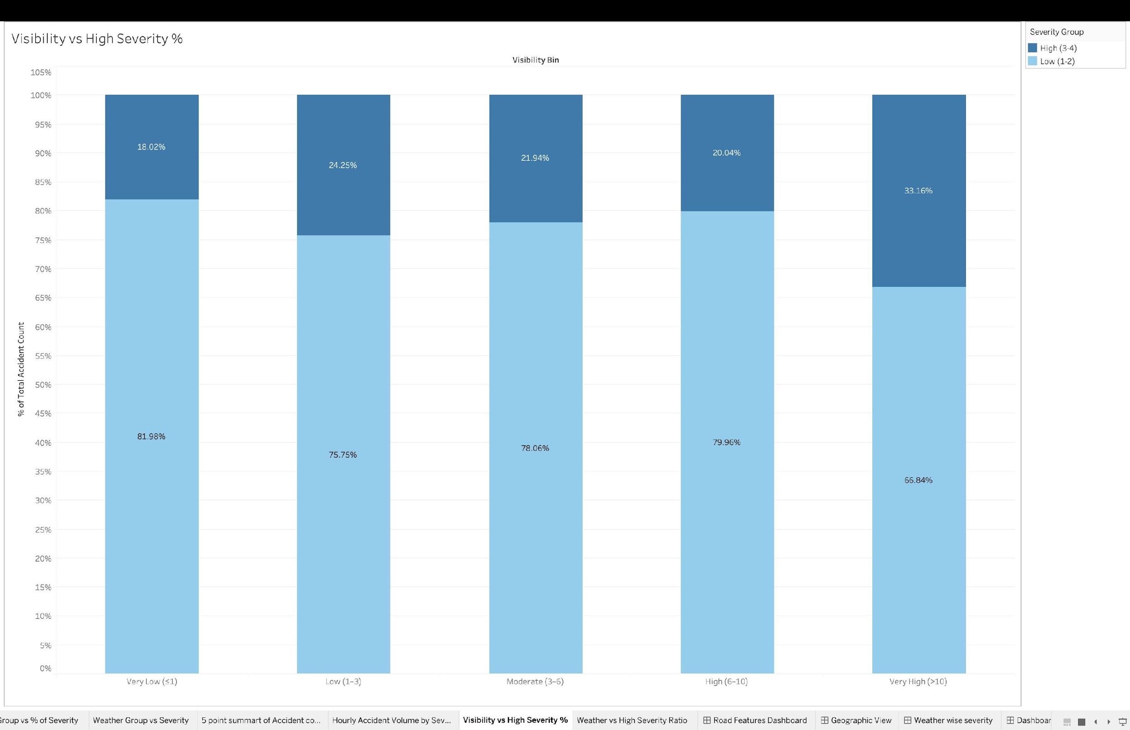
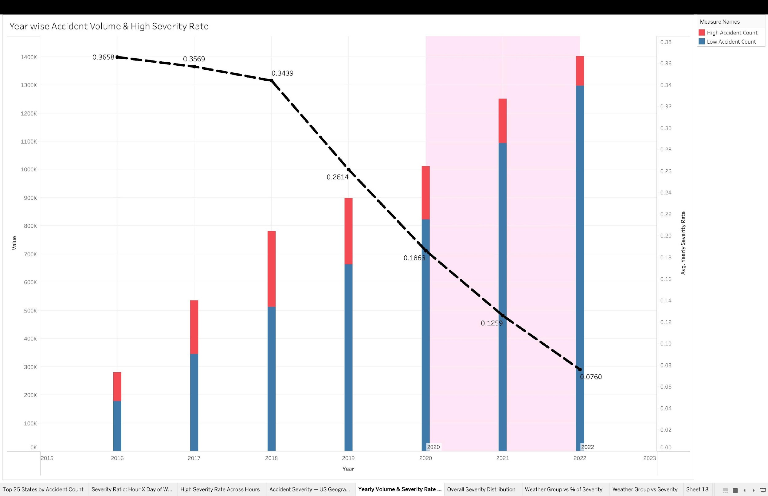
Counter-Intuitive Findings
Clear roads are more dangerous? Severity fell 80%? What the data is really telling us.
Visibility vs High Severity %
Year-wise Volume & Severity Rate
33.16% severity at Very High visibility (>10mi)
Severity rate: 36.6% (2016) → 7.6% (2022)
Open rural highways dominate this bin. Clear roads = high speeds = longer clearance. Visibility measures road type as much as weather condition.
NOT a safety improvement. API feed expansion added millions of Sev 2 records each year — diluting the high-severity proportion. Temporal comparisons are unreliable.
DS612 · IDV · Group 7 · US Accidents 2016-2022
7 / 10

Slide 8
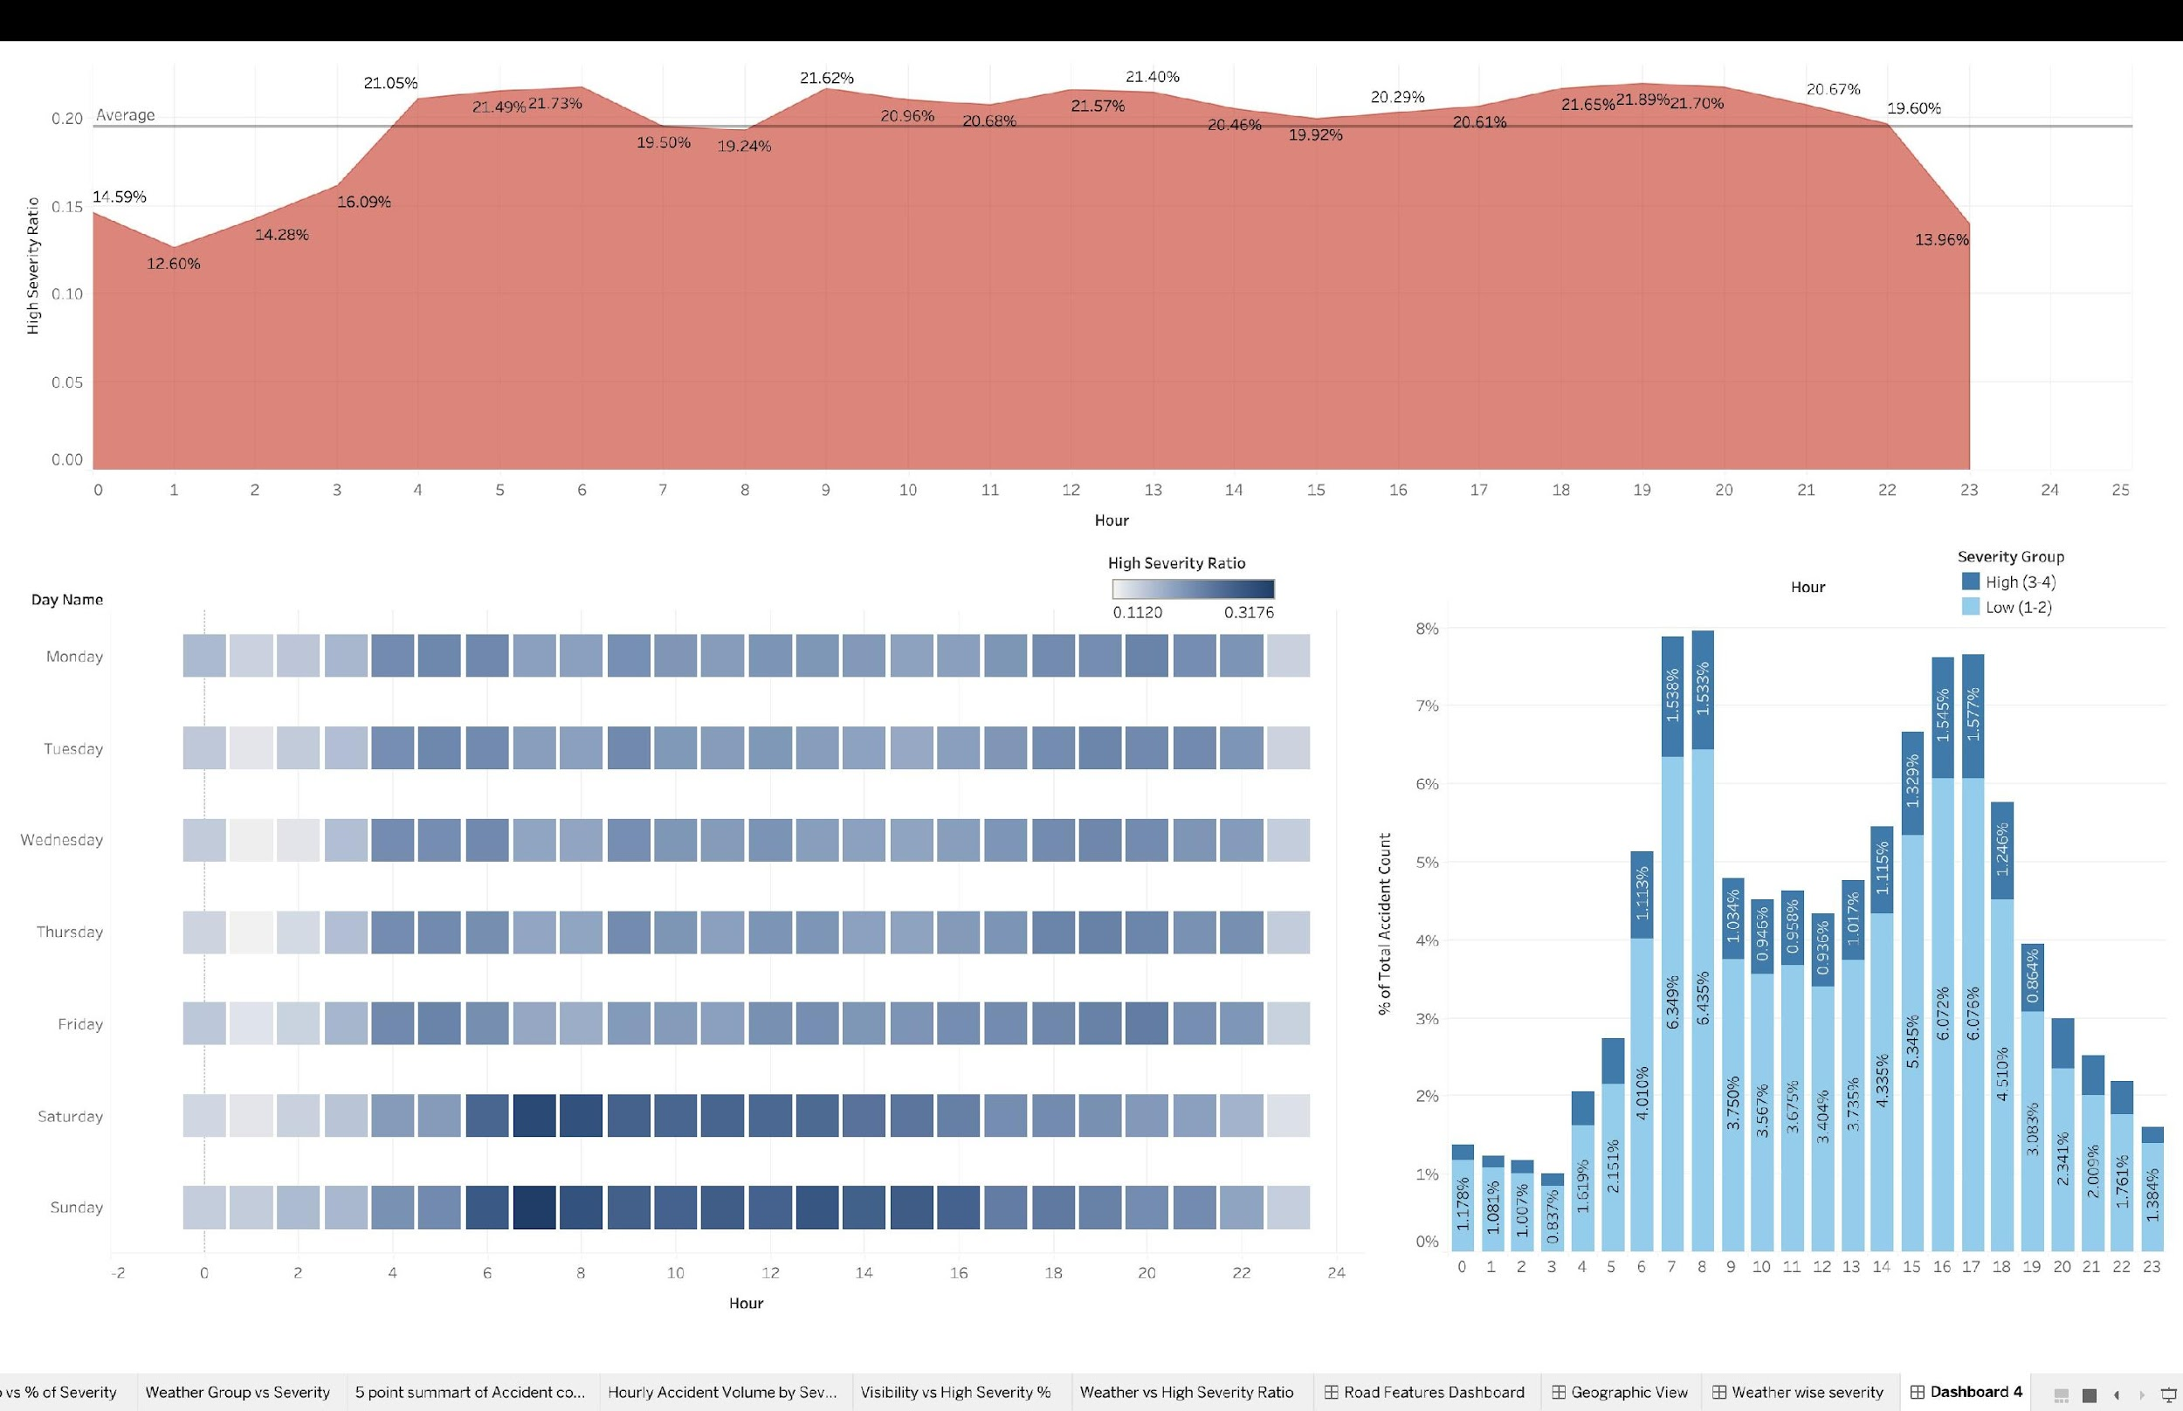
H2: Do Rush Hours Increase Accident Severity?
Partially Supported
19.24%
21.73%
1.53%
0.3176
13.96%
8am rush severity rate
6am peak severity rate
Hour 7-8 high-sev share
Sat 7-9am heatmap
23h — lowest rate
Below the 20% average
Highest in the day
Largest absolute count
Weekend low-traffic spike
Traffic falls, severity falls
DS612 · IDV · Group 7 · US Accidents 2016-2022
8 / 10

Slide 9
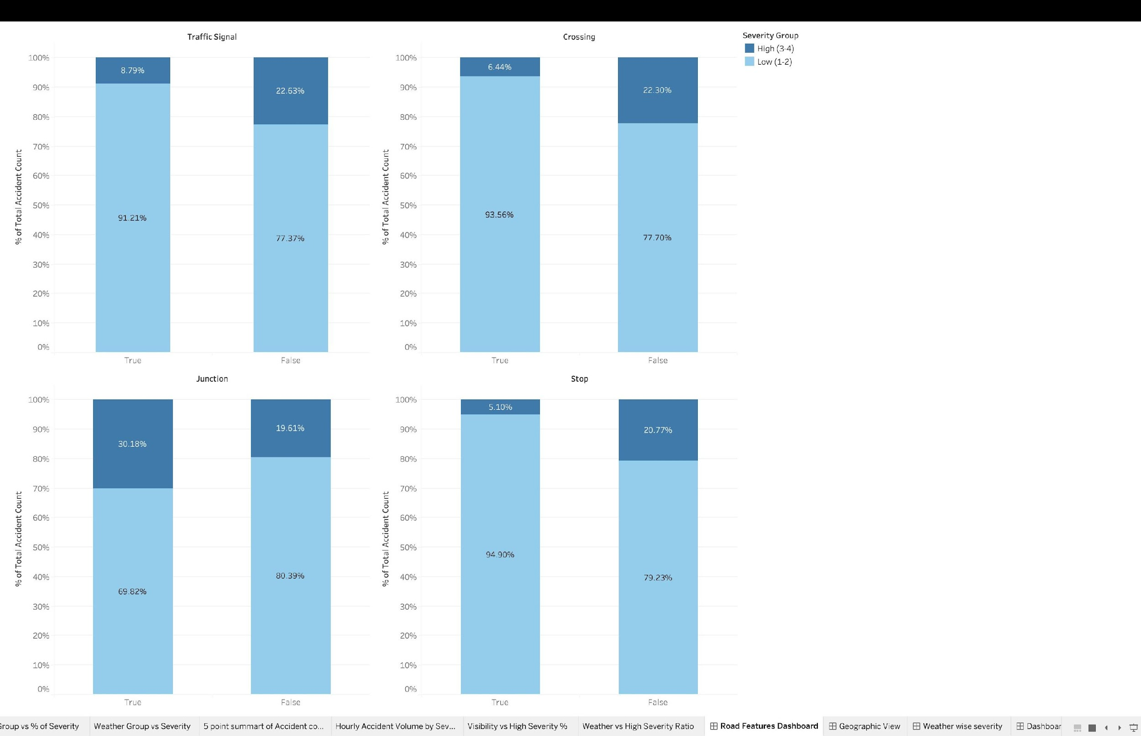
H3 & H4: Infrastructure Beats Weather. Speed Beats Rush Hour.
H3 — Signal effect: 13.84pp
Traffic signals cut severity from 22.63% → 8.79%. That's 2.1× the 6.53pp lift that Rain creates over Clear.
H3 — Crossings: 6.44% (present) vs 22.30%
Mandatory-stop infrastructure consistently lowers severity across all four feature types tested.
Junction danger: 30.18% vs 19.61%
No mandatory stop = complex conflict. Junctions are the only feature that increases severity when present.
Severity in Presence vs Absence of Road Features
H4 — 3-6am sustained plateau
21.05–21.73% severity rate. Low volume + high speed + slow emergency response = long road clearance.
DS612 · IDV · Group 7 · US Accidents 2016-2022
9 / 10

Slide 10
What the Data Really Says
Four hypotheses. Four verdicts. One reframed problem: severity is clearance time, not injury.
Bad weather increases severity
H1
Partially
Rain: 24.38% vs Clear: 17.85%. Gap widened after cleaning. Fog/Snow still underperform expectations — drivers self-regulate.
6.53pp lift
Rush hours increase severity
H2
Partially
Rush hours (7-8am) sit BELOW the average severity rate. They produce the highest absolute counts due to volume alone.
Rate < 19.5%
Infrastructure reduces severity more than weather increases it
H3
Supported
Traffic signals save 13.84pp. Adverse weather adds only 6.53pp over Clear. Infrastructure effect is 2.1× weather.
13.84pp saved
Low-traffic, high-speed periods drive disproportionate severity
H4
Supported
3-6am plateau + Saturday 7-9am heatmap peak (0.3176) + Very High visibility (33.16%) all converge.
33.16% @>10mi
Core finding: Road infrastructure investment (signals, crossings) is the strongest lever for reducing high-severity incidents — more powerful than weather-based interventions.

