Slide 1



Slide 2








Meet Our Team
Backend
Frontend
Aditya Jha
Rebekah Rose
Data Models & Architecture
UI Design
Preethi Pamidi
Project Lead & Technical Oversight
Likitha Movva
Srinidhi Putrevu
Core Logic & APIs
Dashboard & Testing

Slide 3
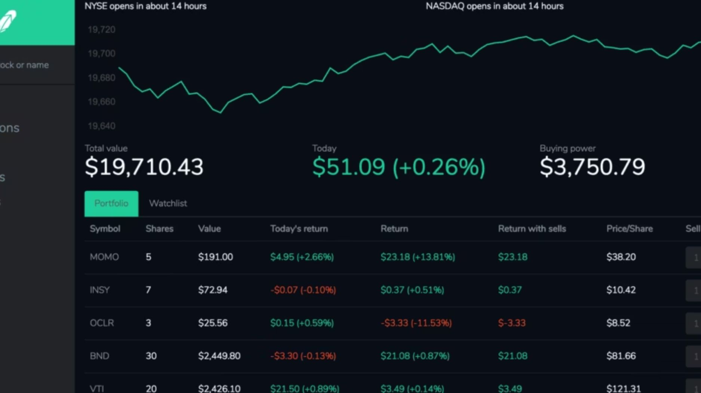
TIRED OF LOOKING AT THESE WEBSITES?

Slide 4

Project Overview: Why FINSNAP404?
FinSnap404 is a full-stack Financial Portfolio Management System designed to empower users to seamlessly manage, track, and analyze their investment portfolios — all in one visually rich and user-friendly platform.

Slide 5





The Problems We're Solving
Unified dashboard
Auto-fetching
Limited Insights
Stale Data

Slide 6
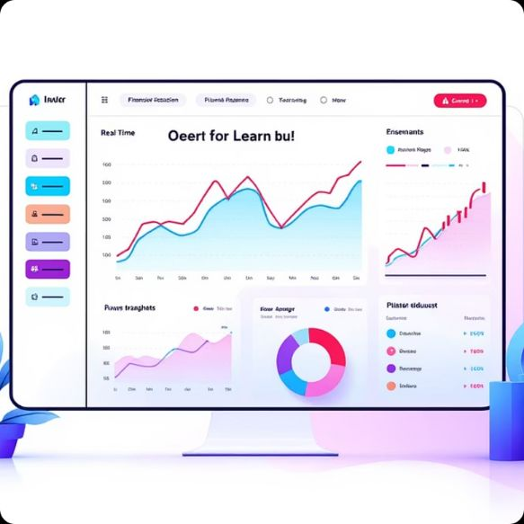


Key Features: What FINSNAP404 Delivers
Built-in Learning
Smart Money Manager
Diverse Investment Types
Curated content on saving, investing basics, asset types, budgeting, and links to trusted external resources.
It uses monthly income, savings goals, and risk tolerance to automatically suggest a personalized budget breakdown.
Support for stocks, bonds, mutual funds, and more within a unified platform.

Slide 7


System Flow: Seamless User Experience
User Login
Secure authentication for protected access.
View Dashboard
Intuitive dashboards with real-time insights.
Fetch Data
Automatic data retrieval from diverse sources.
Update Holdings
Effortless portfolio modification & instant recalculation.

Slide 8
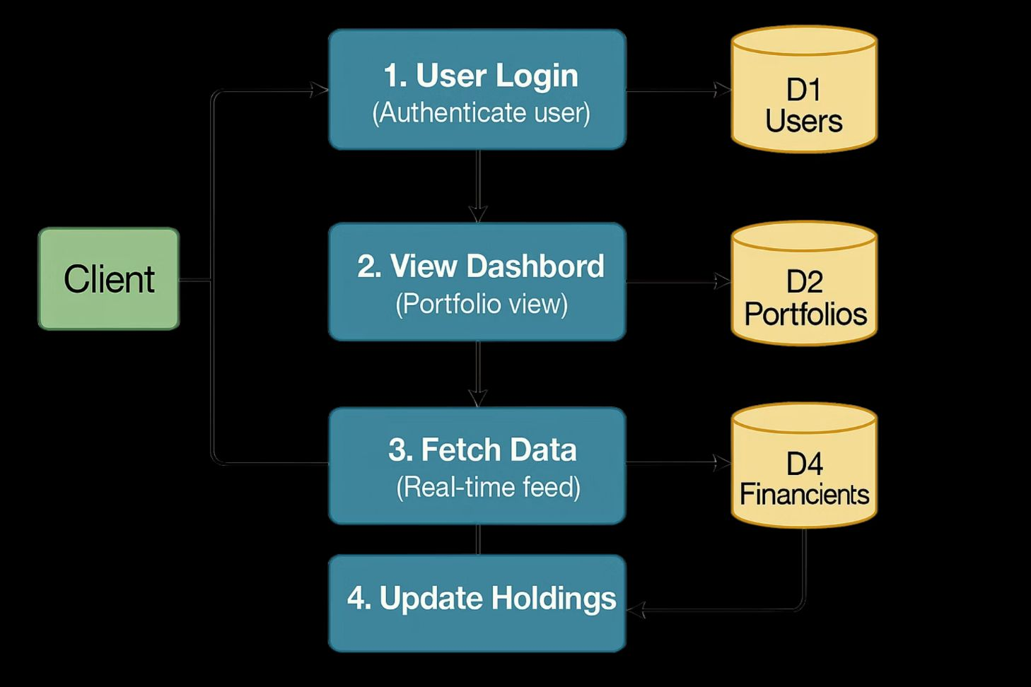
ARCHITECTURAL DIAGRAM
Our system's robust architecture ensures secure, scalable, and efficient managementof financial data, from user interaction to deep analytics.

Slide 9


Technology Stack: Our Building Blocks
Frontend
Backend
Our frontend leverages HTML5, CSS3, and JavaScript, to deliver a responsive, intuitive user interface across all devices.
Our robust backend, built withNode.js and Express, uses MySQL for data storage. Secure RESTful APIs, ensure seamless and reliable data exchange.

Slide 10



Unique Features: Beyond the Basics
Live Financial News
Smart Money Manager
Stay ahead with real-time market updates.Our integrated feed refreshes hourly, delivering the most current financial news directly to your dashboard.
FINSNAP404analyzes your monthly income, savings goals, and risk tolerance to automatically generate a personalized budget breakdown, optimizing your financial journey.

Slide 11



The Road Ahead: Evolution of FINSNAP404
AI-Driven CHATBOT
Live Market Data
Enhanced Security
Integrate advanced risk analytics and artificial intelligence for personalized investment recommendations based on user profiles and market conditions.
Connect with comprehensive external market data feeds for real-time pricing, breaking news alerts, and automatic portfolio impact analysis.
Implement multi-factor authentication, biometric verification, and advanced encryption protocols for maximum data protection.

Slide 12

Ready to Transform Your Investment Strategy🚀
Team 404TEAMNOTFOUND proudly presents a comprehensive Financial Portfolio Management System designed to streamline investment tracking, simplify complex financial data, and empower users with actionable insights.

Slide 13

We're open to questions!
Thank you for your attention.

