Slide 1

Information Security IA-2
Penetrative (Pen) testing tools - Online scanners
VirusTotal
By:
Aditya Kulkarni – 16010121093
Devansh Khandor - 16010121085

Slide 2
Penetration Testing
Identify vulnerabilities through simulated cyberattacks.
Assess security controls against real-world threats.
Comprehensive testing across networks, applications, and devices.
Prioritize risks for informed security decisions.
Meet compliance requirements with regular testing.
Examples of Online Scanners commonly used for various purposes in cybersecurity:
VirusTotal: is an online scanner that analyzes files and URLs to detect malware and other malicious content using multiple antivirus engines.
URLVoid: is an online scanner that checks URLs against blacklists and security databases to identify potentially malicious websites.
Google Safe Browsing: is a service that helps protect users from phishing and malware attacks by checking URLs against a list of unsafe websites.

Slide 3

VirusTotal
Online service that analyzes files and URLs for malware using multiple antivirus engines.
It provides a comprehensive report on the potential threats associated with a file or URL based on the results from various antivirus scanners.
Allows users to upload files or enter URLs to check for viruses, trojans, worms, and other types of malicious content.
It offers a public API that developers and security researchers can integrate into their applications for automated malware analysis.
It widely used by cybersecurity professionals, researchers, and organizations to assess the security risks posed by files and websites.

Slide 4
VirusTotal
Functionalities:
Malware Detection: Identifies viruses, trojans, worms, and other malware in files and URLs.
Multiple Antivirus Engines: Uses a diverse set of antivirus engines to increase detection accuracy.
Detailed Reports: Provides detailed reports with information on detected threats, including hash values, file names, and detection rates.
Public API: Offers an API for automated malware analysis and integration with third-party applications.
Community Contributions: Allows users to contribute to its database by submitting samples and improving detection capabilities over time.

Slide 5
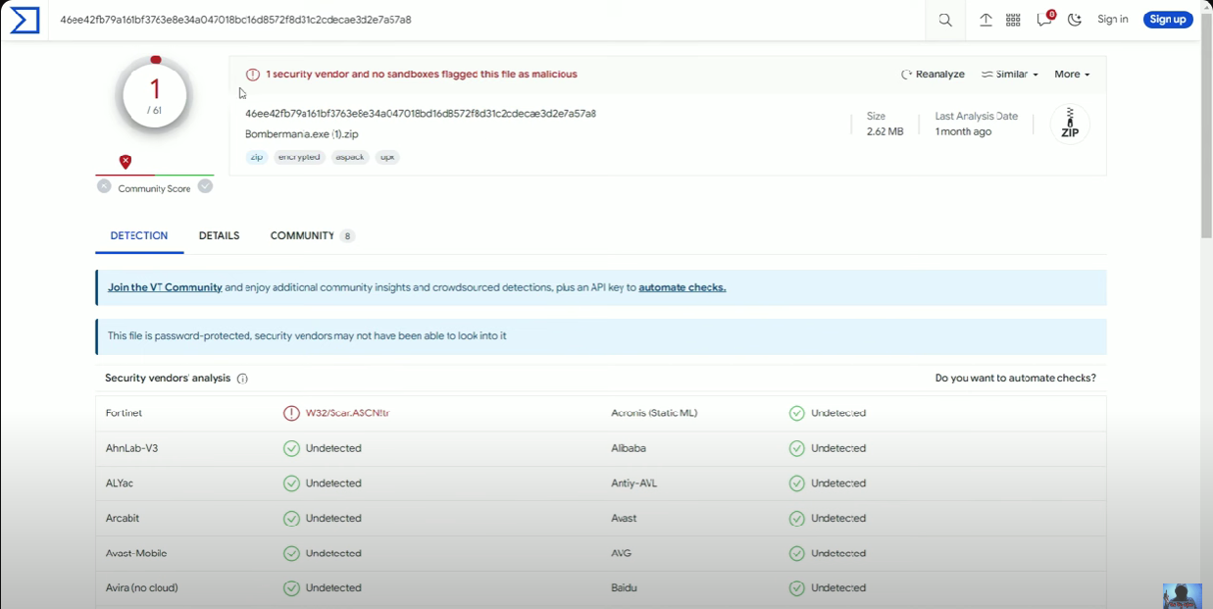
VirusTotal
Implementation:
Detect malware from files

Slide 6
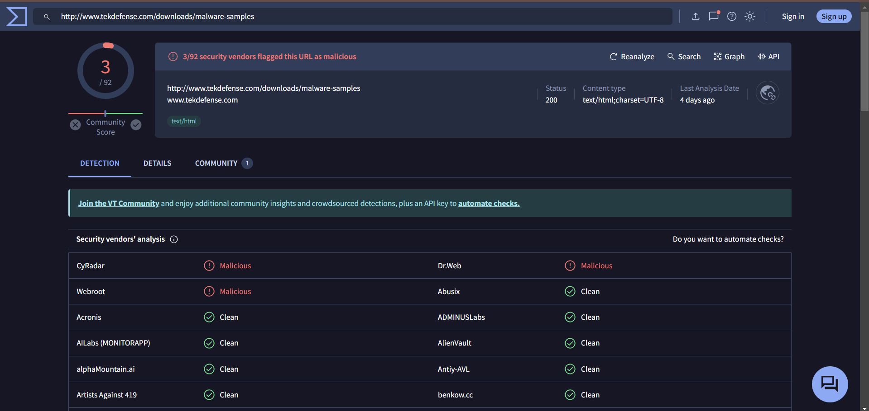
VirusTotal
Implementation:
2. Detect malware from URL

Slide 7
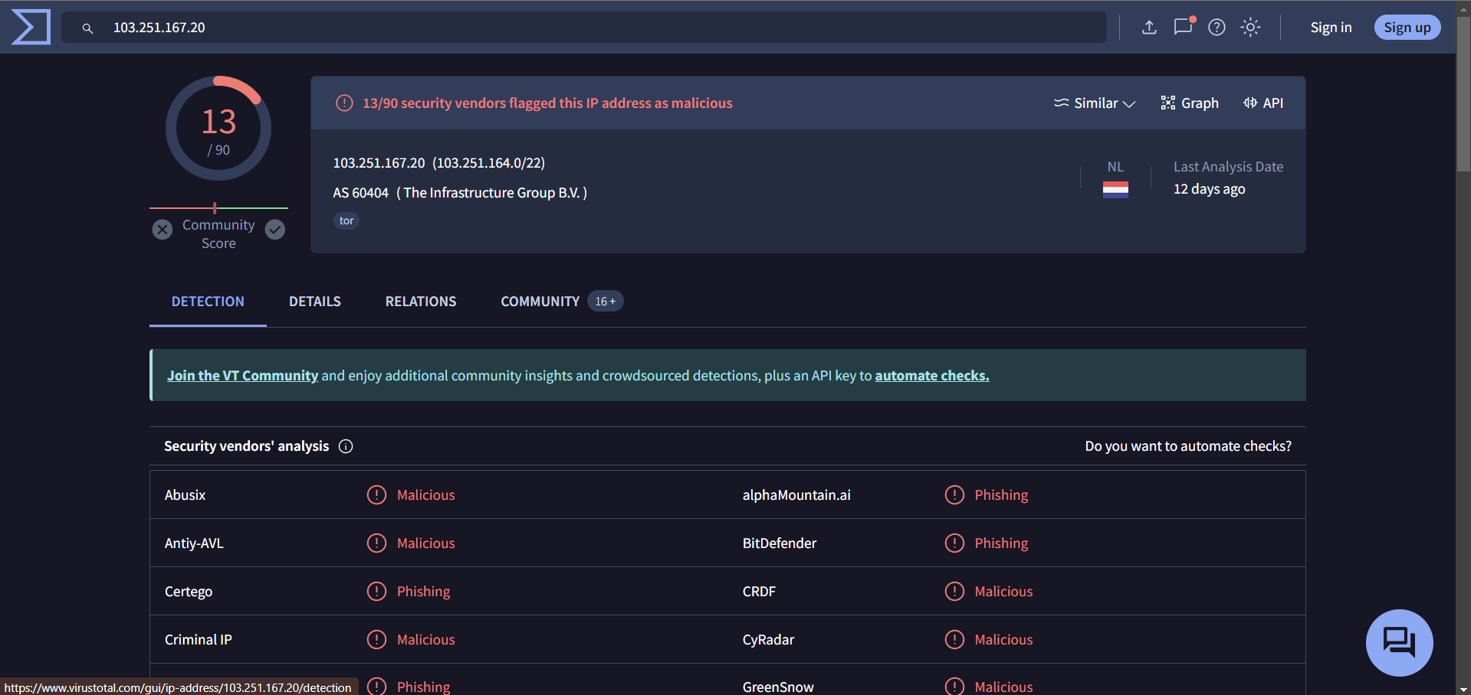
VirusTotal
Implementation:
3. Detect malware from IP Address

Slide 8
VirusTotal APIs
The VirusTotal API is a set of tools and endpoints provided by VirusTotal that allows developers and security professionals to integrate automated malware analysis capabilities into their applications and workflows.
Applications:
Automated Malware Analysis: Enables automated scanning of files and URLs for malware, enhancing security workflows.
Integration with Security Tools: Integrates with SIEMs, firewalls, and endpoint protection solutions for real-time threat intelligence.
Threat Hunting Supports threat hunting activities by providing access to VirusTotal's extensive malware database and analysis capabilities.
Incident Response Facilitates quick incident response by automating malware detection and providing actionable insights.
Security Orchestration: Enables security orchestration and automation by integrating with SOAR platforms to streamline security operations.

Slide 9
VirusTotal APIs

Slide 10
Information Security IA-2
Video Link:
https://youtu.be/7oxEyNDEL5o
Thank You!!

