Slide 1
INTERVIEW TRAINER AGENT
CAPSTONE PROJECT
Presented By:
ADITYA KAMAL-
SJB INSTITUTE OF TECHNOLOGY- ISE

Slide 2
OUTLINE
Problem Statement
Proposed System/Solution
System Development Approach
Algorithm & Deployment
Result
Conclusion
Future Scope
References

Slide 3
Problem Statement
Interview Trainer Agent
The Challenge – An Interview Trainer Agent, powered by RAG (Retrieval-Augmented Generation),
prepares users for job interviews by generating tailored question sets and preparation strategies based
on their profile name, experience level, and job role.
It retrieves role-specific interview questions, industry expectations, behavioral scenarios, and HR
guidelines from recruitment portals, professional networks, and company interview databases.
Users can input their resume or job title, and the agent provides targeted questions, model answers,
and improvement tips.
It supports both technical and soft skill assessment, ensuring a comprehensive interview prep
experience.
This AI-driven assistant builds user confidence, sharpens responses, and increases success rates in
competitive hiring environments.

Slide 4
Proposed Solution
Proposed Solution – AI-Powered Interview Trainer Agent
Our solution is an intelligent Interview Trainer Agent that delivers deeply personalized, end-to-end interview preparation using IBM’s Granite model with Retrieval-Augmented Generation (RAG).
Personalized Question Generation
Dynamically creates interview question sets tailored to each user’s name, experience level, and desired job role.
Focuses preparations around the user’s unique career trajectory and target industry.
RAG-Driven Insights
Employs a RAG architecture to retrieve and synthesize real-world interview content from:
Recruitment portals
Professional networking platforms
Company-specific interview databases
Ensures industry-relevant, role-specific, and up-to-date guidance.

Slide 5
Proposed Solution
Comprehensive Preparation Toolkit
Targeted Questions: Provides relevant technical, behavioral, and HR-style interview questions based on user profile.
Model Answers: Supplies high-quality sample responses demonstrating ideal answering techniques.
Actionable Tips: Delivers concrete suggestions to refine user responses, enhance delivery, and avoid common pitfalls.
Holistic Skill Assessment
Covers both technical competencies (coding challenges, system design, domain-based questions) and soft skills (communication, adaptability, leadership).
Enables well-rounded preparation in line with modern hiring expectations.
Empowering Candidate Confidence
Through a structured, adaptive, and feedback-rich training pathway, the agent helps users:
Build confidence
Improve performance under pressure
Maximize success rates in high-stakes interview environments

Slide 6
System Approach
System Requirements
IBM Cloud Trial Account
Browser (for Watson Assistant UI)
Basic system with internet for deployment testing
Libraries / Tools Used
ibm-watson-assistant (via IBM Cloud UI)
ibm-watson-machine-learning or watsonx.ai (for LLM)
Flask or Streamlit (for backend integration)
requests, json, etc. for API calls (Python backend)
IBM Cloud Services:
Watson Assistant, Watsonx Granite Model, Cloud Functions
/ Foundry (if deployed)

Slide 7
Algorithm & Deployment
Algorithm Selection:
This project employs a Retrieval-Augmented Generation (RAG) architecture combined with IBM Granite large language models (LLMs). RAG is chosen because it effectively blends knowledge retrieval with context-aware text generation, which is essential in delivering interview questions that are both personalized and industry-relevant. By pairing Granite’s powerful natural-language generation capabilities with real-time retrieval from curated interview datasets, the system ensures accuracy, diversity, and adaptability in question delivery.
Data Input:
The model accepts several input features:
User profile details: name, target role, experience level
Resume-based extracted features: skills, education, prior projects
Historical interaction data: accuracy scores, past responses, weak areas
Training Process:
The external interview question bank is converted into embeddings using Granite’s embedding models and stored in a vector database (IBM Cloudant/Db2). The LLM is prompt-tuned with structured interview instructions. During training, semantic similarity retrieval (top-k) is tested and optimized to ensure relevant content retrieval based on user profile vectors. Hyperparameters like retrieval depth, prompt templates, and generation temperature are tuned using offline evaluation and user feedback loops.
Prediction Process:
At runtime, the user’s inputs are converted into query embeddings. The retrieval module identifies the most contextually similar interview questions and HR expectations. These are passed to the Granite generative model, which constructs personalized interview questions, ideal model answers, and real-time improvement tips. During mock interviews, user responses are scored by the model, and future questions are adaptively selected based on response quality, gradually improving user performance in both technical and behavioral skills. The cycle continues interactively, building confidence and refining the user’s preparedness for real interviews.

Slide 8
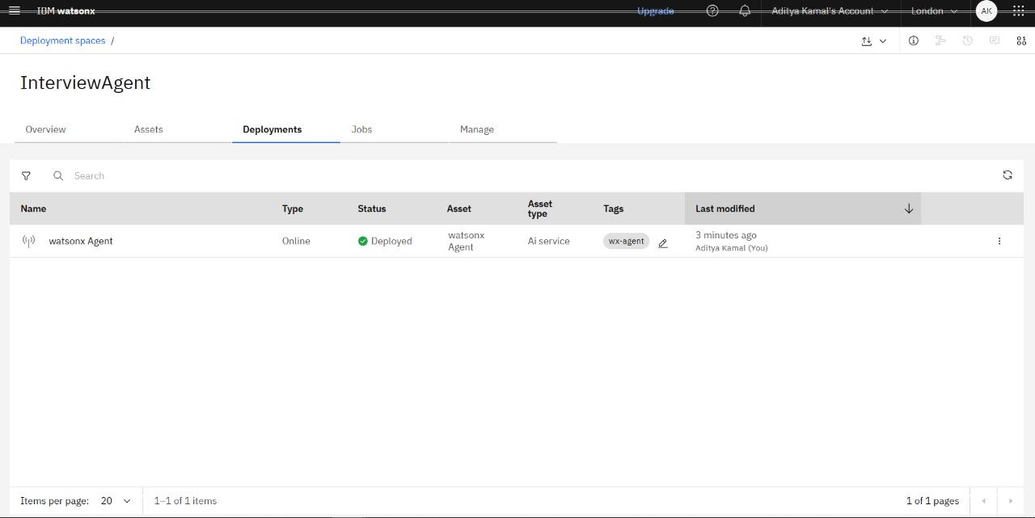
Result

Slide 9
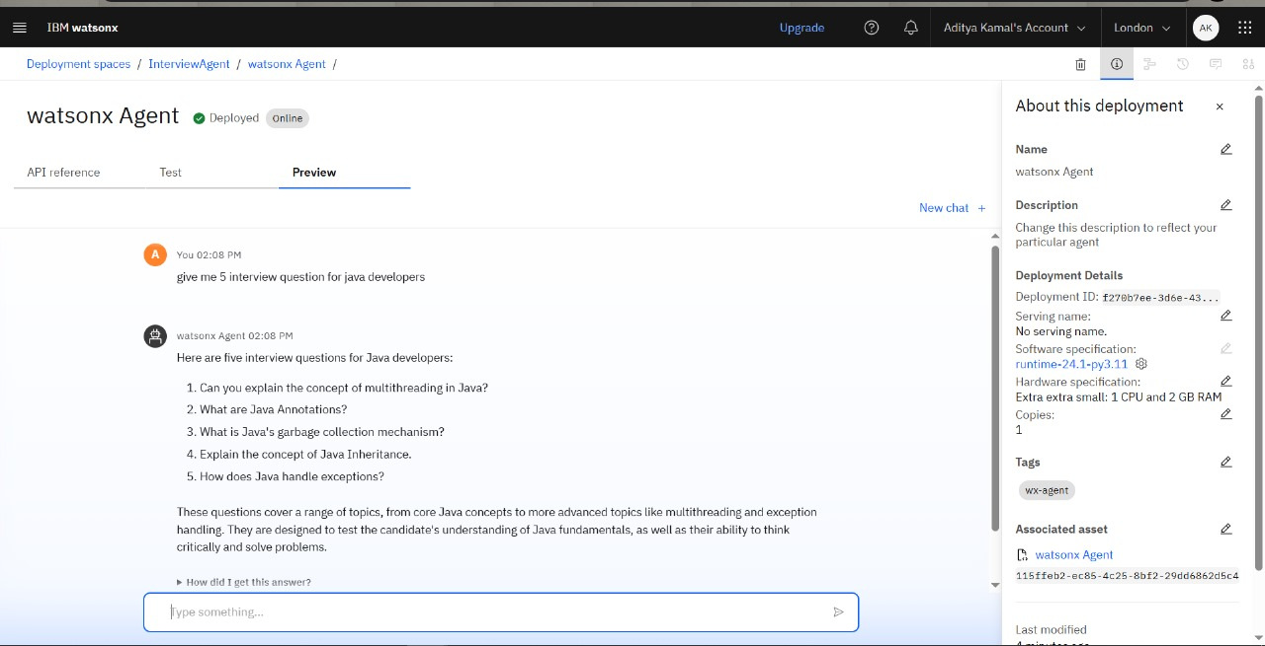
Result

Slide 10
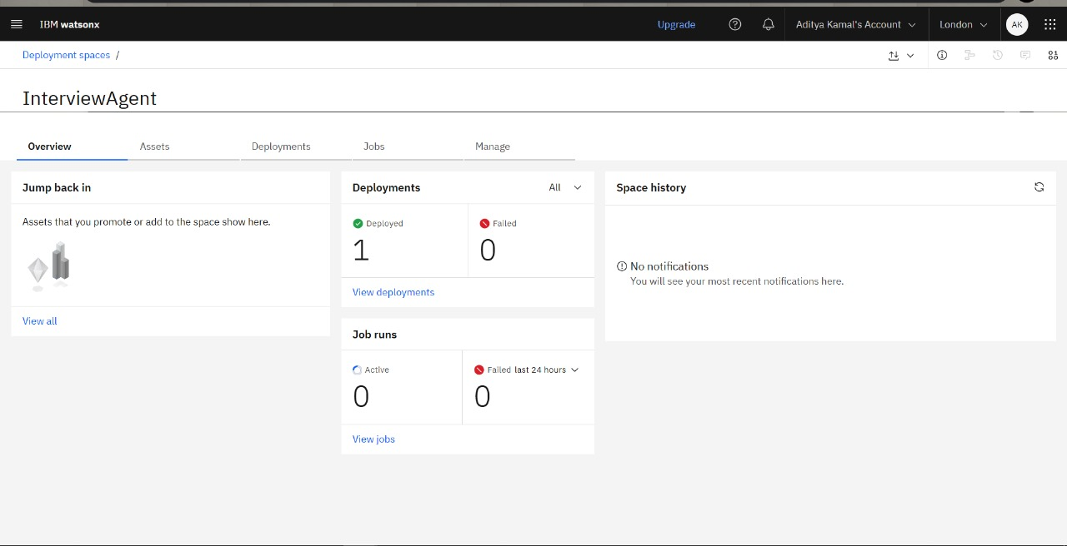
Result

Slide 11
Conclusion
The Interview Trainer Agent successfully demonstrates how advanced AI technologies can revolutionize the interview preparation process by making it intelligent, adaptive, and highly personalized. By combining the powerful natural-language generation capabilities of IBM Granite models with Retrieval-Augmented Generation (RAG), the system delivers role-relevant interview questions, detailed model answers, and actionable feedback based on real-world hiring trends. It effectively guides users through both technical and behavioral preparation, enhancing their confidence and readiness for competitive job markets. This solution has strong potential not only to improve individual performance in interviews, but also to serve as a scalable, industry-aligned platform that modernizes the way candidates prepare for professional opportunities.

Slide 12
Future scope
Voice-based Mock Interviews:
Integrate speech-to-text and voice emotion analysis to conduct verbal mock interviews with real-time assessment of speaking style, confidence, tone, and body language.
Company-Specific Simulation:
Automatically detect target companies from the user’s resume/job application and provide company-specific interview simulations based on past hiring patterns and frequently asked questions.
Adaptive Learning & Career Path Guidance:
Incorporate long-term learning tracking – identifying gaps over multiple sessions and recommending structured learning paths, courses, and career mentorship.
Multilingual Support:
Enable question generation and interview practice in multiple regional and international languages, making it accessible to non-English speaking candidates.
Integration With Job Platforms:
Connect with job portals like LinkedIn, Naukri, or Indeed to fetch upcoming interviews and schedule personalized preparation timelines for the user automatically.
Group/Panel Interview Training:
Extend capabilities to simulate panel interviews and group discussions (GD), including multi-agent interactions to mimic real-world selection rounds.

Slide 13
References
IBM Watson Assistant –
https://www.ibm.com/cloud/watson-assistant
IBM Watsonx & Granite LLMs –
https://www.ibm.com/watsonx
IBM Cloud Documentation –
https://cloud.ibm.com/docs
IBM SkillsBuild - Getting Started with AI –
https://www.skillsbuild.org
Natural Language Processing (NLP) concepts –
https://www.geeksforgeeks.org/nlp-natural-language-processing/
Chatbot Design Guidelines –
https://www.ibm.com/blogs/watson-health/chatbots-design/

Slide 14
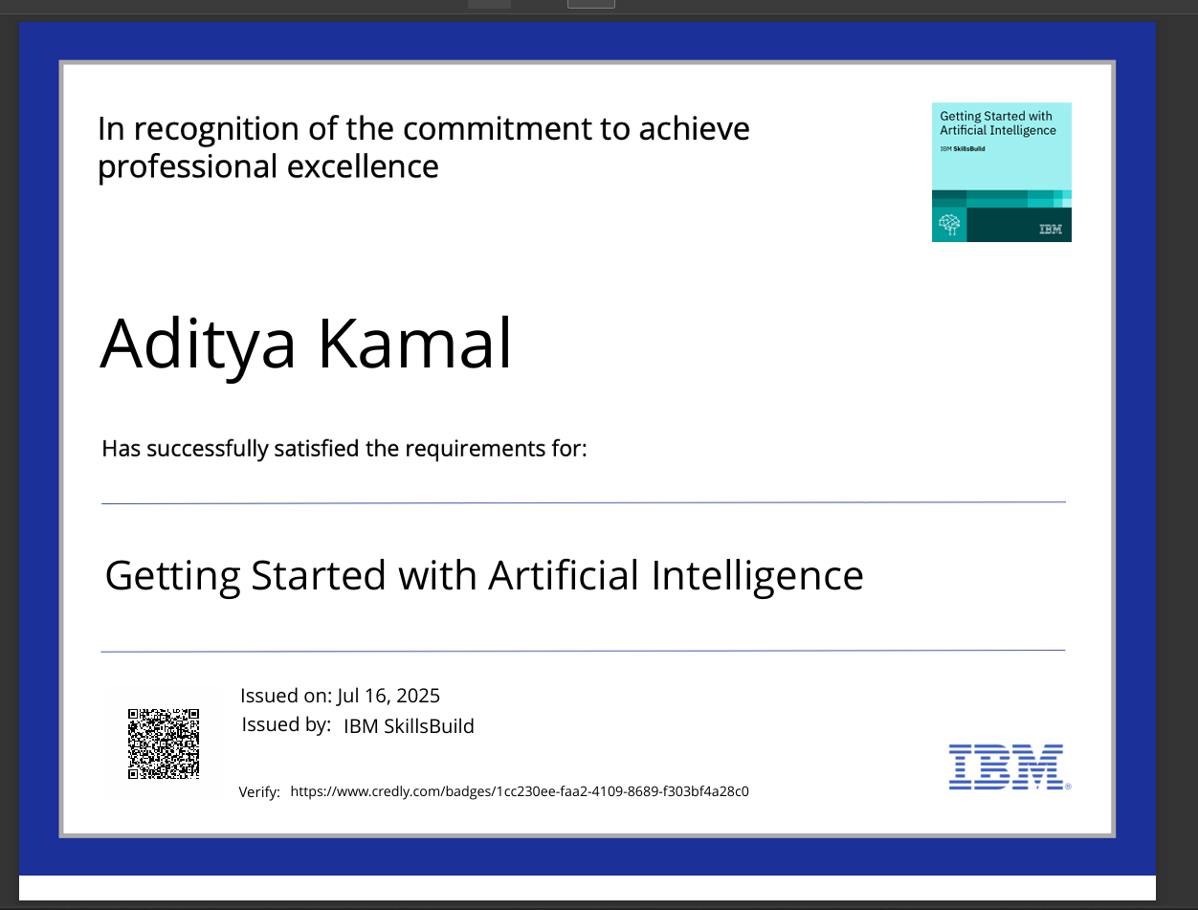
IBM Certifications

Slide 15
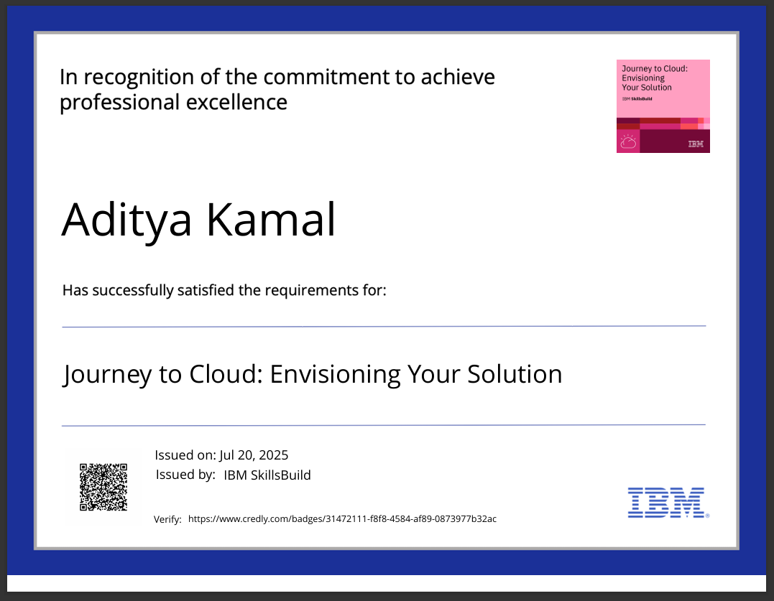
IBM Certifications

Slide 16
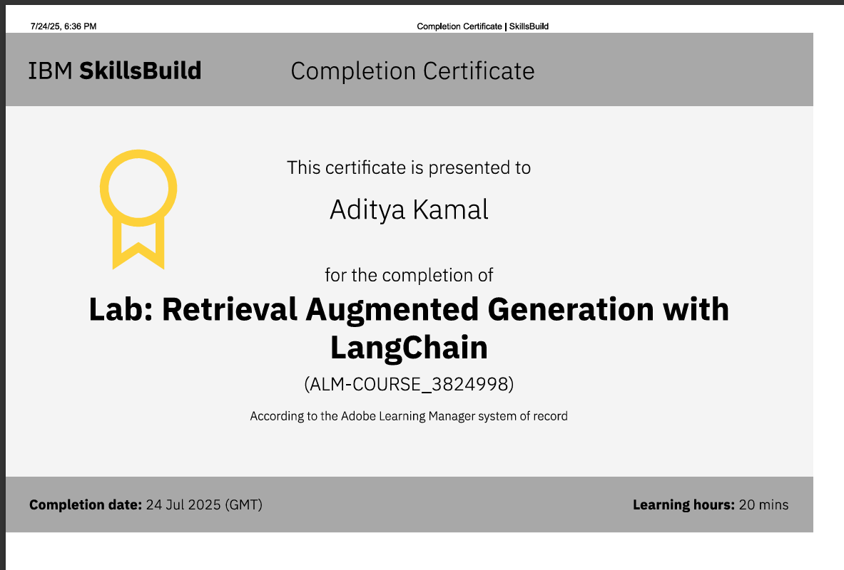
IBM Certifications

Slide 17
THANK YOU

