Slide 1
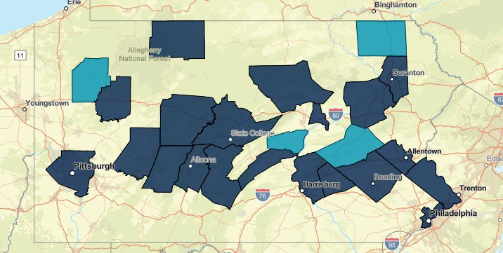
Population Analysis - Overview
Fiscal Year: 2022-2024
# of Medicaid Individuals
26,740
# of Individuals Enrolled in Mediacid & SNAP
26,740
# of Individuals in Medicaid, SNAP and TANF
26,740
Cross Program Enrollment
Cross Program Enrollment
% CER Req…
1.23K
80,000
6,630
6,702
% CER Required
13,408
Total
Increase
60,000
53,260
40,000
80,000
20,000
0
Not Enrolled
Medicaid Only
Medicaid + SNAP + TANF
Medicaid + SNAP
Total
Esri, TomTom, Garmin, FAO, NOAA, USGS, © OpenStreetMap
1.23K
Cross Program Group
ABAWD Work Requirement Individuals
ABAWD Wo…
Retail
11.97K
Employment
Non-Compl…
4.01K
Manufactur...
12.01K
4.03K
Industry
Healthcare
12.01K
3.96K
Education
11.85K
4.02K
Construction
12.17K
3.98K
0
2K
4K
6K
8K
10K
12K
14K
Lost Benifits Count

