Slide 1
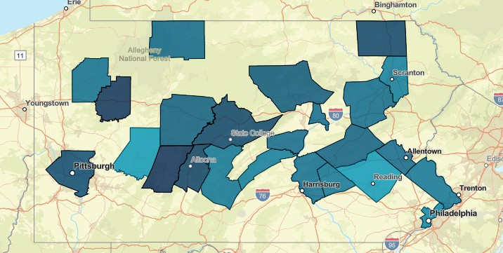
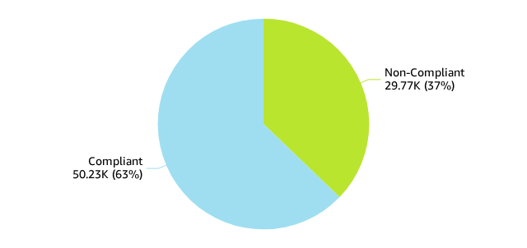
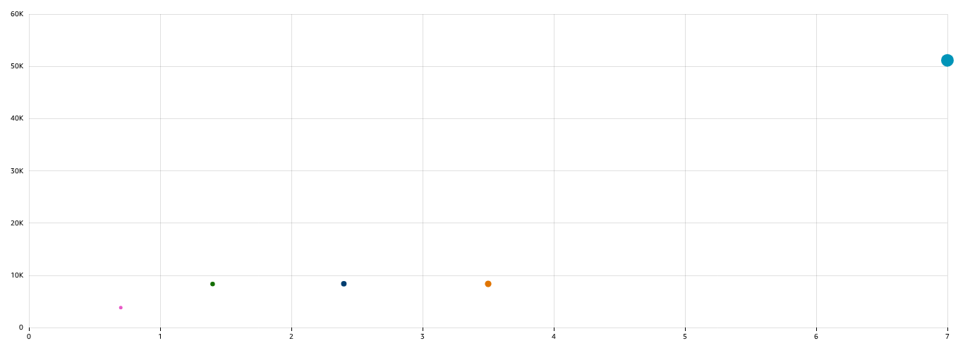
Population Analysis - Overview
Fiscal Year: 2022-2024
# and % of Individuals Receiving Medicaid
26,740
100%
# and % of Individuals Required to Meet CER
26,740
100%
# and % of Individuals with an Exemption
26,740
100%
% CER Required by County
Compliance Status
% CER Required
651
Non-Compliant
Compliant
Esri, TomTom, Garmin, FAO, NOAA, USGS, © OpenStreetMap
572
Compliance Status
Avg. Time on Medicaid for CER Individuals
SHOWING UP TO 2500 DATA POINTS
Enrollment …
4+ years
2-3 years
3-4 years
1-2 years
<1 year
Medical Enrollment Duration
Number of Individuals

