Slide 1
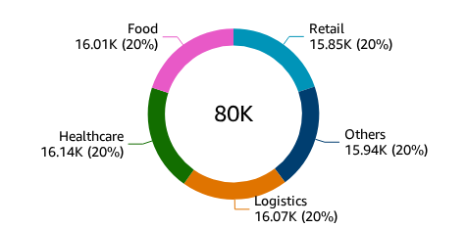
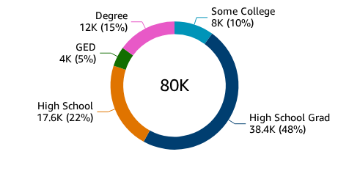
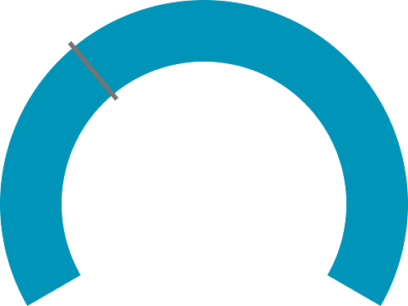
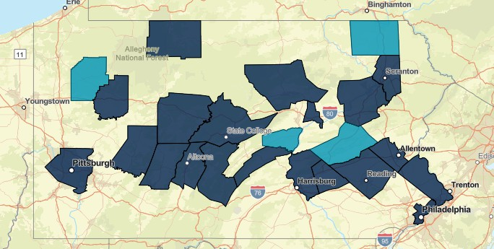
Population Analysis - Prism Data
Fiscal Year: 2022-2024
Education Level
All
Global Filters:
% of Individuals Participating in Work Activities
26,740
Avg. Weekly Participation Hours
26,740
% of Participants Completing Job Trainings
33.42%
Employee Placement Rate
33.42%
Prior Employment Information by Industry
Prior Emplo…
Retail Others Logistics Healthcare Food
Percentage of Individuals with Education Level
Education L…
Some College High Schoo… High School GED
Degree
Likelyhood to find a Job
26,740
299.18%
0
80,000
Unemployment Rate By County
36.79%
36.23%
35.58%
35.49%
35.49%
35.41%
35.41%
35.17%
35.17%
35.09%
35.04%
Top in Demand Occupations
Adams
Northumbe... Lackawanna Armstrong Columbia Dauphin Montgomery
Greene
Pike Chester
York
Clerks
_{CNA's}Auditors _{Drivers}
_{Repair Perso}He_{n}althcare W_{a}orkers _{ls}
County
Technicians
Accountants
Social Workers
Teachers
0%
10%
20%
Medicaid_Percentage (Average)
30%
40%
Job Demand by County
CRE Work Participation
Individual ID
1.23K
35K
32K
30K
25K
20K
Number of Individuals
20K
15K
16K
10K
5K
0
12K
Esri, TomTom, Garmin, FAO, NOAA, USGS, © OpenStreetMap
1.23K
Paid Employment
Community Service
Work Participation
Job Search
Job Training

