Slide 1

Fake New Detection
Aditya Karpe (166)
Saurabh Keskar (114)

Slide 2
Table Of Content
Algorithms Used
Libraries
Exploring the Datasets
Outputs

Slide 3
Algorithm Used
Logistic Regression
Decision Tree
Random Forest
SVM(Support Vector Machine)

Slide 4
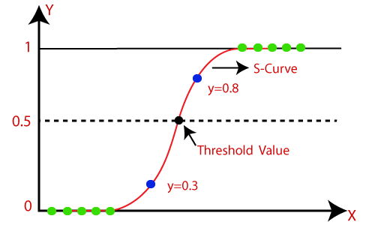
Logistic Regression
Logistic regression is one of the most popular Machine Learning algorithms, which comes under the Supervised Learning technique. It is used for predicting the categorical dependent variable using a given set of independent variables.

Slide 5

Decision Tree
Decision Tree is a Supervised learning technique that can be used for both classification and Regression problems, but mostly it is preferred for solving Classification problems. It is a tree-structured classifier, where internal nodes represent the features of a dataset, branches represent the decision rules and each leaf node represents the outcome.
In a Decision tree, there are two nodes, which are the Decision Node and Leaf Node.

Slide 6
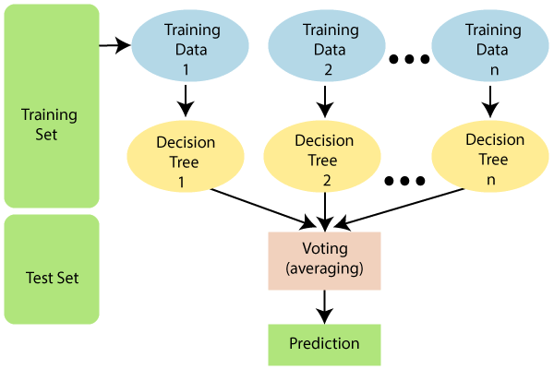
Random Forest
Random Forest is a classifier that contains a number of decision trees on various subsets of the given dataset and takes the average to improve the predictive accuracy of that dataset.
The greater number of trees in the forest leads to higher accuracy and prevents the problem of overfitting.

Slide 7
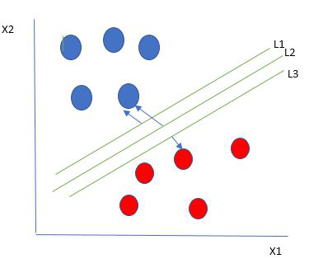
SVM
SVM is also called Support Vector Machine.
If the number of input features is two, then the hyperplane is just a line.
If the number of input features is three, then the hyperplane becomes a 2-D plane.

Slide 8
Libraries
import pandas as pd
import numpy as np
import matplotlib.pyplot as plt
import seaborn as sns
from sklearn.feature_extraction.text import CountVectorizer
from sklearn.feature_extraction.text import TfidfTransformer
from sklearn import feature_extraction, linear_model, model_selection, preprocessing
from sklearn.metrics import accuracy_score
from sklearn.model_selection import train_test_split
from sklearn.pipeline import Pipeline

Slide 9
Exploring The Data Sets
Fake News Data Sets
True News Data Sets
Title - Heading of news
Text - whole news
Subject – Region news
Date – Date of news
Title – Heading of news
Text – whole news
Subject – Category (politics, worldwide,etc)
Date – date of news

Slide 10
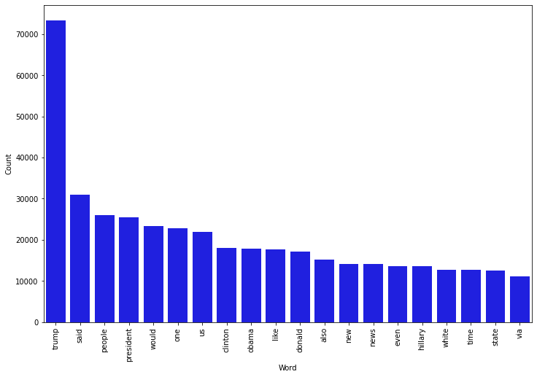
Most Frequent words in Fake News

Slide 11
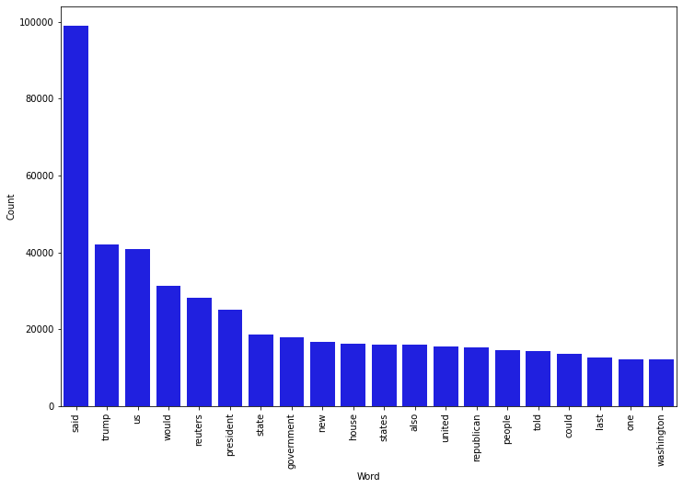
Most Frequent words in True News

Slide 12
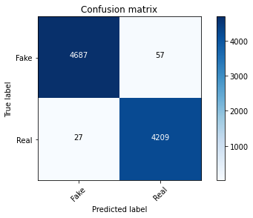

Confusion Matrix
Confusion matrix without normalization in logistic regression
Confusion matrix without normalization in Random Forest

Slide 13


Confusion Matrix
Confusion matrix without normalization in SVM
Confusion matrix without normalization in Decision Tree

Slide 14
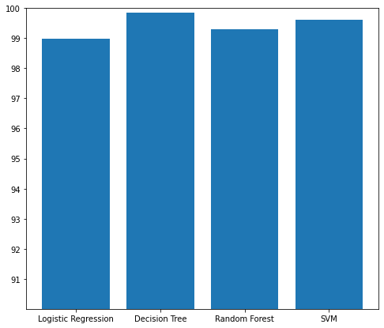
Comparing Different Models

Slide 15
Thank You...

