Slide 1
Code for applying apriori algorithm
Notes:
Apriori algorithm is given by R. Agrawal and R. Srikant in 1994 for finding frequent itemsets in a dataset for boolean association rule. Name of the algorithm is Apriori because it uses prior knowledge of frequent itemset properties. We apply an iterative approach or level-wise search where k-frequent itemsets are used to find k+1 itemsets.

Slide 2
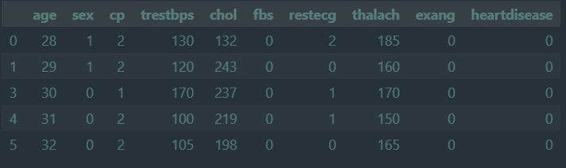
Initial state of cleaned up data
Notes:
This is how the looks after a bit of cleaning up

Slide 3
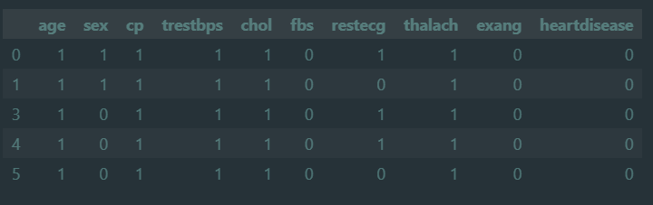
Data after discretizing
Notes:
This was created using applymap function of pandas library.
applymap - This method applies a function that accepts and returns a scalar to every element of a DataFrame
This dataframe is named data_encoded

Slide 4
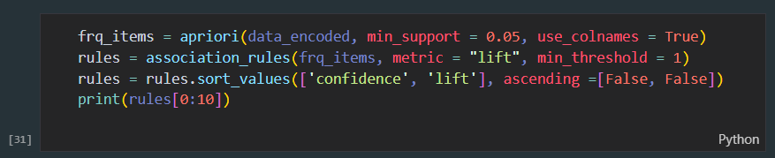
Code we used
Library Used: ‘mlxtend’
‘apriori’ is a function present in the mlxtend library that applies the apriori algorithm on the given dataset and finds the associations rules
Notes:
Mlxtend (machine learning extensions) is a Python library of useful tools for the day-to-day data science tasks.

Slide 5
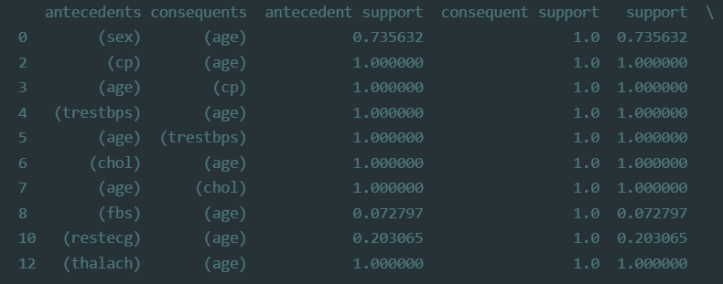
Output:
Notes:
These are the top 10 rules that we got using the apriori algorithm

Slide 6
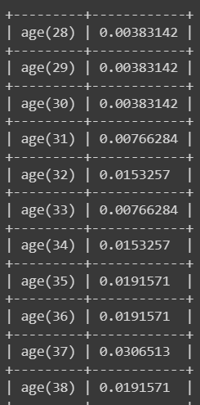
One of the code we implemented was of constructing a Bayesian network considering medical data. As mentioned in the algorithm of BAR, we have to construct bayesian networks for each association rules formed by using the apriori algorithm.
The code used pgmpy library which is a pure python
implementation for Bayesian Networks with a focus on
modularity and extensibility. The ’from pgmpy.models
import BayesianModel’ statement is used to import the
BayesianModel class from the pgmpy.models module.
This allows you to create and work with Bayesian
network models in your code.
print(model.get_cpds('age')) :
The print(model.get_cpds('age')) statement is used to print
the conditional probability distribution (CPD) for the variable
age in the Bayesian network model model.

Slide 7
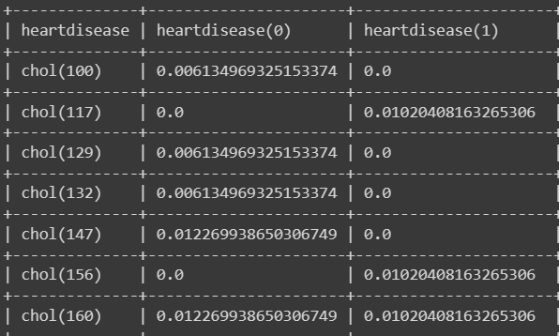
model.get_cpds is a method in a probabilistic graphical model that returns the conditional probability distributions (CPDs) for all of the variables in the model.
print(model.get_cpds('chol')) is a
command to print out the
conditional probability distribution
(CPD) for the variable chol in a
given model.

Slide 8
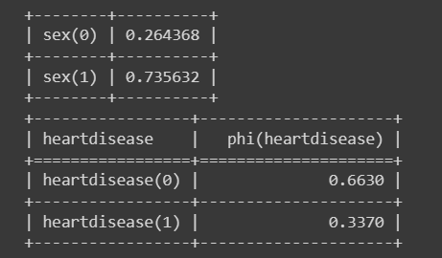
q = HeartDisease_infer.query(variables=['heartdisease'], evidence={'age': 28})
is using the HeartDisease_infer variable to perform a probabilistic query on the given model. This query is asking for the probabilities of the heartdisease variable, given the observed value of the age variable (i.e. age is set to 28)

