Slide 1

EC 392: B.Tech. Project
Atomistic Simulations of 2D Semiconductors
Group member(s)
Aditya Kishore (22095006)
Supervisor
Dr Ankit Arora
Assistant Professor
Department of Electronics Engineering, IIT (BHU) Varanasi
IIT(BHU) Varanasi
1

Slide 2
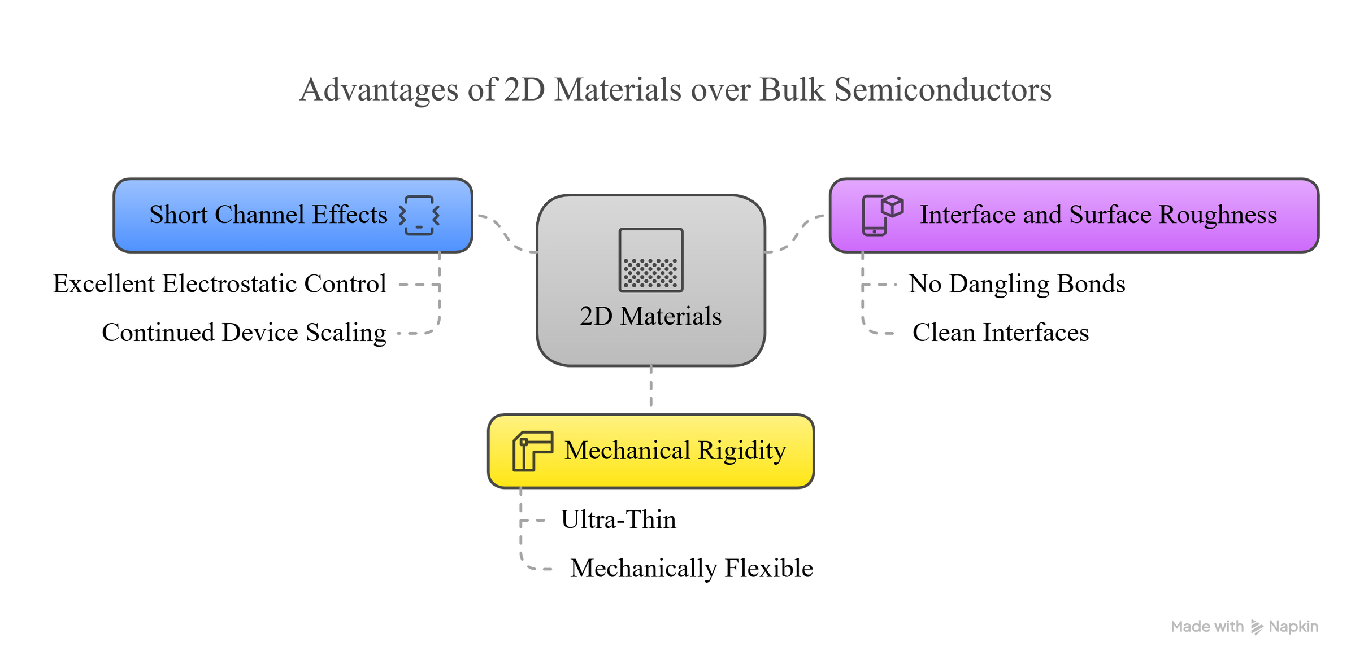
Advantages of 2D Materials over Bulk Semiconductors
IIT(BHU) Varanasi
2

Slide 3
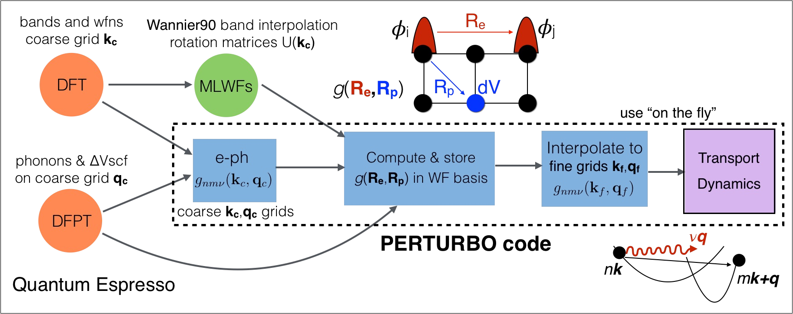


Computational Methodology
J.-J. Zhou, J. Park, I.-T. Lu, I. Maliyov, X. Tong, and M. Bernardi, "Perturbo: a software package for ab initio electron-phonon interactions, charge transport and ultrafast dynamics," Comput. Phys. Commun., vol. 264, p. 107970, 2021.
3

Slide 4
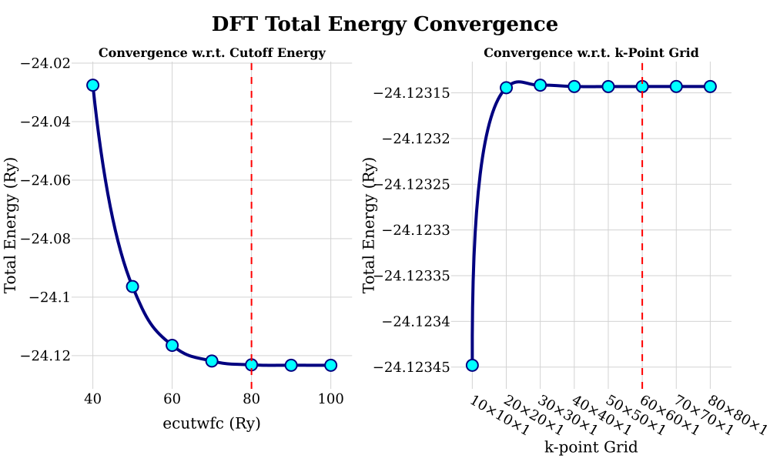
Results
Figure: Convergence for self-consistent field (scf) callculations
IIT(BHU) Varanasi
4

Slide 5
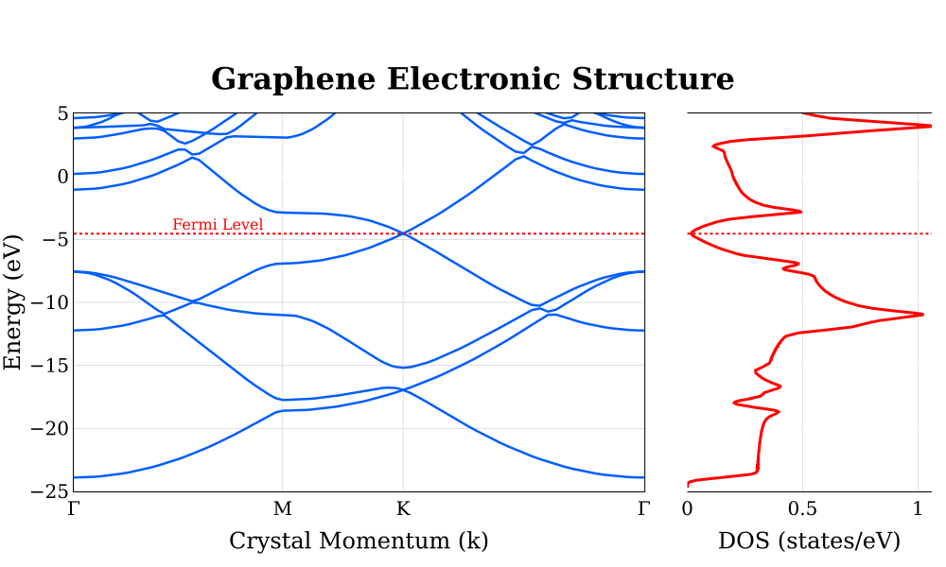
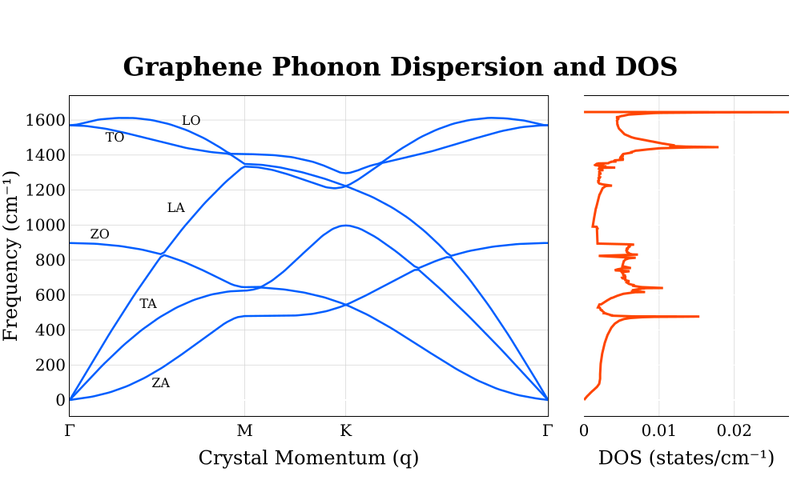
Results
Figure: Electronic and Phonon Badnstrcuture
IIT(BHU) Varanasi
5

Slide 6
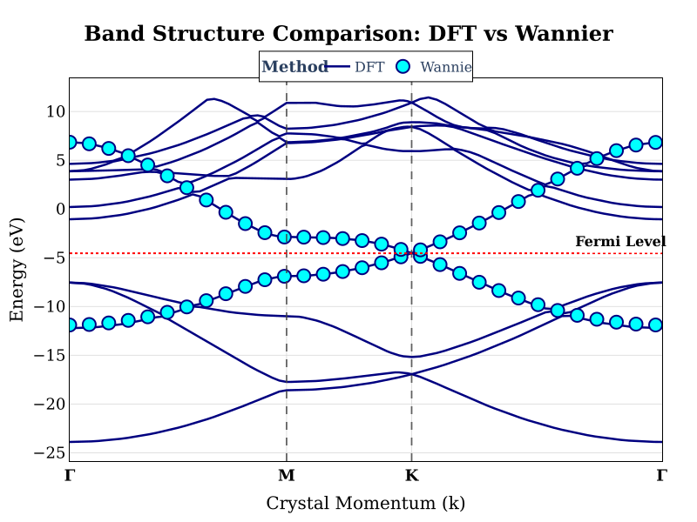
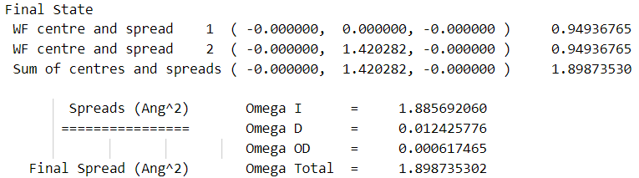
Results
IIT(BHU) Varanasi
6

Slide 7
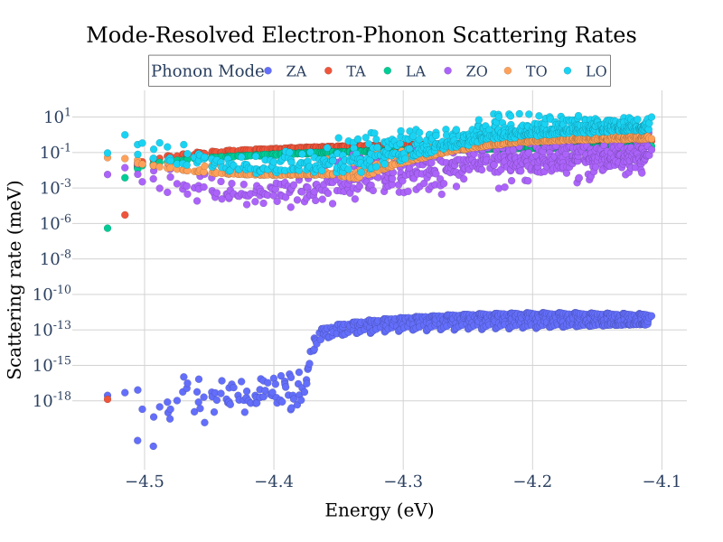
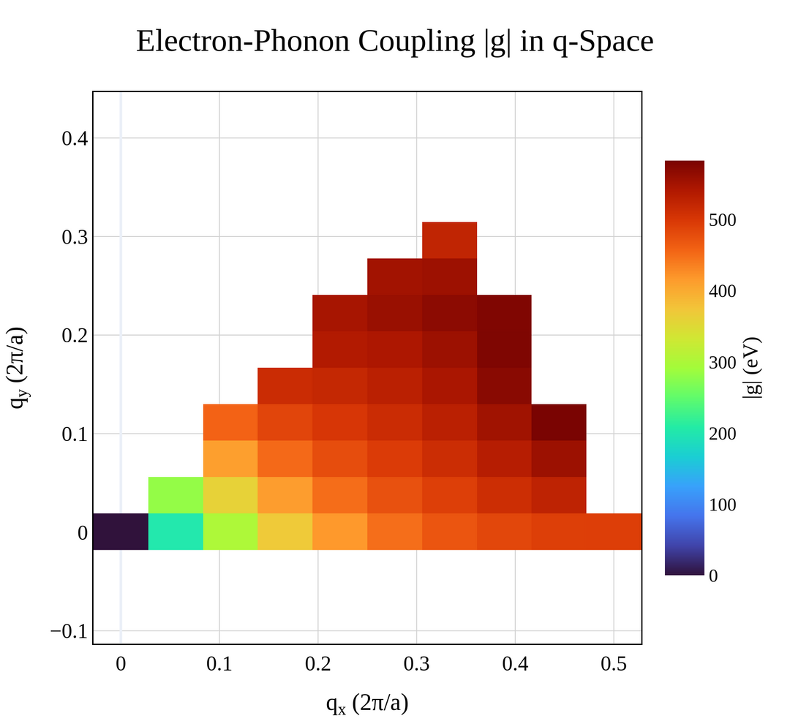
Results
IIT(BHU) Varanasi
7

Slide 8
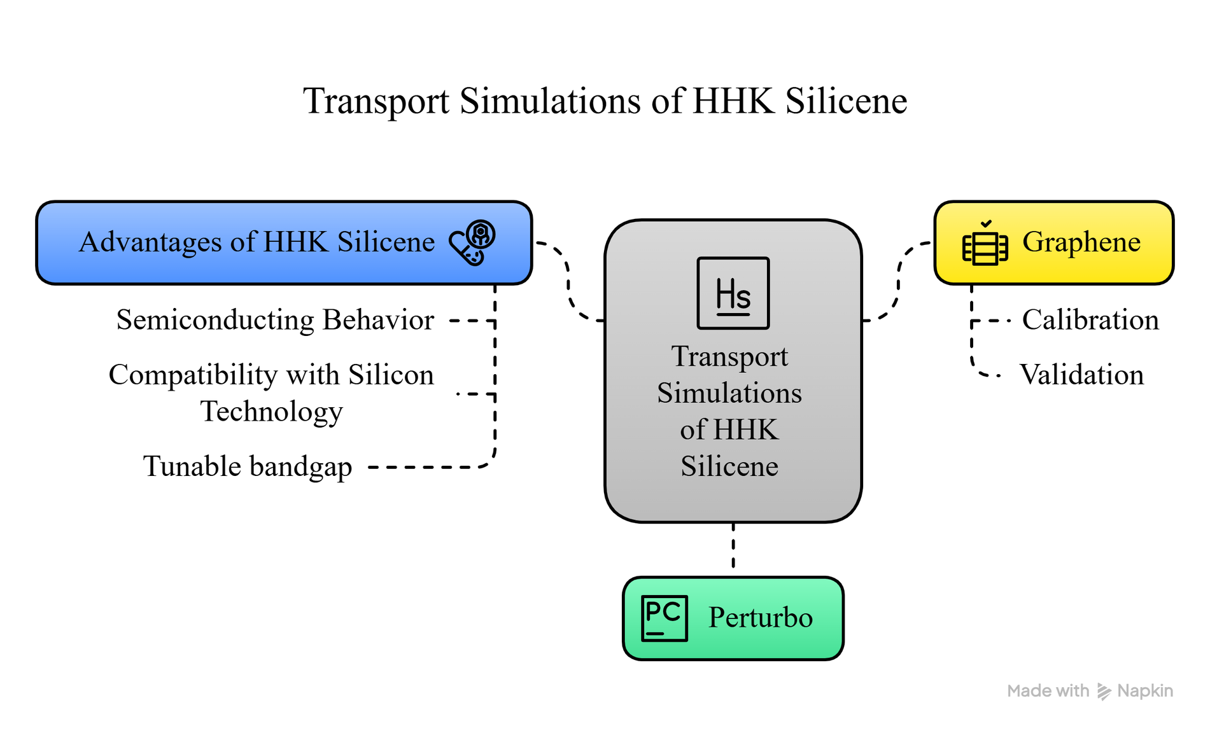
Upcoming Work
IIT(BHU) Varanasi
8

Slide 9
Thank You
IIT(BHU) Varanasi
8

