Slide 1
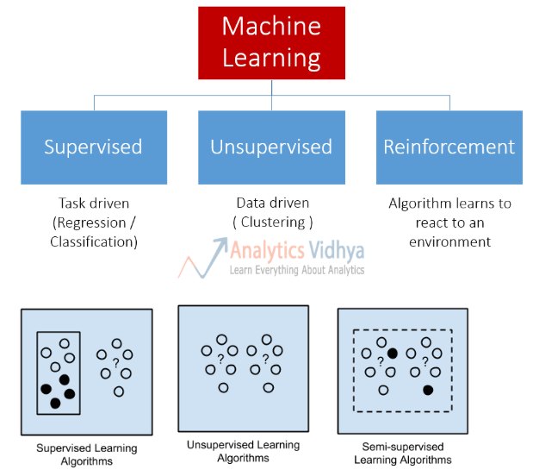
Types of Machine Learning Algos

Slide 2
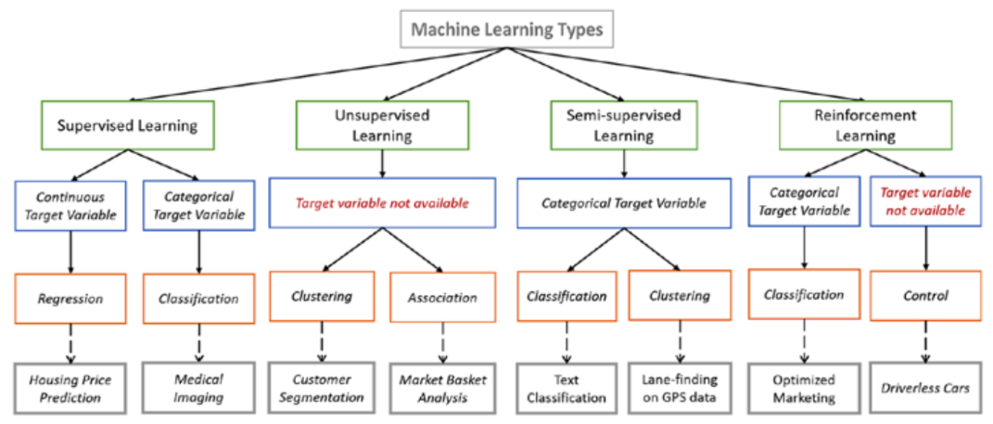
Types of Machine Learning Algos

Slide 3
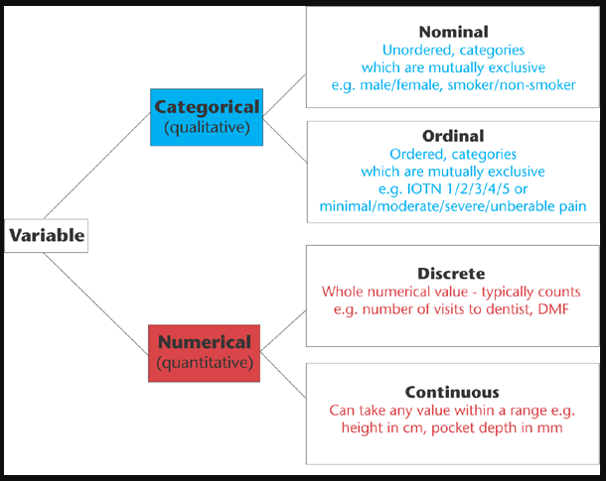
Types of Variables

Slide 4
What is sci-kit learn?
Simple and efficient tools for data mining and data analysis
Accessible to everybody, and reusable in various contexts
Built on NumPy, SciPy, and matplotlib
Open source, commercially usable - BSD license
https://scikit-learn.org/stable/
ML Pipeline
Train & Test
Collect > Clean > Featurize & transformed > Split into Train, Test > Model w Training > Test with Test Data > Put into Production (Inference)
Inference
Actual data > Clean > Featurize & transformed > Inference

Slide 5
Install sci-kit learn
!pip install -U scikit-learn – from jupyter notebook cell <shift+enter>
or
conda install scikit-learn
https://scikit-learn.org/stable/install.html

Slide 6
Regression using scikit-learn
https://scikit-learn.org/stable/supervised_learning.html#supervised-learning

Slide 7
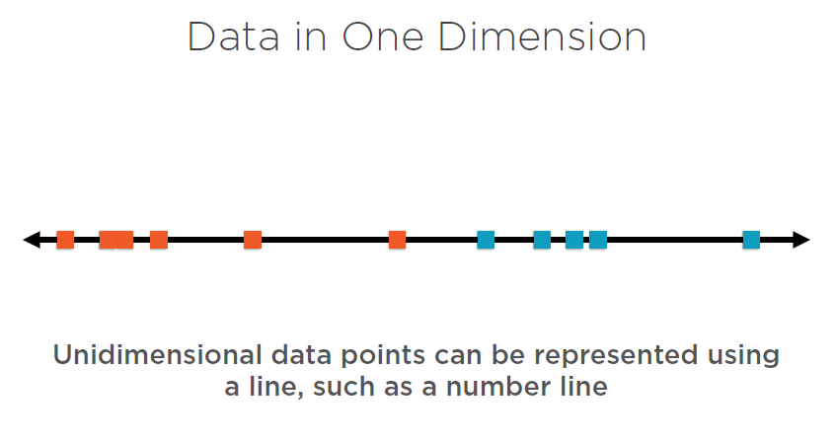

Slide 8
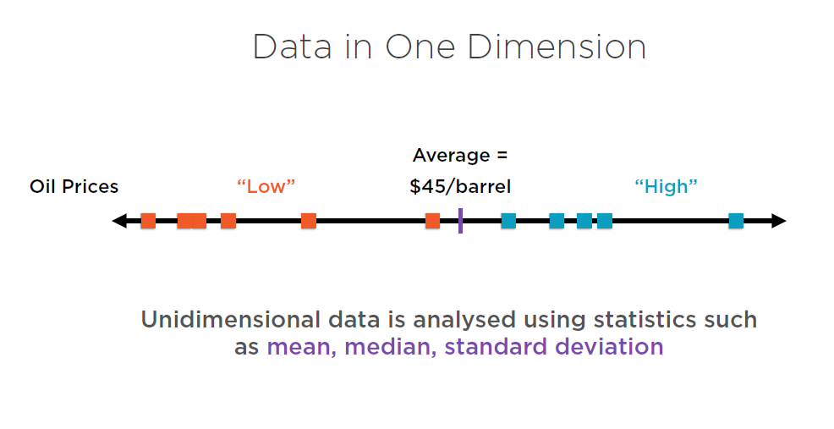

Slide 9
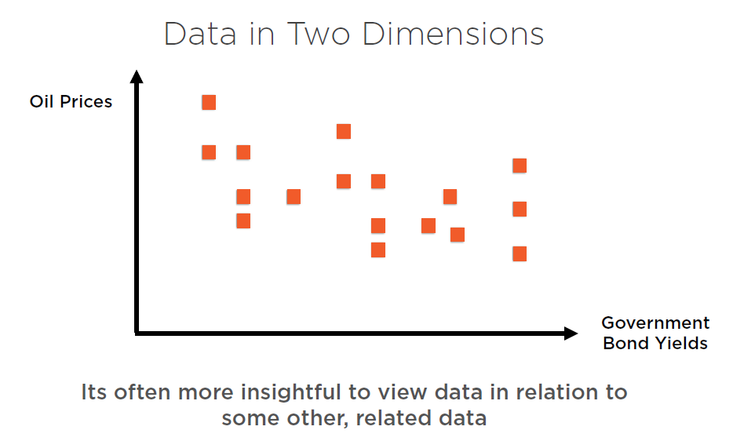

Slide 10
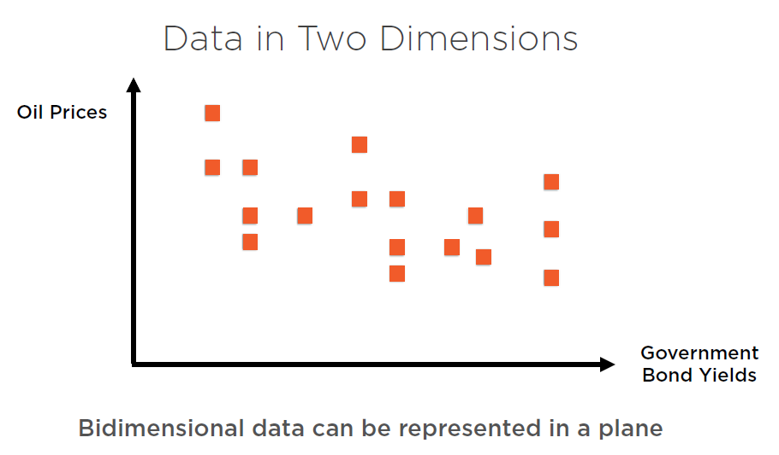

Slide 11
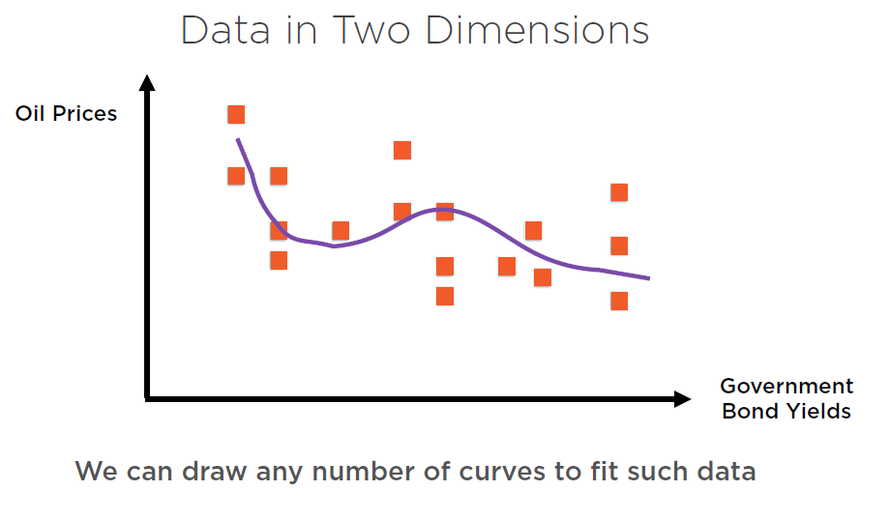

Slide 12
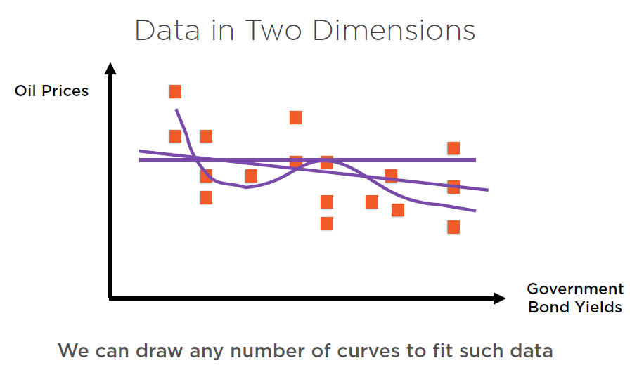

Slide 13
