Slide 1
holiday booking website
Web technology project
Team Members:
Aman Bhat T SRN:01FB16ECS052
Akshay Bharadwaj SRN:01FB16ECS047
Aditya Anirudh Kulkarni SRN:01FB16ECS025

Slide 2
Wanderlust
Wanderlust is a holiday information/booking website that helps you explore new and exciting places that you can travel.

Slide 3
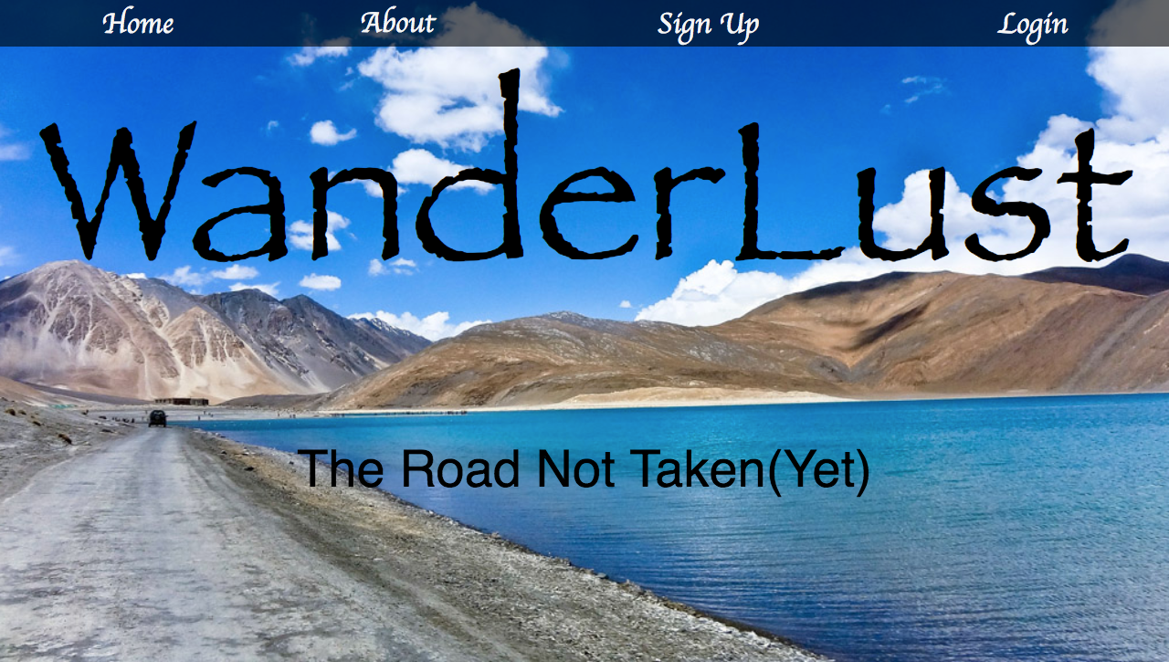
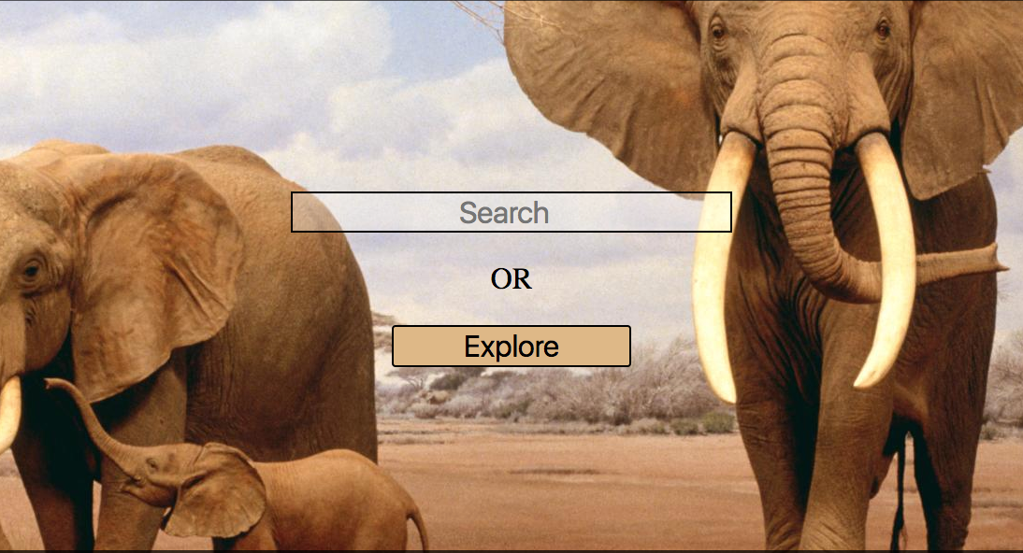
the user experience
This website is intuitive to use for anyone with a basic understanding of computers.
All the elements of the page are self-explanatory and easy to use.

Slide 4
search
The website incorporates a simple, easy to use search engine with which the user can search for a place based on keywords.
It returns hyperlinks to the webpages containing information of relevant travel locations.

Slide 5
explore
The website also guides people who want to explore new places with the help of an Explore option.
This leads to a interactive map with clickable regions that lead to corresponding webpages that the user can explore and choose a holiday destination.

Slide 6
Signup, login and book!
Finally, when the user decides on a place to travel, he just has to follow 3 simple steps to book a holiday.
1. Signup to Wanderlust if not already a member.
2. Login to Wanderlust and click Book Now
3. Enter booking details and click Confirm Booking.
Three simple steps to book an unforgettable holiday!

Slide 7
Thank You

