Slide 1


Cloud Orchestration and Infrastructure Automation Project
PlatePal: Food Application
Presented by:
Aditya Kumar Tiwari, R2142201587
Ajay Saini, R2142211390
Akanksha Singh, R2142201586
Harshit Ojha, R2142211405
Guided by:
Mr. Abhirup Khanna
Systemics Cluster
School of Computer Science

Slide 2

Content
Introduction
Objective
System Design
Sprints
Containers
Micro-services
Roles

Slide 3
I
N
T
R
O
D
U
C
T
I
O
N
This food delivery application is a sophisticated ecosystem of microservices, cutting-edge algorithms, and robust infrastructure designed to delivered and enjoyed food.
At the core of our application lies microservices architecture. We've modularized services, allowing for flexibility, scalability, and fault tolerance. Each microservice has a specific function, from order processing and payment handling to user recommendations and restaurant management.
Our application is designed for scalability, capable of handling peak order volumes without compromising on performance. Load balancing, cloud resources, and containerization ensure a seamless experience for users and restaurant partners.

Slide 4
O
B
J
E
C
T
I
V
E
Scalability: One of the primary objectives is to create a scalable system that can handle increasing user demand without compromising performance.
Flexibility and Maintainability: Use containers to package microservices along with their dependencies, making it easier to deploy and manage them.
High Availability: Use container orchestration to ensure high availability by automatically recovering from failures and distributing workloads across multiple containers.
Continuous Integration/Continuous Deployment (CI/CD): Implement a robust CI/CD pipeline to automate testing, deployment, and updates, ensuring a rapid and reliable release cycle.
Microservices Monitoring: Set up monitoring and logging for microservices within containers. This allows for real-time visibility into the health and performance of each microservice.

Slide 5
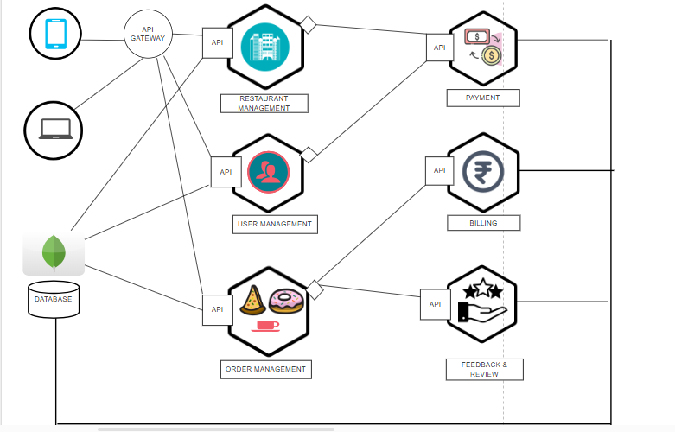
SYSTEM
DESIGN

Slide 6
User Management Service: In user Registration allow users to sign up and create an account to use the application and ensure that the user inputs are valid and that the email address or phone number is unique. And sends a verification email to the user's registered email address with a link or code to confirm their email.
Menu Service: Allows restaurant owners to create, update, and delete menu items. Handles pricing for menu items, including setting base prices and managing variations. Supports detailed descriptions for menu items, including information about ingredients.
Billing Services: It Gathers and stores billing information related to customer orders. This information includes details like order total, itemized charges, taxes. And Sends email receipts to customers after successful payments, providing a record of their transaction for their reference.
Payment Service: This integration allows customers to securely make payments using their preferred methods, including credit/debit cards, digital wallets, or even cash on delivery. Ensures that payment transactions are secure.
Feedback and Rating Service: It enables users of the platform to share their feedback and experiences regarding restaurants and specific dishes they have ordered.
Order Management Services: Sends a confirmation notification with an order ID to the user for reference. Offers real-time tracking from order preparation to delivery or pickup. Provides a delivery route map for delivery orders to keep users informed about their order's progress. Provides order receipts and invoices for users' records and future reference.
MICRO
SERVICES

Slide 7
Sprint 1:
Setting Up the Foundations
User Authentication and Registration User Stories
User Story 1: Implement User Registration
Story: A new user will be able to register for an account on the food delivery app so that he can place orders.
Acceptance Criteria:
There should be a registration form with fields for email and password.
Users must provide a valid email address.
Passwords must meet security requirements (e.g., minimum length, special characters).
After successful registration, the user should receive a confirmation email.
S
P
R
I
N
T
S

Slide 8
User Story 2: Implement User Login and Authentication
Story: As a registered user, he wants to be able to log in to his account securely.
Acceptance Criteria:
There should be a login form with fields for email and password.
Users must enter valid credentials to log in.
Failed login attempts should display appropriate error messages.
Upon successful login, users should be redirected to their profile or a dashboard.
S
P
R
I
N
T
S

Slide 9
Sprint 2:
Browse Restaurants and Menus
Sprint Goal: Develop and enhance the ability for users to browse restaurants and their menus, making it easy for them to find and select their preferred dining options
User Story 1: User can browse and search for restaurants based on various criteria.
Acceptance Criteria:
Users can access a list of available restaurants.
Users can filter restaurants by location, cuisine type, and ratings.
Users can sort restaurants by relevance, rating, or delivery time.
Users can search for specific restaurants by name or keyword.
S
P
R
I
N
T
S

Slide 10
R
O
L
E
S
S. No. | Name | Roll No. | Roles
1 | Aditya Kumar Tiwari | R2142201587 | Development Deployment
2 | Ajay Saini | R2142211390 | Development Testing
3 | Akanksha Singh | R2142201586 | Development Documentation
4 | Harshit Ojha | R2142211405 | Development Deployment
GitHub Link: https://github.com/AkankshaSingh1313/PlatePal.git

Slide 11
Thank You

