Slide 1

CHAPTER 1
INTRODUCTION
NETWORKING

Slide 2
WHAT IS A NETWORK?
A network is simply two or more computers that are linked together.
In short, networks, which consist of computers connected together so that they can communicate, enhance both business and personal productivity by enabling users to share resources.
Computer networks allow users to share data and hardware. They also allow people from all over the world to communicate and collaborate in a variety of ways.

Slide 3
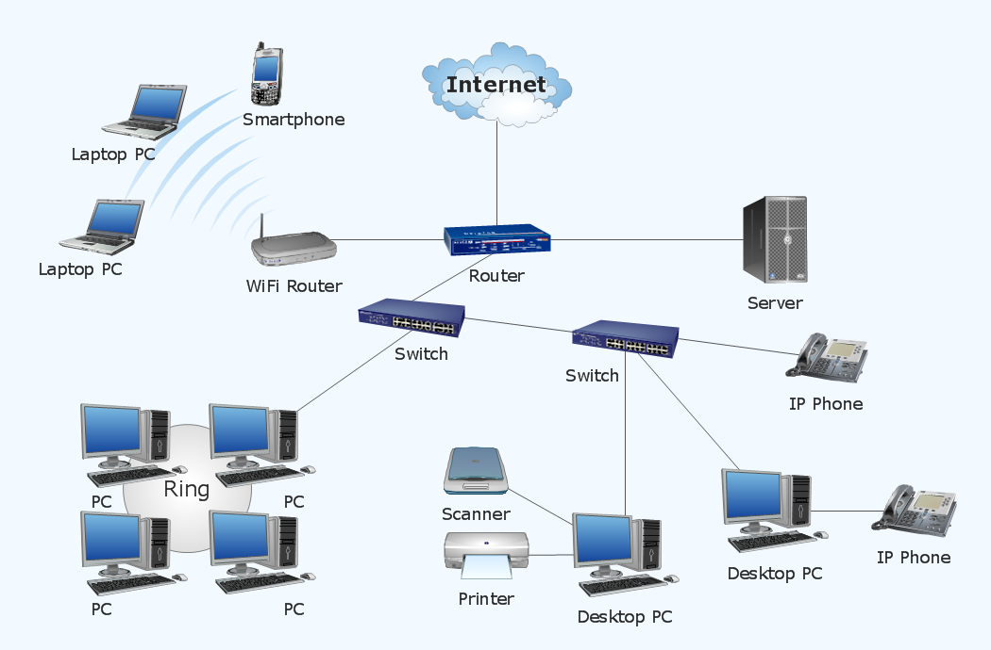
A NETWORK FLOW

Slide 4
TYPES OF NETWORKS
The most common types of networks are:
    Personal Area Networks (PAN)
    Local Area Networks (LANS) and
    Metropolitan area network (MAN)
    Wide Area Networks (WANS).

Slide 5
Personal Area Networks (PAN)
A personal area network (PAN) is a computer network used for communication among computer devices, including telephones and personal digital assistants, in proximity to an individual's body.
The devices may or may not belong to the person in question. The reach of a PAN is typically a few meters.
PANs can be used for communication among the personal devices themselves (intrapersonal communication), or for connecting to a higher level network and the Internet (an uplink).
Personal area networks may be wired with computer buses such as USB and FireWire.
A wireless personal area network (WPAN) can also be made possible with wireless network technologies such as IrDA, Bluetooth, Wireless USB, Z-Wave and ZigBee.

Slide 6
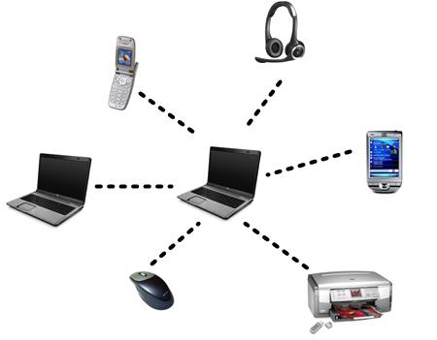

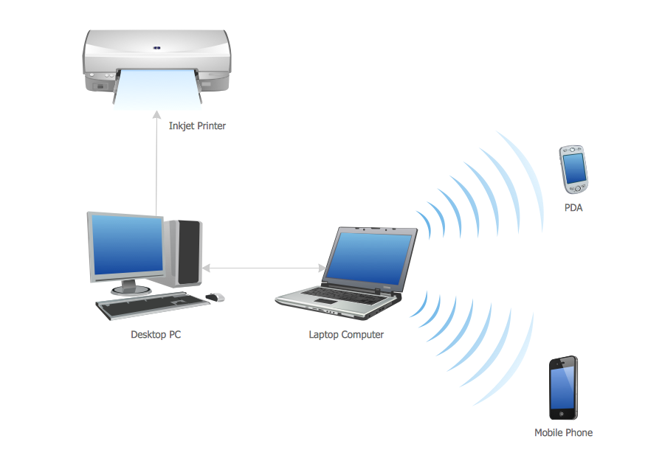

Slide 7
LOCAL AREA NETWORK
Local Area Network (LAN) – a network that spans a small area such as a building or an office.
  Software applications and other resources are stored on a file server.
  Print servers enable multiple users to share the same printer.
Local Area Network (LAN) គឺជា Network ដែលមានទំហំតូចគេច្រើនប្រើក្នុង small to Medium Office ក្នុងផ្ទះ ។ បើសិនជាលើសពី 100 នាក់ឬ Computer លើសពី 100 គ្រឿង ហើយប្រវែងពីចុងម្ខាងនៃ Network ទៅចុងម្ខាងទៀតលើសពី 1000 Feet (ប្រវែង 300m) នោះគេត្រូវត LAN ជាមួយដែលគេហៅ LAN នោះថា internetwork (Network of network) ។

Slide 8
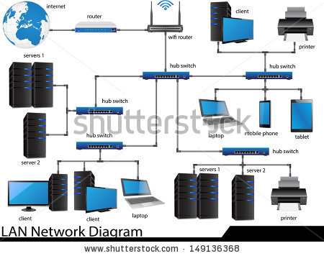
Local Area Network(LAN)

Slide 9
Metropolitan area network(MAN)
A Metropolitan Area Network (MAN) is a network that is utilized across multiple buildings
Commonly used in school campuses or large companies with multiple buildings
Is larger than a LAN, but smaller than a WAN
Is also used to mean the interconnection of several LANs by bridging them together. This sort of network is also referred to as a campus network

Slide 10
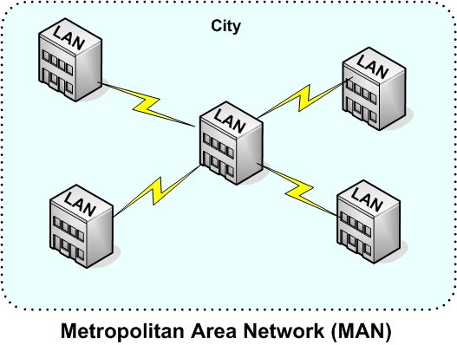
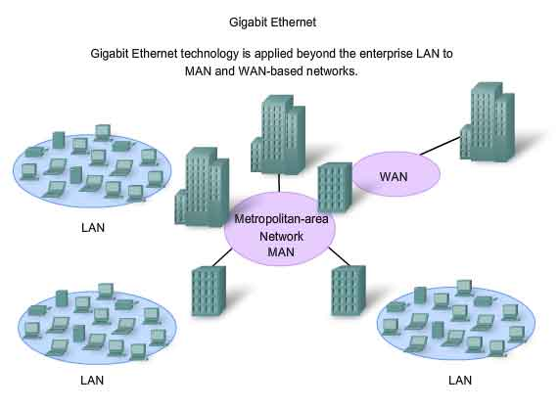

Slide 11
Storage Area Network(SAN)
A SAN (Storage Area Network) is a network designed to transfer data from servers to targets, and it is alternative to a directly attached target architecture, where the storage is connected to the servers on general purpose networks
Additional definitions of a SAN imply that the SAN should also be highly performing, and should be such to enable storage devices to communicate with one another and with computer systems

Slide 12
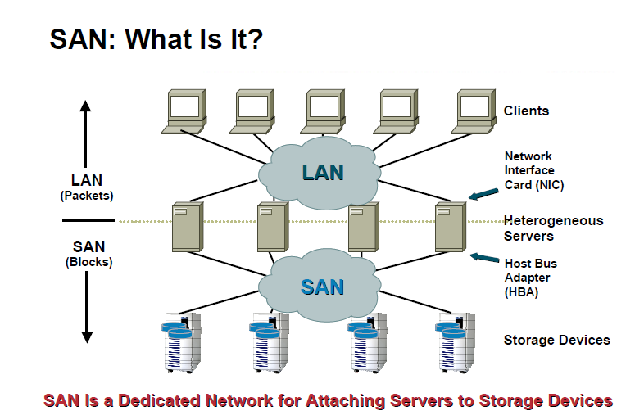

Slide 13
Wide Area Network(WAN).
Wide Area Network (WAN) – a network that spans a wide geographical area; there are several types of WANS
  Campus Area Network(CAN) - a network spanning multiple LANs but smaller than a MAN, such as on a university or local business campus.
  Storage Area Network(SAN) - connects servers to data storage devices through a technology like Fibre Channel.
  Metropolitan Area Network(MAN)- a network spanning a physical area larger than a LAN but smaller than a WAN, such as a city. A MAN is typically owned an operated by a single entity such as a government body or large corporation.

Slide 14
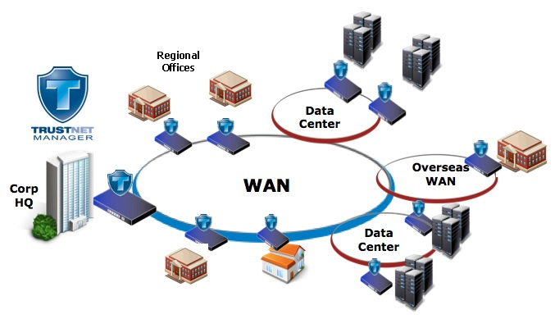
Wide Area Network(WAN).

Slide 15
Wireless LAN
A wireless local area network(LAN) is a flexible data communications system implemented as an extension to, or as an alternative for, a wired LAN.
  Using radio frequency (RF) technology, wireless LANs transmit and receive data over the air, minimizing the need for wired connections.
    Thus, combining data connectivity with user mobility.

Slide 16
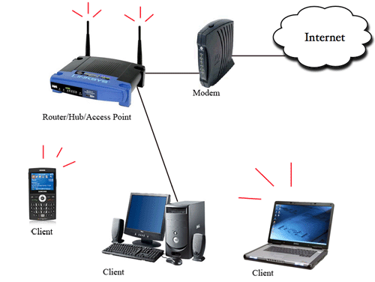

Slide 17
TYPES OF NETWORK (cont)
Intranet – An intranet is a private LAN designed for use by everyone within an organization. An intranet might consist of an internal e-mail system, a message board and one or more Web site portals that contain company news, forms, and personnel information.
Access to an intranet’s web site is restricted by a firewall.
Extranet – a network that connects people within your company with people who are outside your company--all within a secure, password-protected network that can be accessed from anywhere.

Slide 18
BENEFITS OF A NETWORK (Advantage)
សារៈប្រយោជន៍នៃប្រពន្ធ័ Network
  Information sharing: Authorized users can use other computers on the network to access and share information and data. This could include special group projects, databases, etc.
  Hardware sharing: One device connected to a network, such as a printer or scanner, can be shared by many users.
  Software sharing: Instead of purchasing and installing a software program on each computer, it can be installed on the server. All of the users can then access the program from a single location.
  Collaborative environment: Users can work together on group projects by combining the power and capabilities of diverse equipment.

Slide 19
BENEFITS OF A NETWORK (Advantage)
  User ទាំងអស់អាចប្រើ Program និង Data ក្នុងពេលជាមួយគ្នាបានដោយ Program និង​Data ទាំងនោះត្រូវបានផ្ទុកនៅលើម៉ាស៊ិនមេ( Server).
  User អាច Share Peripherals ដូចជា Printer និងឧបករណ៍ប្រើប្រាស់ផ្សេងៗគ្នា ដោយមិនចាំបាច់ចំណយថវិកាទិញឧបករណ៍ទាំងនេះច្រើនសំរាប់ User នីមួយៗទេ។
  ធ្វើរអោយយើងចំណេញពេលវេលាសំរាប់ Back Upឯកសាររបស់យើង។
  វាផ្តល់សិទ្ធ និងសុវត្តិភាពក្នុងការ ការពារទិន្នន័យរបស់យើង វាអាចបែងចែក សិទ្ធទៅអោយ User​នីមួយៗ ទៅតាមការងាររបស់គេម្នាក់ៗ
  User អាចផ្ញើរ Electronic Mail (E-mail)​ទៅកាន់ User ផ្សេងៗទៀតបានក្នុងគោល បំណងទទួលនិងផ្លាស់ប្តូរពត័មាន បានយ៉ាងឆាប់រហ័ស និងបានរយៈចំងាយឆ្ងាយ។

Slide 20
RISKS OF NETWORK COMPUTING(Disadvantage)
The security of a computer network is challenged everyday by:
  Equipment malfunctions
  System failures
    Note: equipment malfunctions and system failures may be caused by natural disasters such as floods, storms, or fires, and electrical disturbances
  Computer hackers
  Virus attacks

Slide 21
Network Terms
Client is a piece of computer hardware or software that accesses a service made available by a server, in which case the client accesses the service by way of a network. The term applies to programs or devices that are part of a client–server model.
Server is a computer that stores and provides resources, data, and services to the network.

Slide 22
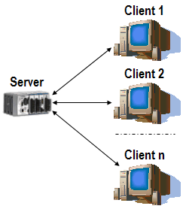
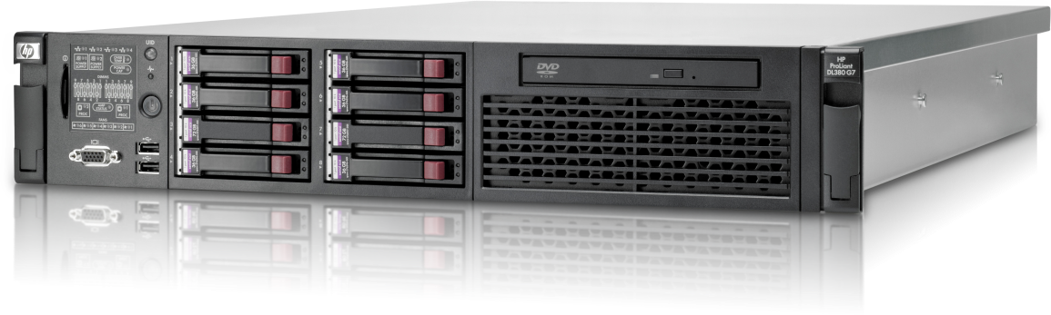
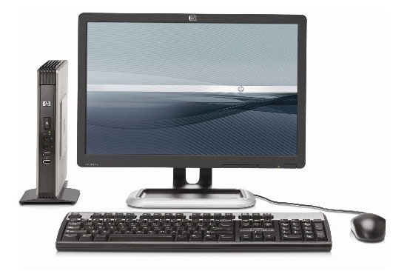
Term Network (cont)

Slide 23
HOW ARE NETWORKS CATEGORIZED?
Networks are usually classified using three properties:
    Topology
    Protocol
    Architecture

Slide 24
NETWORK/COMMUNICATION PROTOCOLS
បើយើងមាន Hardware ដូចជា Network Medium Connector, NIC និង Computer ក៏ Network របស់យើងមិនទាន់ដំណើរការ
មកដែរ ។ Device របស់ Network អាច Communicate ស្គាល់
គ្នាបាន លុះត្រាតែមានប្រើ Network Protocol ដូចគ្នា ។
Protocol គឺជា Rule ដែលកំនត់ថា តើត្រូវបកប្រែ Signal យ៉ាង
ដូចម្តេច តើត្រូវសំគាល់ខ្លួនឯងនិង អ្នកដទៃតាមវិធីណា តើ
ត្រូវចាប់ផ្តើមនិងបញ្ចប់ Communication ដូចម្តេច ហើយត្រូវ
Manage ការ Exchange data យ៉ាងណា ។

Slide 25
NETWORK/COMMUNICATION PROTOCOLS
A protocol is simply an agreed-on set of rules and procedures for transmitting data between two or more devices.
Features determined by the protocol are:
  How the sending device indicates it has finished sending the message.
  How the receiving device indicates it has received the message.
  The type of error checking to be used.

Slide 26
NETWORK/COMMUNICATIONS PROTOCOLS
Most networks use Ethernet, but some network may use IBM’s Token Ring protocol.
On the Internet, the major protocol is TCP/IP (an acronym for Transmission Control Protocol/Internet Protocol).

Slide 27
COMMUNICATION PROTOCOLS
  File transfer protocol (FTP) – used to transmit files.
  Simple mail transfer protocol (SMTP) – used to transmit e-mail messages.
  Post office protocol (POP) – allows the recipient to retrieve messages.
  Wireless application protocol – enables wireless devices to access and use the Internet using a client/server network.
  802.11 – protocol for wireless LAN technology

Slide 28
COMMUNICATIONS SOFTWARE
E-Mail Software – used to send and receive electronic messages using the Internet
Web Browser – allows users to access and view Web pages
Groupware – allows groups of people on a network to share information and to collaborate on various projects

Slide 29
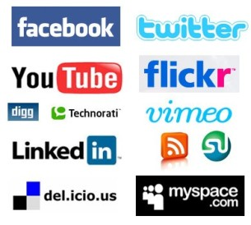
Network Service
  ពាក្យ Network Service មានន័យធម្មតាដូចពាក្យ Service ដែរ ។ យើងប្រហែលជាធ្លាប់បានដឹងថា Network Operating System មួយនោះអាចផ្តល់ File and Print និង Protocol មួយនេះអាចផ្តល់ E-mail ឬ Internet service ជាដើម ។

Slide 30
NETWORK ARCHITECTURE
Network architecture – refers to the way a network is designed and built. The two major types are:
  Peer-to-peer architecture – Computers connect with each other in a workgroup to share files, printers, and Internet access. This is used to connect a small number of computers.
  Client/server architecture – sends information from a client computer to a server, which then relays the information back to the client computer, or to other computers on the network

Slide 31
Peer-to-Peer Network
ដែលហៅថា Peer-to-Peer Network គឺជាប្រពន្ធ័Network មួយដែលសមាជិកទាំងអស់មានសិទ្ធស្មើរគ្នានៅក្នុងការ
Share File, Folder, Printer,​​Scanner,……។ មានន័យថាអ្នក
ណាក៍មានសិទ្ធដើម្បីគ្រប់គ្រងទៅលើ Resource ដែរព្រោះវា
អត់មានServer និងClient ច្បាស់លាស់។
.តែវាអាចដើរតួធ្វើ ជាServer នៅពេលវាផ្តល់នៅservice ទៅអោយគេ។ហើយដើរតួជាClient នៅពេលវាដែលគេស្នើរFiles or Resource ពី គេនៅក្នុងប្រពន្ធ័Network ។

Slide 32
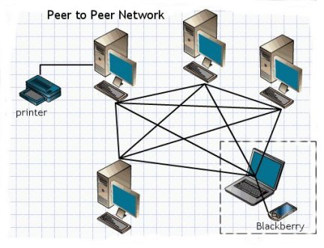
Peer-to-Peer Network

Slide 33
Peer-to-Peer Network (con)
គុណសម្បត្តិ Peer-to-Peer
  អាចShare Resource រឺDevice អោយប្រើរួមគ្នា។
  ងាយស្រួយក្នុងការដំឡើងនិងConfigure
  Computer នីមួយៗមានលក្ខណៈឯករាជ្យ
  មានតំលៃសមរម្យងាយស្រួលពិនិត្យ
  មិនត្រូវការអ្នកIT Administrator
គុណវិបត្តិ Peer-to-Peer
  គ្មានSecurity នៅលើប្រពន្ធ័Network ។
  គ្មានការគ្រប់គ្រងទៅលើ Data។
  Computer នីមួយៗត្រូវតែថែរក្សានិងBackup ដោយខ្លួនឯង។

Slide 34
Client/Server Network
ជាប្រពន្ធ័Network ដែលមាន PC Server ជាអ្នកគ្រប់គ្រងទៅលើប្រពន្ធ័Network ទាំងមូលនិងផ្តល់នូវសេវាកម្ម(Service )ទៅដល់អ្នកប្រើ(User) ទាំងអស់។
គ្រប់ Workstation ទាំងអស់ជាអ្នកប្រើប្រាស់ Resource ​ដែលផ្តល់ ដោយ Server ។
Client មានតួរនាទីជាអ្នកប្រើ Resource ​ដែលផ្ទុកនៅលើ Server។
នៅនៅពេលដែល Client ​បញ្ជូន Data ​ទៅរក្សាទុកនៅក្នុង Server ហើយ Server ​ក៍មានតួនាទីកំណត់សិទ្ធិត្រួតពិនិត្យនូវរាល់ការ Access ក៍ដូចជាការឆ្លើយតបត្រលប់ពី Server ទៅកាន់ Client វិញផងដែរ។

Slide 35
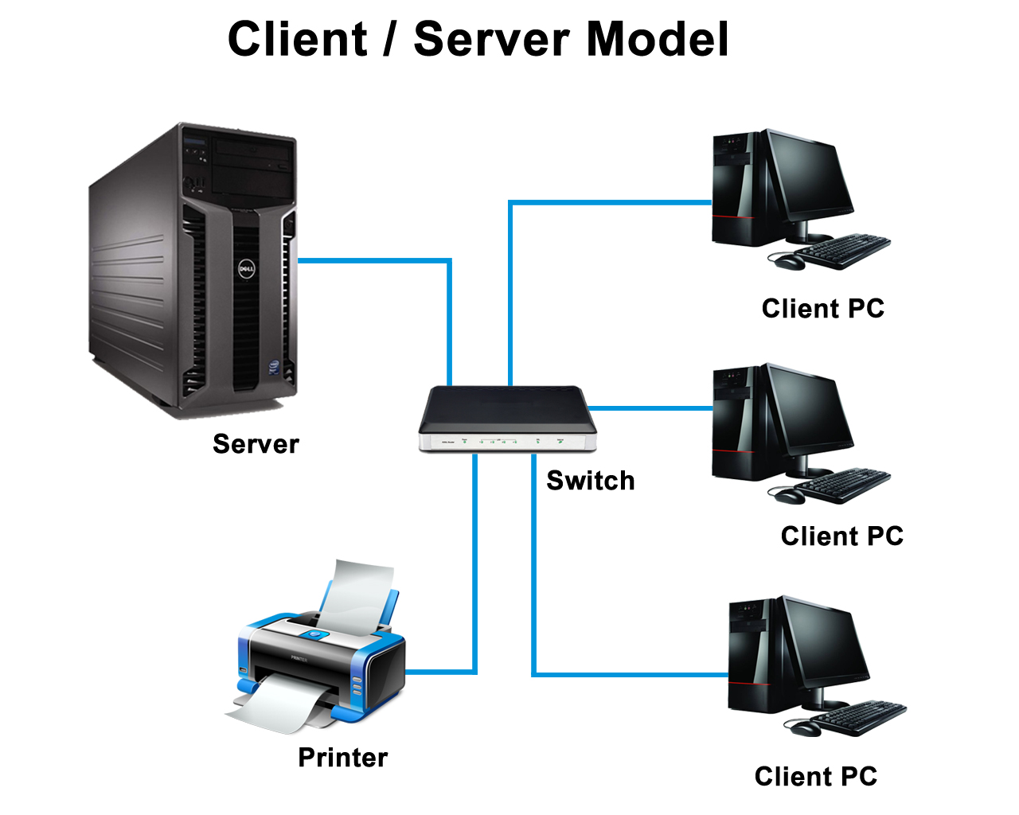
Client/Server Network

Slide 36
Advantage and Disadvantage of Client/Server
គុណសម្បត្តិ
  Network មានលក្ខណៈធំទូលាយ
  User អាចប្រើResource បានទាំងអស់គ្នាដែលនៅលើServer ទៅតាមសិទ្ធរាងខ្លួន។
  Network មាន​Security ខ្ពស់នៅពេលចង់ប្រើប្រាស់ត្រូវការ​Username and Password
  Backup Data ជាប្រចាំទៅតាមកាលវិភាគដែលបានកំនត់
  ងាយស្រួលគ្រប់គ្រង
គុណវិបត្តិ
  នៅបែលដែលServer Down វាមិនអាចដំណើរការResource បាន
  កាConfigure មានលក្ខណៈស្មុគស្មាញ
  ត្រុវការចំណាយលុយច្រើនសំរាប់ការបង្កើតដំបូង

