Slide 1
PRAGATI
CASE B · NEXTUTE × FINANCE CLUB, IIT PATNA
The Data Moat
Every student's weak topics, found before the exam.
Team AlphaQ · Round 1
Excel
OMR sheets
WhatsApp
One clear topic map
IMPACT RIBBON
0.76
2
₹3.6
Prediction accuracy score
Public datasets, not just ours
Cost per student per month
Public data; published rival 0.75
Open University and ASSISTments
All-in, on one laptop
Sources: ml/public_validation (ASSISTments 2009 under the pyKT protocol; OULAD); financial model v1.1, Base case. Screens and graphics are illustrative.
Notes:
Title. 0.76 is the next-answer AUC on ASSISTments 2009 (published DKT 0.754). Two public datasets: ASSISTments 2009 and OULAD. 3.6 rupees is the all-in cost per student per month from the financial model (Base).

Slide 2


















EXECUTIVE SUMMARY: THE PRAGATI LOOP
SUMMARY
PROBLEM
PRODUCT
TECHNOLOGY
TRUST
BUSINESS
THE ASK
APPENDIX
SECTION 1 OF 8
Tests become a weekly to-do list for mentors, at a price owners accept
THE FRICTION & THE FIX
THE FRICTION
1 Capture
Phone photo or Excel becomes clean data
OMR reader
Marks sit on paper and WhatsApp
Weak topics found after the exam
₹17.3 L a year lost to dropouts
Generic apps give no early warning
6 Report
Checked Hindi and English parent updates
8-check verifier
2 Structure
Every question tagged to a syllabus topic
380-topic map
₹3.6
per student, per month
THE FIX
5 Act
Mentors call; every outcome is logged
Intervention log
3 Estimate
Knows each student's strengths, topic by topic
IRT mastery model
One upload gives a topic map
A short weekly list for mentors
Plain reasons, supportive actions
Checked Hindi and English parent notes
Free to run, works offline
4 Flag
A short weekly list: who needs help, why
Calibrated risk model
Sources: product design; financial model v1.1 (₹3.6 all-in cost, Base); case guide baselines. Technical names appear in grey as proof of rigour.
Notes:
Scoring area: All criteriaThe loop in plain English with the technical names as secondary labels. Each step statement is eight words or fewer.

Slide 3










THE PROBLEM: LEAKY REVENUE, MESSY DATA
SUMMARY
PROBLEM
PRODUCT
TECHNOLOGY
TRUST
BUSINESS
THE ASK
APPENDIX
SECTION 2 OF 8
Institutes have the marks, but notice a struggling student only after that student has left
LEAKY REVENUE
THE FRICTION MATRIX
8–15 %
₹17.3 L
Teachers
Owners
of students leave mid-session
fees lost a year, per 400 students
Check OMR sheets by hand
See weak topics after exams
No time for each student
Can't compare batches or teachers
Learn of dropouts too late
Generic apps give no insight
1
WHERE THE DATA LIVES
Excel files
Paper OMR sheets
WhatsApp groups
Messy, unconnected data
No topic view. No early warning.
Parents
Students
The bottleneck
Staff time, no analysis
Get a marks list, nothing more
Can't tell if child improves
Trust slips, fee questions grow
Struggle quietly for weeks
Same plan as whole batch
Noticed only when they stop
Pragati
Clean topic map, weekly list
Who we serve: 22.8 lakh NEET and about 15.4 lakh JEE Main candidates registered in 2025. 27 % of school students use private coaching.
Sources: Participant Guide §2, §7 (illustrative baselines: 12 % dropout, ₹36,000 per leaver); NTA NEET UG 2025 result data; JEE Main 2025 statistics (secondary); NSO CMS Education 2025.
Notes:
Scoring area: Problem framingThe 8-15 percent dropout, 36,000 rupee loss per leaver and 17.3 lakh total are the guide's illustrative baselines (400 x 12 % x 36,000). Market numbers are in financial/research/R7_market_check.md.

Slide 4







REALITY CHECK: MYTH VS PRAGATI
SUMMARY
PROBLEM
PRODUCT
TECHNOLOGY
TRUST
BUSINESS
THE ASK
APPENDIX
SECTION 2 OF 8
We tested the guide's headline numbers and built around what survives
THE INDUSTRY MYTH
THE PRAGATI REALITY
Owners will happily pay ₹40
Rivals list ₹4–21 a student; we test ₹30
COST
Saves a quarter of dropouts
Honest base case: 4 % fewer dropouts, proven in pilots
DROPOUTS
Track every student's app activity
Law bans tracking minors; under-18s get academic data only
MINORS' DATA
Quote the best published score
Our strict student-level test scores 0.71 against 0.79 published
ACCURACY
THE DECISION REFRAME
Not “who will drop out?” but “who do we call this week?”
Score
who is slipping
Explain
plain reasons
Assign
to a mentor
Log
what worked
Sources: case guide; vendor listings (financial/research R1); financial model v1.1 (Base: 4.0 % effective reduction); OULAD student-grouped test, PLOS ONE 2026 (0.794); DPDP Act 2023 s.9(3).
Notes:
Scoring area: Feasibility and business realismFour of the six assumptions tested in the guide. Effective dropout reduction 4.0 % in the v1.1 model against the guide's 25 %. Our OULAD day-28 AUC is 0.706 on a strict student-grouped split.

Slide 5



SYSTEM ARCHITECTURE: THREE LAYERS
SUMMARY
PROBLEM
PRODUCT
TECHNOLOGY
TRUST
BUSINESS
THE ASK
APPENDIX
SECTION 4 OF 8
Three layers, one rule: each institute's data stays its own
Web console
Owner and teacher views
Phone app
Scan, weekly list, parent view
Hindi + English
Reports in both languages
Open export
CSV and API; you own the data
DELIVERY
What people use
Topic mastery
Finds weak topics (IRT)
Early warning
Flags who needs help (LightGBM)
Honest ranges
Percentile bands (conformal)
Safe reports
No invented numbers (8 checks)
INTELLIGENCE
What it works out
Row-level security
Institutes never mix
Consent gate
No consent, no model
Offline-first
Works without internet
Audit log
Who saw what, kept a year
TRUST & DATA
What keeps it safe
31
tables, all isolated
23
API endpoints
380
syllabus topics
116
automated tests
₹3.6
per student a month
Sources: technical/contracts (31 tables, 23 endpoints, 380 topics); tenant isolation tested on PostgreSQL 16; test suites; financial model v1.1 (Base, ₹3.6 all-in).
Notes:
Scoring area: Architecture and engineeringLayered view of the architecture. Keywords in brackets are the technical names for judges: IRT, LightGBM, conformal prediction, row-level security. Local-first: one laptop or one small server per deployment, no paid services.

Slide 6









THE PRODUCT: WEB AND PHONE
SUMMARY
PROBLEM
PRODUCT
TECHNOLOGY
TRUST
BUSINESS
THE ASK
APPENDIX
SECTION 3 OF 8
A web console for the office, a phone app for mentors and parents
3
2
4
1
Illustrative mock-ups, synthetic students
1 Scan on a phone
2 Topic map
3 Weekly list
4 Parent update
Unclear bubbles fixed in one tap
Weak topics for the whole batch
Up to 8 students, with plain reasons
Hindi or English, numbers checked
Mon: Test scanned
Tue: Mentor calls
Wed: Remedial session
Sat: Parent update
Month: Owner sees outcomes
Both surfaces share one API. The phone app is a progressive web app installed from the browser (no app-store fee). Mock-ups use synthetic students; report text comes from our report module.
Notes:
Scoring area: Architecture and productProduct view. 1 is the scan screen, 2 the topic heatmap in the web console, 3 the mentor's weekly list, 4 the parent report in Hindi. The week strip shows the operating rhythm.

Slide 7


KNOW EVERY STUDENT'S WEAK TOPICS
SUMMARY
PROBLEM
PRODUCT
TECHNOLOGY
TRUST
BUSINESS
THE ASK
APPENDIX
SECTION 4 OF 8
Pragati knows each student's weak topics, and tells the teacher how sure it is
1
Pale column = topic probably not taught yet
HOW IT WORKS, IN PLAIN ENGLISH
Kinematics
Laws of motion
Work and energy
Rotation
Gravity
Heat
Electricity
Optics
1
Rates how hard every question is
2-parameter IRT, guessing prior
S-101
S-108
S-115
2
Estimates mastery per topic, with doubt
Per-topic ability, shrunk to the batch
S-122
S-129
S-136
3
Says “not enough data” when unsure
Uncertainty gate on every band
S-143
S-150
S-157
4
Flags a likely wrong answer key
Negative-discrimination detector
Not enough data
Building
Steady
Strong
PUBLIC DATA
Works with small batches: question difficulty pooled across institutes
0.76 vs 0.75
Accuracy on 770 unseen students, public data. Published rival AKT scores higher (0.785); we say so.
SYNTHETIC-DATA GATES
Question difficulty recovered
PENDING
Wrong keys caught, few false alarms
PENDING
Mastery beats raw % correct
PENDING
Sources: ml/public_validation (ASSISTments 2009, pyKT protocol, 770 held-out students; published DKT 0.754, SAKT 0.725, AKT 0.785); heat map is an illustrative mock-up. Gates pending Agent B.
Notes:
Scoring area: Data science, ML and AI rigourPlain-English headline with technical names as secondary labels. The three pending gates (difficulty recovery, wrong-key detection, mastery vs raw percent correct) come from Agent B and must be filled before submission.

Slide 8









EARLY WARNING: THE INTERVENTION JOURNEY
SUMMARY
PROBLEM
PRODUCT
TECHNOLOGY
TRUST
BUSINESS
THE ASK
APPENDIX
SECTION 4 OF 8
Each week a mentor gets a short list: who to call, why, and what to offer
Engagement drops
Six absences in ten classes
Model flags
Appears on the weekly list
Mentor calls
A supportive call, not a warning
Student retained
Outcome logged; list updates
COMPLIANCE MATRIX: WHAT THE LAW LETS US USE
Academic support
Dropout risk
Fee risk
App activity
Under 18
parent consent
Model allowed
Plain rules only
Plain rules only
Never used
18 and over
own consent
What the mentor sees (mock-up)
Model allowed
Model allowed
Model allowed
Own opt-in
PUBLIC DATA
0.46
of the top 10 % flagged really leave; simple rules: 0.24–0.31
Under 18, if counsel agrees
pending legal opinion
Model allowed
Model allowed
Plain rules only
Never used
0.009
calibration error: “30 %” means 30 %
DPDP s.9(3): no tracking of children, even with consent. Under-18 dropout and fee lists use plain rules.
Sources: ml/public_validation (OULAD day 28, student-grouped 5-fold; precision at top 10 %); contracts/routing_policy.yaml; DPDP Act 2023 s.9. On synthetic institutes, early-warning lift is pending.
Notes:
Scoring area: Data science, ML and AI rigour; privacyJourney on top, public-data evidence bottom-left (shrunk), compliance matrix on the right. Locks denote data walls. About a quarter of dropouts are sudden and cannot be predicted from academic data; say so if asked.

Slide 9




HONEST RANGES AND SAFE PARENT REPORTS
SUMMARY
PROBLEM
PRODUCT
TECHNOLOGY
TRUST
BUSINESS
THE ASK
APPENDIX
SECTION 4 OF 8
An honest range instead of a single rank, and parent messages where every number is checked
80 %
of students land inside their range
1
editable exam table
2
1 The range narrows as tests add up. Never a single rank.
2 Hindi and English; every number checked before sending.
EIGHT AUTOMATIC SAFETY CHECKS BEFORE ANY MESSAGE
1
Numbers match the data
2
Topics are real
3
Names added last
4
No banned words
AI drafts
8 checks
Send
5
Right length
6
Trend is correct
7
Tips are approved
8
Format is valid
Any check fails: a safe human-written template goes out instead
Next on the same rails (designed): 7-day study plans and doubt answers from retrieved notes. Works with no AI model at all.
Sources: backend/app/genai (20 templates, 16 tests); contracts/report_numbers.schema.json. Band = quantile model, conformal 80 % target; coverage pending. Mock-ups illustrative.
Notes:
Scoring area: Data science, ML and AI rigour; GenAI guardrailsMock-ups: student profile with the narrowing percentile range, and the Hindi/English parent report. Do not quote a verifier catch rate until the independent adversarial test passes after the E2 fixes.

Slide 10








PRIVACY, SAFETY AND DPDP COMPLIANCE
SUMMARY
PROBLEM
PRODUCT
TECHNOLOGY
TRUST
BUSINESS
THE ASK
APPENDIX
SECTION 5 OF 8
Built for the law and for children: consent first, supportive actions only
OUT: SHARED QUESTION BANK
1
Question difficulty numbers only. No student, no name, no marks.
THE INSTITUTE'S OWN SPACE
one laptop or one private server
2
Student records
Marks and answers
SEEN BY PARENTS AND STUDENTS
Progress and next steps. Never ranks. Never a risk label.
3
Consent ledger
Risk lists: mentors only
1 Rule 10: parent's ID checked at the admission desk
2 One switch for each purpose
3 Withdraw everything in one tap
Raw student data never leaves
SAFETY GUARDRAILS
No leaderboards or public ranks
No batch moves based on scores
Banned-words check on every message
Counsellor contact for each institute
Risk lists: mentors and owner only
Students never see a risk label
DPDP s.9(1) and Rule 10: parental consent · s.9(3): no tracking of children · MoE 2024 cl. 10.2(xi): results for counselling, never public
Sources: DPDP Act 2023 s.9 and Rules 2025 (Rule 10); MoE Guidelines for Coaching Centres 2024; contracts/routing_policy.yaml; tenant isolation tested on PostgreSQL 16. Not legal advice.
Notes:
Scoring area: Feasibility, privacy and safetyCentral lockbox: raw data stays in the institute's own environment; only item difficulty statistics reach a shared bank. We are the data processor; the institute is the data fiduciary. A lawyer's check on the in-person ID flow is still recommended.

Slide 11






BUSINESS MODEL AND UNIT ECONOMICS
SUMMARY
PROBLEM
PRODUCT
TECHNOLOGY
TRUST
BUSINESS
THE ASK
APPENDIX
SECTION 6 OF 8
At ₹30 a student the product pays back in under six months
3.6x
LTV / CAC
5.7
months to pay back
78 %
contribution margin
4.8x on the undiscounted basis most peers quote. The guide claims 10.7x.
Sales and onboarding cost recovered. Guide: 3.1 months.
₹6,740 a month per institute, after serving costs.
1
STRESS TEST: BEAR, BASE, BULL
2
WHERE ₹3.6 A STUDENT GOES
3
WHAT THE OWNER GETS
₹1.0 WhatsApp messages
All benefits
1.7x
₹0.8 Compute and storage
Fees + staff time
0.55x
₹0.7 AI-written reports
Fees only
0.35x
₹0.5 Servers and database
₹0.5 Legal and compliance
1x = pays for itself
Keep 5.5 students a year, or
win 1.5 extra admissions: it breaks even
₹30 per active student per month
Annual contract per session
BEAR
BASE
BULL
₹0.1 Consent checks
0.37x
LTV/CAC 0.75x
1.7x
LTV/CAC 3.6x
3.9x
LTV/CAC 10x
A month, per student, all-in. Run locally: ₹0 extra
Owner's return, all benefits. Every input at its worst: 0.09x.
Source: financial model v1.1 (Mid institute, 400 students, Base; Bear/Bull flex 13 drivers; Stress sets all inputs to worst). Model output from sourced and assumed inputs; willingness to pay is untested.
Notes:
Scoring area: Revenue model and unit economicsv1.1 numbers: LTV/CAC 3.6x discounted (4.8x undiscounted), payback 5.7 months simple, margin 78 %. Return 1.7x with admissions counted, 0.55x on hard benefits (fees plus staff time), 0.35x fees only. Cost stack from the COGS build at Base inputs: WhatsApp 0.8 plus platform fee 0.2, compute 0.8, AI reports 0.7, servers 0.5, compliance 0.5, consent 0.1.

Slide 12

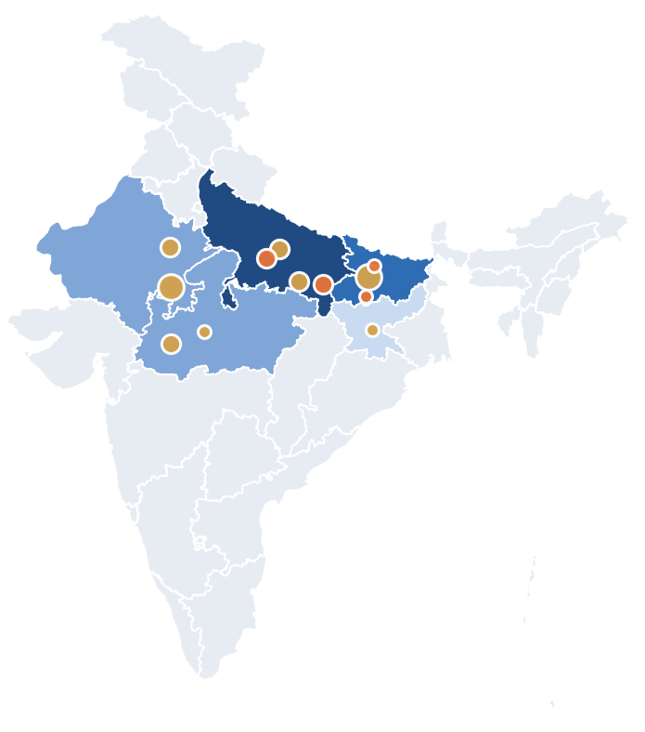
GO-TO-MARKET AND ROADMAP
SUMMARY
PROBLEM
PRODUCT
TECHNOLOGY
TRUST
BUSINESS
THE ASK
APPENDIX
SECTION 6 OF 8
Start in Patna with a free trial on last year's Excel, then grow city by city
FY27
FY28
Oct–Dec 26
Jan–Mar 27
Apr–Jun 27
Jul–Sep 27
Oct–Dec 27
Jan–Mar 28
TECH
Validate on public data
TECH
Prototype and phone app
PILOTS
Free retro-pilots (2)
PILOTS
Paid pilots + controls
SALES
Demos before admissions
SALES
First paying institutes
SCALE
Bihar, UP, Jharkhand
MONEY
Raise ₹45 L
1
WHERE WE SELL FIRST: ADDRESSABLE INSTITUTES
2
COMPETITION (VENDOR LISTINGS)
① Patna: 2 free retro-pilots Bihar 250
₹ / student / mo
OMR
Topic map
Parent report
Hindi
Classplus
4–7
?
?
?
?
② Lucknow: paid pilots, Apr 2027 UP 490
Fedena
10–21
no
?
yes
?
③ Ranchi and Tier-2 cities, FY28 Jharkhand 88
Teachmint
20–40 (est.)
?
?
yes
yes
Pragati
30
yes
yes
yes
yes
④ Rajasthan and MP: after FY28 176 each
yes: shown in listing · no: not shown · ?: not verifiable
Moat: more institutes sharpen question difficulty for all. Weak below about 200 institutes, so early wins come from time saved.
Sources: vendor listings (financial/research R1; ? means not verifiable, not absent); financial model v1.1 (field vs channel economics); roadmap dates are our plan. Year 3, Base: 58 institutes, ₹65 L revenue.
Notes:
Scoring area: Market and go-to-market; moatYear 3 Base: 58 paying institutes, revenue 65.3 lakh, EBITDA 11.9 lakh, break-even month 16, funding need 45 lakh. Channel partners give LTV/CAC 3.4x for small institutes against 1.5x by field sales.

Slide 13



VALIDATION SCORECARD AND THE ASK
SUMMARY
PROBLEM
PRODUCT
TECHNOLOGY
TRUST
BUSINESS
THE ASK
APPENDIX
SECTION 7 OF 8
What we have proved, what we have not, and the one pilot that settles it
VALIDATION SCORECARD
RISK MATRIX
Real accuracy is lower
Fix: Retro-pilot before any sale
1
0.76 accuracy on public student data
1
0.009 calibration error, public data
Owners won't pay ₹30
Fix: Price survey; lead with time saved
2
2
Privacy costs only 0.008 accuracy
IMPACT →
3
3
Mentors ignore the list
Fix: Cap the list; log every outcome
116 tests pass; tenants stay apart
4
Difficulty and wrong-key gates
Hindi quality falls short
Fix: Native review; template fallback
4
Accuracy at a real institute
LIKELIHOOD →
THE ASK
Two free retro-pilots in Patna this winter.
₹45 L
Month 16
₹65 L
Give us last year's Excel. If we don't flag more of the students who left than your attendance rule, at the same workload, we stop.
funding, Base plan
break-even
year-3 revenue
Sources: ml/public_validation; technical/docs/FEASIBILITY_CHECK.md; financial model v1.1 (3-year projection, Base: ₹45 L funding, break-even month 16, year-3 revenue ₹65.3 L, EBITDA ₹11.9 L).
Notes:
Scoring area: Feasibility; honest limitsThe ask is concrete and falsifiable. Funding of 45 lakh and break-even in month 16 are Base outputs of the v1.1 projection; Bear needs 1 crore and does not break even within 36 months.

Slide 14

APPENDIX 1: SCENARIOS AND SENSITIVITY
SUMMARY
PROBLEM
PRODUCT
TECHNOLOGY
TRUST
BUSINESS
THE ASK
APPENDIX
SECTION 8 OF 8
Scenarios and sensitivity: what the model says when inputs move (Mid institute, 400 students)
A
SCENARIOS (BEAR AND BULL MOVE 13 DRIVERS; STRESS MOVES ALL)
C
WHAT MOVES THE OWNER'S RETURN (BASE 1.7x)
Guide
Bear
Base
Bull
Stress
Admissions uplift 0–3 %
0.55x
4.1x
Dropout reduction
25 %
1.0 %
4.0 %
11.3 %
0.6 %
Price ₹40 to ₹20
1.4x
2.3x
Students kept a year
12.0
0.3
1.9
8.2
0.2
Return, all benefits
2.25x
0.37x
1.7x
3.9x
0.09x
Annual fee ₹70k to ₹1.2 L
1.4x
2.1x
Return, fees + staff time
2.25x
0.37x
0.55x
1.3x
0.09x
Mentor minutes per call
1.4x
2x
Students to keep to break even
5.3
3.8
5.5
7.2
11.7
Outreach effect 5–30 %
1.5x
2.1x
CAC, sales and marketing
₹25,000
₹44,889
₹15,567
₹8,386
₹65,111
Precision of the flag
1.5x
1.9x
LTV ÷ CAC, discounted
10.7x
0.75x
3.6x
10x
-0.11x
Months before first flag
1.6x
1.8x
LTV ÷ CAC, undiscounted
10.7x
0.93x
4.8x
15x
-0.13x
Payback, simple (months)
3.1
21.1
5.7
2.6
never
D
OUR LTV ÷ CAC BY CHURN AND ACQUISITION COST
1 %
2 %
3 %
4 %
5 %
B
OWNER'S RETURN BY PRICE AND DROPOUT REDUCTION
₹15k
11.0x
10.0x
9.3x
8.5x
7.8x
₹20
₹30
₹40
₹50
₹60
₹80
₹25k
6.9x
6.2x
5.6x
5.1x
4.7x
5 %
2.4x
1.8x
1.4x
1.2x
1.0x
0.8x
₹35k
4.9x
4.4x
4.0x
3.6x
3.3x
8 %
2.7x
2.1x
1.7x
1.4x
1.2x
0.9x
₹50k
3.4x
3.1x
2.8x
2.5x
2.3x
11 %
3.1x
2.3x
1.9x
1.6x
1.3x
1.0x
₹75k
2.3x
2.1x
1.9x
1.7x
1.6x
15 %
3.6x
2.7x
2.1x
1.8x
1.5x
1.2x
20 %
4.1x
3.1x
2.5x
2.1x
1.8x
1.4x
25 %
4.7x
3.6x
2.8x
2.4x
2.0x
1.6x
Source: financial model v1.1 (Scenarios, Sensitivity). Model output from sourced and assumed inputs, not measured. Base marker on the churn grid is about ₹38k acquisition cost at 3 % churn.
Notes:
Scoring area: Revenue model and unit economics: sensitivity

Slide 15

APPENDIX 2: THREE-YEAR PLAN AND SEGMENTS
SUMMARY
PROBLEM
PRODUCT
TECHNOLOGY
TRUST
BUSINESS
THE ASK
APPENDIX
SECTION 8 OF 8
A three-year plan capped by the market, and how size changes the economics
A
THREE-YEAR PROJECTION (₹)
C
BY INSTITUTE SIZE (BASE)
Bear
Base
Bull
Small
Mid
Large
Revenue in year 3
₹11.0 L
₹65.3 L
₹2.50 Cr
Students
180
400
1,200
EBITDA in year 3
-₹30.2 L
₹11.9 L
₹1.26 Cr
Annual fee per student
₹60,000
₹75,000
₹1,00,000
Paying institutes, end of year 3
15
58
191
Return, all benefits
1.6x
1.7x
2.1x
Funding the model needs
₹1.00 Cr
₹45.0 L
₹30.0 L
LTV ÷ CAC, field sales
1.5x
3.6x
9.2x
Break-even month
after 36
16
4
LTV ÷ CAC, channel partner
3.4x
4.9x
6.1x
Market cap: 1,180 addressable institutes in five states x 8 % penetration (derived, mostly assumption). Bear funding assumes no cost response.
Payback, months
19
6
3
B
BASE CASE, YEAR BY YEAR (₹ LAKH)
₹65.3
WHAT THIS MEANS FOR GO-TO-MARKET
₹48
Mid and large institutes: field sales pays.
Small institutes: channel partners, not reps.
One field rep at 8 % of the market.
Raise ₹45 L, break even in month 16.
Bear case needs ₹1 Cr: we stop if pilots fail.
₹18.9
+11.9
-0.9
-16.1
Year 1 · 28 institutes
Year 2 · 51 institutes
Year 3 · 58 institutes
revenue
EBITDA
Source: financial model v1.1 (Projection, Scenarios; Bear, Base, Bull). Model output from sourced and assumed inputs; willingness to pay is untested. 1 Cr = 100 lakh (L).
Notes:
Scoring area: Revenue model; three-year projection

Slide 16

APPENDIX 3: DATA MODEL AND QUESTION TAGGING
SUMMARY
PROBLEM
PRODUCT
TECHNOLOGY
TRUST
BUSINESS
THE ASK
APPENDIX
SECTION 8 OF 8
31 tables in five groups, all isolated per institute
PEOPLE
LEARNING
RESULTS
institutes, users, students, guardians, batches, batch_changes, consents, legal_settings
topics, topic_prereqs, questions, question_topics, item_params, tests, test_questions, answer_keys, marking_schemes
responses, test_totals, attendance, fees, engagement
INTELLIGENCE
OPERATIONS
DELIBERATELY NOT STORED
mastery_snapshots, risk_scores, predictions, interventions, reports, model_registry
ingest_jobs, omr_templates, audit_log
Counselling notes or mental-health information
ID document images
Student photographs
Any public rank
HOW EVERY QUESTION GETS ITS TOPIC (SO TAGGING COSTS FALL AS WE GROW)
Question text
Shortlist
embedding
Local model picks
Teacher 1-tap
Shared bank
Row-level security on every tenant table; another institute sees 0 rows (tested on PostgreSQL 16)
Source: technical/contracts/schema.sql. Synthetic data: 4 institutes, 3 academic years, known ground truth.
Notes:
Scoring area: Data model

Slide 17

APPENDIX 4: LEGAL BASIS
SUMMARY
PROBLEM
PRODUCT
TECHNOLOGY
TRUST
BUSINESS
THE ASK
APPENDIX
SECTION 8 OF 8
The rules we design against, and what we do about each
Rule
Our response
DPDP Act s.9(1), Rule 10
Verifiable parental consent before processing a minor's data: ID checked at the admission desk, consent recorded per purpose.
DPDP Act s.9(3)
No tracking or behavioural monitoring of children: under 18, academic support uses a model; dropout and fee signals use plain rules.
Fourth Schedule, educational institutions
Narrow and purpose-limited, so we do not rely on it for consent.
DPDP Rules, Rules 6 and 7
Encryption, access control, logs kept one year, breach notice to the institute within hours.
MoE Guidelines 2024, cl. 10.2(xi)
Results stay private; early warning leads to counselling, never public ranks.
MoE Guidelines 2024, cl. 12(vii)
No batch moves based on performance; remedial help is an extra session.
MoE Guidelines 2024, cl. 8(iv), 10.1
Pro-rata refund within 10 days; no test the day after the weekly off.
Rajasthan Act 2025, s.6(2)(d)
Fee plans support four or more equal instalments.
Sources: DPDP Act 2023, DPDP Rules 2025, MoE Guidelines 2024, Rajasthan Coaching Centres Act 2025 (technical/docs/TECH_PLAN.md, section 24). Not legal advice.
Notes:
Scoring area: Legal basis

Slide 18

APPENDIX 5: MODEL CARD AND GO-LIVE GATES
SUMMARY
PROBLEM
PRODUCT
TECHNOLOGY
TRUST
BUSINESS
THE ASK
APPENDIX
SECTION 8 OF 8
How we will know each model works before an institute relies on it
A
HOW WE SPLIT AND COMPARE
B
METRICS AND GATES (FROM contracts/metrics_bars.yaml)
By student and by year
Component
Metric
Gate
Status
Features use only data before the as-of date; never split by row.
Difficulty (IRT)
Recovery r(b̂, b) at 60 answers per item; at 30 answers
≥ 0.90; ≥ 0.85
pending
Baselines at equal workload
Wrong-key detector
Recall on planted wrong keys; false flags per 300 items
≥ 0.80; ≤ 2
pending
Each model sits beside the institute's own rule at the same weekly list size.
Topic mastery
Ability recovery r; next-test AUC vs raw % and BKT
≥ 0.80; better
pending
Uncertainty
Bootstrap intervals over students; three generator seeds; event counts shown.
Knowledge tracing
Next-answer AUC, ASSISTments 2009 (public)
report
0.763
Stress tests
Early warning
AUC-PR vs institute rule; precision at capacity vs rule
+30 %; +25 %
pending
Misspecified generators, a held-out institute, an independent attack on the report checker.
Early warning
Calibration error (public: OULAD day 28)
< 0.05
0.009
Honest misses
A missed gate is reported with its cause; gates are never moved to pass.
Early warning
Median lead time before a student leaves
≥ 21 days
pending
Withdrawal, public
OULAD day-28 AUC, student-grouped 5-fold
report
0.706
C
KNOWN LIMITATIONS, STATED
Synthetic data proves the pipeline, not real-world accuracy.
OULAD is a UK online university; ASSISTments is US school maths.
The percentile mapping is an editable assumption table until real mock-vs-exam pairs exist.
Fairness
Largest recall gap across slices (gender, city tier)
≤ 0.10
pending
Percentile range
Coverage of the 80 % band
77 to 83 %
pending
Parent reports
Numbers matching the facts; independent attack passes
100 %
pending
Sources: technical/contracts/metrics_bars.yaml, technical/docs/agent_prompts/R1_00_COMMON.md, ml/public_validation. Pending gates are filled from metrics.json by technical/scripts/deck_numbers.py.
Notes:
Scoring area: Validation plan and model card

Slide 19

APPENDIX 6: CASE QUESTIONS, ANSWERED
SUMMARY
PROBLEM
PRODUCT
TECHNOLOGY
TRUST
BUSINESS
THE ASK
APPENDIX
SECTION 8 OF 8
Where the case's twelve questions are answered, and how strong the evidence is
#
Technology (70 %)
Where
Evidence
#
Market (30 %) and deliverables
Where
Evidence
T1
Data capture, offline, low effort
Slides 5, 6
Designed
B1
Buyer and measurable return
Slide 11, App. 1
Assumption
T2
Data model; tagging questions to topics
Appendix 3
Built
B2
Pricing, CAC, payback, churn, LTV
Slide 11, App. 1–2
Assumption
T3
Mastery and question difficulty
Slide 7
Measured
B3
Cities, sizes, channels
Slide 12
Assumption
T4
Early warning: dropout, behind, fees
Slide 8
Measured
B4
Competition and a growing moat
Slide 12
Designed
T5
Percentile range, honest uncertainty
Slide 9
Designed
R1
Financial model with sensitivity
App. 1–2
Assumption
T6
GenAI: reports, plans, doubts
Slide 9
Built
R2
Limits: what we did not prove
Slide 13, App. 5
Measured
T7
Multi-tenant, secure, low-cost
Slides 5, 11
Built
i
HOW TO READ THE EVIDENCE COLUMN
Measured: our own run on public data or the test suite.
Built: working code with tests, on synthetic data.
Designed: specified in the contracts, not coded yet.
Assumption: a model input with a range, tested in pilots.
T8
Privacy and safety for minors
Slide 10, App. 4
Built
Every slide states its limits. We show an honest 4 % rather than a hopeful 25 %, and mark a gate pending rather than quote a number we have not measured. The case says teams that state limits score higher.
Source: Participant Guide sections 4, 8 and 10 (questions and rubric). T = technology question, B = business question, R = round-1 deliverable or limit.
Notes:
Scoring area: Problem statement coverage

Slide 20

APPENDIX 7: SOURCE REGISTER
SUMMARY
PROBLEM
PRODUCT
TECHNOLOGY
TRUST
BUSINESS
THE ASK
APPENDIX
SECTION 8 OF 8
Every external number in the deck, where it came from, and where we used it
#
Source
Used for
Confidence
Slide
1
NTA NEET UG 2025 result data (via Careers360, ALLEN)
22.76 lakh registered candidates
High (official)
3
2
JEE Main 2025 statistics (Vedantu; NTA total not found)
About 15.4 lakh unique registrations
Medium (secondary)
3
3
NSO Comprehensive Modular Survey: Education 2025
27 % of school students in private coaching
High (official)
3
4
Case participant guide
8 to 15 % dropout, ₹36,000 per leaver, ₹17.3 lakh, ₹40, 25 %
Illustrative
3, 4
5
Vendor listings: Classplus, Fedena, Edmingle, Teachmint (research R1)
₹4 to ₹40 per student per month anchors
Medium
4, 12
6
Outreach trials in comparable settings (research R4)
Effect of outreach on dropout, 5 to 30 %
Medium
A1
7
OULAD (Open University, CC BY 4.0), our runs
0.706 AUC, 0.009 calibration, 0.46 precision
Measured
1, 4, 8
8
PLOS ONE 2026, OULAD withdrawal study
Published 0.727 / 0.794 / 0.804 anchors
High
4, 8
9
Liu et al., pyKT, NeurIPS 2022; ASSISTments 2009, our runs
DKT 0.754, SAKT 0.725, AKT 0.785; ours 0.763
Measured
1, 7
10
DPDP Act 2023 s.9; DPDP Rules 2025
Parental consent, no tracking of children
High (primary)
4, 8, 10
11
MoE Guidelines for Coaching Centres 2024; Rajasthan Act 2025
cl. 10.2(xi), 12(vii), 10.1, 8(iv); s.6(2)(d)
High (primary)
10, A4
12
WhatsApp and LLM price pages; Patna pay data (research R5, R6)
Cost per student, staff hour ₹100
Medium to high
5, 11
13
Financial model v1.1 (CFO audit, 22 Oct 2026)
Return, LTV/CAC, payback, margin, 3-year plan, scenarios
Model output
2, 4, 11–13, A1–A2
Full citations with URLs and licences: technical/docs/CITATIONS.md and financial/research. Every model number traces to the financial workbook or a metrics.json file.
Notes:
Scoring area: Source register

Slide 21

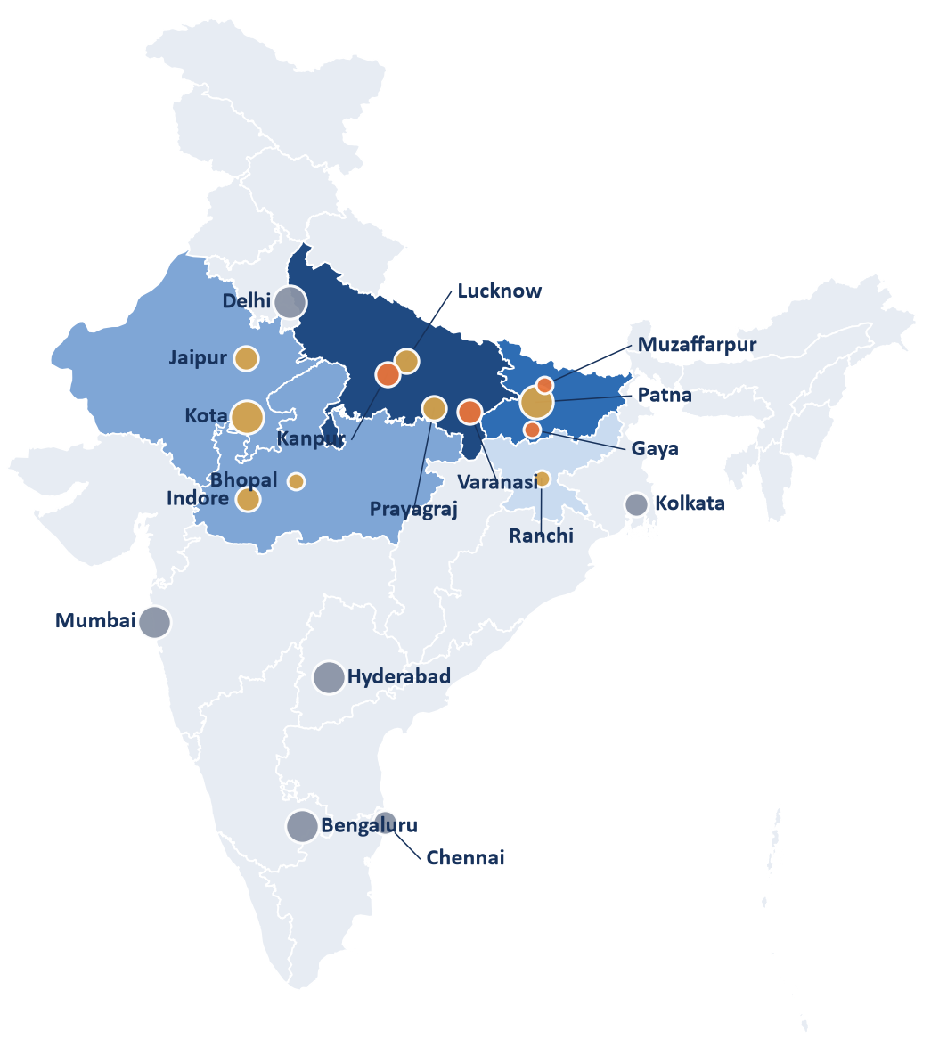
APPENDIX 8: WHERE WE SELL FIRST
SUMMARY
PROBLEM
PRODUCT
TECHNOLOGY
TRUST
BUSINESS
THE ASK
APPENDIX
SECTION 8 OF 8
Where the first hundred institutes are, and how we reach them
Where institutes are (state shade = addressable, Base)
How we start selling
Tier 1
chains dominate; skip
1
Patna, Jan to Mar 2027
2 free retro-pilots on last year's Excel; about 115 to 145 qualifying institutes in Patna (cross-check)
Priority
★★★★★
Tier 2
coaching hubs; start here
2
Lucknow, Apr 2027
Paid pilots with comparison batches; Uttar Pradesh is the largest pool (about 490)
Tier 3
independents; demos
★★★★☆
Bubble size = coaching density
3
Bihar and UP Tier-2, Ranchi, FY28
Gaya, Muzaffarpur, Kanpur, Varanasi, Ranchi by partners and demos
High
★★★☆☆
Medium
4
Rajasthan and MP, after FY28
Kota is chain territory; Jaipur and Indore only after the first three
Low
★★☆☆☆
Density is our qualitative estimate for planning, not a count.
1,180 addressable institutes
five states, independent, 150 to 2,000 students
58 paying by year 3
4.9 % of the 1,180; one field rep, partners for small institutes
Patna first
in-person access
Chains are arriving
Allen opened in Patna and announced six more Bihar cities
Kota
dense, chain-held
KEY TAKEAWAY
Start where we can reach owners in person: Patna.
Sources: financial/research R7 (1,180 = Bihar + UP about 740, +60 % for three more states); model v1.1 (4.9 % share at month 36). State split is our assumption; map for orientation only; city bubbles are indicative.
Notes:
Scoring area: Market and go-to-marketMap: state outlines from a public GeoJSON (datameet-style, orientation only, not an official boundary). Bubble size is our qualitative estimate of coaching density (Kota, Patna highest). State figures are our allocation of the R7 total (Bihar and UP by population, Rajasthan, MP and Jharkhand 40/40/20 of the extension) and must be called an assumption. Chains: Allen opened in Patna and announced six more Bihar cities (R7).

Slide 22
How we used AI, and what we cited
AI tools
Public data and libraries
Claude: planning, code review, documentation.
Google Antigravity agents: code generation.
Perplexity and Gemini Deep Research: literature and regulation research.
Everything was reviewed and tested by the team; research claims were checked against primary sources where possible.
OULAD (CC BY 4.0), ASSISTments 2009, the pyKT benchmark, JEEBench.
Noto Sans Devanagari (SIL OFL), LightGBM, Ollama, FastAPI, PostgreSQL.
Flat Color Icons by Icons8 (CC BY 3.0) via Iconify; Font Awesome icons (CC BY 4.0).
Full list with licences: technical/docs/CITATIONS.md in the repository.
github.com/AdityaKuranjekar/institute-intelligence-platform
Notes:
Mandatory disclosure (Problem Statement, rule 2). Keep this as the last slide of the submitted PDF.

