Slide 1




Intelligence for the coaching institutes that run on Excel, OMR sheets and WhatsApp
CASE B · THE DATA MOAT
Pragati turns one upload into a topic map, a weekly support list and a verified Hindi and English parent report, on the web and on the phone. Offline, private, free to run.
0.763
0.706
₹3.6
AUC on ASSISTments (public data)
AUC on OULAD, day 28 (public data)
per student per month, all-in (model)
Team AlphaQ · Round 1 · Nextute x Finance Club, IIT Patna
Illustrative mock-ups, synthetic data
Notes:
Title. Right-hand screens are illustrative mock-ups rendered from HTML with synthetic values: the web console and three phone screens. The two AUC figures are results on public datasets (ASSISTments 2009 under the pyKT protocol, OULAD day 28); the 3.6 rupee figure is the model's all-in cost per student per month.

Slide 2











EXECUTIVE SUMMARY
ALL CRITERIA · ONE-PAGE VIEW
Small institutes already hold the data. Pragati turns it into a weekly to-do list for mentors, at a price owners can say yes to
SITUATION
Tier-2 and Tier-3 JEE/NEET institutes (150 to 1,200 students) run on paper OMR sheets, Excel and WhatsApp. 22.8 lakh NEET and about 15.4 lakh JEE Main candidates registered in 2025.
0.763
0.46
2.9x
₹3.6
next-answer AUC on ASSISTments
precision at top 10 % (rules 0.24 to 0.31)
institute return, base case
all-in cost per student per month
COMPLICATION
PUBLIC DATA
PUBLIC DATA
MODEL OUTPUT
MODEL OUTPUT
A 400-student institute loses about ₹17 lakh a year to mid-session dropouts, noticed only after students leave. Generic apps store marks but give no topic view or warning, and DPDP s.9(3) bars behavioural tracking of minors.
THE PRAGATI LOOP: CAPTURE → STRUCTURE → ESTIMATE → FLAG → ACT → REPORT
RESOLUTION
Pragati: OMR photo or Excel in, then topic mastery, a weekly support list with plain reasons, and checked Hindi and English parent reports. Runs offline on one laptop for ₹3.6 per student per month.
Capture
Structure
Estimate
Flag
Act
Report
OMR photo, Excel, Forms
380-topic syllabus graph
Difficulty and mastery
Weekly list, plain reasons
Call, remedial session
Checked Hindi / English
Build choice
What we use
Why
WHY IT WINS ON THE RUBRIC (70 % TECHNOLOGY · 30 % BUSINESS)
OMR capture
Corner marks and QR; unclear bubbles sent back
No scanner, works offline
Topic mastery
2-parameter IRT, guessing prior; Rasch if small
Explains itself on sparse tests
Architecture 25
ML rigour 25
Early warning
Calibrated LightGBM; rules for minors' dropout
Legal for under-18s
Local-first, 31 tables with row-level security tested on PostgreSQL 16; 116 automated tests.
Measured on public data against baselines: 0.763 AUC (DKT 0.754); precision 0.46 vs 0.24 to 0.31 for rules.
Percentile
Quantile model, conformal band, NTA table
A range, never a rank promise
Parent report
Facts, local model, 8 checks, template fallback
No invented numbers
Privacy and safety 20
Business 30
THE MOAT
Age- and purpose-aware routing; academic-only features cost just 0.008 AUC; every report checked.
2.9x institute return in base, 1.0x on fees and staff time alone; LTV/CAC 3.7x with the bear case shown.
Every institute adds answers that sharpen question difficulty for all (pooled item statistics, no raw child records shared), and every logged call teaches which actions work. A new rival starts with an uncalibrated question bank and no outcome history.
Sources: NTA NEET UG 2025 result data; JEE Main 2025 unique registrations as reported (secondary); case guide baselines; public validation results; financial workbook (Base). Full register: Appendix 10.
Summary
Problem
Product
Technology
Trust
Business
Validation
Appendix
Notes:
Executive summary in situation, complication, resolution form. Public-data figures are measured (ASSISTments 2009 pyKT protocol; OULAD day 28). 2.9x and 3.6 rupees are model outputs from the financial workbook; 1.0x is the return from fees retained plus staff time only, without the admissions-uplift assumption.

Slide 3









THE PROBLEM AND THE MARKET
PROBLEM FRAMING · PARTICIPANT GUIDE §2, §7
Institutes have the marks, but notice a struggling student only after that student has already left
WHO LOSES TODAY
WHERE THE DATA LIVES
WHAT IT COSTS
Teachers
Learn which topics are weak only after the exam.
Paper OMR sheets
Marks kept; per-question answers rarely are.
8-15 %
of students drop out or default mid-session
Owners
Cannot compare batches or teaching methods.
Excel and registers
Headers, names and dates differ file to file.
₹36,000
fees lost per dropout at month 4
Parents
Get a marks list and little else, so trust suffers.
WhatsApp groups
Photos and chats, with no structure to analyse.
₹17.3 lakh
fees at risk a year (400 students, 12 %)
Students
Noticed only after they stop paying or coming.
Result: no topic view, no early warning
GUIDE BASELINE
WHO WE SERVE
THE BUYER'S CONSTRAINTS
WHAT PRAGATI DOES
22.8 L
NEET UG 2025 registered candidates
NTA result data
Price-sensitive
Low-tech staff
Topic-level view of every student
15.4 L
JEE Main 2025 unique registrations
reported, secondary
Generic apps cost ₹4 to ₹21 per student per month today.
Excel, registers and the phone camera.
A short, supportive list each week
An honest percentile range
27 %
of school students take private coaching
NSO survey 2025
Patchy internet
Minors' data
Verified Hindi and English reports
Ceiling, not a forecast: if every JEE and NEET aspirant's institute paid ₹30 a month, the pool is about ₹137 crore a year (38 lakh x ₹360).
So it must work offline, on one laptop.
DPDP Act and MoE coaching rules apply.
Runs offline, free to run
Next: how it works
Sources: Participant Guide sections 2, 6 and 7 (illustrative baselines); NTA NEET UG 2025 result data; JEE Main 2025 statistics (secondary); NSO CMS: Education 2025; competitor prices from financial/research R1.
Summary
Problem
Product
Technology
Trust
Business
Validation
Appendix
Notes:
Dense problem slide. The 8-15 percent and 36,000 rupee figures and the 17.3 lakh total are the guide's illustrative baselines (400 x 12% x 36,000). The roster index is an assumption in the financial model; competitor price range comes from the finance research (listed prices, low-medium confidence).

Slide 4


STRESS-TESTING THE GUIDE
FEASIBILITY · BUSINESS REALISM
The case guide's example looks great on paper. We tested every number and built around what survives
1
SIX ASSUMPTIONS, TESTED
DECISION REFRAME
Guide assumption
What the evidence says
What we do instead
The wrong question
₹40 per student per month
Generic institute apps list at ₹4 to ₹21 per student per month. ₹40 x 400 students = ₹1.92 lakh a year.
List ₹30, tested from ₹20 to ₹40. Willingness to pay goes to owner interviews first.
"Can a model predict who drops out?"
The right question
25 % of dropouts prevented
8 trials in comparable settings average 15.8 % among students who get outreach; month-1 leavers cannot be flagged.
Model 6.6 % effective reduction. Prove it with comparison batches in a pilot.
"Of the eight students a mentor can call this week, are they the right eight, and does the call help?"
Saved fees pay for the product
Fees retained return 0.75x of the cost on their own.
Lead with staff time and parent reports: fees plus time reach 1.0x.
LTV / CAC of 10.7x
Seasonal billing, 20 % post-exam non-renewal and pilots that do not convert.
3.7x in base; small institutes go self-serve (1.5x).
Score
Explain
Assign
Log
A model with a high AUC that produces a list nobody calls is worth nothing. We cap the list at mentor capacity and judge the system on students retained and actions taken, not on AUC.
Published AUC of 0.794
Our honest student-grouped estimate on OULAD is 0.706; leakage inflates many reported numbers.
Judge on precision at mentor capacity: 0.46 vs 0.24 to 0.31 for rules.
Track app activity for everyone
DPDP s.9(3) bans behavioural monitoring of children, even with consent.
Academic data only for under-18s; it costs 0.008 AUC on OULAD.
8
students per batch per week: the list cap
=
same workload as the institute's own rule
1
logged outcome for every flag
2
FOUR DESIGN PRINCIPLES THAT FOLLOW
Support, never surveillance
Sized to mentor capacity
Every number checked
Free and offline first
Risk lists go to mentors only; no ranks for students or parents.
A short weekly list, compared with the institute's own rule at equal workload.
Reports are verified in code; a template goes out if any check fails.
One laptop, local models, no paid services; syncs when the network returns.
Sources: case guide; financial/research (vendor listings R1, outreach trials R4); financial workbook (Base); OULAD results in ml/public_validation; PLOS ONE 2026; DPDP Act 2023 s.9(3).
Summary
Problem
Product
Technology
Trust
Business
Validation
Appendix
Notes:
This slide shows judges we tested the guide's illustrative numbers instead of copying them. Every 'what we do' value is a workbook output or a measured public-data result. Mentor capacity of eight per batch per week is the cap used in the mock-ups and the early-warning evaluation.

Slide 5

THE PRODUCT
ARCHITECTURE · PRODUCT
One product, two surfaces: a web console for the office, a phone app for mentors and parents
WEB CONSOLE · owner, teacher and compliance views
PHONE APP · scan sheets, weekly list, parent view
1
WHO SEES WHAT
2
A WEEK WITH PRAGATI
Owner
Teacher and mentor
Student
Parent
Mon
Weekly test on OMR; sheets scanned on a phone
Web console
Web and phone
Phone (web app)
Phone or WhatsApp
Mon pm
Topic map and wrong-key flags for the teacher
Batch comparison, retention
Actions done, outcomes
Compliance exports
Topic heatmap, wrong keys
Weekly list with reasons
Log what was done
Own topic mastery
Practice on weak topics
Never a risk score
Weekly Hindi / English note
What improved, what next
No peer ranks
Tue
Mentor list of up to 8, each with reasons
Wed
Remedial session for the weakest topic
Sat
Checked Hindi / English note to parents
Month
Owner sees actions taken and outcomes
Illustrative mock-ups with synthetic students. Both surfaces use one API; the phone app is a progressive web app installed from the browser (no app-store fee).
Summary
Problem
Product
Technology
Trust
Business
Validation
Appendix
Notes:
Product slide. Web console for the office, phone screens for scanning, mentors and parents. Who-sees-what follows the routing policy: risk lists only for mentors and owners; students and parents never see risk scores or ranks.

Slide 6
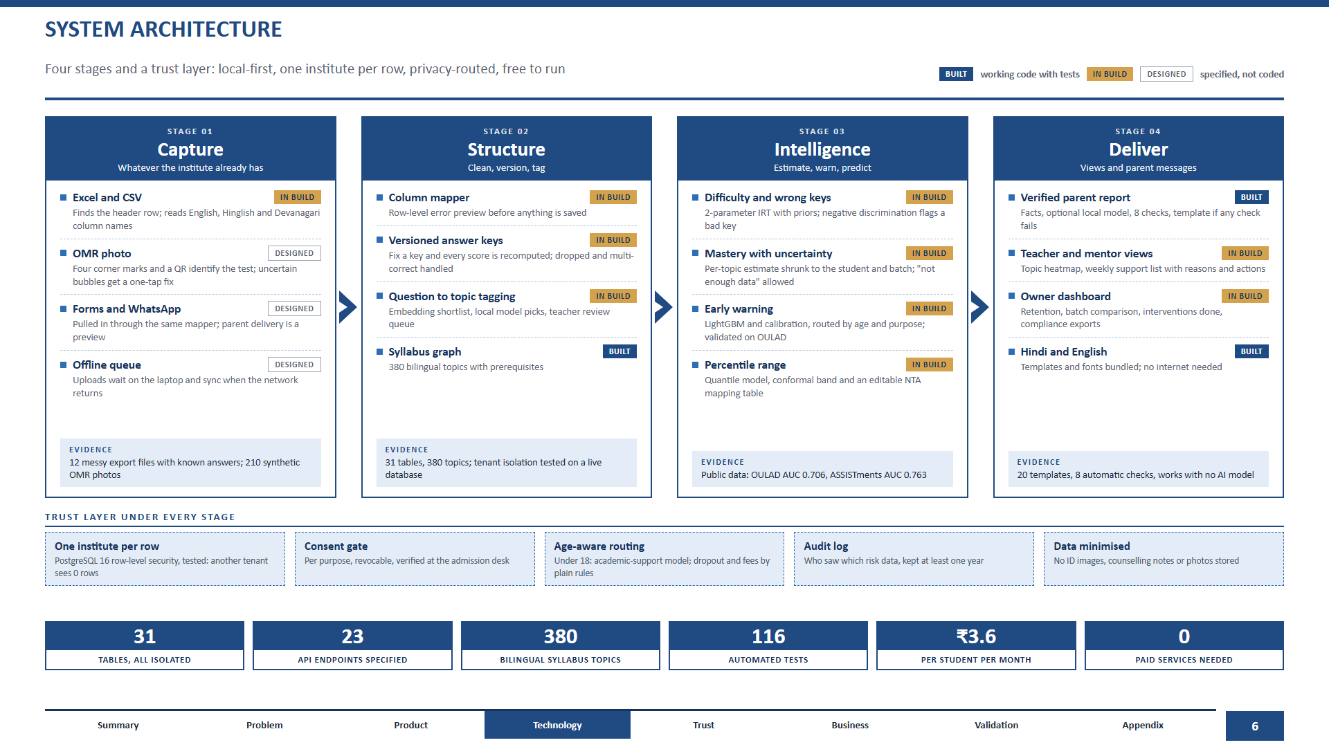
Notes:
Architecture. Status tags: BUILT means working code with tests; IN BUILD means in progress; DESIGNED means specified but not coded. Evidence boxes are real: 12 messy export files and 210 synthetic OMR images exist; 31 tables and tenant isolation tested on a live PostgreSQL 16; OULAD 0.706 and ASSISTments 0.763 on public data; 20 templates and 8 checks.

Slide 7


LEARNING ANALYTICS
ML RIGOUR 25 % · LEARNING ANALYTICS
We estimate what each student knows, topic by topic, and tell the teacher how sure we are
WHAT THE TEACHER SEES
HOW IT WORKS
EVIDENCE ON REAL DATA
1 Answers and versioned keys
2
Blank counts as wrong. Dropped and multi-correct items follow NTA rules; fixing a key re-scores everything.
2 Question difficulty
3
2-parameter IRT with a guessing prior; Rasch for small samples. Negative discrimination flags a bad key.
PUBLIC DATA
770 held-out students, 55,755 predictions, 5-fold, pyKT split. Our 95% interval: 0.756 to 0.779. AKT is higher than ours.
1
3 Mastery per topic
1
Bands, not scores: building, steady, strong, or not enough data.
Shrunk toward the student's overall level and the batch; recent tests count more.
SYNTHETIC-DATA RESULTS
2
A column low for the whole batch means probably not taught yet, not weak students.
Difficulty recovery vs students
PENDING
A question the best students miss is flagged as a likely wrong answer key.
4 Bands with honesty
Wrong-key detection
PENDING
3
A band appears only when the standard error is small; otherwise: not enough data.
Mastery vs raw % correct
PENDING
ILLUSTRATIVE MOCK-UP
SYNTHETIC DATA
Moat curve: difficulty accuracy as more students answer.
Teacher view: topic-level, per student, per batch
Sources: ml/public_validation (ASSISTments 2009, pyKT NeurIPS 2022 reference values); screens are illustrative. Difficulty and mastery results on synthetic data are pending.
Summary
Problem
Product
Technology
Trust
Business
Validation
Appendix
Notes:
Evidence: the bar chart uses the real result file (online IRT 0.763, 1-parameter 0.759, logistic baseline 0.741, BKT 0.714) next to the published pyKT values (DKT 0.754, SAKT 0.725, AKT 0.785). IRT recovery, wrong-key detection and mastery-vs-baseline come from Agent B and must replace the amber placeholders before submission.

Slide 8






EARLY WARNING
ML RIGOUR 25 % · EARLY WARNING
Each week a mentor gets a short list: who to call, why, and what to offer
WHAT THE MENTOR SEES
REAL-DATA CHECK ON OULAD (WITHDRAWAL)
HOW A FLAG IS MADE
Features as of the date, never the future
1
Route by age and purpose
2
Score or apply a plain rule
Plain reasons and a supportive action
A person decides; outcome is logged
ROUTING BY AGE AND PURPOSE
PUBLIC DATA
Academic support
Dropout
Fees
Day 28, 5-fold by student
AUC
P@10 %
Under 18
Model
Plain rules
Plain rules
LightGBM, academic + clicks
0.706
0.46
18 and over
Model
Model
Model
LightGBM, academic only
0.698
0.46
Minors, legal opinion
Model
Model
Plain rules
Logistic, academic only
0.680
0.40
Rule: no assessment
0.521
0.31
Never used for minors: app activity tracking. Flags persist until resolved; list capped at mentor capacity.
Rule: zero clicks, 7 days
0.532
0.24
ILLUSTRATIVE MOCK-UP
Calibration error 0.009. Held-out course: 0.654.
Model on synthetic institutes: pending.
PENDING
Visible to mentor and owner only
Sources: ml/public_validation (OULAD, CC BY 4.0); routing policy: contracts/routing_policy.yaml. About a quarter of dropouts are sudden and cannot be predicted from academic data.
Summary
Problem
Product
Technology
Trust
Business
Validation
Appendix
Notes:
The OULAD table is real: LightGBM with isotonic calibration, student-grouped 5-fold; rules are the two deterministic baselines. Published anchors for context: 0.727, 0.794 and 0.804 at days 14, 28 and 42 (PLOS ONE 2026); ours is lower, so do not claim parity. Precision at top 10 percent is shown as P@10. Early warning on synthetic institutes and the comparison against the institute rule come from Agent C.

Slide 9




PERCENTILE RANGE AND PARENT REPORTS
ML RIGOUR 25 % · GENAI WITH GUARDRAILS
An honest range instead of a single rank, and parent messages where every number is checked
PERCENTILE RANGE
PARENT REPORT: HINDI AND ENGLISH
THE CHECKING PIPELINE
Predicted percentile range, one student
1
Facts from data
100
Attendance, tests, topics, trend, two tips.
80
Optional local AI
60
Only rewords; runs on the laptop.
40
Aug
Oct
Dec
Feb
Apr
The range narrows as more tests come in
Eight checks
2
Numbers, topics, names, banned words, length, trend, tips, schema.
Quantile model plus conformal band, 80 % target (77 to 83 % accepted).
Mapped to the NTA percentile through an editable table: 2026 average curve, with 2024 easy and tough shifts as the uncertainty envelope.
1 Every number and topic comes from the data, never from the AI.
2 Checked before sending: if any check fails, a template is sent instead.
Template fallback
No AI needed
20 templates
Names added last
Safe human-written text if anything fails.
Shown as a range with a disclaimer, never a single number or a rank promise.
Same pipeline, next jobs: a 7-day study plan and doubt answers drawn from retrieved notes, under the same checks. Designed, not in the Round 1 build.
ILLUSTRATIVE MOCK-UP
PENDING
ILLUSTRATIVE MOCK-UP
Report text produced by our report module (template path) for a synthetic student.
BUILT
16 automated tests
Coverage results pending
Hindi still needs a native reviewer
Sources: backend/app/genai (report module), contracts/report_numbers.schema.json. An independent attack on the checker found gaps; fixes are in progress, so no catch rate is claimed here.
Summary
Problem
Product
Technology
Trust
Business
Validation
Appendix
Notes:
Prediction range is schematic until Agent C delivers coverage numbers. The report images use real template output. Do not state a verifier catch rate until the independent adversarial test passes after the E2 fixes.

Slide 10


PRIVACY, SAFETY AND COMPLIANCE
FEASIBILITY, PRIVACY AND SAFETY 20 %
Built for the law and for children: consent first, supportive actions only, no rankings
WHO GETS WHAT
VERIFIABLE PARENTAL CONSENT
THE COST OF PRIVACY, ON REAL DATA
Academic support
Dropout
Fees
App activity
Under 18
Model
Plain rules
Plain rules
Never
1
18 and over
Model
Model
Model
Opt-in
Under 18, legal opinion
Model
Model
Plain rules
Never
2
DPDP Act s.9(3): no tracking or behavioural monitoring of children, even with consent
3
Fourth Schedule: exemption is narrow and purpose-limited, so we do not rely on it for consent
PUBLIC DATA
MoE guidelines cl. 10.2(xi): analyse results and counsel students whose performance is deteriorating
1 Itemised data 2 One switch per purpose 3 Withdraw in one tap
No leaderboards, no public ranks
ID checked at the admission desk (Rule 10); consent recorded per purpose and notice version.
No batch moves based on performance
We act as the processor: the institute stays the data fiduciary; no pooling of children's raw data
Banned-words check on every message
ILLUSTRATIVE MOCK-UP
Counsellor contact for every institute
DESIGNED AND TESTED IN CODE
MoE Coaching Centre Guidelines 2024, cl. 10.2(xi): results should be used for regular analysis and counselling of students whose performance is deteriorating. Our whole flow is built on that sentence.
Sources: DPDP Act 2023 s.9, DPDP Rules 2025, MoE Guidelines 2024; contracts/routing_policy.yaml; OULAD results in ml/public_validation. Not legal advice.
Summary
Problem
Product
Technology
Trust
Business
Validation
Appendix
Notes:
Routing table mirrors contracts/routing_policy.yaml. The OULAD bars show that academic-only features lose only about 0.007 to 0.025 AUC against academic plus click behaviour: privacy is cheap here. A lawyer's check on the in-person ID flow is still recommended.

Slide 11
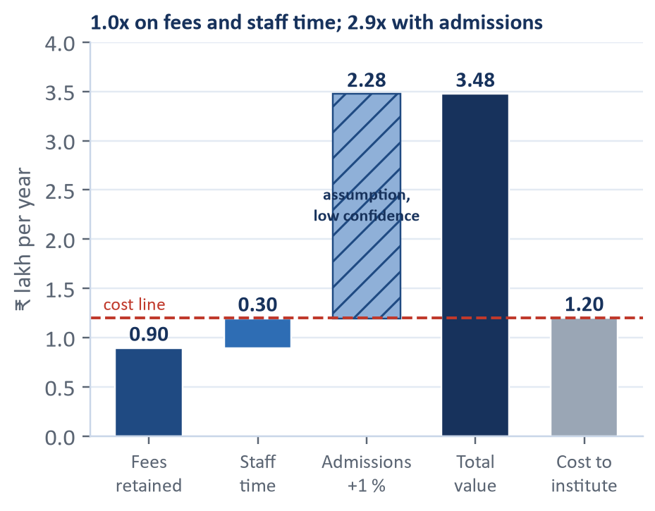
BUSINESS MODEL AND UNIT ECONOMICS
REVENUE MODEL AND UNIT ECONOMICS 20 %
At ₹30 a student, fees kept and staff time saved already cover the cost; every admission it wins is a bonus
PRICE AND COST TO THE INSTITUTE
VALUE BRIDGE, MID INSTITUTE (₹ LAKH / YEAR)
OUR UNIT ECONOMICS: GUIDE VS OURS
List price
₹30 / student / month
Per institute
Guide
Pragati
Range tested
₹20 to ₹40
LTV ÷ acquisition cost
10.7x
3.7x
Payback
3.1 mo
6 mo
Billed per year (active students, seasonal)
₹1.03 lakh
Contribution margin
66 %
78 %
Total cost incl. GST not reclaimed and mentor time
₹1.20 lakh
Revenue per month
₹16,000
₹8,612
Per student per year
≈ ₹285 (0.3 % of fee)
Acquisition cost
₹33,000
₹35,492
Our cost to serve (all-in)
₹3.6 / student / month
Logo retention a year
69 %
64 %
Institutes to cover the team
n/a
18
BY SEGMENT (BASE)
SCENARIOS (MID)
Small
Mid
Large
Bear
Base
Bull
Students
180
400
1,200
Return
0.15x
2.9x
14x
Institute return
2.3x
2.9x
3.6x
Fees retained (₹0.90 L) plus staff time (₹0.30 L) equal the cost: 1.0x with no admissions benefit.
The 2.9x needs a 1 % admissions uplift, our weakest assumption. Every 1 % adds about ₹2.3 L.
Break-even: save 3.5 students a year.
LTV ÷ CAC
-0.1x
3.7x
24x
LTV ÷ CAC
1.5x
3.7x
9.1x
Payback
61 mo
6 mo
2 mo
Payback
18 mo
6 mo
3 mo
Bear sets every input to its worst at once: a stress test, not a forecast.
MODEL OUTPUT
Our base case is deliberately below the guide's: 6.6 % not 25 %, ₹30 not ₹40, 3.7x not 10.7x. It still pays for itself if it saves three or four students a year.
Source: financial workbook (Pricing, Institute_ROI, Unit_Econ, Scenarios). Model output from sourced and assumed inputs; willingness to pay is untested.
Summary
Problem
Product
Technology
Trust
Business
Validation
Appendix
Notes:
Value bridge from the workbook, mid institute, Base: fees retained 89,672; staff time 25 hours x 100 rupees x 12 = 30,000; admissions uplift 1 % x 400 x 95,000 x 60 % margin = 2,28,000; total 3,47,672 against a cost of 1,20,131. Say plainly that two thirds of the value rests on the admissions assumption.

Slide 12



GO-TO-MARKET, MOAT AND ROADMAP
MARKET AND GO-TO-MARKET 10 %
Start in Patna with a free trial on last year's Excel, then grow as the shared question bank gets sharper
1
WHERE WE START, AND WHY
3
COMPETITION (VENDOR LISTINGS, OCT 2026)
PHASE 1 · JAN TO MAR 2027
PHASE 2 · APR 2027 SESSION
PHASE 3 · FY28
Price / student / mo
OMR
Topic analytics
Parent report
Hindi
Consent ledger
Patna
Patna and Lucknow
Bihar, UP, Jharkhand
Classplus
₹4 to ₹7
?
?
?
?
?
Free retro-pilot at 2 institutes on last year's Excel: who left, and would we have flagged them?
Paid pilots with comparison batches; measures written down before we start.
Field sales for mid and large institutes; small ones self-serve (LTV/CAC 1.5x).
Fedena
₹10 to ₹21
no
?
yes
?
no
Edmingle
₹19 to ₹75
no
?
?
?
no
Teachmint
₹20 to ₹40 (est.)
?
?
yes
yes
?
Pragati
₹30
designed
yes
yes
yes
yes
2
CHANNELS
yes: shown in the listing · no: not shown · ?: could not be verified from the listing
4
THE MOAT, AND ITS LIMITS
Nextute network
partner channel, to be agreed
Free retro-pilot
one Excel file, one answer, no install
More institutes
More answers per question
Sharper difficulty, wrong keys caught
Better lists and reports
Field demos, Jan to Mar
before the April admission season
OMR and test-series vendors
referral partners, to be tested
Limit: until the shared bank covers the syllabus, early wins must come from staff time and parent reports, not model accuracy. Only item statistics are pooled; raw records stay with each institute.
5
ROADMAP
Oct 2026
Round 2
Jan to Mar 2027
Apr 2027
Jun 2027
FY28
Public-data validation, synthetic pipeline, 116 tests
Working prototype; judges change the inputs live
Retro-pilots in Patna
Paid pilots start with the session
Publish what worked; fix the percentile table
Bihar, UP, Jharkhand; deep knowledge tracing if it beats IRT
Sources: financial/research R1 (vendor listings; many features unverifiable, so '?' is not 'absent'); financial workbook (segments, pilot assumptions). Roadmap dates are our plan.
Summary
Problem
Product
Technology
Trust
Business
Validation
Appendix
Notes:
GTM follows the unit economics: field sales where LTV/CAC is 3.7 to 9x, self-serve for small institutes at 1.5x. The retro-pilot needs only last year's Excel, so it costs the institute nothing. The competitor table shows only what listings show.

Slide 13
VALIDATION, RISKS AND OUR ASK
FEASIBILITY, PRIVACY AND SAFETY 20 % · HONEST LIMITS
What we have proved, what we have not, the risks, and the one pilot that settles it
PROVED ON PUBLIC DATA
SHOWN ON SYNTHETIC DATA
NOT PROVEN YET
Next-answer AUC
0.763 (DKT 0.754)
Pipeline end to end
116 tests pass
Accuracy on real institutes
needs a pilot
Withdrawal AUC, day 28
0.706 (published 0.794)
Tenant isolation
0 rows across institutes
Willingness to pay
owner interviews
Calibration error
0.009
Report checker
8 checks, template fallback
Real dropout reduction
borrowed from trials
Academic-only cost
0.008 AUC
Difficulty recovery
pending
Hindi quality at scale
native review
Precision at top 10 %
0.46 vs 0.24 to 0.31
Early-warning lift
pending
Other OMR layouts
one-time onboarding
1
KEY RISKS AND HOW WE CONTAIN THEM
OUR ASK
Risk
Mitigation
Two retro-pilots in Patna this winter.
Real accuracy below public-data results
Retro-pilot on last year's Excel before any sale; compare with the institute's own rule at equal workload.
Owners will not pay ₹30
Owner interviews and a price survey first; lead with staff time and parent reports, tested at ₹20 to ₹40.
Give us last year's Excel. If Pragati would not have flagged more of the students who left than your attendance rule, at the same weekly workload, we stop and say so.
Mentors ignore the list
List capped at capacity; every flag needs a logged outcome; owner sees actions done.
Hindi quality
Native reviewer on all templates; template fallback when a check fails.
Changed from the guide: 25 % to 6.6 % dropout reduction; LTV ÷ CAC 10.7x to 3.7x.
DPDP reading changes
Consent-first design that does not depend on the education exemption.
Sources: ml/public_validation; financial workbook; technical/docs/FEASIBILITY_CHECK.md. Amber items are replaced with measured values before submission.
Summary
Problem
Product
Technology
Trust
Business
Validation
Appendix
Notes:
State limitations before the judges do: synthetic data proves the pipeline only; public datasets are from the UK (OULAD) and US (ASSISTments); the percentile mapping is an assumption table. The ask is concrete and falsifiable.

Slide 14
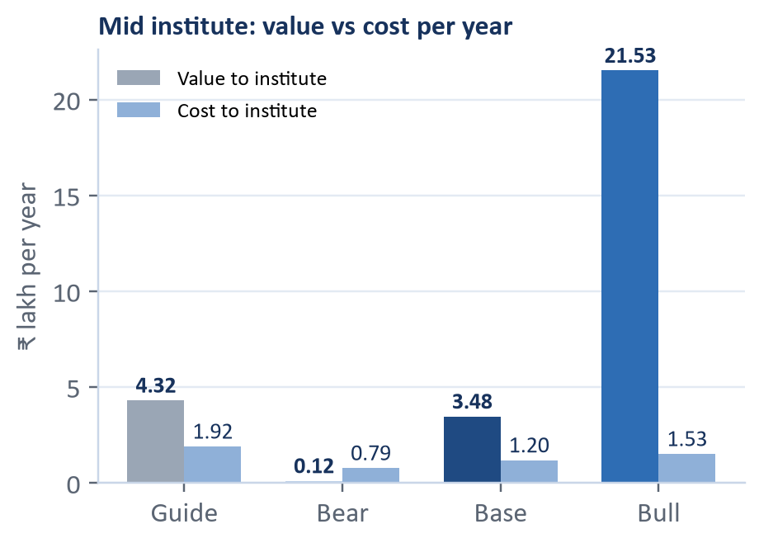
APPENDIX 1: INSTITUTE RETURN ASSUMPTIONS
REVENUE MODEL AND UNIT ECONOMICS 20 %
The assumptions behind the institute return, with ranges and confidence
KEY ASSUMPTIONS (MID, BASE)
INSTITUTE ECONOMICS: GUIDE VS PRAGATI
VALUE VS COST AND WHAT IT MEANS
Assumption
Base
Range
Conf.
Per year, 400 students
Guide
Bear
Base
Bull
Students
400
180 to 1,200
M
Effective dropout reduction
25 %
1.0 %
6.6 %
22 %
Annual fee
₹95,000
70k to 120k
L
Dropouts prevented
12
0.2
2.6
16
Mid-session dropout
10 %
6 to 18 %
L
Outreach effect
15 %
5 to 30 %
M
Fee lost per dropout
₹36,000
₹15,414
₹36,967
₹56,994
Share preventable
45 %
30 to 60 %
L
Fees retained
₹4.32 L
₹2,928
₹89,672
₹9.11 L
Recall, under 18
55 %
40 to 70 %
L
Total value
₹4.32 L
₹11,928
₹3.48 L
₹21.5 L
Recall, 18+
65 %
50 to 80 %
M
Flag precision
35 %
25 to 50 %
L
Total cost to institute
₹1.92 L
₹78,544
₹1.20 L
₹1.53 L
KEY INSIGHTS
Flags acted on
90 %
70 to 100 %
L
Return, all benefits
2.25x
0.15x
2.9x
14x
Fees alone return 0.75x: they do not cover the cost on their own.
Fees plus staff time reach about break-even; every 1 % admissions uplift adds about ₹2.3 lakh.
Save 3 to 4 students a year and it pays for itself.
Platform cost is 0.3 % of a student's fee.
Admissions uplift
1 %
0 to 3 %
L
Return, fees only
2.25x
0.04x
0.75x
5.9x
Staff hours saved
25 a month
10 to 50
L
List price
₹30
₹20 to 40
L
Students to save to break even
5.3
6.5
3.5
2.7
GST reclaimed
60 %
30 to 90 %
L
MODEL OUTPUT
Conf.: H high, M medium, L low. Low means an assumption to test in owner interviews.
Total cost includes the fee, GST net of what institutes reclaim, and mentor time.
Source: financial workbook (Assumptions, Scenarios). Model output, not measured; dropout effect borrowed from 8 trials in comparable settings (mean 15.8 %).
Summary
Problem
Product
Technology
Trust
Business
Validation
Appendix
Notes:
Numbers are from the workbook scenarios table, mid institute. The guide's 25 percent prevention and 2.25x return are shown as the baseline we replaced. Safe wording: randomised trials in comparable settings show 5 to 30 percent among students who get outreach; we model 15 percent.

Slide 15
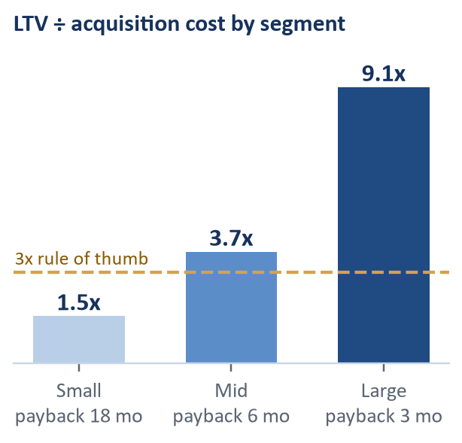
APPENDIX 2: SENSITIVITY
REVENUE MODEL AND UNIT ECONOMICS 20 %
What moves the answer: price, effect size, acquisition cost and churn
UNIT ECONOMICS (MID, BASE)
SENSITIVITY: WHAT MOVES THE ANSWER
TORNADO AND SEGMENTS
Per institute
Guide
Pragati
Institute return (x), by effective reduction and list price
LTV ÷ acquisition cost, one input at a time
LTV ÷ acquisition cost
10.7x
3.7x
₹20
₹30
₹40
₹50
₹60
₹80
Price ₹20 to ₹40
2.1
5.2
5 %
4.0x
2.7x
2.1x
1.7x
1.4x
1.1x
Payback
3.1 months
6 months
8 %
4.5x
3.0x
2.3x
1.9x
1.6x
1.2x
Pilot conversion 15 to 50 %
2.2
5.1
Contribution margin
66 %
78 %
11 %
5.0x
3.4x
2.6x
2.1x
1.7x
1.3x
15 %
5.6x
3.9x
2.9x
2.4x
2.0x
1.5x
Non-renewal 30 to 10 %
3.1
4.3
Lifetime value
₹3.53 lakh
₹1.30 lakh
20 %
6.5x
4.4x
3.4x
2.7x
2.3x
1.7x
Acquisition cost
₹33,000
₹35,492
Monthly churn 5 to 1.5 %
3.1
4.3
25 %
7.3x
5.0x
3.8x
3.0x
2.5x
1.9x
Revenue, monthly
₹16,000
₹8,612
LTV ÷ acquisition cost, by acquisition cost and monthly churn
Pilots per rep 6 to 14
3.1
4.0
1 %
2 %
3 %
4 %
5 %
Contribution, monthly
₹10,600
₹6,740
₹15k
11.0x
9.6x
8.7x
7.9x
7.3x
Base 3.7x
Annual logo retention
69 %
64 %
₹25k
6.4x
5.8x
5.2x
4.8x
4.4x
Institutes to cover fixed team cost
n/a
18
₹35k
4.6x
4.1x
3.7x
3.4x
3.1x
₹50k
3.2x
2.9x
2.6x
2.4x
2.2x
MODEL OUTPUT
₹75k
2.1x
1.9x
1.7x
1.6x
1.5x
Why thinner: seasonal billing, 20 % non-renewal after the session, pilots that do not convert, and a price near the top of what ERPs charge.
MODEL OUTPUT
Base cells: ₹30 with 6.6 % reduction; ₹35k with 3 %.
Source: financial workbook (Scenarios, Sensitivity). List price ₹30; ERP and LMS prices found: ₹4 to ₹21. Willingness to pay is untested.
Summary
Problem
Product
Technology
Trust
Business
Validation
Appendix
Notes:
Heat tables are the two grids of the Sensitivity sheet. Bear, Base and Bull LTV/CAC for the mid institute are -0.1x, 3.7x and 24x. The segment bars show small 1.5x, mid 3.7x, large 9.1x with paybacks of 18, 6 and 3 months.

Slide 16
APPENDIX 3: SCENARIOS
SCENARIOS
Bear, Base and Bull for a mid-size institute, plus segments
MID INSTITUTE (400 STUDENTS)
BY SEGMENT (BASE)
Per year unless stated
Bear
Base
Bull
Small
Mid
Large
Effective dropout reduction
1.0 %
6.6 %
22.2 %
Return
2.3x
2.9x
3.6x
Dropouts prevented
0.2
2.6
16
LTV÷CAC
1.5x
3.7x
9.1x
Institute return, all benefits
0.15x
2.9x
14x
Payback
18 mo
6 mo
3 mo
Institute return, fees only
0.04x
0.75x
5.9x
Students to save to break even
6.5
3.5
2.7
Bear changes every input to its worst value at once. It is a stress test, not a forecast.
Revenue per institute, monthly
₹4,992
₹8,612
₹11,999
Fully loaded acquisition cost
₹1.74 L
₹35,492
₹13,336
LTV ÷ acquisition cost
-0.1x
3.7x
24x
Payback
61 months
6 months
2 months
MODEL OUTPUT
Source: financial workbook (Scenarios sheet). Model output from sourced and assumed inputs, not measured.
Summary
Problem
Product
Technology
Trust
Business
Validation
Appendix

Slide 17
APPENDIX 4: COST PER STUDENT
COST PER STUDENT
About ₹3.6 per student per month, ₹0 extra run locally
COST INPUTS (BEAR / BASE / BULL)
ALL-IN COST
HOW WE KEEP IT LOW
Input
Bear
Base
Bull
₹3.6
Small local models on a laptop
Hosted model, ₹ per 1M input tokens
142.58
23.76
9.51
Hosted model, ₹ per 1M output tokens
712.88
142.58
47.53
Template fallback: no model required
per student per month, inside the planned ₹3 to ₹10 band (financial model check).
WhatsApp utility message, ₹
0.145
0.132
0.115
AI reports per student per month
6
4
4
No paid APIs or hosting
WhatsApp messages per student per month
10
6
4
Compute and storage, ₹ per student per month
1.5
0.8
0.4
LOCAL RUN
One database per deployment, isolated per institute
Consent verification, ₹ per student per year
3.0
1.5
0.5
₹0
App server + database, ₹ per month per stack
9,000
4,000
3,000
WhatsApp only for utility messages, in-window replies free
Institutes sharing one stack
10
20
40
marginal cost: laptop, local model, local database, no paid services.
MODEL OUTPUT
Prices researched 20 Oct 2026 from vendor pages; exchange rate ₹95.05 per US dollar.
Source: financial/assumptions.csv (COGS rows), financial/research. Production costs are assumptions with confidence flags.
Summary
Problem
Product
Technology
Trust
Business
Validation
Appendix

Slide 18
APPENDIX 5: DATA MODEL
DATA MODEL
31 tables in five groups, all isolated per institute
PEOPLE
LEARNING
RESULTS
institutes, users, students, guardians, batches, batch_changes, consents, legal_settings
topics, topic_prereqs, questions, question_topics, item_params, tests, test_questions, answer_keys, marking_schemes
responses, test_totals, attendance, fees, engagement
INTELLIGENCE
OPERATIONS
DELIBERATELY NOT STORED
mastery_snapshots, risk_scores, predictions, interventions, reports, model_registry
ingest_jobs, omr_templates, audit_log
Counselling notes or mental-health information
ID document images
Student photographs
Any public rank
HOW EVERY QUESTION GETS ITS TOPIC (SO TAGGING COSTS FALL AS WE GROW)
Question text
Shortlist
embedding
Local model picks
Teacher 1-tap
Shared bank
Row-level security on every tenant table; another institute sees 0 rows (tested on PostgreSQL 16)
Source: technical/contracts/schema.sql. Synthetic data: 4 institutes, 3 academic years, known ground truth.
Summary
Problem
Product
Technology
Trust
Business
Validation
Appendix

Slide 19
APPENDIX 6: LEGAL BASIS
LEGAL BASIS
The rules we design against, and what we do about each
Rule
Our response
DPDP Act s.9(1), Rule 10
Verifiable parental consent before processing a minor's data: ID checked at the admission desk, consent recorded per purpose.
DPDP Act s.9(3)
No tracking or behavioural monitoring of children: under 18, academic support uses a model; dropout and fee signals use plain rules.
Fourth Schedule, educational institutions
Narrow and purpose-limited, so we do not rely on it for consent.
DPDP Rules, Rules 6 and 7
Encryption, access control, logs kept one year, breach notice to the institute within hours.
MoE Guidelines 2024, cl. 10.2(xi)
Results stay private; early warning leads to counselling, never public ranks.
MoE Guidelines 2024, cl. 12(vii)
No batch moves based on performance; remedial help is an extra session.
MoE Guidelines 2024, cl. 8(iv), 10.1
Pro-rata refund within 10 days; no test the day after the weekly off.
Rajasthan Act 2025, s.6(2)(d)
Fee plans support four or more equal instalments.
Sources: DPDP Act 2023, DPDP Rules 2025, MoE Guidelines 2024, Rajasthan Coaching Centres Act 2025 (technical/docs/TECH_PLAN.md, section 24). Not legal advice.
Summary
Problem
Product
Technology
Trust
Business
Validation
Appendix

Slide 20
APPENDIX 7: MODEL CARD AND GO-LIVE GATES
VALIDATION PLAN AND MODEL CARD
How we will know each model works before an institute relies on it
A
HOW WE SPLIT AND COMPARE
B
METRICS AND GATES (FROM contracts/metrics_bars.yaml)
By student and by year
Component
Metric
Gate
Status
Features use only data before the as-of date; never split by row.
Difficulty (IRT)
Recovery r(b̂, b) at 60 answers per item; at 30 answers
≥ 0.90; ≥ 0.85
pending
Baselines at equal workload
Wrong-key detector
Recall on planted wrong keys; false flags per 300 items
≥ 0.80; ≤ 2
pending
Each model sits beside the institute's own rule at the same weekly list size.
Topic mastery
Ability recovery r; next-test AUC vs raw % and BKT
≥ 0.80; better
pending
Uncertainty
Bootstrap intervals over students; three generator seeds; event counts shown.
Knowledge tracing
Next-answer AUC, ASSISTments 2009 (public)
report
0.763
Stress tests
Early warning
AUC-PR vs institute rule; precision at capacity vs rule
+30 %; +25 %
pending
Misspecified generators, a held-out institute, an independent attack on the report checker.
Early warning
Calibration error (public: OULAD day 28)
< 0.05
0.009
Honest misses
A missed gate is reported with its cause; gates are never moved to pass.
Early warning
Median lead time before a student leaves
≥ 21 days
pending
Withdrawal, public
OULAD day-28 AUC, student-grouped 5-fold
report
0.706
C
KNOWN LIMITATIONS, STATED
Synthetic data proves the pipeline, not real-world accuracy.
OULAD is a UK online university; ASSISTments is US school maths.
The percentile mapping is an editable assumption table until real mock-vs-exam pairs exist.
Fairness
Largest recall gap across slices (gender, city tier)
≤ 0.10
pending
Percentile range
Coverage of the 80 % band
77 to 83 %
pending
Parent reports
Numbers matching the facts; independent attack passes
100 %
pending
Sources: technical/contracts/metrics_bars.yaml, technical/docs/agent_prompts/R1_00_COMMON.md, ml/public_validation. Pending gates are filled from metrics.json by technical/scripts/deck_numbers.py.
Summary
Problem
Product
Technology
Trust
Business
Validation
Appendix

Slide 21



APPENDIX 8: PRODUCT TOUR
PRODUCT TOUR
Six screens of the same flow, from upload to parent report
1
Upload and map: the system fixes the mess
2
Topic map: strengths, gaps, untaught topics
3
Weekly support list: reasons and actions
4
Student profile: mastery with doubt, honest range
5
Owner dashboard: retention, coverage, compliance
6
Parent report in Hindi and English
Illustrative mock-ups rendered from HTML with synthetic values; they become real screenshots once the web app is wired to the models.
Summary
Problem
Product
Technology
Trust
Business
Validation
Appendix
Notes:
Product tour: upload, topic map, support list, profile, owner dashboard, parent report. All images are illustrative mock-ups (HTML rendered by headless Edge) using synthetic data and real report text from the report module.

Slide 22
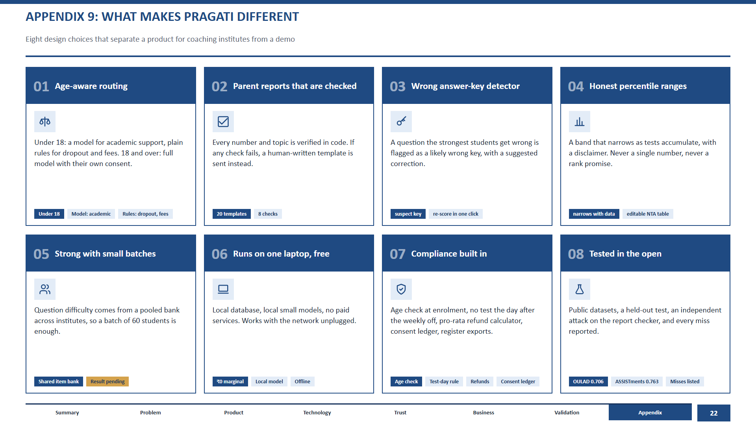
Notes:
Differentiators. Item 05 (small-batch strength) is marked result pending until the difficulty-recovery curve exists. Item 08 refers to public-data results and the independent attack on the report checker, with misses listed.

Slide 23
APPENDIX 10: SOURCE REGISTER
SOURCE REGISTER
Every external number in the deck, where it came from, and where we used it
#
Source
Used for
Confidence
Slide
1
NTA NEET UG 2025 result data (via Careers360, ALLEN)
22.76 lakh registered candidates
High (official)
2, 3
2
JEE Main 2025 statistics (Vedantu; NTA total not found)
About 15.4 lakh unique registrations
Medium (secondary)
2, 3
3
NSO Comprehensive Modular Survey: Education 2025 (via Careers360)
27 % of school students in private coaching
High (official)
3
4
Case participant guide
8 to 15 % dropout, ₹36,000 per leaver, ₹17.3 lakh, ₹40, 25 %
Illustrative
2, 3, 4
5
Vendor listings: Classplus, Fedena, Graphy, Edmingle (financial/research R1)
₹4 to ₹21 per student per month anchors
Medium
4, 12
6
Outreach trials in comparable settings (financial/research R4)
8 trials, mean 15.8 % reduction
Medium
4, 11
7
OULAD (Open University, CC BY 4.0), our runs
0.706 AUC, 0.009 calibration, 0.46 precision
Measured
2, 4, 8, 13
8
PLOS ONE 2026, OULAD withdrawal study
Published 0.727 / 0.794 / 0.804 anchors
High
4, 8
9
Liu et al., pyKT, NeurIPS 2022; ASSISTments 2009, our runs
DKT 0.754, SAKT 0.725, AKT 0.785; ours 0.763
Measured
2, 7
10
DPDP Act 2023 s.9; DPDP Rules 2025
Parental consent, no tracking of children
High (primary)
4, 10
11
MoE Guidelines for Coaching Centres 2024
cl. 10.2(xi), 12(vii), 10.1, 8(iv)
High (primary)
10, A6
12
Rajasthan Coaching Centres Act 2025
s.6(2)(d) instalments
High (primary)
A6
13
WhatsApp and LLM price pages, Patna pay data (financial/research R5, R6)
Cost per student, staff hour ₹100
Medium to high
11, A4
Full citations with URLs and licences: technical/docs/CITATIONS.md and financial/research. Every model number traces to the financial workbook or a metrics.json file.
Summary
Problem
Product
Technology
Trust
Business
Validation
Appendix

Slide 24
APPENDIX 11: CASE QUESTIONS, ANSWERED
PROBLEM STATEMENT COVERAGE
Where the case's twelve questions are answered, and how strong the evidence is
#
Technology (70 %)
Where
Evidence
#
Market (30 %) and deliverables
Where
Evidence
T1
Data capture, offline, low effort
Architecture, Product
Designed
B1
Buyer and measurable institute return
Business model, Appendix 1
Assumption
T2
Data model; tagging questions to topics at scale
Appendices 5, 6
Built
B2
Pricing, CAC, payback, churn, LTV
Business model, Appendix 3
Assumption
T3
Mastery and question difficulty (IRT)
Learning analytics
Measured
B3
Cities and sizes first; channels
Go-to-market
Assumption
T4
Early warning: dropout, falling behind, fees
Early warning
Measured
B4
Competition and a moat that grows
Go-to-market
Designed
T5
Percentile range with honest uncertainty
Percentile and reports
Designed
R1
Financial model with sensitivity
Appendices 1, 2, 3
Assumption
T6
GenAI: reports, study plans, doubts
Percentile and reports
Built
R2
Limits and what we did not prove
Validation, Appendix 7
Measured
T7
Multi-tenant, secure, low-cost architecture
Architecture, Appendix 4
Built
i
HOW TO READ THE EVIDENCE COLUMN
T8
Privacy and safety for minors
Privacy, Appendix 7
Built
Measured: a number from our own run on public data or the test suite.
Built: working code with tests, shown on synthetic data.
Designed: specified in the contracts, not coded yet.
Assumption: a model input with a stated range, to be tested in interviews and the pilot.
Every slide states its limits. We would rather show an honest 6.6 % than copy a hopeful 25 %, and rather mark a gate as pending than quote a number we have not measured. The case says teams that state assumptions and limits score higher, so we put them on the page.
Source: Participant Guide sections 4, 8 and 10 (questions and rubric). T = technology question, B = business question, R = round-1 deliverable or limit.
Summary
Problem
Product
Technology
Trust
Business
Validation
Appendix

Slide 25
How we used AI, and what we cited
AI tools
Public data and libraries
Claude: planning, code review, documentation.
Google Antigravity agents: code generation.
Perplexity and Gemini Deep Research: literature and regulation research.
Everything was reviewed and tested by the team; research claims were checked against primary sources where possible.
OULAD (CC BY 4.0), ASSISTments 2009, the pyKT benchmark, JEEBench.
Noto Sans Devanagari (SIL OFL), LightGBM, Ollama, FastAPI, PostgreSQL.
Full list with licences: technical/docs/CITATIONS.md in the repository.
github.com/AdityaKuranjekar/institute-intelligence-platform
Notes:
Mandatory disclosure (Problem Statement, rule 2). Keep this as the last slide of the submitted PDF.

