Slide 1


Slide 2
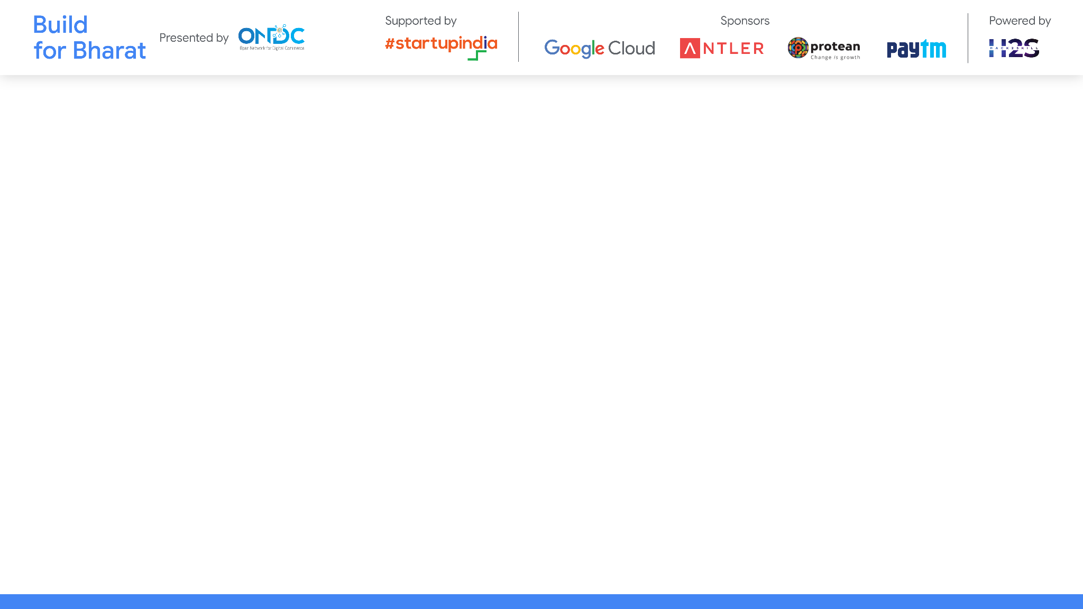
Team Name: Attack On Syntax
Team Leader Name: Aditya Lad
Team Member Names: Aditya Lad, Nishant Lanjewar, Nidhish Wakodikar, Atharv Mandpe
Problem Statement Category: Foundational or Scalable Solution
Problem Statement: Catalogue Scoring
*You can make a copy of the slides. Do not change the template branding.

Slide 3
Architecture & Design for the innovative solution.
URL of Product
Data extraction with help of script
Give metrics weightage to different data fields
Get product score on rate of 10
Getting insights in graphical format
*You can make a copy of the slides. Do not change the template branding.

Slide 4
Define customization & deployment options of your proposed solution.
Parameter Definition: Buyers can customize the parameters used for catalog scoring based on their specific requirements. For example, they can define parameters related to compliance, correctness, and completeness differently depending on their industry regulations or quality standards.
Weight Adjustment: Buyers have the flexibility to adjust the weights assigned to each parameter based on their importance. For instance, they may prioritize correctness over completeness in their catalog assessment.
Scoring Algorithm: The scoring algorithm can be customized to accommodate different scoring methodologies or algorithms preferred by buyers. This allows for flexibility in scoring calculation based on specific business needs.
Integration with Buyer Apps: The solution can be integrated with various buyer applications to seamlessly incorporate catalog scoring functionality. Customization options can be provided for integration to ensure compatibility with different systems.
Cloud Deployment: The solution can be deployed on cloud platforms such as AWS, Azure, or Google Cloud for scalability and accessibility. Buyers can choose the cloud provider and region based on their preferences and regulatory requirements.
On-Premises Deployment: For buyers with strict data privacy or security concerns, the solution can be deployed on-premises within their infrastructure. This provides full control over data and ensures compliance with internal policies.
Hybrid Deployment: A hybrid deployment model can be adopted, combining elements of both cloud and on-premises deployment. This allows buyers to leverage the scalability of the cloud while maintaining sensitive data on-premises.
Containerization: The solution can be containerized using technologies such as Docker and Kubernetes for easier deployment and management across different environments. This facilitates consistent deployment regardless of the underlying infrastructure.
*You can make a copy of the slides. Do not change the template branding.

Slide 5
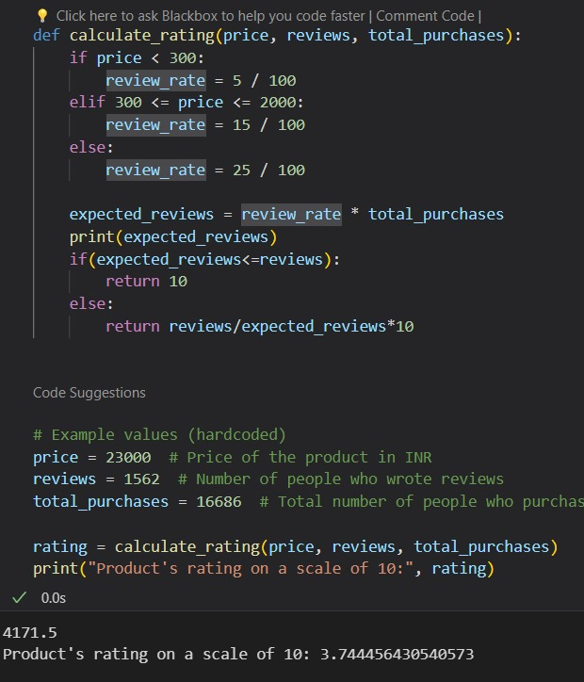
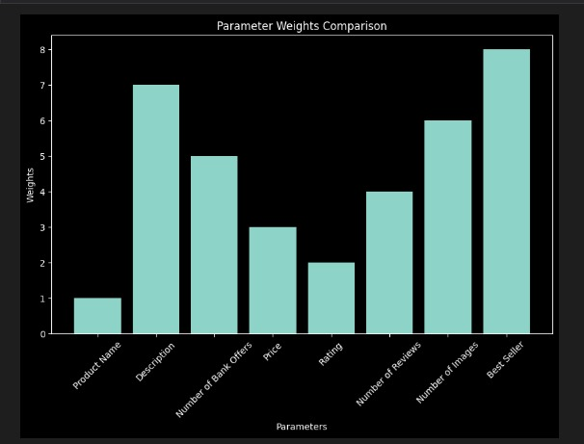
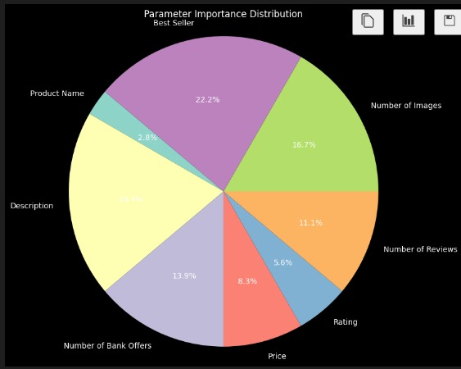
Test cases & data (as applicable) against which the eval criteria can be assessed
For low-value items (less than 300 INR): 5/100 user writes the review
For mid-value items (300 - 2000 INR): 15/100 user writes the review
For high-value items (greater than 2000 INR): 25/100 user writes the review
*You can make a copy of the slides. Do not change the template branding.

Slide 6


Demonstrate working of the solution to the evaluation team
1)Run the data extraction scriptby providing URL to get data in excel.
2)
Product Name: 8
Description: 7
Number of Bank Offers: 5
Price: 3
Rating: 2
Number of Reviews: 4
Number of Images: 6
Best Seller (Yes/No): 1
These weightages determine the contribution of each data field to the overall catalog score.
3) Get product score on scale of 10
4) We'll generate insights in a graphical format using the provided metrics weightage to visualize the importance of each data field.
*You can make a copy of the slides. Do not change the template branding.

Slide 7
Important Links:-
GitHub Public Repository Link
Link to test cases and data files
*You can make a copy of the slides. Do not change the template branding.

Slide 8


