Slide 1
CHATROOM
Team Lead: Vidushi Dhakar
Team members: Gazala Patwala
Yash Porwal
Institution: Techno India NJR

Slide 2
Project is an example of chat application which is basically based on private chATting. It is made up of two applications- 1.client application which runs on user’s pc. 2.server application which runs on any pc on the network. To start chatting client should be connected to server. What is chat application? chat may refer to any kind of communication over the Internet that offers a real-time transmission of text messages from sender to receiver. Online chat may refer to any kind of communication over the Internet that offers a real-time transmission of text messages from sender to receiver.
INTRODUCTION

Slide 3
LANGUAGES AND FRAMEWORKS
FRONTEND-
HTML
CSS
JAVASCRIPT
ANGUALR
BOOTSTRAP
DATABASE-
MOGODB
(ATLAS)
BACKEND-
JAVASCRIPT
TYPESCRIPT
AJAX
JQUERY
EXPRESS.JS
NODE.JS
SOCKET.IO

Slide 4
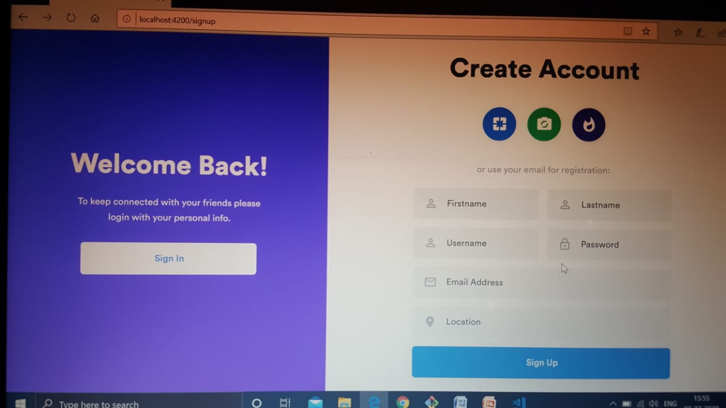
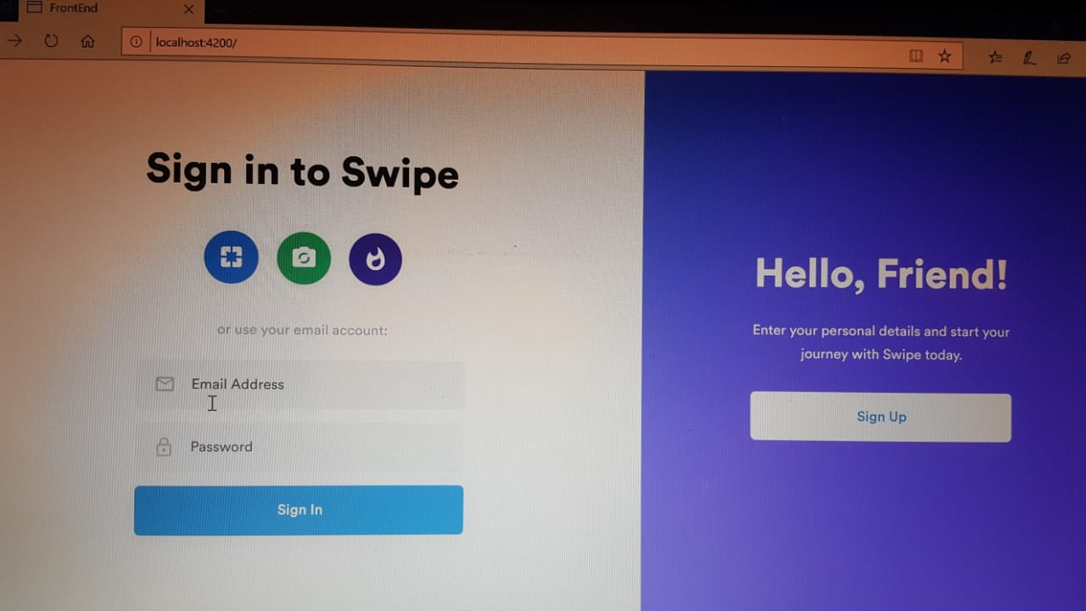
SIGN UP
SIGN IN

Slide 5
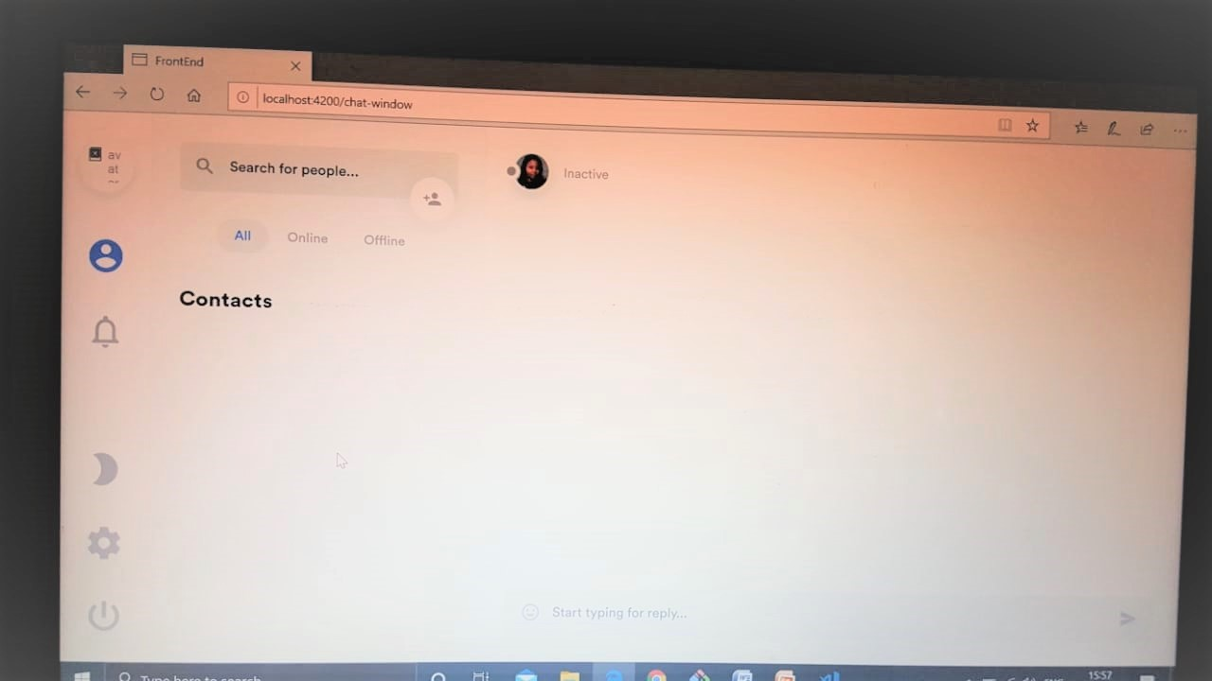
CHATWINDOW

Slide 6
FEATURES
CONTACTS :- ALL,ONLINE,OFFLINE,ADD FRIEND
NOTIFICATION
SETTINGS :- MY ACCOUNT
LOG OUT
CHAT PANNEL :- TEXT AREA,SEND BUTTON

Slide 7
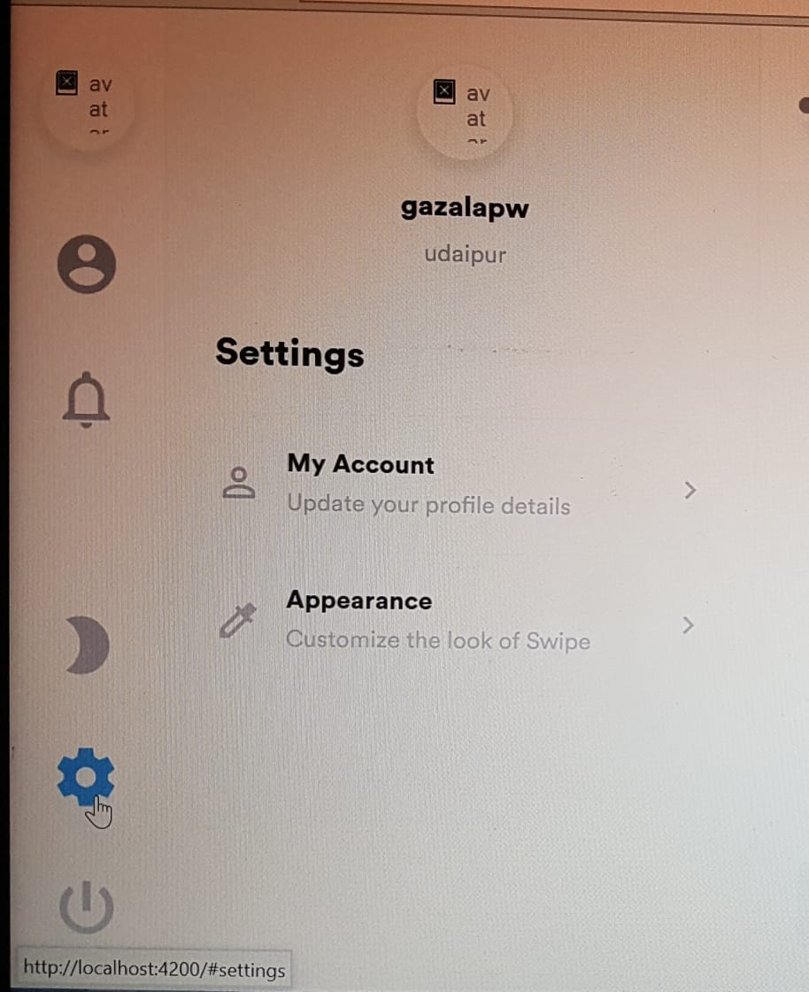
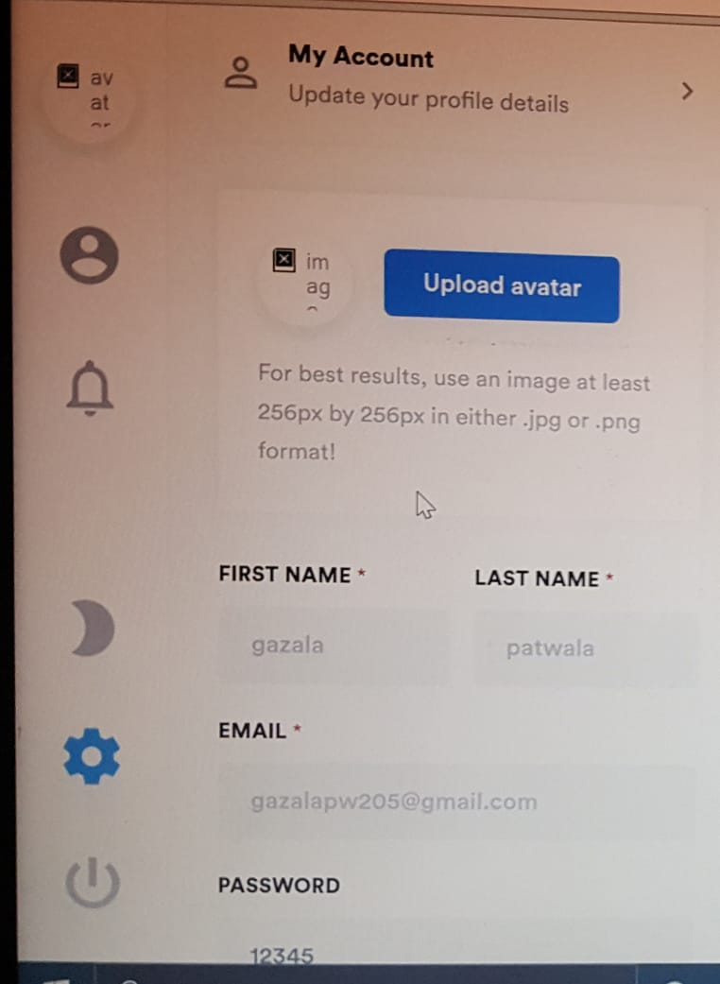
COMPONENTS IN CHATWINDOW
SETTINGS
MY ACCOUNT

Slide 8
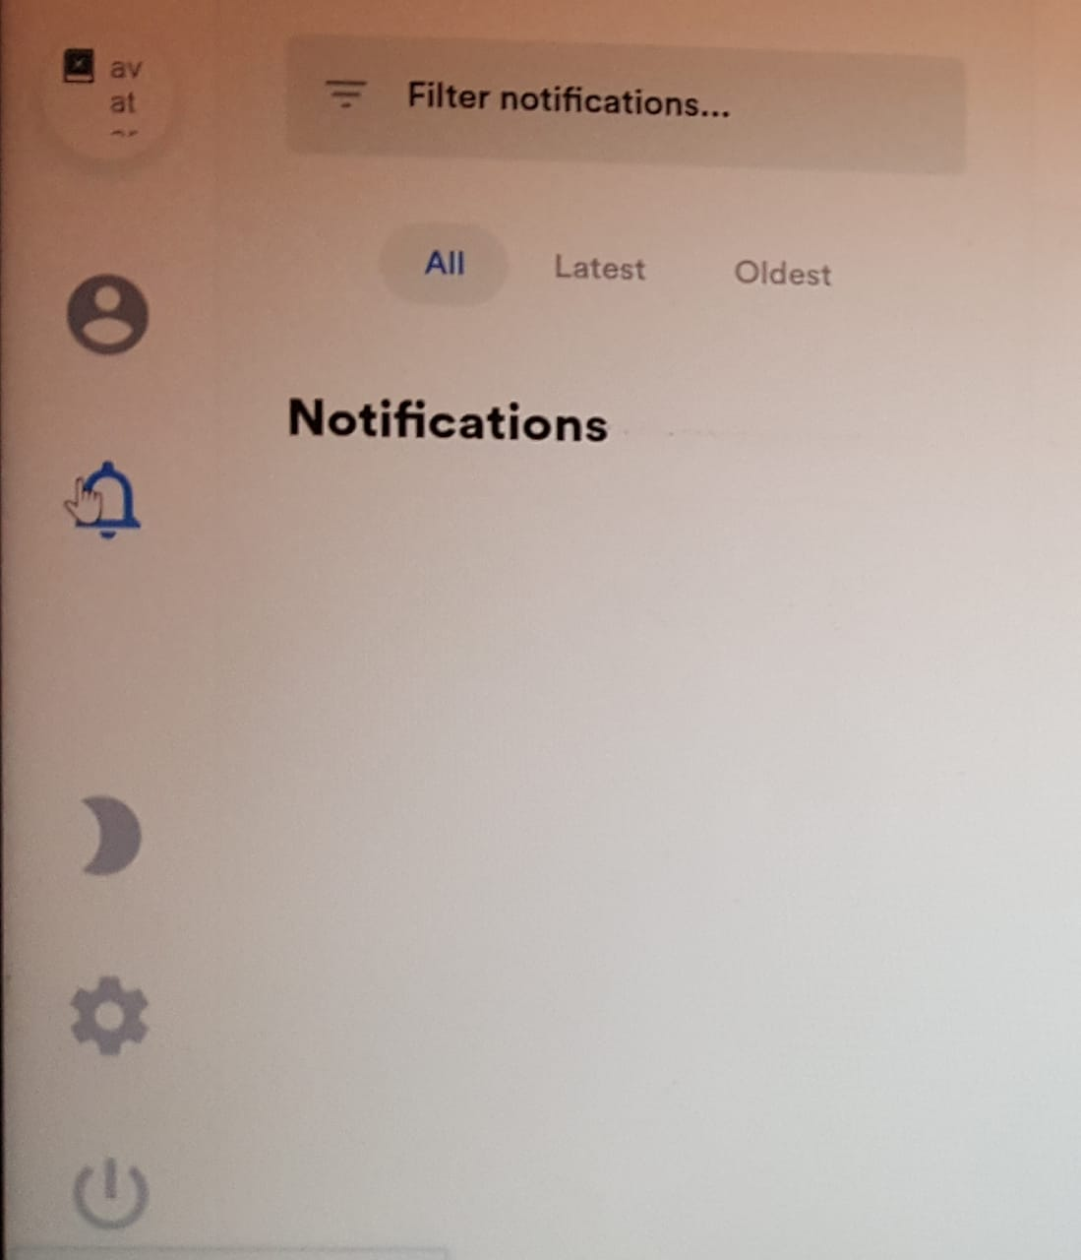
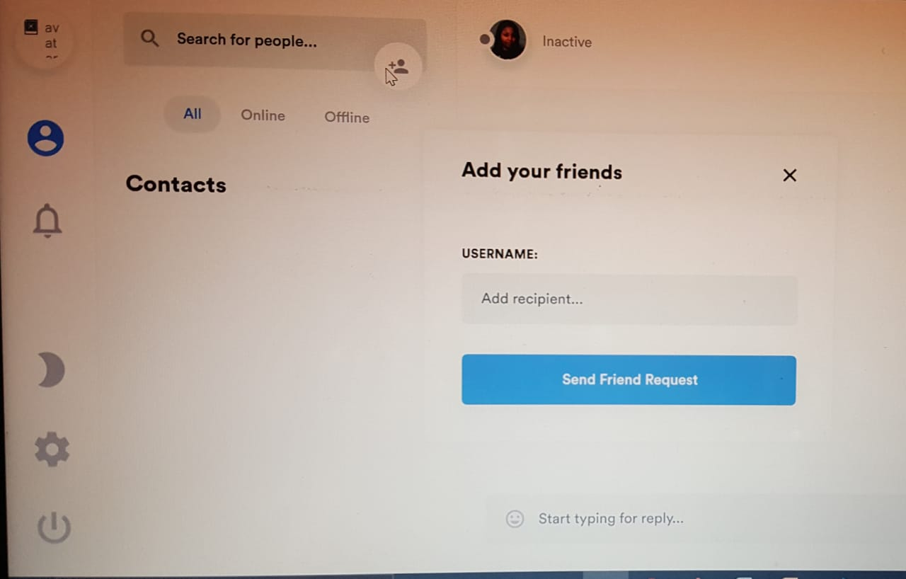
COMPONENTS IN CHATWINDOW
NOTIFICATION
ADD FRIEND

Slide 9
CONCLUSION
There is always a room for improvements in any software package,however good and efficient it may be done.But the most important thing should be flexible to accept further modifications. Right now we are just dealing with text communication. In future this software may be extended to include features such as-
FILE TRANSFER: This will enable the user to send files of different formats to other via the chat application.
VOICE CHAT: This will enhance the application to higher level where communication will be possible via voice calling as in telephone.
VIDEO CALL- Communication will be possible via video calling.

