Slide 1

BCSE206L FOUNDATIONS OF DATA SCIENCE

Slide 2
Module – 1
DATA SCIENCE CONTEXT
What is Data Science
Data Science Process
BI and Data Science
Tools and Skills

Slide 3
DATA SCIENCE CONTEXT
What is Data Science
Data Science Process
BI and Data Science
Tools and Skills

Slide 4
Outline
Data, Big Data and Challenges
Data Science
  Introduction
  Why Data Science
Data Scientists
  What do they do?
Major/Concentration in Data Science
  What courses to take.

Slide 5
Data Science
is a combination of multiple disciplines that uses statistics, data analysis, and machine learning to analyze data and to extract knowledge and insights from it.
  is about data gathering, analysis and decision-making.
  is about finding patterns in data, through analysis, and make future predictions.
By using Data Science, companies are able to make:
  Better decisions (should we choose A or B)
  Predictive analysis (what will happen next?)
  Pattern discoveries (find pattern, or maybe hidden information in the data)

Slide 6
What is Data Science?
An area that manages, manipulates, extracts, and interprets knowledge from tremendous amount of data
Data science (DS) is a multidisciplinary field of study with goal to address the challenges in big data
Data science principles apply to all data – big and small

Slide 7
What is Data Science?
Theories and techniques from many fields and disciplines are used to investigate and analyze a large amount of data to help decision makers in many industries such as science, engineering, economics, politics, finance, and education
  Computer Science
    Pattern recognition, visualization, data warehousing, High performance computing, Databases, AI
  Mathematics
    Mathematical Modeling
  Statistics
    Statistical and Stochastic modeling, Probability.

Slide 8
What To Do With These Data?
Aggregation and Statistics
  Data warehousing and OLAP
Indexing, Searching, and Querying
  Keyword based search
  Pattern matching (XML/RDF)
Knowledge discovery
  Data Mining
  Statistical Modeling

Slide 9
Data Science Relevant
Data Science is used in many industries in the world today, e.g. banking, consultancy, healthcare, and manufacturing.
  Examples of where Data Science is needed:
    For route planning: To discover the best routes to ship
    To foresee delays for flight/ship/train etc. (through predictive analysis)
    To create promotional offers
    To find the best suited time to deliver goods
    To forecast the next years revenue for a company
    To analyze health benefit of training
    To predict who will win elections

Slide 10
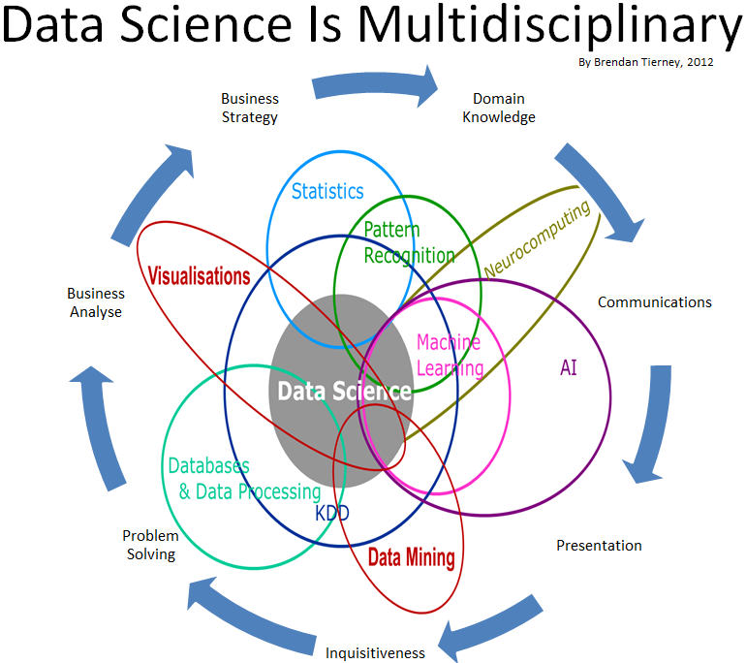
Data Science

Slide 11
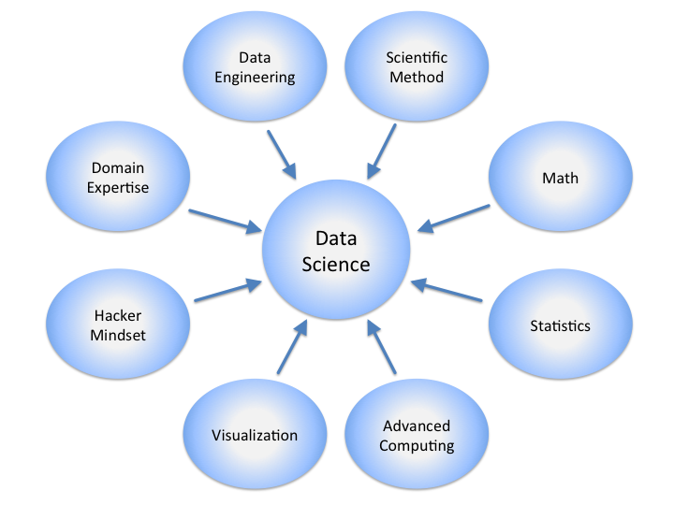
Data Science

Slide 12
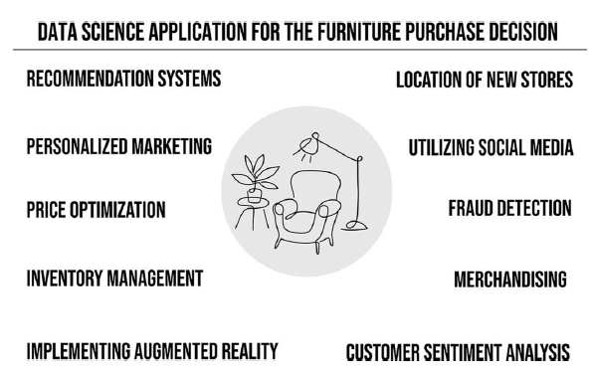
What is Data Science?
Data Science can be explained as the entire process of gathering actionable insights from raw data.
It combines math and statistics, specialized programming, advanced analytics, artificial intelligence (AI), and machine learning with specific subject matter expertise to uncover actionable insights hidden in an organization’s data.
These insights can be used to guide decision making and strategic planning.

Slide 13
Applications
Data Science can be applied in nearly every part of a business where data is available. Examples are:
  Consumer goods
  Stock markets
  Industry
  Politics
  Logistic companies
  E-commerce

Slide 14




Data All Around
Lots of data is being collected
and warehoused
  Web data, e-commerce
  Financial transactions, bank/credit transactions
  Online trading and purchasing
  Social Network

Slide 15
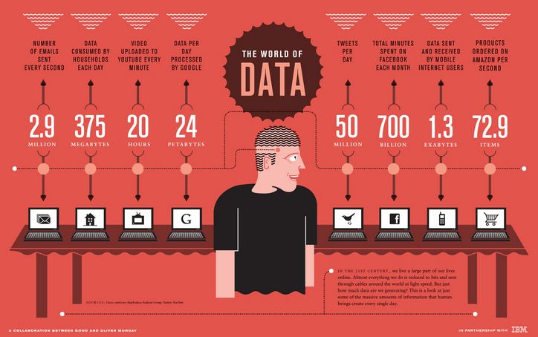
How Much Data Do We have?
Google processes 20 PB a day (2008)
Facebook has 60 TB of daily logs
eBay has 6.5 PB of user data + 50 TB/day (5/2009)
1000 genomes project: 200 TB
Cost of 1 TB of disk: $35
Time to read 1 TB disk: 3 hrs
(100 MB/s)

Slide 16
Big Data
  Big Data is any data that is expensive to manage and hard to extract value from
  Volume
    The size of the data
  Velocity
    The latency of data processing relative to the growing demand for interactivity
  Variety and Complexity
    the diversity of sources, formats, quality, structures.

Slide 17
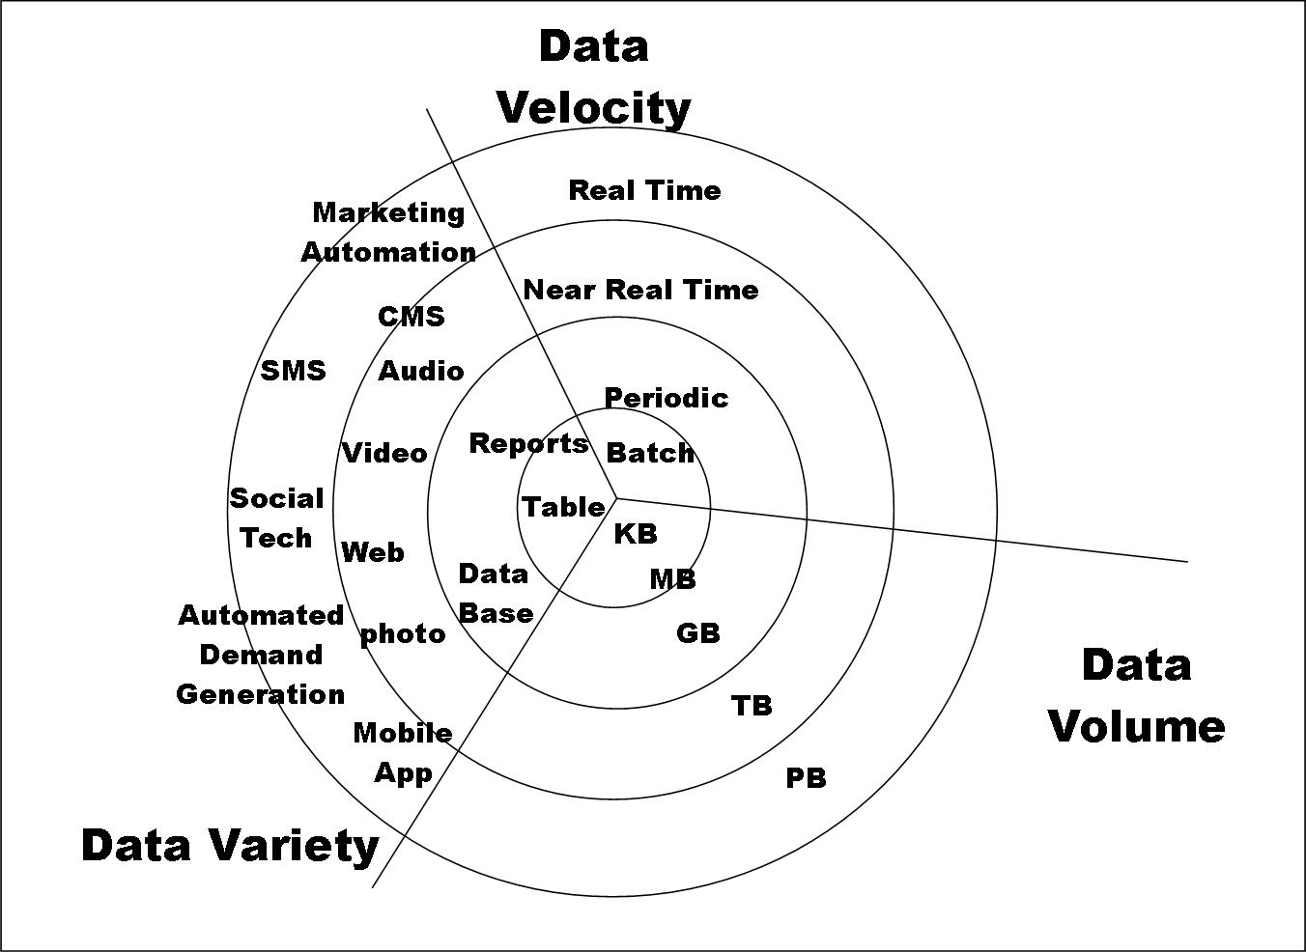
Big Data

Slide 18
Types of Data We Have
Relational Data (Tables/Transaction/Legacy Data)
Text Data (Web)
Semi-structured Data (XML)
Graph Data
Social Network, Semantic Web (RDF), …
Streaming Data
You can afford to scan the data once

Slide 19
Need for Data Science
Today lots of data are generated as we do our day-to-day activity via various electronic gadgets.
The problem is that we are not able to analyze due to inefficient scientific insights such as
  Sales forecasting for coming months / seasonal time / year
  Predict if person wearing a red shirt and have age between 25 and 30, will be interested in the product or not etc.
We are creating data, but we are not utilizing it for behavioral analysis or decision making or predictions.
Data Science helps in recognizing the process of data analysis, data patterns and behaviors patterns for increasing sale.

Slide 20
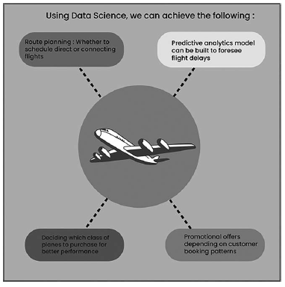
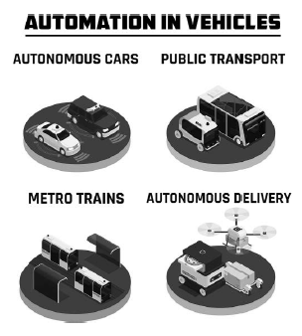
Need for Data Science
Data Science plays huge role in many applications such as :

Slide 21
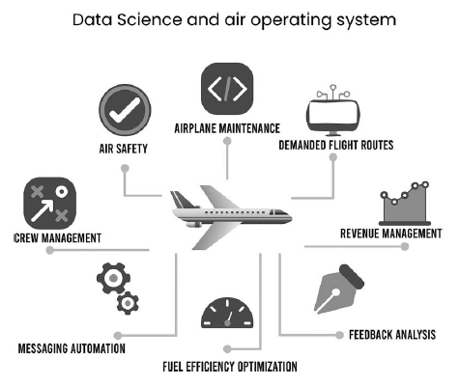
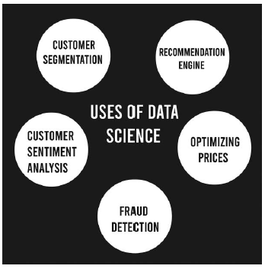
Need for Data Science
Data Science plays huge role in many applications such as :

Slide 22
Need for Data Science - DOMAINS
Lifestyle related (ex: alexa),
public spaces (ex: effective use of QR and sensing technology)
Uplifting of rural lifestyle by technology
Technical (industrial issues)
Robot Navigation
Route Finding
Climate change
Vision Intelligence
Healthcare / Medical Imaging / Internet of Medical Things
Social Network Analysis for Politics / Security / Violence etc.
Space / Defence
Remote Sensing
Animal Care

Slide 23
Need for Data Science - DOMAINS
Education
Automotive
Women / Child
Smart Agriculture
Sports
Security / Fraud Detection
Pollution (Ocean Clean up, Garbage Management)
Neuroscience / genetics (Dementia or Alzheimer / Brain decoding)
Natural Calamities
Device Management / Machine Translation
Next generation Drug Development (cancer / obesity / heart disease etc.)

Slide 24
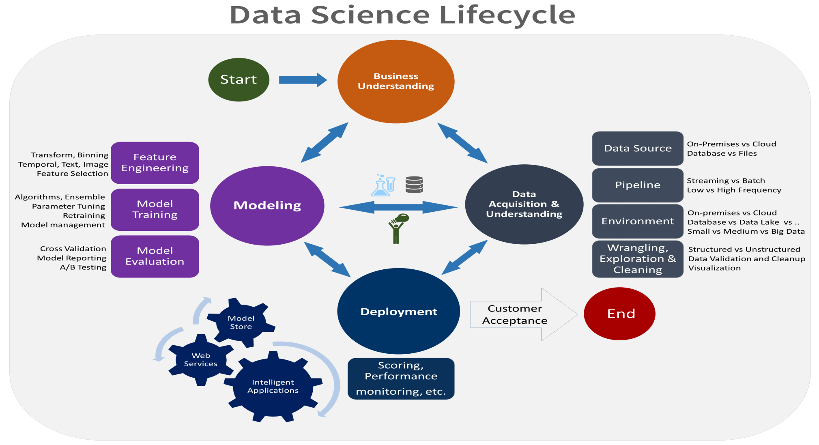
Data Science Life Cycle / Process
The data science lifecycle outlines the complete steps that successful data science projects follow.

Slide 25
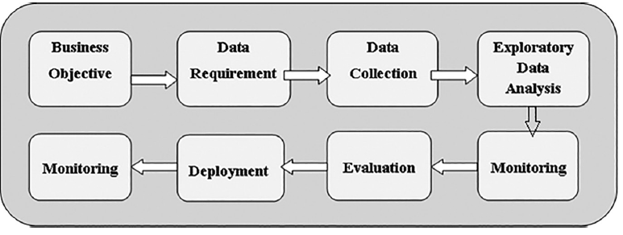
Data Science Life Cycle / Process
There are various steps in data science.
The first step is asking the right question and exploring the data. You must know exactly the problem that needs to be solved. The problem can be understood by asking the right questions.
As per the available data for input, the data may be incomplete for which, exploratory analysis can be done. Or data cleansing can be done on raw data for accurate data input which is a part of exploratory analysis. Then, you need to do modeling.

Slide 26
Data Science Life Cycle / Process
Let us say that if you have to perform machine learning, you need to decide which algorithm to use, and through which model, and then you need to train the model accordingly.
This is the modeling process, which then runs your data through the model.
Then through this process, you come out to the final results of this exercise which includes visualizing the results and preparing a way to communicate the results to the people concerned.

Slide 27
Business Intelligence and Data Science
Business intelligence is one of the initial phases where people want to make some sense out of data.
Earlier the manufacturing and selling was managed through enterprise resource planning ERP system or customer relation-ship management (CRM) systems.
For creating business intelligence through data science, structured data were used.
The ERP or CRM system works on relational data-base system, RDBMS such as Oracle, SQL and MySQL which use structured data inputs.

Slide 28
Business Intelligence vs. Data Science
The business intelligence uses structured data that reports on dashboards. Data science in addition to structured data also uses a lot of unstructured data, for example, Web or comments.
  If we are talking about customer feedback, it may be structured if gathered in formatted rubrics or may be unstructured if scripted for performance analysis. That is, data sources may be in different formats.
Business intelligence is analytical in the sense that you have some data, and you are just trying to present the truth out of it. In the case of data science, we go beyond that.

Slide 29
Business Intelligence vs. Data Science
Business intelligence uses many statistics such as correlations and regressions to predict what will be the sales maybe in the future. In the case of data science, skills are many more as compared to business intelligence.
The focus of business intelligence is pretty much on historical data. In data science, you take historical data, but you also combine it with some other required information and you also try to predict the future.

Slide 30
Data Scientist
A Data Scientist requires expertise in several backgrounds:
  Machine Learning
  Statistics
  Programming (Python or R)
  Mathematics
  Databases

Slide 31
Data Scientist role
A Data Scientist must find patterns within the data. Before he/she can find the patterns, he/she must organize the data in a standard format.
  Here is how a Data Scientist works:
  Ask the right questions - To understand the business problem.
  Explore and collect data - From database, web logs, customer feedback, etc.
  Extract the data - Transform the data to a standardized format.
  Clean the data - Remove erroneous values from the data.
  Find and replace missing values - Check for missing values and replace them with a suitable value (e.g. an average value).
  Normalize data - Scale the values in a practical range (e.g. 140 cm is smaller than 1,8 m. However, the number 140 is larger than 1,8. - so scaling is important).
  Analyze data, find patterns and make future predictions.
  Represent the result - Present the result with useful insights in a way the "company" can understand.

Slide 32
Concentration in Data Science
Mathematics and Applied Mathematics
Applied Statistics/Data Analysis
Solid Programming Skills (R, Python, Julia, SQL)
Data Mining
Data Base Storage and Management
Machine Learning and discovery

Slide 33

Data Scientists
Data scientists are the key to realizing the opportunities presented by big data. They bring structure to it, find compelling patterns in it, and advise executives on the implications for products, processes, and decisions

Slide 34
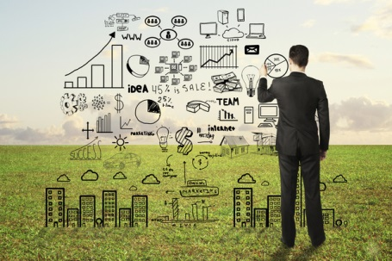
Data Scientists
Data Scientist
  The Sexiest Job of the 21st Century
They find stories, extract knowledge. They are not reporters

Slide 35
What do Data Scientists do?
National Security
Cyber Security
Business Analytics
Engineering
Healthcare
And more ….

Slide 36
Prerequisites for a Data Scientist
There’s a joke that says a data scientist is someone who knows more statistics than a computer scientist and more computer science than a statistician.
Typically a data scientist is given a problem, i.e., business problem, and he needs to solve it. To do that, he asks the question as to what is the problem that needs to be solved, which is the first thing he gets from a problem.
The next thing is to gather the data that is required to solve the problem, so he searches for data from anywhere. In the enterprise, very often the data is not provided in the structured format that he would like to have.

Slide 37
Prerequisites for a Data Scientist
The first step is to get possible raw data in any format. The data may be enterprise data or public data. The raw data collected and converted into required format for analysis.
The cleaned and formatted data used as an input to statistical model through machine learning mechanisms for communicating analytics results to stakeholders.
The role of data scientist is to gather data, process data in required format, manipulates as per requirements and feed for analysis.
The analysis helps to build mathematical models or machine learning models which are used to present system behavior to concern stake-holders.
This is the very high-level view of a day in the life of a data scientist.

Slide 38

Prerequisites for a Data Scientist
There are three essential things required to be a data scientist.
  Curiosity.
  Common sense
  Communication skills
Curiosity: The first step in data science is asking the question what is the problem you are trying to solve; if you ask the right question, then you will get the right answer. This is very crucial step, since it directly impact on project success.
Common Sense: The data scientist needs to be creative in solving problems at hand. In many cases, you may not have sufficient data to conclude; hence, you need to fulfil this gap intelligently.

Slide 39
Prerequisites for a Data Scientist
Communication Skills: After doing all the analysis, if you are unable to communicate the results in the right way, the whole exercise will fail. Communication is the key trait for data scientists. You may be technically brilliant, but if you are unable to communicate the result in the proper way, it will not help.

Slide 40
Components of Data Science
The different components for data science are as follows:
  Machine Learning – Machine learning is the backbone of data science. Data science involves quite a bit of learning the basics of statistics to design a learning algorithm.
  Modeling – Modeling is also a part of machine learning in a way, but you need to be good at identifying what are the algorithms that are more suitable to solve the given problems, which model can be used, and how to train this model.
  Statistics and Probabilities – The statistics and probabilities are like the core foundation of data science. The data scientist must be prominent in statistics and probability theories, so that he can formulate the problems for processing the required results.

Slide 41
Components of Data Science
The different components for data science are as follows:
  Programming Language - For the data science projects, basic programming skills and some fundamental knowledge of databases is required. The most common program-ming languages are Python, R, MATLAB, and Octave. In particular, Python is becoming a very popular programming language in data science because of its ease of learning and the multiple libraries that it supports.
  Database - fundamentals of database is another important aspect to learn for handling databases and extract required information from raw data.

Slide 42
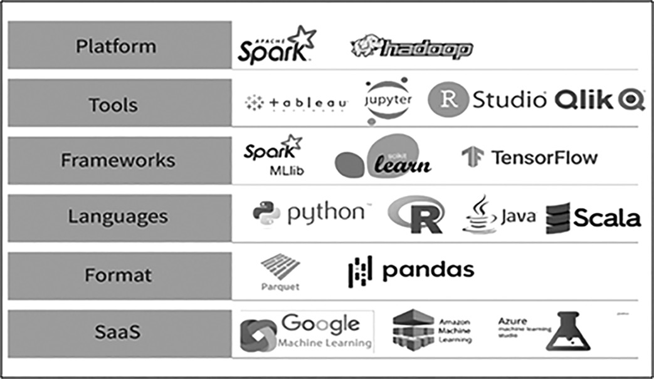
Tools and Skills

Slide 43
Sample Public Data repositories
Awesome Public Datasets
Data World
Google Data Set Search
Kaggle
UCI Machine Learning Repository
United States Government
IEEE DataPort , etc….

Slide 44
Thank You for Your Attention !

