Slide 1
Operating Systems: Threads
Ravi Prakash

Slide 2
Motivation
Most modern applications consist of concurrent tasks
Multiple tasks within the application can be implemented by separate threads
Process creation is heavy-weight while thread creation is light-weight
Can simplify code, increase efficiency
Kernels are generally multithreaded

Slide 3
Benefits
Responsiveness – may allow continued execution if part of process is blocked,
Resource Sharing – threads share resources of process, easier than shared memory or message passing
Economy – cheaper than process creation, thread switching lower overhead than context switching
Scalability – process can take advantage of multiprocessor architectures

Slide 4
Multicore Programming
Multicore or multiprocessor systems putting pressure on programmers
Parallelism: a system can perform more than one task simultaneously
Data parallelism – distributes subsets of the same data across multiple cores, same operation on each
Task parallelism – distributing threads across cores, each thread performing unique operation
Concurrency supports more than one task making progress
Single processor / core, scheduler providing concurrency

Slide 5
Concurrency vs. Parallelism
Concurrent execution on single-core system:
Parallelism on a multi-core system:

Slide 6
Single and Multithreaded Processes

Slide 7
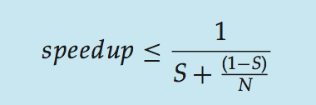
Amdahl’s Law
Consider an application that has both serial and parallel components
S is serial portion
N processing cores
That is, if application is 75% parallel / 25% serial, moving from 1 to 2 cores results in speedup of 1.6 times
As N approaches infinity, speedup approaches 1 / S
Serial portion of an application has disproportionate effect on performance gained by adding additional cores
But does the law take into account contemporary multicore systems?

Slide 10
User Threads and Kernel Threads
User threads - management done by user-level threads library
Three primary thread libraries:
POSIX Pthreads
Windows threads
Java threads
Kernel threads - Supported by the Kernel
Examples – virtually all general purpose operating systems, including:
Windows
Solaris
Linux
Tru64 UNIX
Mac OS X

Slide 11
Many-to-One
Many user-level threads mapped to single kernel thread
One thread blocking causes all to block
Multiple threads may not run in parallel on muticore system because only one may be in kernel at a time
Few systems currently use this model
Examples:
Solaris Green Threads
GNU Portable Threads

Slide 12
One-to-One
Each user-level thread maps to kernel thread
Creating a user-level thread creates a kernel thread
More concurrency than many-to-one
Number of threads per process sometimes restricted due to overhead
Examples
Windows
Linux
Solaris 9 and later

Slide 13
Two-level Model
Similar to M:M, except that it allows a user thread to be bound to kernel thread
Examples
IRIX
HP-UX
Tru64 UNIX
Solaris 8 and earlier

Slide 14
Implicit Threading
Growing in popularity as numbers of threads increase, program correctness more difficult with explicit threads
Creation and management of threads done by compilers and run-time libraries rather than programmers
Three methods explored
Thread Pools
OpenMP
Grand Central Dispatch: Apple
Other methods include Microsoft Threading Building Blocks (TBB), java.util.concurrent package

Slide 15
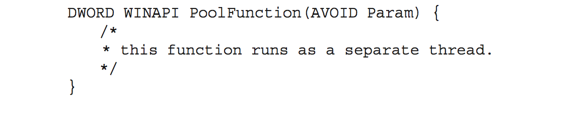
Thread Pools
Create a number of threads in a pool where they await work
Advantages:
Usually slightly faster to service a request with an existing thread than create a new thread
Allows the number of threads in the application(s) to be bound to the size of the pool
Separating task to be performed from mechanics of creating task allows different strategies for running task
Tasks could be scheduled to run periodically
Windows API supports thread pools:

Slide 16
Semantics of fork() and exec()
Does fork()duplicate only the calling thread or all threads?
Some UNIXes have two versions of fork
exec() usually works as normal – replace the running process including all threads

Slide 17
Signal Handling
Signals are used in UNIX systems to notify a process that a particular event has occurred.
A signal handler is used to process signals
Signal is generated by particular event
Signal is delivered to a process
Signal is handled by one of two signal handlers:
default
user-defined
Every signal has default handler that kernel runs when handling signal
User-defined signal handler can override default
For single-threaded, signal delivered to process

Slide 18
Signal Handling (Cont.)
Where should a signal be delivered for multi-threaded?
To the thread to which the signal applies
To every thread in the process
To certain threads in the process
Assign a specific thread to receive all signals for the process

Slide 19
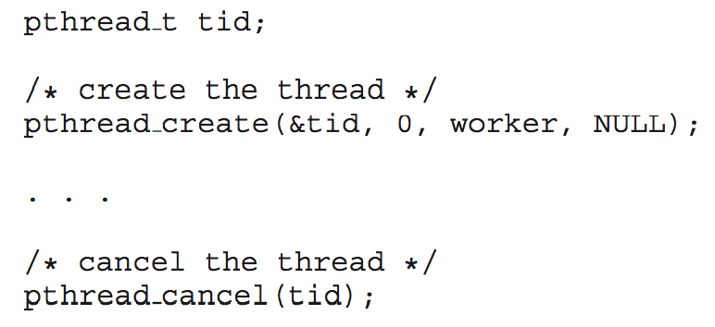
Thread Cancellation
Terminating a thread before it has finished
Thread to be canceled is target thread
Two general approaches:
Asynchronous cancellation terminates the target thread immediately
Deferred cancellation allows the target thread to periodically check if it should be cancelled
Pthread code to create and cancel a thread:

Slide 20
Linux Threads
Linux refers to them as tasks rather than threads
Thread creation is done through clone() system call
clone() allows a child task to share the address space of the parent task (process)
Flags control behavior
struct task_struct points to process data structures (shared or unique)

