Slide 1
Distributed Computing
Definition
A distributed system is a software system in which components located on networked computers communicate and coordinate their actions by passing messages. The components interact with each other in order to achieve a common goal.
Distributed Computing Principles
A distributed system consists of a collection of autonomous computers, connected through a network and distribution middleware, which enables computers to coordinate their activities and to share the resources of the system, so that users perceive the system as a single, integrated computing facility.

Slide 2
Centralized System Characteristics
One component with non-autonomous parts
Component shared by users all the time
All resources accessible
Software runs in a single process
Single Point of control
Single Point of failure
Distributed System
Characteristics
Multiple autonomous components
Components are not shared by all users
Resources may not be accessible
Software runs in concurrent processes on different processors
Multiple Points of control
Multiple Points of failure

Slide 3
Examples of distributed systems
Examples of distributed systems and applications of distributed computing include the following:
Telecommunication networks
Telephone networks and cellular networks
Computer networks such as the Internet
Wireless sensor networks
Routing algorithms

Slide 4
Distributed Systems Vs Network of Computers
A Computer network is an interconnected collection of many autonomous computers able to exchange information.
Computer network usually require users to explicitly login onto one machine, explicitly submit jobs remotely, explicitly move files or data around the network.
Distributed Systems , The existence of multiple autonomous computers in a computer network is transparent to the user.
The OS automatically allocates jobs to processors, moves files between various computers without explicit user intervention.

Slide 5
Resource Sharing
For example, users are concerned with sharing data in the form of a shared database or a set of web pages – not the disks and processors on which they are implemented.
In term service for a distinct part of a computer system that manages a collection of related resources and presents their functionality to users and applications.
File services
Client processes
Server processes
Web Browser ex: client
Search Engine ex: Client /Server

Slide 6
Challenges in Distributed Computing
Heterogeneity
Scalability
Openness
Security
Failure Handling
Concurrency
Transparency

Slide 7
Heterogeneity
Heterogeneous applies to the architectures, models, systems, and applications that comprise substantively different components, as well as to techniques and methodologies
That is, variety and difference applies to all of the following networks; computer hardware; operating systems; programming languages; implementations by different developers.
Ex: the calls for exchanging messages in UNIX are different from the calls in Windows.
The Middleware layer provides a programming abstraction as well as masking the heterogeneity. RMI, CORBA etc.

Slide 8
Openness
Openness is concerned with extensions and improvements of distributed systems.
It determines whether the system can be extended and reimplemented in various ways.
The openness of distributed systems is determined primarily by the degree to which new resource-sharing services can be added and be made available for use by a variety of client programs
New components have to be integrated with existing components.
Differences in data representation of interface types on different processors (of different vendors) have to be resolved.

Slide 9
Concurrency
Components in distributed systems are executed in concurrent processes.
Components access and update shared resources (e.g. variables, databases, device drivers).
Integrity of the system may be violated if concurrent updates are not coordinated.
Lost updates

Slide 10
Scalability
Adaption of distributed systems to accommodate more users
Respond faster (this is the hard one)
Usually done by adding more and/or faster processors.
Components should not need to be changed when scale of a system increases.
Design components to be scalable

Slide 11
Fault Tolerance
Hardware, software and networks fail!
Distributed systems must maintain availability even at low levels of hardware/software/network reliability.
Fault tolerance is achieved by
    Recovery
    Redundancy
Transparency
Distributed systems should be perceived by users and application programmers as a whole rather than as a collection of cooperating components.

Slide 12
Transparencies
Access transparency: enables local and remote resources to be accessed using identical operations.
Location transparency: enables resources to be accessed without knowledge of their physical or network location (for example, which building or IP address).
Concurrency transparency: enables several processes to operate concurrently using shared resources without interference between them.
Replication transparency: enables multiple instances of resources to be used to increase reliability and performance without knowledge of the replicas by users or application programmers.

Slide 13
Failure transparency: enables the concealment of faults, allowing users and application programs to complete their tasks despite the failure of hardware or software components.
Mobility transparency: allows the movement of resources and clients within a system without affecting the operation of users or programs.
Performance transparency: allows the system to be reconfigured to improve performance
as loads vary.
Scaling transparency: allows the system and applications to expand in scale without change to the system structure or the application algorithms.

Slide 14
Access Transparency, Location Transparency
Enables local and remote information objects to be accessed using identical operations.
o Example: File system operations in NFS.
o Example: Navigation in the Web.
o Example: SQL Queries
Enables information objects to be accessed without knowledge of their location.
o Example: File system operations in NFS
o Example: Pages in the Web
o Example: Tables in distributed databases

Slide 15
Access Transparency:
Access transparency hides differences in data representation and invocation mechanisms, allowing users to access resources without knowing the specifics of their location or technology.
Example: A file stored on a remote server can be accessed by a user using the same commands as if the file were stored on their local machine. Network File System (NFS) and Windows Distributed File System (DFS) achieve this by providing a unified file access interface.

Slide 16
Location Transparency:
Location transparency hides the physical location of a resource from users and applications, making it appear as if all resources are located locally.
Example: A user in New York can access a database server located in London without knowing the server's actual location. The distributed database system routes the requests to the appropriate server, providing the illusion that the database is local.

Slide 17
Migration Transparency:
Migration transparency allows resources to move from one location to another without affecting the operation of the system or the users.
Example: Virtual machines (VMs) in a cloud environment can be migrated from one physical server to another for load balancing or maintenance. Users accessing the services hosted on the VMs experience no disruption or change in performance during the migration.

Slide 18
Replication Transparency:
Replication transparency hides the replication of resources from users, allowing multiple copies of resources to exist without users being aware of the replication process.
Example: A web application might replicate its data across multiple servers to ensure high availability and fault tolerance. Users accessing the application do not need to know which server they are connected to, as the system handles replication and consistency behind the scenes.

Slide 19
Failure Transparency:
Failure transparency enables a system to continue functioning correctly even in the presence of hardware or software failures, making these failures invisible to users.
Example: In a distributed e-commerce system, if one of the servers handling transactions fails, another server takes over without the user's transaction being interrupted or lost. The system employs failover mechanisms and redundancy to maintain service continuity.

Slide 20
Concurrency Transparency
Enables several processes to operate concurrently using shared information objects without interference between them.
o Example: NFS
o Example: Automatic teller machine network
o Example: Database management system

Slide 21
Replication Transparency
Enables multiple instances of information objects to be used to increase reliability and performance without knowledge of the replicas by users or application programs
o Example: Distributed DBMS
o Example: Mirroring Web Pages.
Failure Transparency
o Enables the concealment of faults
o Allows users and applications to complete their tasks despite the failure of other components.
o Example: Database Management System

Slide 22
Performance Transparency
Allows the system to be reconfigured to improve performance as loads vary.
Example: Distributed make.
Scaling Transparency
Allows the system and applications to expand in scale without change to the system structure or the application algorithms.
o Example: World-Wide-Web
o Example: Distributed Database

Slide 23
Goals of Distributed Systems
Transparency:
  Access, Location, Migration, Replication, Concurrency, and Failure.
Scalability:
  Handle increased load by adding resources.
Fault Tolerance:.
  System continuity despite component failures

Slide 24
Challenges in Distributed Systems
Heterogeneity:
  Diverse hardware, software, and networks.
Security:
  Protecting data and communication.
Synchronization:
  Consistency in the presence of delays.
Fault Handling:
  Detecting, recovering, and masking faults.

Slide 25
Largest and most complex distributed systems
Google applications and services such as Google Earth
Highlights of this infrastructure include:
An underlying physical infrastructure consisting of very large numbers of networked computers located at data centres all around the world;
A distributed file system designed to support very large files and heavily optimized for the style of usage required by search and other Google applications (especially reading from files at high and sustained rates);

Slide 26
Significant consequences in DC
1. Concurrency:
In a network of computers, concurrent program execution is the norm.
2. No global clock:
When programs need to cooperate they coordinate their actions by exchanging messages. Close coordination often depends on a shared idea of the time at which the programs’ actions occur
3. Independent failures:
All computer systems can fail, and it is the responsibility of system designers to plan for the consequences of possible failures.

Slide 27
The key trends in distributed computing
1. High-Speed and Advanced Networking Technologies The foundation of any distributed system is its network. Trends here focus on increasing bandwidth, reducing latency, and improving network intelligence:
• 5G and Beyond (6G): The widespread rollout of 5G provides significantly faster speeds, lower latency, and greater capacity, which are critical for distributed applications, especially those involving mobile devices, IoT, and real-time data processing at the edge. Future generations like 6G promise even more transformative capabilities.
• Optical Networks: Increased use of fiber optics provides higher bandwidth and lower latency compared to traditional copper cables, essential for interconnecting large data centers and geographically dispersed distributed systems.

Slide 28
• Software-Defined Networking (SDN) and Network Function Virtualization (NFV): ◦ SDN decouples the network control plane from the data plane, allowing for flexible, programmable, and centralized management of network configurations. This enables dynamic adjustments based on traffic demands and optimizes routing and resource allocation in distributed environments. ◦ NFV virtualizes network services (like firewalls, load balancers) to run on standard hardware, making network function deployment more flexible, costeffective, and scalable within distributed systems,
2. Edge Computing and IoT Networking • Distributed Processing at the Edge: The massive influx of data from IoT devices necessitates processing closer to the data source. Edge computing relies on robust, low-latency networking to connect these devices to local processing units and, when necessary, back to centralized cloud resources. • Real-time Communication: For applications like autonomous vehicles, industrial automation, and smart city infrastructure, networking at the edge must support ultra-low latency and high reliability to enable real-time decision-making and control.

Slide 29
• Fog Computing: An extension of edge computing, fog computing acts as an intermediary layer between edge devices and the cloud, providing localized processing, storage, and networking services to further reduce latency and optimize data flow.
3. Network Automation and AI/ML for Network Management
• Intelligent Networks: AI and Machine Learning are increasingly being integrated into network management to automate tasks, predict failures, optimize performance, and enhance security. This includes AIOps (Artificial Intelligence for IT Operations) for proactive monitoring and self-healing networks.
• Intent-Based Networking (IBN): This is a more advanced form of SDN where network administrators define their desired business outcomes (intent), and the network automatically configures itself to achieve those goals, continually monitoring and adapting.
• Network as a Service (NaaS): This trend involves consuming networking capabilities as a cloud service, abstracting away the underlying infrastructure management. This provides organizations with flexible, subscription-based networking solutions that can scale on demand

Slide 30
4. Enhanced Network Security in Distributed Environments
•Zero Trust Networking: As distributed systems expand, traditional perimeter-based security models are insufficient. Zero Trust mandates strict identity verification and continuous monitoring for every user and device attempting to access resources, regardless of their location.
• Secure Access Service Edge (SASE): SASE converges networking and security functions into a single, cloud-native service. It provides secure access to distributed resources for remote workforces and cloud applications, moving security closer to the user and the data.
•Advanced Threat Detection: AI and ML are being used to analyze network traffic patterns and identify anomalies that could indicate cyber threats in real-time across distributed infrastructures.

Slide 31
5. Quantum Networking
•Ultra-Secure Communication: While still largely in research, quantum networking aims to leverage quantum mechanics principles (like entanglement) to enable inherently secure communication channels, potentially resistant to even future quantum computer attacks.
•Distributed Quantum Computing: As quantum computers become more powerful, networking will be crucial to interconnect them, forming distributed quantum systems that can tackle even more complex problems

Slide 32
Distributed Systems Models
Systems Models
Physical Model
Architectural Model
Fundamental Model

Slide 33
Physical models
Physical models consider the types of computers and devices that constitute a system and their interconnectivity, without details of specific technologies.
Architectural models describe a system in terms of the computational and communication tasks performed by its computational elements and the computational elements being individual computers or aggregates of them supported by appropriate network interconnections. Client-server and peer-to-peer are two of the most commonly used forms of architectural model for distributed systems.

Slide 34
3.Functional models take an abstract perspective in order to describe solutions to individual issues faced by most distributed systems. the computational elements being individual computers or aggregates of them supported by appropriate network interconnections.
The interaction model deals with performance and with the difficulty of setting time limits in a distributed system, for example for message delivery.
The failure model attempts to give a precise specification of the faults that can be exhibited by processes and communication channels. It defines reliable communication and correct processes.
The security model discusses the possible threats to processes and communication channels. It introduces the concept of a secure channel, which is secure against those threats.
priate network interconnections

Slide 35
Physical models
Physical models are the most explicit way in which to describe a system; they capture the hardware composition of a system in terms of the computers (and other devices, such as mobile phones) and their interconnecting networks.
A physical model is a representation of the underlying hardware elements of a distributed system that abstracts away from specific details of the computer and networking technologies employed
Baseline physical model
Early distributed systems
Internet-scale distributed systems
Contemporary distributed systems

Slide 36
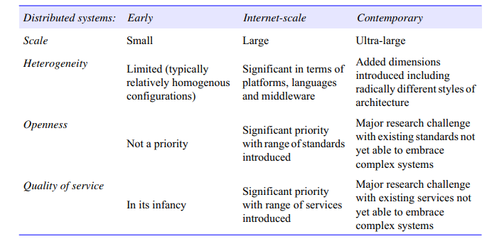
Significant challenges associated with Contemporary Distributed systems

Slide 37
Architectural Models
The architecture of a system is its structure in terms of separately specified components and their interrelationships.
The overall goal is to ensure that the structure will meet present and likely future demands on it.
Major concerns are to make the system reliable, manageable, adaptable and cost-effective.
The architectural design of a building has similar aspects – it determines not only its appearance but also its general structure and architectural style (gothic, neo-classical, modern) and provides a consistent frame of reference for the designHow do they communicate, or, more specifically, what communication paradigm is used?
Communication paradigms
• How entities communicate in a distributed system, and consider three types of communication paradigm:
Interposes communication;
Remote invocation;
Indirect communication.

Slide 38
Communicating entities
In distributed object-based approaches, a computation consists of a number of interacting objects representing natural units of decomposition for the given problem domain.
Objects are accessed via interfaces, with an associated interface definition language (or IDL) providing a specification of the methods defined on an object. Distributed objects have become a major area of study in distributed systems.
Component-based middleware often provides additional support for key areas such as deployment and support for server-side programming.

Slide 39
Interfaces in Programming Languages
Current PL allow programs to be developed as a set of modules that communicate with each other.
A specified interface can be implemented by different modules without the need to modify other modules using the interface
Interfaces in Distributed Systems – When modules are in different processes or on different hosts there are limitations on the interactions that can occur.
Only actions with parameters that are fully specified and understood can communicate effectively to request or provide services to modules in another process

Slide 40
Ctd.
A service interface allows a client to request and a server to provide particular services – A remote interface allows objects to be passed as arguments to and results from distributed modules
Object Interfaces
An interface defines the signatures of a set of methods, including arguments, argument types, return values and exceptions. Implementation details are not included in an interface.
A class may implement an interface by specifying behavior for each method in the interface. Interfaces do not have constructors.

Slide 41
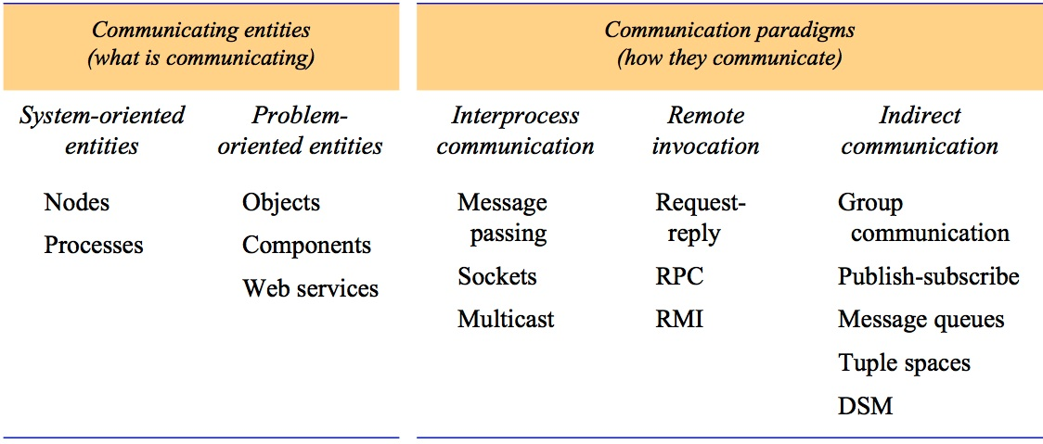
Communicating entities and communication paradigms
Instructor’s Guide for Coulouris, Dollimore, Kindberg and Blair, Distributed Systems: Concepts and Design Edn. 5
© Pearson Education 2012

Slide 42
Architectural Elements and Communicating Paradigms
Elements
Objects
Components
Web services
Communicating paradigms
Inter process Communication IPC
Remote invocation RI
Indirect Communication

Slide 43
IPC
Inter process communication refers to the relatively low-level support for communication between processes in distributed systems,
Including message-passing primitives,
Direct access to the API offered by Internet protocols (socket programming)
Support for multicast communication.

Slide 44
Remote Invocation
Remote invocation represents the most common communication paradigm in distributed systems,
Covering a range of techniques based on a
Two-way exchange between communicating entities in a distributed system and resulting in the calling of a remote operation, procedure or method,

Slide 45
Remote method invocation:
Remote method invocation (RMI) strongly resembles remote procedure calls but in a world of distributed objects.
With this approach, a calling object can invoke a method in a remote object.
As with RPC, the underlying details are generally hidden from the user.
RMI implementations may, though, go further by supporting object identity and the associated ability to pass object identifiers as parameters in remote calls

Slide 46
Preferred Distributed Communication
Remote procedure calls
RPC works is that a sender or client creates a request in the form of a procedure, function or method call to a remote server, which RPC translates and sends.
When the remote server receives the request, it sends a response back to the client and the application continues its process.
When the server processes the call or request, the client waits for the server to finish processing before resuming its process.
In general, RPC applications use software modules called proxies and stubs, which make them look like local procedure calls (LPC).

Slide 47
Key techniques for indirect communication include
Group communication: Group communication is concerned with the delivery of messages to a set of recipients and hence is a multiparty communication paradigm supporting one-to-many communication.
Group communication relies on the abstraction of a group which is represented in the system by a group identifier.
Group Id , Recipients elect to receive messages sent to a group by joining the group. Senders then send messages to the group via the group identifier

Slide 48
Request-reply protocols
Request-reply protocols: Request-reply protocols are effectively a pattern imposed on an underlying message-passing service to support client-server computing
Involve a pairwise exchange of messages from client to server and then from server back to client, with
first message containing an encoding of the operation to be executed at the server and also an array of bytes holding associated arguments
second message containing any results of the operation, again encoded as an array of bytes.

Slide 49
Request-reply protocols: Request-reply protocols are effectively a pattern imposed on an underlying message-passing service to support client-server computing.
involve a pairwise exchange of messages from client to server and then from server back to client
The approach is also used in the HTTP protocol

Slide 50
Architectural Models
Client-Server
Peer-Peer
Multi-tier
Broker architecture
SOA
Microservices arcgitecture

Slide 51
Clients - servers
Illustrates the simple structure in which processes take on the roles of being clients or servers. Clients invoke individual servers
Instructor’s Guide for Coulouris, Dollimore, Kindberg and Blair, Distributed Systems: Concepts and Design Edn. 5
© Pearson Education 2012

Slide 52
Client-server:
In particular, client processes interact with individual server processes in potentially separate host computers in order to access the shared resources that they manage.
Servers may in turn be clients of other servers, as the figure indicates.
For example, a web server is often a client of a local file server that manages the files in which the web pages are stored.
Web servers and most other Internet services are clients of the DNS service, which translates Internet domain names to network addresses.

Slide 53
Ctd..
Another web-related example concerns search engines, which enable users to look up summaries of information available on web pages at sites throughout the Internet.
These summaries are made by programs called web crawlers, which run in the background at a search engine site using HTTP requests to access web servers throughout the Internet.
What about a Search Engine , It is client or Server?

Slide 54
Search Engine , It is client or Server
A search engine is both a server and a client
it responds to queries from browser clients
it runs web crawlers that act as clients of other web servers

Slide 55
A service provided by multiple servers
Instructor’s Guide for Coulouris, Dollimore, Kindberg and Blair, Distributed Systems: Concepts and Design Edn. 5
© Pearson Education 2012

Slide 56
Web proxy server
Instructor’s Guide for Coulouris, Dollimore, Kindberg and Blair, Distributed Systems: Concepts and Design Edn. 5
© Pearson Education 2012

Slide 57
Ctd..
The internet server reads the IP of the proxy and sends the requested data to the IP of that proxy.
The proxy server receives the data, extracts it, and checks it for possible malware.
Once marked safe, the data is forwarded to the requesting device

Slide 58
Web applets
Instructor’s Guide for Coulouris, Dollimore, Kindberg and Blair, Distributed Systems: Concepts and Design Edn. 5
© Pearson Education 2012

Slide 59
Tiered architecture
Tiered architectures are complementary to layering.
Layering deals with the vertical organization of services into layers of abstraction.
Tiering is a technique to organize functionality of a given layer and place this functionality into appropriate servers and, as a secondary consideration, on to physical nodes.

Slide 60
Functional decomposition of a given application
Presentation logic, which is concerned with handling user interaction and updating the view of the application as presented to the user;
Application logic, which is concerned with the detailed application-specific processing associated with the application (also referred to as the business logic, although the concept is not limited only to business applications);
Data logic, which is concerned with the persistent storage of the application, typically in a database management system

Slide 61
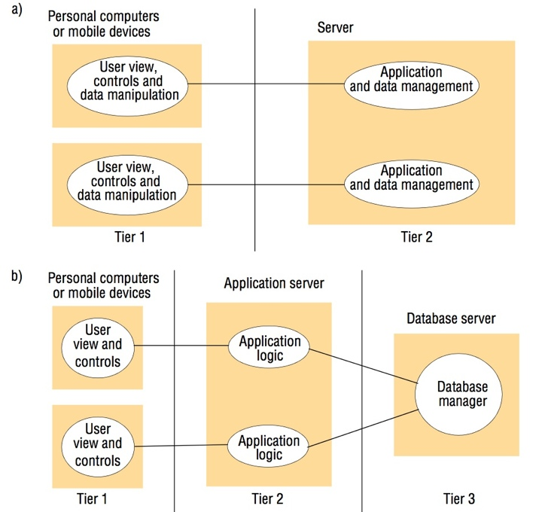
Two-tier Architectures
Instructor’s Guide for Coulouris, Dollimore, Kindberg and Blair, Distributed Systems: Concepts and Design Edn. 5
© Pearson Education 2012

Slide 62
Two-tier
In the two-tier solution, the three aspects mentioned above must be partitioned into two processes, the client and the server.
This is most commonly done by splitting the application logic, with some residing in the client and the remainder in the server (although other solutions are also possible).
The advantage of this scheme is low latency in terms of interaction, with only one exchange of messages to invoke an operation.

Slide 63
Three –Tier Architecture

Slide 64
Three-tier
In the three-tier solution, there is a one-to-one mapping from logical elements to physical servers.
Ex: the application logic is held in one place, which in turn can enhance maintainability of the software.
Each tier also has a well-defined role; for example, the third tier is simply a database offering a (potentially standardized) relational service interface.
This Tired architecture approach generalizes to n-tiered (or multi-tier) solutions where a given application domain is partitioned into n logical elements, each mapped to a given server element

Slide 65
Thin clients and compute servers
Compute server
Network computer or PC
Thin
network
Application
Client
Process
the term thin client refers to a software layer that supports a window-based user interface that is local to the user while executing application programs or, more generally, accessing services on a remote computer.
This concept has led to the emergence of virtual network computing (VNC)

Slide 66
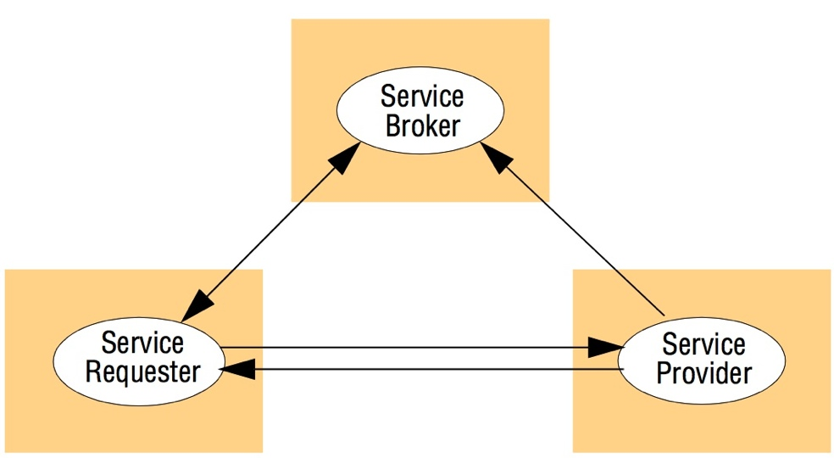
Service Broker Architecture
In web service pattern

Slide 67
web service architectural pattern
The use of brokerage in web services can usefully be viewed as an architectural pattern supporting interoperability in potentially complex distributed infrastructures.
In particular, this pattern consists of the trio of service provider, service requester and service broker
The web service architectural pattern Service Provider Service Broker Service Requester .
This brokerage pattern is replicated in many areas of distributed systems, for example with the registry in Java RMI and the naming service in CORBA.

Slide 68
Ctd..
It must be stressed that the categorizations are not exact and that modern middleware platforms tend to offer hybrid solutions.
For example, many distributed object platforms offer distributed event services to complement the more traditional support for remote method invocation.
For example, an application that is suited to the client-server model such as a database of names and addresses, can rely on middleware that provides only remote method invocation.

Slide 69
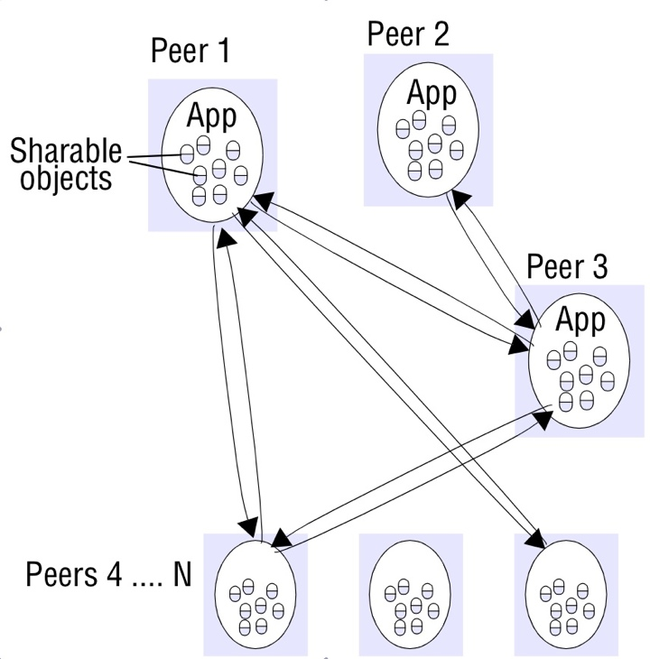
Peer-to-peer architecture

Slide 70
Architectural Pattern- Software and hardware service layers in distributed systems

Slide 71
Software layers
The concept of layering is a familiar one and is closely related to abstraction.
In a layered approach, a complex system is partitioned into a number of layers, with a given layer making use of the services offered by the layer below.
A given layer therefore offers a software abstraction, with higher layers being unaware of implementation details, or indeed of any other layers beneath them. In terms of distributed systems, this equates to a vertical organization of services into service layers.

Slide 72
A distributed service can be provided by one or more server processes, interacting with each other and with client processes in order to maintain a consistent system-wide view of the service’s resources
For example, a network time service is implemented on the Internet based on the Network Time Protocol (NTP) by server processes running on hosts throughout the Internet that supply the current time to any client that requests it and adjust their version of the current time as a result of interactions with each other.
Given the complexity of distributed systems, it is often helpful to organize such services into layers. the important terms platform and middleware, which define as follows:

Slide 73
A platform for distributed systems
A platform for distributed systems and applications consists of the lowest-level hardware and software layers.
These low-level layers provide services to the layers above them, which are implemented independently in each computer, bringing the system’s programming interface up to a level that facilitates communication and coordination between processes.
Intel x86/Windows, Intel x86/Solaris, Intel x86/Mac OS X, Intel x86/Linux and ARM/Symbian are major examples.

Slide 74
Ctd..
Remote Procedure Calls – Client programs call procedures in server programs
Remote Method Invocation – Objects invoke methods of objects on distributed hosts
Event-based Programming Model – Objects receive notice of events in other objects in which they have interest

Slide 75
Fundamental models
Interaction Model
Failure Model
Security Model
Interaction Model
Computation occurs within processes; the processes interact by passing messages, resulting in communication (information flow) and coordination (synchronization and ordering of activities) between processes.
In the analysis and design of distributed systems we are concerned especially with these interactions.

Slide 76
Failure Model
The correct operation of a distributed system is threatened whenever a fault occurs in any of the computers on which it runs (including software faults) or in the network that connects them.
This model defines and classifies the faults.
This provides a basis for the analysis of their potential effects and for the design of systems that are able to tolerate faults of each type while continuing to run correctly

Slide 77
Security Model
Security model defines and classifies the forms that such attacks may take.
Systems openness exposes them to attack by both external and internal agents
Providing a basis for the analysis of threats to a system and for the design of systems that are able to resist them

Slide 78
Interaction Model
The interaction model describes the communication between processes in a distributed system.
It focuses on how processes exchange information and the challenges of achieving coordination in a distributed environment.
Key Concepts
Communication Mechanisms:
  Message Passing: Processes communicate by sending and receiving discrete messages.
  Remote Procedure Calls (RPCs): Abstract communication to resemble local function calls.
  Distributed Objects: Use object-oriented paradigms for process interactions.

Slide 79
Core concerns
Latency:
  Time delay in message delivery caused by propagation delay, queuing, and processing time.
  Affects performance and user experience in distributed systems.
Concurrency:
  Multiple processes operate simultaneously, potentially leading to synchronization issues.
Synchronization:
  Coordinating actions of processes in an asynchronous environment.
  Models:
    Synchronous Systems: Known bounds on execution time and communication delays.
    Asynchronous Systems: No assumptions on time bounds.

Slide 80
Challenges in the Interaction Model:
Unpredictable Delays: Messages can experience varying latencies.
Clock Synchronization: Ensuring consistency of distributed clocks.
Fault Tolerance: Designing mechanisms to handle partial system failures.
Mitigations:
Use of logical clocks (e.g., Lamport clocks) to maintain event order.
Implementing timeout mechanisms to detect communication failures.

Slide 81
Interaction Models based on Synchronization
Synchronous distributed system to be one in which the following bounds are defined:
• The time to execute each step of a process has known lower and upper bounds.
• Each message transmitted over a channel is received within a known bounded time.
• Each process has a local clock whose drift rate from real time has a known bound.

Slide 82
Asynchronous distributed systems:
Many distributed systems, such as the Internet, are very useful without being able to qualify as synchronous systems.
An asynchronous distributed system is one in which there are no bounds on:
• Process execution speeds –process step may take only a picosecond and another a century; all that can be said is that each step may take an arbitrarily long time.
• Message transmission delays – messages from process A to process B may be, a message received after an arbitrarily long time.
• Clock drift rates – again, the drift rate of a clock is arbitrary.

Slide 83
latency
Delay between the start of a message’s transmission from one process and the beginning of its receipt by another is referred to as latency , it includes
time taken for the first of a string of bits transmitted through a network to reach its destination.
The delay in accessing the network, which increases significantly when the network is heavily loaded.
The time taken by the operating system communication services at both the sending and the receiving processes
Also, involves Bandwidth and Jitter

Slide 84
Event Ordering
Sending or receiving a message at one process occurred before, after or concurrently with another event at another process.
The execution of a system is described in terms of events and their ordering despite the lack of accurate clocks.
For example, consider the following set of exchanges between a group of email users, X, Y, Z and A, on a mailing list:
1. User X sends a message with the subject Meeting.
2. Users Y and Z reply by sending a message with the subject Re: Meeting.

Slide 85
Ctd..
In real time, X’s message is sent first, and Y reads it and replies;
Z then reads both X’s message and Y’s reply and sends another reply, which references both X’s and Y’s messages.
Due to the independent delays in message delivery, the messages may be delivered as in Figure.
some users may view these two messages in the wrong order. For example, user A might see

Slide 86
X’s message is sent first
Y reads it and replies
Z then reads both X’s message and Y’s reply
which references both X’s and Y’s messages
But due to the independent delays in message delivery, the messages may be delivered as shown in Figure
user A might see as in the table next

Slide 87
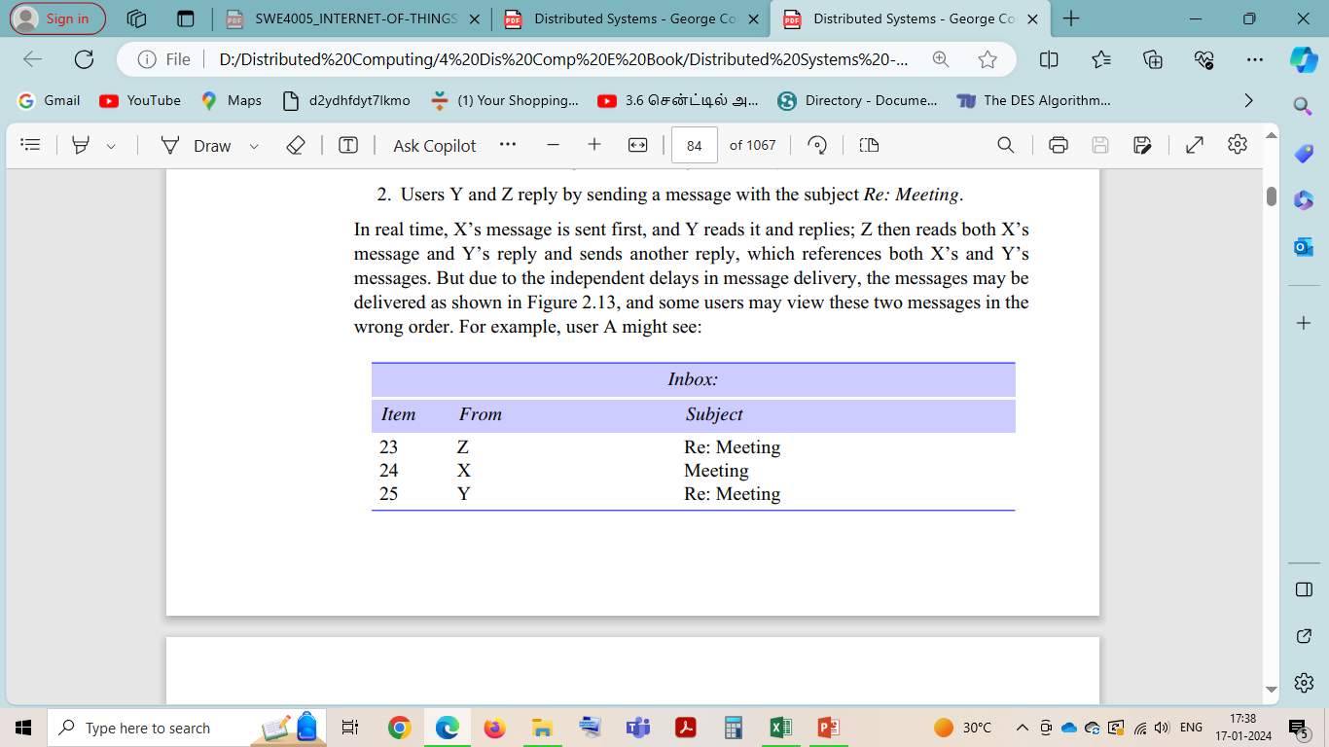
Ctd
some users may view these two messages in the wrong order. For example, user A might see

Slide 88
Ctd
If the clocks on X’s, Y’s and Z’s computers could be synchronized, then each message could carry the time on the local computer’s clock when it was sent.
For example, messages m1, m2 and m3 would carry times t1, t2 and t3 where t1<t2.
If the clocks are roughly synchronized, then these timestamps will often be in the correct order.
Since clocks cannot be synchronized perfectly across a distributed system, Lamport [1978] proposed a model of logical time.

Slide 89
Ctd..
For example, considering only the events concerning
X and Y:
X sends m1 before Y receives m1;
Y sends m2 before X receives m2.
We also know that replies are sent after receiving messages, so we have the following logical ordering for Y:
Y receives m1 before sending m2

Slide 90
Failure Model
In a distributed system both processes and communication channels may fail.
The processes or devices may depart from what is considered to be correct or desirable behavior.
The failure model defines the ways in which failure may occur in order to provide an understanding of the effects of failures.
Understanding distinguishes between the failures of processes and communication channels is important in Distributed Computing

Slide 91
Omission failures
The omission failures refer to cases when a process or communication channel fails to perform actions that it is supposed to do.
Process omission failures
Omission failure of a process is when the process crashes
A process crash is called fail-stop if other processes can detect certainly that the process has crashed, in synchronous system
2. Communication omission failures
The communication channel produces an omission failure if it does not transport a message from p’s outgoing message buffer to q’s incoming message buffer. This is known as ‘dropping messages.

Slide 92
Processes and channels
Communication omission Failure
Generally caused by lack of buffer space at the receiver or at an intervening gateway, or by a network transmission error, detected by a checksum carried with the message data

Slide 93
Arbitrary failures
Arbitrary or Byzantine failure is used to the worst possible failure semantics, in which any type of error may occur.
For example, a process may set wrong values in its data items, or it may return a wrong value in response to an invocation.
An arbitrary failure of a process is one in which it arbitrarily omits intended processing steps or takes unintended processing steps.

Slide 94
Arbitrary failures
Process Arbitrary failures :
Arbitrary failures in processes cannot be detected by seeing whether the process responds to invocations, because it might arbitrarily omit to reply.
2. Communication Arbitrary failures
Channels can suffer from arbitrary failures; for example, message contents may be corrupted, nonexistent messages may be delivered or real messages may be delivered more than once.
Arbitrary failures of communication channels are rare because the communication software is able to recognize them and reject the faulty messages.
Ex: checksums are used to detect corrupted messages, and message sequence numbers can be used to detect nonexistent and duplicated messages.

Slide 95
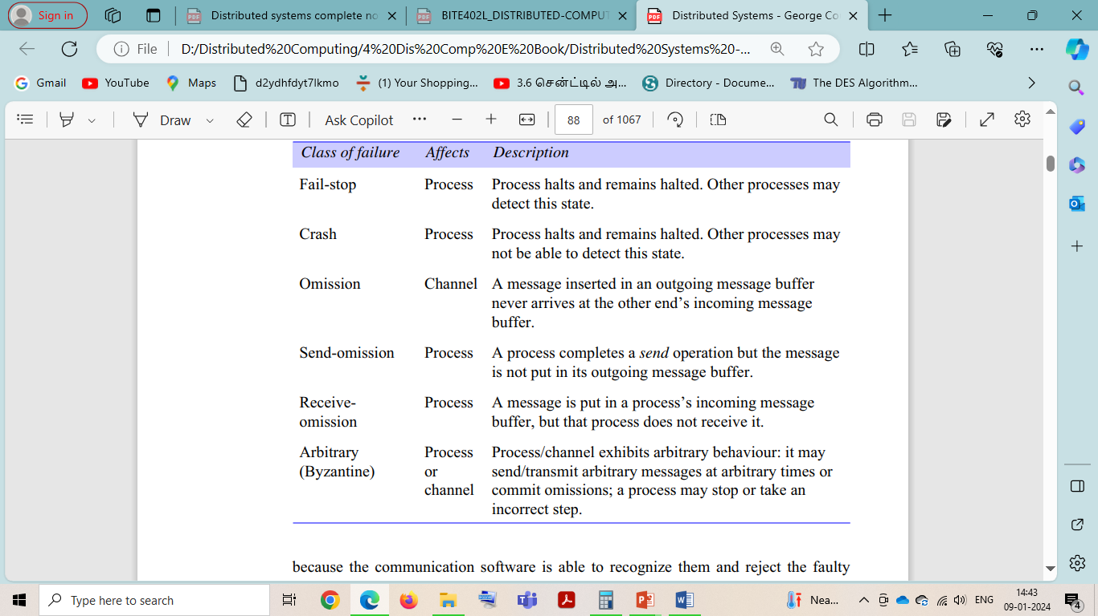
Omission and arbitrary failures

Slide 96
Timing failures
Timing failures are applicable in synchronous distributed systems where time limits are set on process execution time, message delivery time and clock drift rate.
Timing is particularly relevant to multimedia computers with audio and video channels.
Real-time operating systems are designed with a view to providing timing guarantees, but they are more complex to design and may require redundant hardware.

Slide 97
Timing failures
Class of Failure
Affects
Description
Clock
Process
Process’s local clock exceeds the bounds on its
rate of drift from real time.
Performance
Process
Process exceeds the bounds on the interval
between two steps.
Performance
Channel
A message’s transmission takes longer than the
stated bound.

Slide 98
Masking Failures
A knowledge of the failure characteristics of a component can enable a new service to be designed to mask the failure of the components on which it depends.
A service masks a failure either by hiding it altogether or by converting it into a more acceptable type of failure.

Slide 99
Security Model
The modular nature of distributed systems and their openness exposes
them to attack by both external and internal agents. Our security model defines and
classifies the forms that such attacks may take, providing a basis for the analysis of
threats to a system and for the design of systems that are able to resist them.

Slide 100
Objects and principals

Slide 101
The enemy
Copy of
m
The enemy
m’
Process
p
m
Process
q
Communication channel

Slide 102
Secure channels
Principal
A
Principal
B
Process
p
Secure channel
Process
q

Slide 103
Figure 3.4
Protocol layers in the ISO Open Systems Interconnection (OSI) model

Slide 104
Figure 3.6
Internetwork layers

Slide 105
Figure 3.7
Routing in a wide area network
A
1
B
Hosts
2
3
Links
4
or local
C
networks
5
D
6
E
Routers

Slide 106
Networking Principles
1. Packet Switching
The simplest form of packet is a sequence of binary data (an array of bits or bytes) of restricted length, together with addressing information sufficient to identify the source and destination computers.
Packet switching is a fundamental technique used in distributed computing to facilitate communication between various nodes (such as computers, servers, or devices) over a network.
2. Data Streaming
The transmission and display of audio and video in real time is referred to as streaming. It requires much higher bandwidths than most other forms of communication in distributed systems.

Slide 107
3. Switching schemes
Broadcasting is a transmission technique that involves no switching. Everything is transmitted to every node
Circuit switching is a method of communication where a dedicated communication path or circuit is established between two endpoints for the duration of the connection.
Circuit switching is generally not a common approach in distributed computing environments. Instead, distributed computing typically relies on packet switching

