Slide 1

QuizVerse – Interactive Online Quiz Application
CAPSTONE PROJECT
“Level up your mind, one question at a time.”
Presented By:
Aditya Mishra B.Tech – Computer Science & Engineering GLA University, Mathura

Slide 2
OUTLINE
Problem Statement
System Development Approach
Algorithm & Deployment
Result
Conclusion
Future Scope
References

Slide 3
Problem Statement
In today’s digital learning environment, students and educators often lack a lightweight and interactive platform for quiz-based learning and self-evaluation. Most available platforms are either paid, overly complex, or not engaging enough for learners seeking quick knowledge tests.
There is a clear need for a simple, responsive, and gamified quiz application that:
Provides instant feedback and real-time scoring,
Encourages active learning through engaging UI and timed questions, and
Supports practice across multiple domains using a dynamic question set.
Root Cause Summary: The absence of an accessible and visually appealing quiz system limits effective learning reinforcement and continuous knowledge assessment for both students and teachers.

Slide 4
System Approach
Technologies used
Design & Functionality
Tools & Hosting
HTML5 – Structure & layout of web pages
CSS3 – Styling with gradient & glassmorphism UI
JavaScript (ES6) – Handles logic, timer, score, and API data
Open Trivia DB API – Dynamic question fetching
Clean, responsive, and modern UI
Three-screen flow: Landing → Quiz → Scoreboard
Real-time progress bar & timer
Stores quiz attempts using sessionStorage
Interactive animations for better user engagement
Editor: VS Code
Version Control: Git & GitHub
Deployment: Vercel (Live Hosting)

Slide 5
Algorithm & Deployment
Start Quiz: User clicks Start Quiz → Landing page hides.
Fetch Questions: Data fetched from Open Trivia DB API.
Display Question: Randomized options appear with timer (30s).
User Selection: Answer is validated instantly.
Score Update: Correct answers increment score count.
Next Question: Auto-loads next question or ends on last one.
Show Scoreboard: Final score + attempt history displayed.
Play Again: Option to restart the quiz anytime.
Deployment Steps
Developed using HTML, CSS, and JavaScript in VS Code.
Version-controlled via Git & GitHub.
Hosted live using Vercel for public access.
Tested across browsers for responsiveness & smooth UI.

Slide 6
Result
Successfully developed a fully functional quiz web app.
Dynamic questions fetched from Open Trivia DB API.
Features timer, progress bar, instant scoring, and attempt tracking.
Works seamlessly on desktop and mobile devices.
Provides instant feedback to enhance learning engagement.

Slide 7
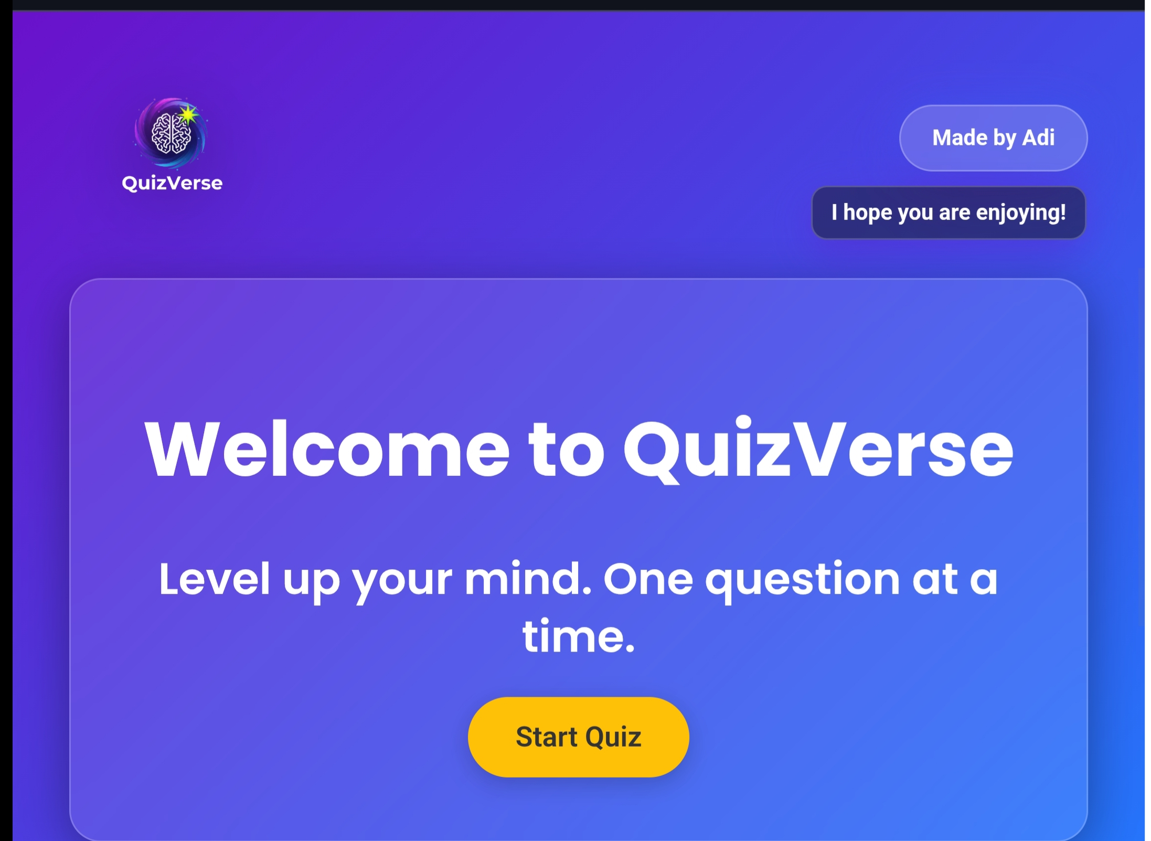
Result

Slide 8
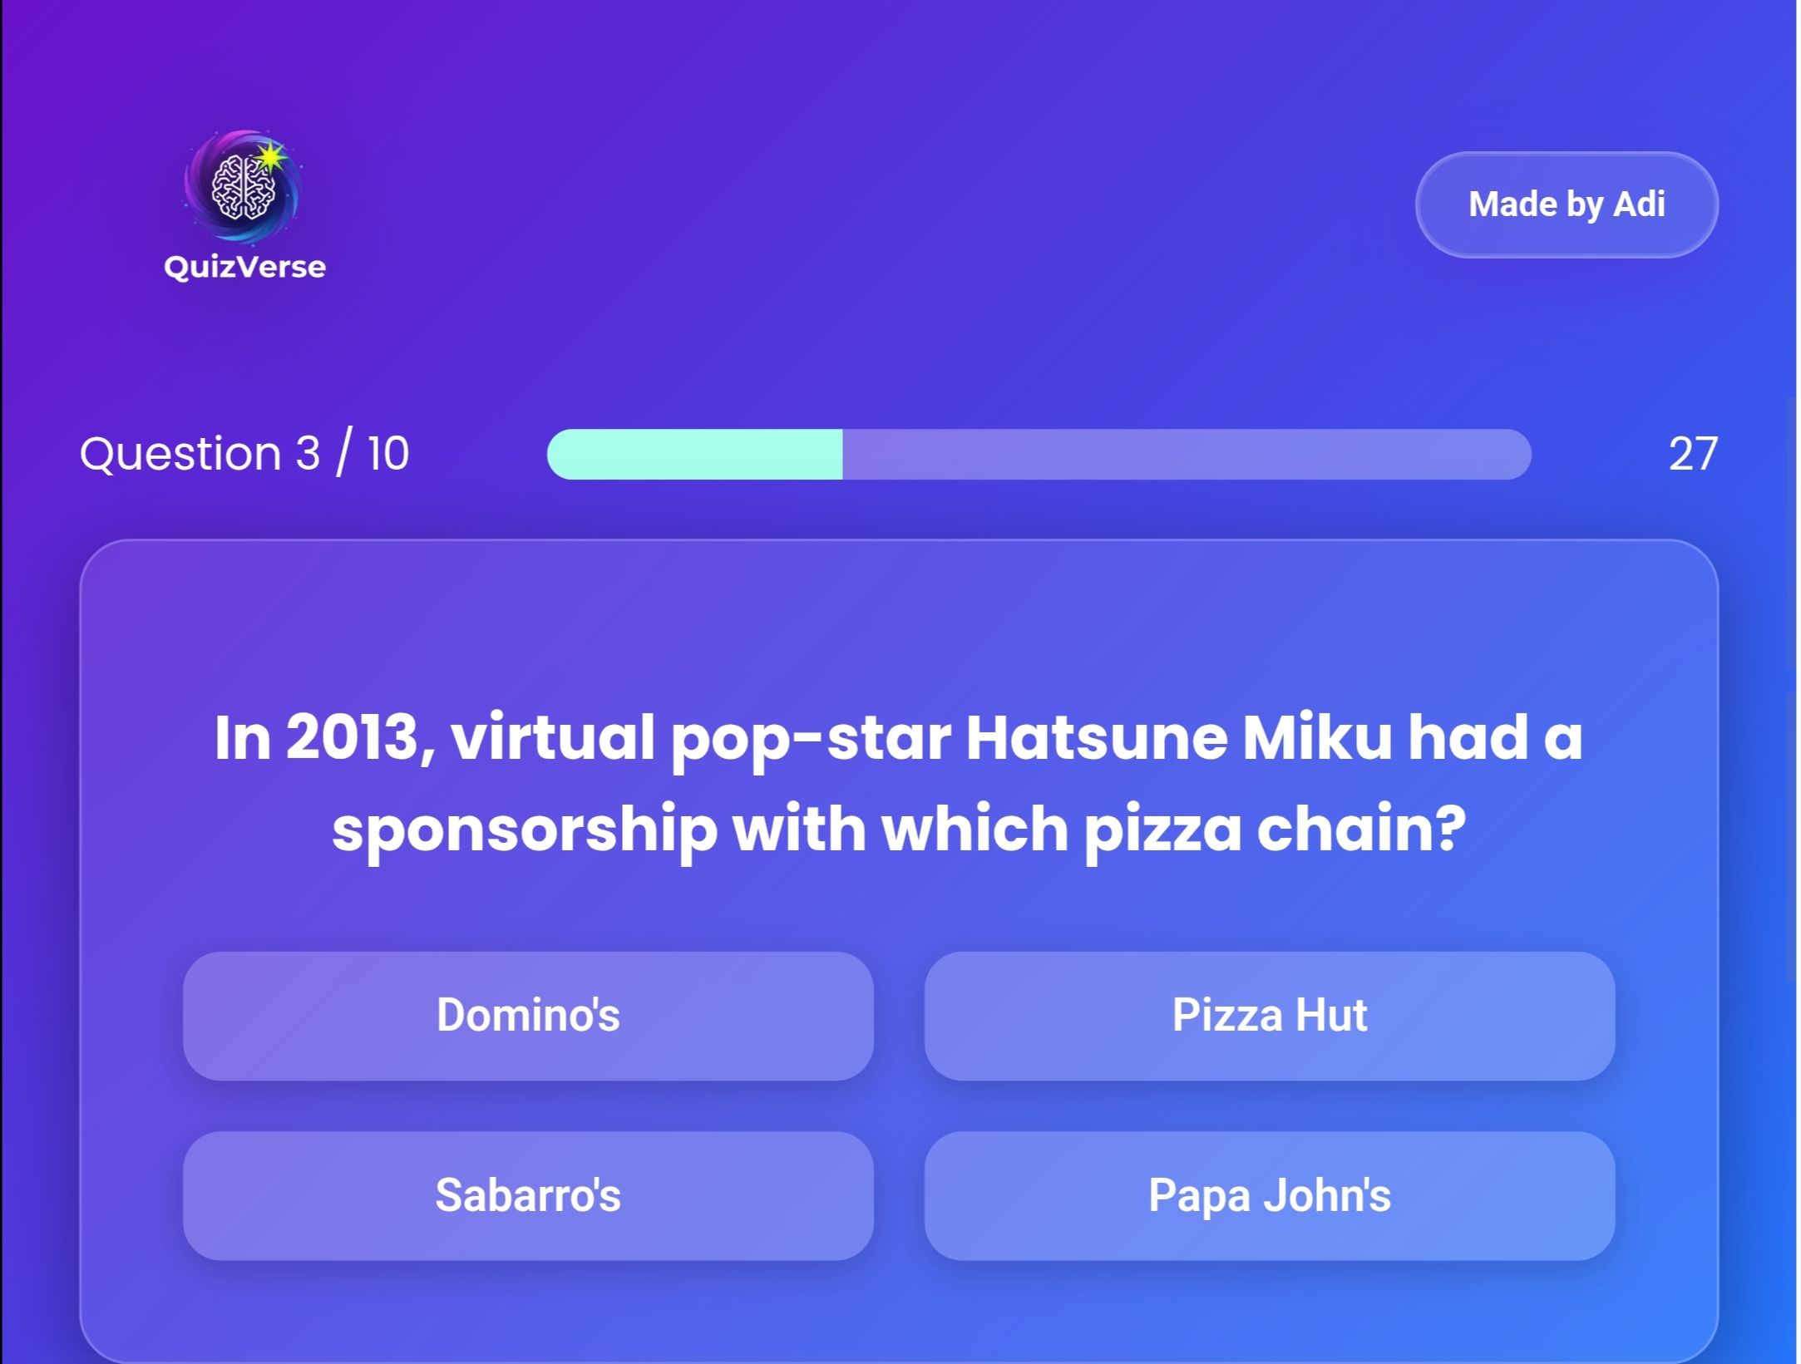
Result

Slide 9
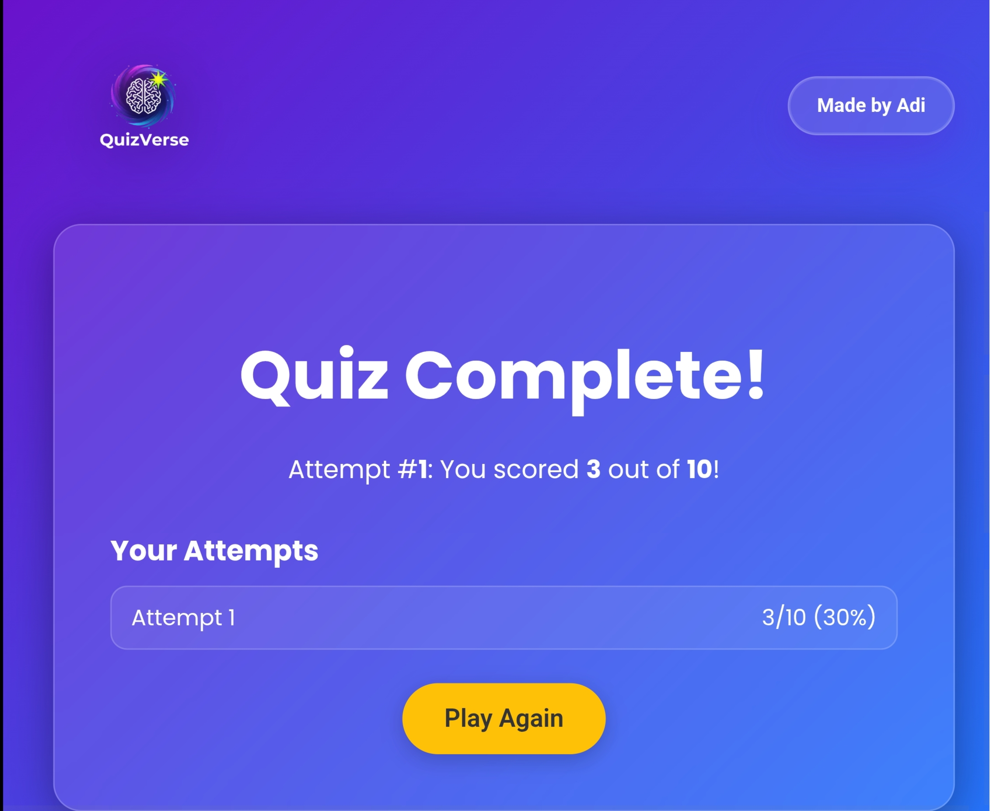
Result

Slide 10
GITHUB AND DEPLOYMNET LINK
GitHub Repository: 🔗 github.com/AdityaMishr11/QuizVerse
Live Deployment: 🌐 quiz-verse-sigma.vercel.app

Slide 11
Conclusion
QuizVerse successfully delivers an interactive, engaging, and user-friendly quiz experience.
Encourages self-learning through instant feedback and dynamic question generation.
Demonstrates strong command over frontend technologies and API integration.
Enhances digital learning by providing a lightweight, accessible, and responsive platform.
Strengthened understanding of UI/UX design, logic building, and web deployment.

Slide 12
Future scope(Optional)
🔹 User Authentication: Add login/signup to track scores across sessions.
🔹 Custom Quiz Creation: Allow educators to create and share their own quizzes.
🔹 Leaderboard System: Introduce global rankings and competitive mode.
🔹 Backend Integration: Use Node.js / Firebase for storing results permanently.
🔹 AI Recommendation: Suggest topics or difficulty levels based on past performance.

Slide 13
References
Open Trivia Database (API) – https://opentdb.com Used for fetching real-time quiz questions dynamically.
MDN Web Docs (Mozilla Developer Network) – https://developer.mozilla.org Reference for JavaScript, CSS, and HTML best practices.
W3Schools – https://www.w3schools.com Learning resource for frontend web development fundamentals.
Google Fonts – Poppins Family – https://fonts.google.com Typography used for a modern, clean UI look.
GitHub & Vercel Documentation – For version control, deployment, and hosting guidance.

Slide 14
THANK YOU

